Slide 1
SOCIAL MEDIA: LIVING IN THE CONNECTED WORLD

Slide 2
Objectives
Explain social media and the differences between social media platforms and social media tools.
Describe the ways in which consumers and businesses use social media for their buying decisions.
Outline the four key elements of a written social media marketing plan.

Slide 3
Objectives
Discuss the importance of setting goals and developing strategies, including targeting an audience, for a social media marketing initiative/trial.
Identify the seven qualities/characteristics of effective social media content/context and the rules of engagement/interaction with social media.
Describe the different means/tools of monitoring, measuring, and managing the social media marketing campaign.

Slide 4
Objectives
Discuss the ethical and legal issues encountered/faced by marketers in social media marketing.
Explain the different types of positions in social media marketing and how to land/do an entry-level job.

Slide 5
Social Media
Different forms of electronic communication through which users can create online communities/groups to exchange:
  Information
  Ideas
  Messages
  Other content such as videos or music

Slide 6
Categories of Social Media
Social media platform – Type of software or technology that allows users to build, integrate/combine, or facilitate/enable a community, interaction among users, and user-generated content
Social media tool – Enables users to communicate with each other online

Slide 7
Social Media Platforms
Act as a home base/center for an online community
To access the conversations held/done there, users must become members
Social-networking sites – Websites that provide virtual communities for people to:
  Share daily activities
  Post/display opinions on various topics
  Increase their circle of online friends, and more

Slide 8
Social Media Platforms
Bookmarking sites – A social bookmarking website is a
centralized online service that allows users to store and share Internet bookmarks. Such a website typically offers a blend/ mixture of social and organizational tools, such as annotation /explanation, categorization, folksonomy-based tagging*, social cataloging and commenting. The website may also interface with other kinds of services, such as citation management software and social networking sites. These give people a place to save, organize, and manage links to Websites and other resources on the Internet https://en.wikipedia.org/wiki/List_of_social_ bookmarking_websites, acc.10/23/2020). id est. Twitter, Printerest etc. *Folksonomy is a classification system in which end users apply public tags to online items, typically to make those items easier for themselves or others to find later (https://en.wikipedia.org/wiki/Folksonomy , acc.10/23/2020).

Slide 9
Social Media Platforms
Social news sites – People post news items or links to outside articles on such sites, then vote on which postings get the most prominent /noticeable display—and viewed by the most readers.
A social news website is an Internet website that features/minds user-posted stories. Such stories are ranked based on popularity, as voted on by other users of the site or by website administrators. Users typically comment online on the news posts and these comments may also be ranked in popularity. Since their emergence/ appearance with the birth of Web 2.0, social news sites have been used to link many types of information, including news, humor/joke, support, and discussion. All such websites allow the users to submit/ send content and each site differs in how the content is moderated (https://en.wikipedia.org/wiki/Social_news_ website, accessed. 10/23/2020).
List of the Top 50 Social News Websites (https://issaasad.org/list-top-50-social-news-websites/, accessed.10/23/2020).

Slide 10
Social Media Platforms
Online forums – Members hold/do conversations by posting messages.
An Internet forum, or message board, is an online discussion site where people can hold conversations in the form of posted messages (https://en.wikipedia.org/wiki/ Internet_forum, accessed.10/23/2020). ie. Quora, Yahoo Groups, Google Answers.
Blogging sites – Blog postings and comments are attached to such sites and typically focus on specific topics.
You may want to practice your writing, create a following, establish your brand, or use blogging as a marketing tool to increase site traffic. It’s also a great way to connect with like-minded people (https://websitesetup.org/ best-blog-sites/, accessed.10/23/2020). ie. WordPress.org , Wix.com, Drupal.
Microblogs – Subscribers get a steady stream of brief updates from anyone ranging from a high-school friend to a celebrity
A micro-blog differs from a traditional blog in that its content is typically smaller in both actual and aggregated file size. Micro-blogs "allow users to exchange small elements of content such as short sentences, individual images, or video links" which may be the major reason for their popularity (https://en.wikipedia.org/ wiki/ Microblogging, accessed.10/23/2020). ie. Tumbir, Twister, Gab.

Slide 11
Social Media Tools
These make the conversation/talk happen
Services like YouTube and Flickr allow people to upload and share media such as photos and videos
  Some videos have gone viral (quickly and widely spread or popularized) and shot their makers to fame (make famous).
  Marketers realize that a viral video can translate to/turn into a jump in demand—and sales—for their products

Slide 12
Social Media Tools
Blogging/diarizing allows people to communicate in greater detail than microblogging does
Marketers use blog postings/notices to:
  Educate consumers and business customers about new products
  Ask for feedback about particular goods and services
  Notify/inform the public about social responsibility initiatives/actions
  Manage public relations crises

Slide 13
Social Media Tools
Companies may
  Designate/assign certain staff members as bloggers
  Hire professional bloggers either in-house or on a consulting basis. You may want to practice your writing, create a following, establish your brand, or use blogging as a marketing tool to increase site traffic. It’s also a great way to connect with like-minded people (target market) brand or use blogging as a marketing tool to increase site traffic.
Microblogging offers short bursts/flashes of news
App – Short for application, it is a free or paid software download that links users to a wide range of goods and services, media and text content, social media platforms, search engines, and the like

Slide 14
App
Marketers
  Know that potential and existing customers use all kinds of apps, and they want to tap into/benefit from the opportunities created by this phenomenon/fact
  Must find ways to identify the apps that will support the goals of their social media marketing efforts
  Need to choose the ones that reach and attract/appeal their target audience and influence/affect consumers to make decisions in favor of their goods and services

Slide 15
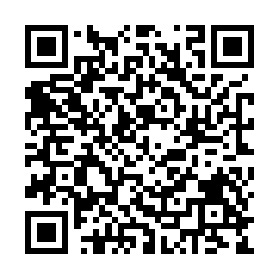
QR Codes
Short for quick response codes
Two-dimensional bar codes that can be read by some mobile phones with cameras
Information contained in the code is shared with the user
  Might lead to a video, give details about a product, or offer a coupon

Slide 16
Why Should Marketers Turn to Social Media?
Social media has quickly grown/outgrow to be an important tool for marketers to:
  Build relationships with customers
  Strengthen brands
  Launch/introduce new products
  Enter new markets
  Boost/increase sales

Slide 17
Why Should Marketers Turn to Social Media?
Consumers are connecting with retailers, restaurants, travel and entertainment firms, financial companies, and other businesses via/through social media
The messages conveyed via social media wield/apply substantial/important power

Slide 18
Social Media Marketing (SMM)
Uses social media portals to create a positive influence on consumers or business customers toward an organization’s:
  Brand
  Goods and services
  Public image
  Website
  *The Social Media Portal (SMP) is a news and information directory/ structure mapping/planning all aspects of social media globally. SMP showcases/presents everything web 1.0, 2.0, 3.0 and beyond, which forms the SMP Landscape/form. The Landscape continually evolves/develops with the social media environment and allows creators and consumers to converge/get together.

Slide 19
Why Should Marketers Turn to Social Media?
Marketers generally view the goal of social media marketing as developing a conversation/communication with potential customers, resulting in a:
  Purchase
  Subscription to an email newsletter
  Registration in an online community
  Participation in an event

Slide 20
Why Should Marketers Turn to Social Media?
Not-for-profit organizations create social media marketing campaigns to expand their reach/attainment
SMM contains three essential/main features:
  It creates a buzz/rumor
  It creates ways for customers or fans to engage in conversations with each other and the organization
  It allows customers to promote/introduce the firm’s messages themselves

Slide 21
Consumer Behavior
Shoppers who shop with search engines do so because these provide the greatest amount of information about products and companies
Search engines help with comparison/ benchmarking shopping, particularly when it comes to price (https://www.cimri.com/ https://www.gittigidiyor.com/)

Slide 22
Consumer Behavior
Consumers rely/depend on the communities created by social media for their buying decisions in order to:
  Learn about new goods and services
  Conduct research and share information
  Make final purchase decisions

Slide 23
Business Behavior
Businesses use social media to build relationships, including partnerships with other companies

Slide 24
Not-for-Profit Organizations
Use social media to:
  Market themselves
  Generate/create donations/charity or other types of funding
  Spur/stimulate an action (subscribe, buy etc.)
  Promote/introduce an event
  Educate the public (psa-covid19: Mask-distance-hygiene)
  Encourage and showcase/display partnerships with other organizations

Slide 25
Creating a Social Media Marketing Plan
Effective social media marketing requires:
  Setting goals
  Developing strategies to reach a target audience
  Social media marketing (SMM) plan – Formal document that identifies and describes goals and strategies, targeted audience, budget, and implementation/execution methods as well as tactics for monitoring/sighting, measuring, and managing the SMM effort

Slide 26
Creating a Social Media Marketing Plan
A well-written plan contains clear, concise/brief prose that covers the salient/important points and answers anticipated/expected questions
Most SMM plans contain:
  An executive summary
  A brief overview/overall asessment
  Analysis of the competition
  The body/main parts of the plan

Slide 27
Goals and Strategies of a Social Media Marketing Plan
SMM actively solicits/pushes for the audience’s participation in the message
Successful SMM efforts require the audience’s trust/reliance
Phases/stages of developing an SMM campaign
  Set goals
  Target the audience
  Develop strategies

Slide 28
Goals and Strategies of a Social Media Marketing Plan
  Produce content/scope
  Implement the plan
  Monitor
  Measure
Social media is helpful for connecting with influencers
  Influencers – Individuals with the capability of affecting the opinions or actions of others

Slide 29
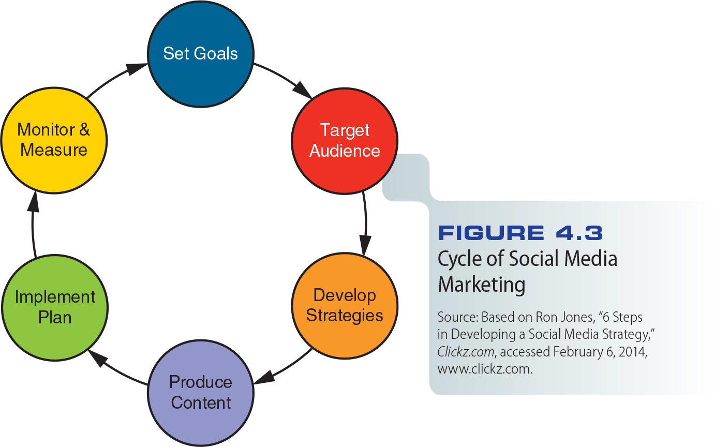
Figure 4.3 - Cycle of Social Media Marketing

Slide 30
Setting Goals
Successful social media marketing campaign starts with clear goals
Once goals are established, marketers are better able to develop strategies and choose the right platforms/media or outlets/ways for their messages
Clear goals help everyone involved/concerned in the campaign to aim/canalise their efforts in the right direction

Slide 31
Setting Goals
Goals should be flexible
  Conditions in the marketing environment may change, and marketers should be able to adapt their goals without scrapping/ruining an entire/whole plan

Slide 32
Targeting the Audience
Social media efforts customize marketers’ approach to targeted audiences/market
Social media marketers arrive at/reach a target audience based/depending on the goal of the marketing effort
  If it is to create brand awareness, the audience will be broader than for strengthening relationships with existing customers

Slide 33
Targeting the Audience
  Marketers narrow this target further by determining which social media will be best suited/fitted to certain types of consumers
In order to pinpoint/find out the audience for social media marketing, firms gather information on :
  Demographics
  What the group or organization needs or wants

Slide 34
Targeting the Audience
  Which of the firm’s products and social media will meet the needs and wants of the particular groups of people

Slide 35
Developing Strategies and Choosing Tactics
Every strategy in an effective social media marketing campaign traces/comes back to the campaign’s goals—and ultimately/ eventually links/connects to a firm’s overall/ all strategic goals
Marketers decide:
  Which social media platforms to use, and how to combine/put together them to reach and engage with/attract the audience

Slide 36
Developing Strategies and Choosing Tactics
  Which social media tools should deliver/tell the campaign’s content, and how best to link them with the selected social media platforms
  Who will participate in the conversation on behalf of the company
  How to make it easy for potential customers to locate/spot and participate in the conversation

Slide 37
Creating Content
SMM content is a two-way street
In order for SMM to succeed, the content of its messages must engage/connect the target audience in the conversation
Content marketing – Creating and distributing relevant/appropriate and targeted material to attract and engage an audience, with the goal of driving/directing them to a desired/wanted action

Slide 38
Creating Content
Content for an effective SMM campaign has:
  A strong brand focus/emphasis
  A focus on the audience rather than the organization
  Targeted keywords (for search engines)
  Relevant/appropriate information
  Shareworthy text and images
  Search Engine Optimization (SEO)
  "2018 Local Search Ranking Factors"
  https://moz.com/local-search-ranking-factors

Slide 39
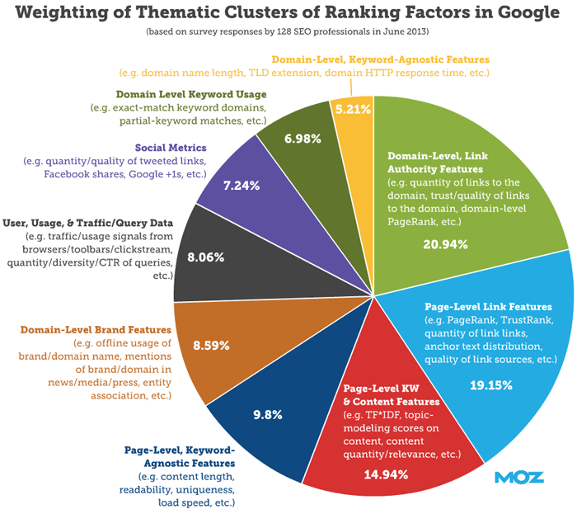

Slide 40
Creating Content
  Invitations to generate content via posts/mails, shares, discussions/debates, reviews/surveys, or other forms of dialogue/communication with the organization as well as with fellow/favorite customers
  Promotions that offer discounts, gifts, or other special deals/promotions in exchange for participation

Slide 41
Implementing the Plan
SMM plan requires a timeline/schedule for implementation
Marketers may decide to create separate schedules for the rollout/introduce (debut) onto each social media platform
SMM plan builds in a specified time period for engaging with the public, and offering special promotions

Slide 42
Implementing the Plan
Timeline includes managing/arranging, monitoring, and measuring the success of the effort
Experts recommend that marketers refrain/ avoid from scheduling content more than a week away because:
  Information can change
  Consumer responses may shift/move
  Events might occur/appear that would change the content

Slide 43
Rules of Engagement* for Social Marketing
Follow rules and guidelines/standards
Use social media channels as they were intended/ aimed
Think before posting/announcing—or deleting
*Military saying. Passion is the driving force for starting and planning a business. But it's not the only thing that keeps it going. It needs to be aligned with the rules of engagement. Rules of engagement will ensure that, when the going gets tough, the business has a clear protocol of actions and priorities. Alongside passion, it is this that will determine success. https://www.businessinsider.com/rules-of-engagement-business-2017-5, Accessed. 10/24/2020).
10 Management Rules of Engagement (https://www.cbsnews. com/news/10-management-rules-of-engagement/, Accessed. 10/24/2020).

Slide 44
Monitoring, Measuring, and Managing the SMM Campaign
Social media monitoring – Process of tracking/following up, measuring, and evaluating a firm’s social media marketing initiatives/attempts (shots)
Social media analytics – Tools that help marketers trace, measure, and interpret / analyze data related to social media marketing initiatives/moves

Slide 45
Monitoring, Measuring, and Managing the SMM Campaign
Monitoring and measuring help marketers understand what their customers need and want, ultimately making adjustments/ adaptations to SMM or product offerings (customer value) to satisfy those customers
Marketers select monitoring tools/means based on the needs of their own firms

Slide 46
Monitoring, Measuring, and Managing the SMM Campaign
Firms calculate the return on investment of their social media marketing initiatives, using:
  Reach – The percentage of people in a target market who are exposed to/received the marketing effort at least once
  Frequency – The number of times an individual is exposed to the marketing material during the campaign

Slide 47
Monitoring, Measuring, Managing the SMM Campaign
Expenses are weighed against savings/ crops
Effective monitoring gives marketers a clearer picture of an organization’s influence via social media
Measuring the success of a social media marketing plan includes such factors as:
  Share of voice (SOV)*
  Awareness of the company or brand
  Level of engagement by the targeted audience
  * Share of Voice in advertising is a measurement model within advertising. Share of voice measures the percentage of media spending by a company compared to the total media expenditure for the product, service, or category in the market (https://en.wikipedia.org/wiki/ Share_of_voice, Accessed. 10/24/2020).

Slide 48
Monitoring, Measuring, and Managing the SMM Campaign
  Influence created
  Popularity among target audience members

Slide 49
Managing/arranging
Managing a social media marketing campaign or a company’s overall social media efforts requires skill/ability, expertise/competence, and understanding of the company’s:
  Brand
  Competitors
  Social media environment

Slide 50
Managing
This means:
  Maintaining a grasp/understanding on the success or failure of previous strategies, knowledge of the benefits/advantages and drawbacks/weaknesses of the different social media platforms and tools, and an ability to interpret data without losing sight of the overall goal
  Being flexible enough to change tactics when necessary to avert/avoid or minimize a crisis

Slide 51
Ethical and Legal Issues
Social media marketers face ethical and legal issues, such as:
  Privacy
  Accountability/responsibility
Well-written social media policies are:
  Consistent with/conforming a firm’s organizational culture and values
  Explain why employees should take certain steps or actions or avoid them

Slide 52
Ethical and Legal Issues
  Broad enough to cover the major points, but brief enough to fit onto two pages
  Linked to other relevant company policies and guidelines
Postings, ads, comments, and even images come under intense scrutiny/examine and must be checked for:
  Accuracy/trueness
  Fair/honest and realistic claims/asserts or promises
  Balance and objectivity

Slide 53
Ethical and Legal Issues
  Potential for misinterpretation
Marketers must:
  Not distribute any personal information without consent/agreeing
  Be vigilant/mindful (attentive) about confidentiality/privacy
When mistakes happen, smart social media marketers:
  Take action to solve the problem or resolve/ settle the issue

Slide 54
Ethical and Legal Issues
  Acknowledge/admit the problem and take responsibility for it
  Communicate with the right people, via the most relevant channels
  Promise to take steps necessary to correct the situation
  Implement the agreed-upon changes or make other concessions/compromises
  Evaluate ways to avoid similar problems in the future

Slide 55
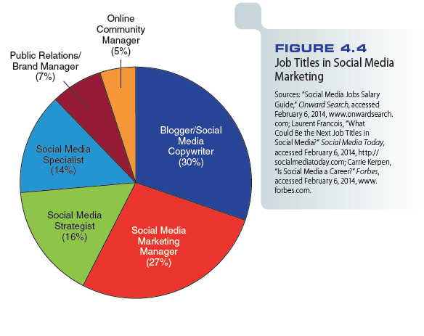
Figure 4.4 - Job Titles in Social Media Marketing

Slide 56
Types of Jobs
Social media marketing manager or digital marketing manager
Social media strategist
Brand manager
Online community manager*
Influencer relations
Social media specialist
Social media analytics
*An online community manager builds, grows, and manages online communities, performing/carrying out Community management, often around a brand or cause (https://en.wikipedia.org/wiki/Online_community _manager, Accessed. 10/24/2020).

Slide 57
Types of Jobs
Social media design
Social media developer
Content programmer
Blogger or copywriter

Slide 58
Tips for Landing a Job in Social Media Marketing
Land/do (practise) an internship
Take online courses that teach social media marketing skills
Highlight/emphasize your own online social profile
Point out/highlight your personality

Slide 59
Zappos Video
http://www.cengage.com/marketing/book_content/boone_9781133628460/videos/ch04.html

