Slide 1
Economics
Public goods, common resources and merit goods
Dr. Cansu Unver-Erbas

Slide 2
AIM OF THIS LECTURE
In this lecture, we will learn about: PUBLIC GOODS, COMMON RESOURCES AND
MERIT GOODS
In the previous lecture, we learned that markets do not always guide resource allocation in an efficient way.
Today, we will focus on some type of goods for which markets do not function efficiently. In such cases, government interventions can improve the efficiency of resource allocation and raise economic welfare.
Following this lecture, you should be able to determine:
state whether goods are rival or non-rival, and excludable or non-excludable;
explain why public goods are under-provided by a market, and common resources are overused;
discuss ways in which governments can overcome such market failures.

Slide 3
TYPE OF GOODS
When thinking about the various goods and services that can be produced, it is
useful to classify them according to two characteristics:
Is the good excludable?
Is the good rival?
A good is excludable if a person can be prevented from using it when they do not pay for it.
A good is rival if its use by one person diminishes other persons’ use.

Slide 4
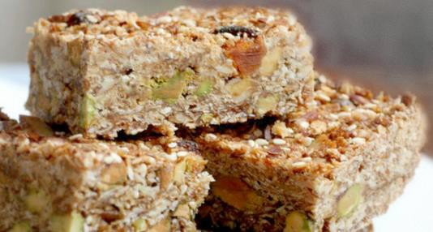
RIVAL

Slide 5

NON-RIVAL

Slide 6
Quick question
Consider whether the following products are rival or non-rival:
economics textbook
roads
fireworks display
loaf of bread
street lighting
fish in the ocean
cinema tickets

Slide 7

EXCLUDABLE

Slide 8
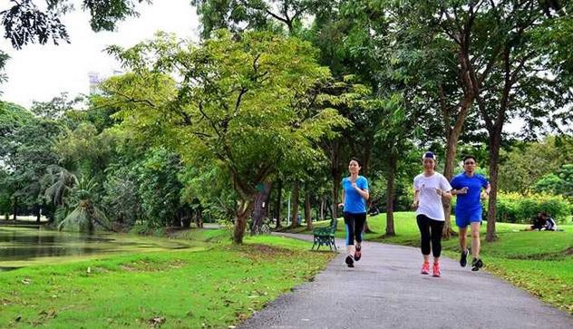
NON-EXCLUDABLE

Slide 9
Quick question
Consider whether the following products are excludable or non-
excludable:
economics textbook
roads
fireworks display
loaf of bread
street lighting
fish in the ocean
cinema tickets

Slide 10
TYPES OF GOODS
Depending on whether the good is excludable and/or rival, they can be classified into 4 categories:
Private Goods: both excludable and rival.
Public Goods: neither excludable nor rival.
Common Resources: rival but not excludable.
Club goods: excludable but not rival.
Competitive markets are generally efficient for private goods only!
10

Slide 11
Four Types of Good
 | Rival | Non-rival
Excludable | Food Clothing Bike | Netflix Cinema tickets (if not full) Football match (if not full)
Non- excludable | Fish in the ocean Environment Wildlife | Streetlighting Fireworks display Basic research
PRIVATE GOODS
CLUB GOODS
COMMON RESOURCES
PUBLIC GOODS

Slide 12
PUBLIC GOODS

Slide 13
THE FREE-RIDER PROBLEM
Suppose a village wants to put on a firework display on Bonfire night. A firm will put on a display for £5000.
On average, each of the village’s 500 residents is willing to pay £20 for the display.
Will it be a ‘good’ thing if there is a firework display?
Is it likely that the firework display will be provided?
(i)
What is the benefit? What is the cost?
£10,000 = 500×£20
£5000
(ii)
Well, the firm could put on the display, charge a price of £10 All 500 residents will purchase tickets since WTP = £20 > £10 Right?
WRONG! The firm won’t sell any tickets

Slide 14
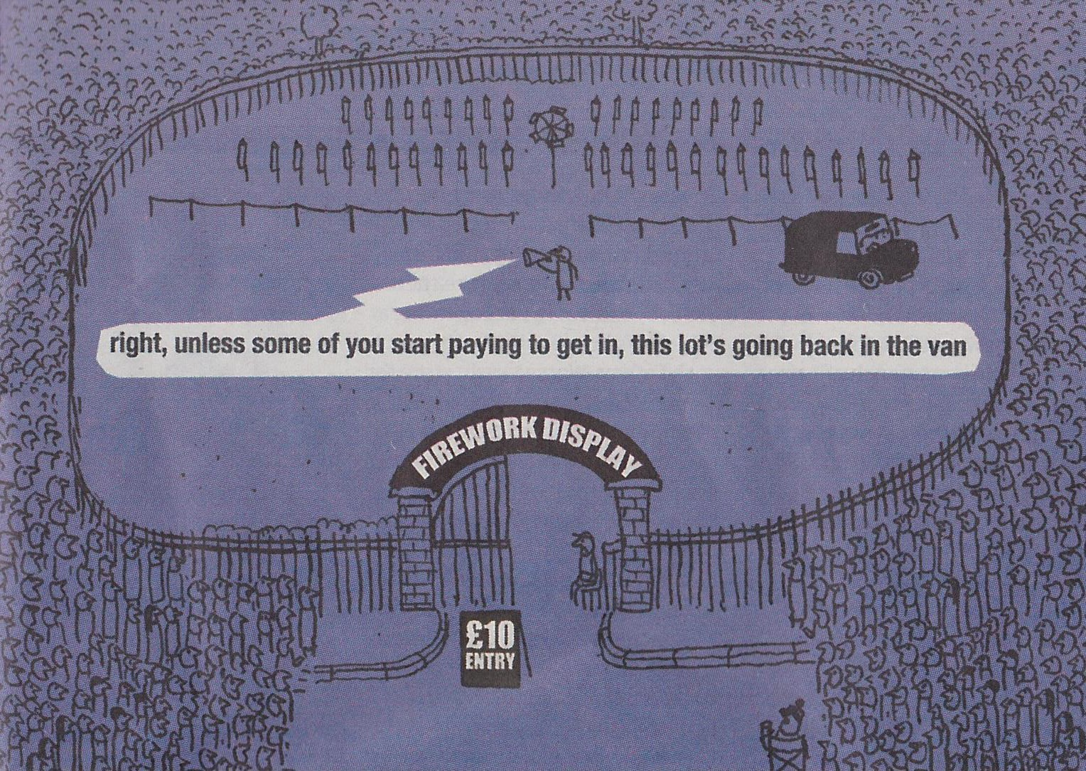

Slide 15
PUBLIC GOODS AND THE FREE-RIDER PROBLEM
People cannot be excluded from enjoying public goods without paying for them because they are non excludable
A free-rider is a person who receives the benefit of a good without paying for it. The free rider problem prevents private markets from supplying public goods.
People do not need to pay in order to enjoy a public good
=> if individuals are rational and self interested only, they do not want to pay for the good.
=> with private markets only, the public good will be under produced and consumed, even though it may have a value to consumers which is higher than the production costs. This (0 quantity produced) would not be an efficient resource allocation.

Slide 16
SOLUTIONS TO THE FREE-RIDER PROBLEM
The government can decide to provide the public good.
-> They should do that if the total benefits for society (usually measured as buyers WTP) > total costs for society (usually measured as the cost of producing the good).
-> To finance the public good, the government can require every citizen to pay a tax and use the tax revenue to provide the public good. This is something the private sector cannot do.

Slide 17
COST-BENEFIT ANALYSIS FOR PUBLIC GOODS
In order to decide whether to provide a public good or not (and what amount to provide), the total benefits of all those who use the good must be compared to the costs of providing and maintaining the public good.
Cost-benefit analysis: a study that compares the costs and benefits to society of
providing a (public) good.

Slide 18
THE OPTIMAL PROVISION OF A PUBLIC GOOD
Theory:
Governments should provide a public good if total benefits > total costs.
The optimal quantity of a public good is such that marginal social benefit gained from an extra unit provided (value of that extra unit for all the consumers) is equal to the marginal cost of providing that extra unit: MSB=MC
The quantity such that MSB=MC is efficient (maximizes total welfare).
  Producing less means forgoing some units whose production cost is
lower than their value to the consumers.
  Producing more means producing some units whose production cost is higher than their value to the consumers.

Slide 19
Public good
Price
S = MPC = MSC
V₁+V₂
V₂
MSB = D₂ + D₁
D₂ D₁
V₁
O
q
Q*
Quantity

Slide 20
Public good
Price
S = MPC = MSC
MSB = D₂ + D₁
D₂ D₁
O
Q₂
Q*
Quantity

Slide 21

Public good
Price
S = MPC = MSC
Welfare Loss
for Society
MSB = D₂ + D₁
D₂ D₁
O
Q₂
Q*
Quantity

Slide 22
COST-BENEFIT ANALYSIS FOR PUBLIC GOODS
In practice the cost-benefit analysis is more challenging than in theory.
Cost can be measured/quantified relatively easily.
Benefits are more difficult to estimate.
Ex 1: new airport close to a city
What is the value of that airport for the inhabitants?
Ex 2: traffic light that will save several lives with some probability.
What is the value of one saved life?

Slide 23
COST-BENEFIT ANALYSIS: APPLICATION
Decision for local town council:
Spend €10 000 on a traffic light at the intersection of 2 busy streets Cost = €10 000
Benefit: increased safety (risk of fatal accident over lifetime decreases from
1.6% to 1.1%)
Should the town council spend the money?
What if one life is saved and the cost is 1000? What if one life is saved and the cost is 10 000? What if one life is saved and the cost is 100 000? What if one life is saved and the cost is 1 000 000?
What if one life is saved and the cost is 10 000 000?

Slide 24
COST-BENEFIT ANALYSIS: HOW MUCH IS A LIFE WORTH?
How much is one life worth?
We could argue it is infinite, but we don’t behave as if life had an infinite value...
People do more risky jobs in return for higher pay.
People do risky activities ‘for fun’.
We don’t have doctors/ambulances at every street corner
We let people die of cold/hunger when we have, as a society, the means to avoid that.
An difficult role of elected governments is to make such cost benefit analyses in a way which represents citizens’ preferences.

Slide 25
COMMON RESOURCES

Slide 26
COMMON RESOURCES
Common resources, like public goods, are not excludable: charge to anyone who wishes to use them.
available free of
Common resources, unlike public goods, are rival: one person’s use of the
common resource reduces other people’s use.
Ex: fish in the sea, wildlife, clean air and water, forests, crowded roads.
If the use of common resources is unregulated, and individuals only act in their own self-interest (not socially responsible), common resources will tend to be over used (compared to what would be efficient from the point of view of social welfare)
This problem was given the name “tragedy of the commons”.

Slide 27
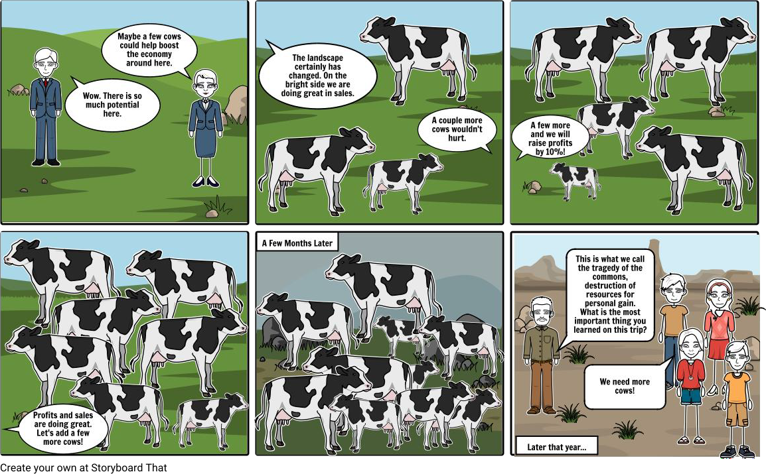
TRAGEDY OF THE COMMONS

Slide 28
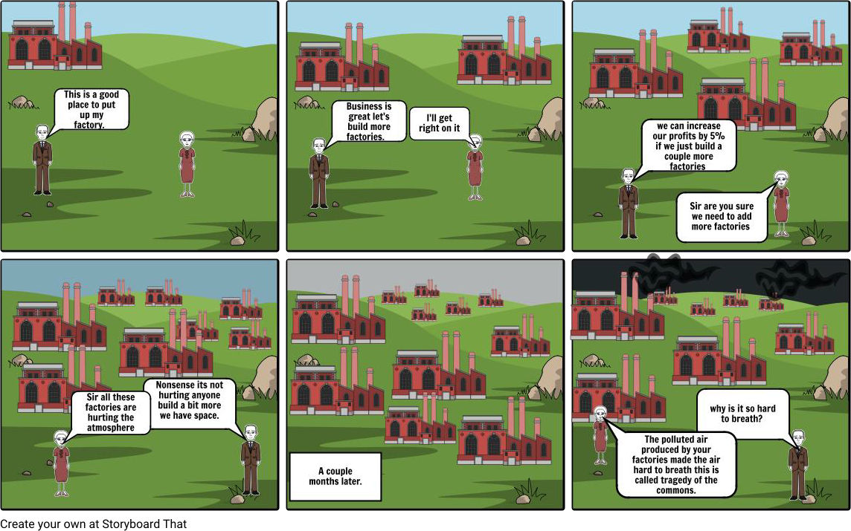
TRAGEDY OF THE COMMONS

Slide 29
The Tragedy of the Commons
PARABLE: “The Tragedy of the Commons”
Small medieval town, where it’s residents raise sheep
The sheep graze on the town common
The town’s residents collectively own the common
All residents are allowed to graze their sheep
The land is plentiful compared to the number of sheep
Over time, the town’s population grows… so does the number of sheep
The grass begins to disappear from overgrazing, and the town common eventually becomes barren
Sheep raising becomes impossible, and people lose their livelihoods
What causes this tragedy?

Slide 30
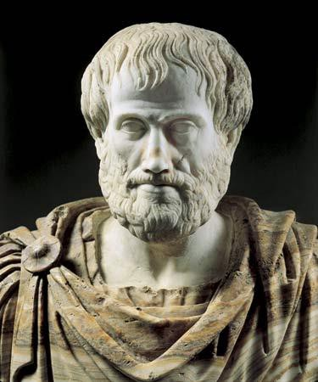
TRAGEDY OF THE COMMONS
Aristotle: “What is common to many is least taken care of, for all men have greater regard for what is their own than for what they posess in common with others.”
30

Slide 31


What Causes the Tragedy of the Commons?
Social and private incentives differ (MSB<MPB)
p
Social optimum
=> No incentive to reduce the size of its flock
Actual number
The tragedy is due to an externality:
allowing one’s flock to graze on the common
land reduces its quality for other families
People neglect this external cost, resulting in
overuse of the land.
O
MSB MPB
Number of sheep

Slide 32
HOW TO AVOID TRAGEDY OF THE COMMONS?
regulate or tax the use of common resources
Ex: regulations regarding hunting seasons, fishing, CO2 emissions by cars, dumping chemical products in rivers.
turn the common resource into a private good
Ex: divide a common land into smaller pieces and make them private.

Slide 33
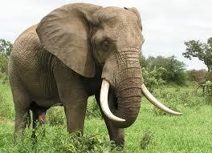
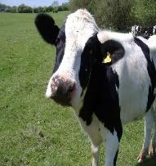
Why are elephants and other wild species are threatened to be
extinct, but not cows?
Both animals have a commercial (and societal) value, but cows are private goods and elephants are common resource, they are not owned by anyone.
Each poacher has a strong incentive to kill as many E as he can find – many poachers – they each have a very small incentive to preserve the E population.
Cows are privately owned, each farmer provides great effort to maintain his
cow population because he reaps the benefits of these efforts.
Solutions: regulation or privatization
  Kenya, Uganda: regulation (illegal to kill E and sell their ivory – laws not always easy to enforce )
  Malawi, Zimbabwe: privatization (made E a private good by allowing people to kill E, but only those on their property -> landowners now have an incentive to preserve E on their land to attract tourists).

Slide 34
PROPERTY RIGHTS
The market fails to allocate resources efficiently when property rights are not well-established (a good does not have an owner with the legal authority to control it).
When the absence of property rights causes a market failure (ex: tragedy of
the commons), the government can try to solve the problem:
  Help define property rights (ex: land privatization)
  Regulate private behavior (ex: wild animal hunting)

Slide 35
MERIT GOODS

Slide 36
MERIT GOODS
Sometimes consumers may have imperfect information about the benefits of a good and are not able to value them appropriately as a result.
Merit goods: the actual benefit of a good is higher than the value attached to
them by the consumer.
Merit goods can be provided by the private sector, but in equilibrium they may be under-consumed because the actual value for consumers (and/or society) is higher than what consumers are willing to pay.
Governments may subsidize merit goods or make their consumption compulsory up to some level to deal with this inefficiency.

Slide 37
EDUCATION AS A MERIT GOOD
Education has two key benefits:
Private benefits: career prospects, networks, learning.
  Individuals may underestimate private benefits.
Social benefits: stock of human capital in a country.
  Individuals don’t take account of social benefits when making decisions about their education, so left to the private market education would be under consumed.
→ Left to private markets, education would be under consumed.
→ In most countries, education is compulsory until a certain age (ex: 16) and
further education is subsidized.

Slide 38
HEALTHCARE, INSURANCE AND PENSIONS AS A MERIT GOODS
Individuals are sometimes bad at assessing risks (of being sick, of having a car accident, of being old and poor) so they underestimate the value of some insurances (healthcare, car accidents, pensions…)
→ Governments:
subsidize healthcare and make some insurance covers compulsory.
encourage savings for private pensions through financial incentives.

Slide 39
DE-MERIT GOODS
De-merit goods are goods which generate private or social costs (negative effects) which are not fully taken into account by the consumers of those goods.
Ex: Alcohol, cigarettes, illegal drugs.
As a consequence, such goods tend to be over-consumed if left to the market mechanism.
=> In many countries such good are taxed more heavily (ex: cigarettes) and/or their consumption is strictly regulated (ex: cannot drink and drive, cannot smoke in public spaces) or forbidden (cannot consume illegal drugs)

Slide 40
SUMMARY
Goods differ in whether they are excludable and whether they are rival.
  A good is excludable if it is possible to prevent someone from using it.
  A good is rival if one person’s enjoyment of the good prevents other
people from enjoying the same unit of the good.
Public goods are neither rival nor excludable.
  Because people are not charged for their use of public goods, they have an incentive to free ride when the good is provided privately and therefore private businesses are not able to provide such goods.
  Governments can provide public goods by taxing individuals and making quantity decisions based upon cost-benefit analyses.

Slide 41
SUMMARY
Common resources are rival but not excludable.
  Because people are not charged for their use of common resources, they tend to use them excessively.
  The resulting tragedy of the commons problem can be solved with regulations limiting the use of common resources or, when possible, privatization of the common resource.
Merit goods have higher private or social benefits than the value attached to them by consumers. They tend to be under-consumed and therefore governments encourage their consumption (compulsory, subsidized).
  De-merit goods have higher private or social costs than what their consumers take into account. They tend to be over-consumed and therefore governments discourage their consumption (illegal, taxed).

