Slide 1
Chapter 1
The Sociological Perspective

Slide 2
Chapter Outline
Putting Social Life into Perspective
The Importance of a Global Sociological Imagination
The Origins of Sociological Thinking
The Development of Modern Sociology
Contemporary Theoretical Perspectives

Slide 3
Putting Social Life Into Perspective
Sociology is the systematic study of human society and social interaction.
Sociologists study societies and social interactions to develop theories of:
  how human behavior is shaped by group life
  how group life is affected by individuals

Slide 4
Society is a large social grouping that shares the same geographical territory and is subject to the same political authority and dominant cultural expectations.

Slide 5
The sociological imagination is the ability to see the relationship between individual experiences and the larger society.
  personal troubles: private problems that affect individuals and the networks of people with which they regularly associate
  social/public issues: problems that affect large numbers of people and often require solutions at the societal level

Slide 6
Sociological Imagination
Overweight, being unemployed, having marital difficulties, or feeling purposeless or depressed.
Private? Or Public?
If they are widely shared with others, it shows us that they are social problems.

Slide 7
Sociological Imagination
https://www.youtube.com/watch?v=gWD6g9CV_sc
Sam Richards- Penn State University

Slide 8
Example: Losing a Job
With sociological imagination:
“I lost my job during an economic recession when many companies were laying off workers.”
Without sociological imagination:
“I lost my job because I wasn’t working hard enough.”
This explanation focuses only on the individual.
With sociological imagination:
»I lost my job during an economic recession when many companies were laying of workers»
Now we connect:
Your personal situation too broader issues like the economy, automation, company downsizing, or global crises

Slide 9
Struggling in school
Personal view:
“I’m bad at school.”
Sociological imagination view:
Maybe the school is underfunded, classes are overcrowded, students must work jobs after school, or certain communities lack resources.

Slide 10
Poverty
Personal view:
“People are poor because they don’t work hard.”
Sociological imagination:
Low wages, limited job opportunities, unequal education, and economic inequality keep many people in poverty.
👉 Poverty is largely a structural issue, not just an individual choice

Slide 11
Feeling Insecure on Social Media
Personal view:
“Everyone else has a better life than me.”
Sociological imagination:
Social media highlights perfect moments and creates unrealistic standards of beauty, success, and happiness.

Slide 12
Marrying Later in Life
Personal view:
“People today don’t value marriage.”
Sociological imagination:
Longer education, high living costs, job insecurity, and changing social values delay marriage.
👉 This is a social trend, not just individual choice.

Slide 13
Being Overweight
Personal (individual) explanation:
“I’m overweight because I’m lazy and don’t have self-control.”
This view blames only the person.
✅ Sociological imagination explanation:
Many people live in environments where fast food is cheap and everywhere, healthy food is expensive, work schedules are long, neighborhoods may not be safe for exercise, and advertising promotes unhealthy eating.

Slide 14
Emotions?
Emotions feel personal, but they are strongly shaped by society.
So they are not “just inside you,” and they are not “just social either.”
They are a mix of both.

Slide 15
Society teaches us how to feel..
• what we should feel
• when we should feel it
• how strongly we should show it
Examples:
Crying at a funeral = expected
Smiling in customer service = expected
Men being told not to cry = social rule
Women being discouraged from anger = social rule
👉 The emotion is real, but the rules around it are social.

Slide 16
Being Overweight
Now we connect the personal experience to:
• Food industry and marketing
• Income and class
• Urban design (lack of parks, sidewalks, gyms)
• Work stress and time pressure

Slide 17
No, sociological imagination does NOT mean “nothing is personal.”
It means that many personal experiences are strongly shaped by society, even though individuals still make choices.

Slide 18
Simple definition to remember…
Sociological imagination = understanding how personal problems are connected to larger social forces!!!!!!

Slide 19
Discussion
In what ways has society shaped who you are today?
How can overspending be analyzed with the sociological imagination?

Slide 20
The Development of Modern Sociology
Early Thinkers: A Concern with Social Order and Stability
  Comte
  Martineau
  Spencer
  Durkheim
Differing Views on the Status Quo: Stability versus Change
  Marx
  Weber
  Simmel
  The Chicago School
  Adams
  Du Bois

Slide 21
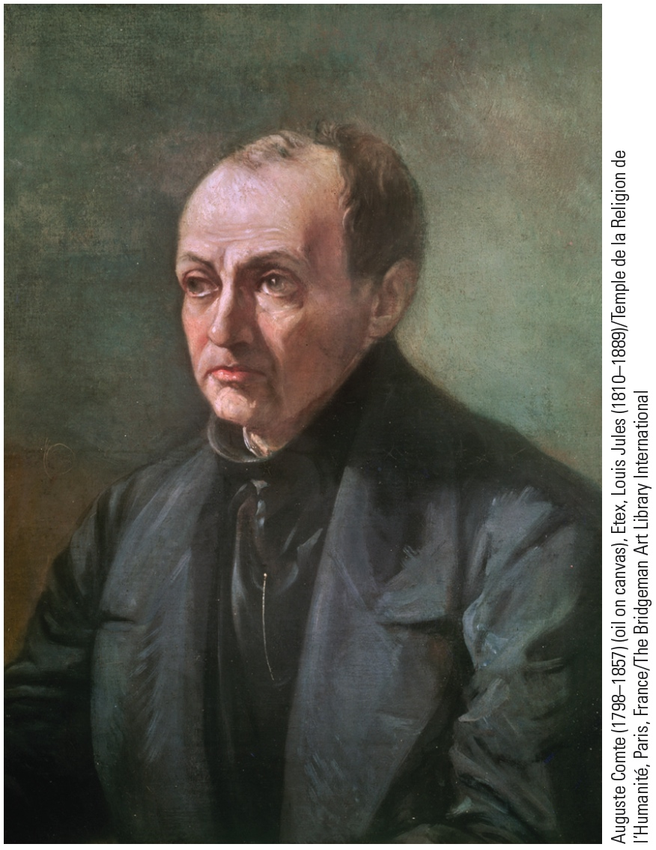
August Comte (1798-1857)
French philosopher
Coined “sociology” frst
Focuses on social statics and social dynamics
positivism: belief that the world can best be understood through scientific inquiry

Slide 22
August Comte
Law of Three Stages (expanded)
Comte believed both individuals and societies pass through:
1. Theological Stage
World explained by:
gods
spirits
religion
Society dominated by priests & kings

Slide 23
Auguste Comte
2. Metaphysical Stage
World explained by:
abstract forces
philosophy
“nature”
Society dominated by philosophers & legal thinkers

Slide 24
August Comte
3. Positive (Scientific) Stage
World explained by:
scientific laws
data
experiments
Society dominated by scientists & sociologists
👉 Sociology was meant to guide society in this final stage.

Slide 25
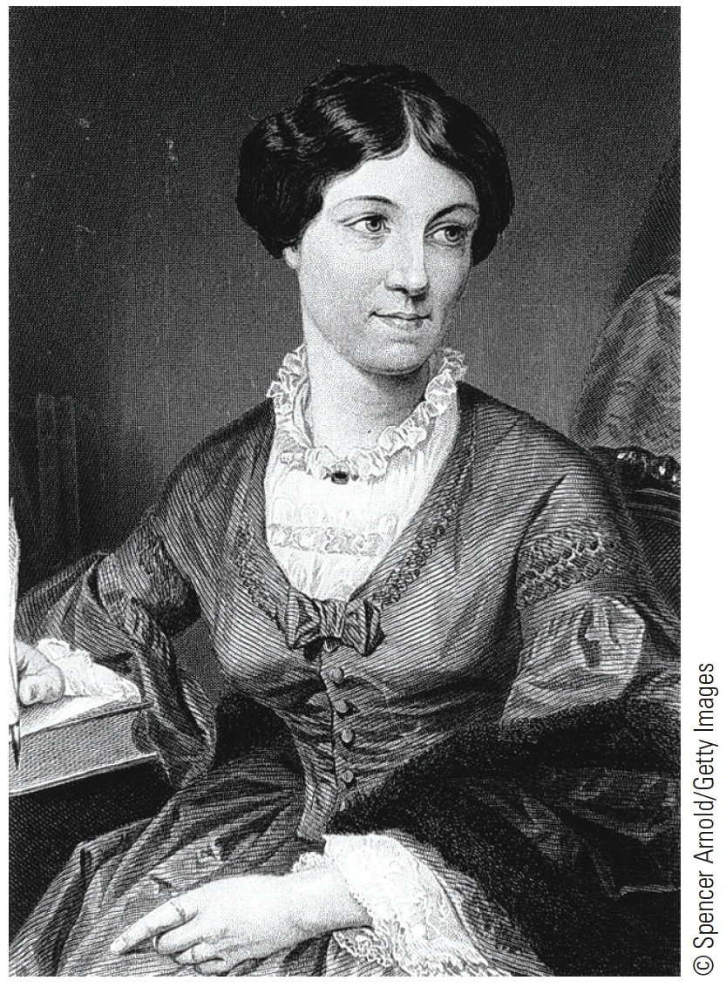
Harriet Martineau (1802-1876)
translated Comte’s works
Society in America
advocate of racial and gender equality
First female sociologist

Slide 26
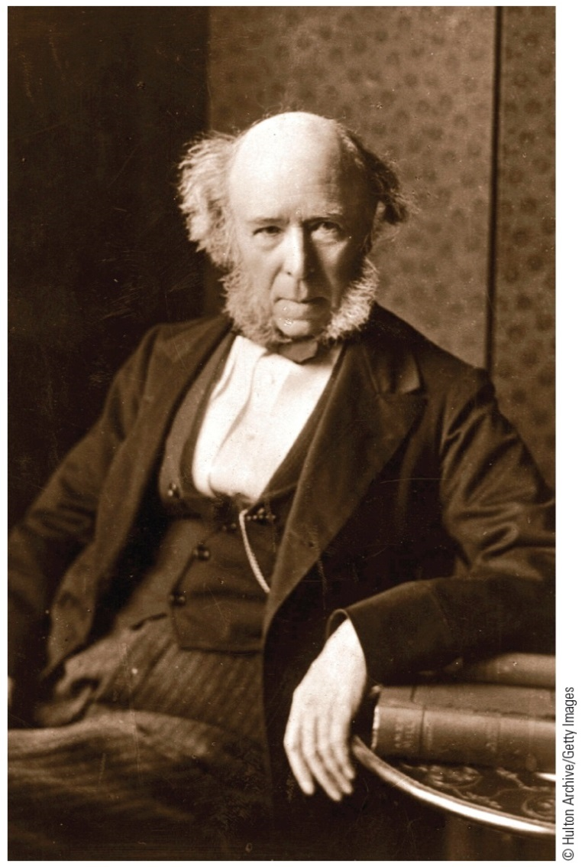
Herbert Spencer (1920-1903)
evolutionary perspective
social Darwinism: belief that species of animals best adapted to their environment survive and prosper
Survival of the fittest

Slide 27
Herbert Spencer-Evolutionary Perspective
Spencer’s Three Systems: Animal Organism vs. Society
Regulatory System
Sustaining System
Distributive System
Just as biological systems work together to keep an organism alive, social institutions work together to maintain the functioning of society.

Slide 28
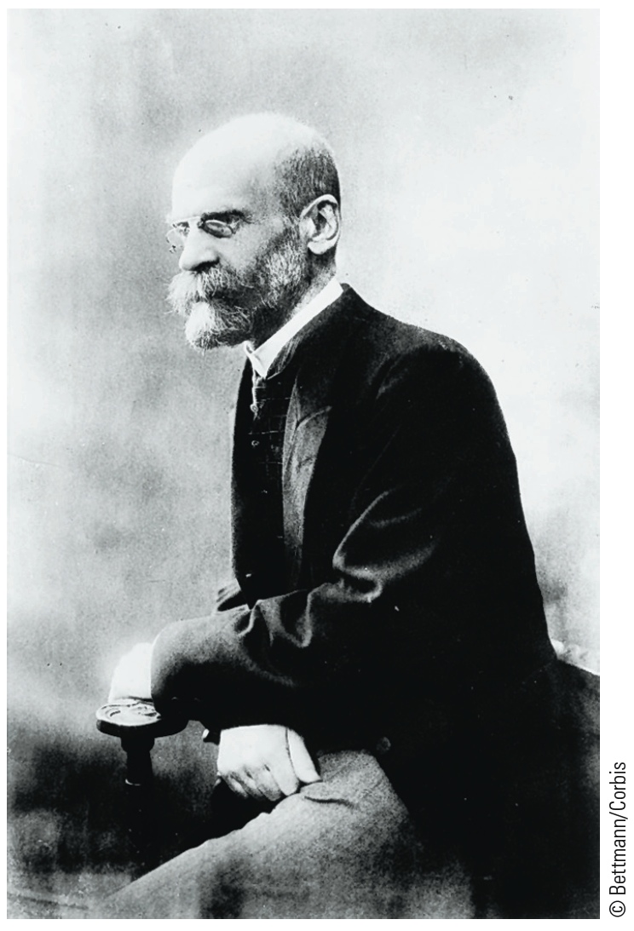
Emile Durkheim (1858-1917)
French sociologist
People are the product of their social environment
Rules of Sociological Method
social facts
anomie
Suicide
Notes:
social facts: patterned ways of thinking, acting, and feeling that exist outside of any one individual but that exert social control over each person
anomie: a condition in which social control becomes ineffective as a result of the loss of shared values and of a sense of purpose in society

Slide 29
Emile Durkheim (1858-1917)
Key Idea: Social Facts (VERY IMPORTANT)
Durkheim said society is made up of social facts: Ways of thinking, acting, and feeling that exist outside the individual and influence us.
Examples of social facts:
• laws
• religion
• traditions
• moral rules
• education
• language
⚠️ We are born into them — we don’t create them individually.

Slide 30
Emile Durkheim-Social Solidarity (How Society Stays Together)
Durkheim asked:
What holds society together?
He identified two types:
1-Mechanical Solidarity
2-Organic Solidarity
*Anomie

Slide 31
Emile Durkheim
Famous Study: Suicide
Durkheim showed that suicide is not just a personal issue — it is influenced by:
• social integration
• social regulation
• religion
• family ties
👉 A perfect example of sociological imagination.

Slide 32
Emile Durkheim
Why Durkheim Matters??
✅ Made sociology scientific
✅ Showed society shapes individuals
✅ Explained social order
✅ Introduced key concepts still used today

Slide 33
Emile Durkheim
Suicide is not just a personal psychological act — it is strongly influenced by society.
Suicide statistics
*sex
*religion
*family life
**Suicide is not just a personal psychological act-it is strongly influenced by society

Slide 34
Emile Durkheim
Durkheim’s Four Types of Suicide
He classified suicide based on two social forces:
• Social integration (how connected people are)
• Social regulation (how controlled life is by norms)

Slide 35
Emile Durkheim
1. Egoistic Suicide (too little integration)
Occurs when people feel:
• isolated
• disconnected
• lonely
Common when:
weak family ties
weak religious/community life
Example: someone with no strong social relationships.

Slide 36
Emile Durkheim
2.Altruistic Suicide (too much integration)
Occurs when individuals are:
• too strongly attached to a group
• willing to die for it
Examples:
soldiers sacrificing themselves
ritual suicides in traditional societies
👉 The group is more important than the individual.

Slide 37
Emile Durkheim
3. Anomic Suicide (too little regulation)
Occurs during:
• economic crashes
• sudden wealth
• major life changes
People feel:
confused
without clear rules
Example: job loss during recession.

Slide 38
Emile Durkheim
4.Fatalistic Suicide (too much regulation)
Occurs when life feels:
• overly controlled
• hopeless
• no freedom
Examples:
prisoners
people in extreme oppression

Slide 39
Emile Durkheim
Type of Suicide | Level of Social Integration | Level of Social Regulation | Main Cause
Egoistic | Low | Normal | Social isolation, weak social ties
Altruistic | High | Normal | Too much attachment to the group
Anomic | Normal | Low | Social instability, loss of norms
Fatalistic | Normal | High | Extreme control and oppression

Slide 40
https://www.youtube.com/watch?v=HSDeI8ZQdc8

Slide 41
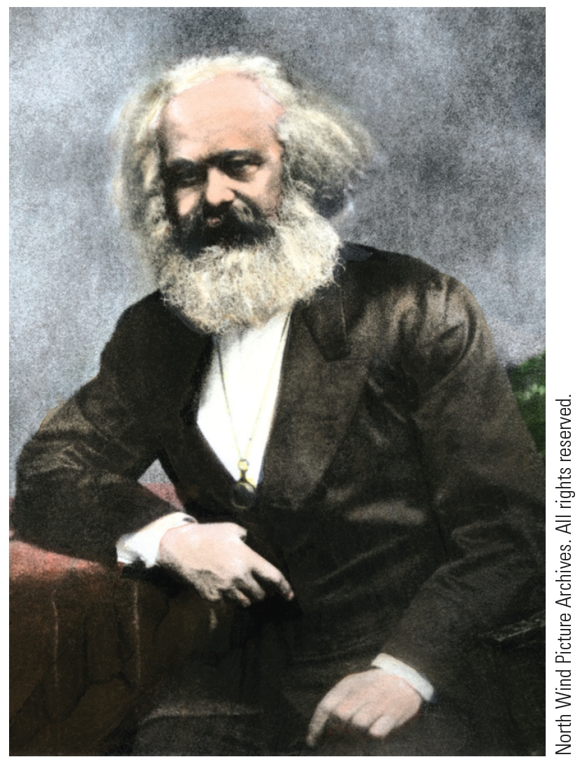
Karl Marx (1818-1883)
German philosopher, economist, and sociologist
• Lived during the Industrial Revolution
• Studied capitalism and inequality
• Believed society is shaped mainly by economic structures

Slide 42
Karl Marx (1818-1883)
Historical Materialism (one of the famous terms)
Marx argued:
History moves forward through conflict between social groups.
Not harmony — but struggle.
Every era has:
• those who control resources
• those who work for them
And conflict between them creates social change.

Slide 43
Karl Marx (1818-1883)
Examples in history:
slave owners vs slaves
lords vs peasants
capitalists vs workers
Each system creates:
👉 specific classes
👉 specific inequalities
👉 specific conflicts
Economic Systems (Modes of Production)
Marx said each society is built on an economic system:
• Feudalism (land-based)
• Capitalism (factory & wage labor)
• Socialism (future system he predicted)

Slide 44
Karl Marx (1818-1883)
Communist Manifesto
Most important term is class conflict
Bourgeoisie:
• factory owners
• business owners
• control wealth and production
Proletariat:
• workers
• sell labor to survive
• produce wealth but don’t own it

Slide 45
Karl Marx (1818-1883)
⚠️ Marx’s main argument:
The bourgeoisie become rich by exploiting workers.
Workers:
work long hours
get low wages
create profits for owners
👉 This exploitation causes class struggle.

Slide 46
Karl Marx (1818-1883)
Why Conflict Is Inevitable (according to Marx)
Because:
✔️ Owners want maximum profit
✔️ Workers want fair wages
❌ Their interests oppose each other
So struggle is built into capitalism.

Slide 47
Karl Marx (1818-1883)
Marx predicted: (Communist Manifesto)
Eventually:
• workers would become aware of exploitation
• organize together
• overthrow capitalism
(This is called class consciousness and revolution)

Slide 48
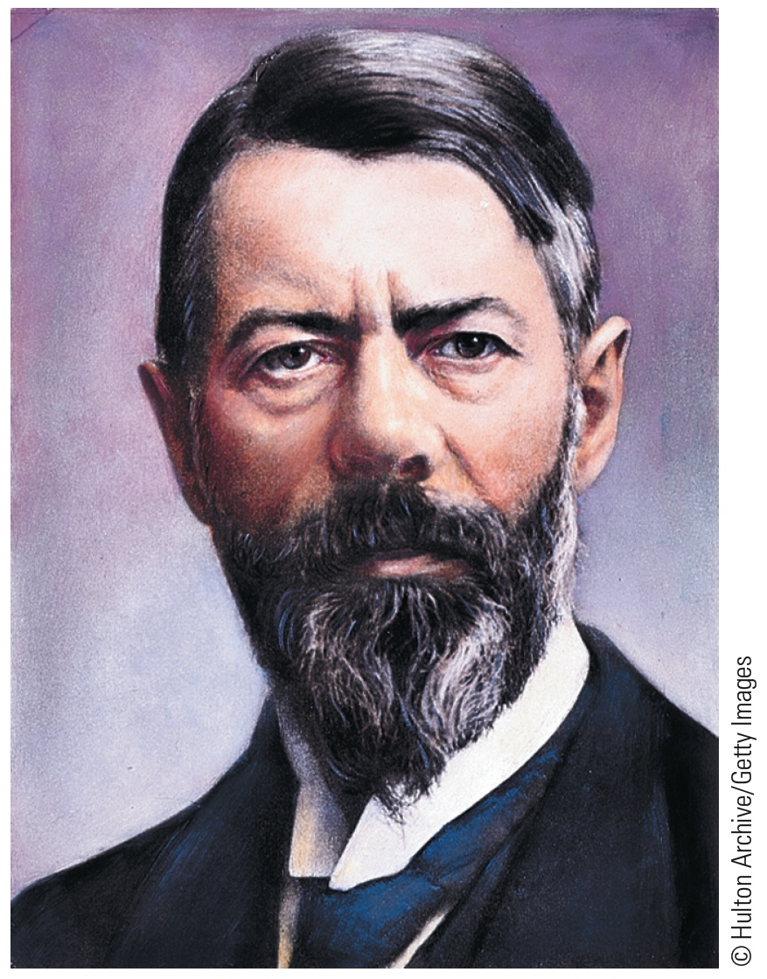
Max Weber (1864-1920)
German sociologist, historian, and economist
• Lived from 1864 to 1920
• One of the founders of interpretive sociology
• Interested in meaning, not just structure or economy
rationalization

Slide 49
Max Weber (1864-1920)
The Protestant Ethic and the Spirit of Capitalism(famous work)
Weber asked:
Why did modern capitalism develop in Western Europe and not elsewhere?
His answer:
👉 Cultural and religious values played a major role.

Slide 50
Max Weber (1864-1920)
Protestant ethic included:
• Hard work
• Discipline
• Self-control
• Saving and reinvesting money
• Viewing work as a moral duty
This created:
➡️ The “spirit of capitalism” — a mindset that supports continuous profit-making and efficiency.

Slide 51
Max Weber (1864-1920)
Rationalization (Key Concept)
Rationalization means:
The process by which traditional, emotional, and value-based ways of life are replaced by efficiency, calculation, rules, and control.
Examples:
• Bureaucracy
• Modern governments
• Corporations
• Schools and hospitals
• Legal systems

Slide 52
Max Weber (1864-1920)
The “Iron Cage”
Weber warned that rationalization creates an iron cage:
• Society becomes highly efficient
• But individuals lose freedom and creativity
• Life becomes controlled by systems and rules
Weber’s Contribution to Sociology
• Showed culture matters
• Introduced interpretive(yorumlayıcı) sociology
• Explained modern bureaucracy
• Analyzed capitalism beyond economics

Slide 53
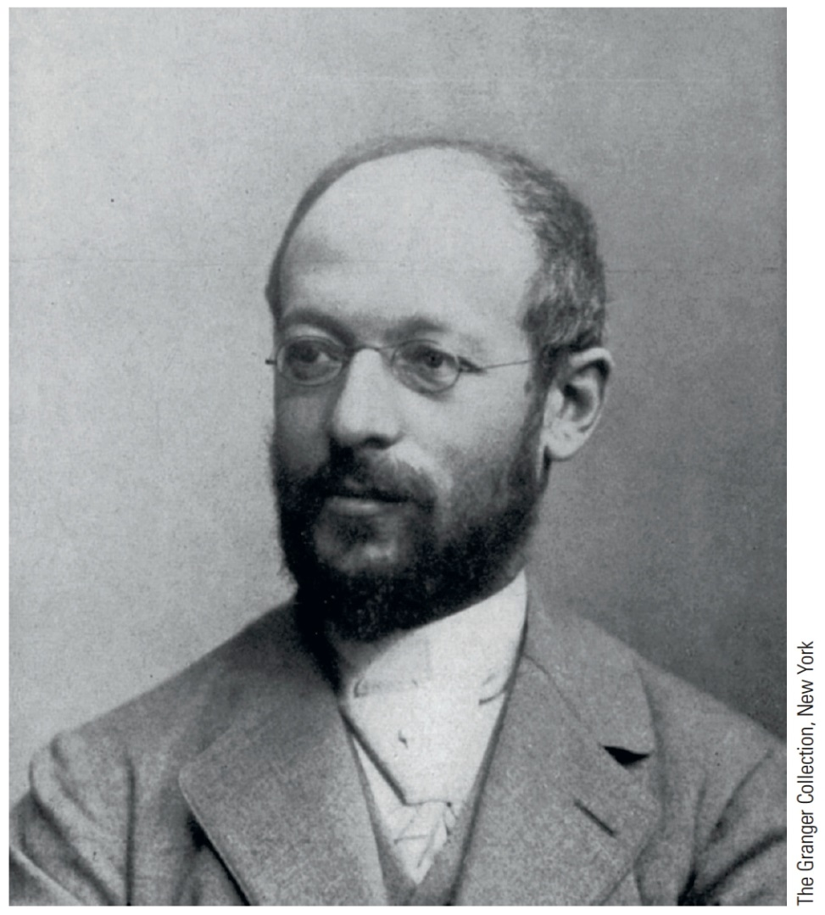
Georg Simmel (1858-1918)
• German sociologist and philosopher
• Focused on everyday social interactions
• Studied how society is created through relationships
• Interested in small groups and social patterns

Slide 54
George Simmel-Group Size
Simmel showed that group size changes social relationships.
🔹 Dyad (2 people)
Examples:
• friendship
• marriage
Characteristics:
✔️ very close
✔️ emotionally intense
❌ unstable (if one leaves, the group ends)
🔹 Triad (3 people)
A third person changes everything:
• mediator (peacemaker)
• alliance builder (two against one)
• power shifts
👉 Groups become more stable but also more complex.

Slide 55
George Simmel-Group Size
As group size increases, relationships become less personal but more stable.
Formal Sociology (Simmel’s main approach)
Simmel argued that sociology should study:
👉 the forms of interaction, not just the content.
Meaning:
Instead of studying:
❌ love,money, religion,
✅ cooperation, conflict, exchange, domination, competition
These forms appear in many areas of life.

Slide 56
George Simmel
There are different types of interaction :
Competition
Division of labor
Subordination&Domination

Slide 57
Subordination and Domination (Simmel)
Simmel studied power relations as another “form” of interaction.
Many social relationships involve hierarchy: leader–follower, boss–worker, teacher–student, state–citizen.
Power is rarely one-sided. Even the subordinate has some influence.Why?
A leader depends on followers to obey.
A boss depends on workers to produce.
A teacher depends on students to participate.
So domination is a relationship, not just control.

Slide 58
Competition (Simmel)
For Georg Simmel, competition is not only hostility—it is a social form that connects people through a shared goal.
Competition is an indirect conflict: competitors may not fight each other directly, but they struggle over the same prize (a job, status, customers, grades).
It creates social order by deciding who gets rewards (money, prestige, power).
It can integrate society: people become linked through markets, schools, and careers—even if they do not know each other.

Slide 59
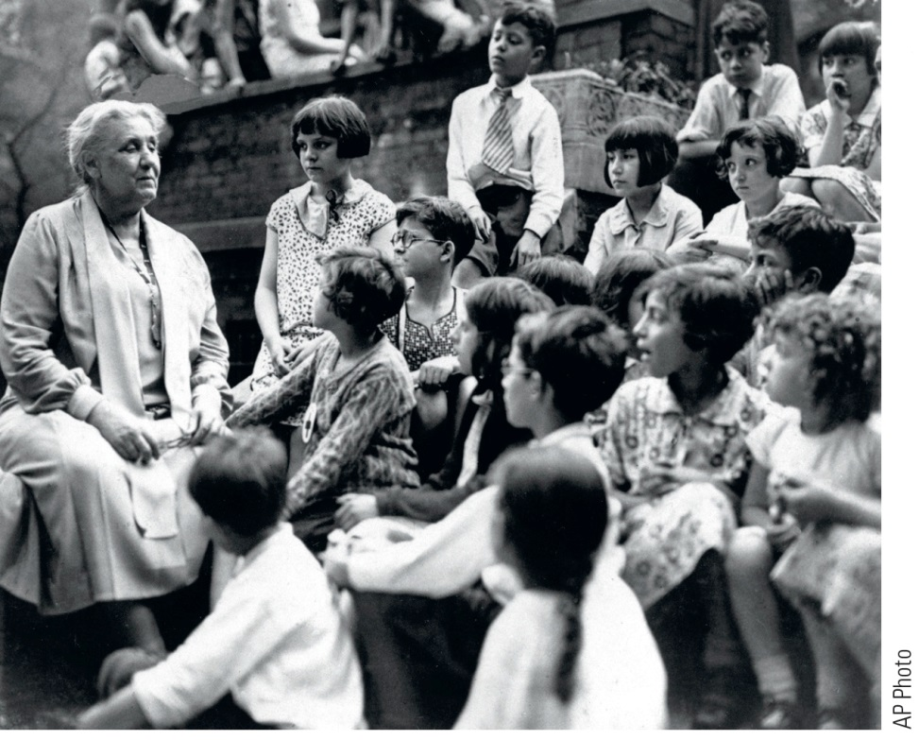
Jane Addams (1860-1935)
Illionis
Womens’ rights activist and social reformer
founded Hull House
Nobel Prize

Slide 60
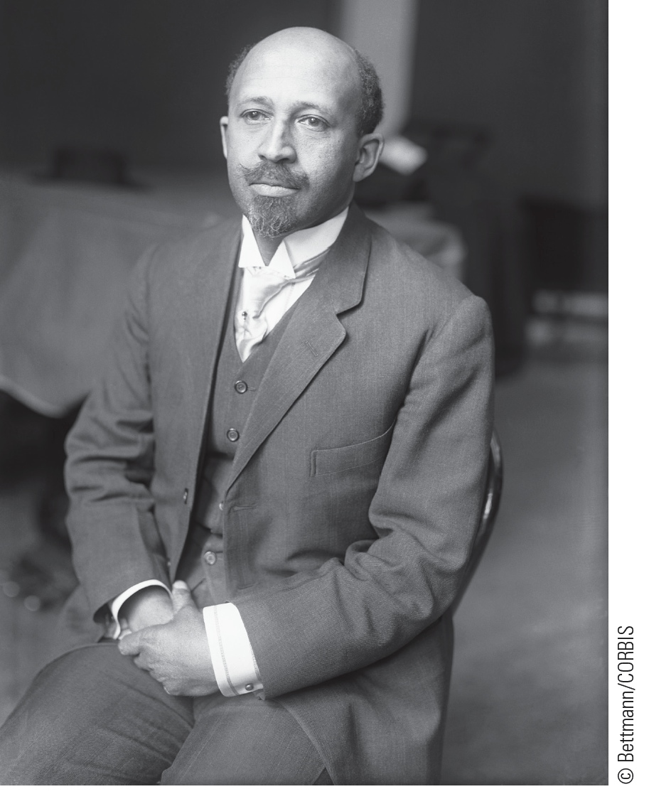
W.E.B. Du Bois (1968-1963)
Afroamerican
The Philadelphia Negro
Race

