Slide 1
Working Capital Management
Slides by Matthew Will

Slide 2
Topics Covered
The Composition of Working Capital
Inventories
Credit Management
Cash
Marketable Securities
Notes:
3
2
2
2
2
2

Slide 3
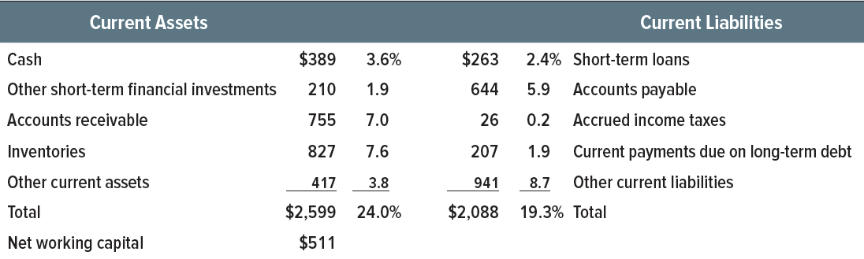
Table 30.1 Current Assets and Liabilities
U.S. manufacturing firms, 4th quarter 2017 ($ billions)

Slide 4
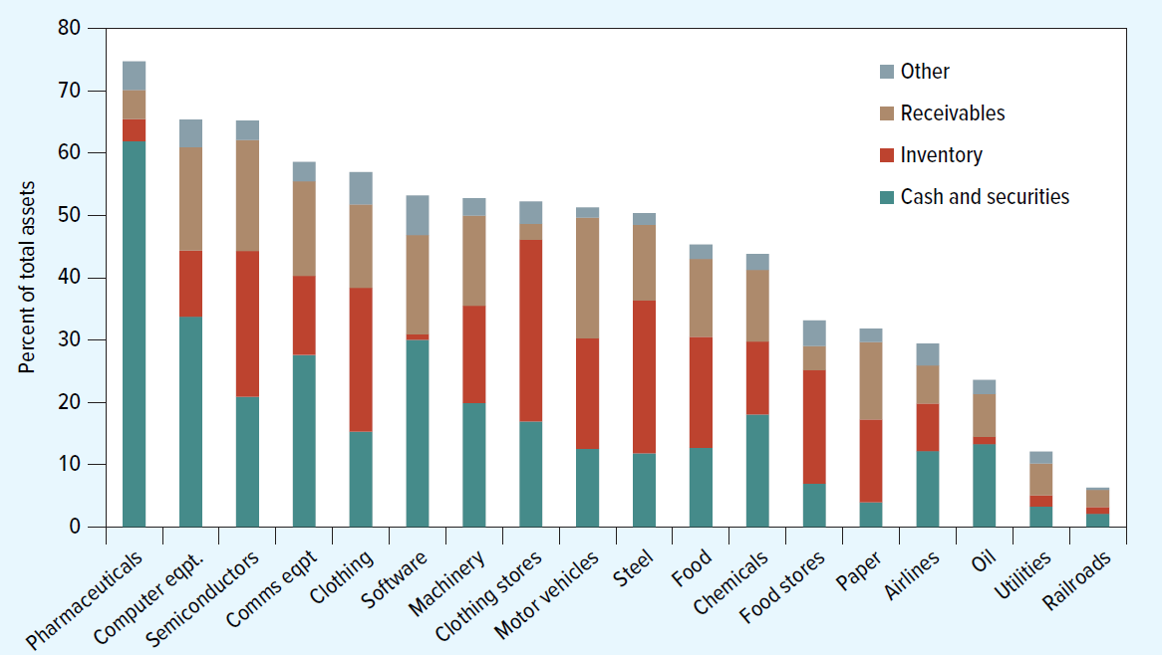
Figure 30.1 Current Assets as a Percentage of Total Assets
4th quarter 2017

Slide 5
Inventories
Components of Inventory
  Raw materials
  Work in process
  Finished goods
Goal = Minimize amount of cash tied up in inventory
Tools used to minimize inventory
  Just-in-time

Slide 6
Inventories Continued
As the firm increases its order size, the number of orders falls and therefore the order costs decline.
However, an increase in order size also increases the average amount in inventory, so that the carrying cost of inventory rises.
The trick is to strike a balance between these two costs.
Notes:
22

Slide 7
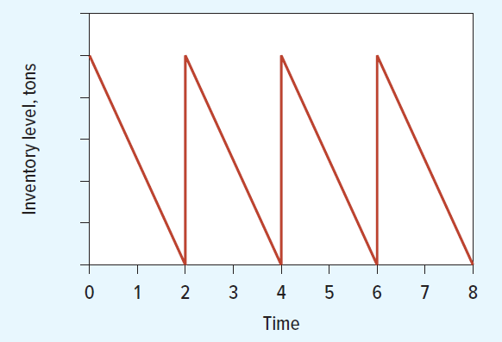
Figure 30.2 Simple Inventory Rule

Slide 8
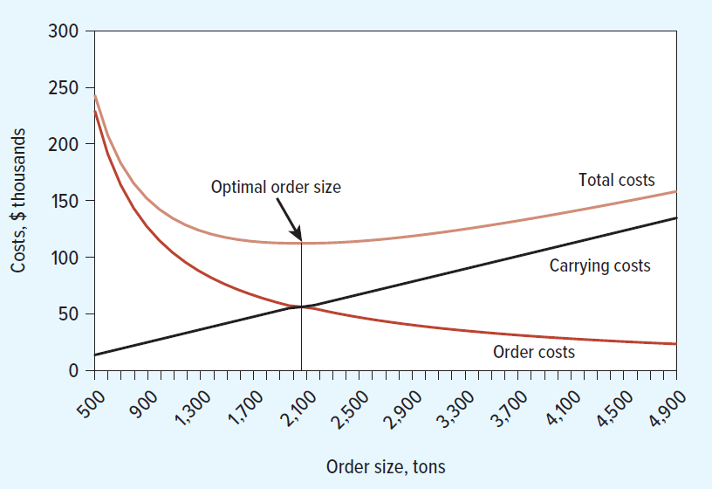
Figure 30.3 Optimal Order Size Determination
Notes:
24

Slide 9
Inventories Concluded
Economic Order Quantity: Order size that minimizes total inventory costs
Notes:
23

Slide 10
Credit Management
Management of trade credit requires answers to five sets of questions:
How long are you going to give customers to pay their bills? Are you prepared to offer a cash discount for prompt payment?
Do you require some formal IOU from the buyer or do you just ask him or her to sign a receipt?
How do you determine which customers are likely to pay their bills?

Slide 11
Credit Management Continued
How much credit are you prepared to extend to each customer? Do you play it safe by turning down any doubtful prospects? Or do you accept the risk of a few bad debts as part of the cost of building a large regular clientele?
How do you collect the money when it becomes due? What do you do about reluctant payers or deadbeats?

Slide 12
Terms of Sale
Terms of Sale: Credit, discount, and payment terms offered on a sale.
Example: 2/10, net 30
2: percent discount for early payment
10: number of days that the discount is available
net 30: number of days before payment is due
Notes:
3

Slide 13
Credit Analysis
Credit Analysis: Procedure to determine the likelihood a customer will pay its bills.
Credit agencies such as Dun and Bradstreet provide reports on the creditworthiness of a potential customer.
Financial ratios can be calculated to help determine a customer’s ability to pay its bills.
Notes:
9

Slide 14
The Credit Decision
Credit Policy: Standards set to determine the amount and nature of credit to extend to customers.
Credit Scoring: What your lender won’t tell you.
Extending credit gives you the probability of making a profit, not the guarantee. There is still a chance of default.
Denying credit guarantees neither profit or loss.
Notes:
17

Slide 15
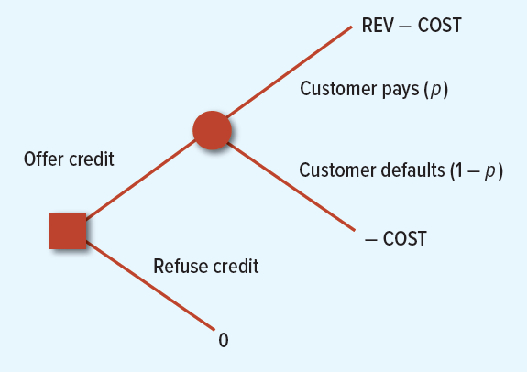
Figure 30.4 The Credit Decision
Notes:
20

Slide 16
The Credit Decision Continued
Based on the probability of payoffs, the expected profit can be expressed as:
The break-even probability of collection is:
Notes:
23

Slide 17
The Credit Decision Continued 2
Example: Cast Iron receives revenues with a present value of $1,200 and incurs costs with a value of $1,000. Therefore the company’s expected profit if it offers credit is:
p × PV(REV − COST) − (1 − p)PV(COST)
= p × 200 − (1 − p) × 1,000
Notes:
23

Slide 18
The Credit Decision Continued 3
Example: If the probability of collection is 5/6, Cast Iron can expect to break even:
Notes:
23

Slide 19
The Credit Decision Continued 4
Example: You can find little information on the firm, and you believe that the probability of payment is no better than .8.
Notes:
23

Slide 20
The Credit Decision Continued 5
Example: Because the customer has paid once, you can be 95% sure that he or she will pay again.
Notes:
23

Slide 21
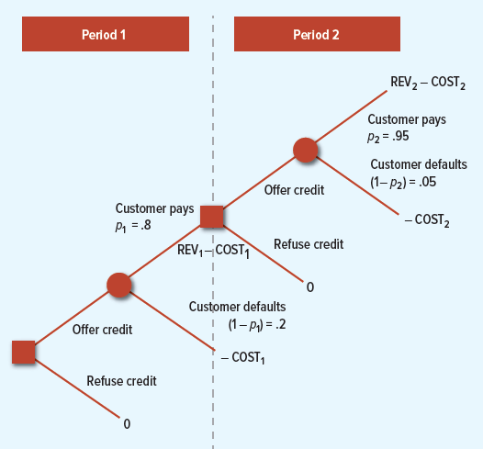
Figure 30.5 Example Illustrated

Slide 22
Collection Policy
Collection Policy: Procedures to collect and monitor receivables.
Factoring: Arrangement whereby a financial institution buys a company's accounts receivable and collects the debt.
Notes:
24

Slide 23
The Credit Decision Concluded
Credit allocation involves judgement. Below are reminders to consider.
Maximize profits
Concentrate on the dangerous accounts
Look beyond the immediate order

Slide 24
Cash
Cash does not pay interest
  Move money from cash accounts into short-term securities
  “Sweep” programs
  Concentration banking
  Lockbox system

Slide 25
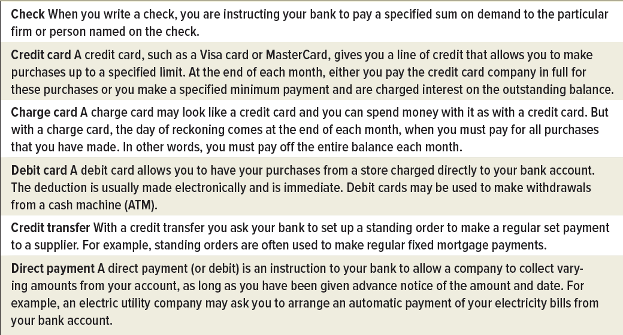
Table 30.3 Ways to Pay Bills

Slide 26
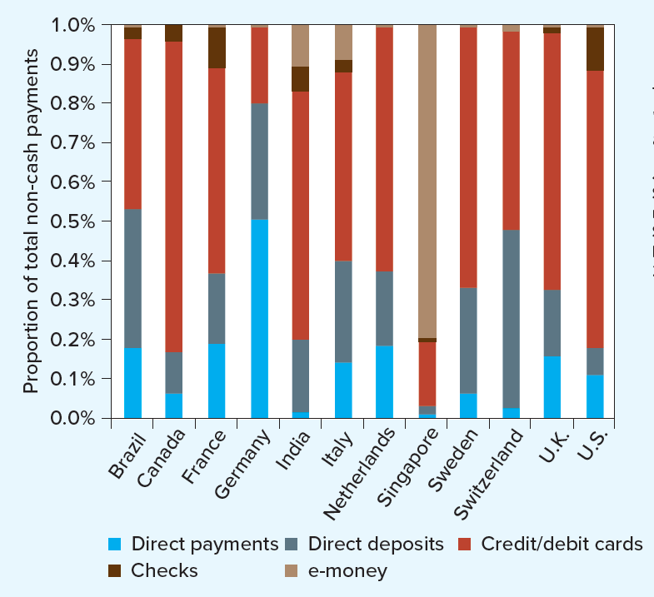
Figure 30.6 How Purchases Are Paid

Slide 27
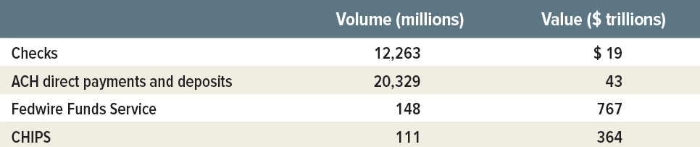
Table 30.4 Use of Payment Systems in the United States, 2016

Slide 28
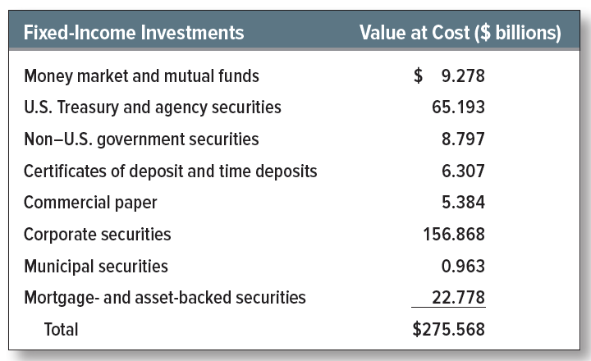
Marketable Securities
Apple 2017 cash investments

Slide 29
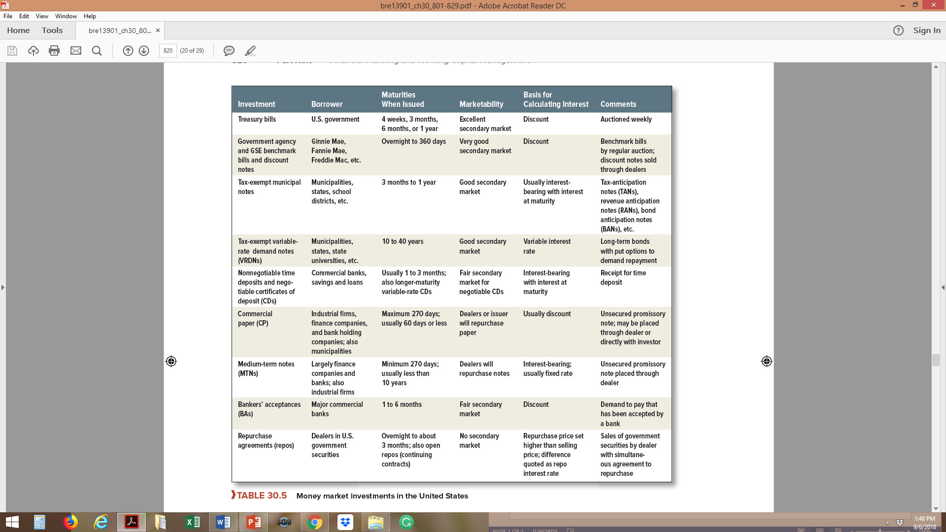
Table 30.5 Money Market Investments in the United States

