Slide 1
Chapter Seven
Mortgage Markets
©McGraw Hill LLC. All rights reserved. No reproduction or distribution without the prior written consent of McGraw Hill.

Slide 2
Mortgages and Mortgage-Backed Securities
Mortgages are loans to individuals or businesses to purchase homes, land, or other real property
Many mortgages are securitized
  Securitization occurs when securities are packaged and sold as assets backing a publicly traded or privately held debt instrument
Mortgages differ from bonds and stocks
  Mortgages are backed by a specific piece of real property
  Primary mortgages have no set size or denomination
  Primary mortgages generally involve a single investor
  Comparatively little information exists on mortgage borrowers

Slide 3
Primary Mortgage Market
Four basic types of mortgages are issued by financial institutions:
  Home mortgages are used to purchase one- to four-family dwellings (called “single-family mortgages”)
    $12.55 trillion outstanding in 2021
  Multifamily dwelling mortgages are used to purchase apartment complexes, townhouses, and condominiums
    $1.88 trillion outstanding
  Commercial mortgages are used to finance the purchase of real estate for business purposes
    $3.31 trillion outstanding
  Farm mortgages are used to finance the purchase of farms
    $0.30 trillion outstanding

Slide 4
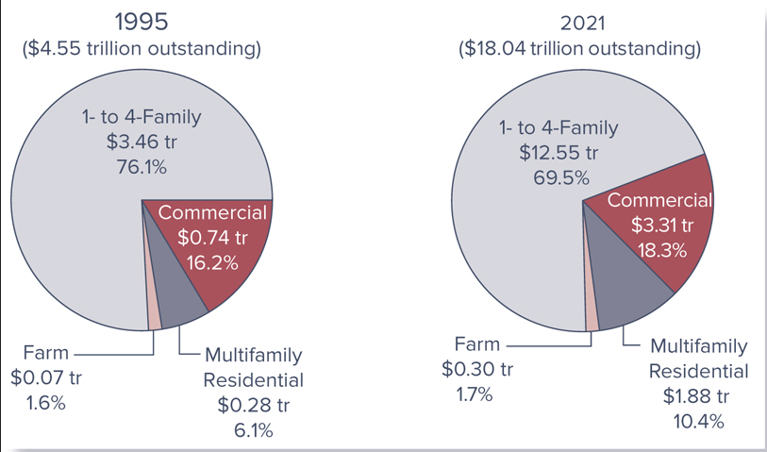
Mortgage Loans Outstanding

Slide 5
Mortgage Characteristics
All mortgage loans are backed by a specific piece of property that serves as collateral to the mortgage loan
A down payment is a portion of the purchase price of the property a financial institution requires the mortgage borrower to pay up front
  Private mortgage insurance (PMI) is generally required when the loan-to-value ratio is more than 80% (i.e., the borrower makes a down payment of less than 20%)
Federally insured mortgages
  Repayment is guaranteed by either the Federal Housing Administration (FHA) or the Veterans Administration (VA)
  Conventional mortgages are not federally insured

Slide 6
Mortgage Characteristics (Continued)
A mortgage is amortized when the fixed principal and interest payments fully pay off the mortgage by its maturity date
Balloon payment mortgages require fixed monthly interest payments for a 3- to 5-year period, at which point full payment of the mortgage principal is due
Fixed-rate mortgages lock in the borrower’s interest rate
  Therefore, required monthly payments are fixed over the life of the mortgage and lenders assume interest rate risk
Adjustable-rate mortgages (ARMs) have interest rates tied to some market interest rate
  Required monthly payments can change

Slide 7
Mortgage Characteristics (Concluded)
Discount points are fees or payments made when a mortgage loan is issued (at closing)
  One discount point paid up front is equal to 1 percent of the principal value of the mortgage
Mortgage contracts generally require the borrower to pay an assortment of fees to cover the mortgage issuer’s costs of processing the mortgage
  E.g., application fee, title search, title insurance, appraisal fee, loan origination fee, closing agent and review fees, etc.
Mortgage refinancing occurs when a mortgage borrower takes out a new mortgage and uses the proceeds obtained to pay off the current mortgage
  Mortgages are most often refinanced when a current mortgage has an interest rate that is higher than the current interest rate

Slide 8
Mortgage Amortization
The fixed monthly payment made by a mortgage borrower generally consists partly of repayment of the principal borrowed and partly of the interest on the outstanding (remaining) balance of the mortgage
  During the early years of the mortgage, most of the fixed monthly payment represents interest on the outstanding principal and a small amount represents a payoff of the outstanding principal
An amortization schedule shows how the fixed monthly payments are split between principal and interest

Slide 9
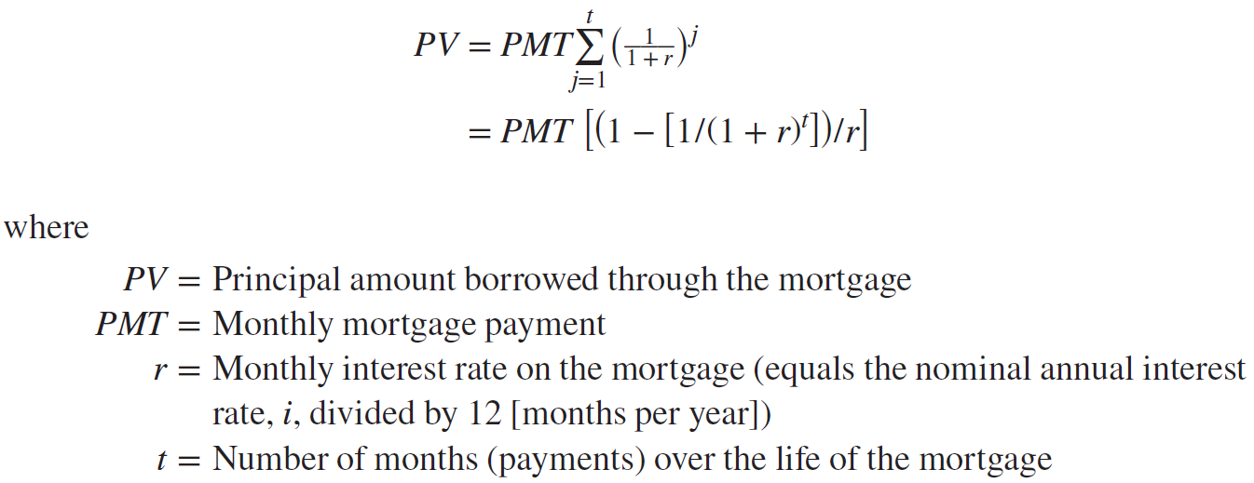
Mortgage Payments
The present value of a mortgage can be written as:

Slide 10
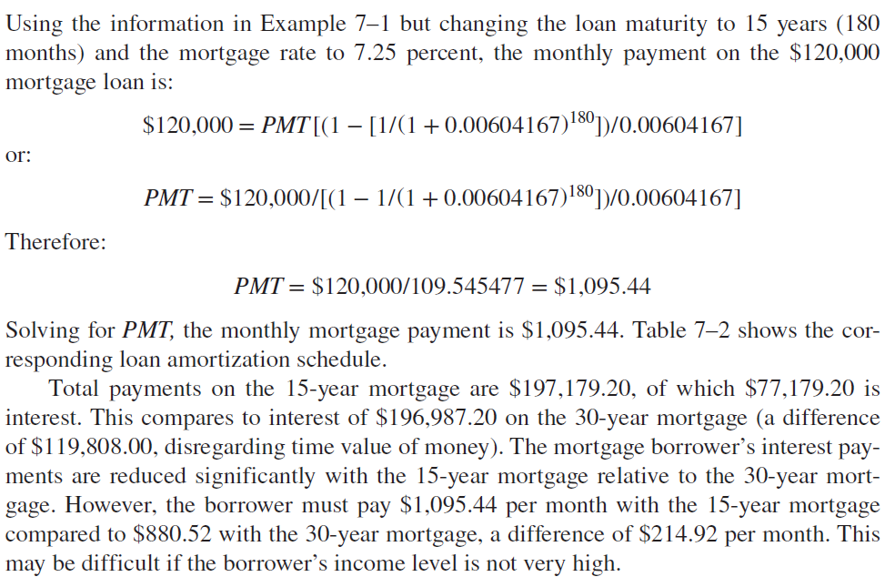
Comparison of Interest Paid

Slide 11
Other Types of Mortgages
Jumbo mortgages are those that exceed the conventional mortgage conforming limits
  Limits are set by the two government-sponsored enterprises, Fannie Mae and Freddie Mac, and are based on the maximum value of any individual mortgage they will purchase from a mortgage lender ($726,200 in 2023, with some exceptions)
Subprime mortgages are mortgages to borrowers who have weakened credit histories
  These borrowers may have weakened credit due to payment delinquencies and possibly more severe problems such as charge-offs, judgments, and bankruptcies

Slide 12
Other Types of Mortgages (Continued)
Alt-A mortgages are considered riskier than a prime mortgage and less risky than a subprime mortgage
  Interest rates on Alt-A loans are usually between prime and subprime rates
Option ARMs are adjustable rate mortgages that offer the borrower several monthly payment options:
  Minimum payment option - Lowest of the four payment options and carries the most risk
  Interest-only payment - Monthly payments must increase substantially after the initial interest-only period lapses
  30-year fully amortizing payment - Borrower pays both principal and interest on the loan, based on a 30-year term
  15-year fully amortizing payment - Based on a 15-year term

Slide 13
Other Types of Mortgages (Concluded)
Second mortgages are loans secured by a piece of real estate already used to secure a first mortgage
  Should a default occur, the second mortgage holder is paid only after the first mortgage is paid off
Home equity loans let customers borrow on a line of credit secured with a second mortgage on their homes
Reverse-annuity mortgages (RAMs)
  Borrower receives regular monthly payments from a financial institution rather than making them
  When the RAM matures (or the borrower dies), the borrower (or the borrower’s estate) sells the property to retire the debt
  RAMs are attractive mainly to older homeowners who have accumulated substantial equity in their homes

Slide 14
Secondary Mortgage Markets
FIs remove mortgages from their balance sheets through one of two mechanisms:
  By pooling recently originated mortgages together and selling them in the secondary market
  By securitizing mortgages (i.e., by issuing securities backed by newly originated mortgages)
Advantages of securitization:
  FIs can reduce their liquidity risk, interest rate risk, and credit risk
  FIs generate fee income, which helps to offset the effects of regulatory constraints

Slide 15
History and Background of Secondary Mortgage Markets
Mortgage market is unique in that the U.S. government is deliberately involved in the development of its secondary markets
  In 1938, the government established the Federal National Mortgage Association (FNMA, or Fannie Mae) to buy mortgages from depository institutions so they could lend to other mortgage borrowers
  To encourage continued expansion in the housing market and to promote competition for FNMA, the U.S. government created the Government National Mortgage Association (GNMA, or Ginnie Mae) and the Federal Home Loan Mortgage Corporation (FHLMC, or Freddie Mac)

Slide 16
Mortgage Sales
FIs have sold mortgages and commercial real estate among themselves for over 100 years
A large part of correspondent banking involves small banks making loans that are too big for them to hold on their balance sheets and selling parts of these loans to large banks with whom they have had a long-term deposit and lending correspondent relationship
  Large banks often sell parts of their loans (i.e., participations) to smaller banks
Mortgage sales occur when an FI originates a mortgage and sells it to an outside buyer
  May be sold with or without recourse

Slide 17
Mortgage-Backed Securities
Securitization of mortgages involves the pooling of a group of mortgages with similar characteristics, the removal of these mortgages from the balance sheet, and the subsequent sale of interests in the mortgage pool to secondary market investors
Mortgage-backed securities allow mortgage issuers to separate the credit risk exposure from the lending process itself
There are three major types of mortgage-backed securities:
  Pass-through security
  Collateralized mortgage obligation (CMO)
  Mortgage-backed bond

Slide 18
Pass-Through Securities
Pass-through mortgage securities “pass through” promised payments of principal and interest on pools of mortgages created by FIs to secondary market participants holding interests in the pools
Three agencies are directly involved in the creation of mortgage-backed pass-through securities
  Government National Mortgage Association (GNMA; Ginnie Mae)
  Federal National Mortgage Association (FNMA; Fannie Mae)
  Federal Home Loan Mortgage Corporation (FHLMC; Freddie Mac)
Private mortgage issuers, such as banks and thrifts, also purchase mortgage pools, but they do not conform to government-related issuer standards

Slide 19
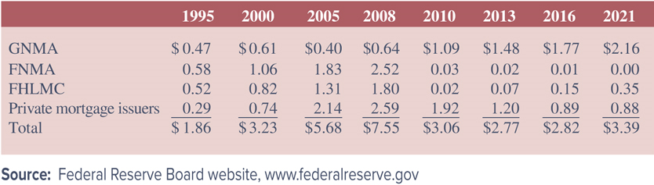
Government-Related Mortgage-Backed Pass-Through Securities Outstanding
Notes:
Table 7–3 reports the amount of mortgage-backed pass-through securities outstanding for each from 1995 through third quarter of 2021.

Slide 20
Pass-Through Securities (Continued)
Government National Mortgage Association (GNMA)
  Began operations in 1968 when it split off from the Federal National Mortgage Association (FNMA)
  Government-owned agency with two major functions: sponsoring mortgage-backed securities programs of FIs and providing timing insurance
Federal National Mortgage Association (FNMA)
  Originally created in 1938 and, since 1968, FNMA has operated as a private corporation owned by shareholders
  Creates mortgage-backed securities (MBSs) by purchasing packages of mortgage loans from banks and thrifts
Federal Home Loan Mortgage Corporation (FHLMC)
  Performs a similar function to that of FNMA except that its major securitization role has historically involved thrifts
Notes:
FNMA was a more active agency than GNMA in creating pass-through securities until the financial crisis.

Slide 21
Government Sponsorship and Oversight of FNMA and Freddie Mac
FNMA and FHLMC represent a huge presence in the financial system, as they have over 44 percent of the single-family mortgages and mortgage pools in the U.S.
In the early 2000s, these two agencies came under fire for several reasons
  The Housing and Economic Recovery Act of 2008 gave the authority for the government’s takeover of the GSEs
  The takeover of Fannie and Freddie, and specifically the commitment to meet all of the firms’ obligations to debt holders, exposes the U.S. government to a potentially large financial risk
  To date, Treasury has provided $119.8 billion to Fannie Mae and $71.6 billion to Freddie Mac to keep them solvent
  FHFA told the two GSEs in October 2019 to prepare for transition out of government control

Slide 22
Mortgage-Backed Securities (Continued)
Collateralized mortgage obligations (CMOs) are mortgage-backed bonds with multiple bond holder classes, or tranches
  Each bond holder class has a different guaranteed coupon
  Mortgage prepayments retire only one tranche at a time, so all other trances are sequentially prepayment protected
Mortgage-backed bonds (MBBs)
  MBBs are bonds collateralized by a pool of assets, also called asset-backed bonds
  The relationship for MBBs is one of collateralization rather than securitization; the cash flows on the mortgages backing the bond are not necessarily directly connected to interest and principal payments on the MBB

Slide 23
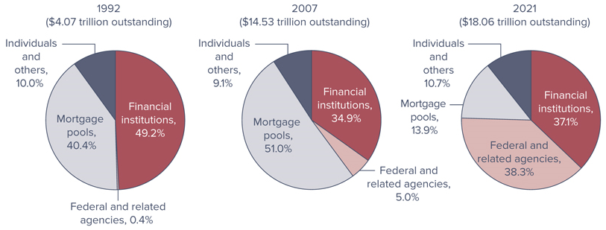
Mortgages Outstanding by
Type of Holder
Notes:
Figure 7–9 shows the distribution of mortgages outstanding in 1992, 2007, and 2021 by type of mortgage holder—the ultimate investor.

Slide 24
International Trends in Securitization
International investors participate in U.S. mortgage and mortgage-backed securities markets
  The value of mortgages held by foreign banks has decreased by 67.2 percent (from $51.6 billion in 1992 to $16.9 billion in 2014), before rebounding to $91.1 billion in 2021
  This compares to primary mortgages issued and held by domestic entities of $18.06 trillion in 2021
After the United States, Europe is the world’s second-largest and most developed securitization market
Germany is one of the countries that moved toward making widespread use of securitization in its mortgage markets

Slide 25
International Trends in Securitization (Continued)
Synthetic securitizations are a far more common form of mortgage financing in countries outside the U.S.
  Refers to structured transactions in which banks use credit derivatives to transfer the credit risk of a specified pool of assets to third parties, such as insurance companies, other banks, and unregulated entities
  Can replicate the economic risk transfer characteristics of a traditional securitization without removing the portfolio of assets from the originating bank’s balance sheet
  Reasons to prefer synthetic securitization might include the complexity and prohibitive cost of a traditional securitization transaction as well as its potentially unfavorable tax implications

Slide 26
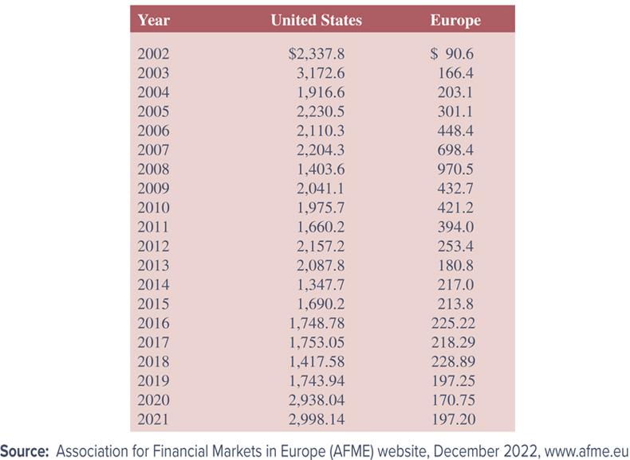
Global Securitized Asset Issuance
Notes:
Table 7–5 reports the value of securitized mortgage issuances in the United States and Europe from 2002 to 2021.

