Slide 1
Chapter 6
Bond Markets
© McGraw Hill LLC. All rights reserved. No reproduction or distribution without the prior written consent of McGraw Hill.

Slide 2
Bond Markets
Equity and debt instruments with maturities of more than one year trade in capital markets
Bonds are long-term debt obligations issued by corporations and government units
  Proceeds from a bond issue are used to raise funds to support long-term operations of the issuer
  If the terms of the repayment are not met by the bond issuer, the bond holder (investor) has a claim on the assets of the bond issuer
Bond markets are markets in which bonds are issued and traded
  Treasury notes (T-notes) and bonds (T-bonds)
  Municipal bonds
  Corporate bonds

Slide 3
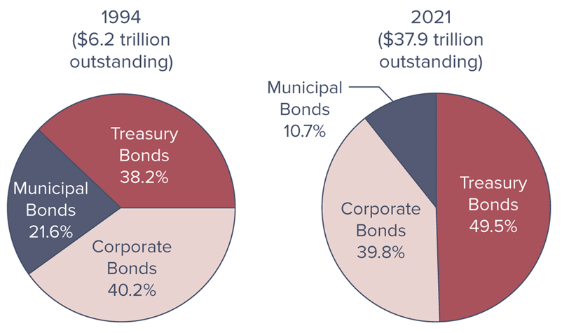
Bond Market Instruments Outstanding, 1994 - 2021
Notes:
Figure 6–1 shows the distribution of each type of bond outstanding in 1994 and 2021.

Slide 4
Treasury Notes and Bonds
Treasury notes and bonds (T-notes and T-bonds) are issued by the U.S. Treasury to finance the national debt and other government expenditures
  $18.8 trillion outstanding in 21
The national debt (ND) reflects the historical accumulation of annual federal government deficits or expenditures (G) minus taxes (T) over the last 200-plus years, as follows:

Slide 5
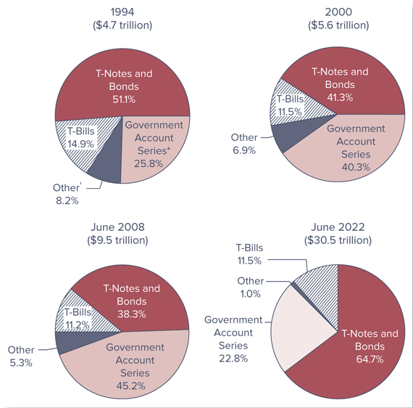
Composition of the U.S. National Debt
Notes:
Figure 6–2 shows the composition of the U.S. national debt from 1994 through 2022.

Slide 6
Treasury Notes and Bonds (Continued)
T-notes and T-bonds are backed by the full faith and credit of the U.S. government and are, therefore, default risk free
T-notes and T-bonds pay relatively low rates of interest (yields to maturity) to investors
T-notes and T-bonds pay coupon interest (semiannually)
T-bills have an original maturity of one year or less, T-notes have original maturities from over 1 to 10 years, while T-bonds have original maturities from over 10 years
Like T-bills, once issued T-notes and T-bonds trade in very active secondary markets

Slide 7
Treasury Notes and Bonds (Concluded)
Treasury issued two types of notes and bonds: fixed principal and inflation-indexed
  Both types pay interest twice per year
  Principal value used to determine the percentage interest payment (coupon) on inflation-indexed bonds is adjusted to reflect inflation (measured by the CPI)
    In other words, the semiannual coupon payments and the final principal payment are based on the inflation-adjusted principal value of the security
Prices are quoted as percentages of the face value on the Treasury security, while coupon rates are set at intervals of 0.125 (or 1/8 of 1) percent

Slide 8
STRIPS
Separate Trading of Registered Interest and Principal Securities (STRIPS) is a Treasury security in which the periodic interest payment is separated from the final principal payment
  Each of the components of the STRIPS are often referred to as “Treasury zero bonds” or “Treasury zero-coupon bonds” because investors in the individual components receive only the single stripped payments in which they invest
Created by the U.S. Treasury in response to the separate trading of Treasury security principal and interest that had been developed by securities firms
May be used to immunize against interest rate risk

Slide 9
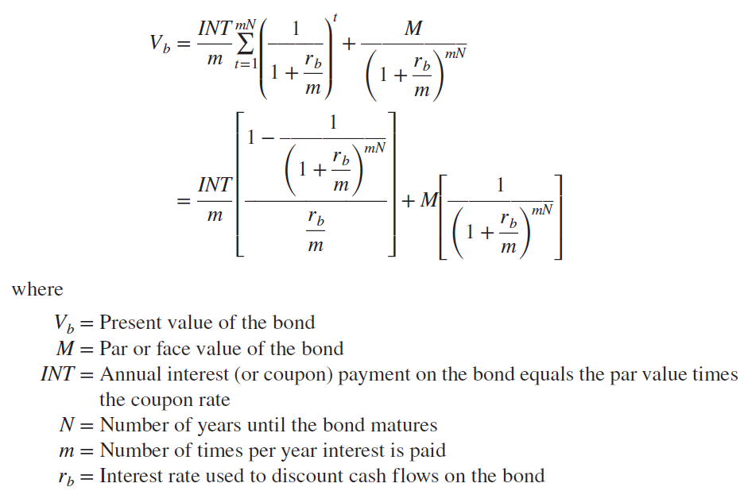
Treasury Note and Bond Yields
Bond value calculated from the following formula is the price (referred to as the clean price) quoted in the financial press:

Slide 10
Accrued Interest
Accrued interest is the portion of the coupon payment accrued between the last coupon payment and the settlement day
  Paid by the buyer to the seller if the T-note or T-bond is purchased between interest payment dates
The purchase price of the T-bond or T-note plus accrued interest is called the full price or the dirty price of the security, while the price without accounting for accrued interest is the clean price

Slide 11
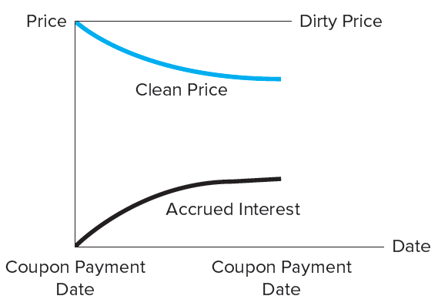
Accrued Interest (Continued)
Accrued interest on a T-note or T-bond is based on the actual number of days the bond was held by the seller since the last coupon payment:
Notes:
Notice that as the purchase date approaches the coupon interest payment date, the accrued interest due to the seller from the buyer increases. Just before a coupon payment date the buyer pays the seller fractionally less than the full coupon payment. However, as the accrued interest portion of the dirty price of the note increases, the clean price of the note decreases to offset this, keeping the overall price of the note to the buyer constant.

Slide 12
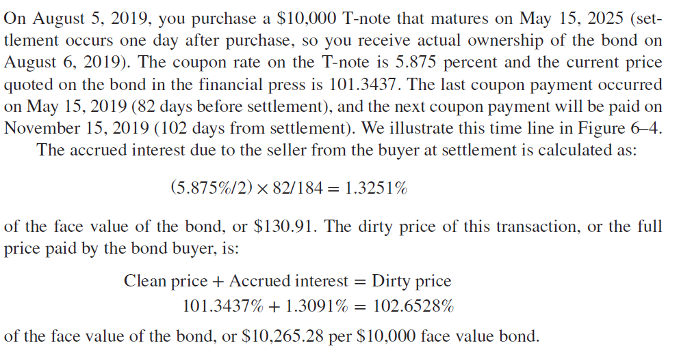
Calculation of Accrued Interest and Yield to Maturity on a Bond

Slide 13
Treasury Inflation Protected Securities (TIPS)
In January 1997, the U.S. Treasury began issuing inflation-indexed bonds called Treasury Inflation Protected Securities (TIPS), which provide returns tied to the inflation rate
  Outstanding value of TIPS was over $1.65 trillion by September 2021
Unlike the fixed-principal bonds, the principal value of a TIPS bond can increase (or decrease) every six months by the amount of U.S. inflation (or deflation) as measured by the percentage change in the CPI
Used by investors who wish to earn a rate of return on their investments that keeps up with the inflation rate over time

Slide 14
Primary and Secondary Market Trading in T-Notes and T-Bonds
U.S. Treasury sells T-notes and T-bonds through competitive and noncompetitive Treasury auctions
  Auction is a single-price auction—all bidders pay the same price, which is the price associated with the highest of the competitive yields bid
  At each auction, noncompetitive bids are filled first
  Next, competitive bids are ranked from the lowest to highest yield (a bidder willing to accept the lowest yield is willing to pay the highest price)
  Coupon rate of the auctioned notes or bonds is the stop-out yield rounded down to the nearest 1/8 percent
Most secondary trading occurs directly through broker and dealer trades

Slide 15
Municipal Bonds
Municipal bonds are securities issued by state and local governments; primary reasons for issuances are the following:
  Fund imbalances between expenditures and receipts
  Finance long-term capital outlays
Attractive to household investors because interest is exempt from federal and most state/local income taxes
General obligation (GO) bonds are backed by the full faith and credit of the issuer
Revenue bonds are sold to finance specific revenue-generating project and are backed by the cash flows from that project

Slide 16


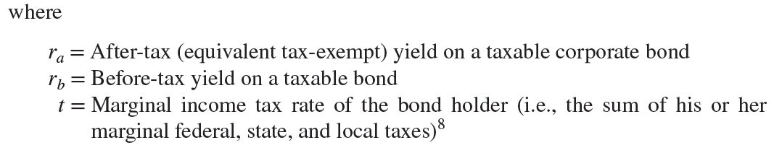
Municipal Bond Yields
The after-tax (or equivalent tax-exempt) yield on a taxable bond can be calculated as follows:
The yield on a tax-exempt municipal bond can be calculated as follows:

Slide 17
Primary Market Trading
Firm commitment underwriting is the issue of securities by an investment bank in which the investment bank guarantees the issuer a price for newly issued securities by buying the whole issue at a fixed price from the issuer
  The investment bank then seeks to resell these securities to suppliers of funds (investors) at a higher price
Best efforts offering is the issue of securities in which the investment bank does not guarantee a price to the issuer and acts more as a placing or distribution agent on a fee basis related to its success in placing the issue
Private placement is a security issue placed with one or a few large institutional buyers
Notes:
The initial (primary market) sale for municipal bonds (and corporate bonds, discussed below) occurs either through a public offering, using an investment bank serving as a security underwriter, or through a private placement to a small group of investors (often financial institutions).

Slide 18
Secondary Market Trading
Secondary market trading for municipal bonds is relatively infrequent
Thin trading is mainly a result of a lack of information on bond issuers, as well as special features (such as covenants) that are built into those bonds’ contracts
  Information on municipal bond issuers (particularly of smaller government units) is generally more costly to obtain and evaluate, although this is in part offset by bond rating agencies

Slide 19
Corporate Bonds
Corporate bonds are long-term obligations issued by corporations
  Minimum denomination on publicly traded corporate bonds is $1,000
  Coupon-paying corporate bonds generally pay interest semiannually
A bond indenture is the legal contract that specifies the rights and obligations of the bond issuer and the bond holders
  Contains several covenants associated with a bond issue
  Bond covenants describe rules and restrictions placed on the bond issuer and bond holders

Slide 20
Corporate Bonds Characteristics
Bearer versus Registered Bonds
  Bearer bonds have coupons attached to the bonds, and the holder presents the coupons to the issuer for payments of interest when they come due
  Registered bonds are those in which the owner is recorded by the issuer and the coupon payments are mailed to the registered owner
Term versus Serial Bonds
  Term bonds are those in which the entire issue matures on a single date
  Serial bonds mature on a series of dates, with a portion of the issue paid off on each

Slide 21
Corporate Bonds Characteristics (Continued)
Mortgage bonds are issued to finance specific projects, which are pledged as collateral for the bond issue
Debentures and Subordinated Debentures
  Debentures are bonds backed solely by the general credit worthiness of the issuing firm, unsecured by specific assets or collateral
  Subordinated debentures are bonds that are unsecured and are junior in their rights to mortgage bonds and regular debentures
Convertible bonds may be exchanged for another security of the issuing firm at the discretion of the bond holder

Slide 22
Corporate Bonds Characteristics (Concluded)
Bonds issued with stock warrants give the bond holder the option to detach the warrants to purchase common stock at a prespecified price up to a prespecified date
Callable bonds
  Many corporate bond issues include a call provision, which allows the issuer to require the bond holder to sell the bond back to the issuer at a given (call) price— usually set above the par value of the bond
  The difference between the call price and the face value on the bond is the call premium
Sinking fund provision is a requirement that the issuer retire a certain amount of the bond issue each year

Slide 23
The Trading Process for Corporate Bonds
Primary sales of corporate bond issues occur through either a public sale (issue) or a private placement in a manner identical to that discussed for municipal bonds
Two secondary markets trade corporate bonds:
  Exchange market (e.g., NYSE Bonds)
  Over-the-counter (OTC) market
Major exchange for corporate bonds is the New York Stock Exchange Bonds Trading Platform
  Most of the trading on the NYSE’s bond market is completed through its NYSE Arca all-electronic trading system
Only a small amount of bond trading volume occurs on organized exchanges
  Most bonds are traded OTC among major bond dealers

Slide 24
Bond Ratings and Interest Rate Spreads
Three major bond rating agencies are the following:
  Moody’s
  Standard & Poor’s (S&P)
  Fitch Ratings
Each of these companies rank bonds based on the perceived probability of issuer default and assign a rating based on a letter grade
  The highest credit quality (lowest default risk) that rating agencies assign is a triple-A (Aaa for Moody’s and AAA for S&P and Fitch)
  Bonds rated below Baa by Moody’s and BBB by S&P and Fitch are considered to be speculative grade bonds and are often termed junk bonds, or high-yield bonds

Slide 25
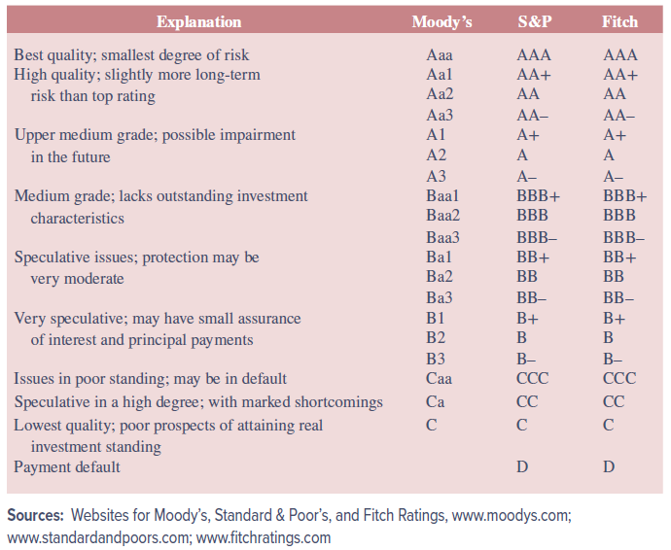
Bond Credit Ratings
Notes:
As a practical matter, a bond needs to be rated if it is to be used as an investment vehicle by certain institutional investors. Bonds rated Baa or better by Moody’s and BBB or better by S&P and Fitch are considered to be investment grade bonds.
Financial institutions (e.g., banks, insurance companies) are generally prohibited by state and federal law from purchasing anything but investment grade bond securities.

Slide 26
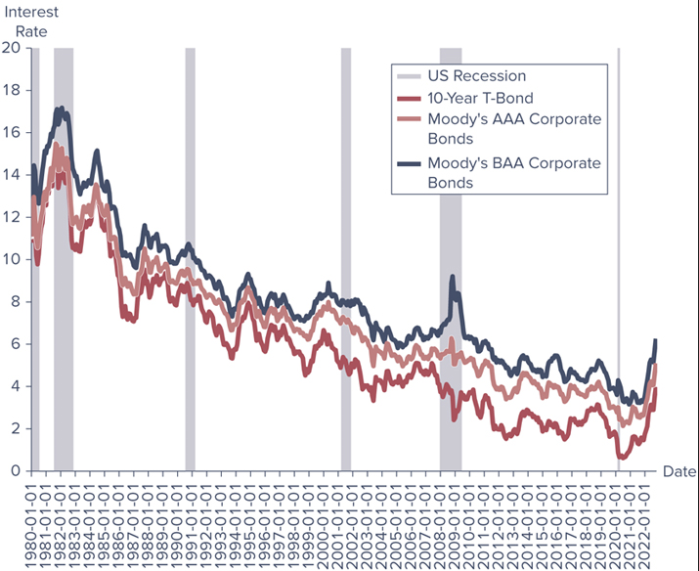
Rates on Treasury Bonds
Notes:
Figure 6–9 shows the rates on 10-year Treasury securities versus Aaa-rated and Baa-rated bonds from 1980 through 2022.

Slide 27
Bond Market Indexes
Indexes are managed by major investment banks and reflect both the monthly capital gain and loss on bonds in the index plus any interest (coupon) income earned
Changes in values of broad bond market indexes can be used by bond traders to evaluate changes in the investment attractiveness of bonds of different types and maturities

Slide 28
Bond Market Participants
The major issuers of debt market securities are federal, state and local governments, as well as corporations
The major purchasers of capital market securities are households, businesses, government units, and foreign investors
  Financial firms hold 60.68 percent of all Treasury securities, 51.9 percent of municipal bonds, and 68.43 percent of the corporate bonds outstanding

Slide 29
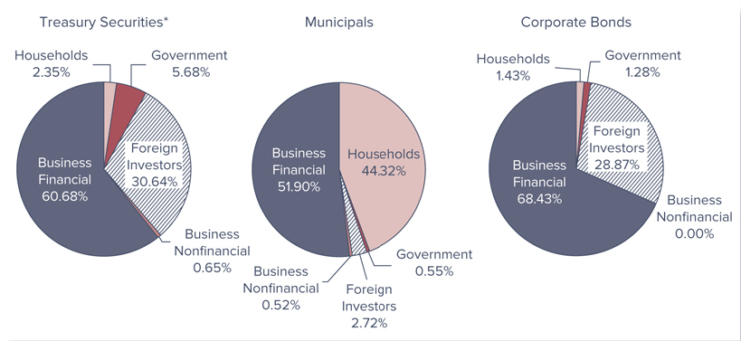
Bond Market Securities Held by Various Groups of Market Participants, 2021

Slide 30
International Aspects of Bond Markets
International bond markets are those markets that trade bonds that are underwritten by an international syndicate, offer bonds to investors in different countries, issue bonds outside the jurisdiction of any single country, and offer bonds in unregistered form
  For bond issuers, the existence of sophisticated international bond markets increases the available financing options and range of assets
  International bond market placements can also increase risk for an issuer

Slide 31
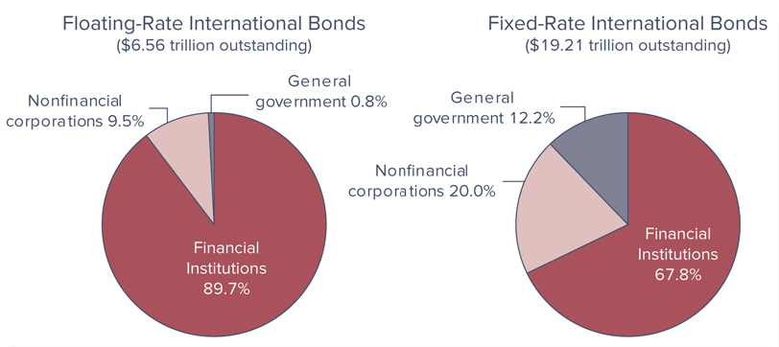
Distributions of International Bonds Outstanding by Type of Issuer, 2021
Notes:
Figure 6–12 illustrates the distribution of international bonds by type of issuer (e.g., financial institutions, governments) as of 2021.

Slide 32
International Aspects of Bond Markets (Continued)
International bonds can be classified into three main groups:
  Eurobonds are long-term bonds issued and sold outside the country of the currency in which they are denominated (e.g., dollar-denominated bonds issued in Europe or Asia)
  Foreign bonds are long-term bonds issued by firms and governments outside of the issuer’s home country and are usually denominated in the currency of the country in which they are issued rather than in their own domestic currency
  Sovereign bonds are government-issued, foreign currency-denominated debt

