Slide 1
CHAPTER 6 &7
THE NATURE OF DATA
COLLECTING AND ANALYSING DATA

Slide 2
DATA
Data is another word for bits of information.
Research uses data as the raw material in order to come to conclusions about some issue.
It depends on the issue being investigated what data needs to be collected.

Slide 3
Although much data seem to be solid fact and permanently represents the truth, this is not the case.
Data are not only elusive, but also ephemeral.
They may be true for a time in a particular place as observed by a particular person, but might be quite different the next day.
And data are not only ephemeral, but also corruptible.

Slide 4
LEVELS OF ABSTRACTION
How do data, the raw materials of research, relate to knowledge as a whole?
They are part of a hierarchy of information, going from the general to the particular, from abstract to concrete.

Slide 5
This hierarchy can be expressed like this:
Theory – abstract statements that make claims about the world and how it works.
Concepts – building blocks of the theory which are usually abstract and cannot be directly measured.
Indicators – phenomena which point to the existence of the concepts.
Variables – components of the indicators which can be measured.
Values – actual units of measurement of the variables. These are data in their most concrete form.

Slide 6
Each theory will contain several concepts, each concept has several indicators, each indicator has several variables, and each variable hasseveral values. For example:
Theory – poverty leads to poor health.
Concepts – poverty, poor health.
Indicators of poverty – low income, poor living conditions, restricted diet, etc.
Variables of poor living conditions – levels of overcrowding, provision of sanitary facilities, infestations of vermin, levels of litter, etc.
Values of levels of overcrowding – numbers of people per room, floor areas of dwellings, numbers of dwellings per hectare, etc.

Slide 7
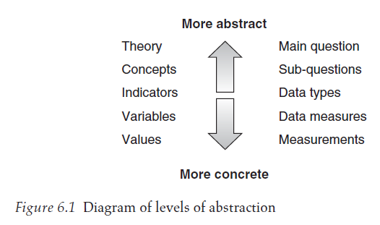

Slide 8
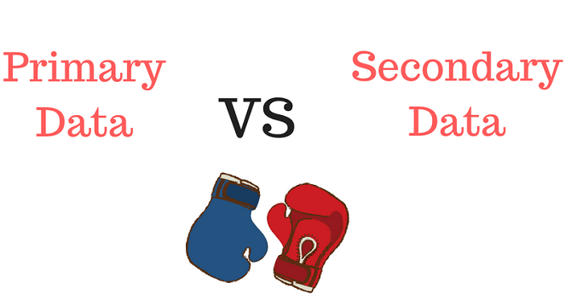
PRIMARY AND SECONDARY DATA
Data come in two main forms, depending on its closeness to the event recorded.
Data that has been observed, experienced or recorded close to the event are the nearest one can get to the truth, and are called primary data.
Written sources that interpret or record primary data are called secondary sources, which tend to be less reliable.

Slide 9
Primary Data
Primary data can provide information about virtually any facet of our life and surroundings. However, collecting primary data is time consuming and not always possible.
Although more data usually means more reliability, it is costly to organize large surveys and other studies.
Furthermore, it is not always possible to get direct access to the subject of research. For example, many historical events have left no direct evidence.

Slide 10
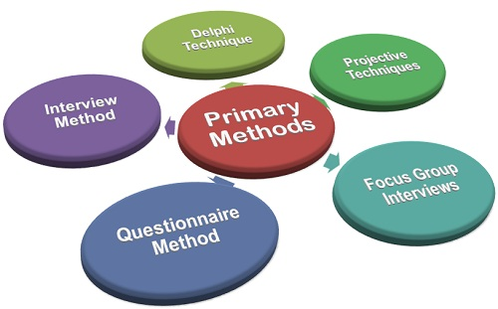

Slide 11
Secondary Data
Secondary data are data that have been interpreted and recorded.
The quality of the data depends on the source and the methods of presentation.

Slide 12
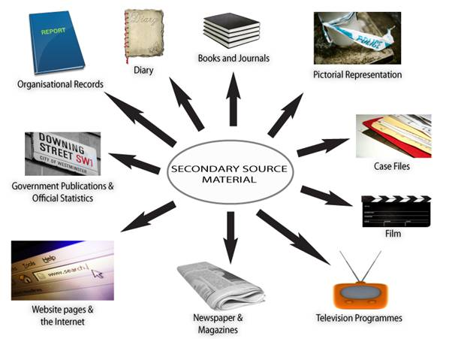

Slide 13
The advantage of using sets of secondary data
is that it has been produced by teams of expert researchers, often with large budgets and extensive resources way beyond the means of a single student,
so it cuts out the need for time consuming fieldwork.

Slide 14
The disadvantage of using sets of secondary data
is that you miss out on the experiences and skills gained by having to generate your own primary data from real-life situations.
The data will also have been collected with a purpose that might not match easily with what you need for your research focus.

Slide 15
A major aspect of using secondary data is making an assessment of the quality of the information or opinions provided.
This is done by reviewing the quality of evidence that has been presented in the arguments, and the validity of the arguments themselves, as well as the reputation and qualifications of the writer or presenter.

Slide 17
QUANTITATIVE DATA
Numbers are used to record much information about science and society, for example pressures, population densities, cost indices etc. This type of data is called quantitative data.
Quantitative data can be measured, more or less accurately because it contains some form of magnitude, usually expressed in numbers.

Slide 18
QUALITATIVE DATA
A lot of useful information cannot be reduced to numbers. People’s judgements, feelings of comfort, emotions, ideas, beliefs etc. can only be described in words. These record qualities rather than quantities, hence they are called qualitative data.
Qualitative data cannot be accurately measured and counted, and are generally expressed in words rather than numbers.

Slide 19
Qualitative research depends on careful definition of the meaning of words, the development of concepts and variables, and the plotting of interrelationships between these.
Observation notes, interview transcripts, literary texts, minutes of meetings, historical records, memos and recollections are all typical examples of qualitative data.
Also qualitative data rely on human interpretation and evaluation and cannot be dispassionately measured in a standard way.

Slide 21
MEASUREMENT OF DATA
Data can be measured in different ways depending on their nature. These are commonly referred to as levels of measurement – nominal, ordinal, interval and ratio.

Slide 22
* NOMINAL LEVEL
Nominal measurement is very basic – it divides the data into separate categories that can then be compared with each other.
By sorting out the data using names or labels you can build up a classification of types or categories. This enables you to include or exclude particular cases into the types and also to compare them.
Nominal data can be analysed using only simple graphic and statistical techniques.

Slide 23
* ORDINAL LEVEL
This type of measurement puts the data into order with regard to a particular property that they all share, such as size, income, strength, etc.
Precise measurement of the property is not required, only the perception of whether one is more or less than the other.
The ordinal scale of measurement increases the range of statistical techniques that can be applied to the data.

Slide 24
* INTERVAL LEVEL
With this form of measurement, the data must be able to be measured precisely on a regular scale of some sort, without there being a meaningful zero.
The interval level of measurement allows yet more sophisticated statistical analysis to be carried out.

Slide 25
* RATIO LEVEL
The ratio level is the most complete level of measurement, having a true zero: the point where the value is truly equal to nought.
A characteristic difference between the ratio scale and all other scales is that the ratio scale can express values in terms of multiples of fractional parts, and the ratios are true ratios.

Slide 26
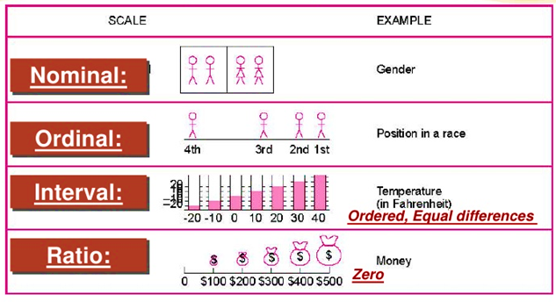

Slide 27
CHAPTER 7
COLLECTING AND ANALYSING
DATA

Slide 28
As a researcher, you will face several problems when seeking previously recorded historical and data. The main of these are that of:
locating and accessing them
authenticating the sources
assessing credibility
gauging how representative they are
selecting methods to interpret them.

Slide 29
TYPES AND SOURCES OF SECONDARY DATA
There are numerous types of secondary data, the main being documentary sources in the form of
written
non-written materials,
survey data
in the form of statistical information.

Slide 30
Written materials
organizational records such as internal reports, annual reports, production records, personnel data;
communications such as emails, letters, notes;
publications, such as books, journals, newspapers, advertising copy, government publications of all kinds etc.

Slide 31
Non-written materials
Television programmes, radio programmes, tape recordings, video tapes, films of all types, including documentary, live reporting, interviews, etc.
Works of art, historical artefacts etc.

Slide 32
Survey data
Government census of population, economic data, sales, economic forecasts, employee attitudes.
These may be carried out on a periodic basis, with frequent regularity or continuously, or ad hoc or one-off occasions. They may also be limited to sector, time, area.

Slide 33
COLLECTING PRIMARY DATA
There are several basic methods used to collect primary data; here are the main ones:
asking questions
conducting interviews
observing without getting involved
immersing oneself in a situation
doing experiments
manipulating models

Slide 34
Research interviews
Interviews are more suitable for questions that require probing to obtain adequate information.
The use of interviews to question samples of people is a very flexible tool with a wide range of applications.
Three types of interview are often mentioned:
Structured interviews
Semi-structure interviews
Unstructured interview

Slide 35
Types of Interview
Structured interview – standardized questions read out by the interviewer according to an interview schedule. Answers may be closed format.
Semi-structured interview – one that contains structured and unstructured sections with standardized and open type questions.
Unstructured interview – a flexible format, usually based on a question guide but where the format remains the choice of the interviewer, No closed format questions.

Slide 36
Additional forms of interviews
Face-to-face interviews
Focus groups
Telephone interviews
Internet and intra-net mediated interviews

Slide 37
Face-to-face interviews can be carried out in a variety of situations: in the home, at work, outdoors, on the move (e.g. While travelling) and can be used to interview people both singly and in groups.
Using visual signs, such as nods, smiles etc., helps to get good responses.

Slide 38
Focus groups can be seen as a type of group interview, but one that tends to concentrate in depth on a particular theme or topic with an element of interaction.
The group is often made up of people who have particular experience or knowledge about the subject of the research, or those that have a particular interest in it e.g. consumers or customers.

Slide 39
Telephone interviews
can be carried out more quickly than face-to-face.
However, you cannot use visual aids to explain questions, and there are no visual clues.
Interviewing very busy people is very difficult.

Slide 40
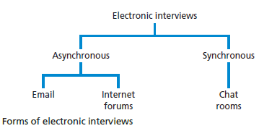
Internet- and intranet-mediated interviewing
Using the Internet or an organisation’s intranet has significant advantages where the population you wish to interview are geographically dispersed.

Slide 41
Interview and type of research
In descriptive studies structured interviews can be used as a means to identify general patterns.
In an explanatory study, semi structured interviews can be used in order to understand the relationships between variables, such as those revealed from a descriptive study, structured interview may also be used in relation to an explanatory study, in statistical sense.

Slide 42
Interviewing competence
There are several areas where you need to develop and demonstrate competence in relation to conduct of semi structured and in-depth research interview . These areas are:
Opening the interview;
Using appropriate language;
Questioning;
Listening;
Testing and summarizing understanding;
Recording and dealing with difficult participants; recording data.

Slide 43
Approaches to questioning
Open questions
Probing questions
Specific and closed questions

Slide 44
Open questions
An open is designed to encourage the interviewee to provide an extensive and developmental answer and may be used to reveal attitudes or obtain facts. It encourage s the interviewee to reply as they wish.
An open question is likely to start with or include, one of the following words: ‘what’, or ‘how’, or ‘why’,.

Slide 45
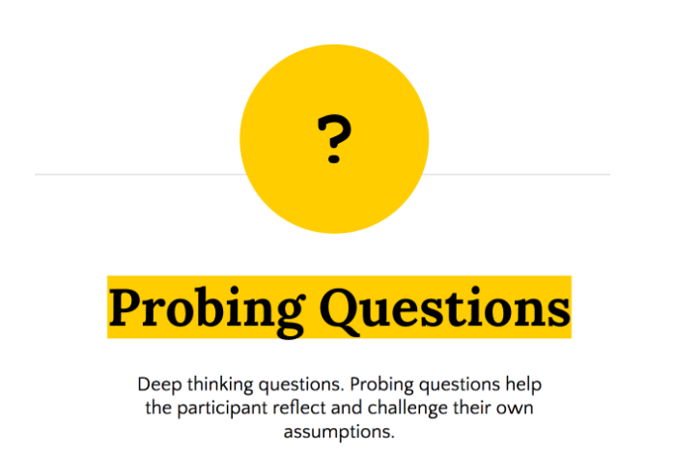
Probing questions
Can be used to explore responses that are of significance to the research topic. They may be worded like open questions but request a particular focus or direction.

Slide 46
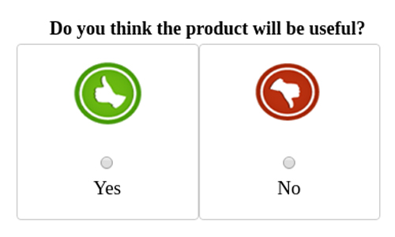
Specific and closed questions
These types of questions are simpler to those used in structured interviews. They can be used to obtain specific information or to confirm a fact or opinion.

Slide 47
QUALITATIVE DATA ANALYSIS
Qualitative data refers to all non-numeric data or data that have not been quantified and can be a product of all research strategies.

Slide 48
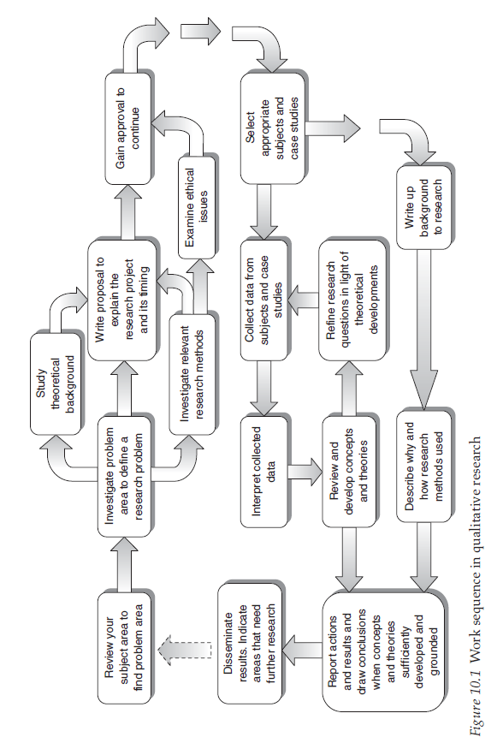

Slide 49
Types of qualitative analysis process
Main types
Summarising (condensation) of meanings
Categorising (grouping) of meanings
Structuring (ordering) of meanings using narrative

Slide 50
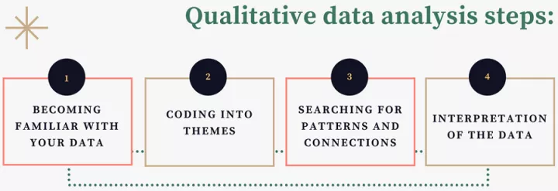

Slide 51
A coding manual can then be produced that lists descriptions or measurements in the form of numbered codes that will be searched for and recorded.
The codes can consist of a word or a phrase.

Slide 52
ANALYSING SECONDARY DATA
Analysis of secondary data can aim at looking for patterns or trends across the results, to track progressions through time, or to seek out repetition of certain results to build up a strong case.
Content analysis
Data mining
Meta analysis

Slide 53
CONTENT ANALYSIS
It consists of an examination of what can be counted in text of any form (articles, advertisements, news items etc.) or other media such as pictures, television or radio programmes or films, and live situations such as interviews, plays, concerts.
Much importance is given to careful sampling and rigorous categorization and coding in order to achieve a level of objectivity, reliability and generalizability and the development of theories.

Slide 54
DATA MINING
It is a technique used extensively by business managements to extract meaningful information from the huge databases that are generated by electronic and other methods in modern businesses.
It is often the starting point in decision based research.
This involves pattern discovery and the prediction of trends and behaviours.

Slide 55
META-ANALYSIS
It consists of making an analysis of the results of a number of results of previous research – an analysis of a collection of analyses, hence ‘meta’-analysis.
This is not the same as a literature review, as it is a statistical analysis of the accumulated data from the results of previous studies rather than a commentary and critical appraisal of the research projects and their outcomes.

