Slide 1
Chapter Twenty-Four
Managing Risk off the Balance Sheet with Derivative Securities
©McGraw Hill LLC. All rights reserved. No reproduction or distribution without the prior written consent of McGraw Hill.

Slide 2
Derivative Securities Used to Manage Risk
Managers are increasingly turning to off-balance-sheet (OBS) instruments such as forwards, futures, options, and swaps to hedge the risks their FIs face
  Derivatives play a role in managing an FI’s interest rate, foreign exchange, and credit risk exposures
As the (controversial) use of derivatives has increased, so have the fees and revenues FIs have generated
  Revenue from derivatives transactions at commercial banks totaled $9.6 billion in 2022
Traders of derivatives can be speculators or hedgers
  Speculators buy derivative contracts to profit from a price increase or sell to profit from a price decrease
  Hedgers take a position in a derivative contract as protection against an increase or decrease in the price of a security
Notes:
2
The rapid growth of derivatives use by both FIs and nonfinancial firms has been controversial. In the 1990s and 2000s, critics charged that derivative contracts contain potential losses that can materialize to haunt their holders, particularly banks and insurance companies that deal heavily in these instruments. As will be discussed in this chapter, when employed appropriately, derivatives can be used to hedge (or reduce) an FI’s risk. However, when misused, derivatives can increase the risk of an FI’s insolvency

Slide 3
Forward and Futures Contracts
A spot contract is an agreement to transact involving the immediate exchange of assets and funds
  Unique feature is the immediate and simultaneous exchange of cash for securities (i.e., delivery versus payment)
A forward contract is an agreement to transact involving the future exchange of a set amount of assets at a set price
  Participants take a position in forward contracts because the future (spot) price or interest rate on an asset is uncertain
  As of 2022, commercial banks held over $24.5 trillion in forward contracts off their balance sheet
  Often involve underlying assets that are nonstandardized
  Buyer and seller must locate and deal directly with each other to set terms of contract
  Once a party has agreed to a forward position, canceling the deal prior to expiration is generally difficult

Slide 4
Forward and Futures Contracts (Continued)
A futures contract is an agreement to transact involving the future exchange of a set amount of assets for a price that is settled daily
  Very similar to a forward contract, with the difference between the two relating to price
    In a forward contract, price is fixed over life of contract, whereas in a futures contract, it is market to market daily (i.e., the contract’s price and the future contract holder’s account are adjusted each day as the futures price for the contract changes)
    Actual daily cash settlements occur between the buyer and seller in response to the marking-to-market process
  In 2022, commercial banks held over $4.2 trillion in futures contracts off their balance sheet

Slide 5

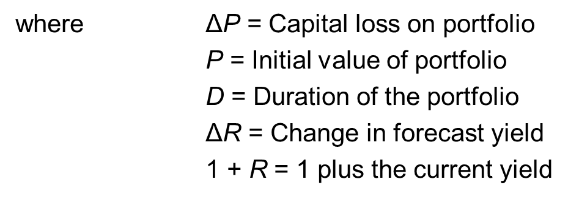
Hedging with Forward Contracts
A naive hedge is a hedge of a cash asset on a direct dollar-for-dollar basis with a forward or futures contract
Managers can predict a capital loss, or change in bond portfolio values (ΔP) from duration equation of Chapter 3:
Hedging allows FIs to immunize assets against interest rate risk
Notes:
5

Slide 6
Hedging with Futures Contracts
Though some hedging of interest rate risk does take place using forward contracts, many FIs hedge interest rate risk either at the micro level (i.e., microhedging) or at the macro level (i.e., macrohedging) using futures contracts
Microhedging is using a derivative securities contract to hedge a specific asset or liability
  Basis risk is a residual risk that occurs because the movement in a spot (cash) asset’s spot price is not perfectly correlated with the movement in the price of the asset delivered under a futures or forward contract
Macrohedging is hedging the entire duration gap of an FI
  Efficiency of the macrohedge is that it focuses only on those mismatches positions that are candidates for OBS hedging activities
Notes:
6

Slide 7
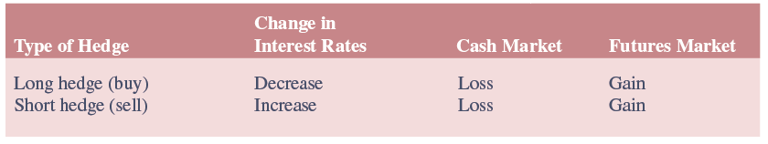
Microhedging with Futures
Number of futures contracts an FI should buy or sell in a microhedge depends on the interest rate risk exposure created by a particular asset or liability on the balance sheet
Key is to take a position in the futures market to offset a loss on the balance sheet due to a move in interest rates with a gain in the futures market
  A long (short) position is the appropriate hedge when the FI stands to lose on the balance sheet if interest rates are expected to fall (rise)
Notes:
7
Table 24–2 summarizes the long and short positions.

Slide 8
Futures Contracts on Interest Rates, May 14, 2023
Notes:
8
Table 24–1 shows part of an interest rate futures quote for May 14, 2023. In this list, a June 2023 Eurodollar futures contract can be bought (long) or sold (short) on May 14, 2023, for 94.5800 percent of the face value of the Eurodollar CD contract, or the yield on the Eurodollar CD contract deliverable in June 2023 will be 5.420 percent (100% – 94.5800%). The minimum contract size on one of these futures is $1,000,000, so a position in one contract can be taken at a price of $945,800.

Slide 9
Profit or Loss on a Futures Position in Eurodollar Futures, Taken on May 14, 2023
Notes:
9
The subsequent profit or loss from a position in June 2023 Eurodollar futures taken on May 14, 2023 (described in the table on the previous slide), is graphically described in Figure 24–1.

Slide 10
Options
FIs have a wide variety of option products to use in hedging, including the following:
  Exchange-traded options
  Over-the-counter (OTC) options
  Options embedded in securities
  Caps, collars, and floors
Use of options has increased in recent years
  In 2022, commercial banks held over $39.4 trillion options
Four basic option strategies that FIs might employ to hedge interest rate risk
Notes:
10

Slide 11
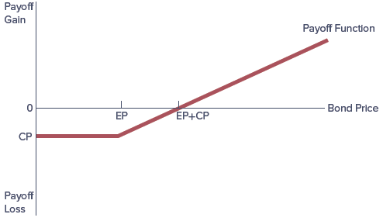
Option Strategies:
1. Buying a Call Option on a Bond
Buying (or taking a long position in) a call option is a strategy to take when interest rates are expected to fall
  As interest rates fall, bond prices rise, and the call option buyer has a large profit potential
  As interest rates rise, bond prices fall, and the potential for a negative payoff (loss) for the buyer of the call option increases
Notes:
11

Slide 12
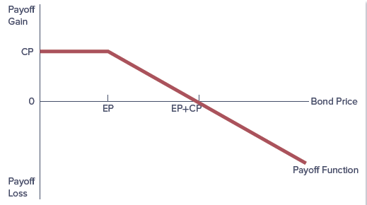
Option Strategies:
2. Writing a Call Option on a Bond
Writing (or taking a short position in) a call option is a strategy to take when interest rates are expected to rise, but is an unacceptable strategy when hedging interest rate risk
  When interest rates rise and bond prices fall, the potential for the writer of the call to receive a positive payoff or profit increases
  When interest rates fall and bond prices rise, the probability that the writer will take a loss increases
Notes:
12
Caution is warranted, however, because profits are limited but losses are unlimited.

Slide 13
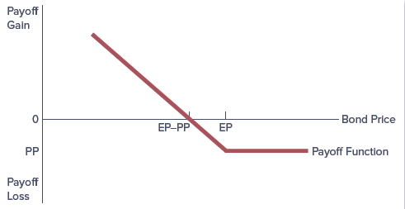
Option Strategies:
3. Buying a Put Option on a Bond
Buying (or taking a long position in) a put option is a strategy to take when interest rates are expected to rise
  When interest rates rise and bond prices fall, the probability that the buyer of the put will make a profit from exercising the option increases
  When interest rates fall and bond prices rise, the probability that the buyer of a put will lose increases
Notes:
13

Slide 14
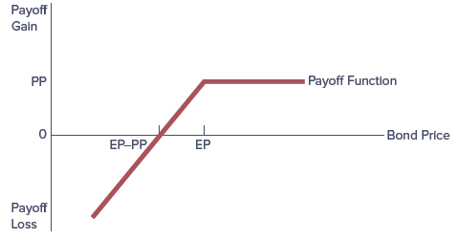
Option Strategies:
4. Writing a Put Option on a Bond
Writing (or taking a short position in) a put option is a strategy to take when interest rates are expected to fall
  When interest rates rise and bond prices fall, the writer of the put is exposed to potentially large losses
  As interest rates fall and bond prices rise, the writer has an enhanced probability of making a profit
Notes:
14
Profits are limited and losses are potentially unlimited (i.e., the investor could potentially lose his or her entire investment in the option). As with the writing of a call option (discussed in more detail below), this makes writing a put option an unacceptable strategy to use when hedging interest rate risk.

Slide 15
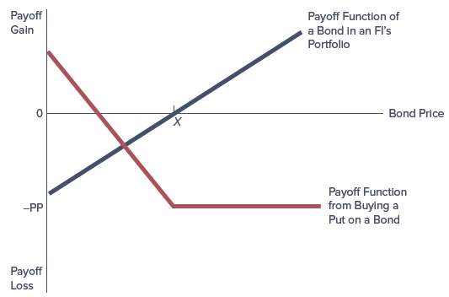
Buying a Put Option to Hedge the Interest Rate Risk on a Bond
Notes:
15
Figure 24–7 shows the gross payoff of a bond and the payoff from buying a put option on it. In this case, any losses on the bond (as rates rise and bond values decrease) are offset with profits from the put option that was bought (points to the left of point X in Figure 24–7). If rates fall, the bond value increases, yet the accompanying losses on the purchased put option positions are limited to the option premiums paid (points to the right of point X).

Slide 16
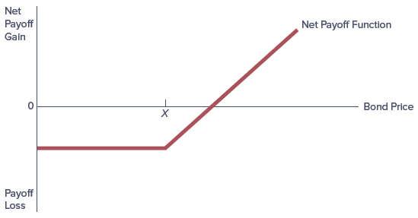
Net Payoff of Buying a Bond Put and Investing in a Bond
Notes:
16
Figure 24–8 shows the net overall payoff from the bond investment combined with the put option hedge. Note in Figure 24–8 that buying a put option truncates the downside losses on the bond following a rise in interest rates to some maximum amount and scales down the upside profits by the cost of bond price risk insurance—the put premium—leaving some positive upside profit potential. Notice too that the combination of being long in the bond and buying a put option on a bond mimics the payoff function of buying a call option (compare Figures 24–3 and 24–8).

Slide 17
Caps, Floors, and Collars
Buying a cap means buying a call option or a succession of call options on interest rates
  Buying an interest rate cap is like buying insurance against an (excessive) increase in interest rates
  In general, FIs purchase interest rate caps if they are exposed to losses when interest rates risk
Buying a floor is similar to buying a put option on interest rates
  If interest rates fall below the floor rate, the seller of the floor compensates the buyer in return for an up-front premium
  Like caps, floors can have one or many exercise dates
  FIs purchase floors when they have fixed costs of debt and have variables rates (returns) on assets or they are net short in bonds
A collar occurs when an FI takes a simultaneous position in a cap and a floor, such as buying a cap and selling a floor
  Purchased by FIs when they are concerned about excessive volatility of interest rates or more commonly to finance cap or floor positions
Notes:
17

Slide 18
Risks Associated with Futures, Forwards, and Options
FIs can be either users or dealers of derivative contracts
  In 2022, 1,139 banks were users of derivatives, with four big dealer banks accounting for some 88.2% of the $190.9 trillion derivatives held by the user banks
Contingent credit risk is likely to be present when FIs expand their positions in forward, futures, and option contracts
  Contingent credit risk relates to the fact that the counterparty to one of these contracts may default on payment obligations, leaving the FI unhedged and having to replace the contract at today’s interest rates, prices, or exchange rates
    Futures are essentially default risk free, unless a systemic financial market collapse threatens the exchange itself
    Default risk is much more serious for forward contracts than for futures contracts because forwards are essentially OTC arrangements
    Standardized options are virtually default risk free, but specialized options purchased OTC have some element of default risk
Notes:
18

Slide 19
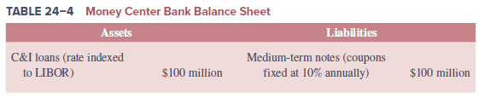

Hedging with Interest Rate Swaps
Market for swaps has grown enormously in recent years
  Value of swap contracts outstanding by U.S. commercial banks was more than $108.9 trillion in 2019
Consider two FIs:
  The first is a money center bank that has raised $100 million of its funds by issuing four-year, medium-term notes with 10% annual fixed coupons rather than relying on short-term deposits to raise funds
  Second party of the swap is a savings bank that has invested $100 million in fixed-rate residential mortgages of long duration
Notes:
19
The opposing balance sheet and interest rate risk exposures of the money center bank and the savings bank provide the necessary conditions for an interest rate swap agreement between the two parties.

Slide 20
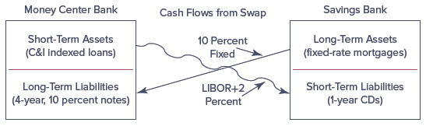
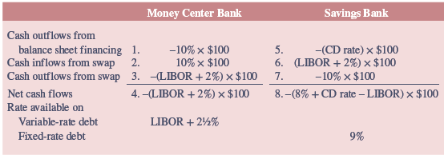
Fixed-Floating Rate Swap and Associated Financing Cost
Notes:
20
For simplicity, we consider an example below of a plain vanilla fixed–floating rate swap (a standard swap agreement without any special features) in which a third-party intermediary acts as a simple broker or agent by bringing together two DIs with opposing interest rate risk exposures to enter into a swap agreement or contract. We depict a possible fixed–floating rate swap transaction in Figure 24–9. The expected net financing costs for the DIs are listed in Table 24–6.

Slide 21
Hedging with Currency Swaps
Currency swaps are used to hedge against foreign exchange rate risk from mismatched currencies on assets and liabilities
Consider two FIs with opposing currency risks:
  U.S. FI with all its $80 million fixed-rate assets denominated in dollars is financing part of its asset portfolio with a £50 million issue of four-year, medium-term British pound notes that have a fixed annual coupon of 10%
    Exposed to risk that the dollar with depreciate against the pound
  FI in the U.K. has all its £50 million assets denominated in pounds and is funding those assets with a $80 million issue of four-year, medium-term dollar notes with a fixed annual coupon of 10%
    Exposed to the risk that the dollar will appreciate against the pound
Notes:
21

Slide 22
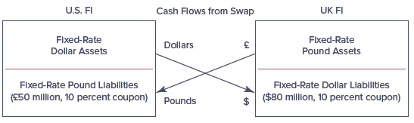
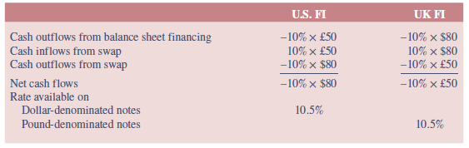
Fixed-Fixed Pound/Dollar Currency Swap and Associated Financing Costs
Notes:
22
From the example on the preceding slide, the UK and U.S. FIs can enter into a currency swap (off the balance sheet) by which the UK FI sends annual payments in pounds to cover the coupon and principal repayments of the U.S. FI’s pound note issue, and the U.S. FI sends annual dollar payments to the UK FI to cover the interest and principal payments on its dollar note issue. We summarize this currency swap in Figure 24–10 and Table 24–7.

Slide 23
Credit Swaps
Credit default swaps (CDSs) allow FIs to better hedge credit risk
  Buyer of CDS makes periodic payments to seller until the end of the life of the swap or until the credit event specified in the contract occurs
  Settlement of the swap in the event of a default involves either physical delivery of the bonds (or loans) or a cash payment
Credit swaps are important for two reasons:
  Credit risk is still more likely to cause an FI to fail than either interest rate risk or FX risk
  Credit default swaps (CDSs) allow FIs to maintain long-term customer lending relationships without bearing the full credit risk exposure from those relationships
Notes:
23

Slide 24
Credit Swaps (Continued)
Total return swap involves an obligation to pay interest at a specified fixed or floating rate for payments representing the total return on a specified amount
  Can be designed to cover any change in value of the principal as well as just the interest
  Often used when there is exposure to a change in the credit risk of the counterparty
Pure credit swap is a swap in which an FI received the par value of the loan on default in return for paying a periodic swap fee
  Similar to buying credit insurance and/or a multi-period credit option
Notes:
24

Slide 25
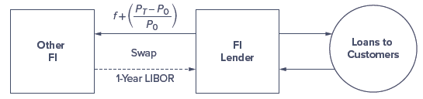
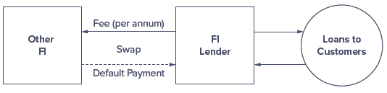
Credit Swaps (Concluded)
Cash Flows on a Total Return Swap
A Pure Credit Swap
Notes:
25

Slide 26
Credit Risk Concerns with Swaps
At the heart of the 2008-2009 financial crisis were derivative securities, mainly credit swaps, held by FIs
Credit risk on swaps and loans differ in three major ways:
  Netting and swaps
    Generally, each party calculates the net difference between the fixed and floating payment due, and one party makes a single payment for the net difference to the other on each payment date
  Payment flows are interest, not principal
    Default risk on interest rate swaps is less than on a regular loan, given interest rate swaps involve swaps of interest payments only measured against some notional principal value, while loans have both interest and principal payments exposed to credit risk
  Standby letters of credit
    Should default occur, standby letter of credit party would provide swap payments in lieu of default party
Notes:
26
The credit risk on a swap is much less than that on a loan of equivalent dollar size.

Slide 27
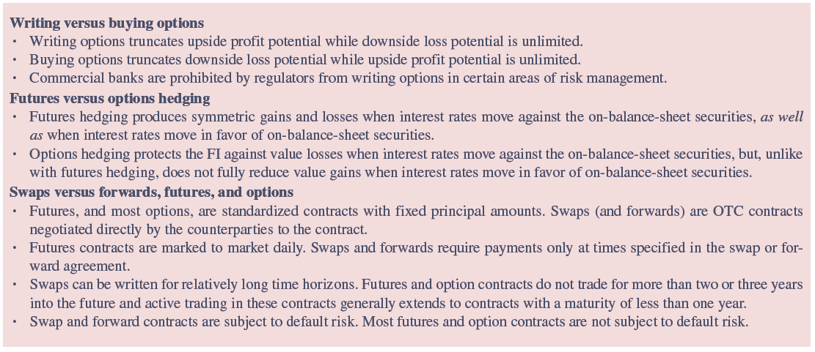
Comparison of Hedging Methods
Notes:
27
As described previously, an FI has many alternative derivative instruments with which it can hedge a particular risk. In this section, we look at some general features of the different types of contracts that may lead to an FI preferring one derivative instrument over another. We summarize these in Table 24–9.

