Slide 1
TYPES OF ETHICS
Res. Asst. Pelin Özçelik

Slide 2
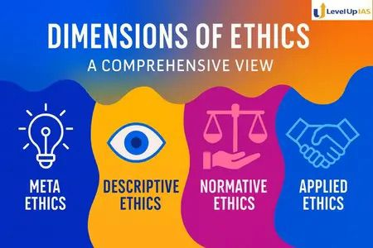
What is the meaning and source of moral concepts?
What values ​​do societies embrace?
What should we do?
What is the right action in this case?

Slide 3
META-ETHICS
Meaning of moral terms
Nature of morality
Objectivism vs. Subjectivism
Moral realism
Moral relativism
Universality
Moral language
Good / Right / Wrong

Slide 4
DESCRIPTIVE ETHICS
Moral beliefs
Cultural values
Social norms
Empirical observation
Ethical practices
Comparative ethics
Behavioral patterns
Tradition

Slide 5
NORMATIVE ETHICS
Moral duties
Justice Rights
Responsibility
Consequences
Utilitarianism
Deontology
Virtue ethics
Moral principles
Obligation

Slide 6
APPLIED ETHICS
Practical issues
Business ethics
Crypto ethics
AI ethics
Medical ethics
Environmental ethics
Corporate responsibility
Human rights
Ethical decision-making
Professional conduct

Slide 7
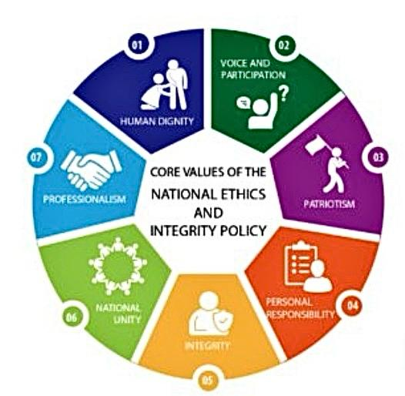
NATIONAL DIFFERENCES IN ETHICS
It means differences between:
Different regions or locations in a country or in entire world.

Slide 8
NATIONAL DIFFERENCES IN ETHICS
These differences mainly came from:
Culture
Attitudes
Religious Beliefs
Education
Nature of Government
Work Environment

Slide 9
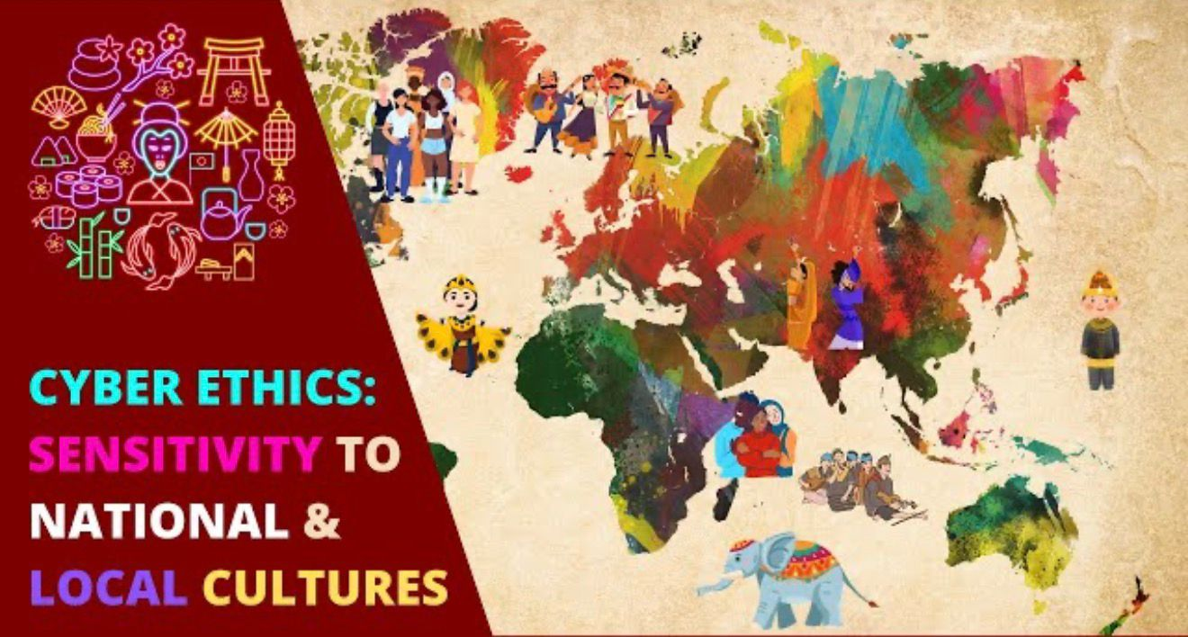
INTERNATIONAL DIFFERENCES IN ETHICS
It means differences between or among countries:
in terms of values, beliefs and cultures.

Slide 10


INTERNATIONAL DIFFERENCES IN ETHICS
Work environments change from nation to nation.
Multinational companies like Toyota, IBM, Apple, Arçelik etc.
Many companies formed well-designed codes of conduct or code of ethics.

Slide 11
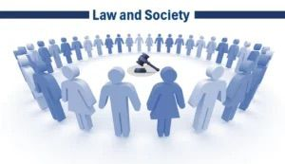
DEFINING TERMS IN ETHICS
Society is the association of people organised under a system of rules.
Rules advance the good of members over time.

Slide 12
DEFINING TERMS IN ETHICS
Morality, could be defined as society’s rule conduct. What people:
Should do
OR
Should’nt do
in various situations.

Slide 13
DEFINING TERMS IN ETHICS
Ethics, therefore could be rational examination of morality or evalution of people’s behaviour.
Ethics is important to every society:
First of all, it plays a critical role in shaping the individual behaviours within the society.
Secondly, ethics helps us balance self-interest and good to society.
Finally, without ethics, society might fall into chaos if we accept that each of us pick and choose what the right thing to do.

Slide 14
DEFINING TERMS IN ETHICS
To re-emphasize, ethics refers to the avolution of moral values, principles and standarts of human conduct and its application in daily life to determine acceptable human behaviour.
(Comparison of right and wrong.)

Slide 15
Thank you for listening…

