Slide 1
Economics “introduction to macroeconomics &growth”
Lecturer : DR CANSU UNVER-ERBAS
Email : cnsunvr@gmail.com & cansu.u.e@cag.edu.tr

Slide 2
Micro vs Macro?
Definition of microeconomics: the study of how households and firms make decisions and how they interact in markets. e.g. Spending on talent by Premier League clubs, your household’s spending per month, etc.
Definition of macroeconomics: the study of economy-wide phenomena including inflation, unemployment, and economic growth. The study of the economy as a whole. We begin our study of macroeconomics with the country’s total income and expenditure. e.g. The UK’s inflation rate for last quarter; the GDP (National Income) of China; etc.

Slide 3
Important issues in macroeconomics
Why does the cost of living keep rising?
Why are millions of people unemployed, even when the economy is booming?
Why there is a recession?
Can the government do anything to combat recessions? Should it?
What is the government expenditure? How does it affect the economy?
Why are so many countries poor? And what type of policies might help them grow out of poverty?

Slide 4
The four key macroeconomic variables
National income (NI)
goal is stable growth in longer term i.e. avoid sharp expansions and contractions
Unemployment (U)
people looking for work but without a job
Inflation (I)
% change in general price level (usually annually, or quarterly)
Balance of payments (BoP)
value of exports minus value of imports.

Slide 5
GDP - Gross Domestic Product
GDP or gross domestic product is the market value of all final goods and services produced in a country in a given time period.
This definition has four attributes:
Market value
Final goods and services
Produced within a country
In a given time period

Slide 6
The gross national income (GNI), relation to GDP
The gross national income (GNI), previously known as gross national product (GNP), is:
The total domestic and foreign output claimed by residents of a country.
GNI consisting of gross domestic product (GDP), plus factor incomes earned by foreign residents (because they pay taxes locally), minus income earned in the domestic economy by non- residents (ppl that lives abroad so their income is not being used locally and they do not pay tax locally)

Slide 7
National income
In the news….
GDP and Economic growth
But, how is GDP measured?
London Olympics 2012 and UK national income

Slide 8
U.S. Gross Domestic Product in billions of chained 1996 dollars

Slide 9
U.S. Gross Domestic Product in billions of chained 1996 dollars

Slide 10
Organization of Economic Activity
Households supply inputs to firms who use knowledge to transform these inputs in production into goods and services that households demand.
For supplying inputs, households receive income from firms which is used for expenditure on final goods and services produced by firms.
This generates a (circular) flow of resources and money in the economy between households and firms
Macroeconomics is primarily concerned with the flow of income (and output): its total size, what makes it contract and expand.

Slide 12
GDP components
These components add up to GDP (denoted Y):
Y = C + I + G + NX

Slide 13
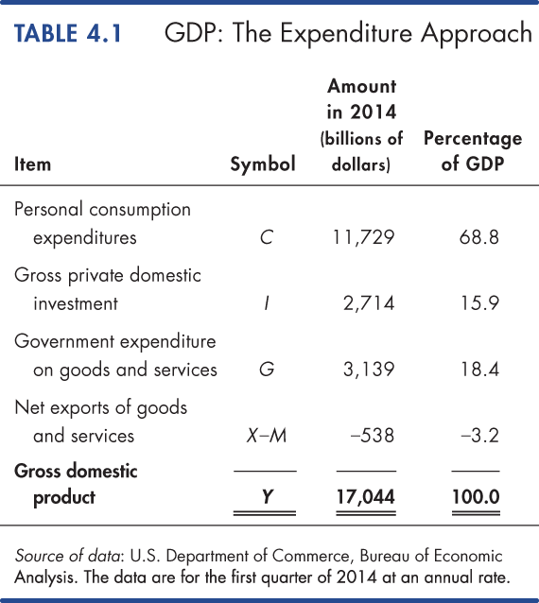

Slide 14
Measuring GDP (cont.)
Nominal GDP and Real GDP
Real GDP is the value of final goods and services produced each year when valued at the prices of a reference base year.
Taking the reference base year as 2020, we describe real GDP as measured in 2021 dollars.
Nominal GDP is the value of goods and services produced during a given year valued at the prices that prevailed in that same year.
Nominal GDP does not consider the ‘real value’ of money i.e., inflation.

Slide 15
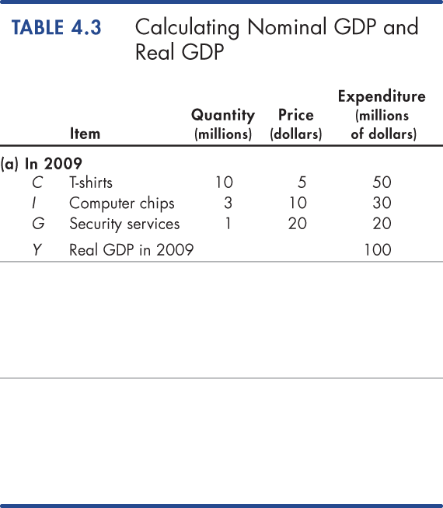
Calculating Real GDP
Table 4.3(a) shows the quantities produced and the prices in 2009 (the base year).
Nominal GDP in 2009 is $100 million.
Because 2009 is the base year, real GDP equals nominal GDP and is $100 million.

Slide 16
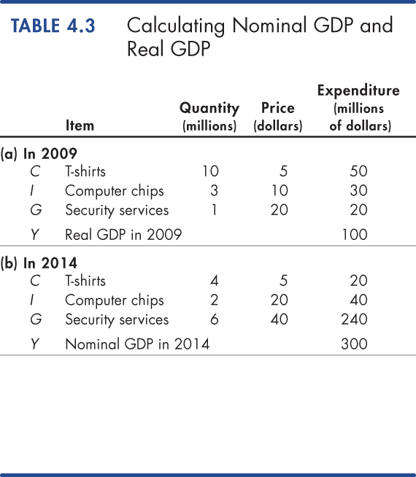
Calculating Real GDP (cont.)
Table 4.3(b) shows the quantities produced and the prices in 2014.
Nominal GDP in 2014 is $300 million.
Nominal GDP in 2014 is three times its value in 2009.

Slide 17
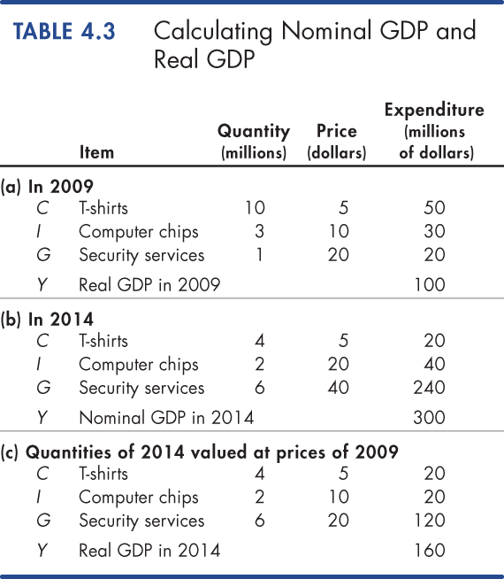
Calculating Real GDP (cont.)
In Table 4.3(c), we calculate real GDP in 2014.
The quantities are those of 2014, as in part (b).
The prices are those in the base year (2009), as in part (a).
The sum of these expenditures is real GDP in 2014, which is $160 million.

Slide 18
The Uses and Limitations of Real GDP
Economists use estimates of real GDP for two main purposes:
To compare the standard of living over time
To compare the standard of living across countries
The Standard of Living Over Time
Real GDP per capita is real GDP divided by the population.
Real GDP per capita tells us the value of goods and services that the average person can enjoy.
By using real GDP, we remove any influence that rising prices and a rising cost of
living, might have happened.

Slide 19
The Uses and Limitations of Real GDP
Long-Term Trend
A good way of comparing real GDP per person over time is to express it as a ratio of some reference year.
For example, in 1960, real GDP per person was $17,210 and in 2013, it was $49,658.
So real GDP per person in 2013 was 2.9 times its 1960 level—that is, $49,658 ÷ $17,210 = 2.9.
Two features for GDP measurements:
The growth of potential GDP per person
Fluctuations of real GDP around potential GDP
The value of real GDP when all the economy’s labour, capital, land, and entrepreneurial ability are fully employed is called potential GDP. (remember the PPF.. From Micro..)

Slide 20
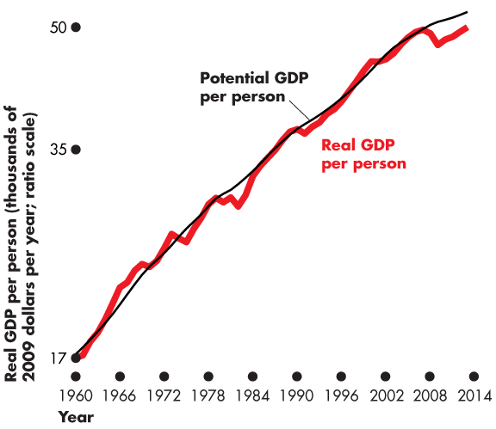
The Uses and Limitations of Real GDP
Potential GDP grows at a steady pace because the quantities of the factors of production and their productivity grow at a steady pace.
Real GDP fluctuates around potential GDP.

Slide 21
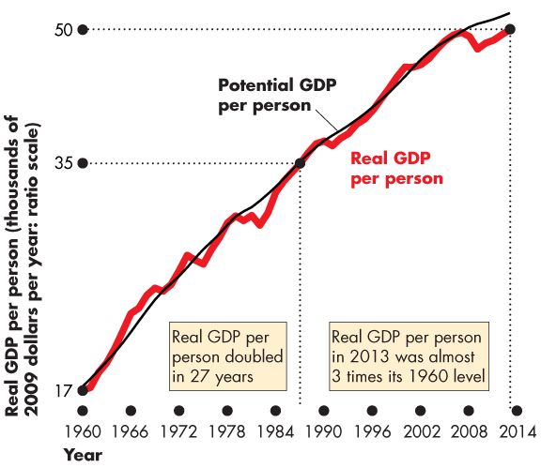
The Uses and Limitations of Real GDP
Real GDP per capita in the United States:
Doubled between 1960 and 1987.
Was 3 times its 1960 level in 2013.

Slide 22
The Uses and Limitations of Real GDP
Real GDP Fluctuations—The Business Cycle
A business cycle is a periodic but irregular up-and-down movement of total
production and other measures of economic activity.
Every cycle has two phases:
Expansion
Recession
and two turning points:
Peak
Trough

Slide 24
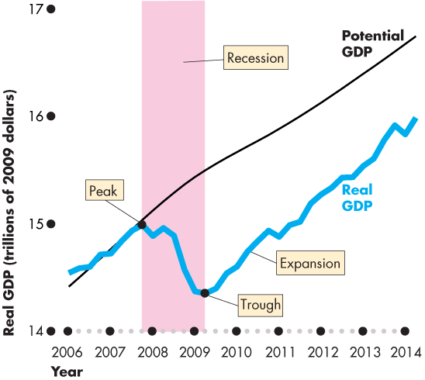
The Uses and Limitations of Real GDP
Figure illustrates the business cycle.
An expansion is a period during which real GDP increases—from a trough to a peak.
Recession is a period during which real GDP decreases—its growth rate is negative for at least two successive quarters.

Slide 25
Actual and potential economic growth – important to understand differences
Actual growth is annual change in GDP (gross domestic product)
Potential growth is annual change in the capacity of economy to produce
goods and services
Potential output (production capacity): the maximum amount of goods and services an economy can turn out when it is most efficient—that is, at full capacity.
Living standards determined by ability of country to produce
Resources, technology and productivity

Slide 26
Economic growth fluctuates
Output gap is actual minus potential output
If actual output < potential output then economy performs below
normal capacity
If potential growth > actual growth, then there’s an increase in spare
capacity and unemployment

Slide 27
Positive vs. Negative Output gap
Just as GDP can rise or fall, the output gap can go in two directions: positive and negative. Neither is ideal.
A positive output gap occurs when actual output > full-capacity output. This happens when demand is very high and, to meet that demand, factories and workers operate far above their most efficient capacity.
A negative output gap occurs when actual output < what an economy could produce at full capacity. A negative gap means that there is spare capacity, or slack, in the economy due to weak demand.

Slide 28
The Uses and Limitations of Real GDP..
Bottom Line…
Do we get the wrong message about the level and growth of economic well-being and the standard of living by looking at the growth of real GDP?
The influences that are omitted from real GDP are probably large.
It is possible to construct broader measures that combine the many influences that contribute to human happiness.
Despite all the alternatives, real GDP per person remains the most widely used indicator of economic well-being.

Slide 29
In conclusion…
The Macroeconomic environment matters for every economy because
it provides the context for decisions made in the industry
Flow of resources from consumers to producers modelled in Circular Flow of Income
Products/services consumption determined by
Tastes/preferences
Resource trade-off
Key macro indicators
National income/growth
Inflation
Balance of payments
Unemployment

