Slide 1
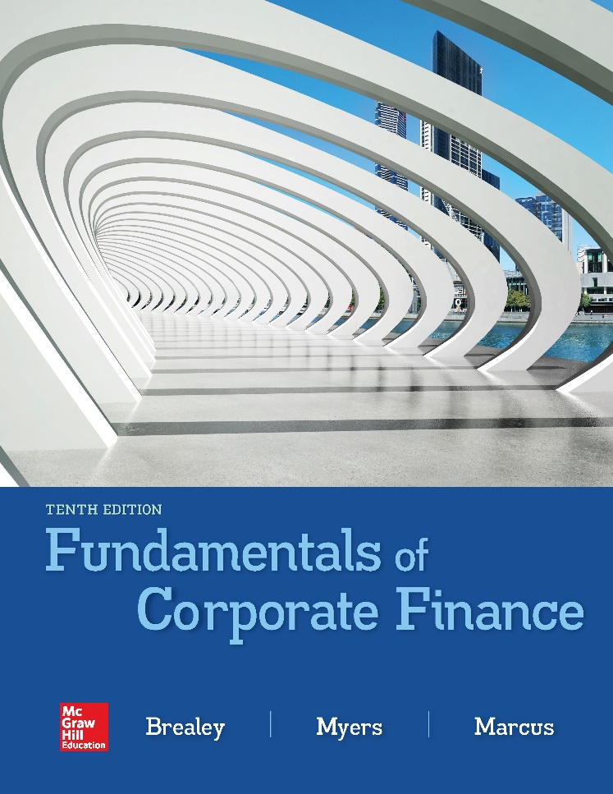

Slide 2
Topics Covered
3.1 The Balance Sheet
3.2 The Income Statement
3.3 The Statement of Cash Flows
3.4 Accounting Practice and Malpractice
3.5 Taxes
Notes:
2

Slide 3
The Balance Sheet (1 of 5)
Definition
  Financial statement that shows the value of the firm’s assets and liabilities at a particular time (from an accounting perspective)
Notes:
3

Slide 4
The Balance Sheet (2 of 5)
The Main Balance Sheet Items
Current Assets
Cash & Securities
Receivables
Inventories
+
Fixed Assets
Tangible Assets
Intangible Assets
Current Liabilities
Payables
Short-term Debt
+
Long-term Liabilities
+
Shareholders’ Equity
=
Notes:
5

Slide 5
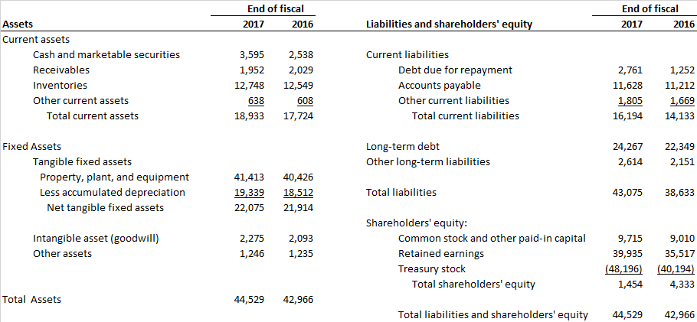
The Balance Sheet (3 of 5)
Home Depot’s Balance Sheet (December 31, 2017) $ Millions

Slide 6
The Balance Sheet (4 of 5)
Common-Size Balance Sheet
  All items in the balance sheet are expressed as a percentage of total assets
Notes:
3

Slide 7
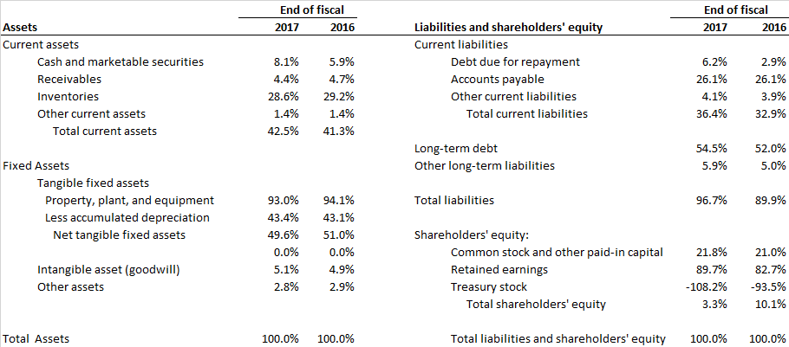
The Balance Sheet (5 of 5)
Home Depot Common Size Balance Sheet (December 31, 2017) $ Millions

Slide 8
Book Values and Market Values (1 of 3)
Book Values
  Value of assets or liabilities according to the balance sheet
Market Values
  The value of assets or liabilities were they to be resold in a market
Generally Accepted Accounting Principles (GAAP)
  Procedures for preparing financial statements
Equity and asset “market values” are usually higher than their “book values”
Notes:
6

Slide 9
Book Values and Market Values (2 of 3)
Example
According to GAAP, your firm has equity worth $6
billion, debt worth $4 billion, assets worth $10
billion. The market values your firm’s 100 million
shares at $75 per share and the debt at $4 billion
Q: What is the market value of your assets?
A: Since (Assets = liabilities + equity), your assets must have a market value of $11.5 billion
Notes:
8

Slide 10
Book Values and Market Values (3 of 3)
Example (continued)
Book Value Balance Sheet
Assets = $10 bil Debt = $4 bil
Equity = $6 bil
Market Value Balance Sheet
Assets = $11.5 bil Debt = $4 bil
Equity = $7.5 bil
Notes:
10

Slide 11
The Income Statement (1 of 3)
Definition
  Financial statement that shows the revenues, expenses, and net income of a firm over a period of time (from an accounting perspective)
Notes:
11

Slide 12
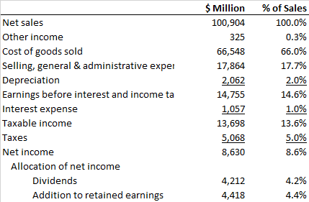
The Income Statement (2 of 3)
Home Depot’s Income Statement (December 31, 2017)
$ Millions
Notes:
13

Slide 13
The Income Statement (3 of 3)
Earnings Before Interest and Taxes (EBIT)
EBIT = total revenues + other income - costs - deprecation
= 100,904 + 325 - (66,547 + 17,864) - 2,062
= $ 14,755 million
Home Depot’s Income Statement (December 31, 2017)
Notes:
12

Slide 14
Profits vs. Cash Flows
Differences
  “Profits” subtract depreciation (a non-cash expense)
  “Profits” ignore cash expenditures on new capital (the expense is capitalized)
  “Profits” record income and expenses at the time of sales, not when the cash exchanges actually occur
  “Profits” do not consider changes in working capital
Notes:
14

Slide 15
The Statement of Cash Flows (1 of 4)
Definition
  Financial statement that shows the firm’s cash receipts and cash payments over a period of time
Notes:
15

Slide 16
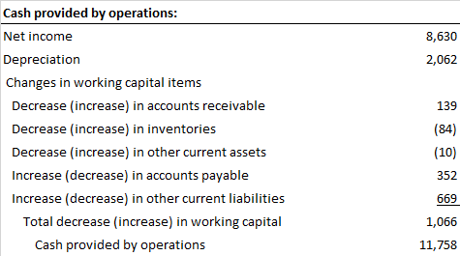
The Statement of Cash Flows (2 of 4)
Home Depot Statement of Cash Flows (December 31, 2017)
$ Millions
Notes:
18

Slide 17
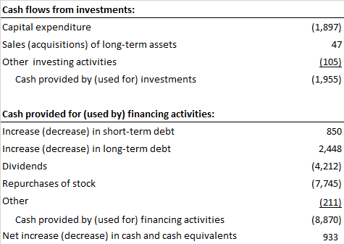
The Statement of Cash Flows (3 of 4)
Home Depot Statement of Cash Flows (December 31, 2017) (continued) $ Millions
Notes:
18

Slide 18

The Statement of Cash Flows (4 of 4)
Home Depot Statement of Cash Flows (December 31, 2017) (continued) $ Millions
Notes:
18

Slide 19
Free Cash Flow
Free Cash Flow (FCF)
  Cash available for distribution to investors after firm pays for new investments or additions to working capital
      FCF = Net Income
      + interest
      + depreciation
      - additions to net working capital
      - capital expenditures
  Home Depot free cash flow =
  $8,630 + $1,057 + $2,062 - $1,066 - $1,955 = $8,728

Slide 20
Accounting Practice
Revenue recognition
Cookie-jar reserves
Off-balance sheet assets and liabilities
Notes:
19

Slide 21
Corporate Tax Rates (2018)
Companies pay tax on their income. The U.S. Tax Cuts and Jobs Act, passed in December 2017, reduced the corporate tax rate from 35% to 21%. Thus for every $100 that the company earns, it pays $21 in federal tax.

Slide 22
Taxes (1 of 5)
Example
Taxes and cash flows can be changed by the use of
debt. Firm A pays part of its profits as debt interest.
Firm B does not.
Notes:
23

Slide 23
Taxes (2 of 5)
FOOD FOR THOUGHT
If you were both the debt and equity holders of the
firm, which would generate more cash flow to you?
?
Notes:
24

Slide 24
Taxes (3 of 5)
FOOD FOR THOUGHT
If you were both the debt and equity holders of the
firm, which would generate more cash flow to you?
Firm A Firm B
Net income 47.4 79
?
+ Interest 40 0
Net cash flow 87.4 79
Notes:
26

Slide 25
Personal Tax Rates (2018)

Slide 26
Taxes (4 of 5)
Taxes have a major impact on financial decisions
Marginal Tax Rate is the tax that the individual pays on each extra dollar of income
Average Tax Rate is the total tax bill divided by total income
Notes:
20

Slide 27
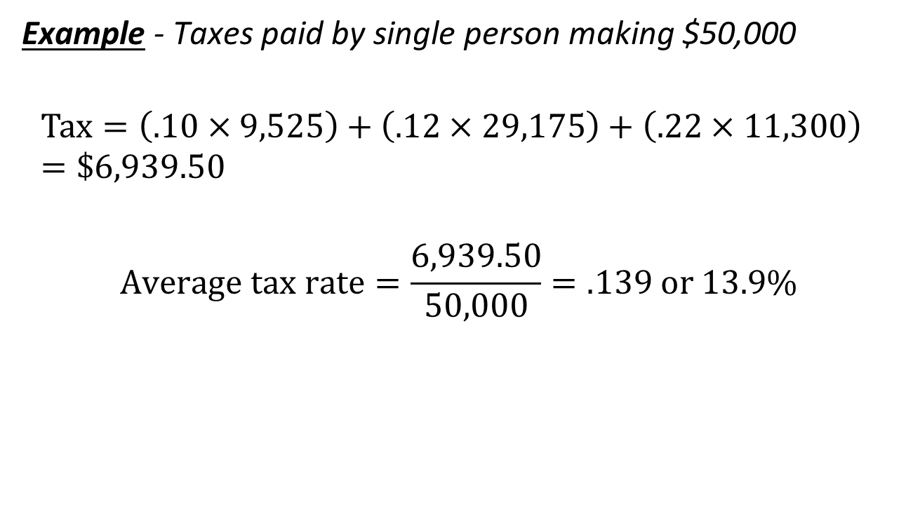
Taxes (5 of 5)
Example - Taxes paid by single person making $50,000
$$Tax=\left(.10×9,525\right)+\left(.12×29,175\right)+\left(.22×11,300\right) =\$6,939.50$$
$$Average tax rate=\frac{6,939.50}{50,000}=.139 or 13.9\%$$

Slide 28
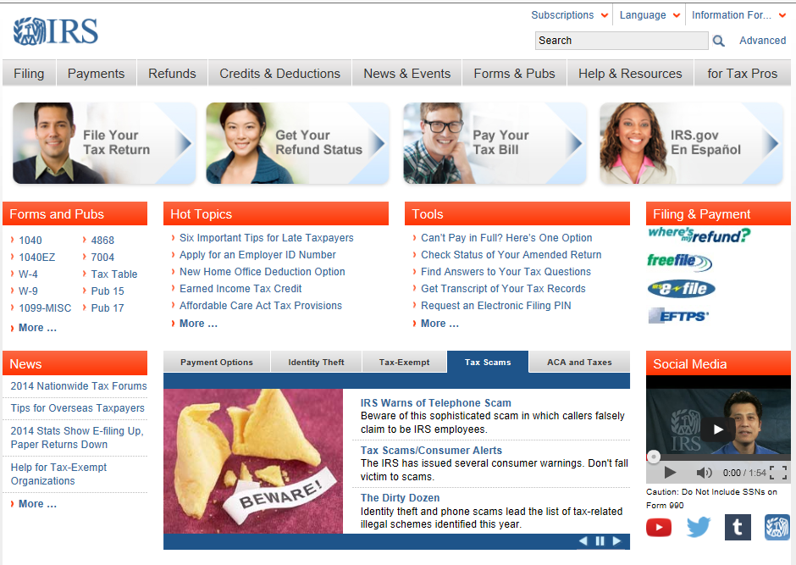
IRS Web Site
IRS Web Site (www.irs.gov)

