Slide 1
International Parity Relationships and Forecasting Exchange Rates
Chapter Six
Copyright © 2018 by the McGraw-Hill Companies, Inc. All rights reserved.
Notes:
This chapter examines several key international parity relationships, such as interest rate parity and purchasing power parity.

Slide 2
Chapter Outline
Interest Rate Parity
Covered Interest Arbitrage
IRP and Exchange Rate Determination
Currency Carry Trade
Reasons for Deviations from IRP
Purchasing Power Parity
PPP Deviations and the Real Exchange Rate
Evidence on Purchasing Power Parity
The Fisher Effects
Forecasting Exchange Rates
Efficient Market Approach
Fundamental Approach
Technical Approach
Performance of the Forecasters
6-2

Slide 3
Interest Rate Parity Defined
IRP is a “no arbitrage” condition.
If IRP did not hold, then it would be possible for an astute trader to make unlimited amounts of money exploiting the arbitrage opportunity.
Since we don’t typically observe persistent arbitrage conditions, we can safely assume that IRP holds.
Most of the time…
6-3

Slide 4
Interest Rate Parity Example
An investor has €10,000 and faces an interest rate in the euro zone of 5%
He could invest in Europe and have €10,500 in one year.
Or he could trade his euro for pounds sterling at the spot exchange rate and invest in the United Kingdom at i£ = 15½%
The spot exchange rates are £1.00 = $1.50 and €1.00 = $1.20, which makes the spot cross rate €1.25 = £1.00:
$$\frac{€1.25}{£1.00}=\frac{€1.00}{\$1.25}×\frac{\$1.50}{£1.00}$$
If he invests in Britain, he hedges his exchange rate risk with a short position in a forward contract on the £9,240 his investment will grow to:
$$\text{£9,240}=€10,000×\frac{£1.00}{€1.25}×1.155$$
IRP says that the 1-year forward exchange rate must be £0.8800/€
$$F_{1}\left(£/€\right)=\frac{\text{£9,240}}{€10,500}=£0.8800/€$$
6-4

Slide 5
Interest Rate Parity Example
€10,000
invest at i€ = 5%
€10,000 × (1.05) = €10,500
1
i€ = 5%; i£ = 15½%
Alternatively
$$\text{S}\text{0}\text{(£/€)}=\frac{£0.80}{€1.00}=\frac{\$1.25}{€1.00}×\frac{£1.00}{\$1.50}$$
Buy £8,000 at spot
£9,240 = €10,500
$$\text{F}\text{1}\text{(£/€)}=\frac{£0.80×1.155}{€1.00×1.05}$$
$$\text{€}\text{10,000}×\frac{£0.80}{€1.00}=\text{ £8,000}$$
$\text{£8,000}×1.15=$£9,240
invest at i£ = 15½%
$$\text{IRP} \text{says} \text{that} \text{the}\text{ 1−}\text{year} \text{forward} \text{rate} \text{must} \text{be}\text{ £0.8800/€ = }\frac{\text{£9,240} }{\text{€10,500}}$$
6-5

Slide 6
Why IRP Holds: Part 1
Suppose that the one-year forward rate was a tiny bit too low at £0.8799/€
An astute trader would move quickly to
Borrow €1,000,000 at i€ = 5%
Trade €1,000,000 for £800,000 at the spot rates
Invest £800,000 at i£ = 15½%
Enter into a short position in a one-year forward contract on £924,000 at £0.8799/€
In one year he has a cash inflow of €1,050,119.33 from the forward contract and owes €1,050,000
Risk-free arbitrage profit of €119.33
6-6

Slide 7
Why IRP Holds: Part 1
At T = 0 borrow at i€ = 5% & sell £924,000 forward
At T = 1, owe €1.05m:
€1,000,000
€1m×(1.05) = €1,050,000
0
1
Buy £800,000 at spot
The easy profit of €119.33 will attract trades that will force prices back into line.
Repay loan with €1,050,000
Sell £924,000 per forward contract
You are short in a forward contract
Sell £924,000 for €1,050,119.33
$$\text{€}\text{£}\text{924}\text{,000}×\frac{€1.00}{£0.8799}=€1,050,119.33$$
$$\text{€}\text{1,000,000}×\frac{£0.80}{€1.00}=\text{ £8}\text{00}\text{,000}$$
invest at i£ = 15½%
£924,000
6-7

Slide 8
Why IRP Holds: Part 2
Suppose that the one-year forward rate was a tiny bit too high at £0.8801/€
An astute trader would move quickly to
Borrow £800,000 at i£ = 15½%.
Trade £800,000 for €1,000,000 at spot rates
Invest €1,000,000 at i€ = 5%
Enter into a long position in a one-year forward contract on £924,000 at £0.8801/€
In one year he has a cash outflow of €1,050,000 from the forward contract and owes £924,000
Risk-free arbitrage profit of €119.31
6-8

Slide 9
Why IRP Holds: Part 2
Invest at i€ = 5%
receive
€1,000,000
€10,000 ×(1.05) = €1,050,000
0
You are long in a forward contract
Buy £924,000 at £0.8801/€
1
this will only cost €1,049,880.70
Repay loan with £924,000
Buy £924,000 forward
Risk-free arbitrage profit of €119.31
At T = 0 Sell £800,000 for €1m at spot; go long in forward contract on £924,000 at £0.8801/€
The easy money will attract traders who will force prices back into line.
T = 1 owe
At T= 0, Borrow £800,000 at
i£ = 15½%
£924,000
$$\text{€}\text{1,000,000}×\frac{£0.80}{€1.00}=\text{ £8}\text{00}\text{,000}$$
6-9

Slide 10
EXHIBIT 6.1 Dollar Cash Flows to an Arbitrage Portfolio
10
Notes:
*Selling the £ receivable “forward” will not result in any cash flow at the present time, that is, CF0 = 0. But at the maturity, the seller will receive $(F − S1) for each pound sold forward. S1 denotes the future spot exchange rate.

Slide 11
Multi-Year Interest Rate Parity
So far we’ve computed the no-arbitrage 1-year.forward rate
To calculate the two-year forward rate compound the interest for 2 years:
£1,067,220
$$\text{F}\text{1}\text{(£/€)}=\frac{£800,000×1.155}{€1,000,000×1.05}$$
spot
£800,000
£924,000
i£ = 15½%.
i£ = 15½%.
$$\text{F}\text{1}\text{(£/€)}=\frac{£924,000}{€1,050,000}=\frac{£0.8800}{€1.000}$$
0
1
2
$$\text{F}\text{2}\text{(£/€)}=\frac{£0.8000×{(1.155)}^{2}}{€1.00×{(1.05)}^{2}}$$
$$=\frac{£0.9680}{€1.00}$$
$$\text{S}\text{0}\text{(£/€)}=\frac{£0.80}{€1.00}=\frac{\$1.25}{€1.00}×\frac{£1.00}{\$1.50}$$
i€ = 5%
i€ = 5%
€1,000,000
€1,050,000
€1,102,500
6-11

Slide 12
IRP Even More Carefully Defined
Interest Rate Parity is a “no arbitrage” condition that suggests that forward exchange rates are defined by today’s spot exchange rates grossed up and down by the future value interest factors:
In our example with a spot rate of £0.80/€, interest rate parity says that the N-year future exchange rate that prevails today must be:
$$\text{F}\text{N}\text{(£/€)}=\frac{£0.8000×{(1+ i_{£})}^{N}}{€1.00×{(1+ i_{€})}^{N}}$$
Notice that we increase the pounds in the spot rate at i£ and the euro in the spot rate by i€ to find the forward rate.
6-12

Slide 13
Currency Carry Trade
Currency carry trade involves buying a currency that has a high rate of interest and funding the purchase by borrowing in a currency with low rates of interest, without any hedging.
The carry trade is profitable as long as the interest rate differential is greater than the appreciation of the funding currency against the investment currency.
6-13

Slide 14
Currency Carry Trade Example
Suppose the 1-year borrowing rate in dollars is 2.01%.
The 1-year lending rate in pounds is 1.00%.
The direct spot ask exchange rate is $1.25/£.
A trader who borrows $1m will owe $1,020,100 in one year.
Trading $1m for pounds today at the spot generates £800,000.
£800,000 invested for one year at 1.00% yields £808,000.
The currency carry trade will be profitable if the spot bid rate prevailing in one year is high enough that his £808,000 will sell for at least $1,020,100 (enough to repay his debt).
No less expensive than:
$$S_{360}^{b}=\frac{\$1,020,100}{\text{£}\text{808,000}}=\frac{\$1.2625}{\text{£}1.00}$$
6-14
Notes:
Notice that the one-year forward rate prevailing at time zero is unimportant here since our trader isn’t hedged.
At a one-year-out spot rate of $1.25 our trader loses $10,100.

Slide 15
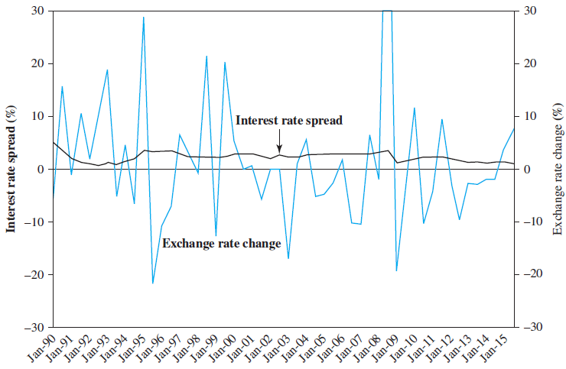
EXHIBIT 6.4 Interest Rate Spreads and Exchange Rate Changes: Six-Month Carry Trade Periods for Australian Dollar–Japanese Yen Pair
6-15
Notes:
Note: Interest rates and exchange rates are obtained from Datastream. For interest rates, interbank six-month rates are used for both countries. The interest rate spread and the rate of change in the exchange rate are plotted at the start of each six-month carry period

Slide 16
Reasons for Deviations from IRP
Transactions Costs
The interest rate available to an arbitrageur for borrowing, i^{b}, may exceed the rate he can lend at, i^{l}.
There may be bid-ask spreads to overcome, F^{b}/Sª < F/S.
Thus, (F^{b}/Sª)(1 + i¥^{l}) − (1 + i¥ ^{b}) ≤ 0.
Capital Controls
Governments sometimes restrict import and export of money through taxes or outright bans.
6-16

Slide 17
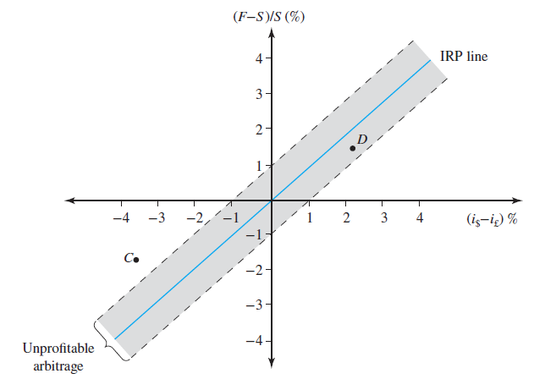
EXHIBIT 6.5 Interest Rate Parity with Transaction Costs
6-17

Slide 18
Transactions Costs Example
Find the “no arbitrage” forward bid and ask prices for a customer facing these retail prices.
 | Borrowing | Lending
i$ | 7.06% | 6.08%
i€ | 2.00% | 1.00%
 | Bid | Ask
Spot | $1.0500/€ | $1.0605/€
Forward | $$F_{1}^{b} (\$/{€)}$$ | $$F_{1}^{a} (\$/{€)}$$
$$F_{1}^{a}(\$/{€)}=\frac{S_{0}^{b}(\$/{€)×(1+i_{\$}^{l})}}{(1+i_{€}^{b})}$$
$$F_{1}^{b}(\$/{€)}=\frac{S_{0}^{a}(\$/{€)×(1+i_{\$}^{b})}}{(1+i_{€}^{l})}$$
6-18
Notes:
At these forward bid and ask prices the customer is indifferent between a forward market hedge and a money market hedge

Slide 19
Step 1
$1m
Borrow $1,000,000 at i$^{b}
$1m×(1+i$^{b})=$1,070,600
0
IRP↓
1
Step 2
$$\$1m×\frac{1}{S_{0}^{a}(\$/{€)}}×\left(1+i_{€}^{l}\right)×F_{1}^{b}(\$/{€)}=\$1m×\left(1+i_{\$}^{b}\right)$$
Buy €942,951.44
at spot ask
No arbitrage forward bid price (for customer):
$$F_{1}^{b}(\$/{€)}=\frac{S_{0}^{a}(\$/{€)×(1+i_{\$}^{b})}}{\left(1+i_{€}^{l}\right)}$$
$$=\frac{\$1.0605/€×(1.0706)}{(1.01)}=\$1.1241/€$$
Step 4
Sell €952,380.95
at forward bid ${ F}_{1}^{b}(\$/{€)}$
$$\$1,000,000×\frac{1}{S_{0}^{a}(\$/{€)}}$$
$$=€942,951.44$$
$$\$1,000,000×\frac{1}{S_{0}^{a}(\$/{€)}}×\left(1+i_{€}^{l}\right)$$
$$=€942,951.44×1.01=\$952,380.95$$
Step 3
Invest €942,951.44 at i€^{l}
(All transactions at retail prices.)
6-19

Slide 20
$${€1m×S}_{0}^{b}(\$/{€)}$$
Step 3:
$${€1m×S}_{0}^{b}(\$/{€)}×(1+i_{\$}^{l})$$
lend at $i_{\$}^{l}$
0
IRP
↓
1
$${€1m×S}_{0}^{b}(\$/{€)}×(1+i_{\$}^{l})÷F_{1}^{a} (\$/{€)}=€1m×(1+i_{€}^{b})$$
No arbitrage forward ask price (for customer):
$$F_{1}^{a} (\$/{€)}=\frac{S_{0}^{b}(\$/{€)}×(1+i_{\$}^{l})}{\left(1+i_{€}^{b}\right) }=\$1.0920/€$$
Step 4
Step 2:
buy € at forward ask
sell €1m at spot bid
$$€1m$$
Step 1: borrow €1m at i€^{b}
€1m×(1+i€^{b})
(All transactions at retail prices.)
6-20

Slide 21
Why This May Seem Confusing
On the last two slides we found
“no arbitrage” forward bid prices of $1.1241/€.
“no arbitrage” forward ask prices of $1.0902/€.
Normally the dealer sets the ask price above the bid—recall that this difference is his expected profit.
But the prices on the last two slides are the prices of indifference for the customer, NOT the dealer.
At these forward bid and ask prices the customer is indifferent between a forward market hedge and a money market hedge.
6-21
Notes:
Note hedging in the forward market and money market are covered fully in chapter 8.

Slide 22
Setting Dealer Forward Bid and Ask
Dealer stands ready to be on the opposite side of every trade.
Dealer buys foreign currency at the bid price.
Dealer sells foreign currency at the ask price.
Dealer borrows (from customer) at the lending rates.
Dealer lends to his customer at the posted borrowing rates.
 | Borrowing | Lending
$ | 7.06% | 6.08%
€ | 2.00% | 1.00%
$$F_{1}^{b}(\$/{€)}=\frac{S_{0}^{b}(\$/{€)×(1+i_{\$}^{b})}}{\left(1+i_{€}^{b}\right)}$$
 | Bid | Ask
Spot | $1.0500/€ | $1.0605/€
Forward | $$F_{1}^{b} (\$/{€)}$$ | $$F_{1}^{a} (\$/{€)}$$
$$F_{1}^{a}(\$/{€)}=\frac{S_{0}^{a}(\$/{€)×(1+i_{\$}^{b})}}{\left(1+i_{€}^{b}\right)}$$
6-22

Slide 23
Setting Dealer Forward Bid Price
Our dealer is indifferent between buying euros today at the spot bid price and buying euros in 1 year at the forward bid price.
$1m
Invest at i$^{b}
$1m × (1+i$^{b})
He is willing to spend $1m today and receive
He is also willing to buy at
$$F_{1}^{b}(\$/{€)}=\frac{S_{0}^{b}(\$/{€)×(1+i_{\$}^{b})}}{\left(1+i_{€}^{b}\right)}$$
$$=\frac{\$1.0500/€×(1.0706)}{(1.02)}=\$1.1021/€$$
$$\$1m×\frac{1}{S_{0}^{b}(\$/{€)}}$$
spot bid
forward bid
$$\$1m×\frac{1}{S_{0}^{b}(\$/{€)}}$$
Invest at i€^{b}
$$\$1m×\frac{1}{S_{0}^{b}(\$/{€)}}×(1+i_{€}^{b})$$
6-23

Slide 24
Setting Dealer Forward Ask Price
Our dealer is indifferent between selling euros today at the spot ask price and selling euros in 1 year at the forward ask price.
€1m × S₀ª($/€)
Invest at i$^{b}
€1m × S₀ª($/€) ×(1+i$^{b})
$$F_{1}^{a}(\$/{€)}=\frac{S_{0}^{a}(\$/{€)×(1+i_{\$}^{b})}}{\left(1+i_{€}^{b}\right)}$$
$$=\frac{\$1.0605/€×(1.0706)}{(1.02)}=\$1.1131/€$$
spot ask
forward ask
$${€1m×(1+i_{€}^{b})×F}_{1}^{a}(\$/{€)}$$
Invest €1m at i€^{b} sell forward at forward ask $F_{1}^{a}(\$/{€)}$
6-24

Slide 25
PPP and Exchange Rate Determination
The exchange rate between two currencies should equal the ratio of the countries’ price levels:
P$
S($/£) =
P£
For example, if an ounce of gold costs $300 in the U.S. and £150 in the U.K., then the price of one pound in terms of dollars should be:
P$
$300
S($/£) =
=
= $2/£
P£
£150
Suppose the spot exchange rate is $1.25 = €1.00. If the inflation rate in the U.S. is expected to be 3% in the next year and 5% in the euro zone, then the expected exchange rate in one year should be $1.25×(1.03) = €1.00×(1.05).
6-25

Slide 26
PPP and Exchange Rate Determination
The euro will trade at a 1.90% discount in the forward market:
$1.25×(1.03)
F($/€)
€1.00×(1.05)
1.03
1 + π$
=
=
=
S($/€)
1.05
1 + π€
$1.25
€1.00
Relative PPP states that the rate of change in the exchange rate is equal to differences in the rates of inflation—roughly 2%.
6-26

Slide 27
PPP and IRP
Notice that our two big equations equal each other:
PPP
IRP
F($/€)
1 + π$
1 + i$
F($/€)
=
=
=
S($/€)
1 + π€
1 + i€
S($/€)
6-27

Slide 28
Expected Rate of Change in Exchange Rate as Inflation Differential
We could also reformulate our equations as inflation or interest rate differentials:
F($/€)
1 + π$
=
S($/€)
1 + π€
F($/€) – S($/€)
1 + π$
1 + π$
1 + π€
=
=
– 1
–
S($/€)
1 + π€
1 + π€
1 + π€
F($/€) – S($/€)
π$ – π€
E(e) =
=
≈ π$ – π€
S($/€)
1 + π€
6-28

Slide 29
Expected Rate of Change in Exchange Rate as Interest Rate Differential
F($/€) – S($/€)
i$ – i€
E(e) =
=
≈ i$ – i€
S($/€)
1 + i€
Given the difficulty in measuring expected inflation, managers often use a “quick and dirty” shortcut:
π$ – π€
≈ i$ – i€
6-29

Slide 30
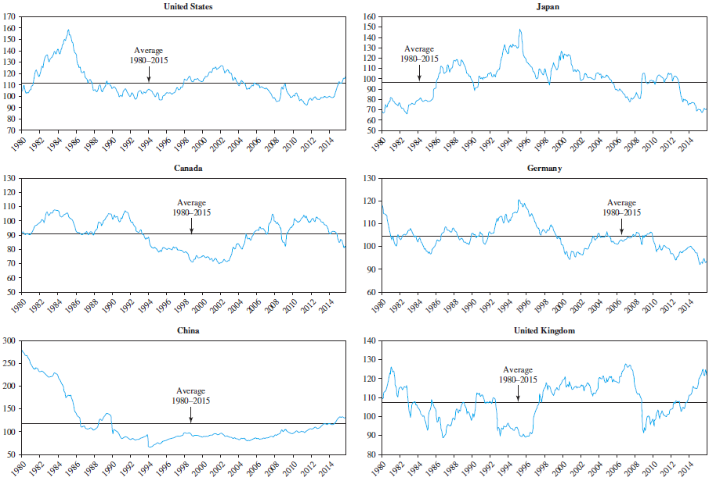
EXHIBIT 6.7 Real Effective Exchange Rates for Selected Currencies (Index, 2010 = 100)
6-30

Slide 31
Evidence on PPP
PPP probably doesn’t hold precisely in the real world for a variety of reasons.
Haircuts cost 10 times as much in the developed world as in the developing world.
Film, on the other hand, is a highly standardized commodity that is actively traded across borders.
Shipping costs, as well as tariffs and quotas, can lead to deviations from PPP.
PPP-determined exchange rates still provide a valuable benchmark.
6-31

Slide 32
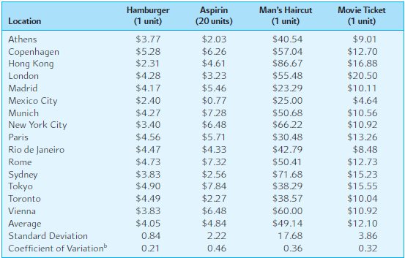
EXHIBIT 6.8 A Guide to World Prices: March 2016
6-32

Slide 33
Approximate Equilibrium Exchange Rate Relationships
E(e)
≈ IFE
≈ FEP
≈ PPP
F – S
(i$ – i¥)
≈ IRP
S
≈ FE
≈ FRPPP
E(π$ – π£)
6-33
Notes:
Approximate

Slide 34
The Exact Fisher Effects
An increase (decrease) in the expected rate of inflation will cause a proportionate increase (decrease) in the interest rate in the country.
For the U.S., the Fisher effect is written as:
1 + i$ = (1 + ρ$ ) × E(1 + π$)
Where:
ρ$ is the equilibrium expected “real” U.S. interest rate.
E(π$) is the expected rate of U.S. inflation.
i$ is the equilibrium expected nominal U.S. interest rate.
6-34

Slide 35
International Fisher Effect
If the Fisher effect holds in the U.S.,
1 + i$ = (1 + ρ$ ) × E(1 + π$)
and the Fisher effect holds in Japan,
1 + i¥ = (1 + ρ¥ ) × E(1 + π¥)
and if the real rates are the same in each country,
ρ$ = ρ¥
then we get the International Fisher Effect:
1 + i¥
E(1 + π¥)
=
1 + i$
E(1 + π$)
6-35

Slide 36
International Fisher Effect
If the International Fisher Effect holds,
1 + i¥
E(1 + π¥)
=
1 + i$
E(1 + π$)
and if IRP also holds,
1 + i¥
F¥/$
=
1 + i$
S¥/$
then forward rate PPP holds:
F¥/$
E(1 + π¥)
=
S¥/$
E(1 + π$)
6-36

Slide 37
Exact Equilibrium Exchange Rate Relationships
IFE
FEP
1 + i¥
PPP
IRP
1 + i$
FE
FRPPP
E(1 + π¥)
E(1 + π$)
6-37

Slide 38
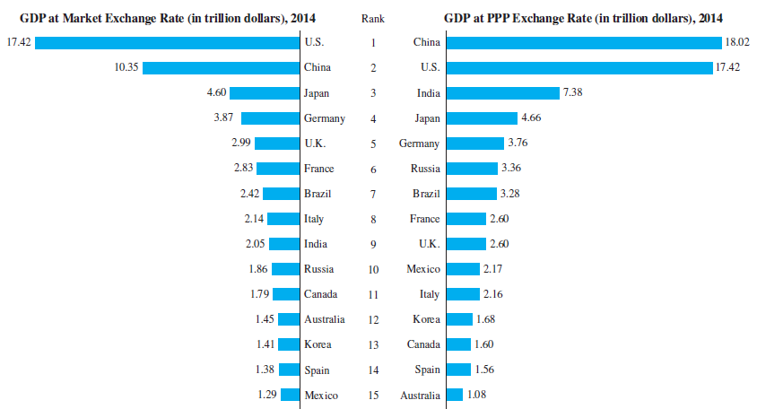
EXHIBIT 6.9 How Large is India’s Economy?
6-38

Slide 39
Forecasting Exchange Rates: Efficient Markets Approach
Financial markets are efficient if prices reflect all available and relevant information.
If this is true, exchange rates will only change when new information arrives, thus:
S_{t} = E[S_{t+1}]
and
F_{t} = E[S_{t+1}| I_{t}]
Predicting exchange rates using the efficient markets approach is affordable and is hard to beat.
6-39
Notes:
“Hard to beat” means that other approaches that cost more to produce don’t seem to provide consistently better forecasts.

Slide 40
Forecasting Exchange Rates: Fundamental Approach
Involves econometrics to develop models that use a variety of explanatory variables. This involves three steps:
Step 1: Estimate the structural model.
Step 2: Estimate future parameter values.
Step 3: Use the model to develop forecasts.
The downside is that fundamental models do not work any better than the forward rate model or the random walk model.
6-40

Slide 41
Forecasting Exchange Rates: Technical Approach
Technical analysis looks for patterns in the past behavior of exchange rates.
It is based upon the premise that history repeats itself.
Thus, it is at odds with the EMH.
6-41

Slide 42
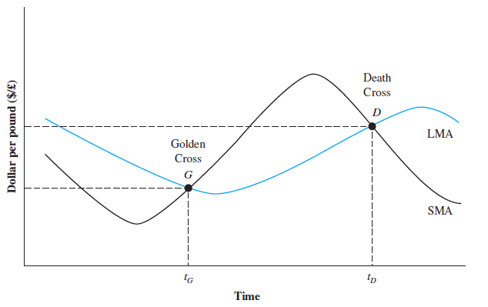
EXHIBIT 6.11 Moving Average Crossover Rule: Golden Cross vs. Death Cross
6-42

Slide 43
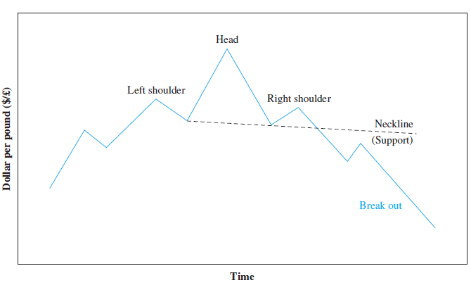
EXHIBIT 6.12 Head-and-Shoulders Pattern: A Reversal Signal
6-43

Slide 44
Performance of the Forecasters
Forecasting is difficult, especially with regard to the future.
As a whole, forecasters cannot do a better job of forecasting future exchange rates than the forecast implied by the forward rate.
The founder of Forbes Magazine once said, “You can make more money selling financial advice than following it.”
6-44

Slide 45
Summary
Interest rate parity (IRP) holds that the forward premium or discount should be equal to the interest rate differential between two countries.
IRP represents an arbitrage equilibrium condition that should hold in the absence of barriers to international capital flows.
If IRP is violated, one can lock in guaranteed profit by borrowing in one currency and lending in another, with exchange risk hedged via forward contract.
As a result of this covered interest arbitrage, IRP will be restored.
6-45

Slide 46
Summary (continued)
IRP implies that in the short run, the exchange rate depends on
(a) the relative interest rates between two countries, and
(b) the expected future exchange rate
Other things being equal, a higher (lower) domestic interest rate will lead to appreciation (depreciation) of the domestic currency. People’s expectations concerning future exchange rates are self-fulfilling.
6-46

Slide 47
Summary (concluded)
Purchasing power parity (PPP) states that the exchange rate between two countries’ currencies should be equal to the ratio of their price levels.
The relative version of PPP states that the rate of change in the exchange rate should be equal to the inflation rate differential between countries. The existing empirical evidence, however, is generally negative on PPP. This implies that substantial barriers to international commodity arbitrage exist.
There are three distinct approaches to exchange rate forecasting:
(a) the efficient market approach,
(b) the fundamental approach, and
(c) the technical approach.
6-47

