Slide 1

Fundamentals of Human Resource Management
Fifth Edition, Global Edition
Chapter 4
Job Analysis and Talent Management
Copyright © 2020 Pearson Education, Ltd. All Rights Reserved

Slide 2
Learning Objectives (1 of 2)
Define talent management, and explain why it is important.
Discuss the process of job analysis, including why it is important.
Explain how to use at least three methods of collecting job analysis information, including interviews, questionnaires, and observations.
Notes:
At the conclusion of this chapter, you will be able to:
Define talent management, and explain why it is important.
Discuss the process of job analysis, including why it is important.
Explain how to use at least three methods of collecting job analysis information, including interviews, questionnaires, and observations.

Slide 3
Learning Objectives (2 of 2)
Explain how you would write a job description.
Explain how to write a job specification.
List some human traits and behaviors you would want an employee to bring to a job if employee engagement is important to doing the job well.
Explain how to write competency-based models.
Notes:
Additionally, at the conclusion of this chapter, you will be able to:
Explain how you would write a job description.
Explain how to write a job specification.
List some human traits and behaviors you would want an employee to bring to a job if employee engagement is important to doing the job well.
Explain how to write competency-based models.

Slide 4
Define talent management and explain why it is important
Talent management is the goal-oriented and integrated process of planning, recruiting, developing, managing, and compensating employees.
Talent management is the main function of human resources management and without effective talent management, an organization will not sustain.
Notes:
LO1: Define talent management, and explain why it is important.
Talent management is the goal-oriented and integrated process of planning, recruiting, developing, managing, and compensating employees.
Talent management is the main function of human resources management and without effective talent management, an organization will not sustain. Now let’s look at why talent management is important and other aspects of talent management.

Slide 5
The Talent Management Process (1 of 2)
Decide what positions to fill, through job analysis, personnel planning, and forecasting.
Build a pool of job applicants by recruiting internal or external candidates.
Obtain application forms and have initial screening interviews.
Use selection tools like tests, interviews, background checks, and physical exams to identify viable candidates.
Notes:
The heart of human resources management is recruitment, selection, training, appraisal, career planning, and compensation. Managers traditionally view these activities as a series of steps listed on this slide.
Many employers use talent management software systems to coordinate their talent related activities.

Slide 6
The Talent Management Process (2 of 2)
Decide on whom to make the offer.
Orient, train, and develop employees so they have the competencies to do their jobs.
Appraise and assess employees and then compensate them to maintain their motivation.
Compensate employees to maintain their motivation.
The heart of human resources management is recruitment, selection, training, appraisal, career planning, and compensation.
Notes:
The heart of human resources management is recruitment, selection, training, appraisal, career planning, and compensation. Managers traditionally view these activities as a series of steps listed on this slide.
Many employers use talent management software systems to coordinate their talent related activities.

Slide 7
The Basics of Job Analysis
Organizations consist of positions that have to be staffed. The organizational chart shows the title of each supervisor’s position and who is accountable to whom, and who has authority for each area, and finally, who is expected to communicate with whom.
A job analysis is the procedure for determining the duties and skill requirements of a job and the kind of person who should be hired for it.
The job analysis produces information for writing job descriptions.
Job descriptions are a list of a job’s duties, responsibilities, reporting relationships, working conditions, and supervisory responsibilities.
Job specifications are a list of a job’s “human requirements,” that is, the requisite education, skills, personality, and so on—another product of job analysis.
Notes:
LO2: Discuss the process of job analysis, including why it is important.
Organizations consist of positions that have to be staffed. The organizational chart shows the title of each supervisor’s position and who is accountable to whom, and who has authority for each area, and finally, who is expected to communicate with whom.
A job analysis is the procedure for determining the duties and skill requirements of a job and the kind of person who should be hired for it.
The job analysis produces information for writing job descriptions.
Job descriptions are a list of a job’s duties, responsibilities, reporting relationships, working conditions, and supervisory responsibilities.
Job specifications are a list of a job’s “human requirements,” that is, the requisite education, skills, personality, and so on—another product of job analysis.
The supervisor or human resources specialist will collect one or more of the following types of information:
Work activities
Human behaviors (lifting weights, walking long distances, etc.)
Machines, tools, equipment, and work aids
Performance standards
Job context (work schedule, work conditions, incentives, etc.)
Human requirements (aptitudes, personality, interests, etc.)

Slide 8
The supervisor or human resources specialist will collect one or more of the following types of information:
Work activities
Human behaviors (lifting weights, walking long distances, etc.)
Machines, tools, equipment, and work aids
Performance standards
Job context (work schedule, work conditions, incentives, etc.)
Human requirements (aptitudes, personality, interests, etc.)

Slide 9
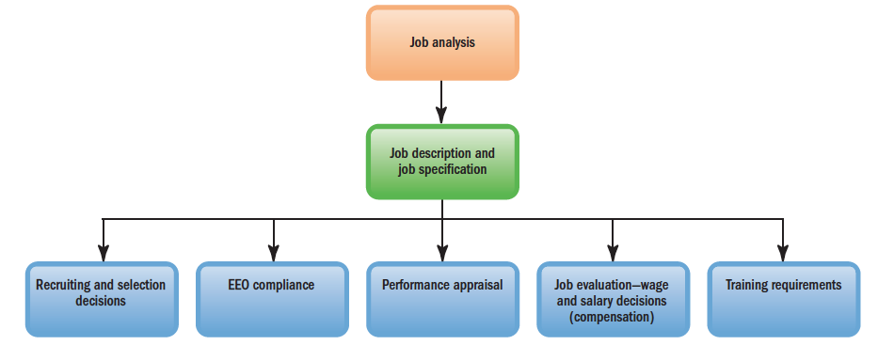
Uses of Job Analysis Information
Notes:
In this slide, we see a visual of the uses of Job Analysis information. As summarized in the graph, the information produced by the job analysis is the basis for several interrelated HR activities that managers engage in almost every day. Specifically:
Recruitment and Selection: The job analysis produces information about what duties the job entails and what human characteristics are required to perform these activities, and thus, helps managers decide what sort of people to recruit and hire.
EEO Compliance: For example, to comply with the Americans with Disabilities Act, employers should know each job’s essential job functions—which in turn requires a job analysis.
Training: The job description lists the job’s specific duties and requisite skills—thus, pinpointing what training the job requires.
Performance Appraisal: A performance appraisal compares each employee’s actual performance with his or her duties and performance standards. Managers use job analysis to learn what these duties and standards are.
Compensation: Compensation levels usually depend on the job’s required skill and education level, safety hazards, degree of responsibility, and so on—all factors you assess through job analysis.

Slide 10
The information produced by the job analysis is the basis for several interrelated HR activities that managers engage in almost every day. Specifically:
Recruitment and Selection: The job analysis produces information about what duties the job entails and what human characteristics are required to perform these activities, and thus, helps managers decide what sort of people to recruit and hire.
EEO Compliance: For example, to comply with the Americans with Disabilities Act, employers should know each job’s essential job functions—which in turn requires a job analysis.
Training: The job description lists the job’s specific duties and requisite skills—thus, pinpointing what training the job requires.
Performance Appraisal: A performance appraisal compares each employee’s actual performance with his or her duties and performance standards. Managers use job analysis to learn what these duties and standards are.
Compensation: Compensation levels usually depend on the job’s required skill and education level, safety hazards, degree of responsibility, and so on—all factors you assess through job analysis.

Slide 11
Steps in Job Analysis
Identify the use of the information and how to collect it
Review relevant background information about the job
Select a sample of positions to focus on
Analyze the job
Verify information with worker and supervisors
Develop a job description and job specification
Notes:
A typical job analysis involves these steps listed on this slide:
Identify the use of the information and how to collect it
Review relevant background information about the job
Select a sample of positions to focus on
Analyze the job
Verify information with worker and supervisors
Develop a job description and job specification

Slide 12
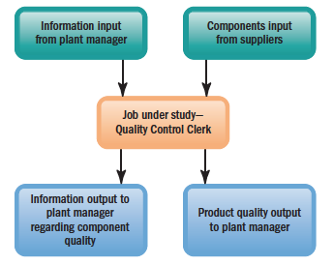
Workflow Analysis
Notes:
A workflow analysis is a detailed study of the flow of work from job to job in a work process.
A process chart (as in this slide) is a workflow chart that shows the flow of inputs and outputs from a particular job.
To answer questions like the below, a workflow analysis should be done:
“Does how this job relates to other jobs make sense?”
“Should this job even exist?”
“Should we redesign how this job is done?”

Slide 13
Business Process Reengineering (1 of 2)
Business Process Reengineering
Identify a business process to be redesigned
Measure the performance of the existing processes
Identify opportunities to improve these processes
Redesign and implement a new way of doing the work
Assign ownership of sets of formerly separate tasks to an individual or a team who use computers to support the new arrangement
Notes:
Business Process Reengineering is redesigning business processes, usually by combining steps, so that small multifunction process teams using information technology do the jobs formerly done by a sequence of departments.
The basic reengineering process involves the steps listed in this slide.

Slide 14
Business Process Reengineering (2 of 2)
Job Redesign
Job enlargement means assigning workers additional same-level activities. This means more duties within the job position that may contribute toward an employee feeling a sense of pride that his or her responsibilities have increased.
Job rotation is systematically moving workers from one job to another. This job redesign strategy is helpful in adding to or building on to employee competencies, if an organization requires broader knowledge of the organization skills.
Job enrichment is redesigning jobs in a way that increases the opportunities for the worker to experience feelings of responsibility, achievement, growth, and recognition.
Notes:
Business process reengineering can result in the following changes to an existing job position through job redesign or the creation of a new job position.
Methods of job redesign include:
Job enlargement means assigning workers additional same-level activities. This means more duties within the job position that may contribute toward an employee feeling a sense of pride that his or her responsibilities have increased.
Job rotation is systematically moving workers from one job to another. This job redesign strategy is helpful in adding to or building on to employee competencies, if an organization requires broader knowledge of the organization skills.
Job enrichment is redesigning jobs in a way that increases the opportunities for the worker to experience feelings of responsibility, achievement, growth, and recognition.

Slide 15
Explain how to use at least three methods of collecting job analysis information, including interviews, questionnaires, and observations
Notes:
LO3: Explain how to use at least three methods of collecting job analysis information, including interviews, questionnaires, and observations.
There are various methods for actually collecting job information, and one should use those that best fit the organization’s purpose. Actually collecting the job analysis information is straightforward. We’ll look at some of these methods of collecting job analysis information.

Slide 16
Interviewing (1 of 2)
The Interview (typical questions asked)
What is the job being performed?
What exactly are the major duties of your position?
What physical locations do you work in?
What are the education, experience, skill, and (where applicable) certification and licensing requirements?
What are the job’s responsibilities and duties?
Notes:
One method of collecting job analysis information is by conducting interviews within the workplace to obtain what activities are involved in a job position. Managers may conduct individual interviews with each employee, group interviews with groups of employees who have the same job, and/or supervisor interviews with one or more supervisors who know the job.
The worker should understand the reason for the interview. There’s a tendency for workers to view such interviews as “efficiency evaluations” and to hesitate to describe their jobs accurately.
This slide lists some of the typical questions asked in this type of job analysis interview.
Structured interviews are when managers use structured guides with the same types of questions, and job analysts who collect information can observe the work by using the questionnaires.

Slide 17
Interviewing (2 of 2)
The Interview (typical questions asked)
What are the basic accountabilities or performance standards that typify your work?
What are your responsibilities?
What are the environmental and working conditions involved?
What are the job’s physical demands? The emotional and mental demands?
Are you exposed to any hazards or unusual working conditions?

Slide 18
Methods for Collecting Job Analysis Information
Questionnaires
Observation
Participant Diary/Logs
Quantitative Job Analysis Techniques
Electronic Job Analysis Methods
Notes:
Other methods for collecting job analysis information include questionnaires, observations, and participant diary/logs.
Having employees fill out questionnaires to describe their job duties and responsibilities is a great way to obtain information from those that actually do the job. Some questionnaires are structured checklists while other questionnaires seek to obtain qualitative data with questions such as “describe the major duties of your job.”
Direct observations are especially useful when jobs consist mainly of observable physical activities—assembly-line workers and accounting clerks are examples. However, observations are not appropriate when the job requires a lot of focus and mental activity by the employee working the job. Managers often use direct observations and interviews together.
Participant diary and logs are another excellent way to obtain first-hand information from employees who are actually participating in the job. This method are daily listings made by workers of every activity in which they engage in, along with the time each activity takes.
Qualitative methods like interviews and questionnaires are not always suitable. For example, if your aim is to compare jobs for pay purposes, a mere listing of duties may not suffice. You may need to say that, in effect, “Job A is twice as challenging
as Job B, and so is worth twice the pay.” For this, quantitative job ratings are useful.
Electronic Job analysis methods are becoming more increasingly used by employers and are electronic or Web-based job analysis methods. The job analyst may use the Web to review existing information about a job and then may send a questionnaire through the Web to job experts in remote locations. This analysis may also include a Skype session to follow up on finalizing knowledge, skills, abilities, and other characteristics required by the job.

Slide 19
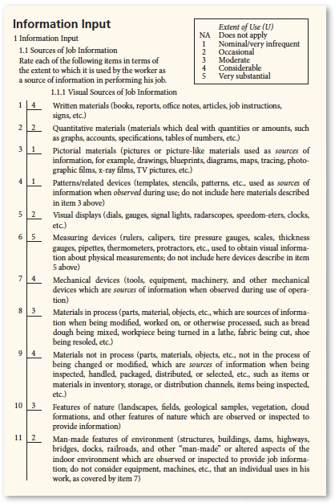
Position Analysis Questionnaire (PAQ)
Notes:
One popular quantitative analysis tool is the Position Analysis Questionnaire (PAQ).
In this slide, we see an example of a portion of a completed page from the Position Analysis Questionnaire.
A PAQ is a questionnaire used to collect quantifiable data concerning the duties and responsibilities of various jobs. Sometimes collecting quantifying data is more appropriate than qualitative methods such as interviews and questionnaires in which discussions are captured. A PAQ score can be added up and shows the rating on each of the job’s activities. The PAQ’s strength is in assigning jobs to job classes to clarify for pay purposes.

Slide 20
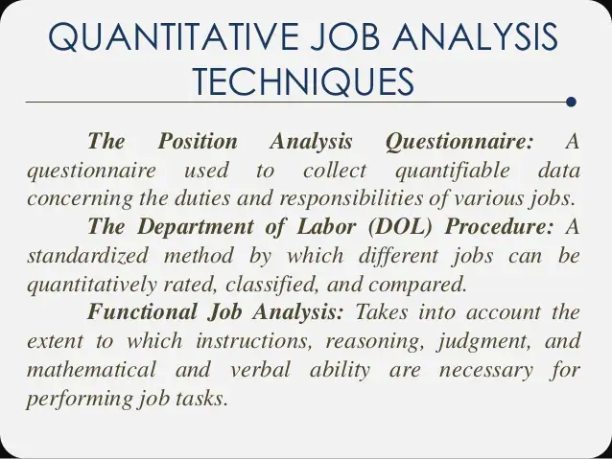

Slide 21
Writing Job Descriptions
Job Identification
Job Summary
Responsibilities and Duties
Authority of Incumbent
Standards of Performance
Working Conditions
Job Specification
Notes:
LO4: Explain how you would write a job description.
The most important product of job analysis is the job description.
A job description is a written statement of what the worker actually does, how he/she does it, and what the job’s working conditions are. This information is used to write job specifications; this information lists the knowledge, abilities, and skills required to perform the job satisfactorily.
Most job descriptions contain sections that cover the following:
Job Identification (contains job title, job grade, date of approval, salary, or pay scale): The FLSA status section identifies the job as exempt or nonexempt.
Job Summary: This should summarize the essence of the job, and include only its major functions or activities.
Responsibilities and Duties: This is at the heart of the job description. This would present a list of the job’s significant responsibilities and duties.
Authority of Incumbent: This identifies the authority span of the job position. This would include information of the jobholder’s relationship with others, reporting structure position, etc.
Standards of Performance: This sets out expectations of the job.
Working Conditions: Provides the context of the job position (outdoors, indoors, etc.)
Job Specification
Another way to view job titles and duties is to just use social media like LinkedIn. Using O*Net is another source to find information on job descriptions.

Slide 22
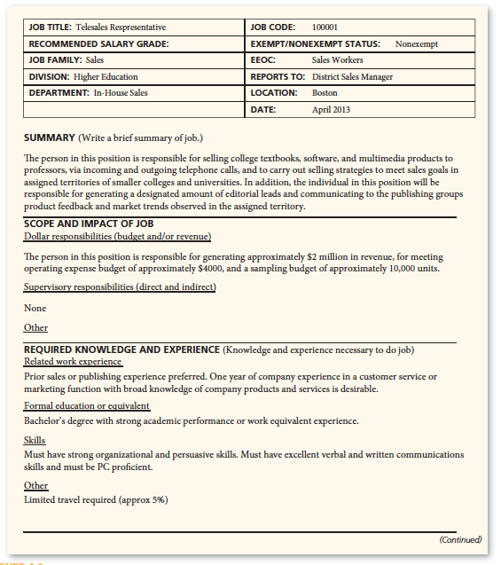
Sample Job Description
Notes:
In this slide, we see a partial sample of a Job Description document. This document was obtained from Pearson Education.

Slide 23
Knowing the Employment Law
AD-Athe Americans with Disabilities Act - Considerations
Reasonable Accommodations
Standards of Performance and Working Conditions
Notes:
Employers must comply with the Americans with Disabilities Act (ADA). Under the ADA, the individual must have the requisite skills, educational background, and experience to perform the job’s essential functions. The EEOC says, “essential functions are the basic job duties that an employee must be able to perform, with or without reasonable accommodation.”
Factors to consider include:
Whether the position exists to perform that function.
The number of other employees available to perform the function.
The degree of expertise or skill required to perform the function.
Whether employees in the position are actually required to perform the function.
What degree of expertise or skill required to perform that function.
Reasonable accommodations might include:
Acquiring or modifying equipment or devices.
Job restructuring.
Part-time or modified work schedules.
Reassignment to a vacant position.
Adjusting or modifying examinations, training materials, or policies.
Providing readers and interpreters.
Making the workplace readily accessible.
Standards of Performance and Working Conditions lists what the company expects the employee to achieve for each of the job description’s main duties and responsibilities.

Slide 24
Writing Job Specifications
Specifications for Trained vs. Untrained Personnel
Specifications Based on Judgment
Job Specifications Based on Statistical Analysis
The Job Requirement Matrix
Task Statement
Notes:
LO5: Explain how to write a job specification.
The job specification takes the job description and answers the question, “What human traits and experience are required to do this job effectively?”
Writing job specifications for trained and experienced employees is relatively straightforward. The job specification tends to focus on factors such as length of previous service, quality of relevant training, and previous job performance. It’s more complex though to write job specifications for jobs being filled with untrained workers.
Most job specifications simply reflect the educated guesses of people like supervisors and human resource managers. The basic procedure is to ask, “What does it take in terms of education, intelligence, training, etc., to get the job done?”
Basing job specifications on statistical analysis rather than only judgment, is the more defensible approach, but it’s more difficult. The aim is to determine statistically the relationship between (1) some predictor and (2) some indicator or criterion of job effectiveness.
Job-requirement matrix is a more complete description of what the worker does and how and why he or she does it. It clarifies each task’s purpose and each duty’s required knowledge, skills, abilities, and other characteristics.
The task statement is a written item that shows what the worker does on one particular job task; how the worker does it; the knowledge, skills, and aptitudes required to do it; and the purpose of the task.

Slide 25
Most job specifications simply reflect the educated guesses of people like supervisors and human resource managers. The basic procedure is to ask, “What does it take in terms of education, intelligence, training, etc., to get the job done?”
Basing job specifications on statistical analysis rather than only judgment, is the more defensible approach, but it’s more difficult. The aim is to determine statistically the relationship between (1) some predictor and (2) some indicator or criterion of job effectiveness.
Job-requirement matrix is a more complete description of what the worker does and how and why he or she does it. It clarifies each task’s purpose and each duty’s required knowledge, skills, abilities, and other characteristics.
The task statement is a written item that shows what the worker does on one particular job task; how the worker does it; the knowledge, skills, and aptitudes required to do it; and the purpose of the task.

Slide 26
Employee Engagement Guide
Employee engagement refers to being psychologically involved in, connected to, and committed to getting one’s job done.
In terms of the job specification, the human resource consulting company Development Dimensions International conducted a study of 3,800 employees, and identified several personal characteristics that seemed to predict the likelihood someone
would be engaged. These traits included adaptability, passion for work, emotional maturity, positive disposition, self-advocacy, and achievement orientation.
With the growing importance of employee engagement, many employers today are appointing special employee engagement managers, with titles such as Employee Engagement Manager or Director of Employee Engagement. HR personnel and managers have created the company’s goals to include employee engagement and it is included in the job descriptions by designing activities that are engaging
Notes:
LO6: List some human traits and behaviors you would want an employee to bring to a job if employment engagement is important to doing the job well.
Employee engagement refers to being psychologically involved in, connected to, and committed to getting one’s job done.
In terms of the job specification, the human resource consulting company Development Dimensions International conducted a study of 3,800 employees, and identified several personal characteristics that seemed to predict the likelihood someone
would be engaged. These traits included adaptability, passion for work, emotional maturity, positive disposition, self-advocacy, and achievement orientation.
With the growing importance of employee engagement, many employers today are appointing special employee engagement managers, with titles such as Employee Engagement Manager or Director of Employee Engagement. HR personnel and managers have created the company’s goals to include employee engagement and it is included in the job descriptions by designing activities that are engaging. The textbook shows an example of an Employee Engagement Manager Job Description.

Slide 27
Using Competencies Models
Notes:
LO7: Explain how to write competency-based models.
Competency-based job analysis involves describing the job in terms of measurable, observable, and behavioral competencies (knowledge, skills, and/or behaviors that an employee doing that job must exhibit to do the job well.)
While a majority of companies still use job descriptions, many are using a newer approach such as competency models or profiles—the knowledge and skills someone needs to do the job.
The aim of compiling such models is to summarize what “competencies” some require for exceptional performance, specifically skills, behavior, knowledge, and/or experience.

Slide 28
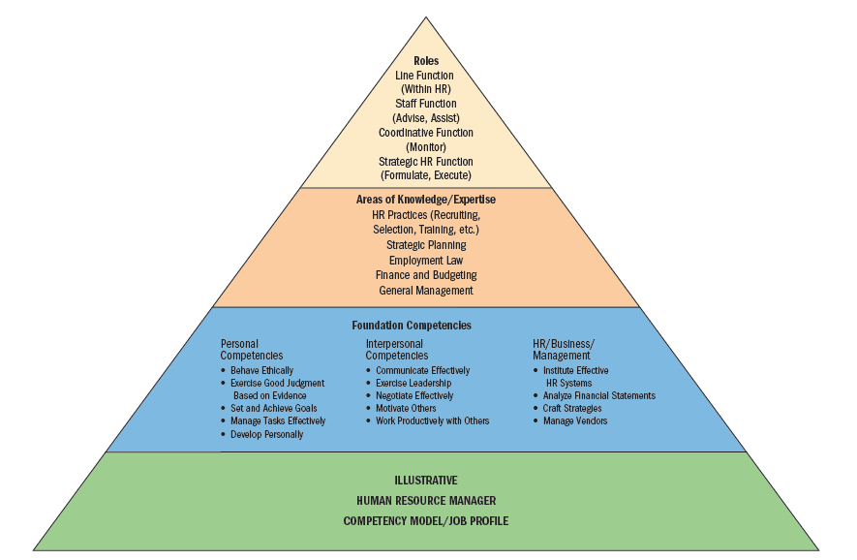
Example Competency Model
Notes:
In this slide, we see an example of a competency model/job profile for a Human Resource Manager.

Slide 29
How to Write Competencies Statements
Open-ended questions
Statement: “In order to perform this job competently, the employee should be able to…”
Three elements:
  Name and brief description
  Observable behaviors
  Proficiency levels
Notes:
Identifying the job’s required competencies is similar to traditional job analysis. Interviews with job incumbents and supervisors ask open-ended questions regarding job responsibilities and activities.
Statements like this might be asked: “In order to perform this job competently, the employee should be able to…”
Ideally, the competency statement will include three elements—the name and brief description; description of the observable behaviors; and proficiency levels.
For example, for a project manager:
Proficiency level 1: Identifies project risks and dependencies and communicates routinely to stakeholders
Proficiency level 2: Develops systems to monitor risks and dependencies and report changes
Proficiency level 3: Anticipates changing conditions and impact to risks and dependencies and takes preventative action
Proficiency level 4: Proactively identifies implications of related internal and external business conditions to risks and dependencies

Slide 30
For example, for a project manager:
Proficiency level 1: Identifies project risks and dependencies and communicates routinely to stakeholders
Proficiency level 2: Develops systems to monitor risks and dependencies and report changes
Proficiency level 3: Anticipates changing conditions and impact to risks and dependencies and takes preventative action
Proficiency level 4: Proactively identifies implications of related internal and external business conditions to risks and dependencies

Slide 31
Summary
The talent management process
The basics of job analysis
The various methods for collecting job analysis information
Writing job descriptions
Writing job specifications
Human traits and behaviors that predict employee engagement
Competency-based job analysis
Notes:
In this chapter, we discussed the following:
The talent management process
The basics of job analysis
The various methods for collecting job analysis information
Writing job descriptions
Writing job specifications
Human traits and behaviors that predict employee engagement
Competency-based job analysis

Slide 32
Fundamentals of Human Resource Management
Fifth Edition, Global Edition
Chapter 5
Personnel Planning and Recruiting
Copyright © 2020 Pearson Education, Ltd. All Rights Reserved
Notes:
In this chapter, we will cover workforce planning and forecasting, effective recruiting, sources of candidates, employee engagement, outside sources of candidates, recruiting a diverse workforce, and developing and using application forms.

Slide 33
Learning Objectives (1 of 2)
Explain the main techniques used in employment planning and forecasting.
Answer the question: “Why is effective recruiting important?”
Name and describe the main internal sources of candidates.
Notes:
At the conclusion of this chapter, you will be able to:
Explain the main techniques used in employment planning and forecasting.
Answer the question: “Why is effective recruiting important?”
Name and describe the main internal sources of candidates.

Slide 34
Learning Objectives (2 of 2)
Discuss a workforce planning method you would use to improve employee engagement.
List and discuss the main sources of outside candidates.
Explain how to recruit a more diverse workforce.
Discuss the main issue to address in developing application forms.
Notes:
Additionally, at the conclusion of this chapter, you will be able to:
Discuss a workforce planning method you would use to improve employee engagement.
List and discuss the main sources of outside candidates.
Explain how to recruit a more diverse workforce.
Discuss the main issue to address in developing application forms.

Slide 35
Explain the main techniques used in employment planning and forecasting
Workforce or employment or personnel planning is the process of deciding what positions the firm will have to fill, and how to fill them. Its aim is to identify and address the gaps between the employer’s workforce today, and the firm’s projected workforce needs.
We will be looking at the various techniques used in employment planning and forecasting
Notes:
LO1: Explain the main techniques used in employment planning and forecasting.
Workforce or employment or personnel planning is the process of deciding what positions the firm will have to fill, and how to fill them. Its aim is to identify and address the gaps between the employer’s workforce today, and the firm’s projected workforce needs.
We will be looking at the various techniques used in employment planning and forecasting.

Slide 36
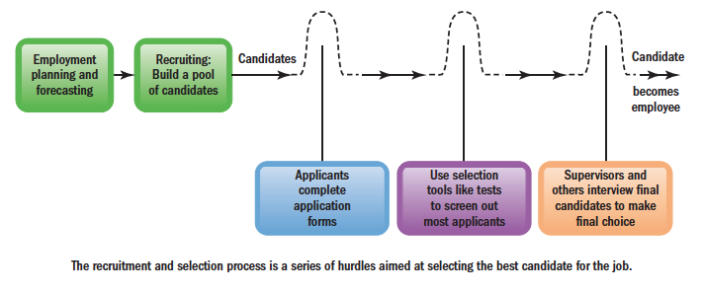
Steps in Recruitment and Selection Process
Notes:
This image illustrates the steps in the recruitment and selection process. First, the employer will analyze the company’s needs with employment planning and forecasting results. Then, a pool of candidates will be found through various ways. Next, applicants will apply to slated positions. Selection tools are then used to screen out unqualified candidates and pool the candidates that most fit the job positions. Next, the interviews will take place and the final choice from the candidates will be chosen. This model demonstrates the basic steps in bringing in employees; however, many processes and tools are used throughout this process in choosing the best candidate from the applicant pool.

Slide 37
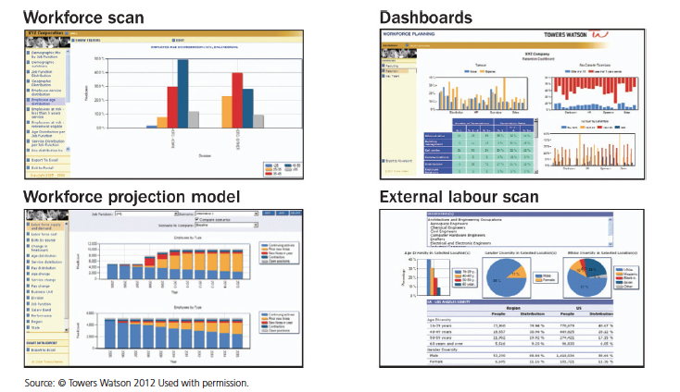
Workforce Planning System
Source: © Towers Watson 2012 Used with permission.
Notes:
This is an example of a workforce planning system, typical of what Towers Watson consulting firm would use in analyzing the client’s business plan and workforce data. This type of analysis will help with projections and to better understand business plan changes that influence headcount and skills requirements within jobs. Systems like this help with what is called succession planning. Succession planning is the ongoing process of systematically identifying, assessing, and developing organizational leadership to enhance performance.

Slide 38
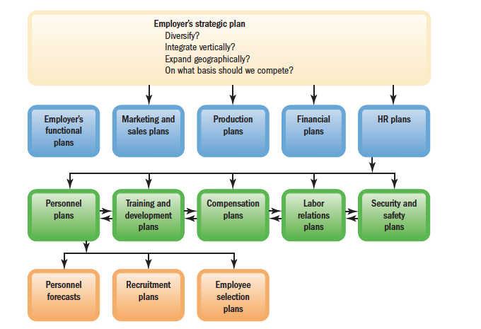
Linking Employer’s Strategy to Personnel Plans
Notes:
The workforce and employment planning is best thought of as an outgrowth of the firm’s strategic and business planning process. Plans to enter a new business, build a new plant, or reduce activities all influence the number of and types of positions to be filled. Many strategic questions are asked first, about what the company will be doing over the next year, two years, five years, etc. In turn, all planning in all areas of the firm are decided based on these questions asked and the analyses done on employment planning decisions.
Supply and demand gaps are analyzed and planned for regarding open positions and available candidates. Forecasted numbers are then projected.

Slide 39
Forecasting Personnel Needs
Trend analysis is the study of a firm’s past employment needs over a period of years to predict future needs. Trend analysis provides an initial rough estimate of future staffing needs.
Ratio analysis is a forecasting technique for determining future staff needs by using ratios between, for example, sales volume and number of employees needed. Ratio analysis assumes that things like productivity remain about the same. If sales productivity were to rise or fall, the ratio of sales to salespeople would change.
Scatter plot is a graphical method used to help identify the relationship between two variables. In forecasts of business activity (like sales), you should also be able to estimate your personnel needs.
Notes:
Managers consider several factors when forecasting personnel needs. From a practical point of view, the demand for the product or service is paramount. Thus, in manufacturing firms, sales are projected first. Then the volume of production needed to meet sales requirements is determined. Finally, the staff needed to maintain this volume of output is estimated.
Staffing needs reflect demand for its products or services, adjusted for changes the firm plans to make in its strategic goals and for changes in its turnover rate and productivity.
Trend analysis is the study of a firm’s past employment needs over a period of years to predict future needs. Trend analysis provides an initial rough estimate of future staffing needs.
Ratio analysis is a forecasting technique for determining future staff needs by using ratios between, for example, sales volume and number of employees needed. Ratio analysis assumes that things like productivity remain about the same. If sales productivity were to rise or fall, the ratio of sales to salespeople would change.
Scatter plot is a graphical method used to help identify the relationship between two variables. In forecasts of business activity (like sales), you should also be able to estimate your personnel needs.

Slide 40
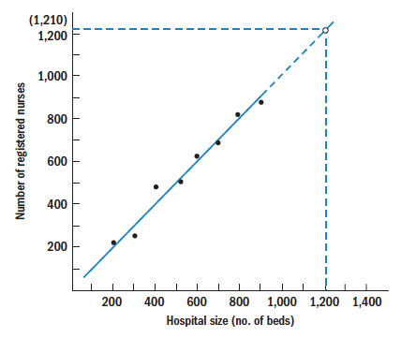
Forecasting Personnel: registered nurses (RNs) example
On the left thetable stating the number of beds corresponding with number of registered nurses needed. This data could, for example, be from determining what other hospitals have on staff in relation to their personnel.
On the right, the scatter plot, shows the comparison of hospital size and number of nurses. When there is a relationship, a line will tend to fall within the data points.
Size of Hospital (Number of Beds) | Number of Registered Nurses
200 | 240
300 | 260
400 | 470
500 | 500
600 | 620
700 | 660
800 | 820
900 | 860
Notes:
As an example of forecasting personnel for a hospital in determining how many registered nurses (RNs) are needed, we look at the number of beds occupied to see how many RNs are needed.
The relationship between hospital size (number of beds) and number of nurses required is what human resources personnel know is needed for projected needs of registered nurses.
On the left we see a table stating the number of beds corresponding with number of registered nurses needed. This data could, for example, be from determining what other hospitals have on staff in relation to their personnel.
On the right, the scatter plot, shows the comparison of hospital size and number of nurses. When there is a relationship, a line will tend to fall within the data points. These graphs are helpful, but do have their drawbacks:
Historical sales/personnel relationships assume that the firm’s existing activities and skill needs will continue as is.
They tend to reward managers for adding employees, irrespective of the company’s needs.
They tend to institutionalize existing ways of doing things, even in the face of change.

Slide 41
Improving Performance Through HRIS
Computerized forecasts enable managers to build more variables into their personnel projections. Computerized systems and Excel spreadsheets quickly translate estimates of projected productivity and sales levels into forecastable personnel requirements. Store traffic and staffing retail stores is one example used in these computerized estimates.
Managerial judgment is also an important phenomenon when predicting staffing needs. Few historical trends, ratios, or relationships will continue unchanged into the future. Judgment is then needed to modify the forecast. Important factors that may modify your initial forecast of personnel requirements include decisions to upgrade quality or to enter into new markets.
Notes:
Computerized forecasts enable managers to build more variables into their personnel projections. Computerized systems and Excel spreadsheets quickly translate estimates of projected productivity and sales levels into forecastable personnel requirements. Store traffic and staffing retail stores is one example used in these computerized estimates.
Managerial judgment is also an important phenomenon when predicting staffing needs. Few historical trends, ratios, or relationships will continue unchanged into the future. Judgment is then needed to modify the forecast. Important factors that may modify your initial forecast of personnel requirements include decisions to upgrade quality or to enter into new markets.

Slide 42
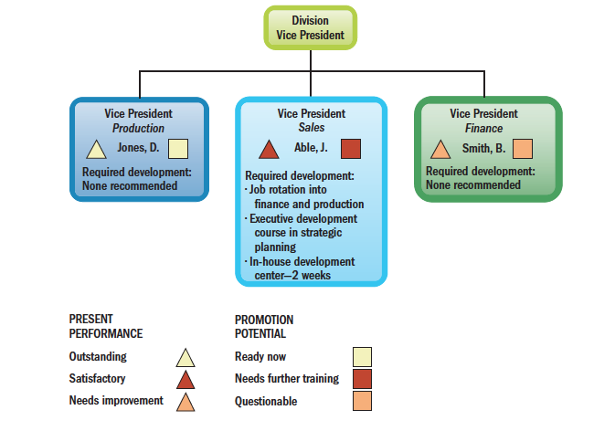
Management Replacement Chart Example
flow of a management replacement chart showing development needs of potential future divisional vice presidents
Notes:
Organizations also need to know the forecast for the supply of personnel inside as well as candidates outside.
This graph depicts an example flow of a management replacement chart showing development needs of potential future divisional vice presidents.
Personnel replacement charts, as shown here, are company records showing present performance and promotability of inside candidates for the most important positions. This graph shows the present performance and promotability for each position’s potential replacement. As an alternative, you can develop a position replacement card. For this, you create a card for each position, showing possible replacements as well as their present performance, promotion potential, and training.
A position replacement card is a card prepared for each position in a company to show possible replacement candidates and their qualifications.

Slide 43
Keeping Data Safe
Since intruders can strike from outside an organization or from within, HR departments can help screen out potential identity thieves by following four basic rules:
Perform background checks on anyone who is going to have access to personal information.
If someone with access to personal information is out sick or on leave, don’t hire a temporary employee to replace him or her. Instead, bring in a trusted worker from another department.
Perform random background checks such as random drug tests. Just because someone passed 5 years ago doesn’t mean their current situation is the same.
Limit access to information such as SSNs, health information, and other sensitive data to HR managers who require it to do their jobs.
Notes:
The employer should control the personal data stored in the organization’s data banks, and all managers must be vigilant about protecting employees’ privacy, for several reasons.
In this slide, we see guidelines in how to secure company data. This is taken from a security company that is a co-founder of ITRC. Let’s look at some of the tips on securing employment data.

Slide 44
Workplace Planning and Forecasting
Forecasting the Supply of Outside Candidates
Predictive Workforce Monitoring
Notes:
Forecasting what the workforce availability will be depends first on the manager’s own sense of what’s happening in his or her industry and locale.
With more jobs being technology-based, many applicants will lack the necessary skills such as in math and teamwork; the manager will therefore have to factor such things as training and development into the workforce plan.
The best talent management practice requires paying continuous attention to workforce planning issues. Managers call this predictive workforce monitoring. Many organizations conduct semiannual organizational capabilities assessments (such as Intel). The staffing department works with the firm’s business heads twice a year to assess workforce needs—both immediate and up to two years in the future.

Slide 45
Answer the question: “Why is effective recruiting important?”
Notes:
LO2: Answer the question: “Why is effective recruiting important?”
Employment recruiting is finding and/or attracting applicants for the employer’s open positions.
Recruiting is important. Using skilled techniques to screen out all but the best is essential to organizational success.
However, effective recruiting is not easy. First, some recruiting methods are superior to others. Second, recruiting depends on nonrecruitment issues such as pay scales. Third, employment law prescribes what you can do.
We’ll continue to look at some recruitment methods in this chapter.

Slide 46
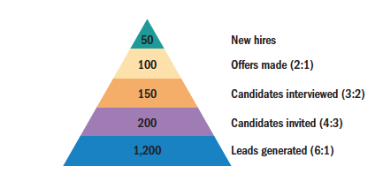
Why Recruiting Is Important
Recruiting Yield Pyramid
Improving Recruitment Effectiveness
Pre-employment Activities
Notes:
The recruiting yield pyramid is the historical arithmetic relationships between recruitment leads and invitees, invitees and interviews, interviews and offers made, and offers made and offers accepted. Filling even a few positions might require recruiting dozens or hundreds of candidates.
The quality of the firm’s recruiting process had a big impact on what candidates thought of the firm. Many candidates have stated that the recruiter was the reason many were impressed with the job and company. Having qualified and effective recruiters are essential to the recruitment process.
Recruitment sourcing is also important to improving recruitment effectiveness. Recruitment sourcing involves determining what your recruitment options are, and then assessing which are best for the job in question.
Employers should also build its brand or reputation amongst potential applicants. The branding often focuses on what it’s like to work at the company, including company values, and the work environment the employer fosters.
Numerous federal, state, and local laws and court decisions restrict what employers can and cannot do when recruiting job applicants. The key question in all recruitment procedures is whether the method limits qualified applicants from applying.
The line and supervisor’s roles are very important and essential. Because these people understand the position and what’s entailed, they should be included in the recruitment process.

Slide 47
Name and describe the main internal sources of candidates
Filling open positions with inside candidates has several advantages. First, there is no substitute for already knowing the candidate’s strengths and weaknesses. Morale and engagement may rise if employees see their colleagues promoted for loyalty and competence. And inside candidates should require less orientation and (perhaps) training than outsiders.
Notes:
LO3: Name and describe the main internal sources of candidates.
Internal sources of candidates is what many companies will first utilize. Filling open positions with inside candidates has several advantages. First, there is no substitute for already knowing the candidate’s strengths and weaknesses. Morale and engagement may rise if employees see their colleagues promoted for loyalty and competence. And inside candidates should require less orientation and (perhaps) training than outsiders.

Slide 48
Main Internal Sources of Candidates
Job Posting
Qualification Skills Inventories
Job postings are the most typical way to source internal candidates. Job posting is publicizing an open job to employees (often by literally posting it on bulletin boards) and listing its attributes, like qualifications, supervisor, working schedule, and pay rate.
Qualification skills inventories may reveal employees who have potential for further training, or who have the right background for the open job. Examining personnel records is also another way to source candidates.
Notes:
Job postings are the most typical way to source internal candidates. Job posting is publicizing an open job to employees (often by literally posting it on bulletin boards) and listing its attributes, like qualifications, supervisor, working schedule, and pay rate.
Qualification skills inventories may reveal employees who have potential for further training, or who have the right background for the open job. Examining personnel records is also another way to source candidates.

Slide 49
Discuss a workforce planning method you would use to improve employee engagement
Notes:
LO4: Discuss a workforce planning method you would use to improve employee engagement.
Internal recruitment and promotion from within is usually the first steps in filling job openings. It seems reasonable that employees tend to be committed to firms that are committed to them. Promotions from within are what many companies do to ensure they maintain their talent. IBM and FedEx are just a couple of firms committed to developing and promoting their talent from within.

Slide 50
Workforce Planning for Employee Engagement
Training Employees to Develop Their Potential
Career-Oriented appraisals
Job Posting System
Notes:
Effective promotion-from-within programs also require providing the training employees need to develop their promotion potential. It also requires career-oriented appraisals. Here the supervisors and employees jointly link the latter’s past performance, career preferences, and developmental needs in a formal career plan. FedEx calls its job posting system JCATS
(Job Change Applicant Tracking System). Announcements of new job openings via this online system usually take place each Friday. All employees applying for the position get numerical scores based on job performance and length of service. They are then advised whether they were chosen as candidates.

Slide 51
Outside Sources of Candidates
Informal Recruiting and Hidden Job Market
Recruiting via the Internet
Notes:
LO5: List and discuss the main sources of outside candidates.
Since employers cannot always get all employees they need from their current staff, they will move to find candidates outside the company.
Many (or most) job openings aren’t publicized at all; jobs are created and become available when employers serendipitously come across the right candidates. One author estimates that half of all positions are filled informally (without formal recruiting). Similarly, one survey found that 28% of those surveyed found their most recent job through word-of-mouth.
Most employers recruit through their own websites, or use job boards (example companies are displayed in this slide). Indeed.com is the largest U.S. job site with over 200 million visits each month.

Slide 52
Social Media and HR
Other Online Recruiting Practices
Pros and Cons
Notes:
Recruiting is also shifting from online job boards to social networking sites. Accenture predicts that about 80% of new recruits will soon come through prospective employees’ social media connections.
Twitter is also used to announce job openings and many companies are employing those means of searching for candidates.
Theladders.com’s Pipeline™ networking tool lets recruiters maintain a dialogue with prospective job seekers even before they’re interested in seeking a job.
Others use Facebook’s friend-finding search function, and Twitter, to learn more about prospective and actual candidates. TalentBin searches sites such as Pinterest to find qualified tech workers.
LinkedIn Recruiter Lite is a site used by companies in browsing members’ resumes and to find passive candidates. Recruiters can then use LinkedIn InMail to send short personalized messages to people they’re interested in.
Online recruiting generates more responses quicker and for a longer time at less cost than just about any other method. But, it has two potential problems.
First, older people and some minorities are still less likely to use the Internet so online recruiting may be inadvertently excluding disproportionate numbers of older applicants.
The second issue is that employers end up deluged with resumes. Self-screening helps.

Slide 53
Improving Performance Through HRIS
Using Applicant Tracking
Improving Online Recruiting Effectiveness
Notes:
Applicant tracking systems are online systems that help employers attract, gather, screen, compile, and manage applicants. Other services such as requisitions management, applicant data collection, and reporting are also used by companies. Many companies use third party companies to handle such services.
Employers can easily improve their online recruiting results. For example, most firms place employment information one click away from their home pages. Applicants can submit their resumes online at almost all Fortune 500 firms’ websites.
Let’s look at the effective Web ad on the next slide. It provides good reasons to work for the company listed.

Slide 54
Ineffective and Effective Web Ads
Ineffective Ad, Recycled from Magazine to the Web | Effective Online Ad (Space Not an Issue)
Process Engineer Pay: $65k–$85k/year | Do you want to help us make this a better world?
Immediate Need in Florida for a Wastewater Treatment Process Engineer. Must have a min. 4–7 years Industrial Wastewater exp. Reply KimGD@WatersCleanX.com | We are one of the top wastewater treatment companies in the world, with installations from Miami to London to Beijing. We are growing fast and looking for an experienced process engineer to join our team. If you have at least 4–7 years’ experience designing processes for wastewater treatment facilities and a dedication to make this a better world, we would like to hear from you. Pay range depending on experience is $65,000–$85,000. Please reply in confidence to KimGD@WatersCleanX.com
Notes:
This ad starts with an attention-grabbing heading and uses the extra space to provide more specific job information. Many employers often include the entire job description. Ideally, the ad should provide a way for potential applicants to gauge if the job is a good fit.

Slide 55

Outside Sourcing of Candidates (1 of 5)
Advertising
Constructing (Writing) the Ad
Notes:
While Web-based recruiting is replacing traditional help wanted ads, print ads are still popular.
For specialized employees, advertising occurs in trade and professional journals such as Sales Management and Women’s Wear Daily.
Experienced advertisers use the guide AIDA to construct ads. Attention, interest, desire, and action are the strategies to attract candidates.

Slide 56
Outside Sourcing of Candidates (2 of 5)
Employment Agencies
Temporary Workers/Alternative Staffing
Notes:
There are three main types of employment agencies: (1) public agencies operated by federal, state, or local governments; (2) agencies associated with nonprofit organizations; and (3) privately owned agencies.
Agencies are useful and go beyond just filling jobs. Agencies may also provide counselors that will visit an employer’s work site, review the employer’s job requirements, and even assist the employer in writing job descriptions.
Most job openings are fee-paid jobs, in which the employers pay the fee. Use one if:
Your firm doesn’t have its own human resources department and feels it can’t do a good job recruiting and screening.
You must fill a job quickly.
There is a perceived need to attract more minority or female applicants.
You want to reach currently employed individuals, who might feel more comfortable dealing with intermediaries.
You want to reduce the time you’re devoting to recruiting.
Employers increasingly supplement their permanent workforces with contingent or temporary workers. This “temp” or “contingent” workforce isn’t limited to clerical or maintenance staff. It includes engineering, science, and management support occupations, such as temporary chief financial officers and chief executive officers.
Employers can hire temp workers either through direct hires or through temporary staff agencies. Direct hiring involves simply hiring workers and placing them on the job. Employers have also used “long-term” temps to fill in for employees who were out sick or on vacation.

Slide 57
Outside Sourcing of Candidates (3 of 5)
Alternative Staffing
Contract Employees
Poaching
Offshoring and Outsourcing Jobs
Notes:
Alternative staffing is the use of nontraditional recruitment sources. Many companies use alternative staffing means for a variety of reasons.
Using contract employees is one such means. Temporary employees (contract workers) are examples of alternative staffing. Even if companies use contract employees through third-party staffing firms, the companies are still liable for illegal contract workers. The employer’s liability depends on the degree to which its supervisors control the temp employee’s activities, so the more the agency does, the better. Many third-party staffing firms handle the training, and negotiate the salaries or pay rate.
Employers can require staffing agencies to conduct background checks on contract workers. Although many firms already do this, employers can make that one of the check-list items provided before interviewing a contract worker.
“Poaching” of current employees from competitors is a popular and potentially useful source of recruits, but also one fraught with potential problems. For example, the target employee (like all employees) almost always has a fiduciary responsibility to the current employer, for instance regarding proprietary employer information. He or she may also have legal obligations. Therefore, proceed with the possibility of litigation in mind. Do not ask for or accept proprietary information about your competitor.
Other alternative staffing means involve offshoring and outsourcing jobs. Rather than bringing people in to do the company’s jobs, outsourcing and offshoring have become common place for many firms. Outsourcing means having an outside vendor supply services that the company’s own employees previously did in-house.
Offshoring means having outside vendors or employees abroad supply services that the company’s own employees previously did in-house.
Doing this can be problematic, such as cultural misunderstandings. However, rising wages in Asia, coupled with reputational issues and a desire to invest more in local communities, is prompting employers to bring jobs back.

Slide 58
Outside Sourcing of Candidates (4 of 5)
Executive Recruiters
Referrals and Walk-Ins
Recruiting Process Outsourcers
On-Demand Recruiting Services
College Recruiting
Notes:
Executive recruiters (also known as headhunters) are special employment agencies that employers retain to seek out top-management talent for their clients. These jobs include key executive and top technical positions. The employer always pays the fees.
Employee referrals are an essential recruitment option. Employers will post openings and requests for referrals on its websites. A referral’s big advantage is that it tends to generate more applicants, more hires, and a higher yield ratio.
Walk-ins are direct applications made at your office and are a big source of applicants. Many employers will give every walk-in a brief interview, even if only to get information on the applicant in case a position should open in the future.
Recruitment process outsourcers (RPOs) are special vendors that handle all or most of an employer’s recruiting needs. They usually sign short-term contracts with the employer and receive a monthly fee that varies with the amount of actual recruiting the employer needs done.
On-demand recruiting services are services that provide short-term specialized recruiting to support specific projects without the expense of retaining traditional search firms.
College recruiting is sending an employer’s representatives to college campuses to prescreen applicants and create an applicant pool from the graduating class.

Slide 59
Outside Sourcing of Candidates (5 of 5)
Internships
Telecommuters
Military Personnel
Notes:
Internships are becoming very common as a source of recruiting. Internships are a win–win situation. They can help students hone business skills, learn more about the employer, and discover their career preferences. About 60% of internships turn into job offers.
Telecommuters do all or most of their work remotely, often from home, using information technology. These are also becoming common ways in which to fill positions.
Military personnel are an excellent source of potential employees as they have many desirable skills. Many military programs help soldiers find jobs after leaving military active service. Walmart, for example, has a five-year program guaranteeing any honorable discharged veteran who left the service in the past year a job.

Slide 60
Recruiting
Building Your Management Skills: Working with Recruiters
Hiring and working with executive recruiters requires some caution. Guidelines include:
Make sure the firm can conduct a thorough search. Under their ethics code, a recruiter can’t approach the executive talent of a former client for two years after completing a search for that client. Therefore, the recruiter must search from a constantly diminishing pool.
Meet the individual who will actually handle your assignment.
Make sure to ask how much the search firm charges. Get the agreement in writing.
Make sure the recruiter and you agree on what sort of person to hire for the position.
Ask if the recruiter has vetted the final candidates. Do not be surprised if the answer is, “No, I just get candidates—we don’t really screen them.”
Therefore, never rely on any recruiter to do all the reference checking. Let them check the candidates’ references, but get notes of these references in writing from the recruiter (if possible). Recheck at least the final candidate’s references yourself.
Preferably use a recruiter who has a special expertise in your specific industry—he or she may have the best grasp of who’s available.
Notes:
Many firms will use executive recruiters also known as “headhunters” in order to find executive candidates, which can be more challenging to find. One of the bigger issues is ensuring that the recruiter really understands your needs and then delivers properly vetted candidates.
In this slide, we see some guidelines when working with executive recruiters.
However, many larger companies such as GE and PepsiCo have their own internal recruiting offices that handle all of the recruitment needs. In many ways, this counters the problems that may arise when using executive “headhunter” recruiting firms.

Slide 61
Recruiting a More Diverse Workforce
Recruiting Women
Recruiting Single Parents
Older Workers
Recruiting Minorities
The Disabled
Notes:
LO6: Explain how to create a more diverse workforce.
Women still face challenges in certain professions, such as engineering. They also fill proportionately fewer high-level managerial posts, and still earn only 70% of what men earn for similar jobs. Besides recruiting women for positions that they generally have not been hired for in the past, companies can also attract women by offering attractive benefits such as workplace flexibility, family planning, and parental care benefits and by having a zero-tolerance for sexual harassment policy.
Recently, there were about 15 million single parent families with children under 18 maintained by the mother and about 5 million maintained by the father. Making the workplace friendly is one strategy to attract single-parents. Surveys suggest that a supportive supervisor can go far toward making the single parent’s work-home balance more bearable.
The fastest labor force segment is those from 45 to 64 years old. Providing flexible schedules is one way to attract older workers. Also, providing part-time opportunities and full-time benefits are other ways in which to attract older workers.
Understanding the barriers that prevent minorities from applying is the first step to correct and then attract minorities. Remedial training, flexible work options, role models, and redesigned jobs are just some ways in which to attract minority workers.
Employers can do several things to tap the huge potential workforce of the disabled. The Labor’s Office of Disability Employment Policy offers several programs including one that helps link disabled college undergraduates who are looking for summer internships with potential employers.

Slide 62
Developing and Using Application Forms
Purpose of Application Forms
Applicant’s Identity, Education, Military, and Work History
Substantive Matters
Previous Progress
Stability
Predict
Notes:
LO7: Discuss the main issues to address in developing application forms.
Application forms are forms used by employers to compile information regarding an applicant’s identity and educational, military, and work history.
Applications can provide information that allows judgments on substantive matters such as education and experience. You can draw conclusions about the applicant’s previous progress and growth, especially important for management candidates. Conclusions about work stability can also be seen in information that the application provides. Additionally, applications may predict which candidates will succeed on the job. Past behavior is a predictor of future behavior and much can be gleaned from application information.

Slide 63
Application Forms and EEO Law
Discriminatory Items to be aware of:
Education
Arrest Record
Notify in case of Emergency
Membership in Organizations
Physical Handicaps
Marital Status
Housing
Video Resumes
Notes:
The application form should comply with equal employment laws. Questions concerning race, religion, age, sex, or national origin are generally not illegal per se under federal law., but are under certain state laws. Items to be cautious of include:
Education
Arrest record
Notify in case of emergency
Membership in organizations
Physical handicaps
Marital status
Housing
Video resumes

Slide 64
Summary
Workforce planning and forecasting with recruitment and selection
All managers need to understand why effective recruitment is important
Filling positions with internal sources of candidates
Workforce plans influence employee engagement
Employers use a variety of outside sources of candidates
Recruiting a diverse workforce
Employers use of application forms
Notes:
In this chapter, we have covered and discussed the following areas:
Workforce planning and forecasting with recruitment and selection
All managers need to understand why effective recruitment is important
Filling positions with internal sources of candidates
Workforce plans influence employee engagement
Employers use a variety of outside sources of candidates
Recruiting a diverse workforce
Employers use of application forms

Slide 65
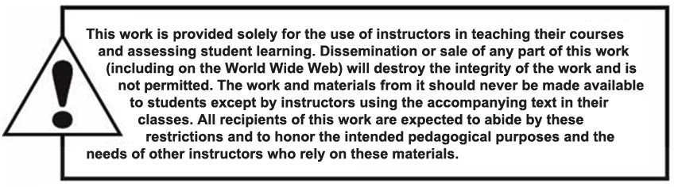
Copyright

