Slide 1
Evaluation of CRM
CRM ANALYTICS
CUSTOMER BASED VALUE
THE RELATIONSHIP LIFE CYCLE
LOYALTY
COMMUNICATION

Slide 2
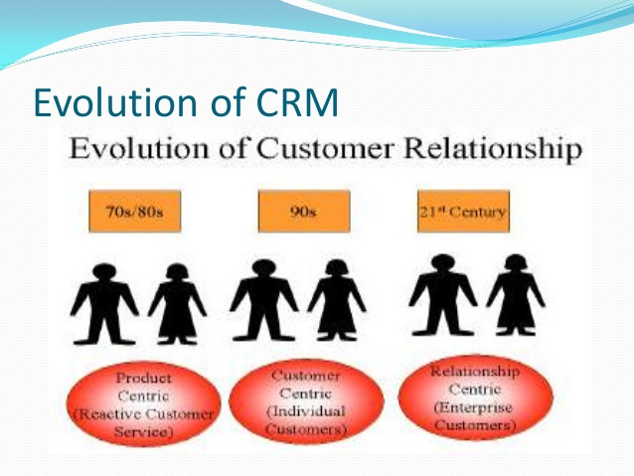

Slide 3
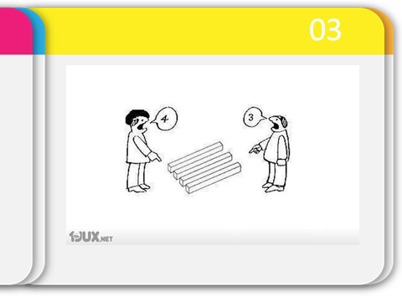
Empathy is important!

Slide 4
CRM
Customer relationship management (CRM) is a combination of people, processes and technology that seeks to understand a company’s customers.
It is an integrated approach to managing relationships by focusing on customer retention and relationship development.
A process that addresses all aspects of identfying customers, creating customer knowledge, building customer relationships and, shaping their perceptions of the organisation and its products (Payne & Frow,2005).

Slide 5
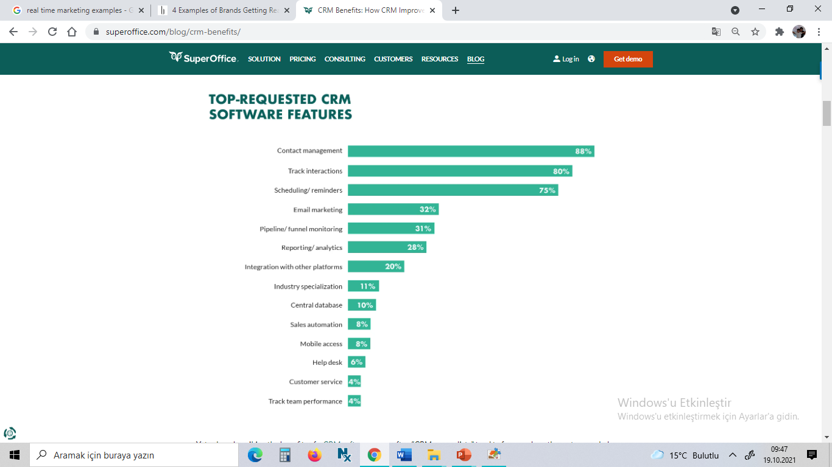

Slide 6
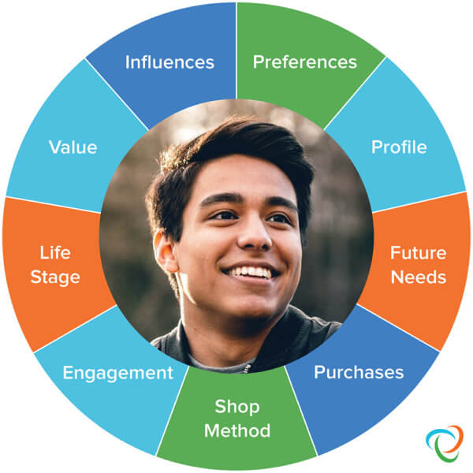
Customer data management

Slide 7
Customer data management (CDM)
is a set of administrative processes that allow data about customers and customer interactions from different source systems to be aggregated and normalized.
A primary goal of CDM is to provide all individuals within the same organization with a holistic, unified view of individual customers and customer segments.

Slide 8
CRM (customer relationship management) analytics
comprises all programming that analyzes data about customers and presents it to help facilitate and streamline better business decisions. CRM analytics can be considered a form of online analytical processing (OLAP) and may employ data mining
.

Slide 9
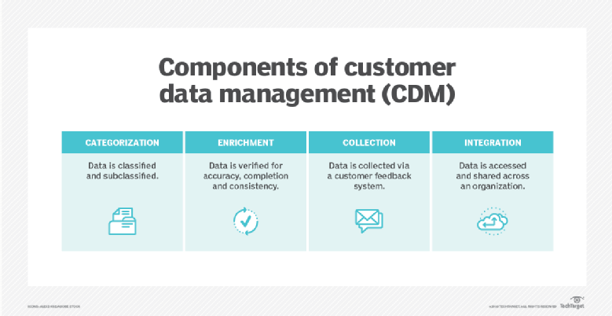
Effective CDM can provide organizations with multiple benefits such as greater visibility of customers and communication channels, higher customer satisfaction and retention rates, increased data quality and higher revenue
. Popular CDM vendors include Oracle, Hadoop, SAP and IBM.

Slide 10
Essential CRM Analytics
1.Customer feedback
«There’s nothing called a negative feedback, it simply helps you to move toward a positive direction»
2. Bird’s eye view of the customer is integral to understand his/her requirement and move ahead with a consistent response.
The CRM software should also capture the customer’s social presence, store visits, blog comments, online buying behavior. Simply put, the CRM should help you step into a customer’s ecosystem.

Slide 11
3. Track engagement levels to check customer preferences, offer popularity, partner visibility, and see how this action can be transformed into more customer share and increase in revenue.
No matter how hard you try to push your product, without proper customer engagement it can’t gain enough traction.

Slide 12
4. Measure and monitor escalation to rely more on FCR (first call resolution) through email, chat or phone. Customer satisfaction ramifies into ‘purchase’ and ‘problem resolution’.
The CRM analytics must measure the frequency of problems that arise with a specific offering, and at what stage of the customer life cycle they are more in number.
This helps you to fix the problem right at the manufacturing stage or something that pops up during the delivery or after first use.
These insights also bring out any issues that are beyond your scope.

Slide 13
5) Gauge (measure) customer lifetime value (LTV) to gain insights into the real value of a customer relationship.
Don’t confuse the sales records for better relationships because the profitability of a business may not be an indicator of customer satisfaction. On the other side, the high billing customer may not stay long with your business and the one who drops in occasionally may yield huge gains.
All that matters is the value of the deal and how often the customers are purchasing our products.

Slide 14
Agile CRM
All-in-one CRMs such as Agile CRM come with many inbuilt features for segmentation.
Geographic segmentation – Run a territory management check.
Demographic segmentation – Tag filtering for different companies – B2B, B2C, Services etc. to get an objectifiable metric.
Psychographic segmentation – analyzing buyer preferences and tracking the visitors to know where they spend most of the time.
Behavioral segmentation – How many times a particular task is done.

Slide 15
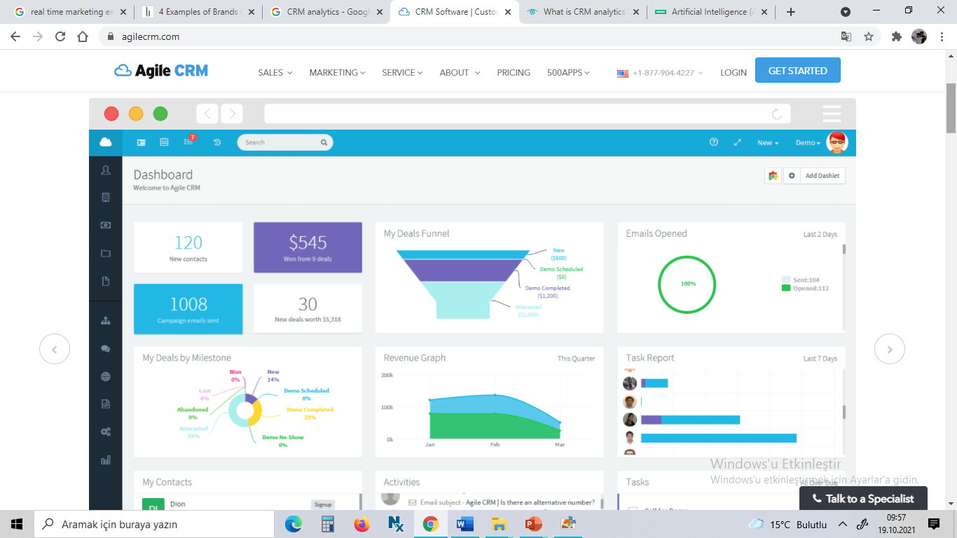
Agile CRM

Slide 16
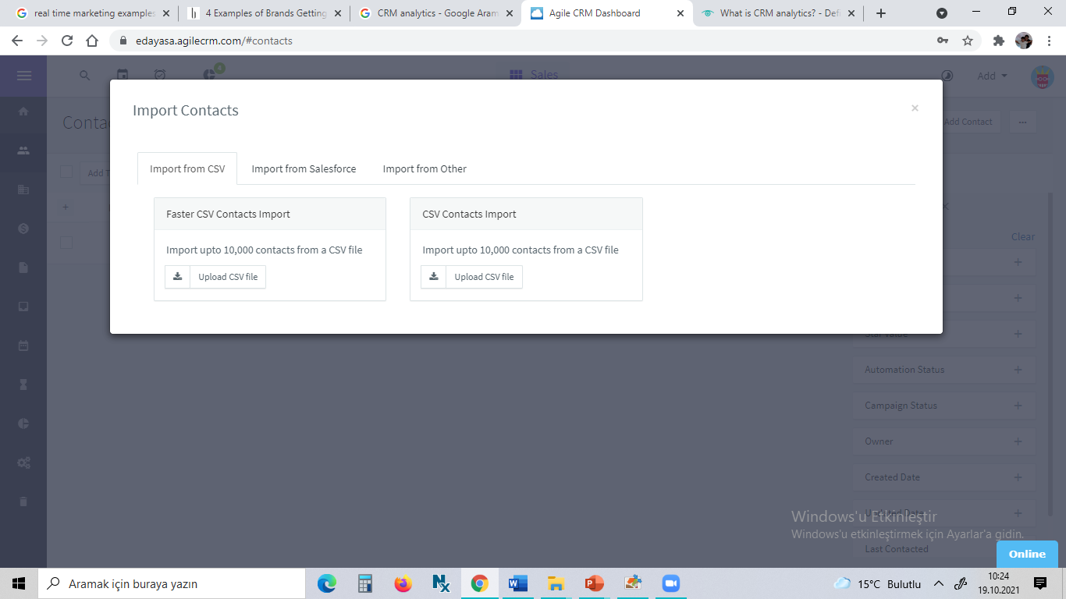

Slide 17
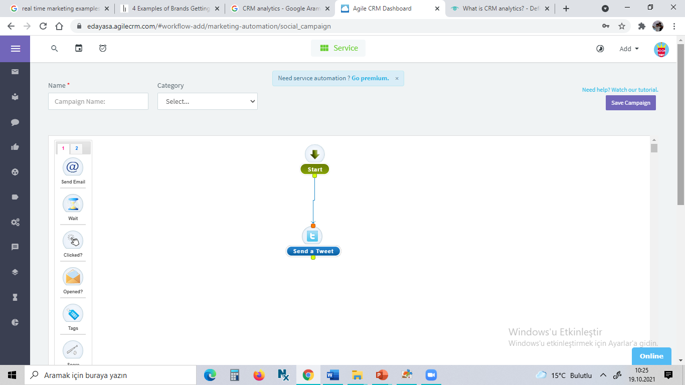

Slide 18

Real time marketing
the walls between customer and company are torn down.
Regis McKenna, adopted the concept of «real-time marketing» CRM targets the buildings of infrastructure which may be used to develop long term customer-supplier relationships.

Slide 19
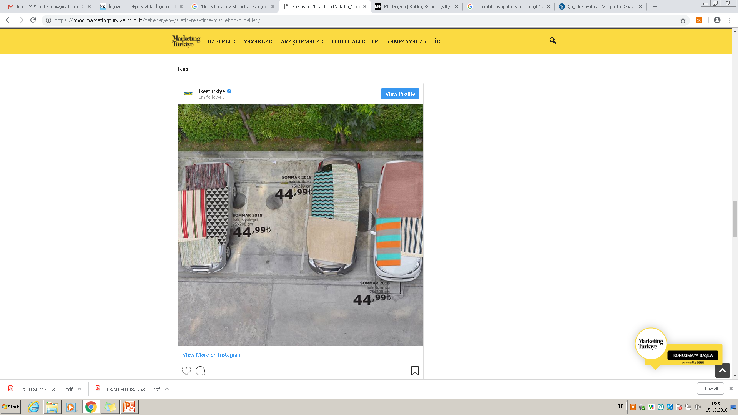

Slide 20
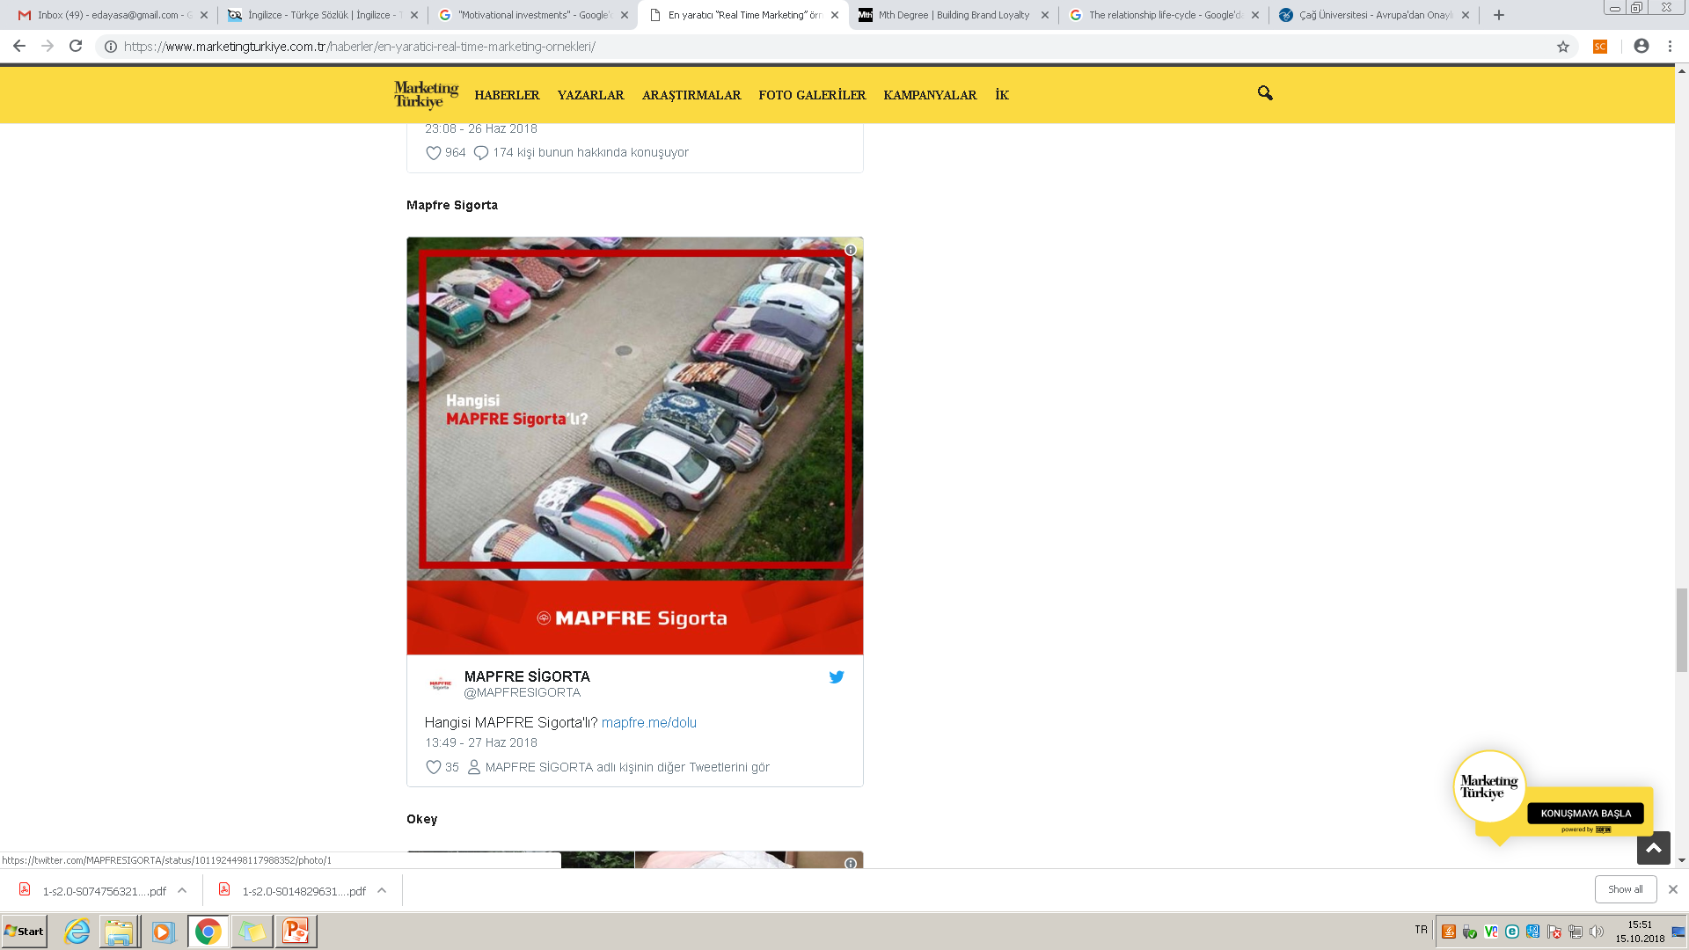

Slide 21
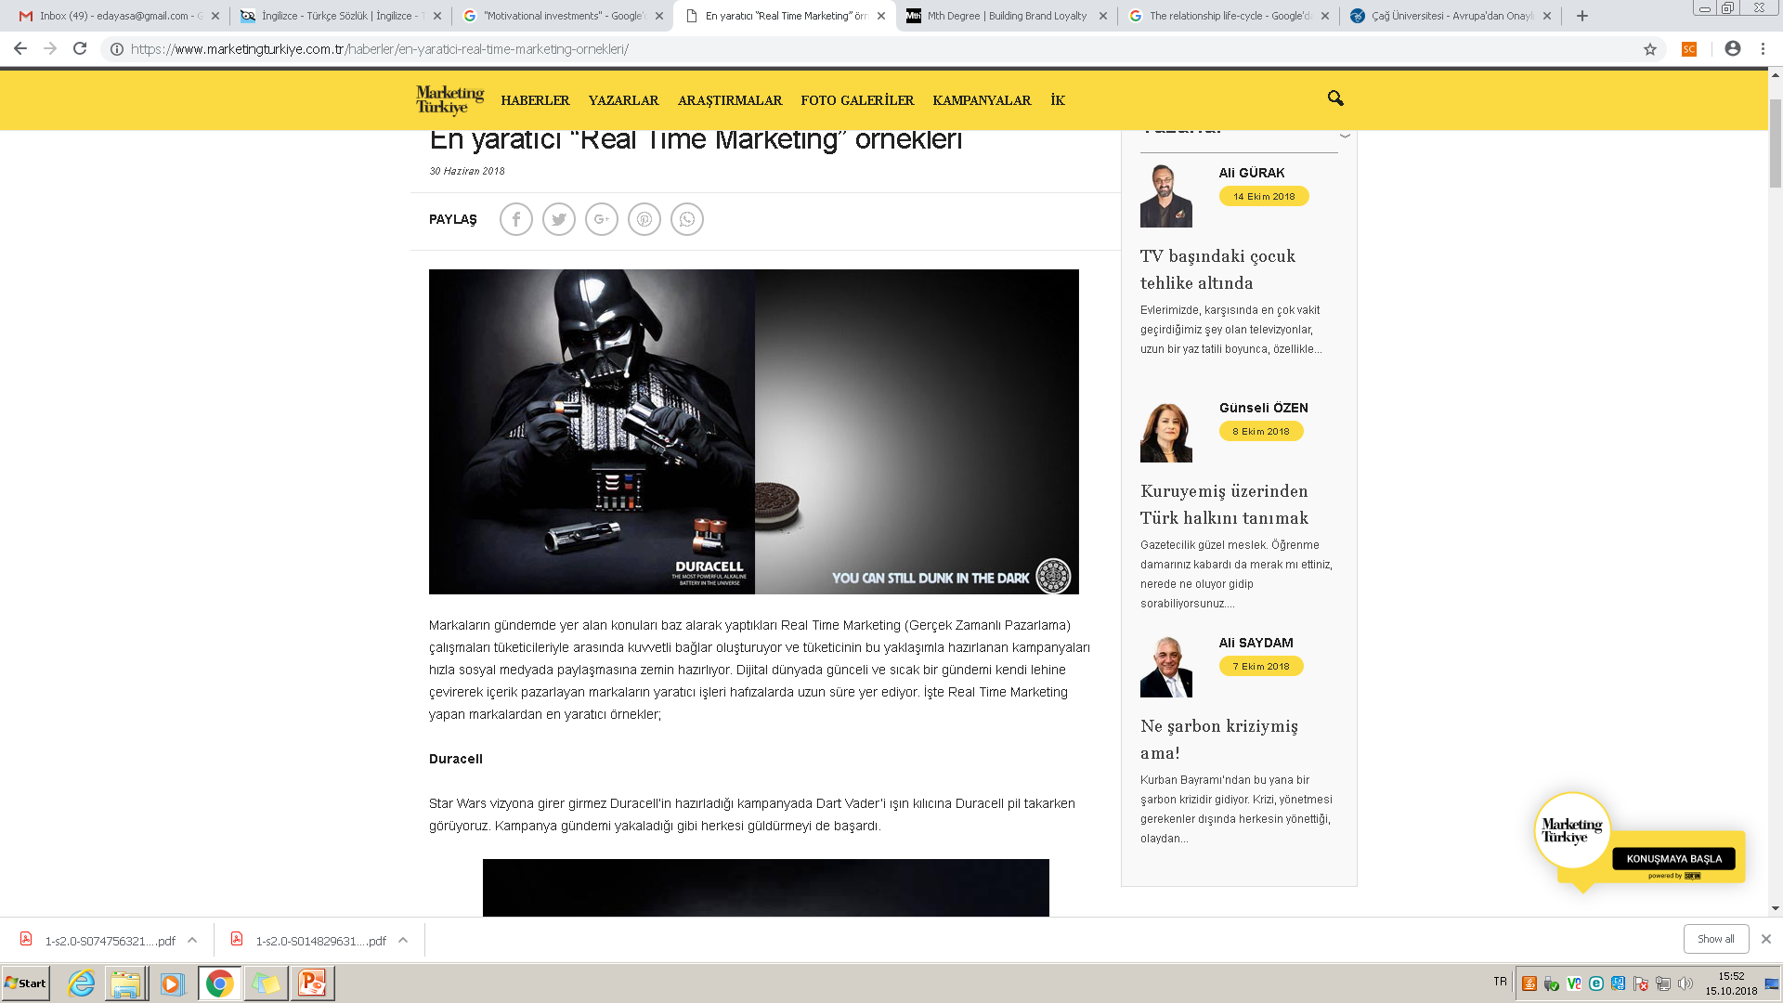

Slide 22
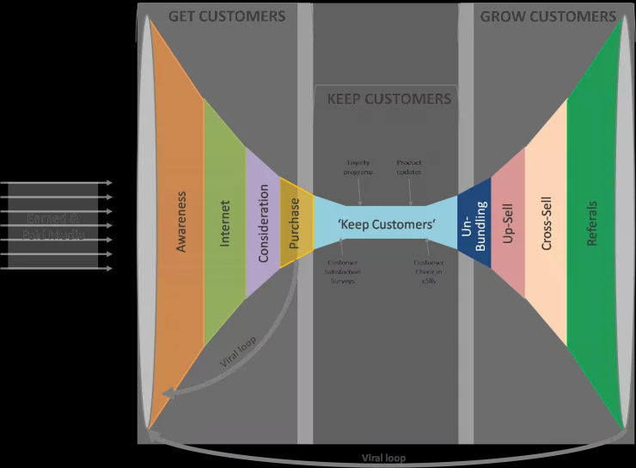
CRM

Slide 23
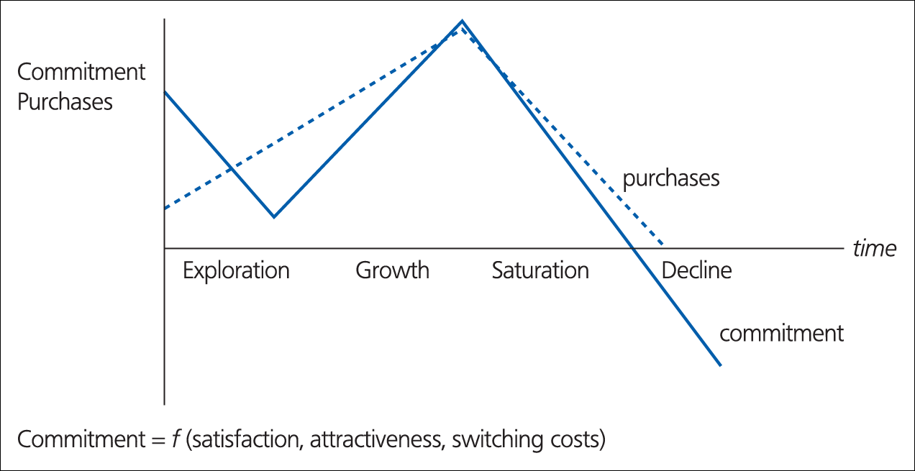
Figure 1.3 The relationship life-cycle
Source: Peelen et al. (1996).

Slide 24
The phases in relationship life cycle
Exploratory: the customer sees the promises made during communication fullfilled for the first time. The first impression make an important impression on the customer’s relations. The level of satisfaction is still relatively low the customers have little or no experience of the products or servicee supplier. The switching costs are still relativelly low.
The Growth: (3 months to 2 years): is charactarised by a sharp rise in the number of purchases. Customers would like to get to know the supplier’s products the satisfaction will be increased, the supplier is now examined more for its performance.

Slide 25
…
The Saturation (usually after more than two years) highest number of purchaes, from suppliers and and the highest commitment degree, not many changes are occuring in either, behavior of purchases, the goodwill has been built up with the customer. Trust grows, switching costs increase.
The Decline phase: number of transactions starts to decrease, at ant time in the phases customers may enter into decline phase. Type of customer and the reduction in the need for the products will be decreased. No longer they neey a product such this .

Slide 26
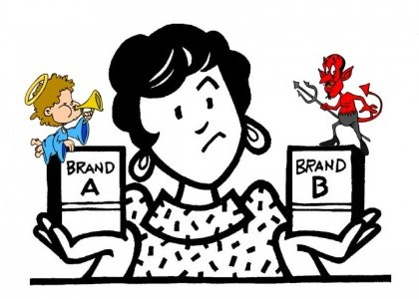
Loyalty
Is a deeply held commitment to rebuy or repatronise a preferred product-service consistently in the future, thereby causing repetitive same brand, or same brand- set purchasing, despite situational influences and marketing efforts having the potential to cause switching behaviour.
Switching behavior: where purchasing is seen as an either/or decision- either the customer stays with you (loyalty) or turns against you.

Slide 27
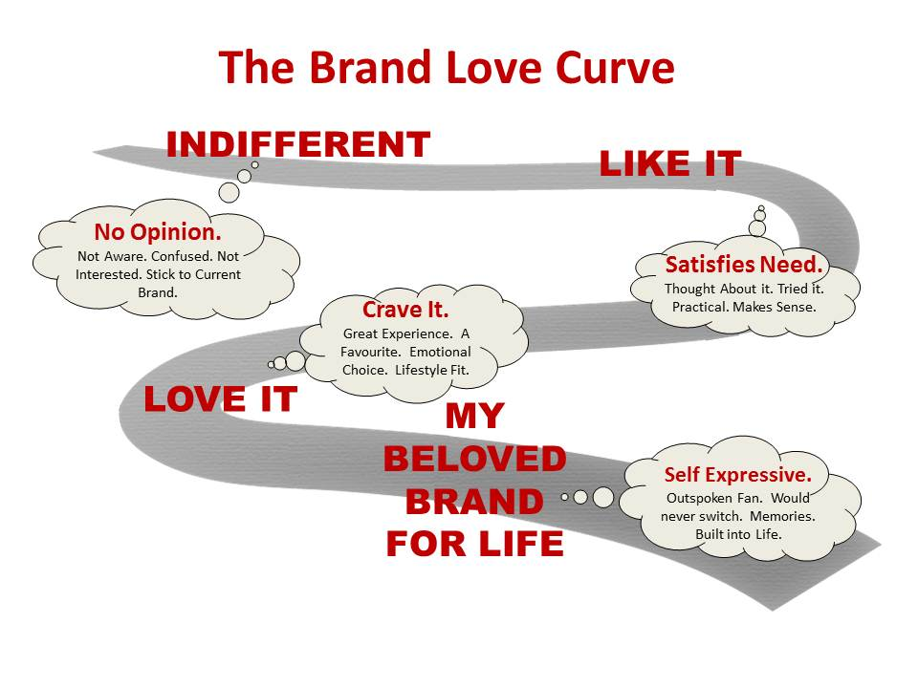

Slide 28
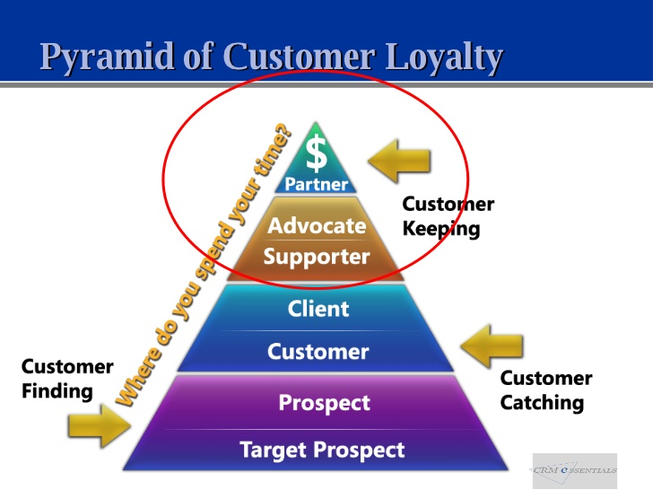

Slide 29
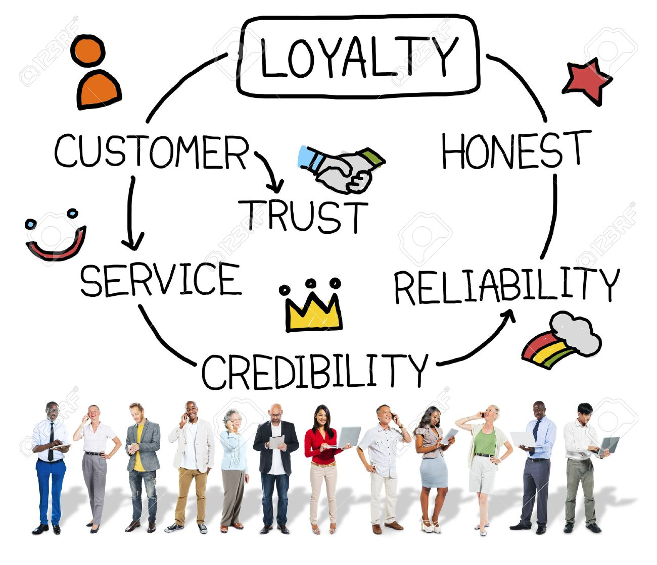

Slide 30
Antecedents to loyalty
There are two distinct viewpoints as to the antecedents to loyalty.
In Figure 3.2. loyalty is seen as more often built on ‘hard’ dimensions, such as value for money, convenience, reliability, safety and functionality, and that these are the prime drivers for product or service choice (Christopher, 1996, p. 60).

Slide 31
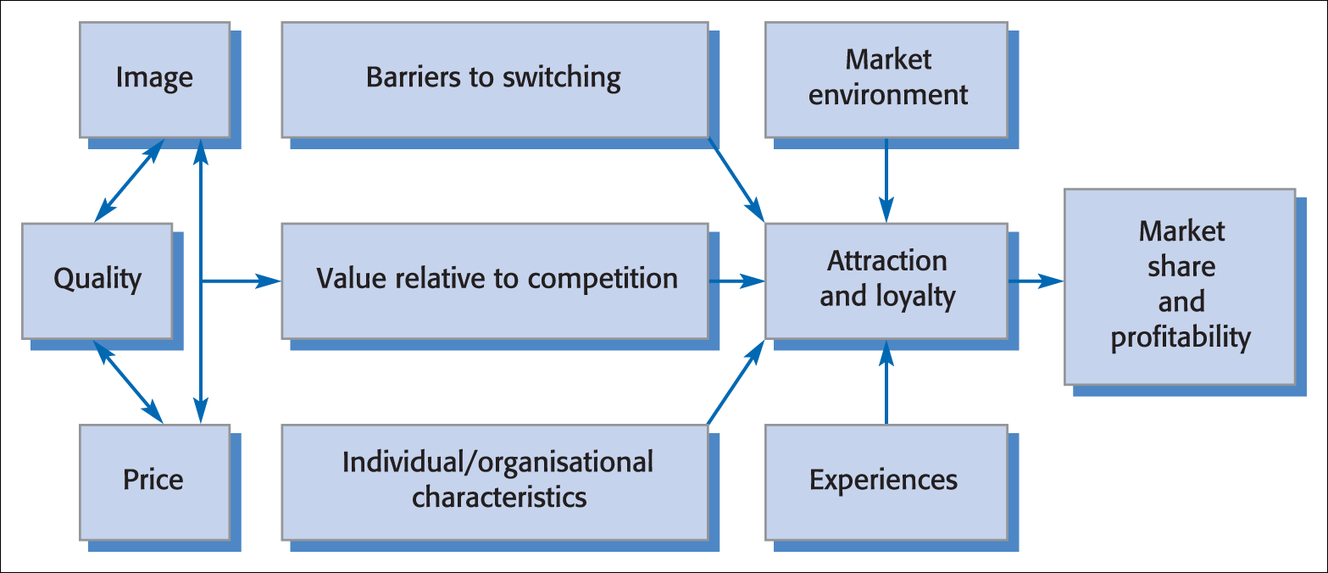
Figure 3.2 Customer loyalty: an integrated model
Source: Adapted from Fredericks and Salter, 1998, p. 64.

Slide 32
An alternative view by Dick and Basu (1994, p. 99).
‘softer’, more intangible factors such as emotion and satisfaction are seen to affect attitude in a decisive way.
Customer loyalty is viewed principally as a result of the bond between an individual’s relative attitude and repeat patronage, again mediated by social norms and situational influences or experiences (Figure 3.3).

Slide 33
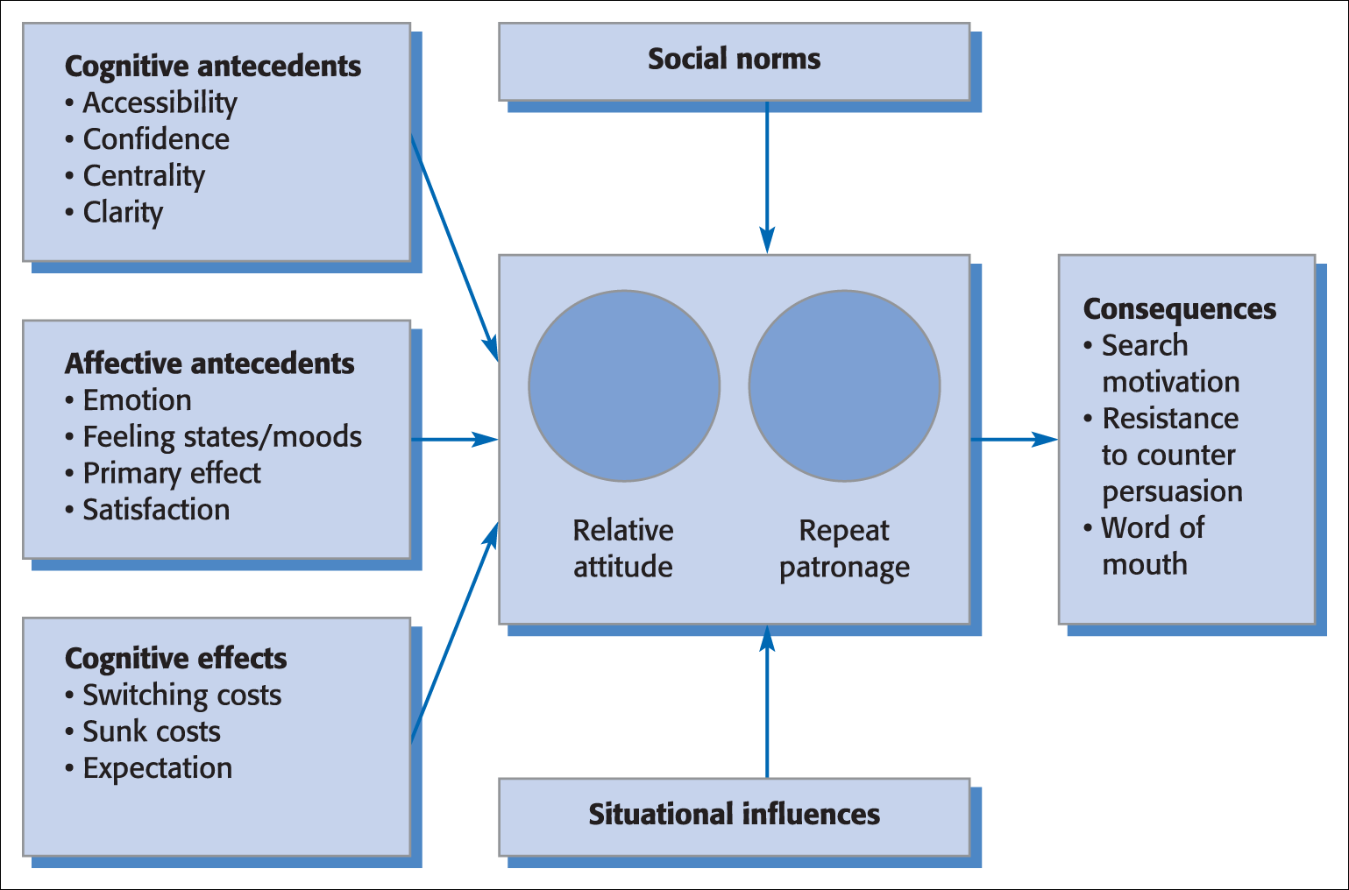
Figure 3.3 Framework for customer loyalty
Source: Adapted from Dick and Basu, 1994, p. 100.

Slide 34

Both models suggest that customer satisfaction sustains loyalty.
The presumption is that loyalty is built upon satisfaction derived from a positive differentiation achieved by providing superior customer service .

Slide 35
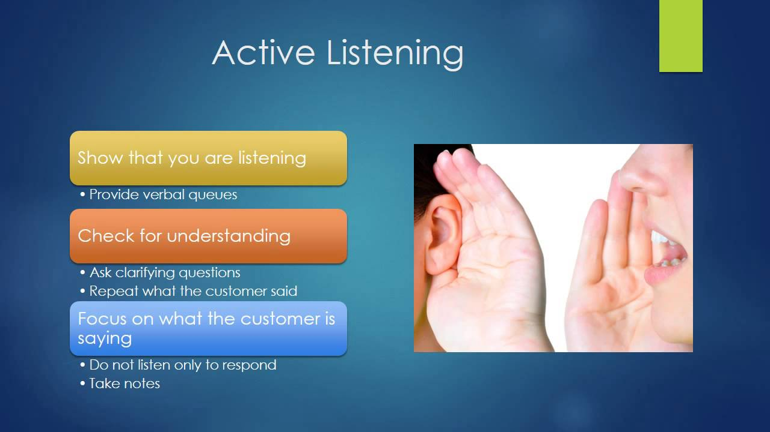

Slide 36
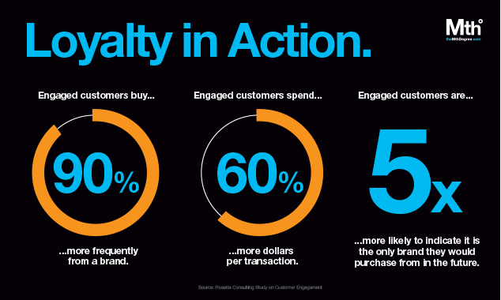
http://themthdegree.com/branding/building-brand-loyalty/

Slide 37
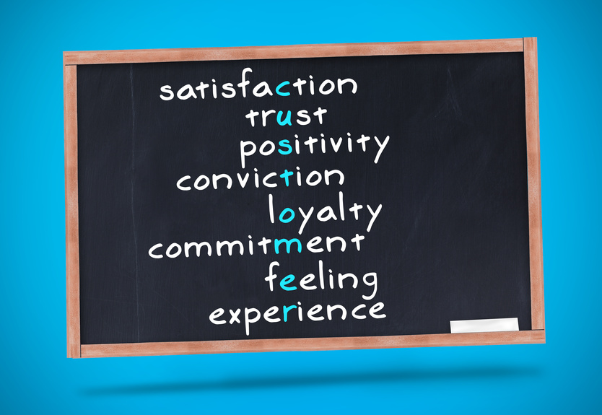
İt is important...

Slide 38
Some rules:
Get the right people to spread the message…
A successful word of mouth campaign depens not just on how many people get the message, but on who is spreading and receiving it.
The richest interactions between customer and product often take place during the purchase process.
Effective communication is important…
Today’s customers appear to have lower expectations for a one and done transactions!

Slide 39
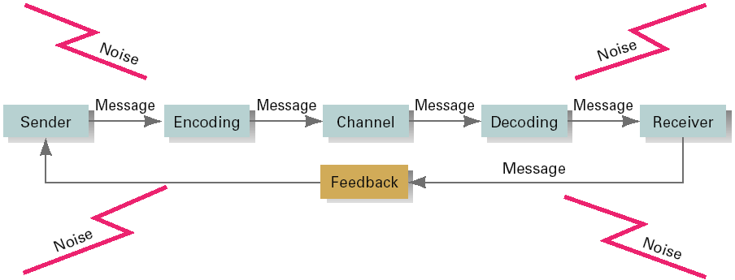
A Communication process

Slide 40
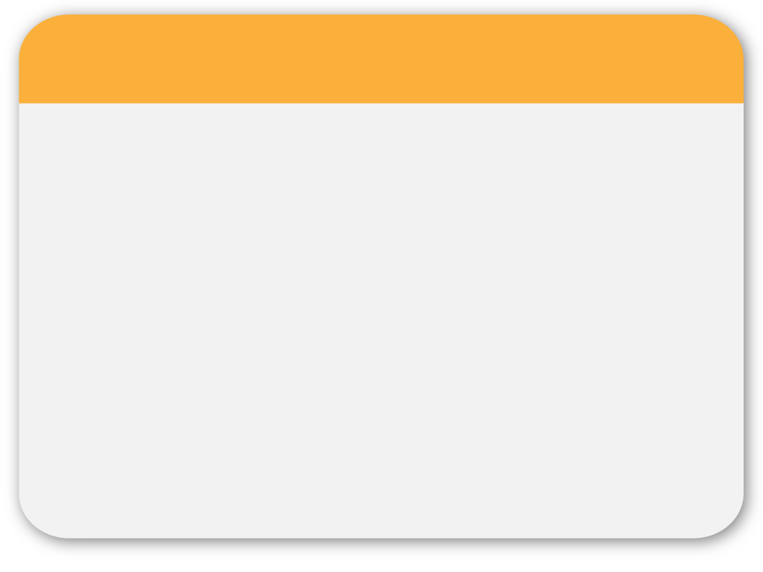
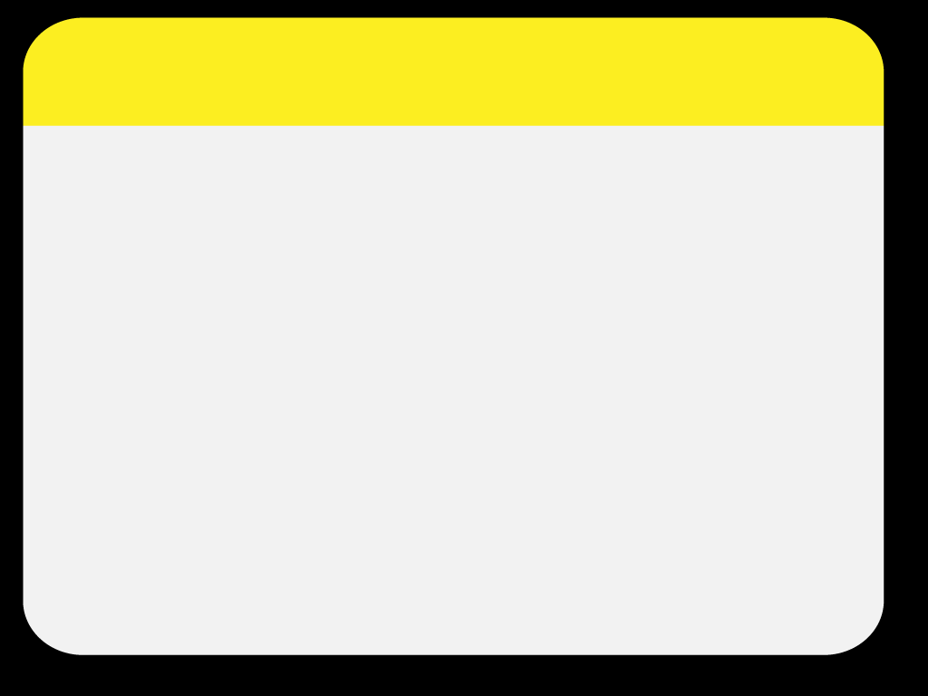
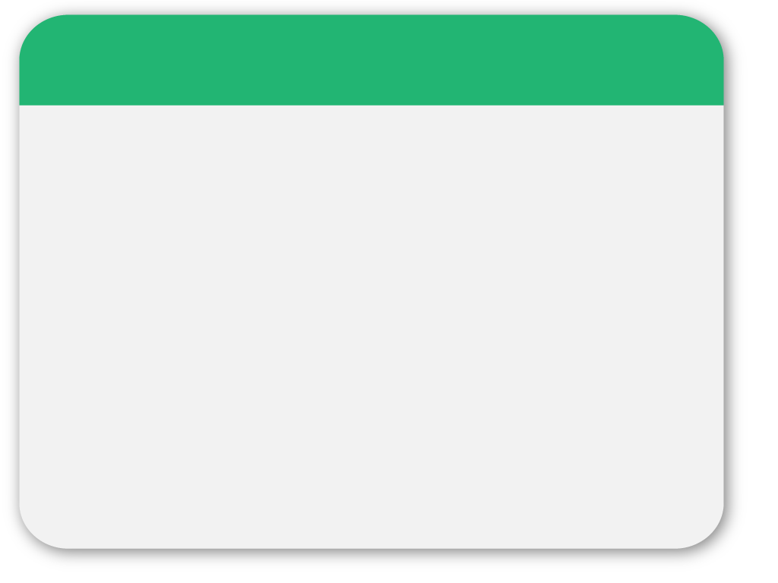
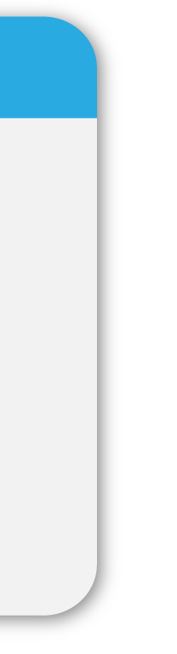
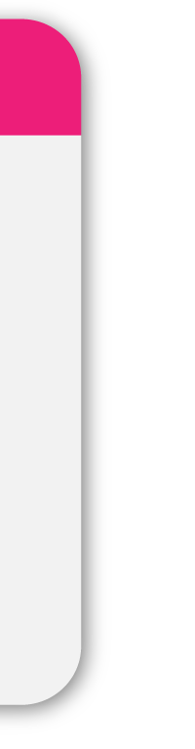
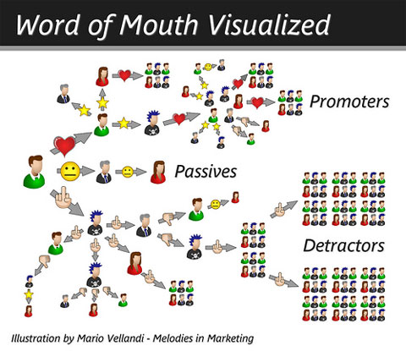
03
PowerPoint picture page
Notes:
40

Slide 41
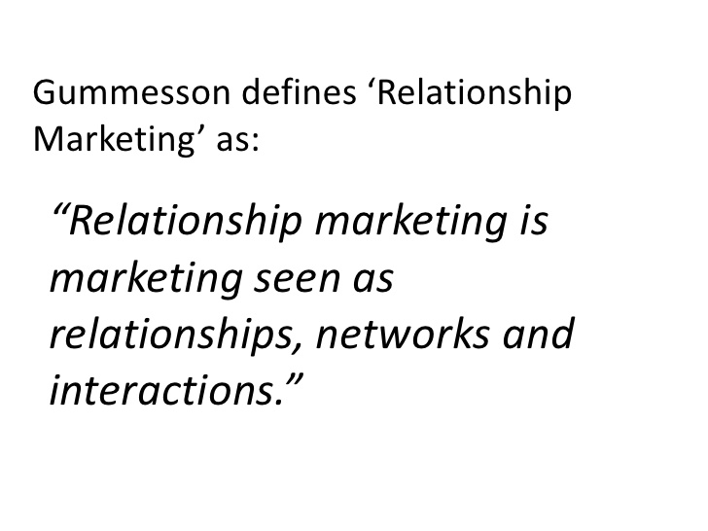

Slide 42
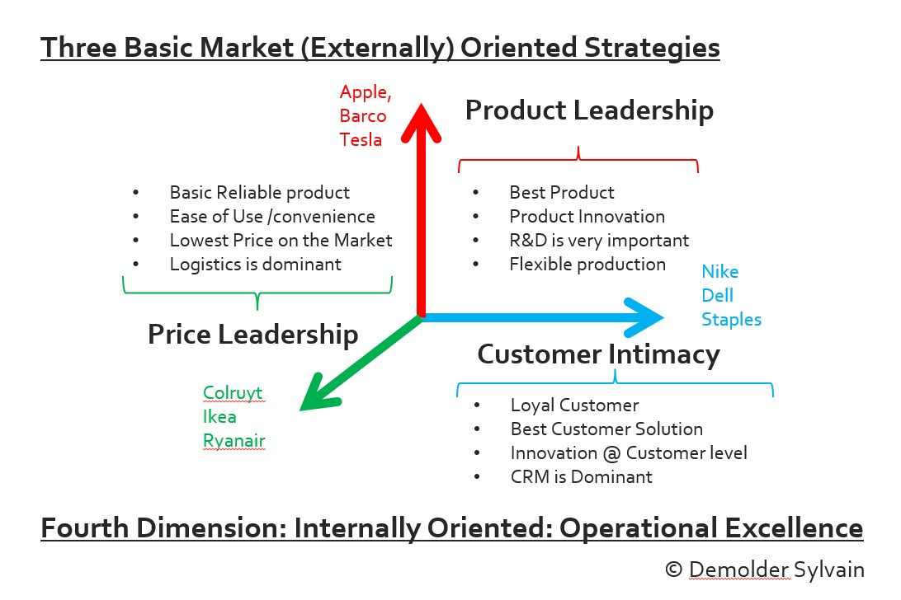
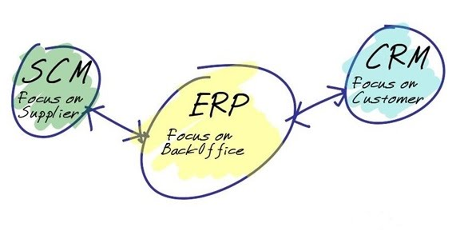
Treacy AND Wiersema (1996)
Company want to amaze its customers!, push the limits

Slide 43
