Slide 1
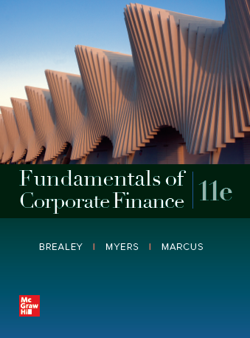
Fundamentals of Corporate Finance, 11th Edition
CHAPTER 5: The Time Value Of Money
© McGraw Hill LLC. All rights reserved. No reproduction or distribution without the prior written consent of McGraw Hill LLC.

Slide 2
Topics Covered
5.1 Future Values and Compound Interest.
5.2 Present Values.
5.3 Multiple Cash Flows.
5.4 Reducing the Chore of the Calculations: Part 1.
5.5 Level Cash Flows: Perpetuities and Annuities.
5.6 Reducing the Chore of the Calculations: Part 2.
5.7 Effective Annual Interest Rates.
5.8 Inflation & The Time Value of Money.

Slide 3
Future Values and Compound Interest 1
Future Value.
Amount to which an investment will grow after earning interest.
Simple Interest.
Interest earned only on the original investment.
Compound Interest.
Interest earned on interest (and the original investment).

Slide 4
Future Values and Compound Interest 2
Example — Simple Interest.
Interest earned at a rate of 6% for five years on a principal balance of $100.
Interest earned per year = 100 × .06 = $6.

Slide 5
Future Values and Compound Interest 3
Example — Simple Interest.
Interest earned at a rate of 6% for five years on a principal balance of $100.
Blank | Today | Blank | Blank | Future Years | Blank | Blank
Blank | 1 | 2 | 3 | 4 | 5 | 6
Interest Earned |  | $6 | 6 | 6 | 6 | 6
Value | $100 | 106 | 112 | 118 | 124 | 130
Value at the end of Year 5 = $130.

Slide 6
Future Values and Compound Interest 4
Example — Compound Interest.
Interest earned at a rate of 6% for five years on the previous year’s balance.
Interest earned per year = prior year balance × .06.

Slide 7
Future Values and Compound Interest 5
Example — Compound Interest.
Interest earned at a rate of 6% for five years on the previous year’s balance.
 | Today |  |  | Future Years
 |  | 1 | 2 | 3 | 4 | 5
Interest Earned |  | $6.00 | 6.36 | 6.74 | 7.15 | 7.57
Value | $100.00 | 106.00 | 112.36 | 119.10 | 126.25 | 133.82
Value at the end of Year 5 = $133.82.

Slide 8
Future Values and Compound Interest 6
Future Value = F V.

Slide 9
Future Values and Compound Interest 7
Example — Future Value.
What is the future value of $100 if interest is compounded annually at a rate of 6% for five years?

Slide 10
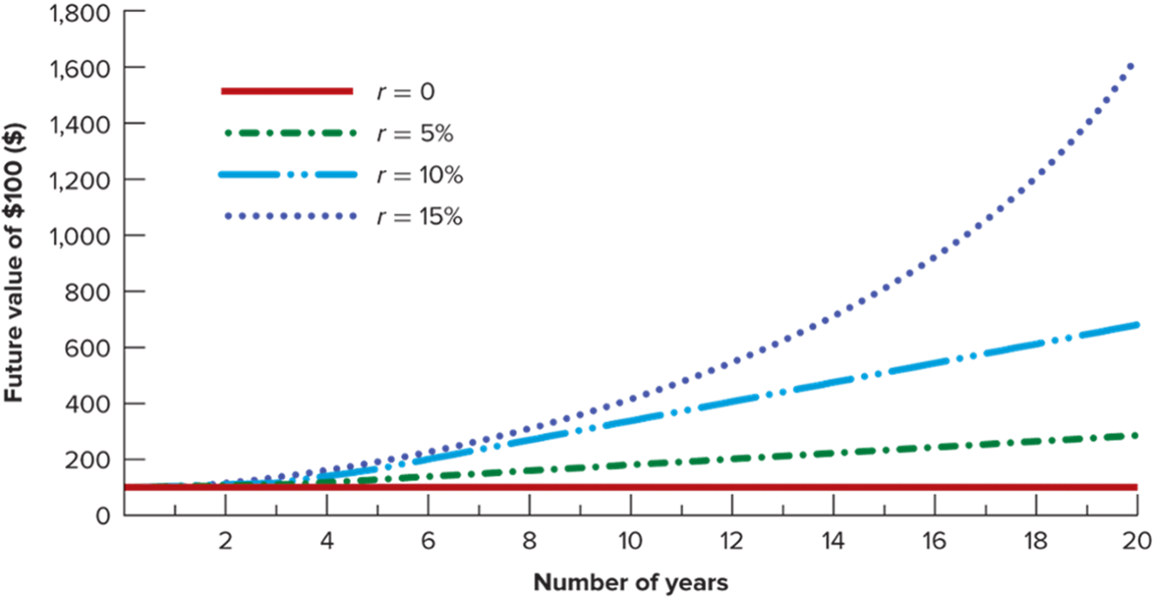
Future Values and Compound Interest 8
Access the text alternative for these images.

Slide 11
Manhattan Island Sale
Peter Minuit bought Manhattan Island for $24 in 16 26. Was this a good deal?
To answer, determine what $24 is worth in the year 2016, compounded at 8%.
Note: The value of Manhattan Island land is well below this figure…

Slide 12
Present Values 1
Access the text alternative for these images.

Slide 13
Present Values 2
Present value = P V.

Slide 14
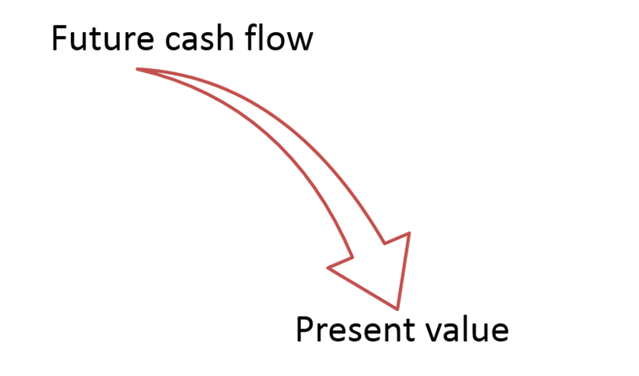
Present Values 3
Discounted Cash Flow (D C F).
Method of calculating present value by discounting future cash flows.

Slide 15
Present Values 4
Example.
You just bought a new computer for $3,000. The payment terms are 2 years same as cash. If you can earn 8% on your money, how much money should you set aside today to make the payment due in two years?

Slide 16
Present Values 5
Discount Factor = D F = P V of $1.
Discount factors can be used to compute the present value of any cash flow.

Slide 17
What is the future value of $10,000 on deposit for 2 years at 6% simple interest?
A) $10,600 B) $11,236 C) $11,200 D) $13,382.26
What is the future value of $10,000 on deposit for 2 years at 6% compound interest?

Slide 18
How much interest will be earned in the next year on an investment paying 12% compounded annually if $100 was just credited to the account for interest?

Slide 19
Assume the total expense for your current year in college equals $20,000. How much would your parents have needed to invest 21 years ago in an account paying 8% compounded annually to cover this amount?

Slide 20
An investment of $100 pays interest of 2.5% per quarter. What will be the value of this investment at the end of 3 years?

Slide 21
A car’s price is currently $20,000 and is expected to rise by 4% a year. If the interest rate is 6%, how much do you need to put aside today to buy the car one year from now?

Slide 22
What will be the approximate population of the United States, if its current population of 300 million grows at a compound rate of 2% annually for 25 years?

Slide 23
What will be the monthly payment on a $75,000 30-year home mortgage at 1% interest per month?

Slide 24
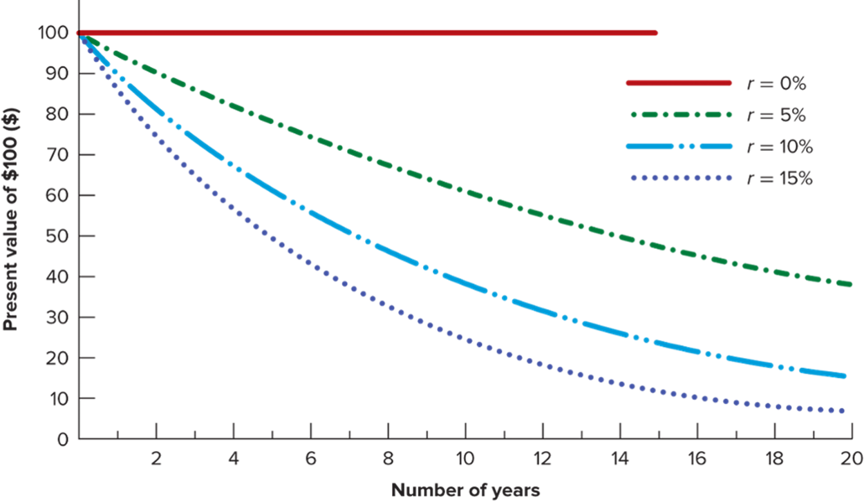
Present Values 6
Access the text alternative for these images.

Slide 25
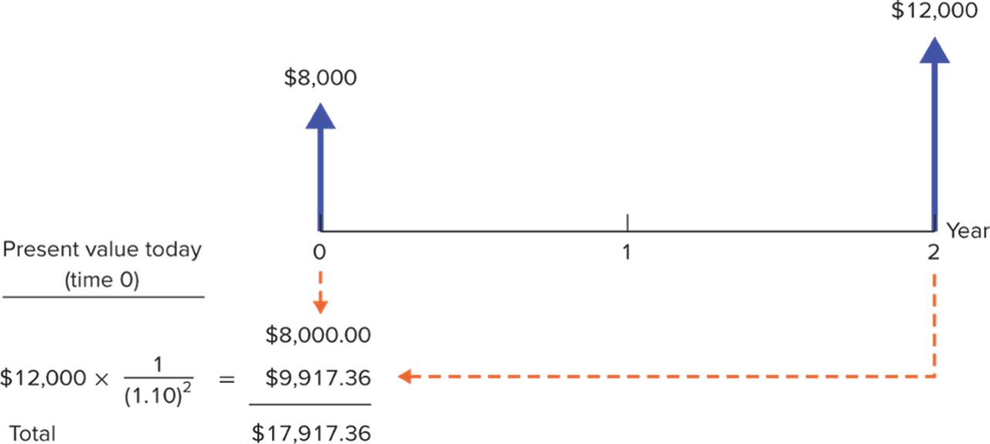
The Statement of Cash Flows
Drawing a timeline helps to calculate the present value of the payments ($8,000 now, $12,000 in two years).
Access the text alternative for these images.

Slide 26
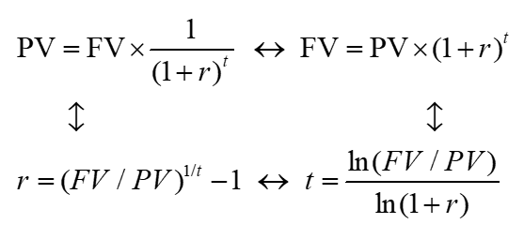
Time Value of Money (Applications) 1
The P V formula has many applications. Given any variables in the equation, you can solve for the remaining variable.
Access the text alternative for these images.

Slide 27
Time Value of Money (Applications) 2
Example.
The U.S. Treasury borrowed money for 10 years, selling each I O U for $777.40. What is the interest rate?

Slide 28
Time Value of Money (Applications) 3
Value of Free Credit.
Implied Interest Rates.
Internal Rate of Return.
Time necessary to accumulate funds.

Slide 29
Future Value of Multiple Cash Flows
Example.
You invest $1,200 in the bank now, and another $1,400 in 1 year. At 8% rate of interest, how much will you be able to spend on a computer in 2 years?
F V₁ = $1,400 × (1.08) = $1,512.00
F V₂ = $1,200 × (1.08 )² = $1,399.68
Total F V = $2,911.68

Slide 30
Present Value of Multiple Cash Flows 1
P Vs can be added together to evaluate multiple cash flows.

Slide 31
Present Value of Multiple Cash Flows 2
Example.
Your auto dealer gives you the choice to pay $15,500 cash now or make three payments: $8,000 immediately and $4,000 at the end of the next two years. If your cost of money is 8%, which do you prefer?

Slide 32
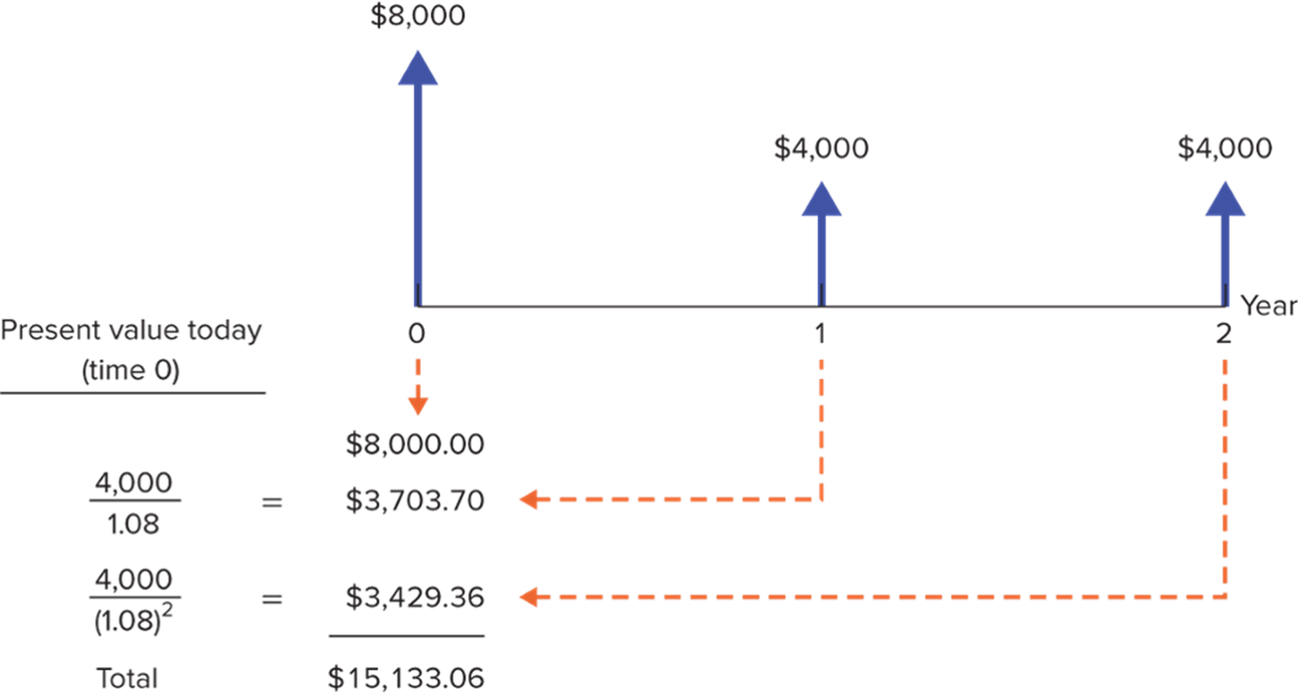
Present Value of Multiple Cash Flows 3
Access the text alternative for these images.

Slide 33
Calculations: Part 1 – Spreadsheets
Example.
Your auto dealer gives you the choice to pay $15,500 cash now or make three payments: $8,000 immediately and $4,000 at the end of the next two years. If your cost of money is 8%, which do you prefer?
Finding the Present Value of Multiple Cash Flows by Using a Spreadsheet
Blank | A | B | C | D
1 | Time until C F | Cash Flow | Present Value | Formula in Column C
2 | 0 | 8000 | $8,000.00 | =P V ($B$6,A2,0,−B2)
3 | 1 | 4000 | $3,703.70 | =P V ($B$6,A3,0, −B3)
4 | 2 | 4000 | $3,429.36 | =P V ($B$6,A4,0, −B4)
5 | SUM: | Blank | $15,133.06 | =SUM(C2:C4)
6 | Discount rate: | .08 | Blank | Blank

Slide 34
Calculations: Part 1 – Financial Calculators 1
n = number of periods.
i = interest rate, expressed as a percentage (not a decimal).
P V = present value.
P M T = amount of any recurring payment.
F V = future value.

Slide 35
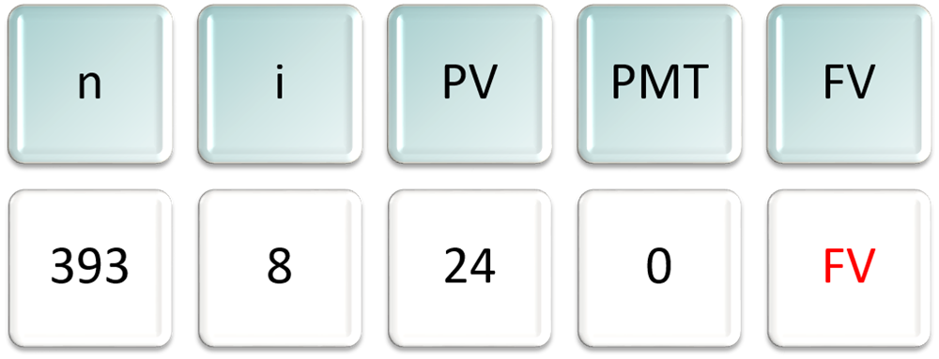
Calculations: Part 1 – Financial Calculators 2
Example.
What is the future value of Peter Minuit’s $24 investment if invested at 8% for 393 years?
Enter each number then push the corresponding financial function key. Compute (C P T) F V and you will get −$327.90 trillion. (Why is there a minus sign?).

Slide 36
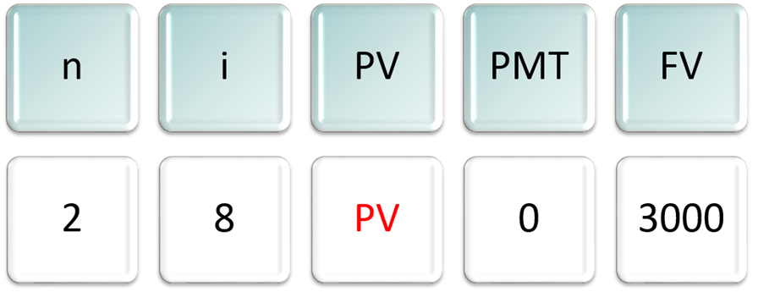
Calculations: Part 1 – Financial Calculators 3
Example.
You just bought a new computer for $3,000. The payment terms are 2 years same as cash. If you can earn 8% on your money, how much money should you set aside today in order to make the payment when due in two years?
Enter known variables and compute (C P T) P V → −$2,572.02.

Slide 37
Perpetuities and Annuities 1
Perpetuity.
A stream of level cash payments that never ends.
Annuity.
Level stream of cash flows at regular intervals with a finite maturity.

Slide 38
Perpetuities and Annuities 2
P V of Perpetuity Formula.
C = cash payment.
r = interest rate.

Slide 39
Perpetuities and Annuities 3
Example.
In order to create an endowment, which pays $100,000 per year forever, how much money must be set aside today in the rate of interest is 10%?

Slide 40
Perpetuities and Annuities 4
Example.
If the first perpetuity payment will not be received until three years from today, how much money needs to be set aside today?

Slide 41
Perpetuities and Annuities 5
P V of Annuity Formula.
C = cash payment.
r = interest rate.
t = Number of years cash payment is received.

Slide 42
Perpetuities and Annuities 6
P V of Annuity Factor (P V A F).
The present value of $1 a year for each of t years.

Slide 43
Perpetuities and Annuities 7
Example.
You are purchasing a car. You are scheduled to make 3 annual installments of $8,000 per year. Given a rate of interest of 10%, what is the price you are paying for the car (that is, what is the P V)?

Slide 44
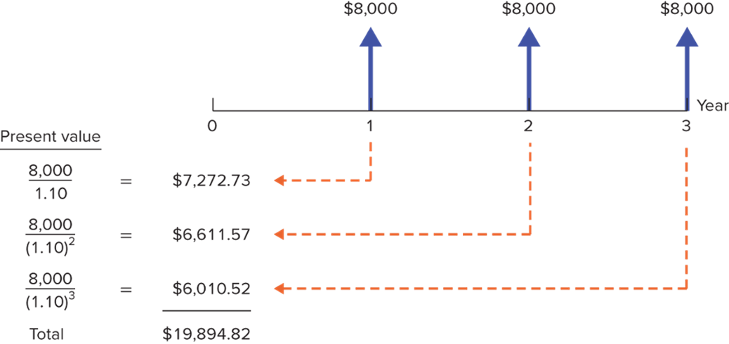
Perpetuities and Annuities 8
Example.
You are purchasing a car. You are scheduled to make 3 annual installments of $8,000 per year. Given a rate of interest of 10%, what is the price you are paying for the car (that is what is the P V)?
Access the text alternative for these images.

Slide 45
Perpetuities and Annuities 9
Applications.
Value of payments.
Implied interest rate for an annuity.
Calculation of periodic payments.
Mortgage payment.
Annual income from an investment payout.
Future Value of annual payments.

Slide 46
Perpetuities and Annuities 10
Example — Future value of annual payments.
You plan to save $3,000 every year for 4 years. Given an 8% rate of interest, what will be the F V of your account?

Slide 47
Perpetuities and Annuities 11
Example.
You are purchasing a home and are scheduled to make 30 annual installments of $10,000 per year. Given an interest rate of 5%, what is the price you are paying for the house (that is, P V)?

Slide 48
Perpetuities and Annuities 12
Example— Future value of annual payments.
You plan to save for 50 years and then retire. Given a 10% rate of interest, if you desire to have $500,000 at retirement, how much must you save each year?

Slide 49
Annuities Due 1
Annuity Due.
Level stream of cash flows starting immediately.
How does it differ from an ordinary annuity?
P V _{Annuity Due} = P V _{Annuity} × (1 + r).
How does the future value differ from an ordinary annuity?
F V _{Annuity Due} = F V _{Annuity} × (1 + r).

Slide 50
Annuities Due 2
Example.
Suppose you invest $429.59 annually at the beginning of each year at 10% interest. After 50 years, how much would your investment be worth?
F V _{AD} = F V _{Annuity} × (1 + r).

Slide 51
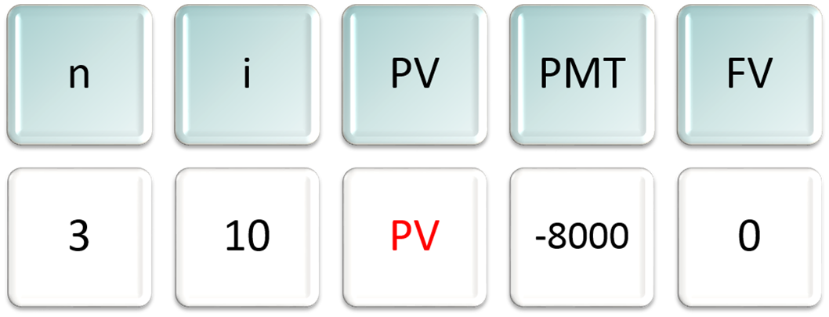
Calculations: Part 2 – Financial Calculators 1
Example.
You are purchasing a car with 3 annual installments of $8,000 per year. At 10% interest, what is the price of the car (that is, P V)?
To get the final answer, compute (C P T) P V and you will get −$19,894.82.

Slide 52
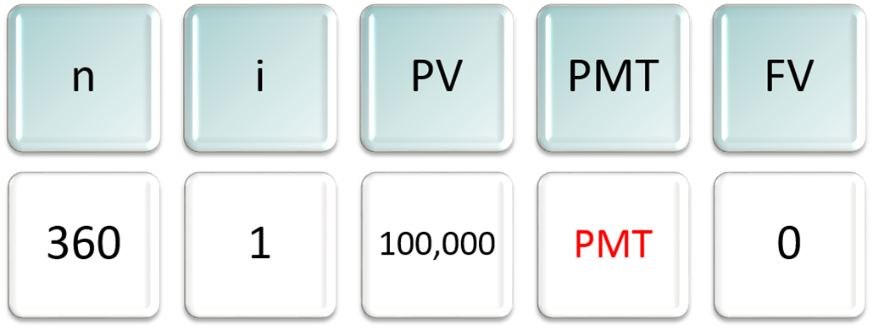
Calculations: Part 2 – Financial Calculators 2
Example.
You are taking out a mortgage for $100,000. You will pay it back over 30 years paying 1% per month. What is your monthly payment?
Compute (C P T) P M T to get −$1,028.61.

Slide 53
Effective Interest Rates 1
Effective Annual Interest Rate.
Interest rate that is annualized using compound interest.
Annual Percentage Rate.
Interest rate that is annualized using simple interest.

Slide 54
Effective Interest Rates 2
Annual Percentage Rate (A P R).
Effective Annual Interest Rate (E A R).
Where- M R = monthly interest rate.

Slide 55
Effective Interest Rates 3
Example.
Given a monthly rate of 1%, what is the Effective Annual Rate(E A R)? What is the Annual Percentage Rate (A P R)?

Slide 56
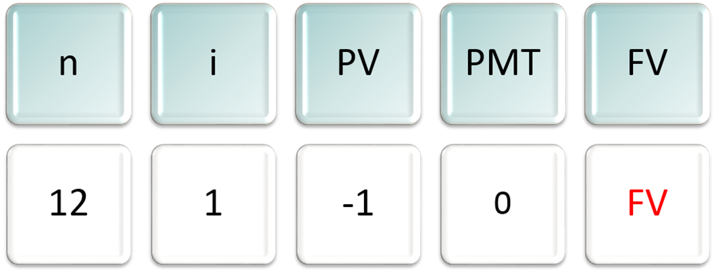
E A R and Financial Calculators
Example.
Given a 12% A P R, what is the Effective Annual Rate, given monthly compounding?
Compute (C P T) F V to get 1.1268 → E A R = .1268, or 12.68%.

Slide 57
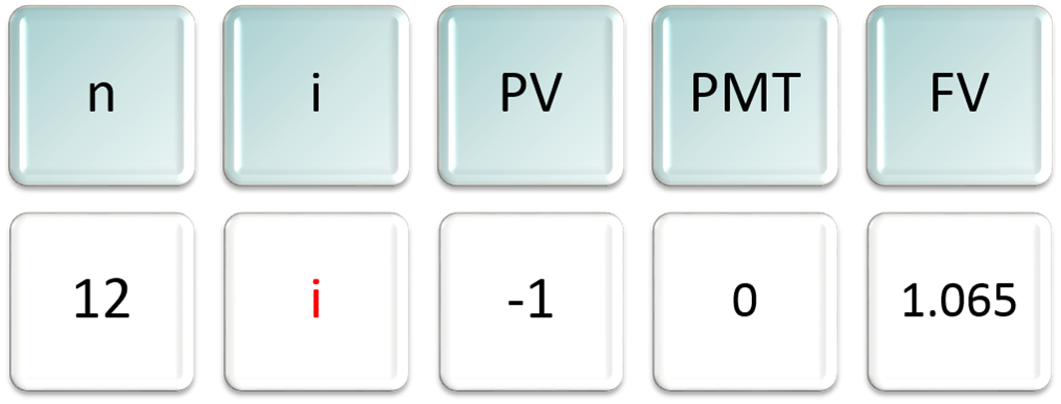
A P R and Financial Calculators
Example.
Given a 6.50 % E A R what is the A P R, given monthly compounding?
Compute (C P T) i to get .5262. Multiply by 12 → A P R = .0631, or 6.31%

Slide 58
Inflation 1
Inflation.
Rate at which (overall) prices increase.
Nominal Interest Rate.
Rate at which money invested grows.
Real Interest Rate.
Rate at which purchasing power grows.

Slide 59
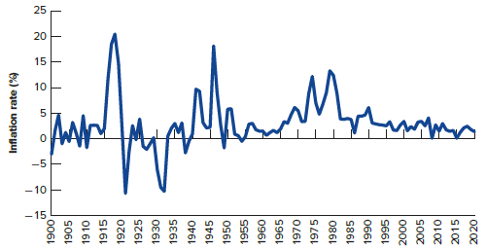
Inflation 2
Annual U.S. Inflation Rates from 1900 – 2015.
Access the text alternative for these images.

Slide 60
Inflation 3
Exact relationship.
Approximation formula.
Real interest rate ≈ nominal interest rate − inflation rate.

Slide 61
Inflation 4
Example.
If the interest rate on one-year government bonds is 6.0% and the inflation rate is 2.0%, what is the real interest rate?
Approximation = .06 − .02 = .04 or 4.0%.

Slide 62
Inflation 5
Remember:
Current dollar cash flows must be discounted by the nominal interest rate.
Real cash flows must be discounted by the real interest rate.

