Slide 1

Past Simple Tense
Verb ‘to be’
was-were

Slide 2





We use verb to be ‘was- were’ to show the status and characteristics of something or someone in the past.
NOW PAST
My grandmother is old now. My grandmother was young 50 years ago.
We are university students right now. We were high school students last year.

Slide 3
Verb "to be" in past simple
WAS NOT
(WASN’T)
WERE NOT
(WEREN’T)
Was
(I, HE, SHE, IT)
Were
(YOU, WE, THEY)

Slide 4
Positive Form:
I was happy living there.
You were always so kind to me.
He was the best runner in the school.
She was the first woman in space.
It was unusual to see Emily crying.
They were stuck on the bus for hours.

Slide 5
‘was’ or ‘were’?
a) When he got home he ______ very tired.
was
b) They ______ the best of friends.
were
c) I ______ a successful chef.
was

Slide 6
‘was’ or ‘were’?
a) When I saw her, she ______ so upset.
was
b) We ______ happy because we won the competition.
were
c) I ______ at the dormitory last night.
was

Slide 7
Negative Form:
I wasn’t happy with the news.
They weren’t at the meeting yesterday.
He wasn’t a student.
She wasn’t at work 2 hours ago.
It wasn’t an interesting book.
We weren’t ready for the exams.

Slide 8
Question Form:
Was she late for work again this morning?
Yes, she was. No, she wasn’t.
Was the test difficult for you?
Yes, it was. No, it wasn’t
Were your parents strict when you were young?
Yes, they were. No, they weren’t.
Were you on vacation last week ?
Yes, I am. No, I am not.
How was your presentation ?
It was impressing.
Where were you yesterday?
I was at work.
Why were you sad this morning?
Because I was alone at home.

Slide 9
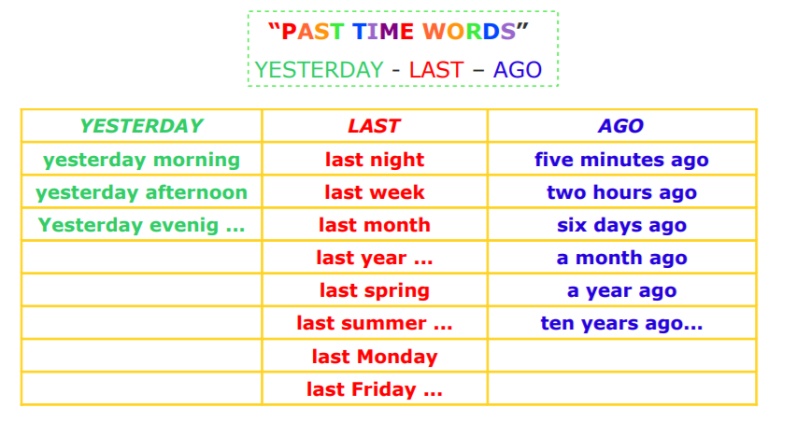

Slide 10
Make questions for underlined words.
They were in the park 2 days ago.
Where were they 2 days ago?
They were in the park 2 days ago.
When were they in the park?
Our sister was 7 last December.
How old was your sister last December?
Their house was old but nice.
How was their house?

Slide 11
Let’s practice!
Go to join.quizizz.com
Enter the code 4619 9985

