Slide 1
Valuing Bonds
Slides by Matthew Will

Slide 2
Topics Covered
Using the Present Value Formula to Value Bonds
How Bond Prices Vary with Interest Rates
The Term Structure of Interest Rates
Explaining the Term Structure
Real and Nominal Rates of Interest
The Risk of Default
Notes:
3
2
2
2
2
2

Slide 3
Terminology
Bond
Security that obligates the issuer to make specified payments to the bondholder.
Face value (par value or principal value)
Payment at the maturity of the bond.
Coupon
The interest payments made to the bondholder.
Coupon rate
Annual interest payment, as a percentage of face value.
Notes:
3
The coupon rate IS NOT the discount rate used in the present value calculations.
The coupon rate merely tells us what cash flow the bond will produce.
Since the coupon rate is listed as a %, this misconception is quite common.

Slide 4
PV Formula to Value a Bond
The price of a bond is the present value of all cash flows generated by the bond (i.e. coupons and face value) discounted at the required rate of return
Note: “cpn” is commonly used as an abbreviation for “coupon”

Slide 5
PV Formula to Value a Bond Continued
Example: France
In October 2014 you purchase 100 euros of bonds in France that pay a 4.25% coupon every year. If the bond matures in 2018 and the YTM is 0.15%, what is the value of the bond?

Slide 6
PV Formula to Value a Bond Continued 2
PV(bond) = PV(annuity of coupons) + PV(principal)

Slide 7
PV Formula to Value a Bond Continued 3
Example
If today is October 1, 2015, what is the value of the following bond? An IBM bond pays $115 every September 30 for 5 years. In September 2020 it pays an additional $1000 and retires the bond. The bond is rated AAA (WSJ AAA YTM is 7.5%)

Slide 8
PV Formula to Value a Bond Continued 4
Example
What is the price of a 7.25% annual coupon bond with a $1,000 face value that matures in three years? Assume a required return of 0.35%.
Notes:
9

Slide 9
PV Formula to Value a Bond Continued 5
Example continued
What is the price of a 7.25% annual coupon bond with a $1,000 face value that matures in 3 years? Assume a required return of 0.35%.
Bond prices are quoted as a percentage of par.
Notes:
9

Slide 10
PV Formula to Value a Bond Concluded
Example: United States
In November 2014 you purchase a three-year U.S. government bond. The bond has an annual coupon rate of 4.25%, paid semiannually. If investors demand a 0.965% semiannual return, what is the price of the bond?

Slide 11
Figure 3.1 The Interest Rate on 10-Year U.S. Treasury Bonds
2012

Slide 12
Figure 3.2 Bond Prices Vary with Interest Rates
Notes:
Plot of bond prices as a function of the interest rate. The price of long-term bonds is more sensitive to changes in the interest rate than is the price of short-term bonds.

Slide 13
How Bond Prices Vary with Interest Rates
Rate of Return: Total income per period per dollar invested
Notes:
24

Slide 14
How Bond Prices Vary with Interest Rates Continued
Example
A bond increases in price from $963.80 to $1,380.50 and pays a coupon of $21.875 during the same period. What is the rate of return?
ROR = 45.5%
Notes:
21

Slide 15
Duration and Volatility

Slide 16
Table 3.4 Calculating the Duration of 9% Seven-Year Bonds
Notes:
The yield to maturity is 4% a year.

Slide 17
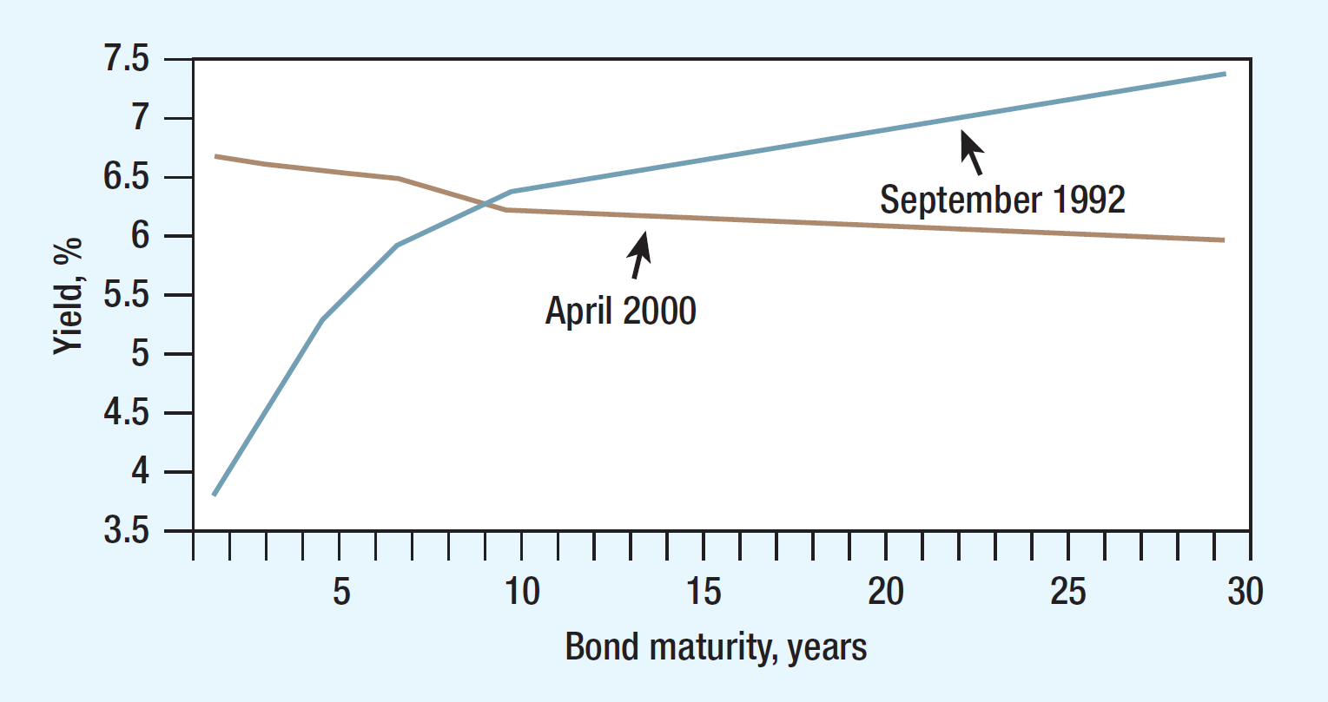
Figure 3.3 The Term Structure of Interest Rates
Notes:
Short- and long-term interest rates do not always move in parallel. Between September 1992 and April 2000, U.S. short-term rates rose sharply while long-term rates declined.

Slide 18
Law of One Price
All interest-bearing instruments are priced to fit the term structure
This is accomplished by modifying the asset price
The modified price creates a new yield, which fits the term structure
The new yield is called the yield to maturity (YTM)

Slide 19
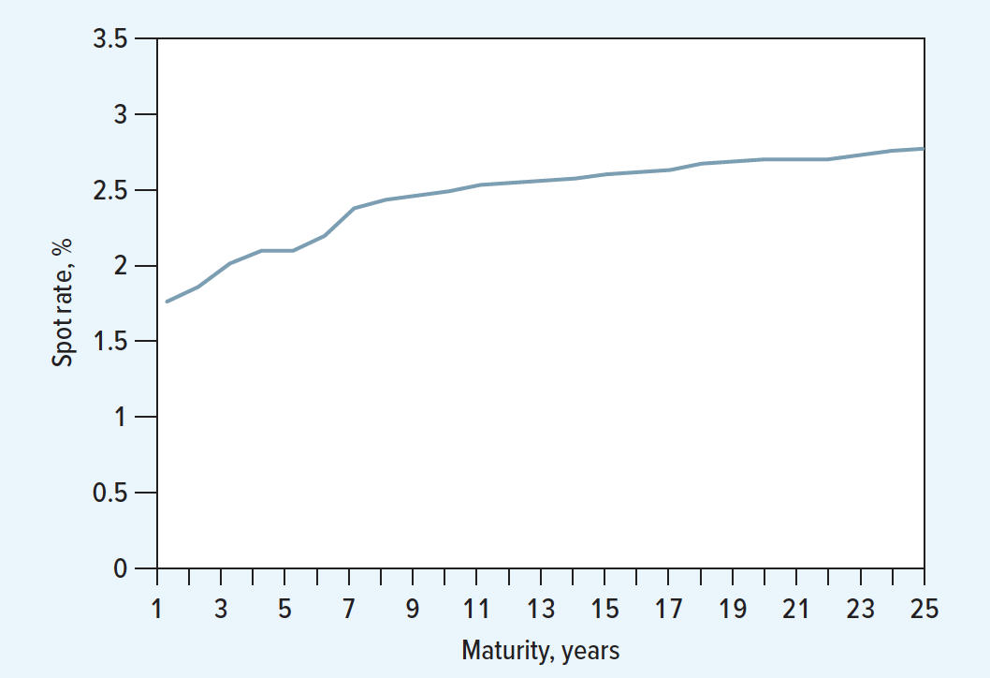
Figure 3.4 Measuring the Term Structure
Spot rates on U.S. Treasury strips, December 2017

Slide 20
Explaining the Term Structure
Expectations Theory
Term structure and capital budgeting
CF should be discounted using term structure info
When rate incorporates all forward rates, use spot rate that equals project term
Take advantage of arbitrage
Notes:
Many theories try to explain the shape of the yield curve. The most popular theory is the unbiased expectations theory. This theory states that forward interest rates are unbiased estimates of expected future spot rates. Term structure implies that for capital budgeting, CF should be discounted to include term structure information. The spot rate used for discounting cash flows should be equal to the term of the project.

Slide 21
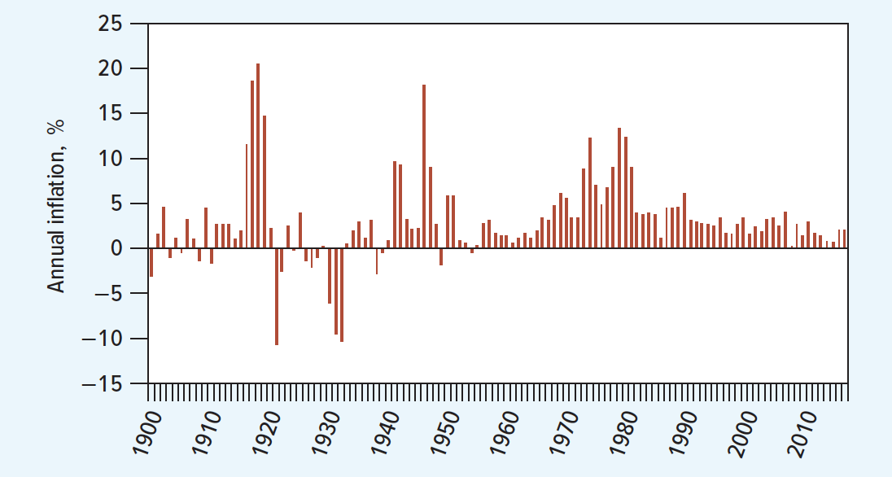
Figure 3.5 Annual Rates of Inflation in the United States from 1900–2017

Slide 22
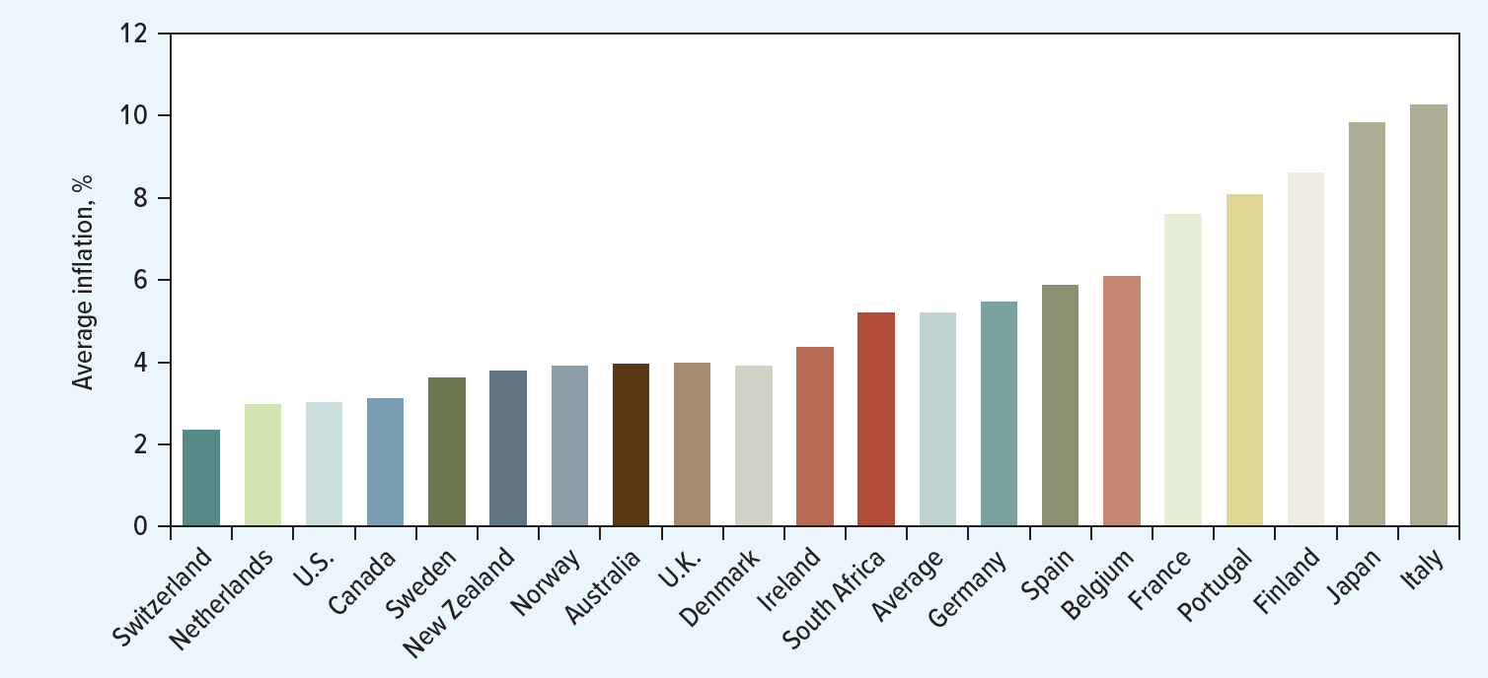
Figure 3.6 Average Rates of Inflation in 20 Countries from 1900–2017
Notes:
The U.S. has, on average, low inflation.

Slide 23
Real and Nominal Rates of Interest
In the presence of inflation, an investor’s real interest rate is always less than the nominal interest rate
Real rate of return:

Slide 24
Real and Nominal Rates of Interest Continued
Example
If you invest in a security that pays 10% interest annually and inflation is 6%, what is your real interest rate?
Real interest rate = .03774 or 3.774%

Slide 25
Real and Nominal Rates of Interest Concluded
Treasury Inflation-Protected Securities (TIPS)
Example
If you invest in a 5% coupon, three-year TIPS and inflation is 3% each year, what are your real annual cash flows?
Year | 1 | 2 | 3
Real cash flows
$50 | $50 | $1,050
Notes:
TIPS: U.S. Treasury–issued debt with fixed real flows, but with nominal cash flows (interest and principal) that increase as the consumer price index increases.
Note: What are the nominal cash flows for the example above?

Slide 26
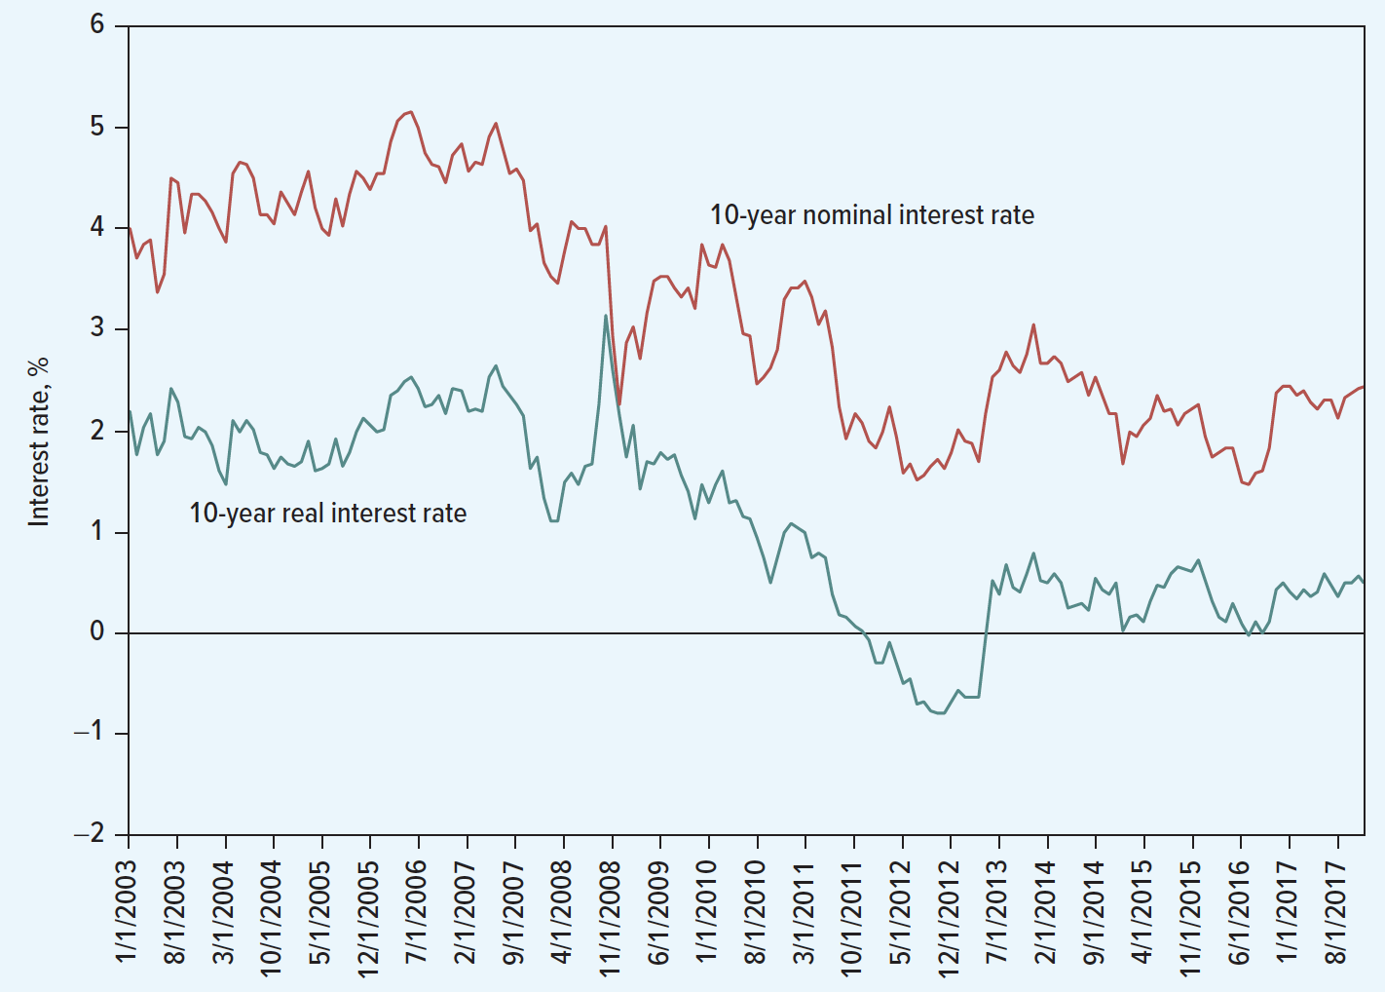
Figure 3.7 Inflation and Nominal Interest Rates
Notes:
The green line shows the real yield on long-term TIPS issued by the U.S. government. The brown line shows the yield on long-term nominal bonds.

Slide 27
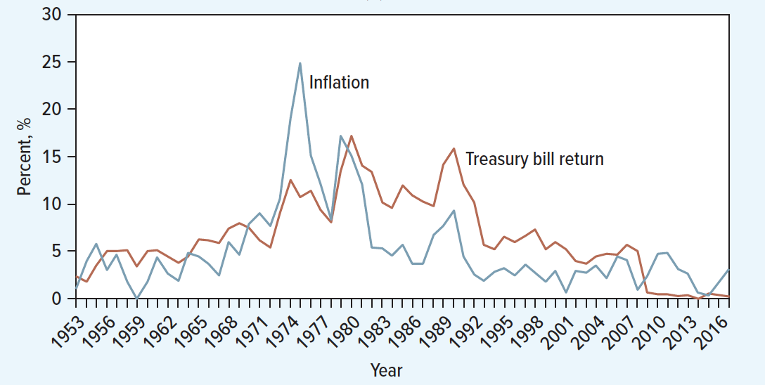
Figure 3.8 The Return on Treasury Bills and the Rate of Inflation, 1953–2017, (a) UK

Slide 28
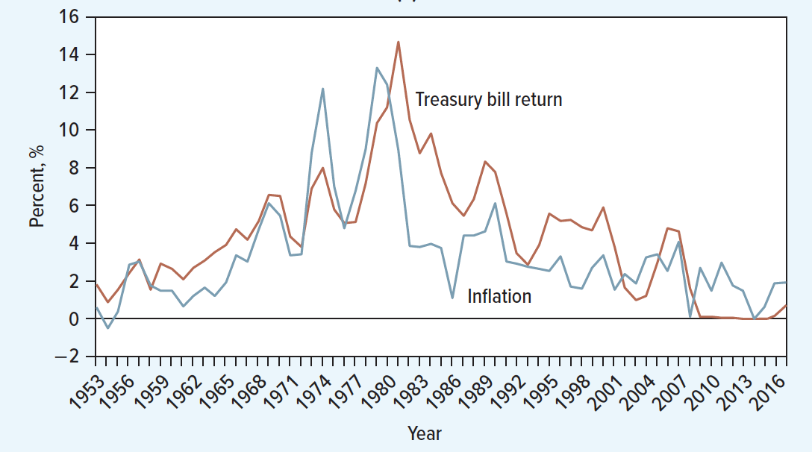
Figure 3.8 The Return on Treasury Bills and the Rate of Inflation, 1953–2017, (b) U.S.

Slide 29
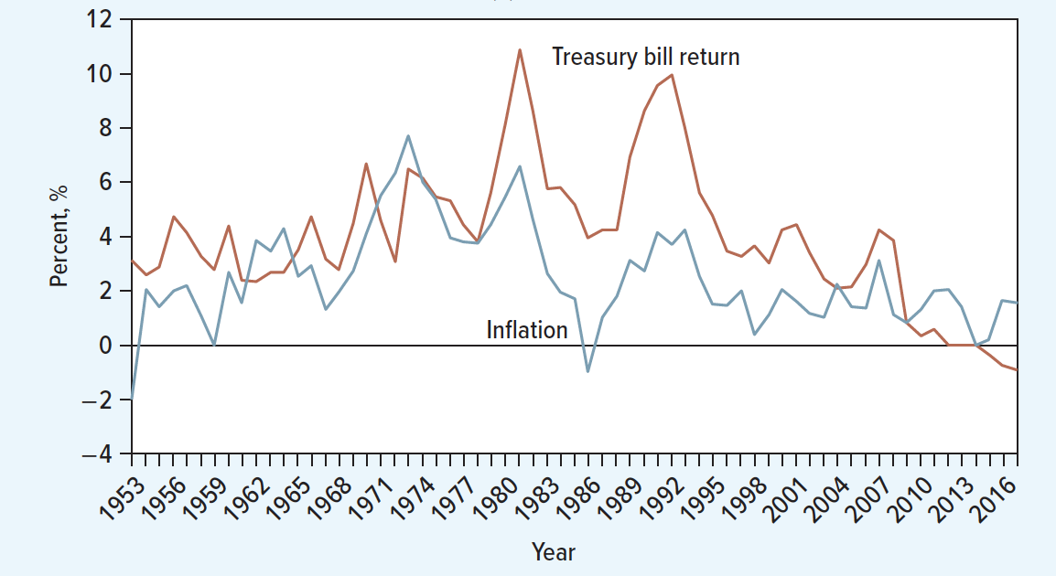
Figure 3.8 The Return on Treasury Bills and the Rate of Inflation, 1953–2017, (c) Germany

Slide 30
The Risk of Default
Default or Credit Risk—The risk that a bond issuer may default on its bonds
Default premium—The additional yield on a bond that investors require for bearing credit risk
Investment-grade bonds—Bonds rated Baa or above by Moody’s or BBB or above by Standard & Poor’s
Junk bonds—Bond with a rating below Baa or BBB

Slide 31
Table 3.7 Prices and Yields of a Sample of Corporate Bonds

Slide 32
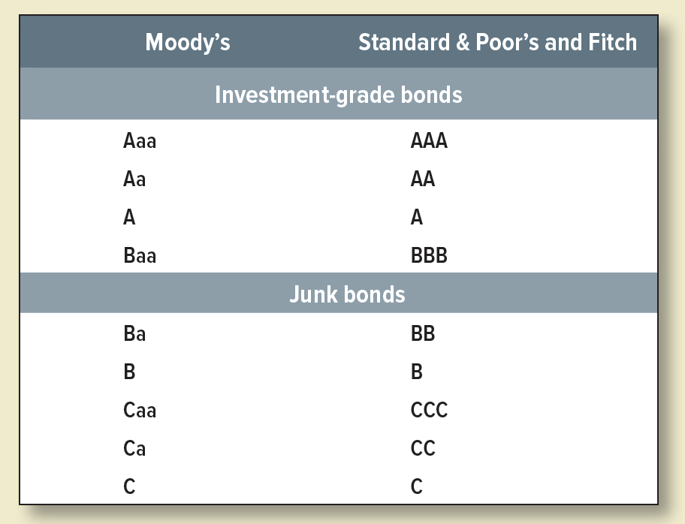
Table 3.8 Key to Bond Ratings

Slide 33
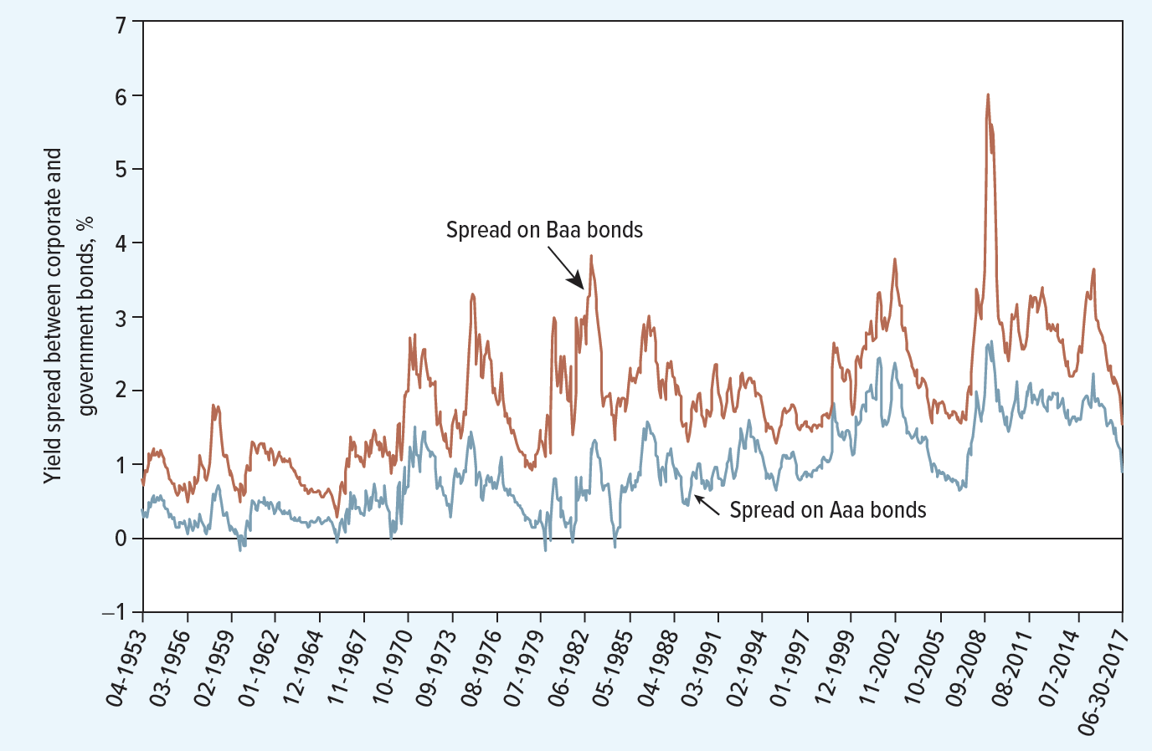
Figure 3.9 Yield Spreads between Corporate and 10-Year Treasury Bonds, January 1953–January 2018

Slide 34
Sovereign Bonds and Default Risk
Sovereign Bonds and Default Risk
Foreign currency debt
Default occurs when foreign government borrows dollars
If crisis occurs, governments may run out of taxing capacity and default
Affects bond prices, yield to maturity
Notes:
This slide introduces foreign currency debt, which is the most common type of debt to cause countries to default. The book includes real-world examples of foreign currency default.

Slide 35
Sovereign Bonds and Default Risk Continued
Sovereign Bonds and Default Risk
Own currency debt
Less risky than foreign currency debt
Governments can print money to repay bonds
Notes:
This slide introduces own currency debt, which is less likely to cause countries to default. The book includes real-world examples of own currency default.

Slide 36
Sovereign Bonds and Default Risk Concluded
Sovereign Bonds and Default Risk
Eurozone debt
Can’t print money to service domestic debts
Money supply controlled by European Central Bank
Notes:
This slide examines the monetary policies of the Eurozone, the member countries of which cannot generate own currency debt. Eurozone countries have ceded control of their money supply to the European Central Bank.

