Slide 1
Introduction to Econometrics
Dr. Cansu Unver-Erbas, FHEA
cansu.u.e@cag.edu.tr
BAP: 2025-1-1 & 2025-1-2 projects

Slide 2
Index
1.1 What is regression analysis
1.2 The simple regression model
1.3 Interpretation of regression results
1.4 How good is the model
1.5 The multiple regression model
1.6 The main assumptions

Slide 3
Regression analysis is a set of statistical methods to analyze (economic and other) models, i.e. formal, mathematical relationships between variables:
Y=f(X)
The dependent variableY is determined by the independent variable(s)
X.
Different from correlation, which is simply a linear association between two variables X andY. Here, withY=f(X), we have an explicit causal link from X to Y based on theory.

Slide 4
Examples and applications Economics:
  Wages depend on experience and schooling;
  Demand depends on price, income and the price of substitute goods;
But also
  The number of days of illness of an individual is affected by their level of stress;
  Health beliefs might affect attendance to mammogram screenings;
  Students performance is affected also by the public/private nature of the school

Slide 5
We use econometrics to quantify these relationships and:
  Measure by how much Y is affected by X;
  Test theories and hypotheses;
  Predict the value of Y given the value of X;
The method of Least Squares (LS or OLS – Ordinary Least Squares) is a very popular and powerful method of estimation, and the one we will be looking at

Slide 6
The process can be represented as:
Theory
Econometric model
Data
Model estimation
Specification testing and diagnostics
Is the model adequate?
Yes
No
Test any hypotheses
Use for predictions and policy making

Slide 7
There are three structures of economic data:
Cross sectional: variables are observed at the same point in time among several units (individuals, firms, countries etc). Examples of these datasets are the census of population, opinion polls, or in general samples that contain no time variation in them. Main focus of this module. Label: x_{i}
Time series: the same unit (individual, firm, country…) is observed over time. Usually macro variables and many time frequencies: daily, weekly, monthly, quarterly, yearly… Label: x_{t}
Panel, or longitudinal: combines both: the same cross sectional units are followed over time. Label: x_{it}.

Slide 8
The simplest set up: only one X and a linear relationship withY: easier to
understand!
Suppose we think consumption (Y) depends on income (X) and we have some data: it looks like a linear relationship
4
3
Y 2
1
0
0
2
4
X
6
8

Slide 9
Our model can therefore be written as
Y_{i} = β₁ + β₂ X_{i}+ u_{i}
β₁ and β₂ : the population parameters, the “true” parameters of this relationship that define the Population Regression Function. We would need access to the whole population.
Y_{i} = β₁ + β₂ X_{i}+ u_{i}
Actual value of Y of each individual i
Stochastic part, the error
Model prediction of Y given X: deterministic part of the equation, the PRF, the values on the line. What on average Y is given a certain value of X

Slide 10
Blue dots = the actual data, the (Y_{i}, X_{i}) pairs: eg, the actual consumption and
income level of each individual i.
Red line = the modelled relationshipY_{i}= β₁ + β₂ X_{i} : the expected (= average) consumption of each individual given their income level.What on average people at that income level are expected to consume, according to the model.
The distance between the two is the error (the arrows in the graph).
4
3
Y 2
1
0
•
0
2
4
X
6
8

Slide 11
The modelled equation
Y_{i}= β₁ + β₂ X_{i} + u_{i}
represents what happens in theory for the whole population; it is the
“true” relationship and it is characterised by parameters β₁ and β_{2 .}
The deterministic part of this equation β₁ + β₂ X_{i} is called the Population Regression Function or PRF. It represents the average, or expected, level of Y for each given level of X (the expected value of Y conditional upon X). The errors allow for differences between modelled behaviour and reality. They are distributed above and below the regression line.
11

Slide 12
Why do we need an error term?
Intrinsic randomness of human behaviour: social sciences are not like natural sciences; random events can happen;
Vagueness of theory or unavailability of data: we are unaware of other factors (as we will see this can be a serious problem);
Peripheral variables whose effect is so small as to be random; parsimony of models is important: what is the core of the modelled behaviour;
Errors of measurement in the data;

Slide 13
Key issue is that we have no access to the population => we use a sample and derive the Sample Regression Function (SRF);
∧
∧
Rather than the true β₁ and β₂ we estimate ^{β}1 and β₂, their sample
estimators:
∧ ∧
Y_{i} = β₁ + β₂ X_{i} + u_{i}
∧
∧ ∧
Y_{i} = Y_{i} + u_{i}
∧
∧ ∧
₌ β₁ + β₂ X _{i}
The deterministic part (the SRF) again is a line of points Y_{i}
Again th∧e actual value ofY (Y_{i}) is equal to the expected value (_{Yi} ) plus an error (u_{i}).
∧
The numerical values of the estimators that we get, i.e. the estimates we
∧
get, the β, will vary with the sample we have; they will not be identical
across samples or to the true parameters.

Slide 14
For ex: two random samples (samples 1 and 2) could compare to the true population as follows:
650
SRF2
SRF1 PRF
600
550
500
450
0
50
100
150
PRF SRF1
SRF2

Slide 15
TRUE MODEL: PRF
SAMPLE: SRF
Y_{i} = β₁+ β₂ X_{i} + u_{i}
β₁ = intercept parameter
β₂ = slope parameter u = error, or noise Parameters are fixed
∧
∧
∧
Y = β+ β X
+ u
∧ i 1 2 i
i
= sample estimator of β₁
β₂ = sample estimator of β₂
= residual
β
∧ 1
∧
u
Estimators are variables
∧
Our job is to calculate the estimators ( β) and make inference about the true parameters (β) on the basis of them.
There are several methods of estimation.We will focus only on LS.
LS calculates the best possible line, the one closest to the points, i.e. with smallest possible errors
15

Slide 16
1.3 Interpretation of regression results
In a linear equation of the type
Y_{i} = β₁ + β₂ X_{i} + u_{i}
β₁ = intercept: the value of Y when X is 0.
β₂ = the slope: the change in (the expected value of) Y due to a 1-unit increase
in X.
For example, you model weekly family consumption as a function of weekly family income, both measured in $, and get:
∧
= 17.0 + 0.6 X_{i}
Y_{i}
Weekly consumption when family income is 0 is $17.
An extra $ in weekly income increases (average) consumption by $0.6, i.e. 60 cents
And if income increased by $2? Well, then consumption should increase by
2*(0.6) = $1.2
16

Slide 17
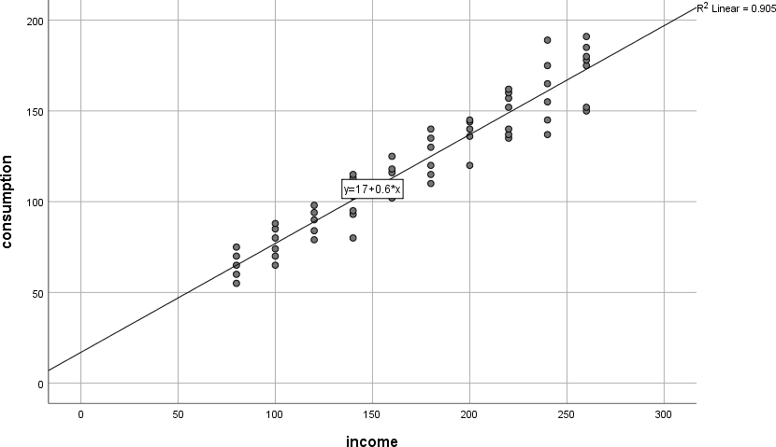

Slide 18
We can use these results to make predictions, for example:
What is the expected weekly consumption of a family with weekly income of $120?
17+0.6*(120) = 89
This means that on average a family with a weekly income of $120 is expected to consume $89. This is a prediction, the value on the line. In reality some will consume more and others less. The difference as we know is the error (the residual, see graph on the previous slide).Ex:
Take two observations from your sample with oncome $120: one consumes $79 the other consumes $98. their residuals are respectively
79-89 = -10 and 98-89 = 9

Slide 19
What is the expected weekly consumption of a family with weekly
income of $215?
17+0.6*(215) = 146
If you had an actual observation in your sample with income 215 and consumption 150 what is their residual?
4
Where would they be with respect to the regression line?
They would be above the regression line, as their actual consumption in larger than the expectation
19

Slide 20
Example 2: CEO salaries (in $000) and ROE (in %), estimated on a sample
of 209 CEOs:
S_{i} = 963.191+18.501 roe
How do we interpret the result?
For each 1% increase in ROE CEO salaries increase by $18,501. When ROE is 0% the average CEO salary is $963,191
∧
Example 3: wage ($ per hour) and years of education, on a sample of 526 individuals:
∧
W_{i} = −0.90 + 0.54educ_{i}
Negative intercept: nobody has 0 years of education; for each extra year of education
hourly wage increases by 54 cents
How do we interpret the results?
20

Slide 21
One important thing you must know
Many economic (econometric) models are expressed in natural logs.
If both the dependent and independent variables of your regression are in natural logs then the slope coefficient is an elasticity.
I.e.
Y_{i} = 0.9 + 0.16 X_{i} +u_{i}
means that a 1-unit increase in X leads to a 0.16 units increase inY
BUT
lnY_{i} = 0.9 + 0.16lnX_{i} +u_{i}
means that a 1% increase in X will lead to a 0.16% increase inY.
21

Slide 22
1.4 How good is the model?
A measure of goodness of fit is the coefficient of determination R²: how close to the data points is the regression line.
The R² measures the proportion of the variation in Y that is explained by the model, rather than being due to error; i.e., the proportion of the changes inY that are explained by the changes in X.
For example in the consumption income regression we had R²= 0.905:
This means that 90.5% of the changes in consumption are explained by
those in income.
Remember that 0 < R² < 1: the higher, the stronger is the model
22

Slide 23
A dependent variable is likely to be determined by several
explanatory variables, not just one: X₂, X_{3,} X₄ etc.
=> multiple regression model
Examples:
  Earnings are not determined only by education but also by experience, sector etc.;
  Demand depends on price as well as income, price of substitutes etc;
  Output depends on several inputs of production and various other environmental variables;
Same set up as the simple regression
23

Slide 24
Interpretation very similar to simple regression model Y_{i} = β₁ + β₂ X_{1i} + β₃ X_{2i} + u_{i}
β₁ = intercept: value ofY when all the Xs are 0.
β₂ , β₃ = partial regression coefficients: in the linear model they measure the isolated effect onY of each variable keeping the other variable(s) fixed = ceteris paribus = all other relevant factors being equal.

Slide 25
Example:
Weekly family consumption (in £) as a function of number of children and income (in £):
C_{i} = β₁ + β₂ IN_{i} + β₃ CH_{i} +u_{i}
β₂ = effect on family consumption of an additional pound of income;
β₃ = effect on family consumption of an additional child;
So if we get
^
C_{i}
= 16.3 +0.68IN_{i} +11.5CH_{i}
This means that an extra £ of income (keeping the number of children fixed) increases weekly consumption by 68 pence, and an extra child(keeping income fixed) increases it by £11.5.

Slide 26
Continuing on this example:
C_{i} = 16.3 +0.68IN_{i} +11.5CH_{i}
^
What is the expected weekly consumption of a family with 2 children
and a weekly income of £360?
^
_{C} = 16.3 +(0.68)*(360) + 11.5*(2) = 284.1
i
By how much would their consumption increase on average if their weekly income increased by £50?
∆C = (0.68)*(50) = 34
(You can verify that their consumption would be 318.1)
By how much would their consumption increase on average if their
weekly income increased by £50 AND they had an extra child?
∆C = (0.68)*(50)+(11.5)*(1) = 34+11.5 = 45.5
You can verify that their consumption would be
16.3 +0.68*(410)+(11.5)*(3) =329.6
26

Slide 27
Example.
Manufacturing output as a function of labour and capital inputs:
^
ln Y_{i}
= 2.89 + 0.67lnL_{i} + 0.52lnK_{i}
Since the model is in logs the coefficients will be (partial) elasticities, thus:
a 1% increase in labour input increases output by 0.67%;
a 1% increase in capital input increases output by 0.52%;
Note for your interest:
The sum of these partial elasticities is known as total elasticity of scale, or total returns to scale; it indicates the % increase in output if you increase both inputs by 1%:
In this case output would increase by 0.67+0.52 = 1.19%
We have “increasing returns to scale” as the measure is >1. Decreasing
returns are <1 and constant returns are =1
27

Slide 28
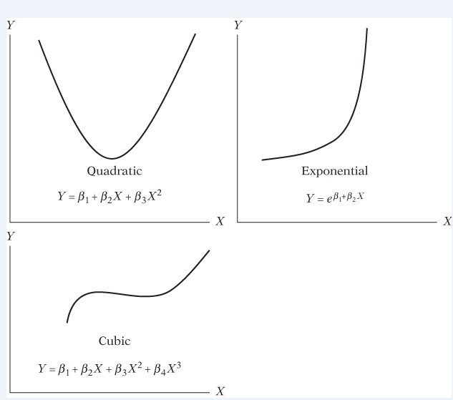
And a couple more things before we end…
The R² (coefficient of multiple determination) now measures the proportion of the variation inY explained by the model, i.e. by all the explanatory variables jointly.
In our examples we have used linear functions. Regression can be applied however to other functions, i.e. other relationships between X andY. The interpretation of coefficients in that case differs a bit
You would have to take the logs to estimate this one

Slide 29
1.6 The main assumptions
For your regression model to produce good, reliable results some assumptions have to be met.Without going into technical details I will list the most important ones
Correct specification of the model
The errors have a 0 mean: the random factors cancel each other out
No measurement errors in the
Xs
Constant variance of the errors (homoscedasticity)
Independence of the errors from each other (no autocorrelation)
Independence of the errors from X

Slide 30
Is the model linear? Quadratic? Log linear? Check your scatterplots, read the theory.
Correct specification of the model
Have all the relevant variables been included? Specification bias is a serious problem.
Are all the variables measured correctly?
No measurement errors

Slide 31
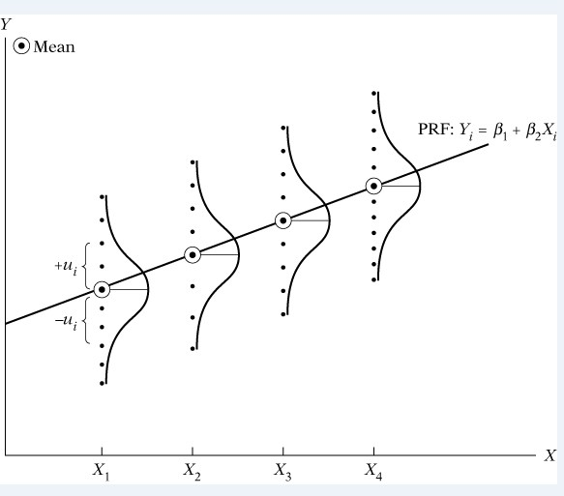
The errors have a 0 mean:
the random factors cancel each other out
We also often assume they are normally distributed

Slide 32
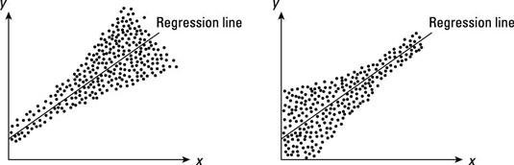
Non constant variance:
Constant variance of the errors (homoscedasticity)
The residuals must vary around the regression line in the same way,
independently of the level of X. If not your estimators will be “inefficient”
i.e. they will have too large variances and will be more imprecise.

Slide 33
No “autocorrelation”: for ex. one’s consumption has nothing to do with another’s. If not, again you get inefficient estimators.
The errors are independent from one another
extra
Generally OK in cross sectional data but can be a problem in time series:
My “excess” consumption today will probably affect how much I
will consume tomorrow!
The effects of this year’s pandemic are going to be felt for a long
time.

Slide 34
Also known as exogeneity of the independent variables: their effect on Y is direct and unrelated to the error:
Independence of the
errors from X
X
Y
u
If X and u are correlated then the OLS estimators will attribute to X some of the variation inY that actually comes from the error term, biasing the measurement of the true effect of X.
X
Eg: earnings (Y) depend on schooling (X) and unobserved ability (in u); however ability indirectly also affects schooling. Since it is not explicitly measured in the model its effect will “muddle” that of X, whose relevance will probably appear larger
Y
u

Slide 35

Regression analysis is a power tool to quantify the causal relationship between some IVs and a DV.
We can measure the effect that each of the IVs has on the DV.
We can make predictions using our estimates.
There are of course some necessary assumptions for our estimators to be OK.
35

