Slide 1
Economics
Chap 5: Background to Supply (Part 2)
Dr. Cansu Unver-Erbas

Slide 2
AIM OF THIS LECTURE
In Chapter 5, we are learning about: how firms make their decisions (supply
side).
In the previous lecture, we learned about production and costs.
Following this lecture, you should be able to determine:
How much output should a firm produce?
How much profit does a firm make?
When is it better for a firm to shut down/exit a market?

Slide 3
READING MATERIAL
Mankiw, G. and Taylor, M. (2017). Microeconomics. Cengage Learning.
Chapter 6: Background to supply: Firms in competitive markets (part 2: p.127- 144)
Lipsey and Chrystal, 13th Edition, ch. 6, 129-134
Sloman, Wride and Garratt, 9th Edition, ch.5.6, p.162-163

Slide 4
PERFECT COMPETITION
Reminder from Chap 2: In most of this course, we assume that the market is competitive, i.e., we study how buyers and sellers interact in perfectly competitive markets (we will study how buyers and sellers interact in other types of markets in Chap 8).
In perfectly competitive markets, buyers and sellers are so numerous that no single buyer or seller can influence the market price (i.e., they are small compared to the size of the market). We say that they are “price takers”.
Competitive firm behavior:
No control over the price of the good => Each firm is a price taker.
Each firm can sell any quantity at the market price.
Each firm observes the market price and decides how much output to
produce and whether to shut down/exit a market

Slide 5
TOTAL REVENUE, TOTAL COST AND PROFIT
We assume that a firm’s objective is to make a profit as large as possible, i.e., to
maximize profit.
Profit = Total revenue – Total cost Profit = TR –TC

Slide 6
VARIOUS MEASURES OF REVENUE: average and marginal revenue
How much revenue does the firm get on average? For the last unit?
Average revenue (AR)
This is the amount that the firm earns per unit of output sold
AR = TR/Q
Why? Recall that TR = unit price x quantity sold = pQ If a firm produces 100 units of output and sells it at £5
Total revenue = £5 x 100 = £500
Average revenue = £500/100 = £5
2) Marginal revenue (MR)
This is the extra revenue of selling one more unit of output
= price
MR = ∆TR/∆Q
= TR(Q+1) –TR(Q)
7

Slide 7
MARGINAL REVENUE and AVERAGE REVENUE: price takers
Suppose the market price is 10. What’s the relationship between AR and MR?
10 from 1 unit
AR = 10/1= 10
Output per day | Price | Total revenue | Average revenue | Marginal revenue
0 | 10 | 0 | - | - |  | From 0 to 1 unit MR = 10 – 0 = 10
1 | 10 | 10 | 10 | 10
2 | 10 | 20 | 10 | 10 |  | From 1 to 2 units MR = 20 – 10 = 10
3 | 10 | 30 | 10 | 10
4 | 10 | 40 | 10 | 10
5 | 10 | 50 | 10 | 10
6 | 10 | 60 | 10 | 10
7 | 10 | 70 | 10 | 10
20 from 2 unit
AR = 20/2= 10
8

Slide 8
PROFIT MAXIMIZATION
In competitive markets:
Average revenue = Marginal revenue = Price of the good
AR = MR = P
In non-competitive markets, P = AR but ≠ MR.
How much should a firm produce in order to maximize profits?
9

Slide 9
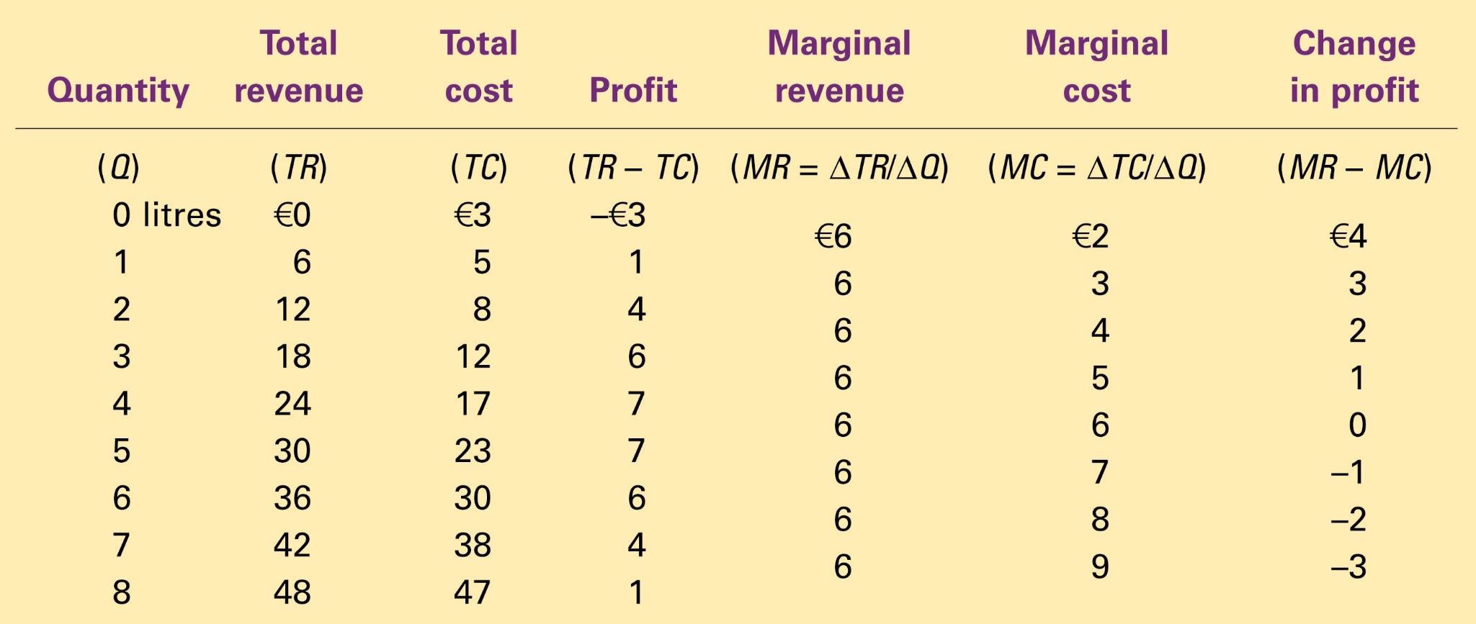
PROFIT MAXIMIZATION: A NUMERICAL EXAMPLE
Copyright©2011 South-Western

Slide 10
PROFIT MAXIMIZATION: A NUMERICAL EXAMPLE
Copyright©2011 South-Western

Slide 11
PROFIT MAXIMIZATION: A NUMERICAL EXAMPLE
Profit is maximum when Q=4 or when Q=5 => the firm should thus produce 4 or 5 units.
Another way of finding the optimal production level is by comparing marginal revenue with marginal cost.
Production should be increased as long as marginal revenue > marginal cost.
Production should stop at the point where marginal revenue = marginal cost
(Q=5).
12

Slide 12
PROFIT MAXIMIZATION: A NUMERICAL EXAMPLE
Copyright©2011 South-Western

Slide 13
PROFIT MAXIMIZATION: A NUMERICAL EXAMPLE
Copyright©2011 South-Western

Slide 14
One of 10 Principles of Economics (Chap 1): Rational people think at the margin.
PROFIT MAXIMIZATION
Firms can apply this principle when deciding how much to produce:
If marginal revenue > marginal cost => increase production Intuition: Recall that when an extra unit is produced,
the amount that TR (total revenue) increases by is MR
the amount that TC (total cost) increases by is MC
=> If MR > MC, then producing an extra unit increases TR more than TC
If marginal revenue < marginal cost => decrease production
If marginal revenue = marginal cost => production level is optimal
=> profit is maximized

Slide 15
Profit is maximised when producing a quantity such that:
PROFIT MAXIMIZATION
MR = MC
In perfect competition: MR = P (=AR)
So a firm in perfect competition maximises profits when it produces a quantity such that the marginal cost for that quantity equals the ongoing market price:
P = MC

Slide 16
PROFIT MAXIMIZATION
Note:
The marginal revenue curve is also the demand curve that the firm (not the whole market!) faces.
The demand curve for a competitive firm is perfectly elastic because the good sold by the firm has many perfect substitutes (the same good sold by competitor firms).
In competitive markets, the firm’s supply curve is given by its marginal cost curve. (however, only that part that is situated above the AVC-curve – see further!).
The firm’s marginal cost curve determines the quantity the firm is willing to supply at each price.
18

Slide 17
SHUT DOWN AND EXIT DECISIONS
A shutdown refers to a short-run decision not to produce anything during a specific period of time because of current market conditions.
Exit refers to a long-run decision to leave the market.
A firm that shuts down temporarily still pays the fixed cost, but not the variable costs of producing.
A firm that exits saves both its fixed and variable costs. Exit can only be done in the long run.
Example: farmer and cost of land.
decides not to produce any crops this season=>pays the fixed cost of land
decides to exit the market=>will not pay the cost of land

Slide 18
SHUT DOWN DECISION (SHORT TERM)
Sunk costs are costs that have already been committed and cannot be recovered.
Sunk costs should be ignored when making decisions given that the decision outcome does not impact the sunk cost!
Fixed costs (FC) are sunk costs in the short term, e. g., rent for a factory space is a sunk cost in the short term.

Slide 19
SHUT DOWN DECISION (SHORT TERM)
Shut down if profit without taking FC into account < 0 if TR – (TC – FC) < 0
if TR – VC < 0 if TR < VC
if TR/Q < VC/Q if P*Q/Q < VC/Q if P < AVC
The firm shuts down if the revenue it gets from producing is less than the variable cost of production (TR<VC) OR when the market price is lower than the AVC (P<AVC)
⇒ The portion of the marginal cost curve that lies above average variable cost is the competitive firm’s short-run supply curve.

Slide 20
EXIT DECISION (LONG TERM)
The firm exits if the revenue it would get from producing is less than its total cost.
Exit if TR < TC
Exit if TR/Q < TC/Q
Exit if P < ATC
The firm will enter if the revenue it would get from producing is higher than its
total cost.
Enter if TR > TC
Enter if TR/Q > TC/Q
Enter if P > ATC
=> The competitive firm’s long-run supply curve is the portion of its marginal
cost curve that lies above average total cost.

Slide 21
PROFIT MAXIMIZATION
Profit = TR – TC
= P*Q – TC
= (P*Q/Q – TC/Q)*Q
= (P – ATC)*Q
This expression is useful for representing the firm’s profit on a graph.
28

Slide 22
Profit as the Area between Price and Average Total Cost
(a) A Firm with Profits
Price
MC
ATC
Profit
P
ATC
P = AR = MR
0
Q
(profit-maximizing quantity)
Quantity
29
Copyright©2011 South-Western

Slide 23
Profit as the Area between Price and Average Total Cost
(b) A Firm with Losses
Price
MC ATC
ATC
P
P = AR = MR
Loss
0
Q
Quantity
(loss-minimizing quantity)
30
Copyright©2011 South-Western

Slide 24
PROFIT IN THE SHORT RUN VS LONG RUN
There are two key differences in between the short and long run:
There are no sunk fixed costs in the long run (i.e., all costs are variable).
The number of firms in the market is not fixed in the long run, firms can enter or leave the market freely.
Reminder: The market supply curve is the horizontal sum of all firms’ supply curves (Chap 2).

Slide 25
PROFIT IN THE LONG RUN
Suppose all firms have access to the same technology for producing the good and to the same markets for buying the inputs => firms have the same cost curves (identical firms).
If firms already in the market are profitable => new firms will enter the market => the quantity supplied will increase => the price will decrease => profits will decline.
If firms already in the market are making losses => some existing firms will exit => the quantity supplied will decrease => the price will rise => profits will increase.

Slide 26
PROFIT IN THE LONG RUN
At the end of this process of entry and exit, firms that remain in the market must be making zero profit.
Profit=(P-ATC)*Q = 0 only if P = ATC
The process of entry and exit ends only when price and average total cost are
driven to equality.
So: P = MC = ATC in long run
(MC = ATC at the minimum of ATC)
=>The long run equilibrium of a competitive market with free entry and exit must have firms operating at their efficient scale.

Slide 27
PROFIT IN THE LONG RUN
Why do competitive firms stay in business if they make zero profit?
Profit = total revenue - total cost.
Total cost includes both explicit and implicit cost.
The owners receive a revenue for the time and money invested in their
business.
This revenue is equal to the remuneration they would have obtained by using their time/money in a different activity.

Slide 28
GENERAL SUMMARY
Because a competitive firm is a price taker, its revenue is proportional to the amount of output it produces: TR = P x Q
The price of the good equals both the firm’s average revenue and its marginal revenue: P = AR = MR
To maximize profit, a firm chooses the quantity of output such that marginal revenue equals marginal cost.
Maximum profit: q for which MR = MC.
For firms in competitive market, this is also the quantity at which price equals marginal cost:
Maximum profit: qi for which p = MC.

Slide 29
GENERAL SUMMARY
The portion of the marginal cost curve that lies:
above AVC represent the short-run supply curve
above ATC represent the long-run supply curve.
In the short run, when a firm cannot recover its fixed costs, the firm will choose to shut down temporarily if the price of the good is less than average variable cost (p < AVC).
In the long run, when the firm can recover both fixed and variable costs, firm
will exit if the price is less than average total cost (p < ATC).
In a market with free entry and exit, profits are driven to zero in the long run and all firms produce at the efficient scale.

