Slide 1
DESCRIPTIVE STATISTICS
Prof. Dr. Şehnaz Şahinkarakaş
Adapted from McMillan & Schumacher, 2013

Slide 2
Nothing new!! You are already using it!!

Slide 3
Types of Statistics
There are two broad categories of statistical techniques: descriptive and inferential.
Descriptive statistics
Used to summarize, organize, and reduce large numbers of observations.
Focus is on «what is» with respect to the sample data
E.g. What is the average reading grade level of the fifth-graders in the school?
The most fundamental way to summarize data, and it is crucial in interpreting the results of quantitative research.
Inferential statistics [TO BE STUDIED LATER]
Used to make inferences or predictions about the similarity of a sample to the population
Commonly used in reporting results.
Depend on descriptive statistics.
Without a complete understanding of descriptive statistics, therefore, inferential statistics make very little sense.

Slide 5
SIMPLE STATISTICS
Frequency
Mean
Mode
Median
Standard deviation

Slide 6
Presentation of Data (Frequency)
In most studies, there are many different scores
The simplest organization of the scores is to list them from highest to lowest (a rank-order distribution).
The rank-order distribution is transformed to a frequency distribution

Slide 7
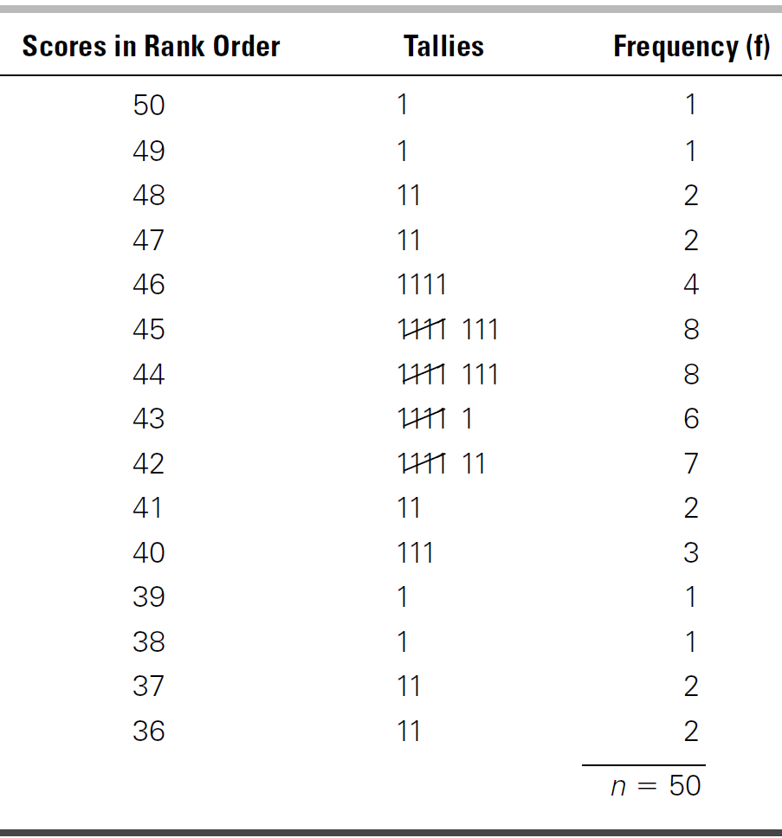
i) Frequency Distributions
Frequency Distributions of Scores
Unorganized Scores

Slide 8
Class Interval Example: Frequency Distribution of Counseling Duration

Slide 9
Percentage example: Frequency Distribution of a Survey

Slide 10
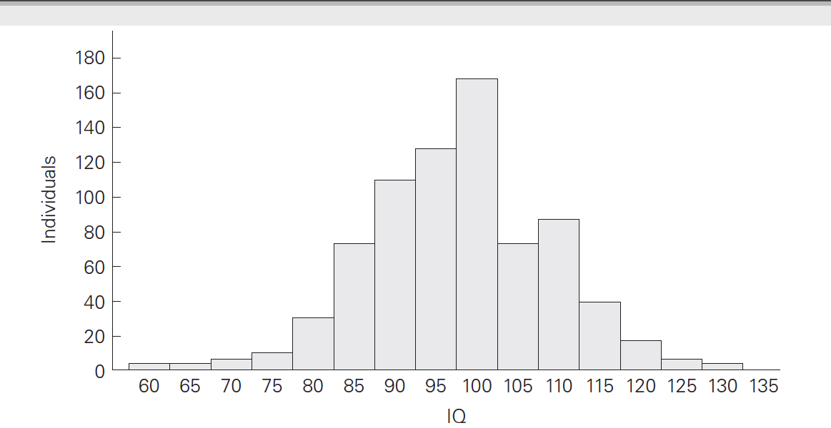
ii) Histograms & Bar Graphs
Frequency data are often effectively displayed pictorially.
Histogram: represents the frequency of occurrence of each score or interval (continuous data)
.

Slide 11
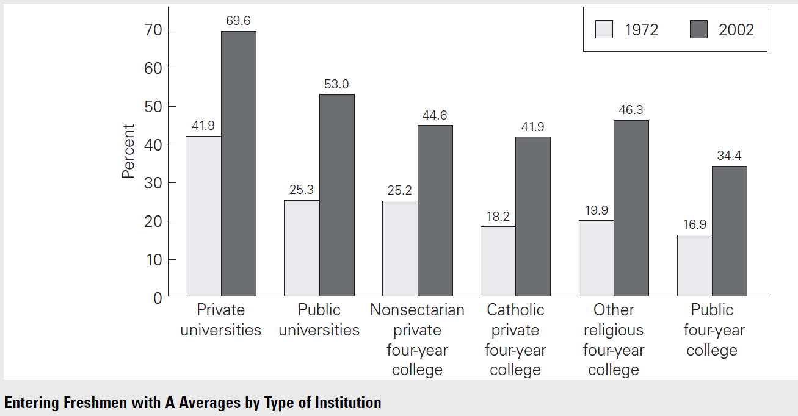
A bar graph
looks like a histogram; however, the ordering of the columns is arbitrary (not an order from least to most).
Used with nominal variables

Slide 12
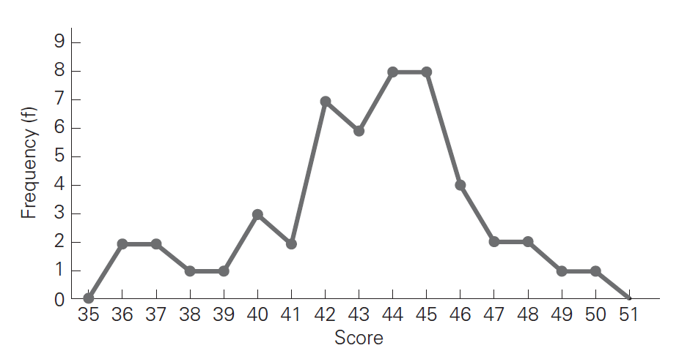
iii) Frequency Polygons
Very similar to a histogram, but uses single points not bars; these points are then connected by a line.

Slide 13
Measures of Central Tendency
Typical or average score or observation
Mean
Median
Mode
Each provides a numerical index of the typical score of a distribution.

Slide 14
Mean
Adding up all the scores and then dividing the sum by the total number of scores.
10, 15, 18, 23, 29= mean is 19 [(10+15+18+23+29)/5)]
Weakness:
when a distribution contains extremely high or low scores (i.e., outliers), the mean is pulled toward the extreme score.
E.g.
Scores: 4, 5, 7, and 40
Mean= 14.

Slide 15
Presentation of means in a table

Slide 16
Median
The point which separates the higher half of a sample from the lower half (the midpoint)
i.e. 50% of the scores lie below the median and 50% above
Uneven number of scores: 5, 4, 3, 2, 1 --- Median= 3
Even number of scores: 10, 8, 6, 4 --- Median= 7
Unafffected by the actual value
E.g.
Scores= 10, 15, 16, 19, 105
Median= 16
(better indicator of central tendency than the mean, 33)
Can be used
for highly skewed data
to divide one group of respondents into two groups of equal numbers.

Slide 17
Mode
The score that occurs most frequently in a distribution
Rarely used in educational research
Only if the need to know the most common score (when the data is nominal)
E.g.
25, 20, 18, 18, 18, 16, 15, 14, 14, 10, 10
Mode= 18

Slide 18
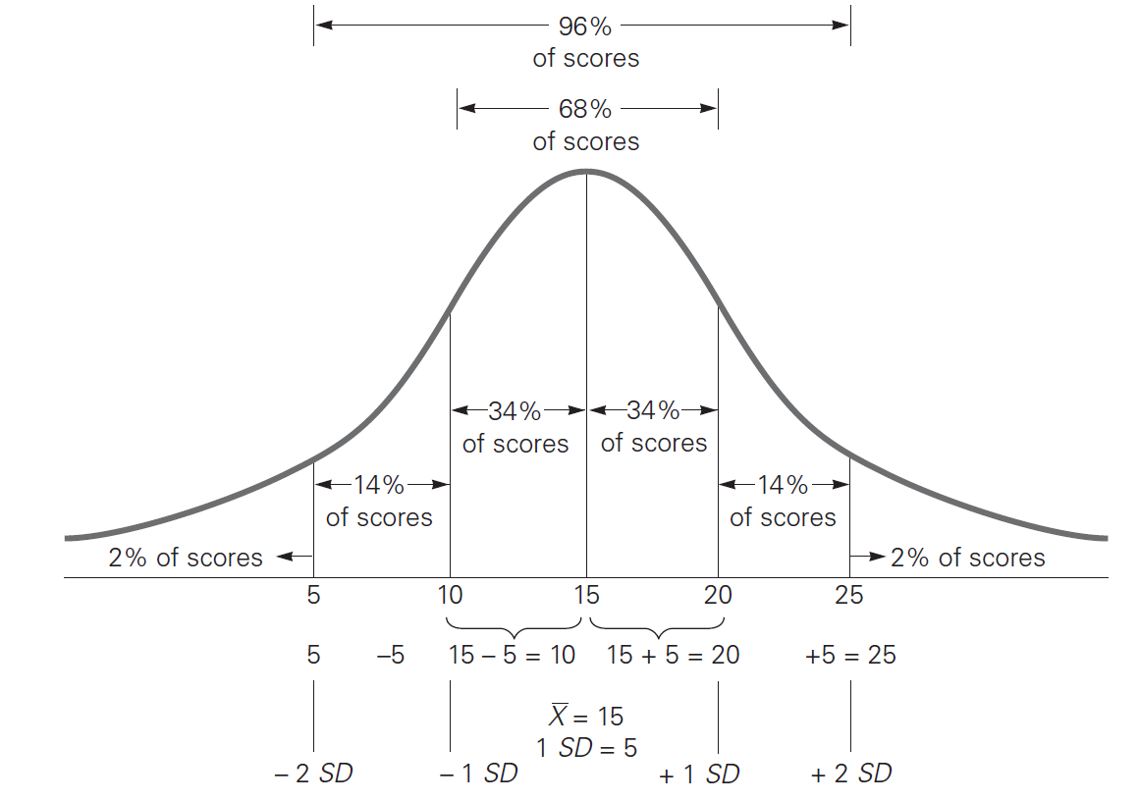
Distribution of Scores
NORMAL DISTRIBUTION: Relatively symmetrical distribution of scores
the mean, median, and mode will be about the same.

Slide 19
SKEWNESS
Scores are positively skewed if most of the scores are at the low end of the distribution, with a few high scores
Scores are negatively skewed if most scores are located at the high end.
Mean is higher (than median/mode) in a positively skewed distribution
Mean is lower (than median/mode) in a negatively skewed distribution.

Slide 20
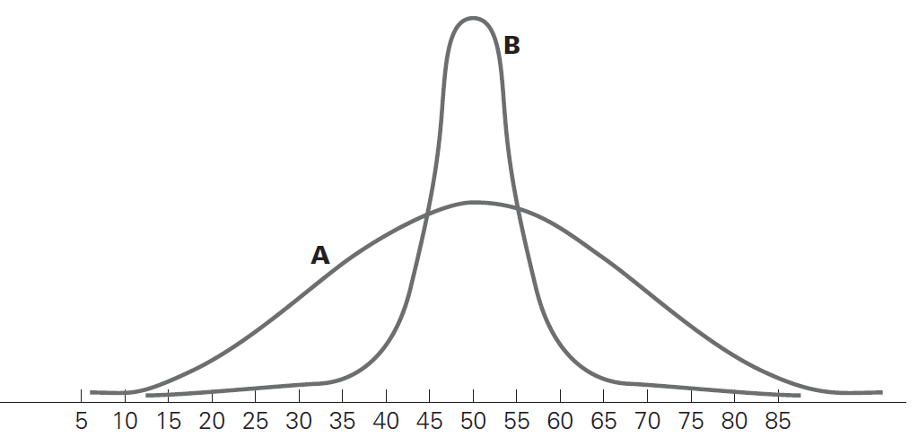
KURTOSIS
Related to the TAILS of a distribution (& whether flat or peaked)
Mostly used for outliers
B--High kurtosis (>3) values indicate that the distribution is rather peaked (clustered in the centre), with long thin tails.
A--Low kurtosis (<3) values indicate that the distribution is flat (clustered in the centre), with long thin tails.
More outliers
Less outliers

Slide 21
MEASURES OF VARIABILITY
Variability
the difference between the scores of the distribution.
Two common measures of variability
range
standard deviation.

Slide 22
i) Range
the most obvious measure of dispersion.
simply the difference between the highest and lowest scores in the distribution.
E.g.
the lowest of 30 scores on a test= 65
the highest score= 90
the range= 25 (90-65= 25)
can be misleading if there is an atypically high or low score.
fails to indicate anything about the variability of scores around the mean of the distribution.
Better used with Ordinal Variables

Slide 23
ii) Standard deviation
a numerical index that indicates the average variability of the scores--the distance of the scores from the mean
the distance between each score and the mean is calculated & the amount that each score deviates / differs from the mean is determined
the standard deviation (SD) is simply the average of all the deviation scores, the average distance of the scores from the mean
Better used with Continuous Variables

Slide 26
CLASS A: heterogeneous set of scores that spread out widely from the mean– larger SD
CLASS B: homogeneous set of scores that cluster around the mean—lower SD

Slide 27
Interpreting SD
For both schools, Mean & Median are the same
Range
School 1= 95-45= 50
School 2= 80-60= 20

Slide 28
Standard Scores (z-score)
The z score is a kind of standard deviation that allows us to
find the probability of a value occurring in a normal distribution
compare two samples from different populations.
Can be either negative or positive:
Minus or plus indicates that the value is below or above the mean.
The midpoint (Mean) in Standard Normal Distribution is always 0
The intervals increase one by one.
Each number on the horizontal axis corresponds to a z-score.
The z-score tells us how many standard deviations an observation is away from the mean.

Slide 30
Standard Deviation vs. Z-Score
Standard deviation measures how spread out the data is.
Low SD → Data points are close to the mean.
High SD → Data points are widely spread.
Z-score tells us how far a data point is from the mean, in standard deviation units.
Z = (X - Mean) / SD
Z > 0 → Above the mean
Z < 0 → Below the mean
When to use sd; when to use z-score?
SD: When analyzing variability in a dataset.
Z-score: When comparing individual performance to a group

Slide 31
An example

Slide 33
Outliers
Refers to a data point that falls far outside the main distribution of scores.
An outlier can distort statistical analyses that include actual values of all the scores, such as the mean and standard deviation.
Some visual displays can be used to identify extreme scores, but outliers are typically identified as data points that are three standard deviations from the mean.

Slide 34
Boxplots
There are times when mean, median, and mode aren’t enough to describe a dataset
You need to have information on the variability or dispersion of the data. A boxplot is a graph that gives you a good indication of how the values in the data are spread out.

Slide 35
A boxplot is used to show a visual distribution of numerical data and variability by displaying quartiles (or percentages) and averages.
It can tell you about your outliers and what their values are. It can also tell you if your data is symmetrical, how tightly your data is grouped, and if and how your data is skewed
Boxplots show five characteristics of a data set:
minimum value,
first (25%) quarter,
median,
third (75%) quarter,
maximum value.

Slide 36
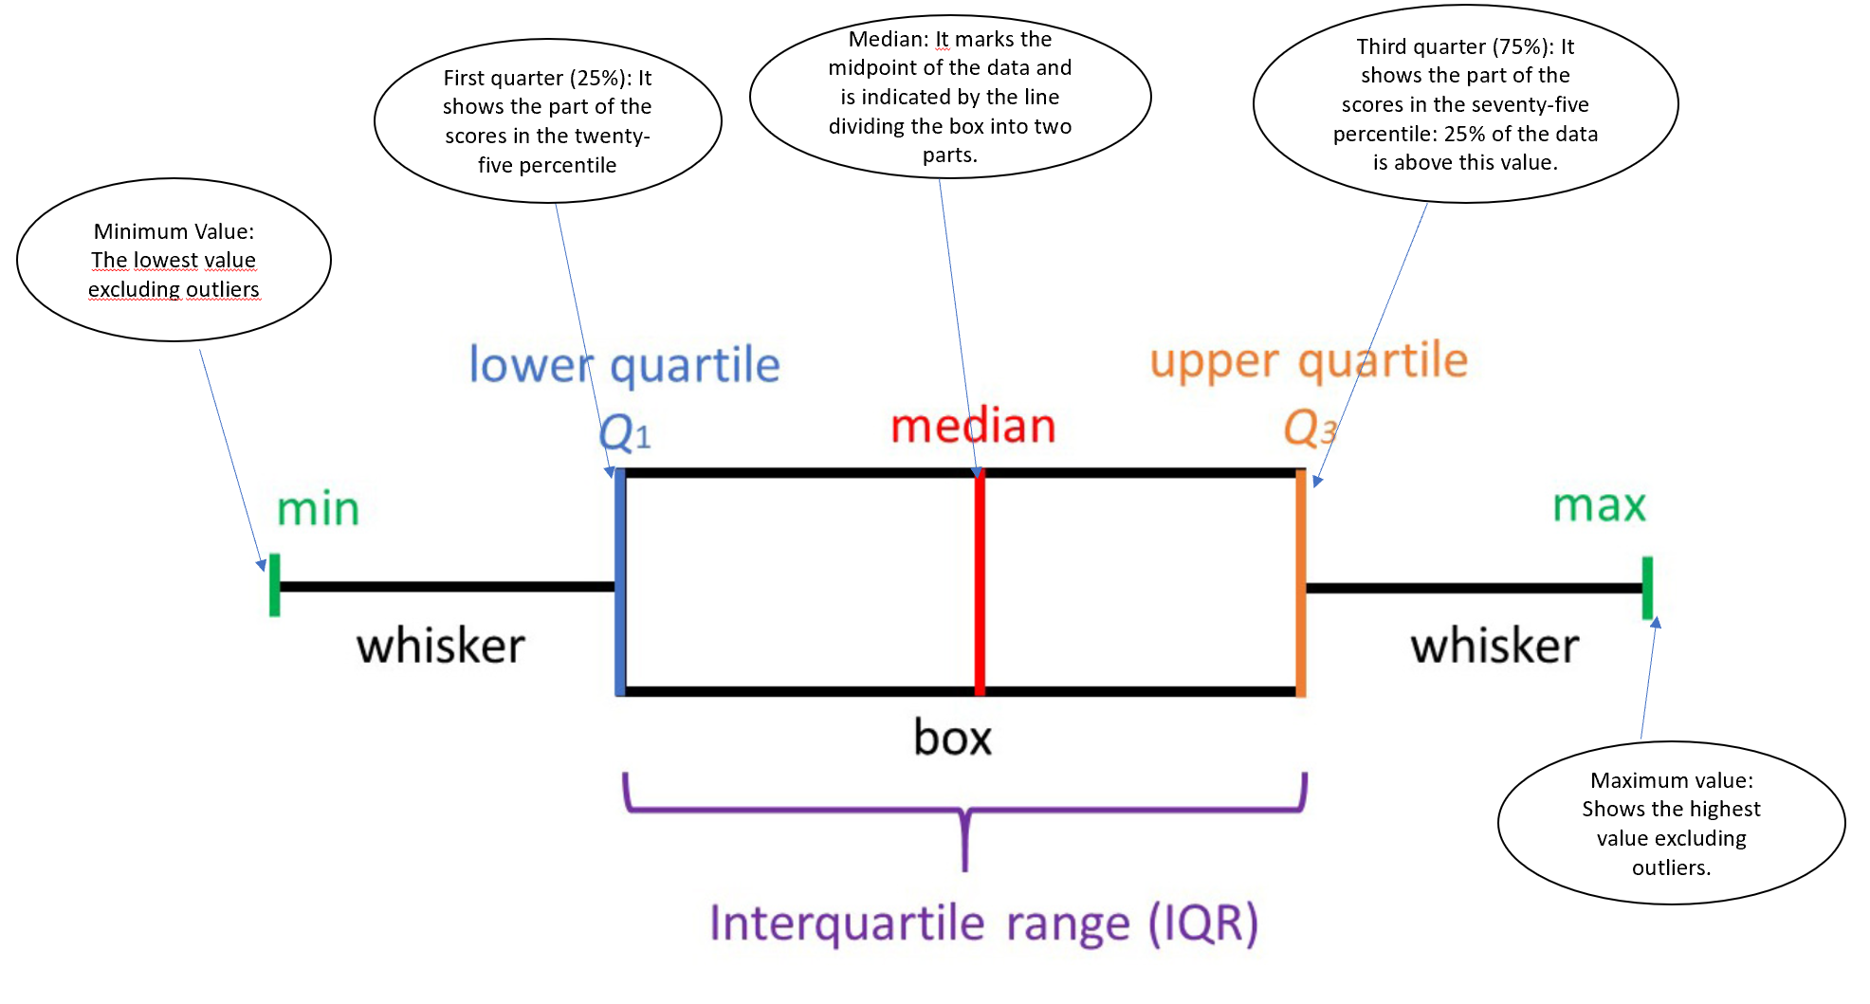

Slide 37
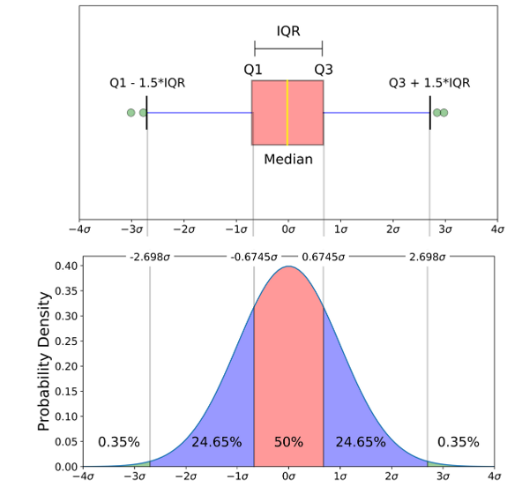

Slide 38
Range, Interquartile Range, Boxplot
Click on the following link to learn more about boxplots

