Slide 1
Reviewing an Article

Slide 2
Effects of Reciprocal Teaching Strategies on Reading Comprehension by Choo, Eng, and Ahmad (2011)
1. Introduction
  Purpose of the Study
  Research Questions / Hypotheses
2. Methodology
  Research Design
  Participants (How many? Any characteristics, etc)
  Instruments (What data collection toos were used?)
  Procedure & data collection (What steps were followed to collect data?)
  Data Analysis (How was the data analysed?)
3. Findings and Discussion
4. Conclusion

Slide 3
INTRODUCTION

Slide 4
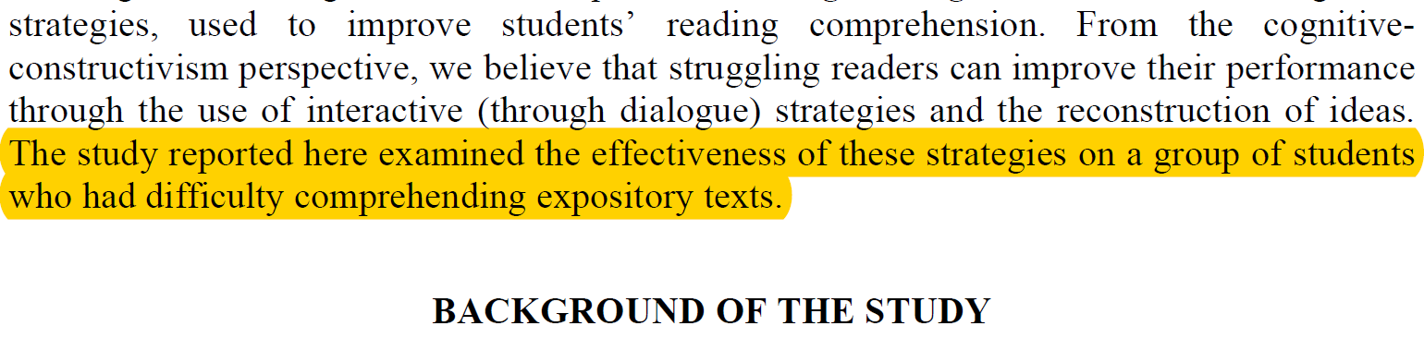
Introduction-Purpose:
  to find out how ‘reciprocal teaching strategies’ could help low-proficiency Sixth-Form students improve their reading comprehension.

Slide 5
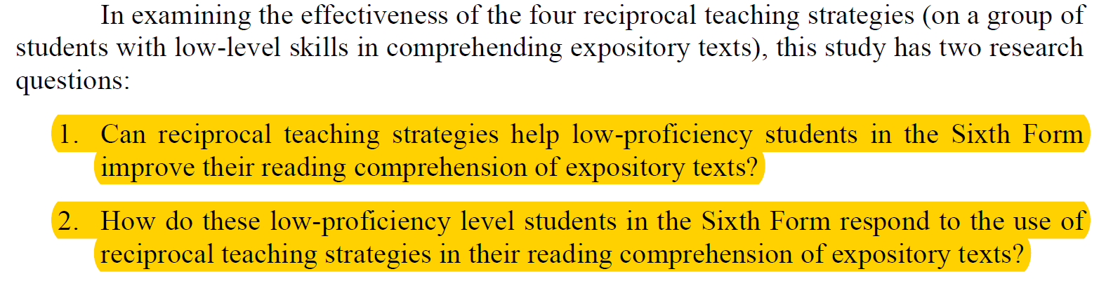
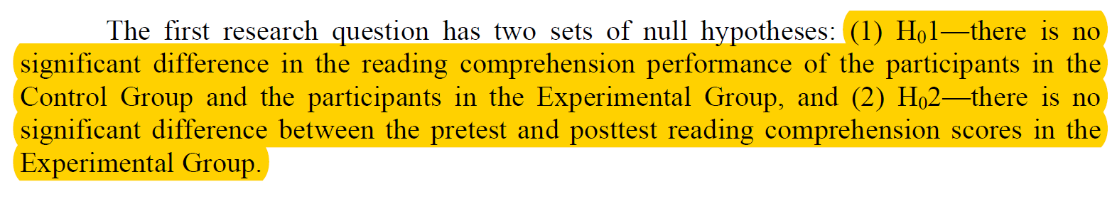
Research Questions & Hypotheses

Slide 6
METHODOLOGY

Slide 7
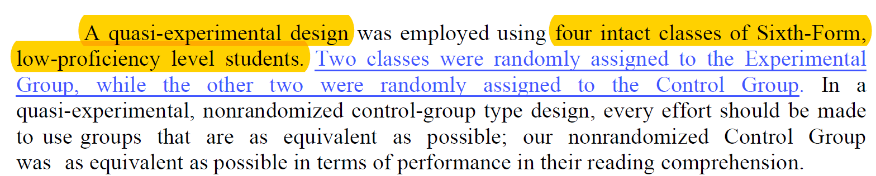
Research Design

Slide 8
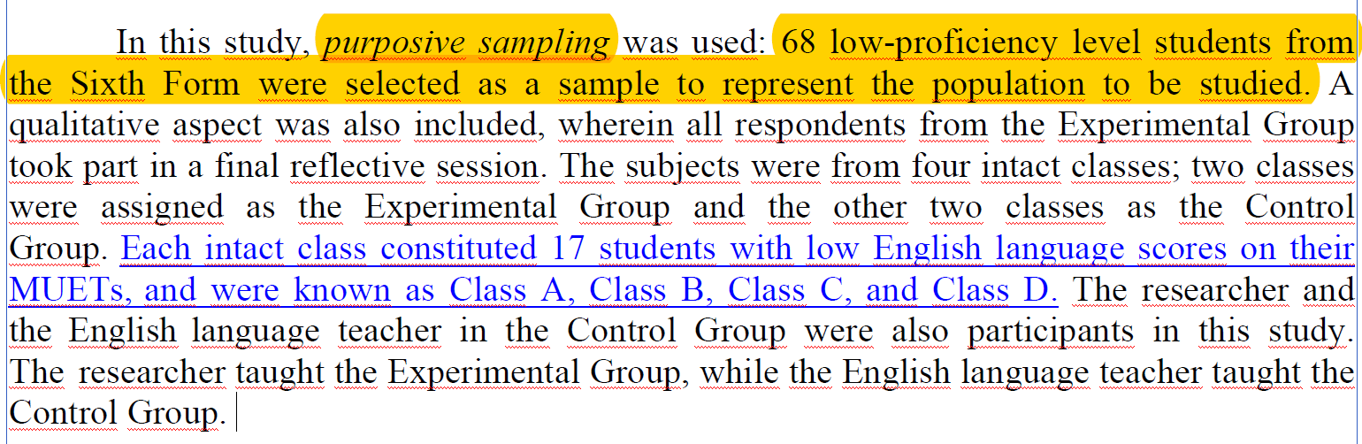
Participants

Slide 9
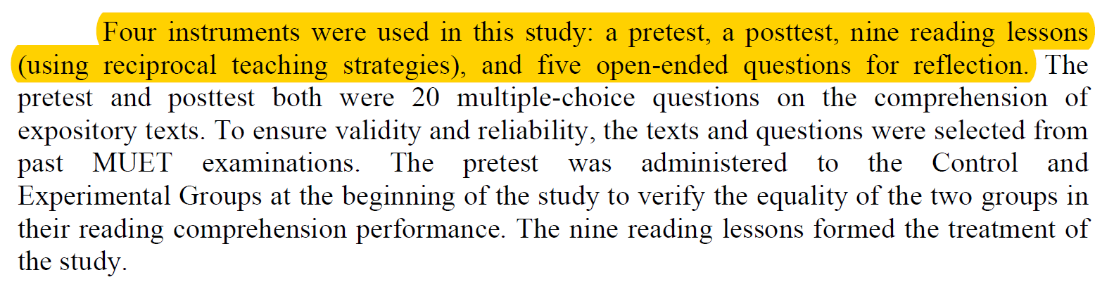
Instruments

Slide 10
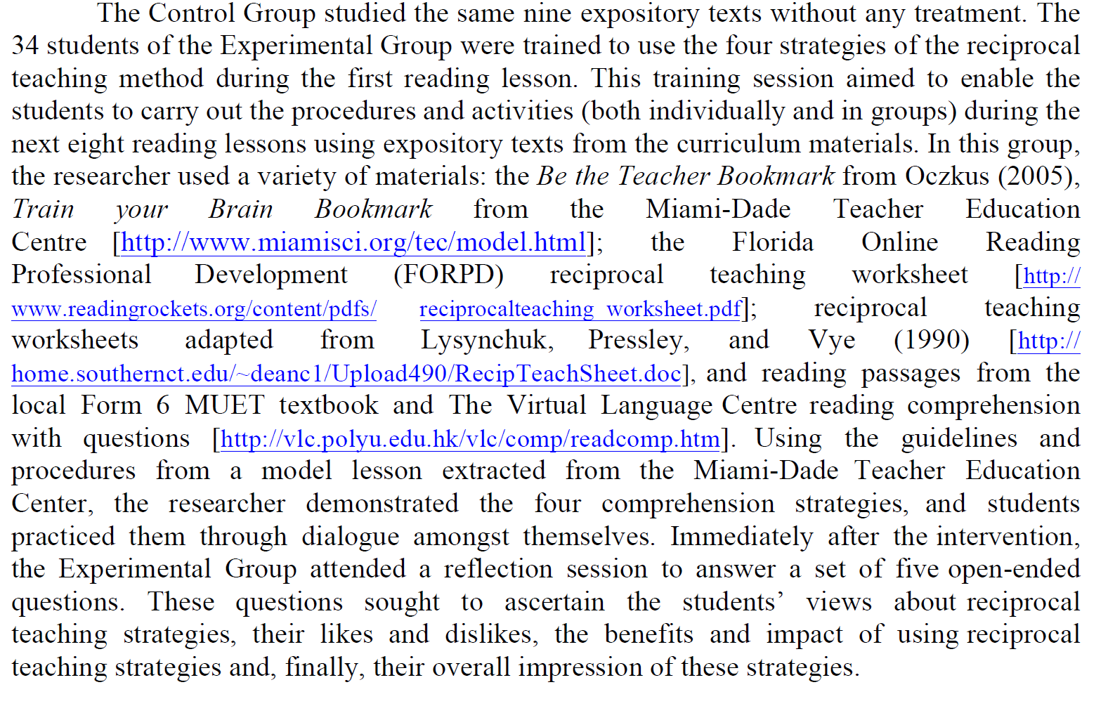
Procedure and Data Collection

Slide 11
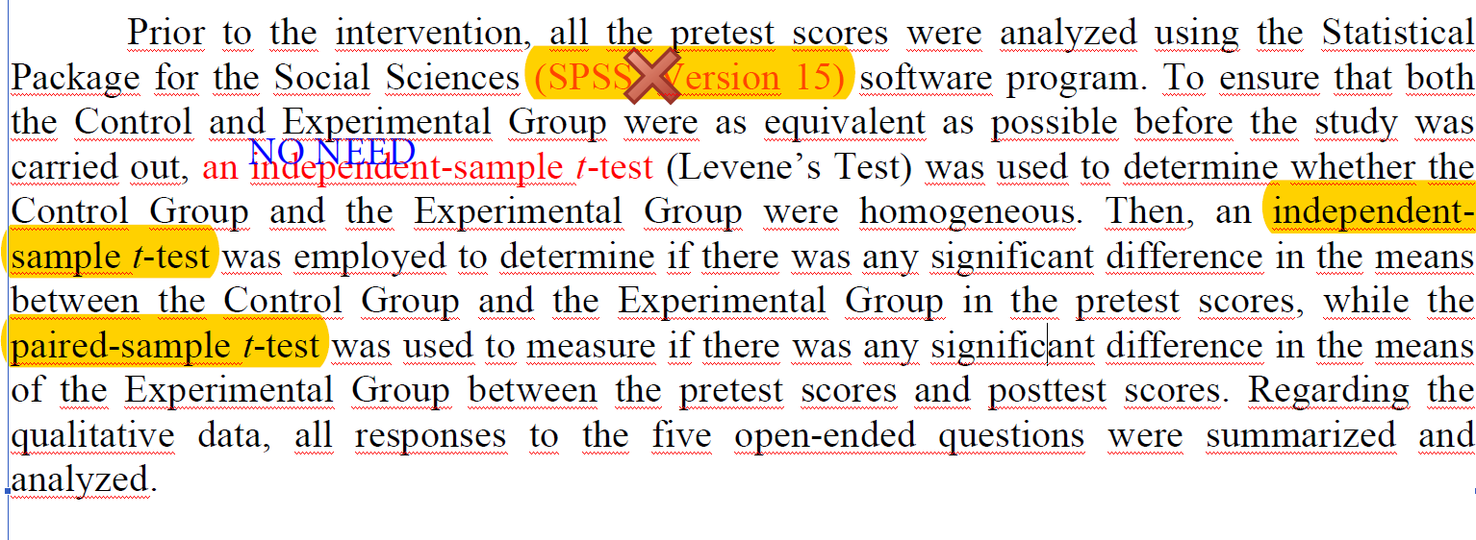
Data Analysis

Slide 12
FINDINGS

Slide 13
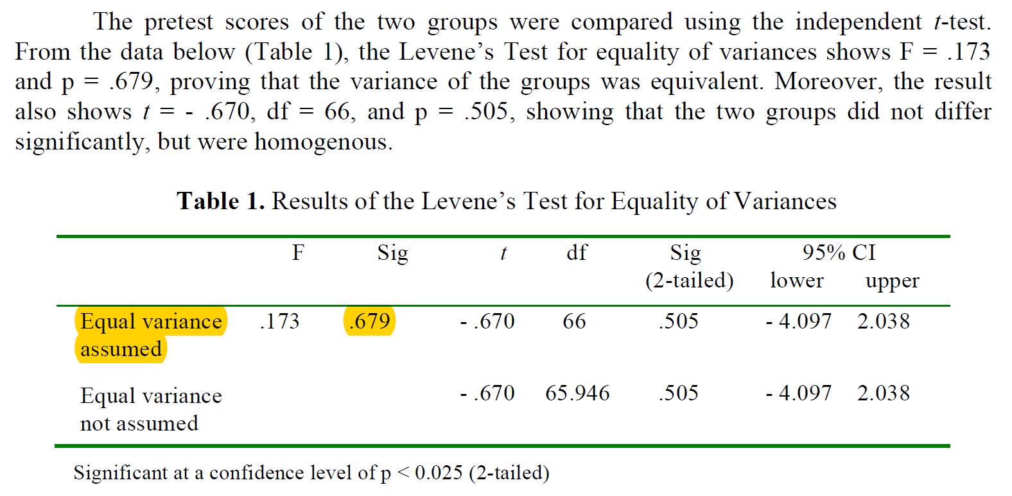
Is this table correctly used?
What do we understand from this table?

Slide 14
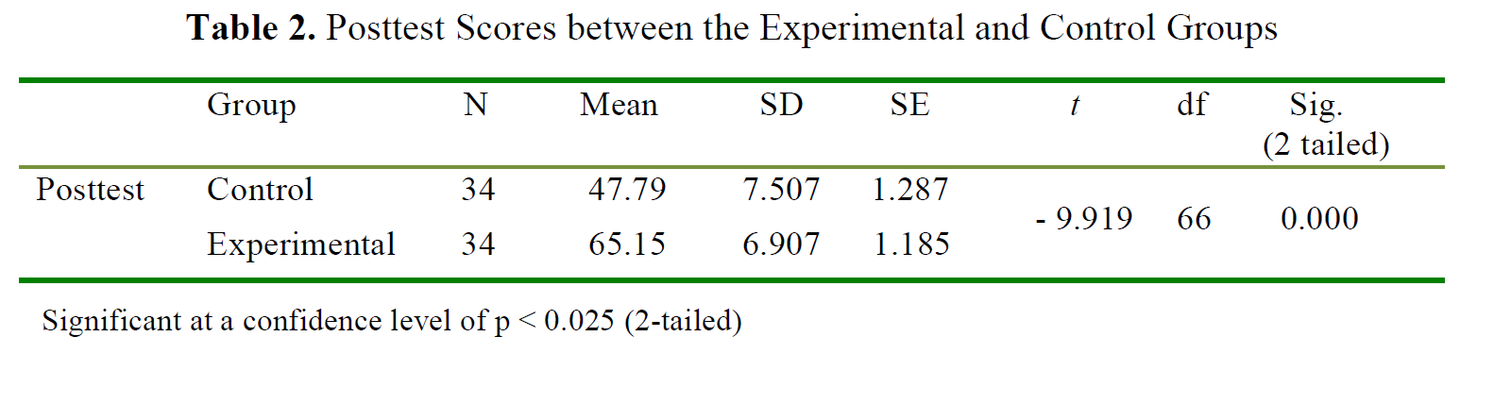
What does this table tell us?

Slide 15
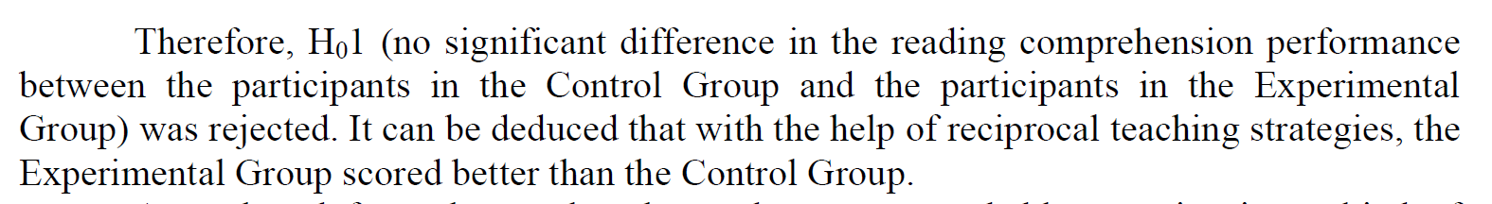
Writing about the hypothesis

