Slide 1
Chapter Eleven
Commercial Banks: Industry Overview
©McGraw Hill LLC. All rights reserved. No reproduction or distribution without the prior written consent of McGraw Hill.

Slide 2
Commercial Banks
Commercial banks are the largest group of financial institutions in terms of the dollar value of assets
Also called depository institutions because a significant proportion of their funds come from customer deposits
Major assets are loans (financial assets), and major liabilities are deposits
Perform services essential to U.S. financial markets
  Play a key role in the transmission of monetary policy
  Provide payment services
  Offer maturity intermediation services
Banks are regulated to protect against a disruption in the provision of these services and the cost this would impose on the economy and society at large

Slide 3
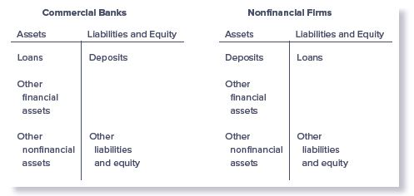
Differences in Balance Sheets of Commercial Banks and Nonfinancial Firms

Slide 4
Commercial Bank Assets
Majority of the assets held by commercial banks are loans
  In 2021, net loans and leases amounted 46.7% of total assets
Bank premises and fixed assets, other real estate owned, intangible assets, and all other assets amounted to 27.0% of total assets in 2021
Investment securities generate interest income and provide banks with liquidity
  Include interest-bearing deposits purchased from other FIs, federal funds sold to other banks, repurchase agreements, U.S. Treasury and agency securities, municipal securities issued by states and political subdivisions, mortgage-backed securities, and other debt and equity securities
  In 2021, the investment portfolio totaled 26.3% of total assets

Slide 5
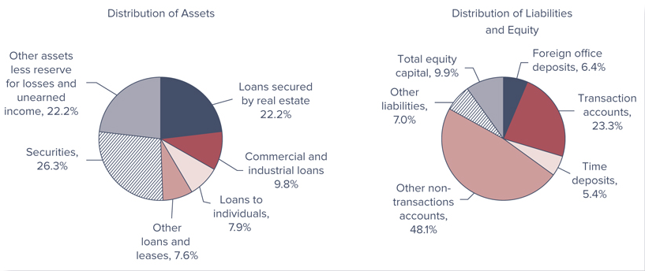
Distribution of Commercial Bank Assets, Liabilities, and Equity, 2021

Slide 6
Commercial Bank Assets (Continued)
Commercial banks face unique risks because of their asset structure:
  Credit (i.e., default) risk is the risk that promised cash flows from loans and securities held by FIs may not be paid in full
  Liquidity risk is the risk that a sudden and unexpected increase in liability withdrawals may require an FI to liquidate assets in a very short period of time and at low prices
  Interest rate risk is the risk incurred by an FI when the maturities of its assets and liabilities are mismatched and interest rates are volatile
  Credit, liquidity, and interest rate risk all contribute to a commercial bank’s level of insolvency risk, the risk that an FI may not have enough capital to offset a sudden decline in the value of its assets relative to its liabilities
©McGraw Hill LLC. All rights reserved. No reproduction or distribution without the prior written consent of McGraw Hill.
Notes:
Chapters 20-25 discuss each of these types of risks in more detail.

Slide 7
Commercial Bank Assets (Concluded)
Loans and investment securities continue to be the primary assets of the banking industry
Loans secured by real estate have consistently been the largest asset class for commercial banks over the 1992–2019 period, but real estate loans have been shrinking steadily from 2007 to 2014
In 2016, the volume of 1–4 family mortgages originated by nonbanks surpassed the volume originated by banks
  Nonbanks accounted for 52.5 percent of the volume of 1–4 family mortgages originated in 2017, up significantly from the financial crisis-era low of 23.5 percent in 2007
Proportion of commercial and industrial loans have been declining since 2000
©McGraw Hill LLC. All rights reserved. No reproduction or distribution without the prior written consent of McGraw Hill.
Notes:
Question: Why have real estate loans been shrinking (from 2007 to 2014)?
Answer: The major reason for this has been the fact that a substantive share of 1–4 family mortgage origination and servicing migrated from banks to nonbanks following the financial crisis.

Slide 8
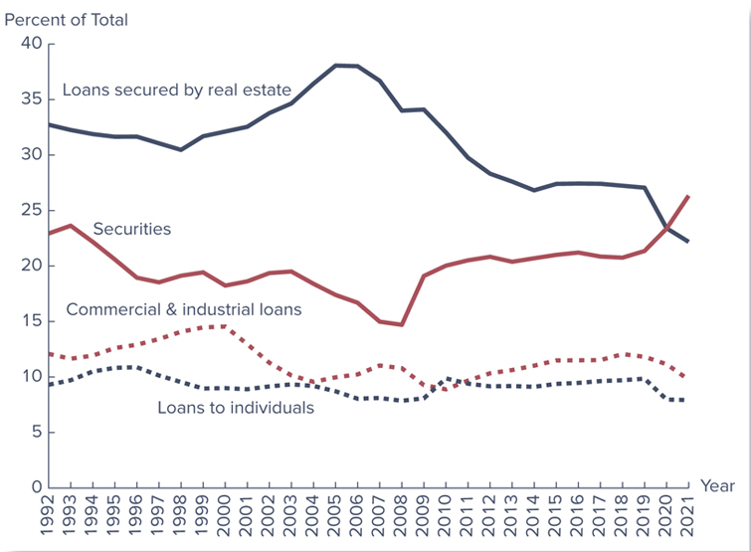
Portfolio Shift: U.S. Commercial Banks’ Financial Assets
©McGraw Hill LLC. All rights reserved. No reproduction or distribution without the prior written consent of McGraw Hill.
Notes:
Figure 11–4 shows broad trends over the 1992–2021 period in the four principal earning asset areas of commercial banks:
Loans secured by real estate (which includes residential and nonresidential real estate loans, construction and development loans, farmland loans, etc.)
Commercial and industrial loans
Loans to individuals (credit card loans, auto loans, etc.)
Securities (U.S. Treasury securities, mortgage-backed securities, state and municipal securities, and equity securities)

Slide 9
Commercial Bank Liabilities: Deposits
Transaction accounts are checkable deposits that are either demand deposits or NOW accounts
  Transaction accounts are about 28.0% of total deposits
  Interest-bearing checking accounts are called negotiable order of withdrawal (NOW) accounts
Household savings and time deposits (normally individual account holdings of less than $100,000)
  Important components of bank retail savings accounts are small nontransaction accounts, which include passbook savings accounts and retail time deposits
Large time deposits ($100,000 or more)
  Primarily made up of negotiable CDs, fixed-maturity interest-bearing deposits with face values of $100,000 or more that can be resold in the secondary market
©McGraw Hill LLC. All rights reserved. No reproduction or distribution without the prior written consent of McGraw Hill.
1-9
Notes:
Commercial banks have two major sources of funds (other than the equity provided by owners and stockholders): (1) deposits and (2) borrowed or other liability funds.

Slide 10
Commercial Bank Liabilities: Borrowed or Other Liability Funds
Nondeposit liabilities include a broad array of instruments:
  Shorter maturity instruments
    Purchase of federal funds (bank reserves) on the interbank market
    Repurchase agreements (temporary swaps of securities for federal funds)
  Longer maturity instruments
    Issuance of notes and bonds
Liability structure of banks’ balance sheets tends to reflect shorter maturity structure than that of their asset portfolio
Relatively more liquid instruments, such as deposits and interbank borrowings, are used to fund relatively less liquid assets, such as loans
  Interest rate risk—or maturity mismatch risk—and liquidity risk are key exposure concerns for bank managers
1-10
©McGraw Hill LLC. All rights reserved. No reproduction or distribution without the prior written consent of McGraw Hill.

Slide 11
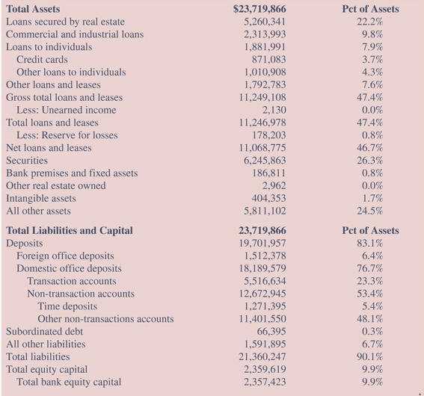
Balance Sheet of U.S. Commercial Banks ($ millions)
©McGraw Hill LLC. All rights reserved. No reproduction or distribution without the prior written consent of McGraw Hill.
Notes:
Note that in Table 11–1, which shows the aggregate balance sheet of U.S. banks, in 2021, deposits amounted to $19,701.96 billion (83.1 percent of total assets) and subordinated debt and all other liabilities were $66.40 and $1,591.90 billion (0.3 percent and 6.7 percent of total assets), respectively.
Of the total stock of deposits, transaction accounts represented 28.0 percent of total deposits (and 23.3 percent of total assets), or $5,516.63 billion.
Small nontransaction accounts compose 57.9 percent of total deposits (and 48.1 percent of total assets).
Large time deposits amounted to $1,271.40 billion, or approximately 6.5 percent of total deposits (and 5.4 percent of total assets) in 2021.
Nondeposit liabilities comprise borrowings and other liabilities that total 7.0 percent of total assets, or $1,658.30 billion.

Slide 12
Commercial Bank: Equity
Commercial bank equity capital consists mainly of common and preferred stock (listed at par value), surplus or additional paid-in capital, and retained earnings
  Commercial bank equity capital was 9.9% of total liabilities and equity in 2021
Capital Purchase Program, part of Troubled Assets Relief Program (TARP), was intended to encourage U.S. FIs to build capital and increase flow of financing to U.S. businesses and consumers to support the U.S. economy
Largest banks subject to annual stress tests, designed to ensure that the banks are properly capitalized
  2010 Wall Street Reform and Consumer Protection Act
©McGraw Hill LLC. All rights reserved. No reproduction or distribution without the prior written consent of McGraw Hill.

Slide 13
Off-Balance-Sheet (OBS) Activities
Banks engage in many fee-related activities off the balance sheet, such as the following:
  Issuing various types of guarantees (e.g., letters of credit)
  Making future commitments to lend
  Engaging in derivative transactions – futures, forwards, options, and swaps
Off-balance-sheet (OBS) assets
  When an event occurs, this item moves onto asset side of balance sheet or income is realized on income statement
Off-balance-sheet (OBS) liabilities
  When an event occurs, this item moves onto liability side of balance sheet or an expense is realized on income statement
Banks have both earnings and regulatory “tax-avoidance” incentives to undertake OBS activities
©McGraw Hill LLC. All rights reserved. No reproduction or distribution without the prior written consent of McGraw Hill.
11-13
Notes:
By undertaking off-balance-sheet activities, banks hope to earn additional fee income to complement declining margins or spreads on their traditional lending business. At the same time, they can avoid regulatory costs or “taxes” since reserve requirements and deposit insurance premiums are not levied on off-balance-sheet activities (see Chapter 13).

Slide 14
Off-Balance-Sheet (OBS) Activities
(Continued)
Use of derivative contracts accelerated during 1992–2010 period; accounted for much of the growth in OBS activity
  Notional value of OBS activities at commercial banks was $10,252.8b in 1992 compared to $4,593.0b of on-balance-sheet activities
  By 2010, the notional value of OBS bank activities was $254,731.5b (compared to the $13,254.2b value of on-balance-sheet activities) before falling to $180,421.6b in 2019
At the heart of the financial crisis were losses from OBS mortgage-backed securities, created and held by FIs
  Losses from the falling value of OBS securities reached over $1 trillion worldwide through 2009
  TARP gave U.S. Treasury funds to buy “toxic” mortgages and other securities from FIs
11-14
©McGraw Hill LLC. All rights reserved. No reproduction or distribution without the prior written consent of McGraw Hill.
Notes:
As a result of the role derivatives played in the financial crisis, the 2010 Wall Street Reform and Consumer Protection Act has called for a revamping of the U.S. financial regulatory system that includes extending regulatory oversight to unregulated OTC derivative securities.

Slide 15
Other Fee-Generating Activities
Trust services are offered by only the largest banks
  Trust department of a commercial bank holds and manages assets for individuals or corporations are offered by only the largest banks
    Individual trusts represent about one-half of all trust assets managed by commercial banks
    Pension fund assets are the second largest group of assets managed by trust departments of commercial banks
Correspondent banking is the provision of banking services to other banks that do not have the staff resources to perform the services themselves
  Services include check clearing and collection, foreign exchange trading, hedging services, and participation in large loan and security issuances
11-15
©McGraw Hill LLC. All rights reserved. No reproduction or distribution without the prior written consent of McGraw Hill.
Notes:
Commercial banks engage in other fee-generating activities that cannot be easily identified from analyzing their on- and off-balance-sheet accounts. Two of these include trust services and correspondent banking.

Slide 16
Size, Structure, and Composition of the Industry
Number of commercial banks in U.S. has been declining, though much of this is due to mergers and acquisitions
  2021 – 4,231 banks
  1984 – 14,483 banks
It was not until the 1980s and 1990s that regulators allowed banks to merge with other banks across state lines (i.e., interstate mergers)
  In 1994, Congress passed legislation (the Reigle-Neal Act) easing branching by banks across state lines
It has only been since 1987 that banks have possessed powers to underwrite corporate securities
  Full authority to enter the investment banking (and insurance) business was received only with the passage of the Financial Services Modernization Act in 1999
11-16
©McGraw Hill LLC. All rights reserved. No reproduction or distribution without the prior written consent of McGraw Hill.

Slide 17
Shadow Banking
Activities of nonfinancial service firms that perform banking services have been termed shadow banking
  Shadow banking system intermediates the flow of funds between net savers and net borrowers
  Credit intermediation is performed through a series of steps involving many nonbank financial service firms
  Face significantly reduced regulation than traditional banks
  Can often perform credit intermediation process more cost efficiently than traditional banks
2010 Wall Street Reform and Consumer Protection Act called for regulators to be given broad authority to monitor and regulate nonbank financial firms that pose risks to the financial system
11-17
©McGraw Hill LLC. All rights reserved. No reproduction or distribution without the prior written consent of McGraw Hill.

Slide 18
Bank Size and Concentration
Community banks have less than $1 billion in asset size and tend to specialize in retail banking
  Retail banking is consumer-oriented banking, such as providing residential and consumer loans and accepting smaller deposits
  Decreasing both in number and importance, as asset share has dropped from 36.6% in 1984 to 4.9% in 2021
Relative asset share of largest banks (over $1 billion in size) increased from 63.4 percent in 1984 to 95.1 percent in 2021
  Regional or superregional banks engage in a complete array of wholesale banking, or commercial-oriented, activities
    Have access to the markets for purchased funds (e.g., interbank or federal funds market), to finance lending and investment activities
  Money center banks engage heavily in wholesale activity in money markets, with retail banks and large firms as clients
11-18
©McGraw Hill LLC. All rights reserved. No reproduction or distribution without the prior written consent of McGraw Hill.

Slide 19
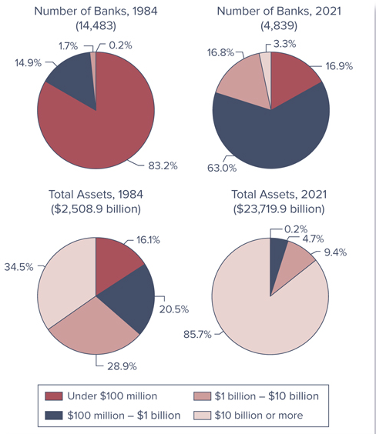
U.S. Bank Asset Concentration,
1984 versus 2021
©McGraw Hill LLC. All rights reserved. No reproduction or distribution without the prior written consent of McGraw Hill.

Slide 20
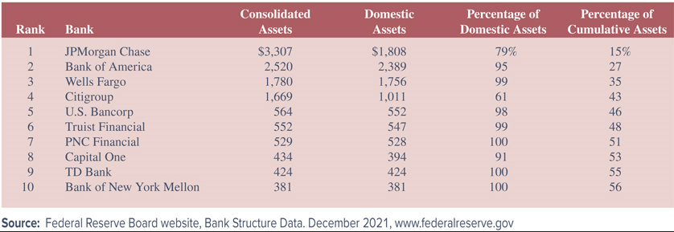
Top Ten U.S. Banks Listed by Total Assets, 2021
(in billions of dollars)
11-20
©McGraw Hill LLC. All rights reserved. No reproduction or distribution without the prior written consent of McGraw Hill.
Notes:
The largest 10 U.S. banks as of 2021 are listed in Table 11–3. The ranking is by consolidated assets at the holding company level. The table also lists size of the domestic assets and domestic assets as a percentage of consolidated assets. The last column shows cumulative consolidated assets as a percentage of the sum of consolidated assets for all banks.
Thus, the top 10 U.S. banks represent 56 percent of consolidated assets for all banks.

Slide 21
Bank Size and Activities
Size has traditionally affected the types of activities and financial performance of commercial banks
Small banks typically focus on the retail side
  Generally hold fewer OBS assets and liabilities than large banks
  Rarely hold derivative securities
  More sheltered from competition in highly localized markets
  Lend to smaller, less sophisticated customers than do large banks
11-21
©McGraw Hill LLC. All rights reserved. No reproduction or distribution without the prior written consent of McGraw Hill.

Slide 22
Bank Size and Activities
(Continued)
Large banks usually engage in both retail and wholesale banking, but focus on the wholesale side of the business
  Operate with lower amounts of equity capital than do small banks
  Tend to use more purchased funds and have fewer core deposits
  Lend to larger corporations, which means their interest rate spreads (i.e., the difference between their lending rates and deposit rates) and net interest margins (i.e., interest income minus interest expense divided by earning assets) have usually been narrower than those of smaller regional banks
  Pay higher salaries and invest more in buildings and premises
  Diversity their operations and services more than small banks
  Generate more noninterest income than small banks
11-22
©McGraw Hill LLC. All rights reserved. No reproduction or distribution without the prior written consent of McGraw Hill.

Slide 23
Industry Performance
Strong performance of commercial banks during early 2000s
  Federal Reserve cut interest rates 13 times during this period
  Lower interest rates made home purchasing more affordable
  Development of new financial instruments helped banks shift credit risk from their balance sheets to financial markets and other FIs, such as insurance companies
  Improved IT helped banks manage their risk better
Rising interest rates in mid-2000s caused performance to decline, but not significantly
  Third quarter 2006 earnings represented the second highest quarterly total ever reported by the industry
  Industry’s core capital ratio increased to 10.36%, the highest level since new, risk-based capital ratios were implemented in 1993
  No FDIC-insured banks failed during 2005 or 2006
11-23
©McGraw Hill LLC. All rights reserved. No reproduction or distribution without the prior written consent of McGraw Hill.

Slide 24
Industry Performance
(Continued)
Performance deteriorated in late 2000s as U.S. economy experienced its strongest recession since Great Depression
  For all of 2007, net income was $99.94 billion, a decline of $45.28 billion (31.1 percent) from 2006
  Average ROA for 2007 was 0.81 percent, the lowest yearly average since 1991 and the first time in 15 years that the industry’s annual ROA had been below 1 percent
  One in four institutions (25.0 percent) was unprofitable in 2008
Bank performance slowly recovered in 2010 – 2016
  2010 industry ROA and ROE increased to 0.65% and 5.85%, respectively; by 2016, industry ROA and ROE increased to 1.04% and 9.27%, respectively
  By the end of 2019, 96.4 percent of banks were profitable
  ROA and ROE declined due to COVID-19 but fully recovered to pre-pandemic levels in 2021
©McGraw Hill LLC. All rights reserved. No reproduction or distribution without the prior written consent of McGraw Hill.
11-24

Slide 25
Regulators
U.S. banks may be subject to the supervision and regulations of as many as four separate regulators:
  Federal Deposit Insurance Corporation (FDIC) was established in 1933 and insures deposits of commercial banks
    Acts as receiver and liquidator when insured bank is closed
    Manages the Depositors Insurance Fund, or DIF
  Office of the Comptroller of the Currency (OCC) is the oldest U.S. bank regulatory agency, established in 1863
    Primary function is to charter (and close) national banks
  Federal Reserve System (FRS) serves as the country’s central bank, has regulatory power over some banks, and where relevant, their holding company parents
  State bank regulators perform function similar to those the OCC performs, but only for state-chartered commercial banks
11-25
©McGraw Hill LLC. All rights reserved. No reproduction or distribution without the prior written consent of McGraw Hill.

Slide 26
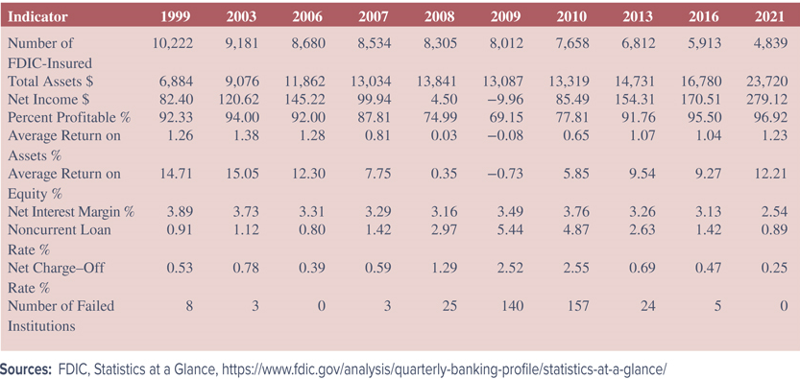
Selected Indicators for U.S. Commercial Banks:
1999 through 2021
11-26
©McGraw Hill LLC. All rights reserved. No reproduction or distribution without the prior written consent of McGraw Hill.
Notes:
Table 11–4 presents selected performance ratios for the commercial banking industry for 1999 through 2021.
The performance in the late 1990s and early and mid-2000s was quite an improvement from the recessionary and high interest rate conditions in which the industry operated in the late 1980s. As reported in Table 11–4, the average ROA and ROE for commercial banks in the early 2000s was as high as 1.38 percent and 15.05 percent, respectively, compared to 1989 when ROA and ROE averaged 0.49 percent and 7.71 percent, respectively.

Slide 27
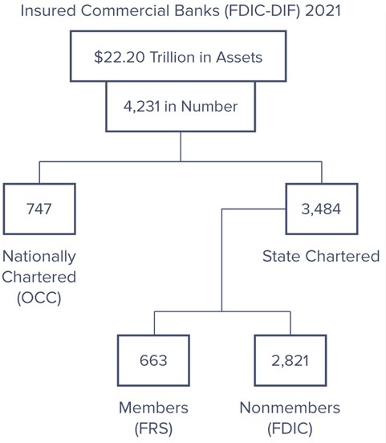
Bank Regulators
©McGraw Hill LLC. All rights reserved. No reproduction or distribution without the prior written consent of McGraw Hill.
11-27
Notes:
All 747 nationally chartered banks shown in Figure 11–8 are automatically members of the Federal Reserve System (FRS). In addition, 663 of the state-chartered banks have also chosen to become members.

Slide 28
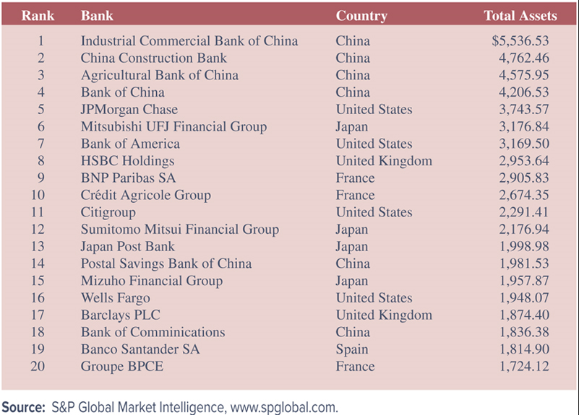
The 20 Largest (in Total Assets) Banks in the World, 2022
©McGraw Hill LLC. All rights reserved. No reproduction or distribution without the prior written consent of McGraw Hill.
11-28
Notes:
Table 11–5 lists the 20 largest banks in the world, measured by total assets (in billions of dollars), as of April 2022.
Chinese banks dominate the list as 4 of the top 5 banks are headquartered in China.
Only 4 of the top 20 banks are U.S. banks.

Slide 29
Global Issues
Advantages of international expansion
  Risk diversification
  Economies of scale
  Innovations
  Funds source
  Customer relationships
  Regulatory avoidance
Disadvantages of international expansion
  Information/monitoring costs
  Nationalization/expropriation
  Fixed costs
©McGraw Hill LLC. All rights reserved. No reproduction or distribution without the prior written consent of McGraw Hill.
11-29

Slide 30
Global Banking Performance
The financial crisis of 2008-2009 spread worldwide and banks saw losses that were magnified by illiquid markets
  Largest banks in the Netherlands, Switzerland, and the U.K. had net losses in 2008
  Banks in Ireland, Spain, and the U.K. were especially hard hit because they had large investments in mortgages and mortgage-backed securities, both U.S. and domestic
Many European banks averted outright bankruptcy thanks to direct support from their central banks and national governments
©McGraw Hill LLC. All rights reserved. No reproduction or distribution without the prior written consent of McGraw Hill.
11-30

Slide 31
Global Banking Performance (Continued)
Greece suffered a severe debt crisis in the spring of 2010
  Problems from the Greek banking system then spread to other European nations, such as Portugal, Spain and Italy
  The situation stabilized after 2012, but a major debt payment was due from Greece to creditors on June 30, 2015
    Deal was reached that required Greece to surrender to all its creditors’ demands, including tax increases, pension reform, and the creation of a fund (under European supervision) with state-owned assets earmarked to be privatized or liquidated
European banking system was rocked again in June 2016 with “Brexit”
  The EU and the UK Trade and Cooperation Agreement was signed on December 30, 2020, and entered into force on May 1, 2021
11-31
©McGraw Hill LLC. All rights reserved. No reproduction or distribution without the prior written consent of McGraw Hill.

