Slide 1
MAT 304 Data Analysis & Reporting
Chapter 2
The Research Process

Slide 2
Characteristics of Research
Characteristics of research determine whether a research is free of biases, prejudices, and subjective errors or not. The terms are very commonly used in research and the success of any research depends on these terms. They can be summarised as:
1. Generalized
2.Controlled
3. Rigorous
4. Empirical
5. Systematic
6. Reliability
7. Validity
8. Employs hypothesis
9. Analytical & Accuracy
10. Credibility
11. Critical

Slide 3
Characteristics of Research
1. Generalised: The sample is the representative of the identified population and the findings on the sample should be applicable to the entire population.
E.g. A study on the small hotels and resort in a given city (Adana) would involve the researcher studying selected properties after the city is divided into zones (East, West, North, South and Central). He may also divide the properties on the basis of number of rooms for categorisation and selection for study purposes thus ensuring that the findings are representative of entire city.
2. Controlled: The concept of control implies that, in exploring causality in relation to two variables (factors), you set up your study in a way that minimizes the effects of other factors affecting the relationship
E.g. Destination studies are not controllable as they have variables like geography, climate, accessibility, seasonality, etc but studying the effects of standard operating procedures in a hotel applied in a particular service can be controlled.

Slide 4
Characteristics of Research
4. Empirical: (deneysel)
The processes adopted should be tested for the accuracy and each step should be coherent in progression. This means that any conclusions drawn are based upon firm data gathered from information collected from real life experiences or observations.
Empirical nature of research means that the research has been conducted following rigorous scientific methods and procedures. Quantitative research is easier to prove scientifically than qualitative research. In qualitative research biases and prejudice are easy to occur.
3. Rigorous:
One must be careful in ensuring that the procedures followed to find answers to questions are relevant, appropriate and justified. Again, the degree of rigor varies markedly between the physical and social sciences and within the social sciences.

Slide 5
Characteristics of Research
5. Systematic:
Chaotic or disorganized procedures would never yield expected outcomes. The steps should follow a logical sequence to get to the desired outcome.
E.g The meal in a fine dine restaurant at a five star hotel cannot commence with dessert being served before the starter or soup course.
6. Reliability:
This is a the degree to which the result of a measurement, calculation, or specification can be depended on to be accurate.
If any research yields similar results each time it is undertaken with similar population and with similar procedures, it is called to be a reliable research.

Slide 6
Characteristics of Research
7. Validity & Verifiability:
It is the extent to which a concept, conclusion or measurement is well-founded and likely corresponds accurately to the real world.
Validation refers to accuracy of measurement whether or not it measures what it is supposed to measure.
The findings of a study should be verifiable by the researcher as well as anyone else who wants to conduct the study on similar guidelines/ under similar conditions.
8. Employs Hypothesis:
Any research definitely begins with formulation of a hypothesis.
A hypothesis can be defined as an educated guess about the relationship between two or more variables
A question is what forms the base and is later termed as hypothesis and it may or may not draw a logical outcome.
Part of the research process involves testing the hypothesis, and then examining the results of these tests Hypothesis may prove to be wrong or null or void after the study is conducted.

Slide 7
Characteristics of Research
9. Analytical & Accurate : Data collected should be reasonable and free of errors to be easily analysed.
Accuracy also measures whether research tools have been selected in best possible manner and research procedures suits the research problem or not. Selection of appropriate data collection tools is essential for a research.
E.g. Guest Comments Card in hotels or Feedback Collection Card in a dining outlet gives the guest a chance to be honest in commenting about the standard of services in comparison to asking them to give a verbal feedback.
10. Credibility: The extent to which an analysis of finding can be treated to be trustworthy is tremed as credibility.
The research study conducted based on primary data is always reliable and carries more credibility.
Researches based on secondary data are not reliable as such data may have been manipulated or distorted by earlier researchers to suit their work.
A certain percentage of secondary data can be used if the primary source is not available but basing a research completely on secondary data when primary data can be gathered is least credible.

Slide 8
Characteristics of Research
11. Critical: Critical scrutiny ( dikkatli inceleme) of the procedures used and the methods employed is crucial to a research enquiry. The process of investigation must be foolproof and free from drawbacks. The process adopted and the procedures used must be able to withstand critical scrutiny.

Slide 9
Business Research and the Internet

Slide 10
Primary Research
Primary data are collected directly from respondents using data collection methods like survey interviews, questionnaires, measurements, direct observations. There are various advantages in conducting online surveys compared with traditional survey methods. These include the following:
The responses and feedback can be obtained faster.
Costs for conducting online surveys are less compared with traditional survey methods.
Questionnaires can be delivered to the respondents faster.
Confidentiality is maintained as only the recipients read the questionnaire.
Respondents can reply to the questionnaire at their convenience.
Apart from online surveys, organizations are also conducting online focus groupstudies.
Although there are several advantages in using the Internet, there are certain drawbacks as well. Online surveys lack face-to-face interaction. Also, lack of accessibility of the Internet among the population compared with other media is a major limitation.

Slide 11
Secondary Research
Secondary data are the data that already exist which have been collected by some other person or organization for their use and are generally made available to other researchers free or at a concessional rate. Major use of the Internet in business research is in the area of secondary research.
The research reports and databases maintained by major research companies are also available on the net. This makes it faster, economical and reliable for companies to know about competitor activities.
The very essence of the Internet as a major source of secondary information probably springs forth from the advantages of its broad scope, covering virtually every topic and the reasonable cost in acquiring them.

Slide 12
Business research can be defined as a systematic and objective process of gathering, recording and analysing data to guide business decision-making.
Business research is mainly used to reduce the uncertainty of decisions. Marketing, finance, human resources, and manufacturing are some of the areas of business research that are covered in an organization.
Three types of business research studies are mainly employed by organizations: market research, operations research and motivational research.
Basic research refers to a focused, systematic study or investigation undertaken to discover new knowledge or interpretations and establish facts or principles in a particular field. Applied research refers to investigation undertaken to discover the applications and uses of theories, knowledge and principles in actual work or in solving problems.
The key objective of any business research is to provide accurate, relevant and timely information to the top management, so that they can make effective decisions.
In business, decision-making goes through four key interrelated stages: problem/ opportunity identification, problem/opportunity selection, problem/opportunity resolution and implementing the course of action. Business research helps the management in each of these stages by providing useful and timely information.

Slide 13
Steps in the Research Process

Slide 14
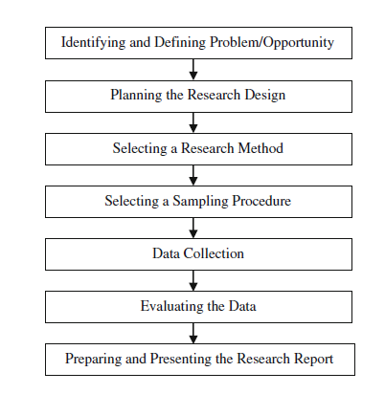

Slide 15
1. Identifying and Defining the Research Problem
The initial step in the research process is the identification of the problem
A research problem is a definite or clear expression [statement] about an area of concern, a condition to be improved upon, a difficulty to be eliminated, or a troubling question that exists in scholarly literature, in theory, or within existing practice that points to a need for meaningful understanding and deliberate investigation.
A research problem does not state how to do something.
E.g. understanding economic background of society may not address the issues of unemployment in the same society therefore unemployment needs to studied differently and individually to assess the underlying problems.

Slide 16
Some sources of Research Problems may be identified as follows:
Personal Experiences.
Media: Documentation done on various issues, live coverage, panel discussions etc.
Resources: Literature such as books, journals, news articles, periodicals etc may facilitate the researcher to identify a relevant problem based on the area of interest.
Government / Official Records: The orders passed by government. The decisions given in various cases by courts, the petitions and surveys conducted become important sources to shortlist finer prints in abrader problem.
People: A group of individuals may be studied to understand how they behave, how tiny respond to a particular situation do or what responses are generated when they are influenced from within or outside the group.
Discussions: A researcher may be able to come to a conclusion to identify a research problem by discussing the perspectives with peers, colleagues, seniors in the field, guides etc.
Problems: It may be decided to examine the existence of certain issues or problems relating to society, sciences or any subjects in reference.
Programs: These may be used to evaluate the effectiveness of an interference, involvement or intrusions.
Phenomena: To establish the existence of regularity and to understand if a procedure would yield similar results overtime when used repetitively. This includes causes and effects and relationships between variables.
Ideas from external sources.
Interdisciplinary Perspectives

Slide 17
As businesses today operate in a highly volatile environment governed by various macro environmental factors, they need to constantly assess their relative position and identify the various problem areas or opportunities they need to work upon in order to sustain themselves competitively in the market.
For instance, a company producing cell phone wave protectors (devices that protect the cell phone from harmful radiations) may realize that its new product is not selling, but it may not know the reason for this at the outset. Although it has identified the problem in a broader perspective, in terms of what is to be researched. They need to define the problem specifically.
A researcher can focus his efforts on collecting relevant information, if the problem is defined properly.
If a company wants to define a research problem such as declining sales, it needs to explore the research problem further through exploratory research.

Slide 18
Exploratory Research
Exploratory research aims at understanding the topic being researched.
This process involves evaluating the existing studies on related topics, discussing the problem with experts, analysing the situation and so on.
At the end of this process, the researchers should be clear about what type of information needs to be gathered and how the research process should proceed.
Secondary data analysis (from magazines, journals, online articles, company literature, etc) and pilot studies are the most popular tools used in exploratory research.
E.g. For our problem of low sales, since it is a new product in the market, it may be difficult to obtain information but can use pilot studies that involve collecting data from the actual respondents in order to gain insight into the topic and help the researcher in conducting a larger study

Slide 19
Important Considerations In Selecting A Research Problem:
A good problem statement begins by introducing the broad area in which you research focuses on, so that you lead the reader to the specific issues you are investigating. A good research problem should include the following statements:
Persuasive Topic:
Viability
The So What Test:

Slide 20
Process Of Formulation Of A Research Problem:
An appropriate statement of research problem would need the researcher to follow the follow certain steps to be able to arrive at the expected outcome with an addition of reasonable new knowledge.
1. Developing a Conceptual Framework:
Before making a short list of the last elements to be studied, the researcher must conceptualize, identify, and choose an expansive discipline.
Consider the set of questions that will best address the issue and create objectives that answer these questions.
E.g. The project report for a new hotel would include feasibility studies, market and competitor evaluations, budgetary and resource requirements, as well as any required licenses and approvals.

Slide 21
Process Of Formulation Of A Research Problem:
2. Referring the available literature on the problem:
An extensive literature reference is necessary to find out the available information about the identified problem.
It is the study of available knowledge in the field and esp. in the perspective of problem stated by the researcher.
It provides a description, summary, and critical evaluation of these works in relation to the research problem being investigated.
To carry out review of literature, you need to locate, read and evaluate research documents, reports as well as thesis and other sources of academic materials.
E.g. The reservation manager researches past occupancy trends for the previous two to three years to project future business volumes.

Slide 22
Process Of Formulation Of A Research Problem:
The reference to the available literature and the reviewing it has the following advantages:
Brings clarity and focus to the research problem;
Improves the methodology:
Expands knowledge base in the research area:
Contextualizes your findings:

Slide 23
Procedure for reviewing the literature:
a) Explore the existing literature in your area of study;
b) Review the literature selected;
c) Develop a theoretical framework;
d) Develop a conceptual framework.

Slide 24
a) Explore the available literature: It is essential to have at least a general understanding of the topic area and the issue that needs to be researched in order to define search criteria and conduct an efficient literature search in the area of interest. The creation of a bibliography for this large subject using books, magazines, and journals comes after.
b) Review the literature chosen: The chosen literature must be critically examined in order to draw connections between the research problem and the ideas covered in earlier publications. The findings for each of the relevant subtopics or subareas can be recorded separately by the researcher and then combined later. For easier comparison and analysis, the results may then be organized in a table fashion depending on these factors or themes. Summarize the information where it logically goes under the previously developed assumption as the reading and referencing continue.
Read critically with particular reference to the following aspects:
Notice whether the facts supporting your theoretical framework have been definitely proven.
Note the theories put forward, the criticisms of these and their basis, the methodologies adopted and the criticisms of them.
Examine to what extent the findings can be generalized to other situations. Determine the places where little or nothing is known-the gaps in the body of knowledge.

Slide 25
c) Develop a theoretical framework:
Theoretical framework consists of concepts and, together with their definitions and reference to relevant scholarly literature, existing theory that is used for a particular study. This framework must demonstrate an understanding of theories and concepts that are relevant to the research study and that relate to the broader areas of knowledge being considered.
Therefore, we can conclude that theoretical framework and review of literature are complementing each other. A theoretical framework cannot be developed if we do not look into the literature and inversely if we do not have a good theoretical framework; it is not possible to do an effective review of the literature

Slide 26
✓ Autobiographies
✓ Correspondence: email, letters
✓ Descriptions of travel
✓ Diaries,
✓ Eyewitnesses
✓ Oral histories
✓ Literary works
✓ Interviews
✓ Personal narratives
✓ First-hand newspaper and magazine accounts of events
✓ Legal cases, treaties
✓ Statistics, surveys, opinion polls,
✓ Cartoons, postcards, posters
✓ Records of organizations, government agencies (e.g. annual reports, treaties, constitutions, government documents)
Types of Literature:
Primary Literature: Primary sources means original study, based on direct observation, use of statistical records, interviews, or experimental methods, of actual practices or the actual impact of practices or policies. They are authored by researchers, contain original research data, and are usually published in a peer-reviewed journal. Printed Literature Sources:
✓ Diaries
✓ Letters
✓ Speeches
✓ Patents
✓ Photographs
✓ Newspaper articles
✓ Journal articles
✓ Theses and dissertations
✓ Survey Research (e.g., market surveys, public opinion polls)
✓ Proceedings of Meetings, conferences and symposia
✓ Original Documents (i.e. birth certificates, wills, marriage licenses, trial transcripts)

Slide 27
Electronic Sources of Literature:
✓ Internet
✓ E-mail communication
✓ Interviews (e.g., telephone, e-mail)
✓ Video recordings (e.g. television programs)
✓ Audio recordings (e.g. radio programs)
✓ Web sites
✓ Communications through social networking applications (e.g. Face book, blogs, RSS, U-tube etc.)
Secondary Literature: Secondary literature consists of interpretations and evaluations that are derived from or refer to the primary source literature. Examples include review articles (such as meta-analysis and systematic reviews) and reference
✓ Biographical works
✓ Commentaries
✓ Criticisms
✓ Dictionaries
✓ Histories
✓ Journal articles (depending on the discipline, these can be primary)
✓ Magazine and newspaper articles (this distinction varies by discipline)
✓ Monographs, other than fiction and autobiography
✓ Textbooks (also considered tertiary)
✓ Websites (also considered primary)
✓ Biographies, Encyclopaedias, dictionaries, handbooks
✓ Textbooks & monographs on a topic
✓ Literary criticism & interpretation
✓ History & historical criticism
✓ Political analyses
✓ Reviews of law and legislation
✓ Essays on morals and ethics
✓ Analyses of social policy
✓ Study and teaching material
✓ Articles, such as literature reviews,
✓ Commentaries, research articles in all subject disciplines
✓ Criticism of works of literature, art and music
works.

Slide 28
Writing up the literature review: In order to comply with the first function of literature review i.e. to provide theoretical background to your study:
When reading the available literature, underline the major themes and give them the proper headings.
Change the main headings into subheadings that are precise, descriptive of the theme in question, and follow a logical progression.
Record the significant findings under these subheading with respect to the theme in question, highlighting the reasons for and against an argument if they exist, and identify gaps and issues.

Slide 29
What are the parts of literature review?
A literature review can be a part of a research paper or scholarly article, usually falling after the introduction and before the research methods sections
Introduction:
An introductory paragraph that explains what your working topic and thesis is
A forecast of key topics or texts that will appear in the review
Potentially, a description of how you found sources and how you analyzed them for inclusion and discussion in the review (more often found in published, standalone literature reviews than in lit review sections in an article or research paper)
Body:
Summarize and synthesize: Give an overview of the main points of each source and combine them into a coherent whole
Analyze and interpret: Don’t just paraphrase other researchers – add your own interpretations where possible, discussing the significance of findings in relation to the literature as a whole
Critically Evaluate: Mention the strengths and weaknesses of your sources
Write in well-structured paragraphs: Use transition words and topic sentence to draw connections, comparisons, and contrasts.
Conclusion:
Summarize the key findings you have taken from the literature and emphasize their significance
Connect it back to your primary research question

Slide 30
Bibliography
https://www.sciencebuddies.org/science-fair-projects/science-fair/writing-a-bibliography-apa-format

Slide 31
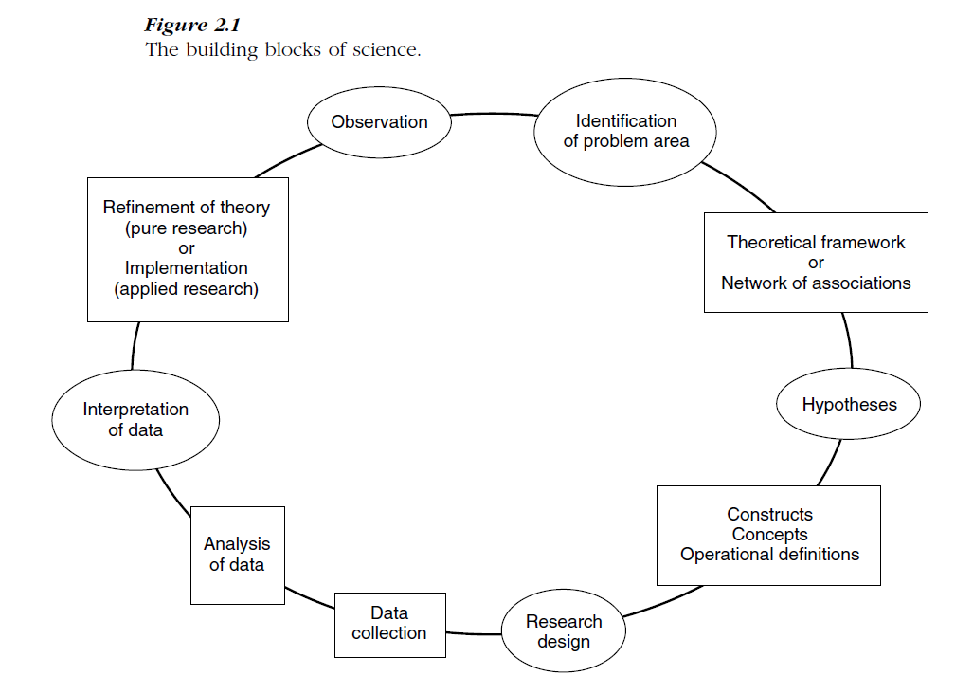

Slide 32
A sales manager might observe that customers are perhaps not as pleased as they used to be. The manager may not be certain that this is really the case but may experience anxiety and some uneasiness that customer satisfaction is on the decline. This process of observation or sensing of the phenomena around us is what gets most of the research—whether applied or basic—started. The next step for the manager is to determine whether there is a real problem, and if so, how serious it is. This problem identification calls for some preliminary data gathering. The manager might talk casually to a few customers to find out how they feel about the products and customer service. During the course of these conversations the manager might find that the customers like the products but are upset because many of the items they need are frequently out of stock, and they perceive the salespersons as not being helpful. From discussions with some of the salespersons, the manager might discover that the factory does not supply the goods on time and promises new delivery dates that it fails on occasions to keep. Salespersons might also indicate that they try to please and retain the customers by communicating the delivery dates given to them by the factory.

Slide 33
Integration of the information obtained through the informal and formal interviewing process has helped the manager to determine that a problem does exist. It also helps the manager to formulate a conceptual model or theoretical framework of all the factors contributing to the problem. In this case, there is a network of connections among the following factors: delays by the factory in delivering goods, the notification of later delivery dates that are not kept, the promises of the salespersons to the customers (in hopes of retaining them) that cannot be fulfilled, all of which contribute to customer dissatisfaction.
From the theoretical framework, which is a meaningful integration of all the information gathered, several hypotheses can be generated and tested to determine if the data support them. Concepts are then operationally defined so that they can be measured. A research design is set up to decide on, among other issues, how to collect further data, analyze and interpret them, and finally, to provide an answer to the problem. The process of drawing from logical analysis an inference that purports to be conclusive is called deduction.

Slide 34
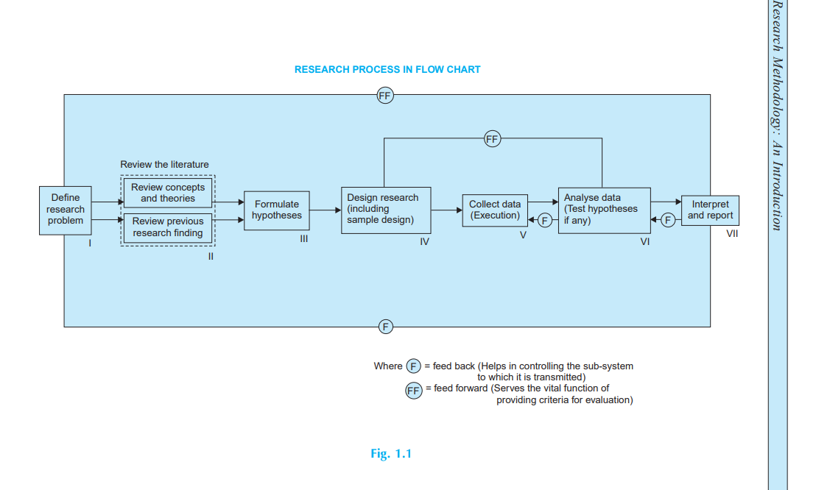

Slide 35
The Research Design

Slide 36
Preparing the Statement of Research Objectives
Once the problem is clearly defined, it becomes absolutely essential to determine the objectives of the research
The statement of objectives should be:
as precise as possible.
Be brief and specific
Limit the number of objectives
If the objective of the research is to study the perceptions of the customer, a typical research question could be: ‘Do the customers perceive the radiations from their cell phones to be hazardous to health?’
Once the objectives and the research questions are identified, a researcher has to develop a hypothesis statement that reflects these research objectives.

Slide 37
The objectives provide an accurate description of the specific actions you will take in order to reach the aim. An objective is measurable and operational. It tells specific things you will accomplish in your project. The objective should be as clearly and crisply stated as possible. Usually only one or at the most two objectives should be taken up in one study. If there are more than two objectives, then it may be appropriate to address the additional objectives through a separate study. Objectives are the goals set out to attain in a study.
They inform a reader what you want to attain through the study.
It is extremely important to word them clearly and specifically.
Characteristics of Objectives:
1. Specific: Precisely what you mean to achieve. 2. Important: Indicate the relevance/importance of study. 3. Measurable: What you would do/measure in terms of studying an issue. 4. Practical: They should offer a solution to a problem. 5. Realistic: Vague objectives should be avoided. Any objective that is not practically achievable should be ignored. 6. Feasible: Researcher should be able to practice and perform as per stated objectives. 7. Evaluable: These objectives set forth for study have to be such that they can be evaluated in different situations and using tools for research.
The objectives should be SMART.
• Specific • Measurable • Achievable • Relevant • Time bound

Slide 38
For Example:
Descriptive studies:
To describe the types of incentives provides by Hotel XYZ to employees in Mumbai.
To find out the opinion of the employees about the medical facilities provided by five star hotels in Mumbai.
Co-relational studies:
To ascertain the impact of training on employee retention.
To compare the effectiveness of different loyalty programmes on repeat clientele.

Slide 39
Types of Research Designs
Research design can be a quantitative or qualitative research with have extensive components. They can both be used or applied distinctively or together.
Quantitative Research design: A quantitative research design shares similar characteristics with a scientific research in the following ways:
An outline question stating the problem that needs to be solved.
Has a set order and procedure used to answer these questions?
Analyses the data generated.
Draws its conclusion after the data has been collated and analyzed so that the conclusion drawn from the findings are not predetermined.
A quantitative research design is used to examine the relationship between variable by using numbers and statistics to explain and analyze its findings

Slide 40
Type of Research Design
Qualitative Research Design: Qualitative research design, on the other hand, is exploratory in nature as it tries to discover not guess the conclusion. It seeks to answer the questions what and how. It is a process to identify or develop a hypothesis that is further tested using other techniques.
A qualitative research design is used to explore the meaning and understanding of complex social environments, like the nature of experiences gained by a tourist by reading about the texts and stories shared by them.
It also intends to understand, describe or discover the findings. The researcher is usually the primary instrument that formulates the question and interprets the meaning of a data. The data used are mostly documented words from interview, newspapers videos etc. More than one type of data is collected during this research, from the field, where the participants are. In other words, the research goes beyond the intended scope, so making it emergent because the method of research changes and different types of data might be collected as the research goes on.

Slide 41
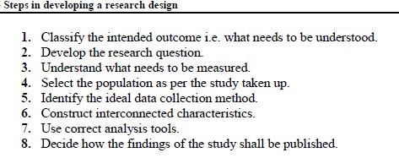

Slide 42
Developing the Hypotheses
A hypothesis is a statement based on some presumptions about the existence of a relationship between two or more variables that can be tested through empirical data.
When a researcher is developing a hypothesis, he/she will try to assume an answer for a particular research question and then test it for its validity.
For instance, if the research question is—‘Why are the sales of refrigerators going up in winter? In this case, the hypothesis could be—‘The sales of refrigerators are going up during winter due to off-season discounts’
If a research study is to be conducted about the consumption patterns of tea and coffee in India, the hypothesis could be: ‘Consumption of tea is higher in North India and coffee in South India because of the varying lifestyles of these two regions’. This hypothesis adds factors of geographic location and lifestyle to the research problem

Slide 43
Developing the Hypotheses
For example, if a company wants to know whether its sales will increase, then a hypothesis—‘The sales will increase’ versus ‘The sales will not increase’ will add little value to the research question as they are almost the same as the research question itself. Once the hypothesis is developed, the next stage in the research process, the research design phase, begins.
Hypotheses specify the relationship between at least two variables,and are testable. For a hypothesis to function properly, other researchers must be able to reproduce the results that prove or disprove it.
The researcher does not know about a phenomenon, but has an intuition to form the basis of certain assumption or guesses. These are tested by collecting information that will enable you to conclude if your assumption was correct.

Slide 44
A hypothesis is used in an experiment to define the relationship between two variables. The purpose of a hypothesis is to find the answer to a question. A formalized hypothesis will force us to think about what results we should look for in an experiment.
The first variable is called the independent variable. This is the part of the experiment that can be changed and tested. The independent variable happens first and can be considered the cause of any changes in the outcome. The outcome is called the dependent variable.
The verification process can have one of the three outcomes. Your assumption may prove to be:
1. Right;
2. Partially right; or
3. Wrong.

Slide 45
Independent variables are variables that stand on their own and aren’t affected by anything that you, as a researcher, do. You have complete control over which independent variables you choose. During an experiment, you usually choose independent variables that you think will affect dependent variables. Those are variables that can be changed by outside factors. If a variable is classified as a control variable, it may be thought to alter either the independent variable or dependent variable but it isn’t the focus of the experiment.
Example: you want to know how calorie intake affects weight. Calorie intake is your independent variable and weight is your dependent variable. You can choose the calories given to participants, and you see how that independent variable affects the weights. You may decide to include a control variable of age in your study to see if it affects the outcome.

Slide 46
The six most common forms of hypotheses are:
1. Simple Hypothesis.
2. Complex Hypothesis.
3. Empirical Hypothesis.
4. Null Hypothesis (Denoted by "HO")
5. Alternative Hypothesis (Denoted by "H1")
6. Logical Hypothesis.
7. Statistical Hypothesis.
If enough evidence accumulates to support a hypothesis, it moves to the next step — known as a theory — in the scientific method and becomes accepted as a valid explanation of a phenomenon.
The null hypothesis, H0 is the commonly accepted fact; it is the opposite of the alternate hypothesis. Researchers work to reject, nullify or disprove the null hypothesis. Researchers come up with an alternate hypothesis, one that they think explains a phenomenon, and then work to reject the null hypothesis.
Null hypothesis: H0: The world is flat.
Alternate hypothesis: The world is round.

Slide 47
file:///C:/Users/Duygu/Downloads/215-Article%20Text-1032-3-10-20220526.pdf
https://www.shs-conferences.org/articles/shsconf/pdf/2023/04/shsconf_sdmc2022_02006.pdf
file:///C:/Users/Duygu/Desktop/%C4%B0%C4%B0BF%202022/MAT%20304/social%20media%20article%20with%20hypothesis.pdf

Slide 48
Proper Data Collection
• Proper Conclusion
• A proper formulated hypothesis may lead to a good reasonable, utilized and proper conclusion. If the hypothesis is better than the conclusions drawn by a researcher would be better for solution of a problem.
• The formulation of hypothesis provides a study with focus. It tells you what specific aspects of a research problem to investigate.
• A hypothesis tells you what data to collect and what not to collect, thereby providing focus to the study.
• As it provides a focus, the construction of a hypothesis enhances objectivity in a study.
• A hypothesis may enable you to add to the formulation of a theory. It enables you to specifically conclude what is true or what is false.
e. Hypothesis should be very specific and limited to the piece of research in hand because it has to be tested.

Slide 49
How does one go about developing working hypotheses? The answer is by using the following approach:
(a) Discussions with colleagues and experts about the problem, its origin and the objectives in seeking a solution;
(b) Examination of data and records, if available, concerning the problem for possible trends, peculiarities and other clues;
(c) Review of similar studies in the area or of the studies on similar problems; and
(d) Exploratory personal investigation which involves original field interviews on a limited scale with interested parties and individuals with a view to secure greater insight into the practical aspects of the problem.

Slide 50
If you are going to propose a hypothesis, it’s customary to write a statement. Your statement will look like this: “If I…(do this to an independent variable)….then (this will happen to the dependent variable).” For example:
If I (decrease the amount of water given to herbs) then (the herbs will increase in size).
If I (give patients counseling in addition to medication) then (their overall depression scale will decrease).
If I (give exams at noon instead of 7) then (student test scores will improve).
If I (look in this certain location) then (I am more likely to find new species).
A good hypothesis statement should:
Include an “if” and “then” statement (according to the University of California).
Include both the independent and dependent variables.
Be testable by experiment, survey or other scientifically sound technique.
Be based on information in prior research (either yours or someone else’s).
Have design criteria (for engineering or programming projects).

