Slide 1
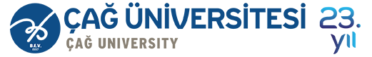

Course Title
Financial Literacy
Course Coordinator
Assist.Prof.Dr. Gökhan Sökmen
Research Assistant
Gözde Elbir

Slide 2
Learning Objectives
After studying this chapter;
You will be able to know sources of financial resources and accounting system,
You will be able to know financila statement,
You will be able to explain cash flow statement, income statement and balance sheet,
You will be able to define assets, liabilities and equity,
You will be able to know link between balance sheet and income statement,
You will be able to create balance sheet and income statement.

Slide 3
Understanding the Business
Sources of Financial Resources
Stockholders
Creditors
Potential Return for Stockholders:
Dividends
Higher future stock prices
Potential Return for Creditors:
Interest

Slide 4


The Accounting System and Decision Makers
Accounting System
Financial Accounting Reports
Periodic financial statements and related disclosures
External Decision Makers
Evaluate the company
Managerial Accounting Reports
Detailed plans and continuous performance reports
Internal Decision Makers
Run the company
provided to
Creditors
Investors
Managers

Slide 5
What is a Financial Statement?
A financial statement is a quantitative way of showing how a company is doing.
Three different ways of representing the financial state of a company:
Cash Management (can the company meet its obligations?)
Profitability (Is it making money?) - the income statement
Assets versus Liabilities (what is the value of the company? Who owns what?) - the balance sheet
Each one of these questions is answered by the Financial Statements.

Slide 6
Cash Flow Statements
  These answer the important managerial question “do I have enough cash to run my business”
Income Statements
  This is the financial sheet that tells you if your company is profitable or not.
Balance Sheets
  How much debt do I have? How large are my assets? This sheet tells you the answer to these questions.

Slide 7
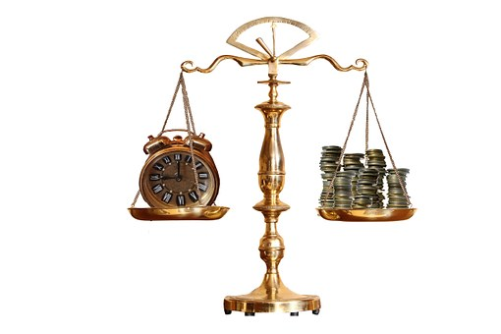
Time Period & Structure
The tables can be prepared at any point in time such as:
End of the year (for the year ended, annual reports)
Quarterly (for the quarter ended, quarterly reports)
Monthly (for the month ended, monthly reports)
The financial statement heading includes:
Name of the entity (Company name)
Title of the statement (e.g., Balance Sheet)
Specific date of the statement (e.g., at December 31, 2018)
Unit of measure (in millions of dollars)

Slide 8

The Balance Sheet
Definition
  Financial statement that shows the value of the firm’s assets and liabilities at a particular time (from an accounting perspective)

Slide 9
The Balance Sheet
Fred’s Factory 31.12.2018 Balance Sheet
Assets | Liabilities
Current Assets Cash Account receivable Inventories Prepaid expenses Other current assets Fixed Assets Building Land Vehicles Investments Equipment Intangibles | Current Liabilities Accounts payable Accrued expenses Short-term loans Taxes payable Long-term Liabilities Equity Common stock Retained Earnings
Total Assets = Total Liabilities and equity
The Balance Sheet is a financial snapshot at a specific point in time.

Slide 10
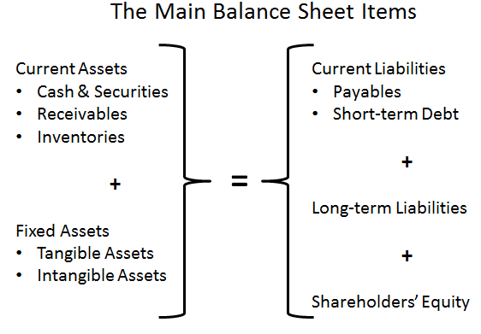
The Balance Sheet

Slide 11
The Balance Sheet
EXPLANATION
Name of the entity
Title of the statement
Specific date of the statement
Unit of measure
Resources controlled by the company
Amount of cash in the company’s bank accounts
Amounts owed by customers from prior sales
Ingredients and beverages ready for sale
Factories, production equipment, and land
Total amount of company’s resources
Sources of financing for company’s resources
Financing supplied by creditors
Amounts owed to suppliers for prior purchases
Amounts owed to banks on written debt contracts
Financing provided by stockholders
Amounts invested in the business by stockholders
Past earnings not distributed to stockholders
Total sources of financing for company’s resources
LE-NATURE’S INC.
Balance Sheet
At December 31, 2015
(in millions of dollars)
Assets:
Cash $ 10.6
Accounts receivable 6.6
Inventories 51.2
Property, plant, and equipment 459.0
Total assets $527.4
Liabilities and stockholders’ equity:
Liabilities
Accounts payable $ 26.0
Notes payable to banks 381.7
Total liabilities 407.7
Stockholders’ equity
Common stock 55.7
Retained earnings 64.0
Total stockholders’ equity 119.7
Total liabilities and stockholders’ equity $527.4
The notes are an integral part of these financial statements.

Slide 12
The Accounting Equation
A = L + SE
Liabilities
Stockholders’
Equity
Assets
Economic Resources
Sources of Financing for Resources
Where the money came from
Liabilities: from Creditors
Stockholders’ Equity:
from Stockholders
How the money is invested
The balance sheet reports a company's assets, liabilities, and stockholders' equity at a specific point in time.

Slide 13

Elements of the Balance Sheet
A = L + SE
Assets
Liabilities
Stockholders’
Equity
Economic resources with probable future benefits owned or controlled by the entity.
Debts or obligations (claims to a company’s resources) that result from a company’s past transactions and will be paid with assets or services. Entities that a company owes money to are called creditors.
The financing provided by the owners and the operations of the business.
Sample Asset accounts Current assets Cash Inventory Accounts receivable Fixed assets Equipment Property | Sample Liability accounts Accounts payable Credit card payable Loan payable | Sample Equity accounts Owner’s equity Retained earnings

Slide 14

Assets
An asset is a present economic resource controlled by the entity as a result of past events.
Assets are categorized as either current or non-current in nature.

Slide 15
Assets
Current assets - Assets that the entity expects to turn to cash within one year (and cash itself) or that are intended for sale or consumption as part of the entity’s normal operating activities:
- Inventory (stock) is the name for goods that have been purchased for resale, but are not yet sold.
- A trade receivable (debtor) is the term given to the money that is owed from a credit customer.

Slide 16
Assets
Non-current assets - All other assets. Typically assets that the entity expects to use for periods that extend beyond one year.
There are 4 types of non-current asset:
1. Tangible assets, referred to in the statement of financial position as property, plant and equipment, can be seen and touched (they are tangible in nature), for example a car, a house, or a desk.
2. Intangible assets cannot be seen or touched, but have value.
3. Available-for-sale assets (financial assets) are investments that are denominated in money, or in paper (such as shares and bonds) which the entity holds for financial gain and which will be sold by the entity in the future.
4. Investments in associates are also investments in paper shares; however, the intention is to retain these investments as part of the entity’s normal activities.

Slide 17
Liabilities
Liabilities - a present obligation of the entity to transfer an economic resource as a result of past events.
Like assets, liabilities are presented in the financial statements according to the length of time an entity expects the liability to be outstanding.

Slide 18
Liabilities
Current liabilities - Liabilities that are due to be settled within 12 months or that are incurred as part of the firm’s normal operating (trading) activities. For example:
- A trade payable (creditor) is the term given to the money that is owed from a supplier who provided goods on credit
- A loan from a bank is a liability because at some point in the future the entity has to pay this back.
Non-current liabilities - All other liabilities. Usually payable in periods that extend beyond one year.

Slide 19
Equity
Equity is the residual interest in the assets of the entity after deducting all its liabilities.

Slide 20
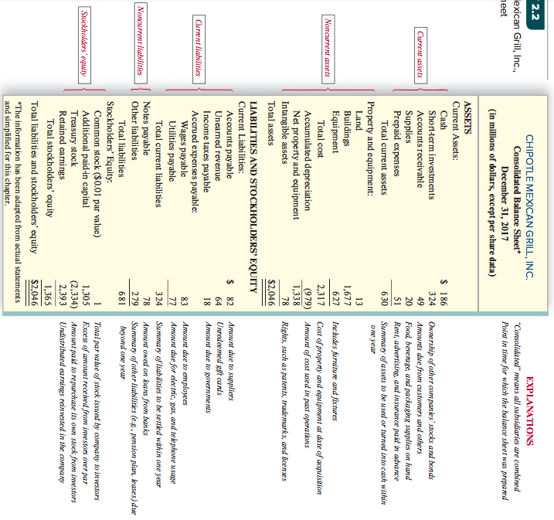

Chipotle Mexican Grill, Inc., Balance Sheet
*The information has been adapted from actual statements and simplified for this chapter.

Slide 21
Unrecorded but Valuable Assets and Liabilities
$$$
Many very valuable intangible assets, such as trademarks, patents, and copyrights are not reported on the balance sheet.
Intangible assets not reported:
  Internally developed over time
  Not purchased
Some liabilities, called off-balance-sheet financing, are not reported as liabilities on the balance sheet.
Off-balance-sheet financing:
  Some equipment or building rentals

Slide 22
Balance Sheet
Assets
Cash $ 40
Accounts receivable 100
Land 200
Total assets $340
Liabilities
Accounts payable $ 50
Notes payable 150
$200
Owners’ Equity
Capital stock $100
Retained earnings 40
$140
Total liabilities
and owners’ equity $340
Must Equal
Notes:
23

Slide 23
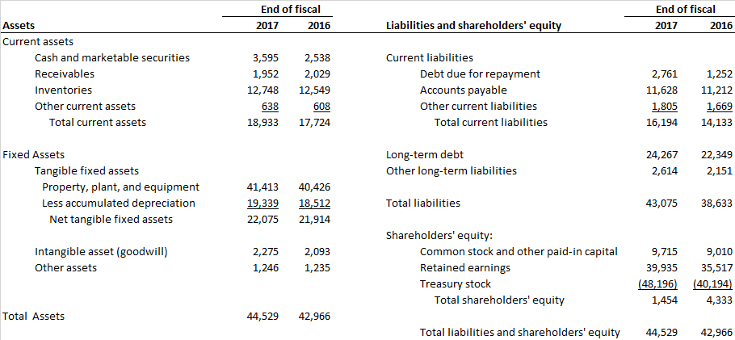
The Balance Sheet
Home Depot’s Balance Sheet (December 31, 2017) $ Millions

Slide 24
The Balance Sheet
Common-Size Balance Sheet
  All items in the balance sheet are expressed as a percentage of total assets

Slide 25
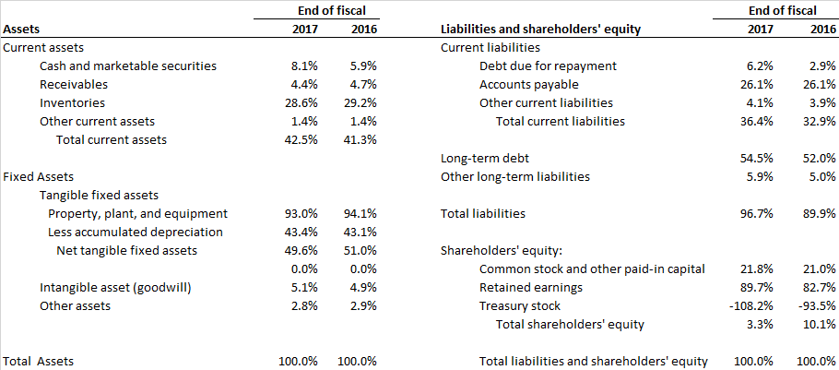
The Balance Sheet
Home Depot Common Size Balance Sheet (December 31, 2017) $ Millions

Slide 26
Book Values and Market Values
Book Values
  Value of assets or liabilities according to the balance sheet
Market Values
  The value of assets or liabilities were they to be resold in a market
Generally Accepted Accounting Principles (GAAP)
  Procedures for preparing financial statements
Equity and asset “market values” are usually higher than their “book values”
Notes:
6

Slide 27
The Balance Sheet
Example 1: Construct a balance sheet for Sophie’s Sofas given the following data. What is shareholders’ equity?
Input variables:
Cash Balance | $10.000
Inventory of Sofas | $200.000
Store and Property | $100.000
Acounts Receivable | $22.000
Acounts Payable | $17.000
Long Term Debt | $170.000

Slide 28
The Balance Sheet
Answer 1:
Assets |  |  | Liabilities & Shareholders' Equity
Cash | $10.000 |  | Accounts Payable |  | $17.000
Accounts Receivable | 22.000 |  | Long Term Debt |  | 170.000
Inventory | 200.000
Store and Property | 100.000 |  | Shareholders Equity |  | 145.000
Total Assets | $332.000 |  | Total liabilities & shareholders' equity |  | $332.000

Slide 29
The Balance Sheet
Example 2: South Sea Baubles has the following (incomplete) balance sheet. What is shareholders’ equity in 2018 and 2019?
BALANCE SHEET AT END OF YEAR (figures in millions)
Assets | 2018 | 2019 |  | Liabilities and Shareholders' Equity | 2018 | 2019
Current Assets | $90 | $140 |  | Current liabilities | $50 | $60
Net fixed assets | 800 | 900 |  | Long-term debt | 600 | 750

Slide 30
The Balance Sheet
Answer 2:
 | 2018 | 2019
Total assets | Current assets + Net fixed assets 90 + 800 = 890 | Current assets + Net fixed assets 140 + 900 =1040
Total liabilities | Current liabilites + Long-term debt 50 + 600 = 650 | Current liabilites + Long-term debt 60 + 750 = 810
Equals equity | 890 − 650 = 240 | 1040 − 810 = 230

Slide 31
The Income Statement
Definition
  Financial statement that shows the revenues, expenses, and net income of a firm over a period of time (from an accounting perspective)
Notes:
11

Slide 32

The Income Statement
Elements of the Income Statement
Revenues
Cash and promises received from delivery of goods and services.
Examples:
Sales Revenue
Fee Revenue
Interest Revenue
Rent Revenue
Expenses
Resources used to earn period’s revenues.
Examples:
Cost of Goods Sold
Wages Expense
Rent Expense
Depreciation Expense
Insurance Expense
Repair Expense
Income Tax Expense
The Income Statement is a measure of performance of the business.

Slide 33
The Income Statement Equation
R - E = NI
Revenues
Expenses
Net Income
Cash and promises received from delivery of goods and services.
Resources used to earn period’s revenues
Revenues earned minus expenses incurred. Also called “profit”, “net earnings”, or “the bottom line.”
If total expenses exceed total revenues, a net loss is reported.

Slide 34
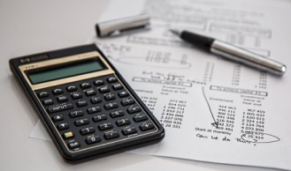
The Income Statement
EXPLANATION
Name of the entity
Title of the statement
Accounting period
Unit of measure
Cash and promises received from sale of beverages
Cost to produce beverages sold
Other operating expenses (utilities, delivery costs, etc.)
Cost of using borrowed funds
Income taxes on period’s income before income taxes Revenues earned minus expenses incurred
LE-NATURE’S INC.
Income Statement
For the Year Ended December 31, 2015
(in millions of dollars)
Revenues
Sales revenue $275.1
Expenses
Cost of goods sold 140.8 Selling, general, and administrative expenses 77.1 Interest expense 17.2
Income before income taxes 40.0 Income tax expense 17.1
Net income $ 22.9
The notes are an integral part of these financial statements.

Slide 35
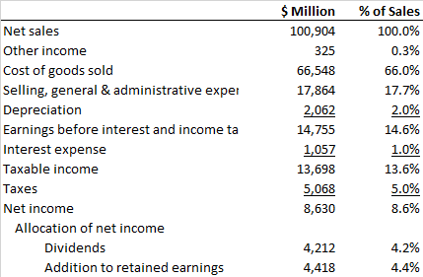
The Income Statement
Home Depot’s Income Statement (December 31, 2017)
$ Millions
Notes:
13

Slide 36
The Income Statement
Earnings Before Interest and Taxes (EBIT)
EBIT = total revenues + other income − costs
− deprecation
= 100,904 + 325 − (66,548 + 17,864) − 2,062
= $ 14,755 million
Home Depot’s Income Statement (December 31, 2017)
Notes:
12

Slide 37
Corporate Tax Rates
Example 3: Companies pay tax on their income. The U.S. Tax Cuts and Jobs Act, passed in December 2017, reduced the corporate tax rate from 35% to 21%. Thus for every $100 that the company earns, it pays $21 in federal tax.

Slide 38
Taxes
Answer 3:
Taxes and cash flows can be changed by the use of debt.
Firm A pays part of its profits as debt interest.
Firm B does not.
Notes:
23

Slide 39
Balance Sheet and Income Statement
Example 4:

Slide 40
Balance Sheet and Income Statement
Example 5: Henry Josstick has just started his first accounting course and has prepared the following balance sheet and income statement for Omega Corp. Unfortunately, although the data for the individual items are correct, he is very confused as to whether an item should go in the balance sheet or income statement and whether it is an asset or liability Prepare the balance sheet and income statement by rearranging the above items.
Balance Sheet |  |  | Income Statement
Payables | $35 |  | Net Sales | $700
Less accumulated depreciation | 120 |  | Cost of goods sold | 580
Long-term debt | 350 |  | Selling, general, and adminstrative expenses | 38
Property, plant, and equipment | 520 |  | Debt due for repayment | 25
Inventories | 50 |  | Cash | 15
Receivables | 35 |  | Taxes | 15
Interest expense | 25 |  | Depreciation | 12
Shareholders' equity | 90
Notes:
23

Slide 41
Balance Sheet and Income Statement
Answer 5:
Balance Sheet
Cash | $15 |  | Debt due for repayment | $25
Receivables | 35 |  | Payables | 35
Inventories | 50 |  | Total current liabilities | $60
Total current assets | $100
 |  |  | Long-term debt | 350
Property, plant, and equipment | $520 |  | Total liabilities | $410
Less accumulated depreciation | 120
Net fixed assets | $400 |  | Shareholders' equity | 90
Total assets | $500 |  | Total liabilites and shareholders' equity | $500
Notes:
23

Slide 42
Balance Sheet and Income Statement
Answer 5:
Income Statement
Net sales | $700
Cost of goods sold | 580
Selling, general, and administrative expenses | 38
Depreciation | 12
EBIT | $70
Interest expense | 25
Taxable income | $45
Taxes | 15
Net income | $30
Notes:
23

Slide 43
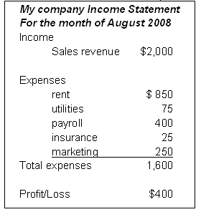
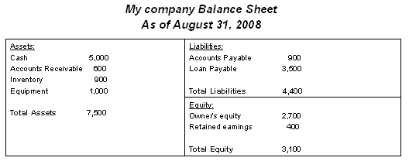
Link between balance sheet and income statement
Profit or loss is taken from the bottom line of the income statement and recorded on the balance sheet in the Retained Earnings equity account. Retained earnings accumulate over the life of the business.
  When a business operates at a profit, it increases in equity (is worth more)
  When a business operates at a loss, it decreases in equity (is worth less)

Slide 44
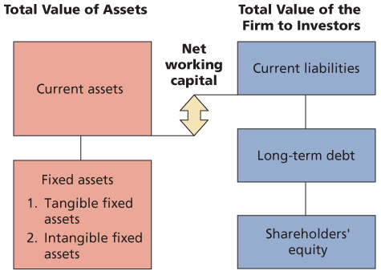
Statement of Financial Position
Notes:
ROSS

Slide 45
Net Working Capital
Net Working Capital
  Current Assets – Current Liabilities
  Positive when the cash that will be received over the next 12 months exceeds the cash that will be paid out
  Usually positive in a healthy firm

Slide 46
The Statement of Cash Flows
Definition:
  Financial statement that shows the firm’s cash receipts and cash payments over a period of time
Notes:
15

Slide 47
Statement of Cash Flows
Statement of Cash Flows
Operating Activities
Financing Activities
Investment Activities

Slide 48
Statement of Cash Flows
Operating Activities: Adjusts net income by all non-cash items related to operating activities and changes in net working capital
•Accounts Receivable – deduct the increases
• Accounts Payable – add the increases
• Inventories – deduct the increases

Slide 49
Statement of Cash Flows
Investing Activities
– Capital Expenditures
– Buying or Selling Marketable Securities
Financing Activities
– Payment of Dividends
• Retained Earnings = Net Income–Dividends
– Changes in Borrowings

Slide 50
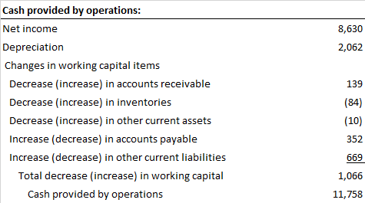
The Statement of Cash Flows
Home Depot Statement of Cash Flows (December 31, 2017)
$ Millions
Notes:
18

Slide 51
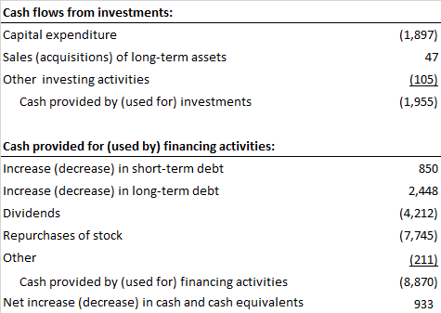
The Statement of Cash Flows
Home Depot Statement of Cash Flows (December 31, 2017) (continued) $ Millions
Notes:
18

Slide 52

The Statement of Cash Flows
Home Depot Statement of Cash Flows (December 31, 2017) (continued) $ Millions
Notes:
18

Slide 53
Free Cash Flow
Free Cash Flow (FCF)
  Cash available for distribution to investors after firm pays for new investments or additions to working capital
      FCF = Net Income
      + interest
      + depreciation
      - additions to net working capital
      - capital expenditures
  Home Depot free cash flow =
  $8,630 + $1,057 + $2,062 - $1,066 - $1,955 = $8,728

Slide 54
Example 6:
Here are the 2018 and 2019 (incomplete) balance sheets for Newble Oil Corp.
What was owners’ equity at the end of 2018 and 2019?
What was the change in net working capital between 2018 and 2019?
Balance Sheet (in millions)
Assets | 2018 | 2019 |  | Liabilities | 2018 | 2019
Current Assets | $310 | $420 |  | Current liabilities | $210 | $240
Net fixed assets | 1.200 | 1.420 |  | Long-term debt | 830 | 920

Slide 55
Answer 6:
What was owners’ equity at the end of 2018 and 2019?
Total assets = Current Assets + Net fixed assets
Total liabilities = Current liabilities + Long-term debt
Owner’s equity = Total assets − Total liabilities
 | 2018 | 2019
Total assets | $1.510 | $1.840
Total liabilities | 1.040 | 1.160
Owner's equity | $470 | $680

Slide 56
Answer 6:
b. What was the change in net working capital between 2018 and 2019?
Net working capital 2019 = Current assets 2019 − Current liabilities 2019
Net working capital 2018 = Current assets 2018 − Current liabilities 2018
Change in NWC= Net working capital 2019 − Net working capital 2018
Net working capital 2019 | $180
Net working capital 2018 | 100
Change in net working capital | $80

Slide 57
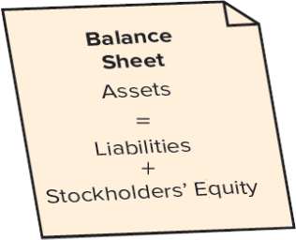
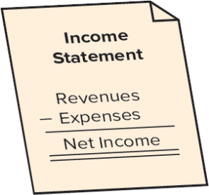
Summary of Balance Sheet and Income Statement
Financial Statement | Purpose | Structure | Examples of Content
Balance Sheet (Statement of Financial Position) | Reports the financial position (economic resources and sources of financing) of an accounting entity at a point in time. |  | Cash, accounts receivable, plant and equipment, long-term debt, common stock
Income Statement (Statement of Income, Statement of Earnings, Statement of Operations) | Reports the accountant’s primary measure of economic performance during the accounting period. |  | Sales revenue, cost of goods sold, selling expense, interest expense

