Slide 1

Loanable Funds Theory and Interest Rates
Understanding how interest rates are determined through the fundamental balance of supply and demand in financial markets.

Slide 2
The Core Principle: Supply Meets Demand
The Fundamental Balance
Real-World Example
Interest rates are determined by the equilibrium between the supply of funds (savings) and the demand for funds (investments). This market mechanism creates the "price of money" that governs borrowing and lending throughout the economy.
Consider an economy where households increase their savings rate. The supply of loanable funds rises, pushing interest rates downward. This makes it easier and cheaper for businesses to obtain credit for expansion projects.
Conversely, during periods of high inflation when savings decline, the demand for funds exceeds supply. Interest rates rise as borrowers compete for the limited pool of available capital, making credit more expensive across the economy.
When Supply Exceeds Demand: Interest rates decrease, making credit more accessible and encouraging investment activity.
When Demand Exceeds Supply: Interest rates increase, reflecting the scarcity of available funds and the competition among borrowers.

Slide 3





Key Factors Affecting Interest Rates
Inflation Expectations
Economic Growth Rate
Central Bank Policies
Future price level predictions directly influence nominal interest rates as lenders demand compensation for purchasing power erosion.
Faster economic expansion increases investment demand, putting upward pressure on interest rates.
Monetary policy decisions directly impact short-term rates and influence the entire yield curve structure.
Risk Premium
Liquidity Conditions
Country risk and credit risk add layers of compensation demanded by lenders for uncertainty.
The ease of converting assets to cash affects the premium investors require for holding various securities.

Slide 4
The Fisher Equation: Linking Nominal and Real Rates
Understanding the Relationship
Where:
The Fisher Equation reveals that the nominal interest rate (what you observe in the market) consists of two components: the real interest rate (the true cost of borrowing) and compensation for expected inflation.
i = Nominal Interest Rate
r = Real Interest Rate
Practical Example: If expected inflation is 6% and the real interest rate is 4%, then the nominal interest rate will be 10%. This means lenders require 4% real return plus 6% to offset inflation's erosion of purchasing power.
πe = Expected Inflation
This relationship is fundamental to understanding why interest rates rise during inflationary periods even when real borrowing costs remain stable.

Slide 5
From Theory to Practice
We've seen how interest rates are determined in the market through supply and demand for loanable funds
Now we'll explore how these interest rates are used in practical financial calculations
The time value of money principle helps us understand how interest rates affect the value of money over time
This forms the foundation for all investment and financing decisions

Slide 6

Time Value of Money: Why Today Matters More
"One Turkish Lira today is worth more than one Turkish Lira in the future."
This fundamental principle underlies all financial analysis and investment decisions. Money available today can be invested to earn interest or generate returns, making it inherently more valuable than the same amount received in the future.
Therefore, in financial analysis, all future cash flows must be discounted to their present value to make meaningful comparisons and investment decisions. This concept forms the foundation for valuation, capital budgeting, and financial planning across all sectors of the economy.

Slide 7
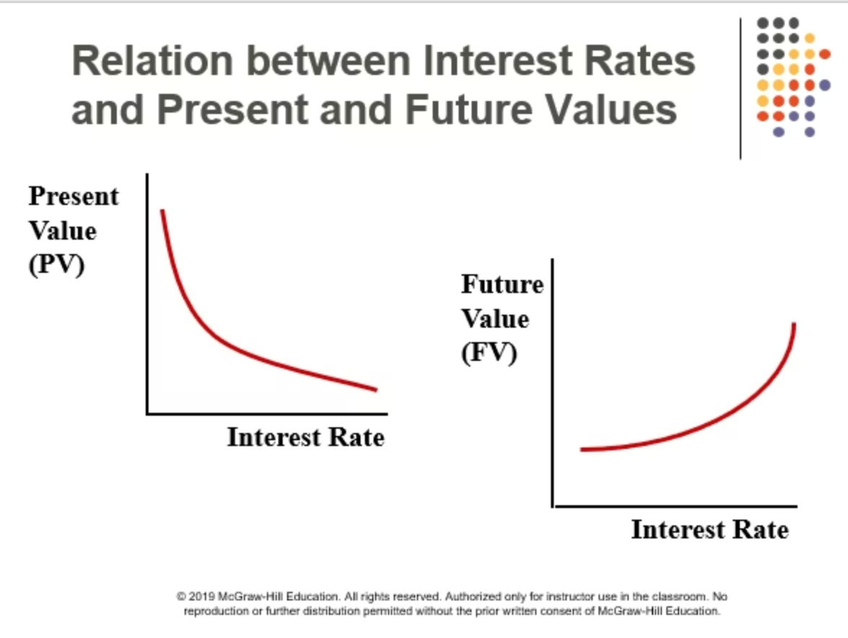
Interest Rates and Value Relationships
The following illustration visually represents how changes in interest rates affect both present and future values, highlighting their distinct relationships.

Slide 8
Understanding the Relationships
Interest rates play a crucial role in determining the present and future value of money, as outlined in these key relationships:
Present Value relationship
Future Value relationship
As interest rates increase, present value decreases (inverse relationship)
As interest rates increase, future value increases (direct relationship)
Why these relationships exist
Practical implications
Higher discount rates reduce the current worth of future money, while higher rates increase the growth of current investments
Interest rate changes significantly impact investment valuations and financial planning decisions

Slide 9
Future Value: Growing Your Investment
01
02
The Formula
Define Variables
FV = PV × (1 + i)ⁿ
FV = Future Value, PV = Present Value, i = Interest rate per period, n = Number of periods
03
04
Apply the Calculation
Calculate Result
Investment of ₺1000 at 8% annual interest for 3 years
FV = 1000 × (1.08)³ = ₺1,259
Understanding Compound Growth
Practical Application
The future value formula captures the power of compound interest, where you earn returns not only on your initial investment but also on the accumulated interest from previous periods.
This calculation is essential for retirement planning, education savings, and any long-term financial goal where you need to understand how much your current investment will grow over time.

Slide 10

Present Value: What Future Money Is Worth Today
The Reverse Calculation
Present value reverses the future value calculation, answering the critical question: "What is a future payment worth in today's terms?"
Example Application: If you will receive ₺1,259 in 3 years and the interest rate is 8%, then:
PV = 1,259 / (1.08)³ = ₺1,000
This tells us that receiving ₺1,259 three years from now is equivalent to having ₺1,000 today, given an 8% discount rate.
Why This Matters
Present value calculations are crucial for evaluating investment opportunities, comparing different payment streams, and making informed financial decisions across various time horizons.

Slide 11



Net Present Value: The Investment Decision Tool
Where: CFt = Cash flow at time t, i = Discount rate (interest rate), I0 = Initial investment
NPV > 0
NPV = 0
NPV < 0
Investment is profitable and creates value. The project should be accepted.
Investment breaks even. The decision depends on other strategic factors.
Investment destroys value and should be rejected.
Practical Example
An investment costs ₺1,000 and generates ₺400 each year for 3 years. The discount rate is 10%.
NPV = [400/(1.10)¹] + [400/(1.10)²] + [400/(1.10)³] - 1,000
NPV = 363.64 + 330.58 + 300.53 - 1,000 = ₺994.75 - ₺1,000 ≈ +₺5
Since NPV > 0, this investment is profitable and should be pursued.

Slide 12
Excel Applications for Financial Calculations
Calculation
Excel Formula
Explanation
Future Value (FV)
=FV(0.08, 3, 0, -1000)
Calculates the future value of ₺1000 invested at 8% for 3 years
Present Value (PV)
=PV(0.08, 3, 0, 1259)
Calculates the present value of ₺1259 to be received in 3 years at 8%
Net Present Value (NPV)
=NPV(0.10, 400, 400, 400) - 1000
Calculates the project's net present value using a 10% discount rate
These Excel functions streamline complex financial calculations, enabling rapid analysis of investment opportunities and financial planning scenarios. Mastering these tools is essential for modern financial analysis and decision-making.

Slide 13
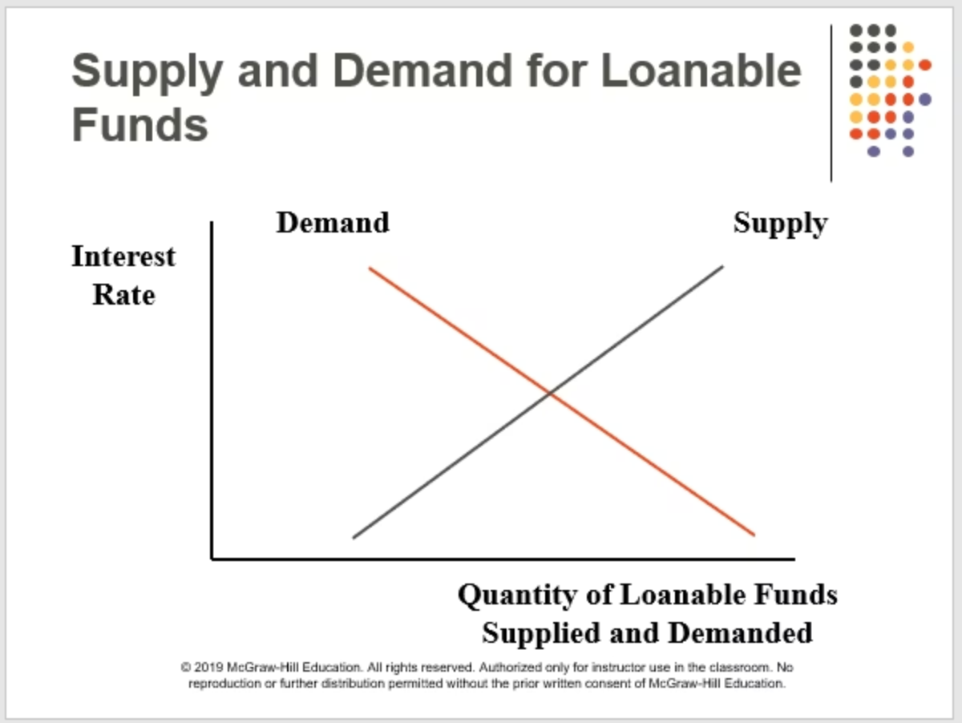
Supply and Demand for Loanable Funds
The intersection of the upward-sloping supply curve (S) and the downward-sloping demand curve (D) determines the equilibrium interest rate (i*) and the equilibrium quantity of loanable funds (Q*). At this point, the quantity of funds that savers are willing to supply precisely matches the quantity of funds that borrowers wish to demand, establishing the market-clearing price for money.

Slide 14
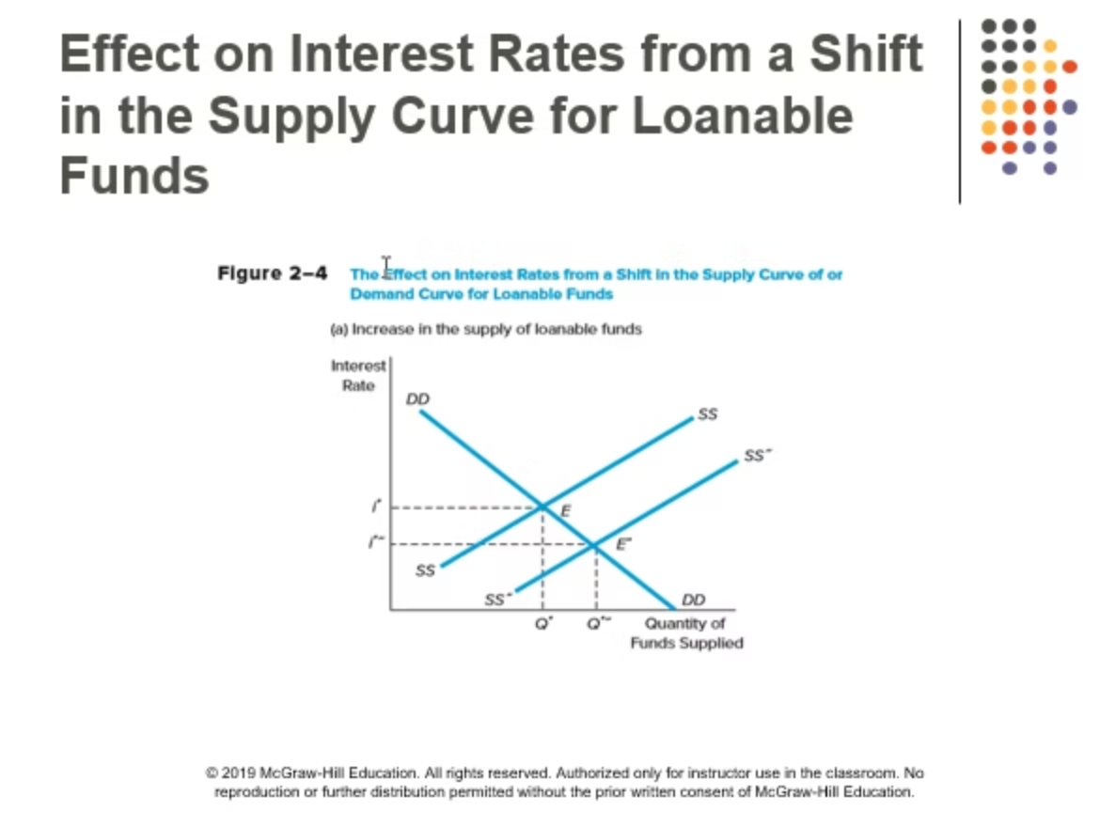
Factors Shifting the Supply of Funds

Slide 15
Additional Factors Shifting Supply
Income and Demographics
Preferences and Precautionary Motives
As household income rises, especially among middle and high-income groups, savings tend to increase → S shifts right, putting downward pressure on interest rates.
When economic uncertainty grows, precautionary savings rise as households build financial buffers → S shifts right.
Financial Inclusion
Tax Policy
Greater access to banking and fintech services encourages households to channel their savings into the formal financial system → S shifts right.
Tax incentives promoting savings (e.g., private pension plans, tax exemptions on interest income) lead to higher savings → S shifts right.
Inflation Expectations
If expected inflation increases, the real return on savings declines. The effect is ambiguous: some savers demand higher nominal rates, while others reduce savings due to eroding value.

Slide 16

Factors Shifting Investment Demand
Technology and Profitability
When expected net returns on investment projects increase due to technological advances or improved market conditions, firms are more willing to borrow → D shifts right, pushing interest rates upward.
Institutional Efficiency
Improvements in legal predictability, contract enforcement, and reductions in bureaucratic costs encourage borrowing for productive investments → D shifts right.
Investment Incentives
When capital expenditures become more attractive through government tax subsidies or investment incentives → D shifts right.
Alternative Financing
If access to equity financing or government grants increases, the need for debt financing declines → D shifts left, reducing pressure on interest rates.

Slide 17

The Crowding Out Effect
Government Borrowing Impact
When the budget deficit increases, the government's demand for funds rises significantly → D curve shifts right.
Since both the public and private sectors borrow from the same pool of loanable funds, the equilibrium interest rate increases as competition for available capital intensifies.
The Crowding Out Effect: As interest rates rise due to increased government borrowing, some private investment projects become unprofitable or too expensive to finance. These projects are "crowded out" of the market, potentially reducing private sector growth and innovation.
Important Caveat: During economic recessions, public investment may only partially crowd out private investment, since the economy operates below potential output and there may be idle resources available.

Slide 18
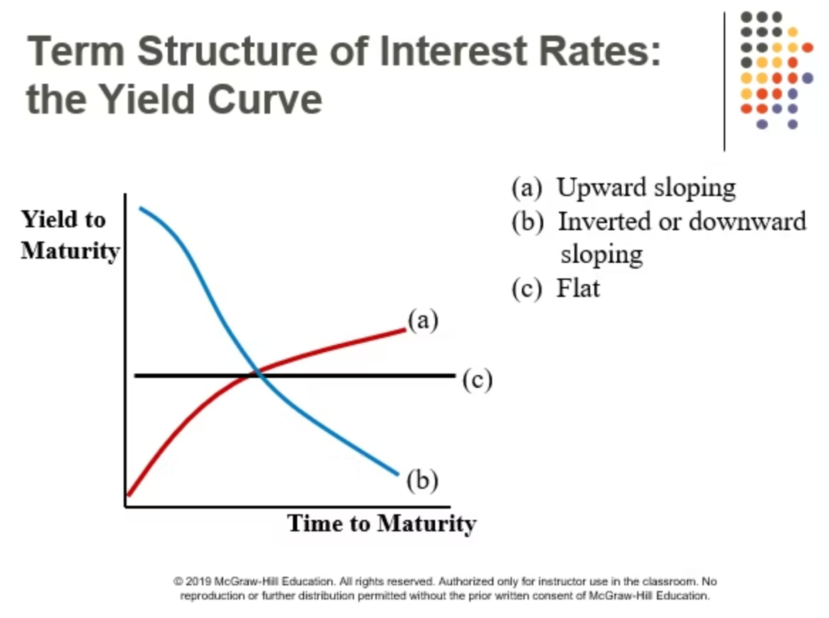
The Yield Curve: Term Structure of Interest Rates
Interest rates are not a single number—they vary by maturity, forming what is known as the yield curve or term structure of interest rates. This relationship between interest rates and time to maturity provides crucial insights into market expectations and economic conditions.

Slide 19



Types of Yield Curves
Normal (Upward-Sloping) Curve
Inverted Curve
Flat Curve
Short-term rates exceed long-term rates, often signaling economic slowdown expectations or tight monetary policy. Historically, inverted yield curves have preceded recessions.
Short- and long-term rates are roughly similar, indicating market uncertainty about future economic conditions and the transition between economic phases.
Long-term interest rates exceed short-term rates. This occurs because of the Inflation Premium (greater uncertainty about inflation in the long run) and the Liquidity Premium (long-term assets are less liquid, so investors demand extra return).

Slide 20
Theories Explaining the Term Structure
Expectations Hypothesis
Liquidity Preference Theory
Market Segmentation Theory
The long-term interest rate approximately equals the average of expected future short-term rates. If markets expect rates to rise, the yield curve slopes upward.
Investors require an additional "liquidity premium" for holding long-term securities due to increased price risk and reduced flexibility → curve naturally slopes upward.
Investors prefer specific maturity segments based on their needs, and each segment's rate is determined by its own supply and demand conditions independently.

Slide 21








The Risk Structure of Interest Rates
Not all debt instruments with the same maturity carry the same interest rate. Four main factors explain why rates differ across securities:
Default (Credit) Risk
The possibility that the borrower may fail to make payments. Government bonds generally carry the lowest risk, while small or highly leveraged firms face higher risk. Investors demand a risk premium, pushing the interest rate upward.
Liquidity
The ease with which an asset can be converted into cash without significant loss in value. Less liquid bonds require higher compensation → interest rates increase.
Term and Inflation
Tax Treatment
Longer maturities increase inflation uncertainty. Investors demand both an inflation premium and a liquidity premium to compensate for higher risk and reduced flexibility.
Interest income exempt from taxation can offer lower nominal yields since investors focus on after-tax returns. Tax-advantaged securities trade at premium prices (lower yields).

Slide 22

Monetary Policy and Interest Rates
Central Bank Tools
Policy Implementation
The Central Bank (CBRT) manages money supply and liquidity through its short-term policy rate, which serves as the anchor for the entire interest rate structure.
Contractionary (Tight) Monetary Policy:
Policy rate ↑
Liquidity is withdrawn from the system
Short-term interest rates rise
Expansionary Monetary Policy:
Credit becomes more expensive
Policy rate ↓
Aggregate demand cools, reducing inflation pressure
Open market purchases ↑
Short-term interest rates fall
Expectations Channel: The Central Bank's communication and forward guidance influence market expectations of future inflation and interest rates, which in turn affect long-term yields even before policy changes occur.
Credit expands throughout the economy
Aggregate demand increases

Slide 23


Fiscal Policy and Interest Rate Dynamics
Demand Curve Shifts Right
Budget Deficit Increases
The D curve in the loanable funds market shifts rightward as government competes for available capital.
Government borrowing demand rises as fiscal spending exceeds revenue collection.
Crowding Out Effect
Interest Rates Rise
Higher interest rates make some private investment projects unprofitable, reducing private sector investment.
All else equal, the equilibrium interest rate increases due to increased competition for funds.
Important Context: During an economic recession, public investment may only partially crowd out private investment, since the economy operates below potential output (output gap exists). In such cases, fiscal stimulus can actually complement private investment by boosting aggregate demand and business confidence.

Slide 24
Open Economy: Capital Flows and Interest Rates
In economies with free capital mobility, global interest rates and country risk premiums become key determinants of domestic interest rates. The domestic financial market no longer operates in isolation but is integrated into the global financial system.
Interest Rate Parity (Simplified Intuition)
Where: Δee = Expected exchange rate change
Capital Inflows (Net Inflows)
Capital Outflows
When foreign investors find domestic assets attractive:
When domestic investors seek foreign opportunities or flee risk:
Increased demand for domestic assets
Reduced fund supply (S shifts left)
Supply of funds rises (S shifts right)
Interest rates increase, assuming other factors remain constant
Interest rates may decline
Exchange rate depreciates
Exchange rate appreciates
Tighter financing conditions domestically
Improved financing conditions for domestic borrowers
Potential balance of payments pressure

Slide 25
Key Takeaways: Interest Rate Determination
Market Equilibrium
Interest rates are determined by the intersection of supply (savings) and demand (investment) for loanable funds, creating the fundamental "price of money" in the economy.
Multiple Influences
Inflation expectations, economic growth, monetary policy, fiscal policy, risk premiums, and global capital flows all shape interest rate levels and movements.
Term and Risk Structure
Interest rates vary by maturity (yield curve) and risk characteristics, reflecting market expectations, liquidity preferences, and credit quality differences.
Time Value Foundation
The time value of money principle—that money today is worth more than money tomorrow—underlies all financial analysis, from simple savings to complex investment decisions.
Policy Implications
Both monetary and fiscal policy significantly impact interest rates, with important consequences for investment, consumption, and overall economic activity through various transmission channels.

