Slide 1
Economics
Market Power
Dr. Cansu Unver-Erbas

Slide 2
AIM OF THIS LECTURE
In this lecture, we will learn about: MARKET POWER
In the previous lectures, we have assumed perfect competition: sellers have no pricing power, i.e., they are price takers.
-> Competitive markets, under certain conditions, guide resource allocation in an
efficient way.
However, perfect competition is at one extreme of the competition spectrum. Markets are usually not perfectly competitive: sellers have at least some pricing/market power.
The power to influence the market price is called market power -> market failure.

Slide 3
LECTURE OUTLINE
Monopoly
Imperfect Competition
  Monopolistic competition
  Oligopoly

Slide 4
MONOPOLY

Slide 5
COMPETITION SPECTRUM
Competition Spectrum
Perfect Competition
Monopoly

Slide 6
MONOPOLY
Monopolies lie at the other end of the competition spectrum.
Theory:
A monopoly is a firm that is the only seller of a product without close substitutes.
Practice:
A firm has monopoly power if it is the dominant seller in a market and as a result is able to exert some control over the market.

Slide 7
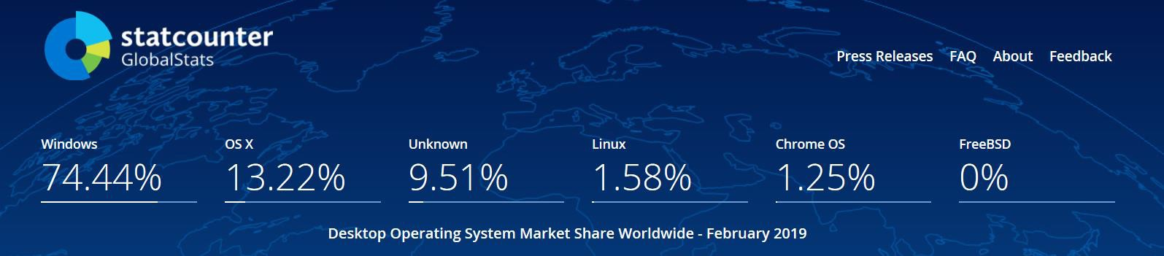
EXAMPLE OF A MONOPOLY
If you own a PC, it probably uses some version of Windows, sold by Microsoft.
Operating systems market shares:
Microsoft has no close competitors => their business decisions are not well
described by the model of competitive firms from previous chapters.

Slide 8
MONOPOLY
Monopolies lie at the other end of the competition spectrum.
Theory:
A monopoly is a firm that is the only seller of a product without close substitutes.
Practice:
A firm has monopoly power if it is the dominant seller in a market and as a result is able to exert some control over the market.

Slide 9
MONOPOLY
Monopolies lie at the other end of the competition spectrum.
Theory:
A monopoly is a firm that is the only seller of a product without close substitutes.
Practice:
A firm has monopoly power if it is the dominant seller in a market and as a result is able to exert some control over the market, e.g., Microsoft (about 75% market share) and Google (about 70%).
-> In what follows we will assume that there is only 1 seller. Because it can choose the market price of its product, a monopoly is a price maker.

Slide 10
WHY MONOPOLY ARISE
A fundamental cause of monopoly is barriers to entry.
Other firms cannot enter because:
only the monopoly owns a key resource (does not occur often in reality);
the government gives a single firm the exclusive right to produce a good or service (e.g., Sweden has an alcohol retail monopoly);
the costs of production are such that a single producer is more efficient than a
large number of producers (e.g., for water distribution);
a firm is able to gain control of other firms in the market and thus grows in size
(e.g., facebook).

Slide 11

EXAMPLE OF A MONOPOLY
National Football League (NFL) has no close competitors. However, anyone can attempt to replicate the NFL. With enough capital you could create a football league, create teams, get media coverage, find sponsors, lease a stadium, etc. The problem is that the barriers to entry in order to make the venture profitable are high to the point that it simply isn't worthwhile. Especially after a couple colossal failures by those who have tried.

Slide 12
HOW MONOPOLIES MAKE PRODUCTION AND PRICING DECISIONS
Contrarily to competitive firms, a monopoly faces a demand that is not perfectly elastic: the monopoly faces the market demand.
(a) A Competitive Firm’s Demand Curve
(b) A Monopolist’s Demand Curve
Price
Price
Demand
Demand
0
Quantity of Output
0
Quantity of Output
9
Copyright©2011 South-Western

Slide 13
HOW MONOPOLIES MAKE PRODUCTION AND PRICING DECISIONS
A monopoly faces the market demand curve (downward sloping) :
if monopoly raises the price, consumers will buy less,
if monopoly reduces the quantity of output it sells, the price per unit of output increases.
A monopoly can choose any point (P, Q) on the demand curve.
The demand curve provides a constraint on a monopoly’s ability to profit from its
market power.
Which point is the best?
13

Slide 14
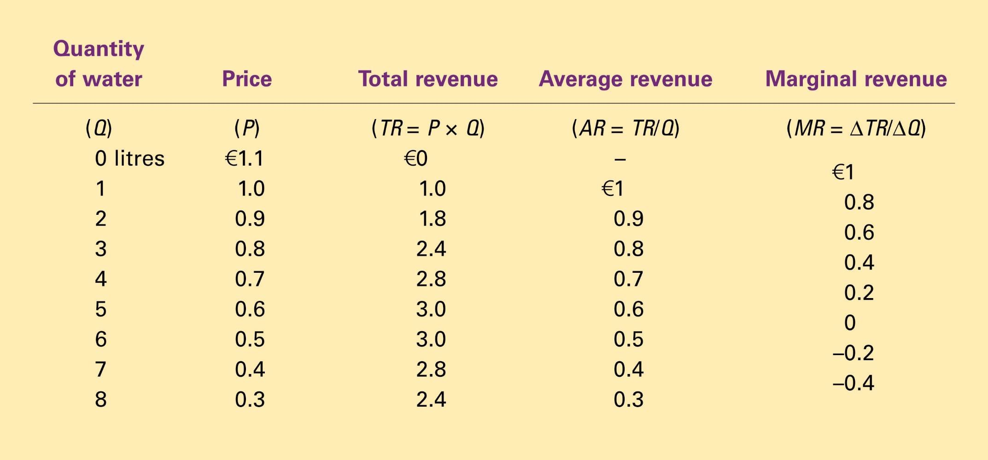
Monopoly’s Total, Average, and Marginal Revenue
Notice: P = AR but not equal to MR!!!
Copyright©2011 South-Western

Slide 15
Price
€1,1 1,0
0,9
0,8
0,7
0,6
0,5
0,4
0,3
0,2
0,1
0
–1
–2
–3
–4
Demand (average revenue)
Marginal revenue
1 2 3 4 5 6 7 8
Quantity of Water
12
Copyright©2011 South-Western

Slide 16
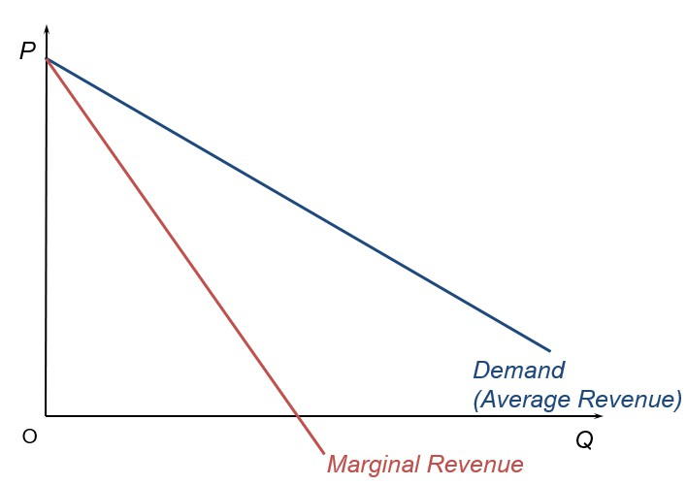
HOW MONOPOLIES MAKE PRODUCTION AND PRICING DECISIONS
A monopoly’s marginal revenue is always lower than the price of the good
(graphically: marginal revenue curve lower than demand curve).
Intuition: when an extra unit is sold, total revenue increases by less than the price,
because price of all units has to decrease.
16

Slide 17
HOW MONOPOLIES MAKE PRODUCTION AND PRICING DECISIONS
When a monopoly increases the amount it sells, this has two effects on total
revenue:
output effect: Q is higher → tends to increase total revenue
price effect: P is lower → tends to decrease total revenue
=> Total revenue may either increase or decrease (marginal revenue may be positive or negative) depending on whether the output effect or price effect is dominant.

Slide 18

TOTAL REVENUE AND MARGINAL REVENUE
P
Producing an extra unit of output:
increases the amount of units sold but
it lowers the price for which all units are sold
P₁ P
Loss of revenue
2
D=AR
Additional revenue
O
Q₁
Q₂
Q

Slide 19
Total revenue and marginal revenue
P
Producing an extra unit of output:
increases the amount of units sold but
it lowers the price for which all units are sold
P₁ P₂
P₃ P₄
D=AR
O
Q₁
Q₂
Q₃ Q₄
Q
19

Slide 20
Total revenue and marginal revenue
P
Producing an extra unit of output:
increases the amount of units sold but
it lowers the price for which all units are sold
P₁ P₂
P₃ P₄
An extra unit of
output does not affect TR
D=AR
O
Q₁
Q₂
Q₃ Q₄
Q
MR

Slide 21
HOW MONOPOLIES MAKE PRODUCTION AND PRICING DECISIONS
Which quantity should the monopoly produce?
Objective: maximize profit.
Compare marginal revenue (MR) and marginal cost (MC) of each unit produced. Optimal Q ⇒ MR = MC (profit maximization)

Slide 22
EQUILIBRIUM UNDER MONOPOLY
Costs and Revenue
2. . . . and then the demand curve shows the price consistent with this quantity.
1. The intersection of the marginal-revenue curve and the marginal-cost curve determines the profit-maximizing quantity . . .
B
Monopoly
price
Average total cost
A
Marginal cost
Demand
Marginal revenue
0
Q_{M}
Quantity
Copyright©2011 South-Western

Slide 23
HOW MONOPOLIES MAKE PRODUCTION AND PRICING DECISIONS
Monopolists’ profit maximizing quantity is at the intersection of marginal revenue
and marginal cost curves.
After the monopoly chooses the quantity of output such that MR=MC, it uses the demand curve to find the price at which each unit of good will be sold.
This price exceeds the marginal cost.
Competitive firm produces Q: P=MR=MC
Monopoly firm produces Q: P>MR=MC
23

Slide 24
THE MONOPOLY’S PROFIT
Costs and Revenue
Marginal cost
Monopoly E price
B
Monopoly
Average total cost
profit
Average
total
cost
D
C
Demand
Marginal revenue
0
^{Q}MAX
Quantity
Copyright©2011 South-Western

Slide 25
THE WELFARE COST OF MONOPOLY
Does a monopoly lead to a good allocation of resources? Is a monopoly a good way to organize a market?
Consumers’ standpoint: monopoly is undesirable because it charges high prices.
Producer’s standpoint: monopoly is desirable because it allows high profits. Society as a whole’s standpoint?

Slide 26
THE WELFARE COST OF MONOPOLY
Reminder:
Total surplus can be used as a measure of a society’s economic well being.
Total surplus = consumer surplus + producer surplus.
Consumer surplus (CS) = willingness to pay for a good - amount they actually pay for it
Producer surplus (PS) = amount producers receive for a good - cost of producing it

Slide 27
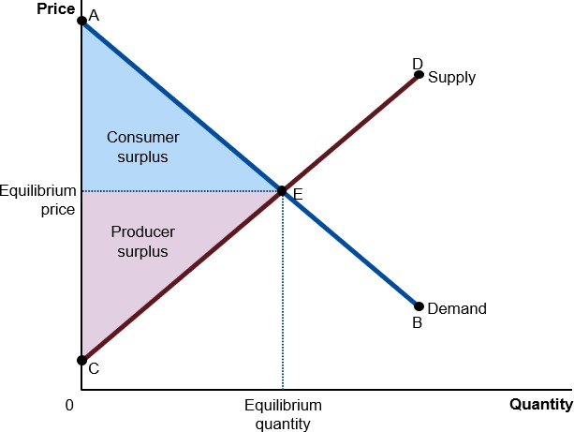
REMINDER: PERFECT COMPETITION

Slide 28
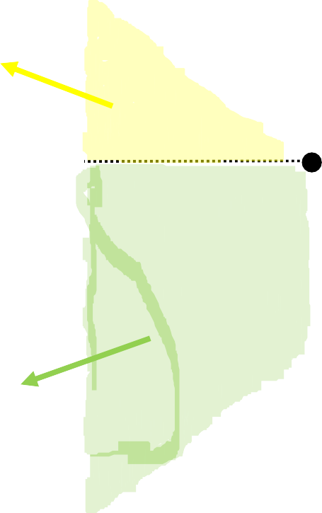
INEFFICIENCY OF MONOPOLY
Price
Deadweight loss
Marginal cost
CS
Monopoly
price
PS
Marginal revenue
Demand
0
Monopoly quantity
Efficient quantity
Quantity
Copyright©2011 South-Western

Slide 29
THE WELFARE COST OF MONOPOLY
In a monopoly, less is produced and it is sold at a higher price than under perfect
competition.
The total welfare is greater under perfect competition than under monopoly.
The difference between the socially optimum surplus and the surplus obtained with a monopoly is the welfare cost of the monopoly, or the monopoly deadweight loss.
(Competitive markets lead to the socially optimal level of output → there is no deadweight loss in competitive markets.)

Slide 30
PUBLIC POLICY TOWARDS MONOPOLIES
Contrarily to competitive markets, monopolies do not lead to an optimal allocation
of resources (social welfare is not maximized).
Policy makers’ goal: maximize social welfare.
Policy makers’ tools: policies (laws, regulations…)
Policy makers can solve the monopoly problem:
by trying to make monopolized industries more competitive
by regulating behaviour of monopolies
by turning some private monopolies into public enterprises
by doing nothing at all

Slide 31
IMPERFECT COMPETITION

Slide 32
COMPETITION SPECTRUM
Competition Spectrum
Perfect Competition
Monopoly

Slide 33
COMPETITION SPECTRUM
Competition Spectrum
Perfect Competition
Monopoly
Most real firms:
do compete (as opposed to monopoly)
are not price takers, they have some market power (as opposed to
perfect competition)

Slide 34
COMPETITION SPECTRUM
Competition Spectrum
Perfect Competition
Monopolistic Competition
Oligopoly
Monopoly
Imperfect Competition
Most real firms:
do compete (as opposed to monopoly)
are not price takers, they have some market power (as opposed to
perfect competition)

Slide 35
MARKET STRUCTURES
Many industries are somewhere in between perfect competition and monopoly: They face competitors, but competition is not so high to make them price takers → imperfect competition.
Two types of imperfect competition:
Monopolistic competition: market structure in which many firms sell similar (but not identical) products (e.g., books, restaurants).
Oligopoly: market structure in which only a few firms offer similar or identical products (e.g.: beer market)

Slide 36
MARKET STRUCTURES
Number of Firms?
Many
firms
Type of Products?
One firm
Few firms
Differentiated products
Identical products
Monopoly
Oligopoly
Monopolistic Competition
Perfect
Competition
Tap water
Railway service
Airplanes
Beer
Novels
Restaurants
Wheat
Milk
Copyright©2011 South-Western

Slide 37
COMPETITION SPECTRUM
Competition Spectrum
Perfect Competition
Monopolistic Competition
Oligopoly
Monopoly
Imperfect Competition

Slide 38
MONOPOLISTIC COMPETITION
This refers to a market in which there are many sellers that compete with each other to sell their products. Their products are differentiated (i.e., imperfect substitutes for each other) such that they have some market power.
→ For this reason, each seller can influence the price they charge for their products. A seller can thus set a higher price without loosing all of its customers to low-priced rivals.
Attributes of a market with monopolistic competition:
many firms;
product differentiation;
free entry/exit: firms can enter or exit market without restrictions (no barriers of entry/exit).
Examples: books, CDs, restaurants, clothes, furniture, haircuts

Slide 39
MONOPOLISTIC COMPETITION – SHORT RUN
Product different from those of other firms
→ firm faces downward sloping demand curve (like monopoly and unlike perfect
competition) (as it is a price maker)
→ firm follows rule for profit maximization: produce Q such that MR = MC and use the demand to find the price consistent with that quantity.
→ Thus, short term for monopolistic competition largely similar to monopoly
situation.

Slide 40
MONOPOLISTIC COMPETITION – SHORT RUN
Firm Makes Profit
Price
MC
ATC
Price
Average total cost
Profit
Demand
MR
0
Profit- maximizing quantity
Quantity
Copyright©2011 South-Western

Slide 41
MONOPOLISTIC COMPETITION – LONG RUN
Free entry/exit
=> If firms on the market are making profits, new firms will enter the market.
=> Customers will have more choice between a higher number of similar products.
=> The demand faced by each firm shifts to the left (demand curve for the firm more price elastic) => profit falls.
NB: If firms on the market are making losses=> (some) firms exit=> rise in demand=> profit increases.
Entry/exit process continues until firms in the market make zero economic profit (P
= ATC). Thus, similar to perfect competition.
41

Slide 42
MONOPOLISTIC COMPETITION – LONG RUN
Price
MC
ATC
P = ATC
Demand
MR
0
Profit-maximizing
quantity
Quantity
Copyright©2011 South-Western

Slide 43
MONOPOLISTIC COMPETITION – LONG RUN
As in monopolies, P > MC
As in competitive markets, P = ATC → profit=0.
Profit maximization → MR = MC (independent of market type)
Demand downward sloping → P > MR, so P > MC.
Free entry → economic profit driven to zero.
43

Slide 44
Monopolistic versus Perfect Competition (Long run)
(a) Monopolistically Competitive Firm
(b) Perfectly Competitive Firm
Price
Price
MC
ATC
MC
ATC
P
P = MC
P = MR
(demand
curve)
MR
Demand
0 | Quantity | Efficient | Quantity | 0 | Quantity produced = | Quantity
 | produced | scale |  |  | Efficient scale
Copyright©2011 South-Western

Slide 45
Monopolistic versus Perfect Competition (Long run)
Two main differences:
Mark-up: with monopolistic competition, price exceeds the marginal cost (mark-up
= P - MC). (holds for all price makers)
Excess capacity: with monopolistic competition, quantity produced by each firm is below the efficient scale (below min of ATC).
45

Slide 46
Monopolistic versus Perfect Competition (Long run)
(a) Monopolistically Competitive Firm
(b) Perfectly Competitive Firm
Price
Price
MC
ATC
MC
ATC
mark-up
P
P = MC
P = MR
(demand
curve)
Marginal
cost
MR
Demand
0
Quantity produced
Quantity
0
Quantity produced
Quantity
Copyright©2011 South-Western

Slide 47
Monopolistic versus Perfect Competition (Long run)
(a) Monopolistically Competitive Firm
(b) Perfectly Competitive Firm
Price
Price
MC
ATC
MC
ATC
mark-up
P
P = MC
P = MR
(demand
curve)
Marginal
cost
MR
Demand
0 | Quantity | Efficient | Quantity | 0 | Quantity produced = | Quantity
 | produced | scale |  |  | Efficient scale
Excess capacity
Copyright©2011 South-Western

Slide 48
Monopolistic versus Perfect Competition (Long run)
On the one hand, firms under monopolistic competition produce where its demand curve is tangent to its average total cost curve.
→ Because demand curve is negatively sloped, monopolistically competitive firms
will produce an output less than the one at which LRAC reaches its minimum.
Such firms are said to have excess capacity.
≠ Competitive firms produce at the lowest possible average total cost per unit: they are as efficient as possible in terms of production costs per unit.
On the other hand, consumers might value and thus benefit from monopolistic
competition by having a greater variety of products to choose from.
Is the society better off transforming monopolistically competitive industries into competitive industries? Not clear, trade-off between cost savings and loss of product differentiation.

Slide 49
Monopolistic versus Monopoly(Long run)
On the one hand, freedom of entry & lack of supernormal profit (in the long run) under monopolistic competition are likely to keep prices down for consumers and encourage cost saving.
On the other hand, monopolies are likely to achieve greater economies of scale and have more funds for investment and research and development.
Not clear whether the society is better off transforming monopolies into monopolistically competitive industries.

Slide 50
Comparison Table
Perfect competition
Monopolistic competition
Monopoly
1. Output rule
MR = MC
MR = MC
MR = MC
2. Short-run profits?
supernormal
supernormal
supernormal
3. Price taker?
yes
no
no
4. Price
equals MC
above MC
above MC
5. Efficient output?
yes
no
no
6. Number of firms
many
many
one
7. Entry in long run?
yes
yes
no
8. Long-run profits?
normal
normal
supernormal

Slide 51
COMPETITION SPECTRUM
Competition Spectrum
Perfect Competition
Monopolistic Competition
Oligopoly
Monopoly
Imperfect Competition

Slide 52
OLIGOPOLIES
Oligopoly applies to industry which contains only a few competing firms.
The behaviour of oligopolists is strategic, which means that they must take explicit account of the impact of their decisions on competing firms and of the reactions they expect from competing firms.
In some oligopolistic industries there are only a few firms, but oligopoly is also consistent with a large number of small sellers as long as a big few dominate.
The UK supermarkets provide a good example of an oligopolistic market. In the first quarter of 2014,
4 big firms between them occupied nearly 75% of the market (Tesco with 28.6%,
Asda with 17.4%, Sainsbury’s with 16.5% and Morrisons with 11.1%),
5 smaller supermarkets between them occupied about 20% of the market (Co- op, Waitrose, Aldi, Lidl, and Iceland).

Slide 53
OLIGOPOLIES
The interdependence of firms in a oligopoly pulls them in two distinct directions: Competition: they compete in quantity or prices.
Because competition is destructive and lead to lower profits, oligopolists might
prefer to collude with each other.
Collusion: By acting together as if they were a monopoly, the firms could take actions that jointly maximise industry profits and share these profits between them (e.g., by agreeing on output, prices, advertising expenditures…).
Oligopolists will make more profits as a group if they cooperate, however, any one firm may make more profits for itself if it goes it alone while the others cooperate.
→ They face a basic dilemma between competing and colluding.

Slide 54
SUMMARY – Monopoly
A monopoly is a firm that is the sole seller in its market.
It faces a downward-sloping demand curve for its product.
A monopoly’s marginal revenue is always below the price of its good (P > MR).
Like a competitive firm, a monopoly maximizes profit by producing the quantity
at which marginal cost and marginal revenue are equal (MC = MR).
Unlike a competitive firm, its price exceeds its marginal revenue, so its price exceeds marginal cost (P>MC).
A monopolist’s profit-maximizing level of output is below the level that
maximizes the sum of consumer and producer surplus.
A monopoly causes deadweight losses similar to the deadweight losses caused
by taxes.
Public authorities may therefore intervene in monopolistic markets in order to raise economic welfare.

Slide 55
SUMMARY – Imperfect Competition
Monopolistic competition: hybrid of monopoly and competition.
  Firms face downward sloping demand, charge prices above marginal
cost but do not make profits in the long run.
  Many markets in the economy are monopolistically competitive.
  Theory does not yield simple advice for public policy: allocation of resources in such markets is not optimal, but little can be done to improve it.
An oligopoly is a market structure in which a market is dominated by a small
number of large sellers.
  They respond strategically to each other’s actions.
  They can compete or collude.

