Slide 1
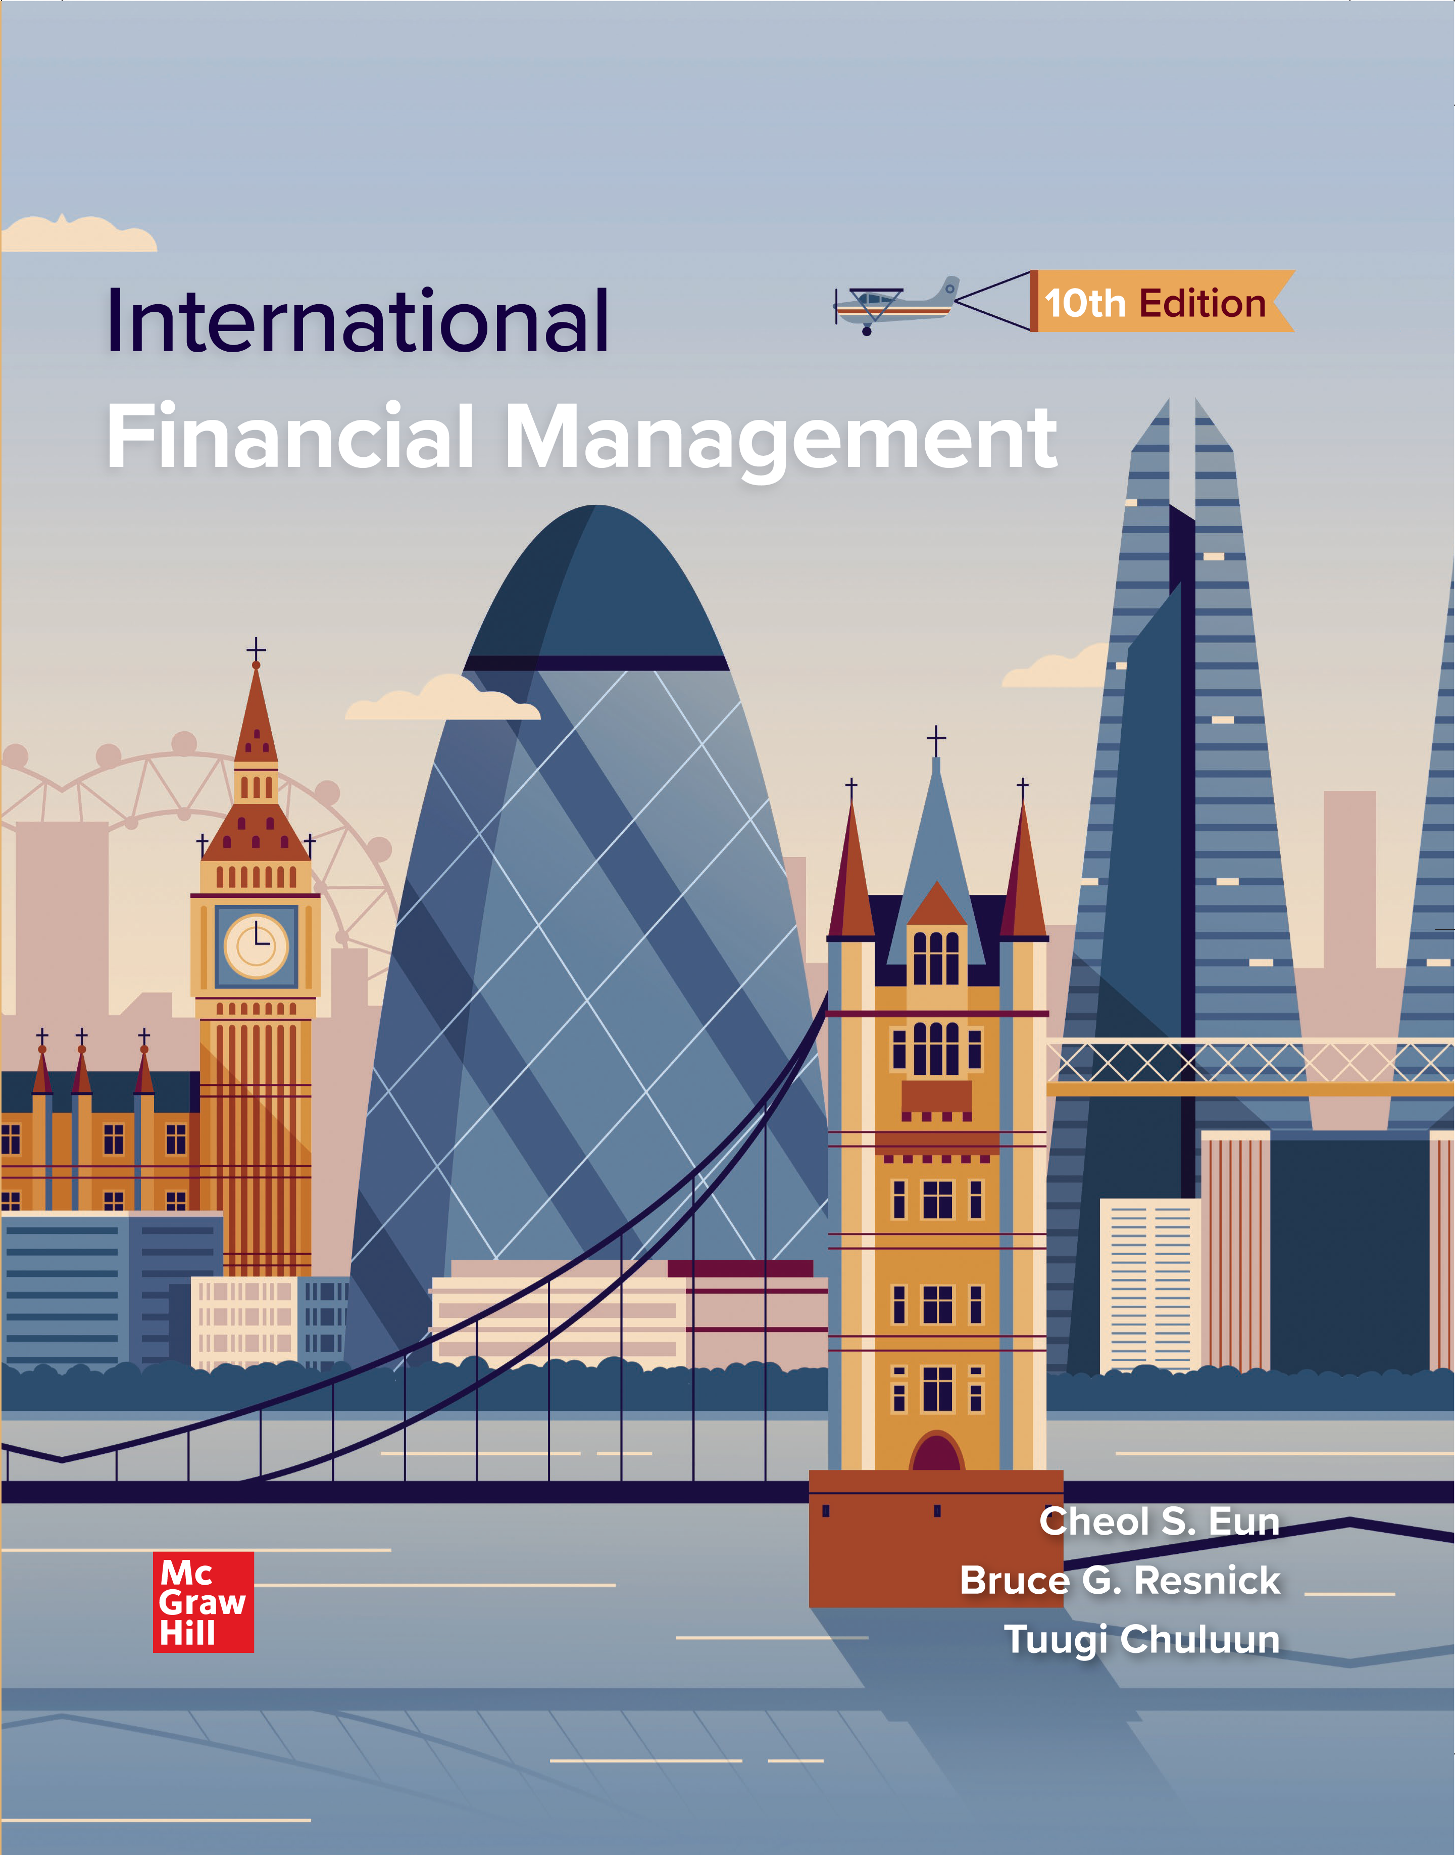
Chapter Eleven
International Banking and Money Market
© McGraw Hill LLC. All rights reserved. No reproduction or distribution without the prior written consent of McGraw Hill LLC.
Notes:
CHAPTER 11 differentiates between international bank and domestic bank operations and examines the institutional differences of various types of international banking offices. International banks and their clients constitute the Eurocurrency market and form the core of the international money market.

Slide 2
Chapter Outline 1
International Banking Services.
The World’s Largest Banks.
Reasons for International Banking.
Types of International Banking Offices.
Correspondent Bank.
Representative Offices.
Foreign Branches.
Subsidiary and Affiliate Bank.
Edge Act Banks.
Offshore Banking Centers.
International Banking Facilities.
Capital Adequacy Standards.

Slide 3
Chapter Outline 2
International Money Market.
International Money Market.
Alternative Risk-Free Rates
Eurocredits.
Forward Rate Agreements.
Euronotes.
Eurocommercial Paper.
C M E S O F R Futures Contracts.
International Debt Crisis.
History.
Debt-for-Equity Swaps.
The Solution: Brady Bonds.
The Asian Crisis.
Global Financial Crisis.

Slide 4
International Banking Services 1
International banks can be characterized by the types of services they provide that distinguish them from domestic banks:
Facilitate the imports and exports of their clients by arranging trade financing.
Serve their clients by arranging for foreign exchange necessary to conduct cross-border transactions and make foreign investments.
Assist their clients in hedging exchange rate risk through forward and options contracts.
Trade foreign exchange products for their own account.

Slide 5
International Banking Services 2
Major features that distinguish international banks from domestic banks are the types of deposits they accept and the loans and investments they make.
Large international banks both borrow and lend in the Eurocurrency market.
Banks are frequently structured as bank holding companies so that they can perform both traditional commercial banking functions and engage in investment banking activities.
Notes:
Bir para birimi, ait olduğu ülkenin dışındaki bir bankada tutuluyorsa buna Eurocurrency denir ve bu fonların işlem gördüğü piyasa da Eurocurrency market olarak adlandırılır.
Örnek:
ABD dolarının Londra’daki bir bankada tutulması → Eurodollar
Japon yeninin Türkiye’de tutulması → Euroyen
Euro’nun ABD’de tutulması → Euroeuro
Buradaki “Euro” kelimesi Euro para birimini ifade etmez, sadece “para biriminin kendi ülkesi dışında tutulduğunu” gösterir.

Slide 6
The World’s 30 Largest Banks 1
Exhibit 11.1 The World’s 30 Largest Banks (in billions of U.S. dollars, as of March 2022).
Rank | Bank | Country | Total Assets | Net Income | Market Value
1 | I C B C | China | 4,914.7 | 45.8 | 249.5
2 | China Construction Bank | China | 4,301.7 | 39.3 | 210.4
3 | Agricultural Bank of China | China | 4,159.9 | 31.3 | 140.1
4 | Bank of China | China | 3,731.4 | 27.9 | 116.7
5 | Mitsubishi U F J Financial | Japan | 3,406.5 | 5.2 | 69.7
6 | B N P Paribas | France | 3,044.8 | 7.6 | 79.1
7 | H S B C Holdings | United Kingdom | 2,984.2 | 4.0 | 120.3
8 | Bank of America | Unites States | 2,832.2 | 17.9 | 336.3
9 | Credit Agricole | France | 2,399.5 | 2.6 | 41.0
10 | Sumitomo Mitsui Financial | Japan | 2,256.8 | 4.9 | 48.9
11 | Wells Fargo | United States | 1,959.5 | 7.4 | 181.5
12 | Postal Savings Bank of China | China | 1,736.2 | 9.3 | 112.4
13 | Bank of Communications | China | 1,635.8 | 11.1 | 47.9
14 | T D Bank Group | Canada | 1,358.6 | 9.1 | 120.6
15 | Royal Bank of Canada | Canada | 1,308.2 | 8.8 | 135.0

Slide 7
The World’s 30 Largest Banks 2
Rank | Bank | Country | Total Assets | Net Income | Market Value
16 | China Merchants Bank | China | 1,278.5 | 14.1 | 192.8
17 | Intesa Sanpaolo | Italy | 1,226.7 | 3.7 | 53.3
18 | Shanghai Pudong Development | China | 1,215.7 | 8.5 | 47.4
19 | Industrial Bank | China | 1,207.2 | 9.7 | 66.5
20 | U B S | Switzerland | 1,125.8 | 6.5 | 57.3
21 | Bank of Nova Scotia | Canada | 911,2 | 5.1 | 75.3
22 | Commonwealth Bank | Australia | 816.2 | 5.7 | 120.7
23 | Bank of Montreal | Canada | 761.8 | 4.1 | 59.4
24 | State Bank of India | India | 638.1 | 3.1 | 40.8
25 | U S Bancorp | United States | 553.4 | 6.1 | 86.9
26 | Truist Bank | United States | 517.5 | 4.9 | 77.8
27 | SberBank | Russia | 486.9 | 10.4 | 85.7
28 | P N C Financial Services | United States | 474.4 | 8.4 | 75.8
29 | Itau Unibanco Holdings | Brazil | 389.7 | 3.7 | 48.5
30 | H D F C Bank | India | 233.6 | 4.1 | 105.9
Source: Compiled from The Global 2000, www.forbes.com.

Slide 8
Reasons for International Banking 1
Low marginal costs:
Managerial and marketing knowledge developed at home can be used abroad with low marginal costs.
Knowledge advantage:
Foreign bank subsidiary can draw on parent bank’s knowledge of personal contacts and credit investigations for use in that foreign market.
Home nation information services:
Local firms in a foreign market may be able to obtain more complete information on trade and financial markets in the multinational bank’s home nation than is obtainable from foreign domestic banks.
Prestige:
Very large multinational banks have high perceived prestige, which can be attractive to new clients.

Slide 9
Reasons for International Banking 2
Regulation advantage:
Multinational banks are often not subject to the same regulations as domestic banks.
Wholesale defensive strategy:
Banks follow their multinational customers abroad to avoid losing their business at home and abroad.
Retail defensive strategy:
Multinational banking operations help a bank prevent the erosion of its traveler’s check, tourist, and foreign business markets from foreign bank competition.
Transactions costs:
Multinational banks may be able to circumvent government currency controls.

Slide 10
Reasons for International Banking 3
Growth:
Foreign markets may offer opportunities for growth not found domestically.
Risk reduction:
Greater stability of earnings with diversification.

Slide 11
Types of International Banking Offices
Correspondent bank.
Representative offices.
Foreign branches.
Subsidiary and affiliate banks.
Edge Act banks.
Offshore banking centers.
International banking facilities.

Slide 12
Correspondent Bank
A correspondent bank relationship is established when two banks maintain a correspondent bank account with one another.
Beneficial because a bank can service its M N C clients at a low cost, without the need of having bank personnel physically located in many countries.
Disadvantage is that the bank’s clients may not receive the same level of service.
Correspondent banking allows a bank’s M N C client to conduct business worldwide through his local bank or its contacts

Slide 13
Representative Offices
A representative office is a small service facility staffed by parent bank personnel that is designed to assist M N C clients of the parent bank in dealings with the bank’s correspondents.
Serves as a way for the parent bank to provide its M N C clients with a level of service greater than that provided through a correspondent relationship.
Representative offices also assist M N C clients with information about local business practices, economic information, and credit evaluation of the M N C’s foreign customers.

Slide 14
Foreign Branches
A foreign branch bank operates like a local bank but is legally a part of the parent bank.
Subject to the banking regulations of both the home country and the country in which it operates.
May be established for various reasons:
Can provide a much fuller range of services for its M N C customers than can be provided through a representative office.
Books of a foreign branch are part of the parent bank’s books.
Facilitates competition on a local level with banks of the host country.
Notes:
Branch banking is the most popular way for U.S. banks to expand operations overseas.

Slide 15
Subsidiary and Affiliate Banks
Both subsidiary and affiliate banks operate under the banking laws of the country in which they are incorporated.
A subsidiary bank is a locally incorporated bank that is either wholly owned or owned in major part by a foreign parent.
An affiliate bank is one that is only partially owned but not controlled by its foreign parent.
U.S. parent banks find subsidiary and affiliate banking structures desirable because they can underwrite securities.

Slide 16
Edge Act Banks
Edge Act was a 19 19 amendment to Section 25 of the 19 14 Federal Reserve Act.
Edge Act banks are federally chartered subsidiaries of U.S. banks that are physically located in the United States and can engage in a full range of international banking activities.
Edge Act banks are typically located in a state different from that of the parent to get around the prohibition on interstate branch banking.
Edge Act banks are not prohibited from owning equity in business corporations, unlike domestic commercial banks.

Slide 17
Offshore Banking Centers
An offshore banking center is a country whose banking system is organized to permit external accounts beyond the normal economic activity of the country
Offshore banks operate as branches or subsidiaries of the parent bank.
Principal features that make a country attractive for establishing an offshore banking operation are virtually total freedom from host-country governmental banking regulations.
Notes:
The International Monetary Fund has recognized the Bahamas, Bahrain, the Cayman Islands, Hong Kong, Panama, and Singapore as major offshore banking centers.

Slide 18
International Banking Facilities
An international banking facility (I B F) is a separate set of asset and liability accounts that are segregated on the parent bank’s books, though it is not a unique physical or legal entity
Any U.S.-chartered depository institution, a U.S. branch or subsidiary of a foreign bank, or a U.S. office of an Edge Act bank may operate an I B F.
Originally established largely as a result of the success of offshore banking.
Have been successful in capturing a large portion of Eurodollar business previously handled offshore.

Slide 19
Organizational Structure of International Banking Offices from the U.S. Perspective
Type of Bank | Physical Location | Accept Foreign Deposits | Make Loans to Foreigners | Subject to Fed Reserve Requirements | F D I C Insured Deposits | Separate Legal Equity from Parent
Domestic bank | U.S. | No | No | Yes | Yes | No
Correspondent bank | Foreign | N/A | N/A | No | No | N/A
Representative office | Foreign | No | No | Yes | Yes | No
Foreign branch | Foreign | Yes | Yes | No | No | No
Subsidiary bank | Foreign | Yes | Yes | No | No | Yes
Affiliate bank | Foreign | Yes | Yes | No | No | Yes
Edge Act bank | U.S. | Yes | Yes | No | No | Yes
Offshore banking center | Technically Foreign | Yes | Yes | No | No | No
International banking facility | U.S. | Yes | Yes | No | No | No

Slide 20
Capital Adequacy Standards
Bank capital adequacy refers to the amount of equity capital and other securities a bank holds as reserves against risky assets to reduce the probability of a bank failure
Three pillars of capital adequacy:
Minimum capital requirements.
Supervisory review process.
Effective use of market discipline.
Basel
was announced on September 12, 2010
Designed to substantially strengthen the regulatory capital framework and increase the quality of bank capital.
Notes:
On December 7, 2017, the Basel Committee announced additional reforms to Basel III that seek to restore credibility in the calculation of risk-weighted assets and improve the comparability of banks’ capital ratios. They are scheduled for implementation through 2021.

Slide 21
International Money Market
Eurocurrency is a time deposit in an international bank located in a country different from the country that issued the currency.
For example, Eurodollars are deposits of U.S. dollars in banks located outside of the United States, while Eurosterling are deposits of British pound sterling in banks outside of the United Kingdom.
Eurocurrency market is an external banking system that runs parallel to the domestic banking system of the country that issued the currency.
Origin can be traced back to the 19 50s and 19 60s.

Slide 22
Eurocurrency Market 1
Eurocurrency market operates at the interbank and/or wholesale level, with most transactions being interbank transactions in the amount of $1,000,000 or more.
LIBOR (London Interbank Offered Rate) was a common reference rate.
Beginning on January 1, 2022, a new series of reference rates, known collectively as Alternative Risk-Free Rates (R F Rs), went into effect for the various Eurocurrencies.
These R F Rs are based on overnight wholesale transactions that are unsecured or secured repurchase or “repo” transactions and representative of actual market transactions.
Representative of risk-free rates, or nearly risk-free rates.
Notes:
London has historically been, and remains, the major Eurocurrency financial center.

Slide 23
Eurocurrency Market 2
Exhibit 11.4 Alternative Risk-Free Rates
Currency (Symbol) | R F R
U.S. Dollar (U S D) | Secured Overnight Financing Rate (S O F R)
Sterling (G B P) | Sterling Overnight Index Average (S O N I A)
Euro (E U R) | Euro Short Term Rate (€ S T R)
Swiss Franc (C H F) | Swiss Average Overnight Rate (S A R O N)
Japanese Yen (J P Y) | Tokyo Overnight Average Rate (T O N A R)

Slide 24
Eurocredits
Eurocredits are short- to medium-term loans of Eurocurrency extended by Eurobanks.
Loans are denominated in currencies other than the home currency of the Eurobank.
Because the loans are often too large for one bank to handle, Eurobanks will band together to form a bank lending syndicate to share the risk.
Credit risk on these loans is greater than on loans to other banks in the interbank market.
Interest rate on Eurocredits must compensate the bank for the added credit risk.

Slide 25
Forward Rate Agreements 1
A major risk Eurobanks face in accepting Eurodeposits and in extending Eurocredits is interest rate risk resulting from a mismatch in the maturities of the deposits and credits
An interbank contract that allows the Eurobank to hedge the interest rate risk in mismatched deposits and credits is a forward rate agreement (F R A).
F R A involves two parties:
Buyer agrees to pay seller the increased interest cost on a notional amount if interest rates fall below an agreed rate.
Seller agrees to pay buyer the increased interest cost if interest rates increase above the agreed rate.

Slide 26
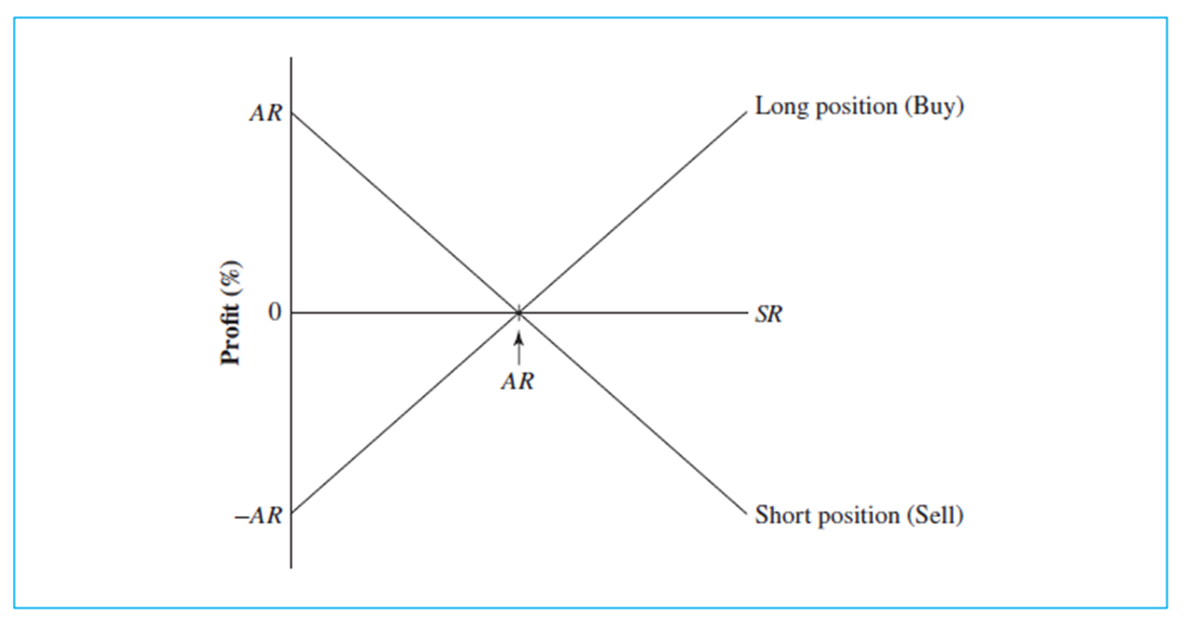
F R A Payoff Profile
Access the text alternative for slide images.

Slide 27
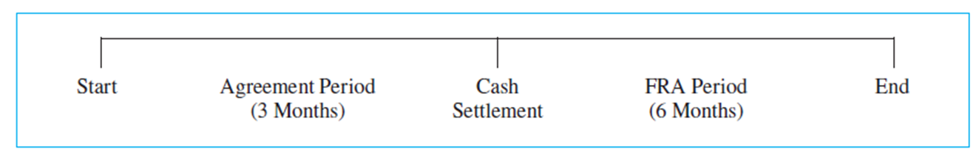
Forward Rate Agreements 2
F R As are structured to capture the maturity mismatch in standard-length Eurodeposits and credits
Example: The F R A might be on a six-month interest rate for a six-month period beginning three months from today and ending nine months from today.
This would be a “three against nine” F R A .
Access the text alternative for slide images.

Slide 28
Forward Rate Agreements 3
Payment amount under an F R A is calculated as the absolute value of:
Days denotes the length of the F R A period.
Notes:
FRAs can be used for speculative purposes also.

Slide 29
Euronotes
Euronotes are short-term notes underwritten by a group of international investment or commercial banks called a “facility”
Client-borrower makes an agreement with a facility to issue Euronotes in its own name for a period of time, generally 3 to 10 years.
Sold at a discount from face value and pay back the full face value at maturity.
Maturity is typically three to six months.
Attractive to borrowers because interest expense is usually slightly less in comparison to syndicated Eurobank loans.

Slide 30
Eurocommercial Paper
Eurocommercial paper, like domestic commercial paper, is an unsecured short-term promissory note issued by a corporation or a bank and placed directly with the investment public through a dealer
Sold at a discount from face value, like Euronotes.
Maturities typically range from one to six months.
Vast majority of Eurocommercial paper is denominated in the euro and the U.S. dollar.
Eurocommercial paper issuers tend to be of much lower quality than their U.S. counterparts.
As such, yields tend to be higher.

Slide 31
C M E S O F R Futures Contract
One-Month and Three-Month S O F R interest rate futures contracts traded on the C M E Group are two important contracts.
The C M E Three-Month S O F R futures contract is written on a hypothetical risk-free deposit of dollars with quarter year maturity.
Contract trades in the March, June, September, and December cycle.
Contract is a cash settlement contract.
Contracts trade out 39 quarters into the future.

Slide 32
International Debt Crisis
International debt crisis was caused by lending to the sovereign governments of some less-developed countries (L D Cs).
Crisis began on August 20, 19 82, when Mexico asked more than 100 U.S. and foreign banks to forgive its $68 billion in loans. Soon after, Brazil, Argentina, and more than 20 other developing countries announced similar problems in making the debt service on their bank loans.
At the height of the crisis, Third World countries owed $1.2 trillion.
Source of the international debt crisis was oil.
U.S. banks claimed there was official arm-twisting from Washington to assist the economic development of the Third World countries.

Slide 33
Debt-for-Equity Swaps
A debt-for-equity swap is the sale of sovereign debt for U.S. dollars to investors desiring to make equity investment in the indebted nation
As part of debt rescheduling agreements among the bank lending syndicates and the debtor nations, creditor banks would sell their loans for U.S. dollars at discounts from face value to M N Cs desiring to make equity investment in subsidiaries or local firms in the L D Cs.
L D C central bank would buy the bank debt from a M N C at a smaller discount than the M N C paid, but in local currency.
The M N C would use the local currency to make preapproved new investment in the L D C that was economically or socially beneficial to the L D C and its populace.
Notes:
During the LDC debt crisis, a secondary market developed for LDC debt at prices discounted significantly from face value. The secondary market consisted of approximately 50 creditor banks, investment banks, and boutique market makers.

Slide 34
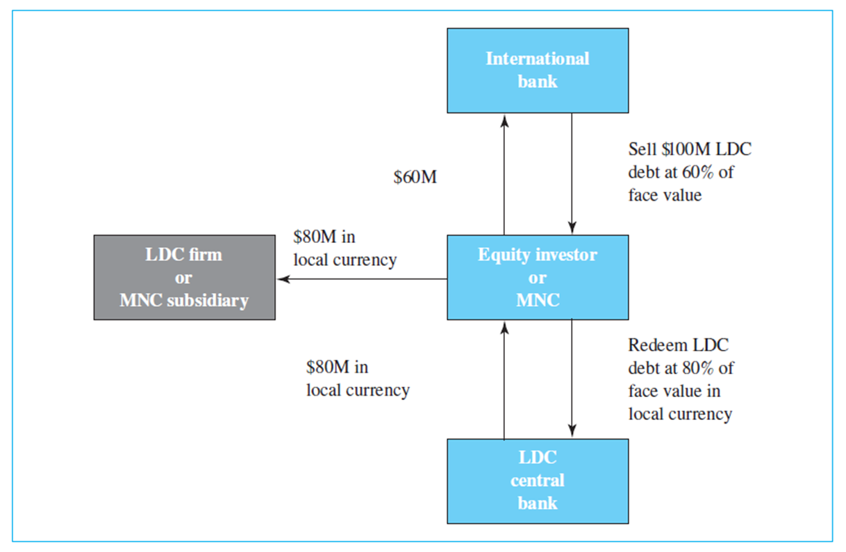
Debt-for-Equity Swap Illustration
Access the text alternative for slide images.
Notes:
Exhibit 11.9 diagrams a hypothetical debt-for-equity swap. The exhibit shows a MNC purchasing $100 million of Mexican debt (either directly or through a market maker) from a creditor bank for $60 million, that is, at a 40 percent discount from face value. The MNC then redeems the $100 million note from the Mexican central bank for the equivalent of $80 million in Mexican pesos at the current exchange rate. The Mexican pesos are invested in a Mexican subsidiary of the MNC or in an equity position in an LDC firm. The MNC has paid $60 million for $80 million in Mexican pesos.

Slide 35
The Solution: Brady Bonds 1
U.S. Treasury Secretary Nicholas F. Brady of the first Bush administration is largely credited with designing a strategy in the spring of 19 89 to resolve the international debt crisis.
Creditor banks were offered one of three options:
Convert their loans to marketable bonds with a face value equal to 65% of the original loan amount.
Convert the loans into collateralized bonds with a reduced interest rate of 6.5% (that is, Brady bonds).
Lend additional funds to allow the debtor nations to get on their feet.
Notes:
Few banks chose the third alternative.

Slide 36
The Solution: Brady Bonds 2
Brady bonds are loans converted into collateralized bonds with a reduced interest rate devised to resolve the international debt crisis in the late 19 80s.
Called for extending the debt maturities by 25 to 30 years and the purchase by the debtor nation of zero-coupon U.S. Treasury bonds with a corresponding maturity to guarantee the bonds and make them marketable.
By August of 19 92, 12 of 16 major debtor nations had reached refinancing agreements accounting for 92% of their outstanding private bank debt.
Over $100 billion in bank debt has been converted to Brady bonds.
Notes:
Few banks chose the third alternative.

Slide 37
The Asian Crisis
Crisis began in mid-19 97 when Thailand devalued the baht. Consequently, other Asian countries devalued their currencies by letting them float.
Crisis followed a period of economic expansion in the region financed by record private capital inflows.
Bankers from the G-10 countries actively sought to finance growth opportunities in Asia by providing businesses with a full range of products and services, leading to domestic price bubbles in East Asia, particularly in real estate.
Close interrelationships common among commercial firms and financial institutions in Asia resulted in poor investment decision making.

Slide 38
Global Financial Crisis: Credit Crunch 1
Credit crunch, or inability of borrowers to easily obtain credit, began in the United States in the summer of 2007 and turned into a global financial crisis and economic downturn.
Origin of credit crunch can be traced back to three key contributing factors:
Liberalization of banking and securities regulation.
Global savings glut.
Low interest rate environment created by the Federal Reserve in the early part of this decade.

Slide 39
Global Financial Crisis: Credit Crunch 2
During this time, subprime mortgages were re-packaged into mortgage-backed securities (M B Ss) to be sold to investors.
The amounts of subprime M B S debt in structured investment vehicles (S I Vs) and collateralized debt obligations (C D O s), and who exactly owned it, were essentially unknown, or at least unappreciated.
When subprime debtors began defaulting on their mortgages, trading in the interbank Eurocurrency market essentially ceased and liquidity worldwide dried up.

Slide 40
Global Financial Crisis: Aftermath
Dramatic changes have taken place in the financial services industry, the auto industry, and in financial markets worldwide
More political and regulatory scrutiny of banking operations and the functioning of financial markets followed:
Basel
Dodd-Frank Wall Street Reform and Consumer Protection Act in the U.S.

Slide 41
End of Main Content
© McGraw Hill LLC. All rights reserved. No reproduction or distribution without the prior written consent of McGraw Hill LLC.

Slide 42
Accessibility Content: Text Alternatives for Images

Slide 43
F R A Payoff Profile – Text Alternative
Return to parent-slide containing images.
This graph shows Profit percentage on the y-axis. There are two points shown on the y-axis that include A R and negative A R. There is a horizontal line starting at 0 on the y-axis that is labeled S R. There is a diagonal line starting at A R on the y-axis going downward that is labeled Short position (Sell) and another diagonal line starting at negative A R on the y-axis going upward that is labeled Long position (Buy). There is a point labeled A R where these three lines intersect.
Return to parent-slide containing images.

Slide 44
Forward Rate Agreements 2 – Text Alternative
Return to parent-slide containing images.
There are three points shown on the time line. The first point is Start, the middle point is Cash Settlement, and the last point is End. The time between start and cash settlement is called the agreement period, which lasts three months. The time between cash settlement and the end is the F R A period, which lasts six months.
Return to parent-slide containing images.
44

Slide 45
Debt-for-Equity Swap Illustration – Text Alternative
Return to parent-slide containing images.
This illustration has three boxes on the right side. The boxes are stacked one over the other with arrows in between. Box 1 is labeled International bank. Box 2 is labeled Equity investor or M N C. Box 3 is labeled L D C central bank. Boxes 1 and 2 have arrows pointing back and forth to each other. The arrow from Box 1 to Box 2 is labeled Sell $100M L D C debt at 60% of face value. The arrow from Box 2 to Box 1 is labeled $60M. Boxes 2 and 3 have arrows pointing back and forth to each other. The arrow from Box 2 to Box 3 is labeled Redeem L D C debt at 80% of face value in local currency. The arrow from Box 3 to Box 2 is labeled $80M in local currency. There is another box to the left of Box 2 that is labeled L D C firm or M N C subsidiary. There is an arrow pointing from Box 2 to this box that is labeled $80M in local currency.
Return to parent-slide containing images.
45

