Slide 1
CRM. Chapter 7…
Value disciplines

Slide 2
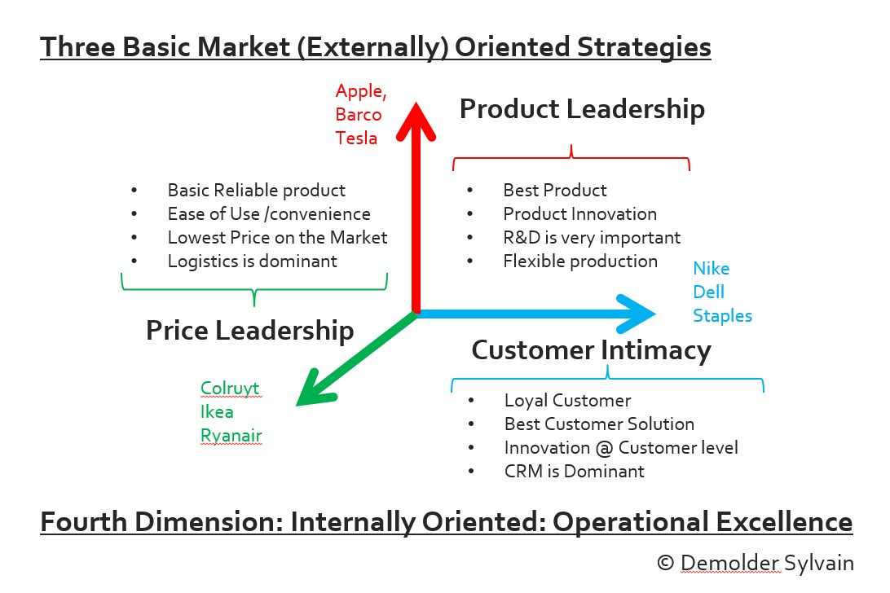
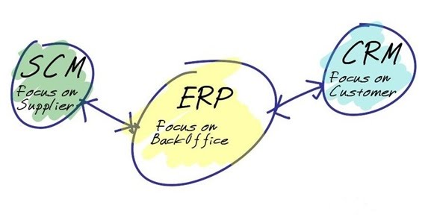
Treacy AND Wiersema (1996)
Company want to amaze its customers!, push the limits

Slide 3
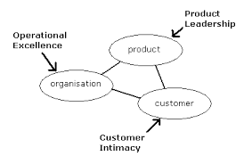

Slide 4
Some organizations will concentrate on their relationship with their customers (to increase customer satisfaction and retention by better understanding the customer's needs and preferences).
Other organizations will focus on their products (constantly developing new ideas and getting them to market quickly).
The third group of organizations focus primarily on themselves and their internal processes (sharing best practices between different units, reducing costs and improving efficiency).

Slide 5
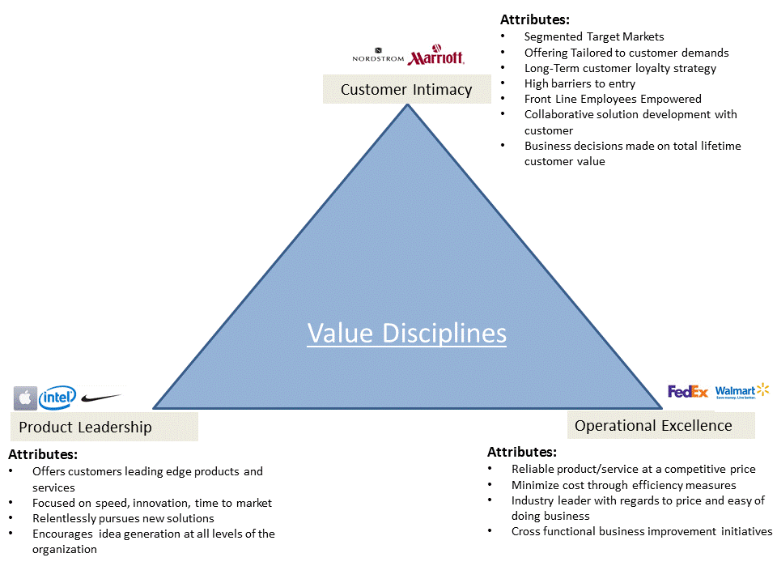

Slide 6
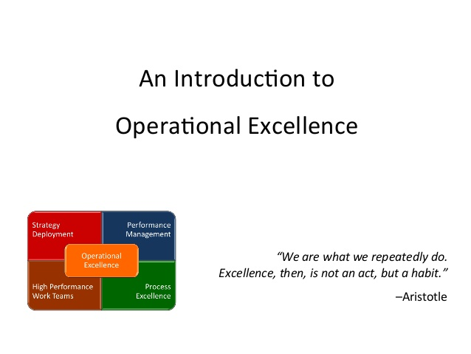

Slide 7

Selling strategies

Slide 8
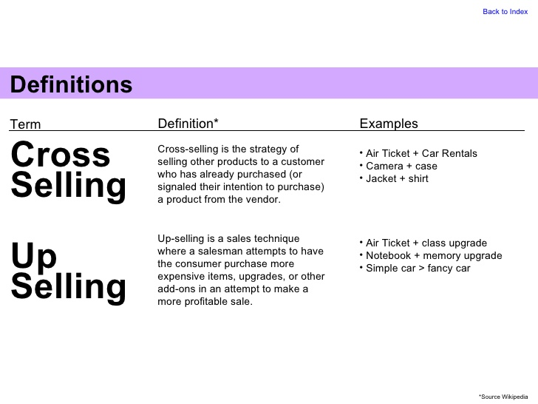

Slide 9
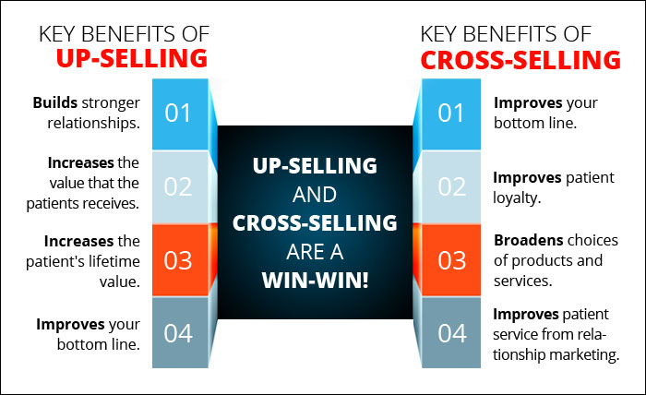

Slide 10
