Slide 1
ECONOMICS
“Market Competition”
LECTURER : DR CANSU UNVER-ERBAS
Email : Cnsunvr@gmail.com

Slide 2
LEARNING OBJECTIVES
Perfect Competition.
Profit Maximization.
Competition in the Short Run.
Competition in the Long Run.

Slide 3
Market Structure
Market Structure – the number of firms in the market, the ease with which firms can enter and leave the market, and the ability of firms to differentiate their products from those of their rivals.
Competitive market structure – many firms produce identical products and firms can easily enter and exit the market.

Slide 4
Firms ‘must do’
To achieve the objective of maximum economic profit, a firm must make five decision
What to produce and what quantities
How to produce
How to organise and compensate its managers and workers
How to market and price its products
What to produce itself and buy from others
Is making such decisions easy?

Slide 5
WHAT IS AN OUTPUT IN A MARKET?
It is much easier in some contexts, but what is output?
What the firm sells to obtain revenue? (i.e. Attendance tickets, Clothing, equipment…)
Service (financial advice, insurance, banking, etc.)
Typically, this definition will depend on the type of market we are referring to.
Perfect competition
Monopoly
Monopolistic competition.
  Inefficient market allocations

Slide 6
Market Structures: What Is Perfect Competition?
Assumptions:
  the firm’s production cost is small relative to market demand so there is room for many firms to enter into these kind of markets.
➔ Very low barriers to entry (if any at all)
  each firm is perceived to produce a good or service that has no unique characteristics, so consumers don’t care which firm’s good they buy
    Many consumers and many buyers, all buying and selling the same (a homogeneous) product.
    Doesn’t matter where it’s bought – same product.

Slide 7
Market Structures:
How Perfect Competition Arises
Assumptions:
  compared to the entire market, a buyer (or seller) is virtually insignificant and cannot alter the market price unilaterally
➔ A single user’s action cannot change the market price/quantity in any significant way.
  buyers and sellers have perfect information ➔ ➔ If a supplier increases their price, buyers get the product elsewhere.
IMPLICATION: In perfect competition, each producer is too small to affect prices

Slide 8
Market Structures:
What Is Perfect Competition?
Price Takers: In perfect competition, each firm is a price taker.
A price taker is a firm that cannot influence the price of a good or service.
No single firm can influence the price—it must “take” the equilibrium market price.
Each firm’s output is a perfect substitute for the output of the other firms, so the demand for each firm’s output is perfectly elastic.

Slide 9
Why the Firm’s Demand Curve Is Horizontal
Perfectly competitive markets have five characteristics that force firms to be price takers:
Many small buyers and sellers
All firms produce identical products
Buyers and sellers have full information about price and product characteristics
Negligible transaction costs
Firms can freely enter and exit the market

Slide 10
Why Price takers?
If you try to sell a well-known brand of tennis racket on the web you will find that there are many companies competing with you no doubt offering the same or similar price for this identical product.
Also you will see that there are lots of customers looking for these rackets, neither the individual firms or customers are sufficiently powerful enough to alter the market price.
In fact you will find out pretty quickly that it is very hard to make a decent profit selling these products, as is true for most restaurants selling standard burgers or basic pizzas.

Slide 11
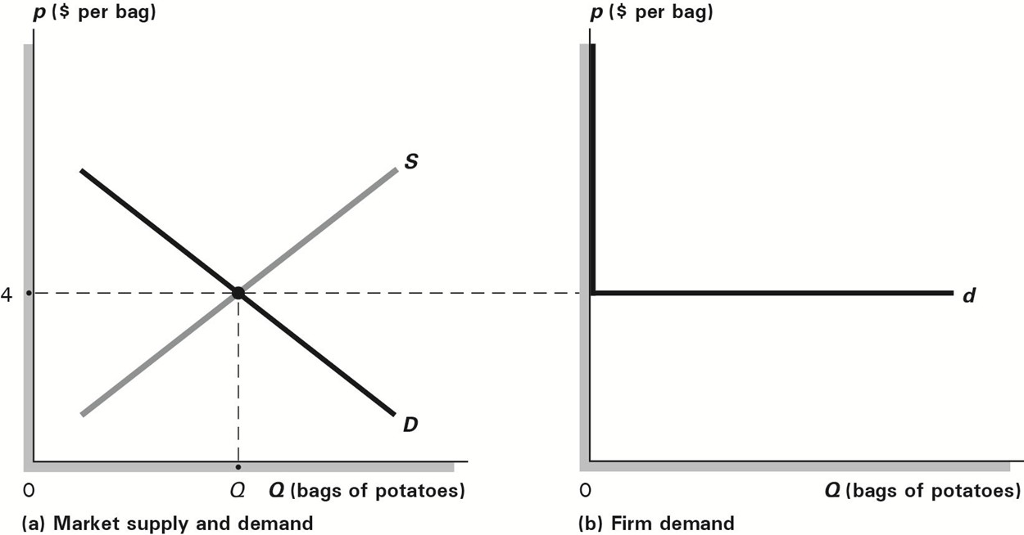
Market Structures:
What Is Perfect Competition?
Price Takers e.g. a bag of potatoes (Remember: no branding; many buyers; many sellers)
Distinguishing Market Demand and Firm Demand in Perfect Competition

Slide 12
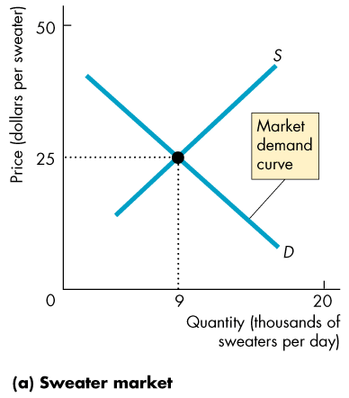
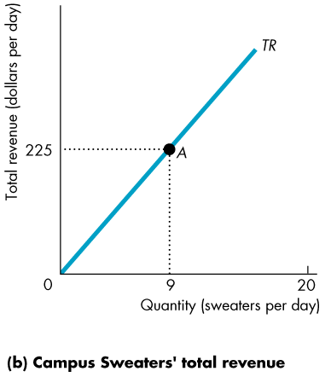
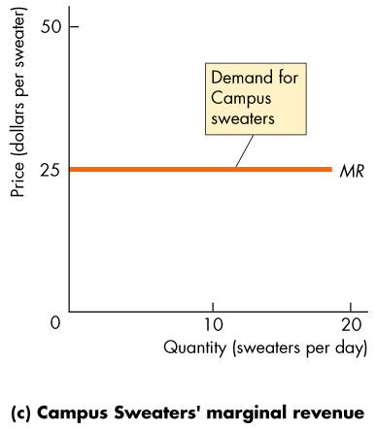
What is the market ‘price taking’ value?
It is the Marginal Revenue (MR) in Perfect
Competition.
A firm’s total revenue equals price, P,
multiplied by quantity sold, Q, or P × Q.
A firm’s marginal revenue is the change
in total revenue that results from a
one-unit increase in the quantity sold.
(or the slope of the TR) 225/9-25

Slide 13
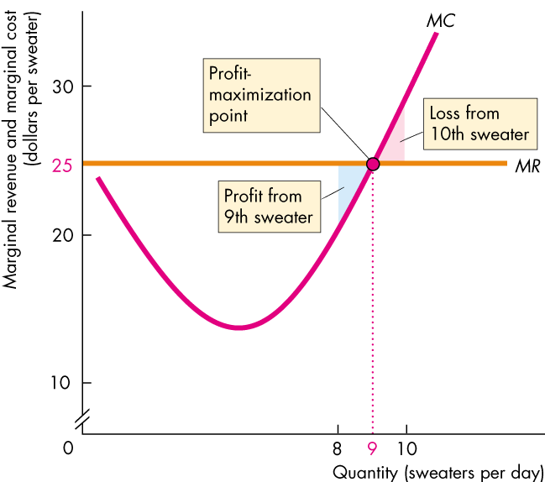
Market Equilibrium
Firms maximize profits when: Marginal Revenue (MR) = Marginal Cost (MC)

Slide 14



Slide 15
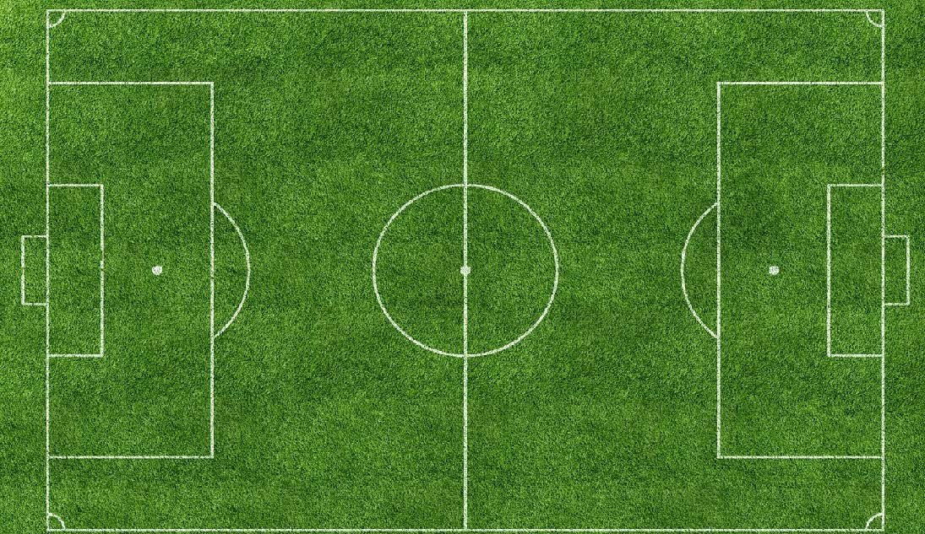





Threat of new entrants
Porter’s model: five forces for competitive rivalry within an industry
Bargaining power of suppliers
Competitive rivalry within industry
Bargaining power of customers
Threat of substitutes

Slide 16
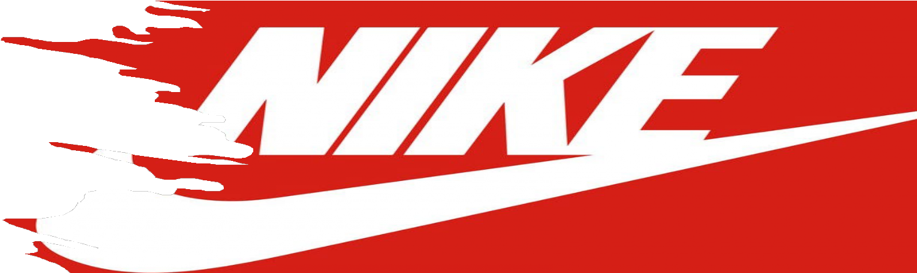

EXAMPLE
‘’ According to our analysis, competitive rivalry within the industry is a key force which has the potential to curtail Nike’s growth. The competition is increasing from both established, as well as upcoming and local sports-apparel and footwear companies. In case Nike is unable to adapt to changing trends, its growth could be impacted.
The company relies heavily on wholesale channel and big wholesale customers could exert leverage to attain higher product discounts/ better credit terms. The low barriers to entry in the Internet retailing business could enhance the competition in the industry. Also, Nike needs to address the problem of counterfeit products to dilute the threat from small players.’’

Slide 17
Competitive Rivalry Within The Industry
Intense competition from established and upcoming rivals could threaten Nike’s market share growth
The global market for athletic footwear, apparel and equipment is characterized by intense competition, with presence of a large number of players such as Puma, Adidas, V.F Corporation, Asics, etc.
The global athletic products industry is exposed to continuous changes in consumer preferences and technology; if Nike is unable to adapt to these changes quickly, it could suffer losses in its market share.
Rising competition from emerging players such as Under Armour and Lululemon Athletica, which focus on niche market segments such as performance apparel and yoga-focused apparel, also pose a threat to Nike’s share of selected markets.
Nike also faces rising competition from local players in emerging markets, who are increasingly improving their product quality.
Having said that, Nike has a strong brand reputation which likely will continue to propel strong demand for its products. Further, Nike continues to differentiate its products within an innovative product portfolio, leveraging a particularly strong brand with enhanced marketing activities.

Slide 18
Bargaining Power Of Suppliers
While no single supplier holds significant bargaining power, footwear production is concentrated in Vietnam, China and Indonesia
Nike’s footwear and apparel products are manufactured by third-party contract manufacturers outside the U.S. in various countries, including Vietnam, China, Indonesia, Argentina, Brazil, India and Mexico.
Nike’s footwear production is largely conducted in Vietnam, China and Indonesia as contract factories in these countries in fiscal 2013 comprised around 42%, 30%, and 26% of total Nike brand footwear production, respectively. Hence,both sovereign issues and currency effects could be a cause for concern for Nike.
No single footwear factory or apparel factory accounted for more than 6% of total Nike brand footwear production and Nike brand apparel production respectively in fiscal 2013; hence, due to a large base of suppliers, we believe their bargaining power is limited.
The switching costs in changing suppliers is significant.
However, suppliers generally share the inflationary pressure (related to raw material costs and labor expenses) with Nike through manufacturing service pricing.

Slide 19
Bargaining Power Of Customers
Big wholesale customers could exert some bargaining power
Nike caters to its customers through both the wholesale and direct-to-consumer channels, which accounted for 80.6% and 18.9% of total Nike brand’s sales respectively, in fiscal 2013.
Direct-to-consumer sales rose by 23% in fiscal 2013, as compared to 6% growth in the wholesale channel; hence Nike is looking to strengthen its direct channel.
Certain big wholesale customers hold bargaining power as they could widen their partnership with Nike’s competitors or provide their own private label offerings to earn higher profitability.
Bargaining power of end-customers is low as Nike has a very strong brand image and holds an innovative product portfolio.
However, customers could also choose other brands owing to factors such as price, advertising, product sponsorship, and changing styles.

Slide 20
Threat Of New Entrants
– Requirement for high capital and research investments could limit the entry of new players; however, there is a threat from new e- commerce players
Significant capital resources are required for creating a new brand as large investments are needed for marketing and procuring floor space; hence, this restricts the entry of newer players.
Nike enjoys a great degree of brand recognition and loyalty, and it will be a difficult for a new player to match its level.
Having said that, we believe more Internet companies could start selling competitors’ footwear, apparel and equipment online as the barriers to entry are low in this business.

Slide 21
Threat Of Substitute Products
Counterfeit products represents the biggest threat in this area
The worldwide demand for athletic footwear, clothing and equipment is expected to grow in the future as customers cannot substitute these products.
However, the problem of counterfeit products is an area to watch. As the quality of counterfeit products has been improving over the recent past, we believe this could threaten the company’s sales in emerging markets and could also potentially dilute Nike’s brand value.

Slide 22
Profit
Economic profit = revenue minus economic cost
π = R − C.
If profit is negative, π < 0, the firm makes a loss.
Copyright © 2018, 2015, 2012 Pearson Education, Inc. All Rights Reserved

Slide 23
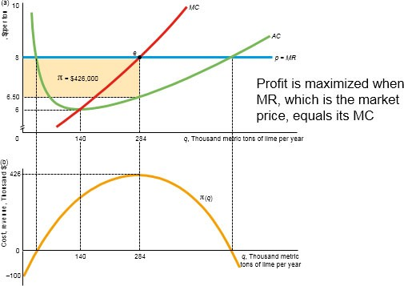
Output Decision Rules
Output Rule 1: The firm sets its output where its profit is maximized.
Output Rule 2: A firm sets its output where its marginal profit is zero. (max function)
Output Rule 3: A firm sets its output where its marginal revenue equals its marginal cost:
MR (q ) = MC (q ).
The Supply curve is above the AC
Optimal point (max profit) is when MR=MC
Copyright © 2018, 2015, 2012 Pearson Education, Inc. All Rights Reserved

Slide 24
Short-Run Market Supply with Identical Firms
As the number of firms grows very large, the market supply curve approaches a horizontal line at the minimum point of the AVC curve.
Thus, the more identical firms producing at a given price, the flatter (more elastic) the short-run market supply curve at that price.

Slide 25
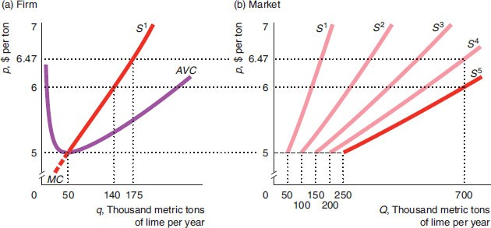
Short-Run Market Supply with Five Identical Lime Firms
Copyright © 2018, 2015, 2012 Pearson Education, Inc. All Rights Reserved

Slide 26
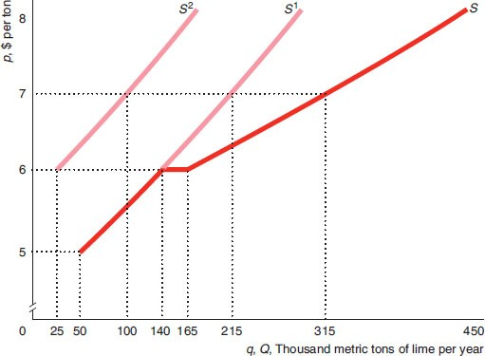
Short-Run Market Supply with Two Different Lime Firms
Copyright © 2018, 2015, 2012 Pearson Education, Inc. All Rights Reserved

Slide 27
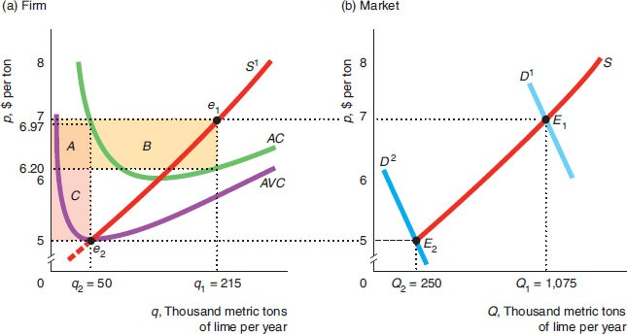
Short-Run Competitive Equilibrium in the Lime Market
Different
demand
curves

Slide 28
Long-Run Competitive Profit Maximization (1 of 2)
The firm chooses the quantity that maximizes its profit using the same rules as in the short run.
The firm picks the quantity that maximizes long-run profit, the difference between revenue and long-run cost.
Equivalently, it operates where long-run marginal profit is zero and where marginal revenue equals long-run marginal cost.

Slide 29
Long-Run Competitive Profit Maximization (2 of 2)
After determining the output level, q*,
that maximizes its profit or minimizes its loss, the firm decides whether to produce or shut down.
The firm shuts down if its revenue is less than its avoidable or variable cost.
In the long run, the firm shuts down if it would make an economic loss by operating since all costs are variable.

