Slide 1
Fundamentals of
Corporate Finance
Tenth Edition
Chapter 2
Financial Markets and Institutions
©2020 McGraw-Hill Education. All rights reserved. Authorized only for instructor use in the classroom. No reproduction or further distribution permitted without the prior written consent of McGraw-Hill Education.

Slide 2
Topics Covered
2.1 The Importance of Financial Markets and Institutions.
2.2 The Flow of Savings to Corporations.
2.3 Functions of Financial Markets and Intermediaries.
2.4 The Crisis of 2007-2009.

Slide 3
The Importance of Financial Markets 1
Businesses have to go to financial markets and institutions for the financing they need to grow.
Financing Decision.
  Source of Funds (Capital).
  Capital Structure.

Slide 4
The Importance of Financial Markets 2
Examples of financing decisions by Apple Computer
April 1976: Apple Computer Inc. founded | Mike Makkula, Apple’s first chairman, invests $250,000 in Apple shares.
1976: First 200 computers sold | Parts suppliers give Apple 30 days to pay. (Financing from accounts payable.)
1978–79 | Apple raises $3.5 million from venture capital investors.
December 1980: Initial public offering | Apple raises $91 million, after fees and expenses, by selling shares to public investors.
May 1981 | Apple sells 2.6 million additional shares at $31.25 per share.
April 1987 | Apple pays its first dividend at an annual rate of $.12 per share.
Early 1990s | Apple carries out several share repurchase programs.
1994 | Apple issues $300 million of debt at an interest rate of 6.5%.
1996–97: Apple reports a $740 million loss in the second quarter of 1996. Lays off 2,700 employees in 1997. | Dividend is suspended in February 1996. Apple sells $661 million of debt to private investors in June 1996. The borrowing provides “sufficient liquidity” to execute Apple’s strategic plans and to “return the company to profitability.”
September 1997: Acquires assets of Power Computing Corp. | Acquisition is financed with $100 million of Apple stock.

Slide 5
The Importance of Financial Markets 3
Examples of financing decisions by Apple Computer (continued)
2004: Apple is healthy and profitable, thanks to iMac, iPod, and other products. | Apple pays off the $300 million in long-term debt issued in 1994, leaving the company with no long-term debt outstanding.
2005–13 | Apple’s profits grow rapidly. It invests in marketable securities, which accumulate to $147 billion by June 2013.
2012–13 | Apple announces plans to pay out $100 billion to shareholders over the next 3 years. It also borrows a record $17 billion.
2013–15 | Apple’s Capital Return Program distributes cash to shareholders by paying dividends and repurchasing shares. The planned total distribution is $200 billion by 2017.
2015 | Apple issues $14.5 billion in dollar-denominated debt, €4.8 billion in euro debt, as well as debt issued in U.K. pounds, Swiss francs, and Japanese yen.
February 2016 | Apple’s market capitalization, the total market value of all its outstanding shares, is $851 billion, far in excess of the $140 billion cumulative investment by Apple’s shareholders. The cumulative investment includes $105 billion of retained earnings.

Slide 6
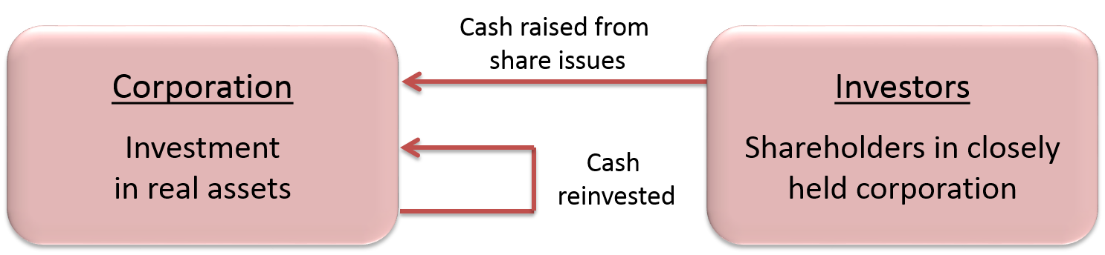
The Flow of Savings to Corporations 1
Access the text alternative for these images

Slide 7
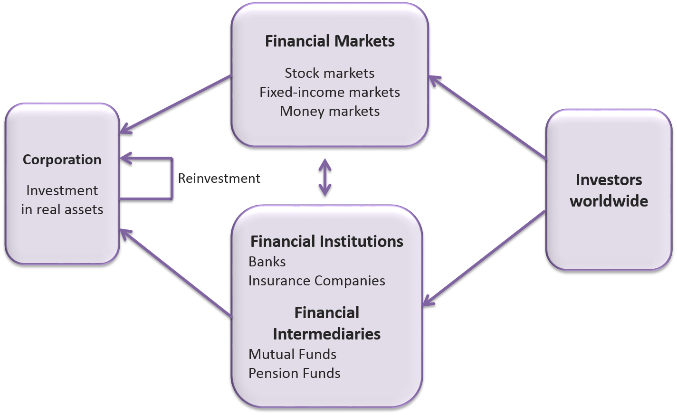
The Flow of Savings to Corporations 2
Access the text alternative for these images

Slide 8
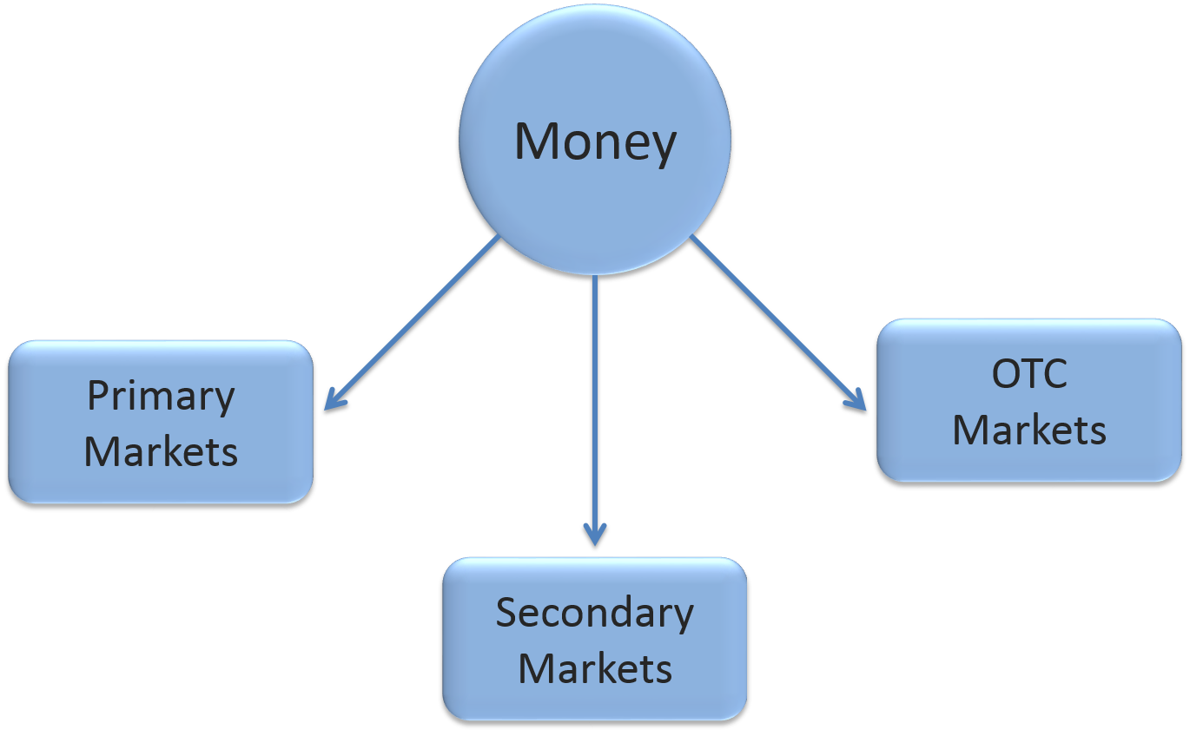
The Flow of Savings to Corporations 3

Slide 9
The Flow of Savings to Corporations 4
Financial Market.
  Market where securities are issued and traded.
Primary Market.
  Market for the sale of new securities by corporations.
Secondary Market.
  Market in which previously issued securities are traded among investors.

Slide 10
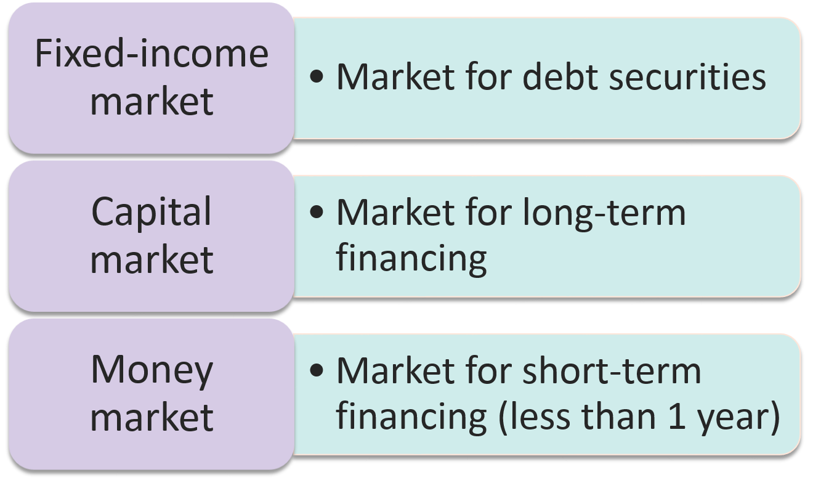
The Flow of Savings to Corporations 5
Access the text alternative for these images

Slide 11
The Flow of Savings to Corporations 6
Foreign exchange markets.
Chapter 22.
Commodities markets.
Chapter 24.
Markets for options and other derivatives.
Chapters 23 and 24.

Slide 12
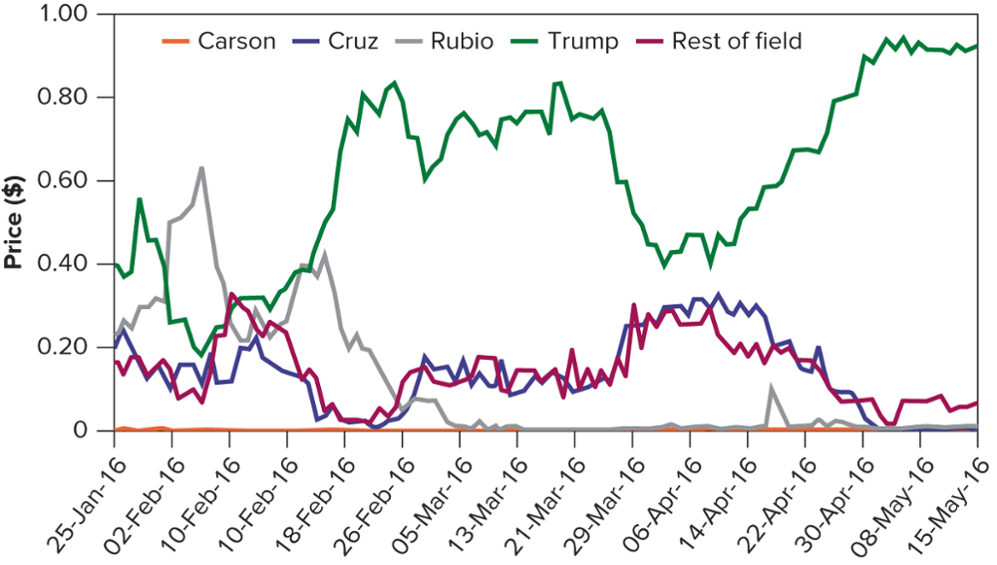
The Flow of Savings to Corporations 7
2016 U.S. Republican Convention Nomination Market.
Access the text alternative for these images

Slide 13
The Flow of Savings to Corporations 8
Financial Intermediary.
  An organization that raises money from investors and provides financing for individuals, companies, and other organizations.
Financial Institution.
  A bank, insurance company, or similar financial intermediary.

Slide 14
The Flow of Savings to Corporations 9
Mutual Fund.
  An investment company that pools the savings of many investors and invests in a portfolio of securities.
Hedge Fund.
  A private investment pool, open to wealthy or institutional investors, that is only lightly regulated and therefore can pursue more speculative policies than mutual funds.
Pension Fund.
  Fund set up by an employer to provide for employees’ retirement.

Slide 15
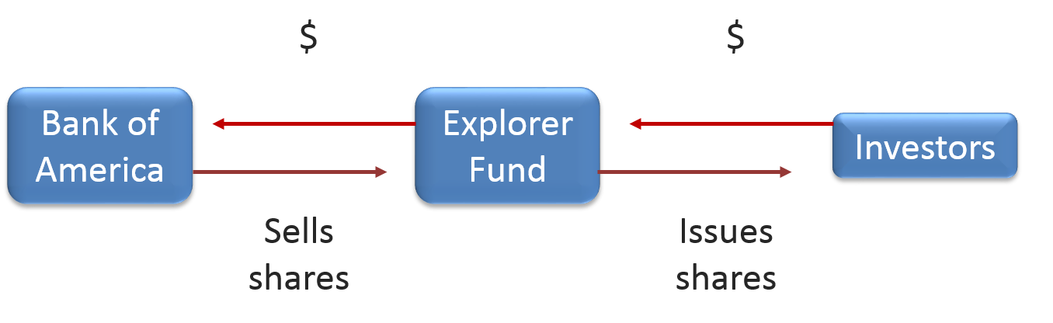
The Flow of Savings to Corporations 10
Access the text alternative for these images

Slide 16
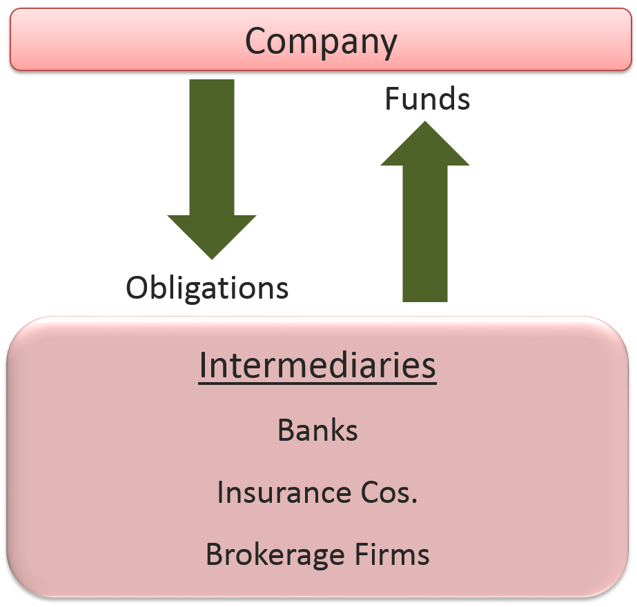
The Flow of Savings to Corporations 11
Access the text alternative for these images

Slide 17
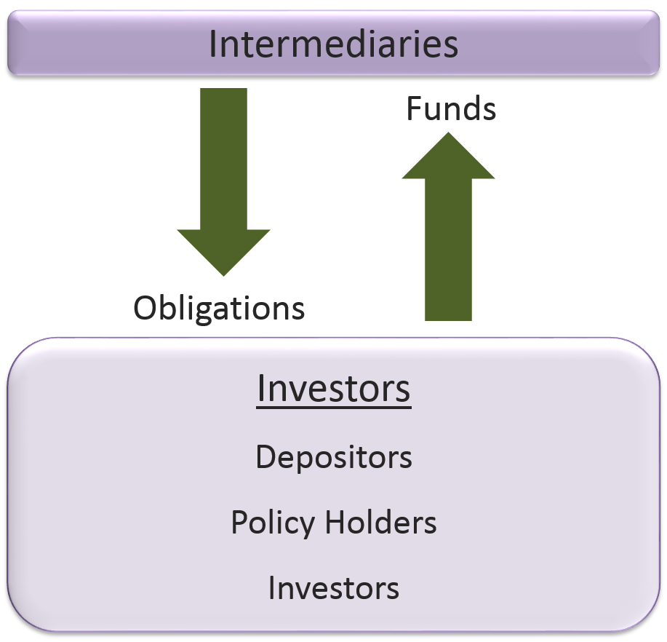
The Flow of Savings to Corporations 12
Access the text alternative for these images

Slide 18
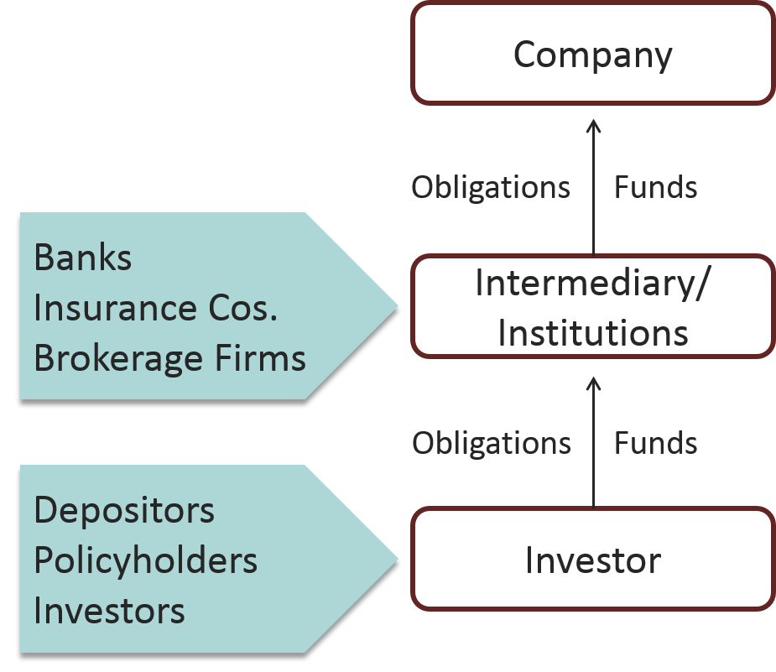
The Flow of Savings to Corporations 13
Access the text alternative for these images

Slide 19
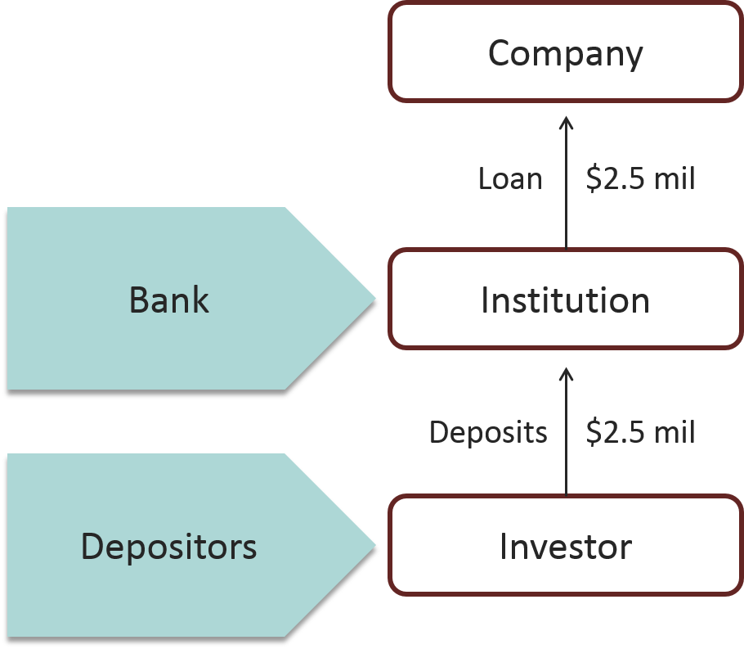
The Flow of Savings to Corporations 14
Access the text alternative for these images

Slide 20
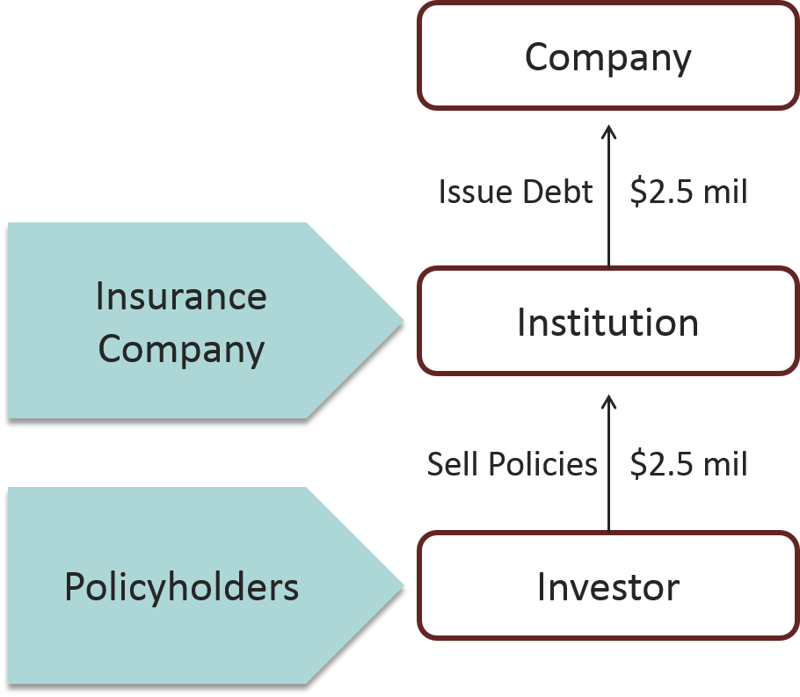
The Flow of Savings to Corporations 15
Access the text alternative for these images

Slide 21
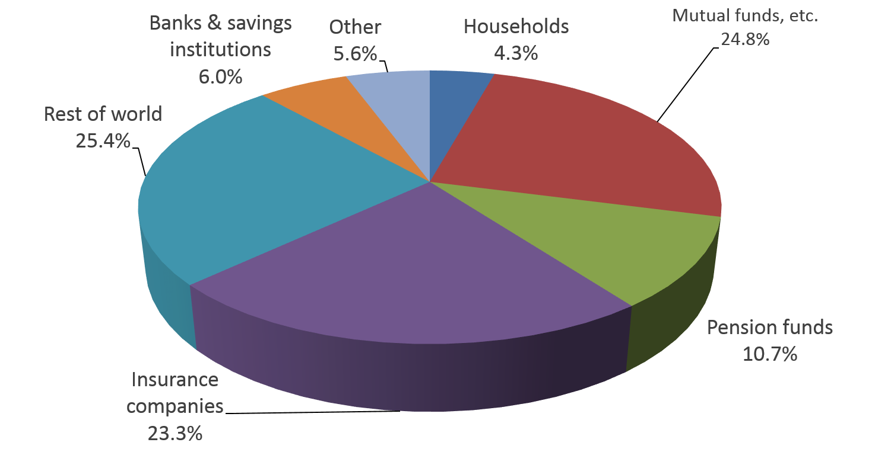
Total U.S. Financing 1
Holdings of Corporate and Foreign Bonds (Qtr. 3, 2015).
Access the text alternative for these images

Slide 22
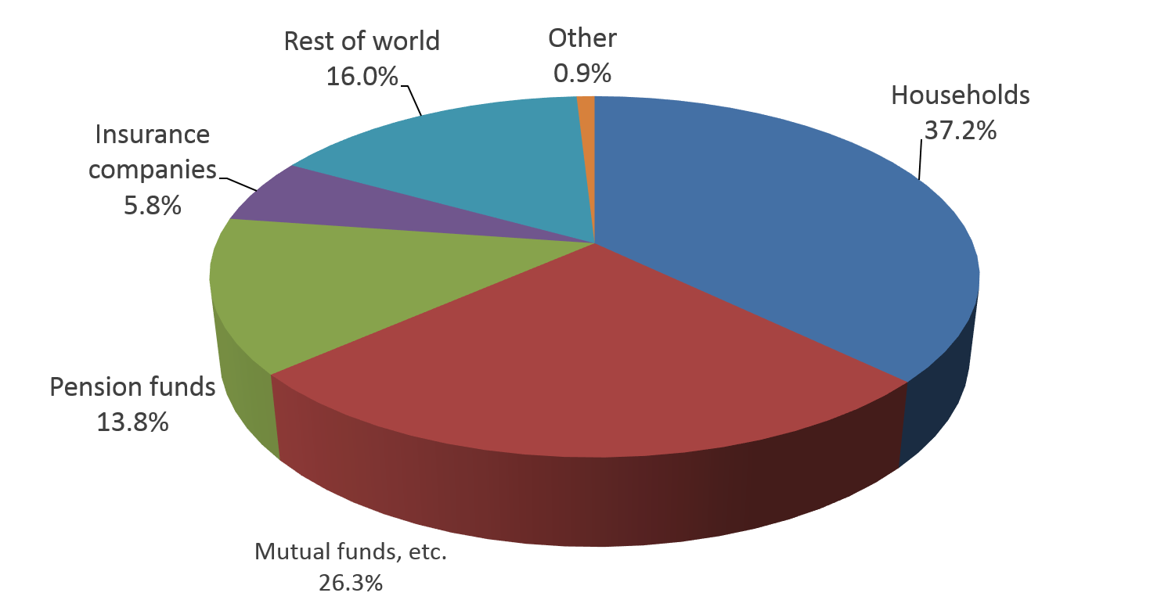
Total U.S. Financing 2
Holdings of Corporate Equities (Qtr. 3, 2015).
Access the text alternative for these images

Slide 23
Function of Financial Markets 1
Transporting cash across time.
Risk transfer and diversification.
Liquidity.
Payment mechanism.
Provide information.

Slide 24
Function of Financial Markets 2
Information Provided by Financial Markets.
Commodity prices.
Interest rates.
Company values.
Interest rates on long-term corporate bonds, March 2016.
Credit Rating | Interest Rate
AAA | 2.59%
AA | 2.62
A | 3.03
BBB | 4.32
BB | 5.62
B | 8.32

Slide 25
Function of Financial Markets 3
Market Capitalization ($ millions)
 | Number of Shares | × | Stock Price | = | Market Capitalization
Callaway Golf (ELY) | 93.8 | × | $8.76 | = | $821
Alaska Air Group (ALK) | 124.7 | × | $80.77 | = | $10,074
Entergy (ETR) | 178.5 | × | $75.92 | = | $13,551
Yum! Brands (YUM) | 408.7 | × | $77.77 | = | $31,875
General Electric (GE) | 9,331.0 | × | $30.34 | = | $283,091

Slide 26
The Crisis of 2007-2009
Easy money.
Subprime mortgages.
Mortgage backed securities.
Bear Sterns.
AIG.
IMF.
Greece.

Slide 27
Accessibility Content:
Text Alternatives for Images

Slide 28
The Flow of Savings to Corporations 1
Text Alternative
A box on the right is marked "investors: shareholders in closely held corporation." A box on the left is marked "corporation: investment in real assets." Investors points to corporation with the caption: cash raised from share issues. Another arrow points from corporation back to itself with the caption: cash reinvested.
Return to slide containing original image

Slide 29
The Flow of Savings to Corporations 2
Text Alternative
This chart shows four boxes with directional arrows between them. The box labeled Investors Worldwide has directional arrows to two boxes. The first is labeled in bold Financial Markets, followed by a regular text list including Stock markets, Fixed-income markets, and Money Markets. The second box contains the bolded text, Financial Institutions, followed by unbolded text Banks and Insurance companies. Another bolded line follows: Financial Intermediaries, with the unbolded list, Mutual Funds and Pension Funds following. The two blocks described as leading from Investors Worldwide have a two-direction arrow between them. The fourth box, labeled with bolded Corporation with Investment in real assets unbolded, has arrows coming from the two Financial boxes previously described. The Corporation box also has an arrow leading onto itself labeled Reinvestment.
Return to slide containing original image

Slide 30
The Flow of Savings to Corporations 5
Text Alternative
Fixed-income market - Market for debt securities.
Capital market - Market for long-term financing.
Money market - Market for short-term financing (less than 1 year).
Return to slide containing original image

Slide 31
The Flow of Savings to Corporations 7
Text Alternative
This graph depicts a prediction market for the 4 leading 2016 Republican Presidential candidates. A 5th is added to represent the rest of the field.
This time-series graph shows dates from 1/25/16 to 5/15/16 on the x-axis and price in $ ranging from 0 to 1 on the y-axis. There are five lines shown on the graph representing the four leaders for the 2016 Republican Convention Nomination, with a fifth line representing the rest of the field combined. The lines show Trump in the lead through nearly the entire time span, with a dip in early February, when Rubio had a high upswing. Trump's other notable dip was in mid-April, but no other candidate surpassed him during that dip.
Return to slide containing original image

Slide 32
The Flow of Savings to Corporations 10
Text Alternative
Three boxes labeled Bank of America, Explorer Fund, and Investors are shown. From Bank of America, an arrow labeled Sells Shares leads to Explorer Fund. From Explorer Fund an arrow labeled Issues shares leads to Investors. From Investors an arrow labeled with a dollar symbol leads back to Explorer Fund. From Explorer fund an arrow labeled with the dollar symbol leads to the Bank of America.
Return to slide containing original image

Slide 33
The Flow of Savings to Corporations 11
Text Alternative
The chart shows company marked at the top with a downward arrow marked obligations. This leads to intermediaries which include banks, insurance companies, and brokerage firms. An upward arrow labeled funds leads from intermediaries back up to company.
Return to slide containing original image

Slide 34
The Flow of Savings to Corporations 12
Text Alternative
The chart shows intermediaries marked at the top with a downward arrow marked obligations. This leads to investors which include depositors, policy holders, and investors. An upward arrow labeled funds leads from investors back up to intermediaries.
Return to slide containing original image

Slide 35
The Flow of Savings to Corporations 13
Text Alternative
The chart shows a box at the bottom labeled investor, which includes depositors, policyholders, and investors, with an arrow marked obligations and funds leading upwards to a box labeled intermediary/institutions, which includes banks, insurance companies, and brokerage firms. Another arrow from this labeled obligations and funds leads upward to the top box labeled company.
Return to slide containing original image

Slide 36
The Flow of Savings to Corporations 14
Text Alternative
The chart shows a box at the bottom labeled investor, which includes depositors, with an arrow marked deposits $2.5 mil leading upwards to a box labeled institution, which includes banks. An arrow from institution labeled loan $2.5 mil leads upward to the top box labeled company.
Return to slide containing original image

Slide 37
The Flow of Savings to Corporations 15
Text Alternative
The chart shows a box at the bottom labeled investor, which includes policyholders, with an arrow marked sell policy $2.5 mil leading upwards to a box labeled institution, which includes insurance companies. An arrow from institution labeled issue debt $2.5 mil leads upward to the top box labeled company.
Return to slide containing original image

Slide 38
Total U.S. Financing 1 Text Alternative
Holdings of corporate and foreign bonds, quarter 3, 2015. The total amount is $11.9 trillion.
The pie graph's divisions with percentages are as follows: Households (4.3%), Mutual funds (24.8%), Pension funds (10.7%), Insurance companies (23.3%), Rest of world (25.4%), Banks and savings institutions (6.0%), Other (5.6%).
Return to slide containing original image

Slide 39
Total U.S. Financing 2 Text Alternative
Holdings of corporate equities, quarter 3, 2015. The total amount is $34.1 trillion. The pie graph's divisions with percentages are as follows: Households (37.2%), Mutual funds (26.3%), Pension funds (13.8%), Insurance companies (5.8%), Rest of world (16.0%), Other (0.9%).
Return to slide containing original image

