Slide 1
Sources of the English Vocabulary
Pages 22–36
English Lexicology

Slide 2
The Indo-European Language Family
English belongs to the Germanic branch.
  Other branches: Romance, Slavic, Celtic, Indo-Iranian, Hellenic.
  Languages share phonological and lexical similarities.

Slide 3
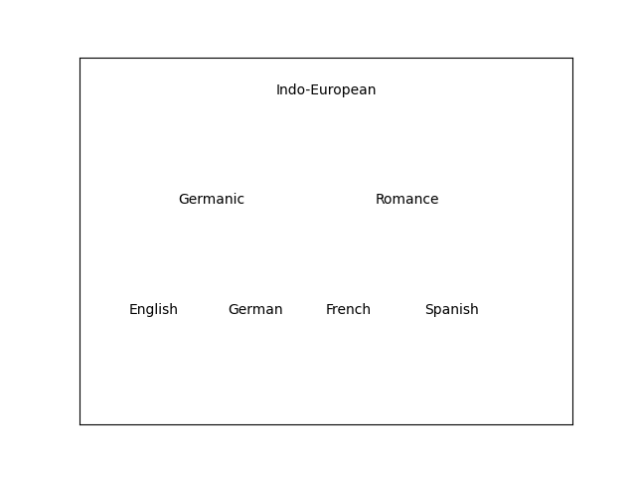
Indo-European Language Tree (Simplified)

Slide 4
Native Words in English (25–35%)
Germanic origin (Old English roots).
  Short, frequent, everyday words.
  Examples: house, mother, sun, eat, go, love.
  Emotionally expressive and informal.

Slide 5
Reasons for Borrowing
Identity and cultural contact.
  Prestige (French influence).
  Filling lexical gaps.
  Scientific and technical progress.

Slide 6
Latin Influence on English
Old English period (religion, trade).
  Renaissance: science and scholarship.
  Examples: animal, area, editor, radius, phenomenon.
  Latin often associated with formal style.

Slide 7
French Influence (After 1066)
Norman Conquest impact.
  Law, government, military vocabulary.
  Examples: court, judge, army, royal.
  Created synonym triplets: kingly – royal – regal.

Slide 8
Scandinavian Influence (Vikings)
Danelaw region influence.
  Everyday vocabulary.
  Examples: sky, skin, skirt, take, they, them.
  Place names ending in -by (Derby, Grimsby).

Slide 9
Greek Influence
Mainly scientific and technical vocabulary.
  Often via Latin or French.
  Examples: drama, chaos, democracy, metaphor.
  Used in medicine, philosophy, science.

Slide 10
Other European Sources
Italian: piano, opera, balcony.
  Spanish: tomato, potato, cigar.
  German: kindergarten, blitz.
  Dutch: yacht, coffee.

Slide 11
Non-European Sources
Arabic: algebra, alcohol, zero.
  Hindi: shampoo, bungalow, jungle.
  Japanese: kimono.
  Global expansion increased borrowing.

Slide 12
Adaptation (Assimilation) of Loanwords
Fully assimilated: table, animal.
  Partially assimilated: radius – radii.
  Unassimilated: café, cliché.
  Changes affect spelling and pronunciation.

Slide 13
Direct and Indirect Borrowing
Direct: omelette (from French).
  Indirect: coffee (via Dutch from Turkish).
  Source vs origin distinction.

Slide 14
Modern English Vocabulary Growth
Scientific and industrial revolution impact.
  American English influence.
  Emergence of new Englishes worldwide.
  English as a global language.

Slide 15
Conclusion – A Mosaic Language
English vocabulary is multilingual.
  Native core + massive borrowings.
  Historical events shaped vocabulary.
  Borrowing remains active today.

