Slide 1
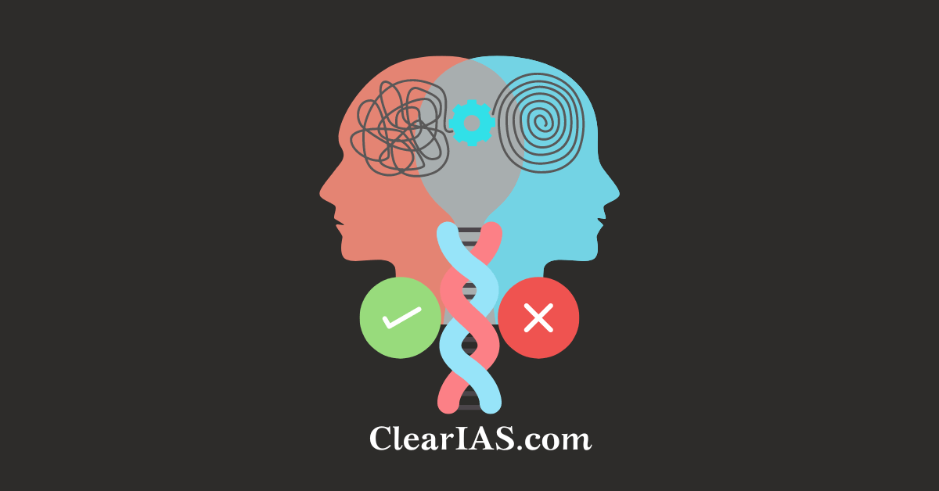
ETHICAL
DILEMMAS
Res. Asst. Pelin ÖZÇELİK

Slide 2
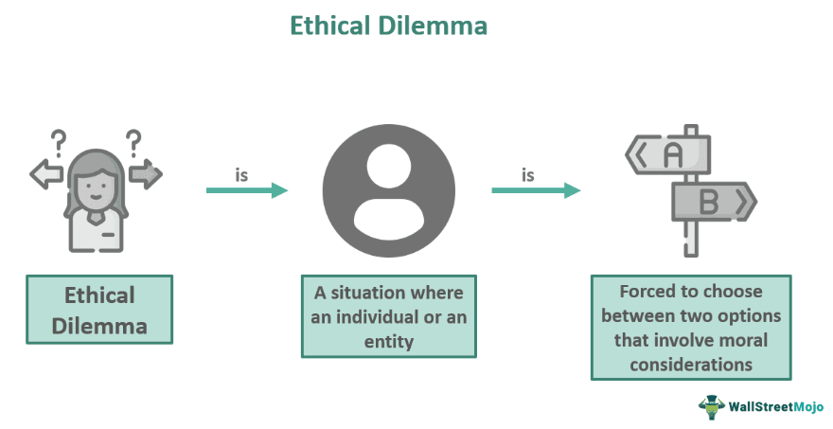
The definition of ‘’Ethical Dilemma’’ and Some Examples About Urgent Ethical Dilemmas and Ethical Dilemmas of 21st Century
‘’Ethical Dilemma’’ is a situation in which two moral principles conflict with one another.

Slide 3
The definition of ‘’Ethical Dilemma’’ and Some Examples About Urgent Ethical Dilemmas and Ethical Dilemmas of 21st Century
An ethical dilemma is a situation that can be difficult to navigate because it involves a clash between one’s morals and something else.
It’s like when you come to a fork in the road and decide which way to go, except each path is based on different values or principles.

Slide 4
Examples of Some Urgent Ethical Dilemmas:
Environmental problems
Overconsumption
War and armament
Discrimination based on gender and ethnicity
Examples of Most Common Ethical Dilemmas of 21st Century :
The Paradox of Technological Progress
Globalization and Ethical Pluralism
The Morality of Artificial Intelligence and Consciousness
Bioethics and the Redefinition of Life
Social Justice and Redistribution in a Digital Economy
Freedom of Expression in an Era of Cancel Culture

Slide 5
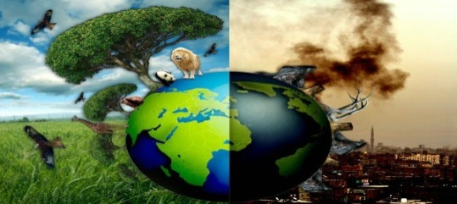
Urgent Ethical Dilemmas: Environmental Problems
According to ''Anthropocentric ethics'', only humans have moral value. Accordingly, although humans are responsible to the natural world, they do not have a direct responsibility towards it.
In the early days of the environmentalism movement, air and water pollution, toxic waste and misuse of pesticides, as well as whether we have moral responsibilities towards future generations, were among the issues questioned.
Since utilitarians limit the expected benefit to people in the immediate vicinity, people living in other countries or future generations are not taken into account. Since human interests are at the forefront, the extinction of other species is not considered important.
Apart from philosophical ethics, there is a general understanding in religious ethics that people have responsibilities towards the natural world, that people are trustees of resources entrusted to them by a creator, and that we should respect the environment created by God.

Slide 6
Urgent Ethical Dilemmas: Overconsumption
Local production has now been replaced by transnational production and there is a universal circulation of this production. Borders have been crossed and the circulation of the economy has spread everywhere.
According to Bauman, our society is a consumer society and he explains consumption and consumer society in this context through globalization and global competition.
The dilemma we hear most often pondered these days is whether a person consumes to live or lives to be able to consume. In other words, can we still talk about living apart from consuming and do we need it?

Slide 7
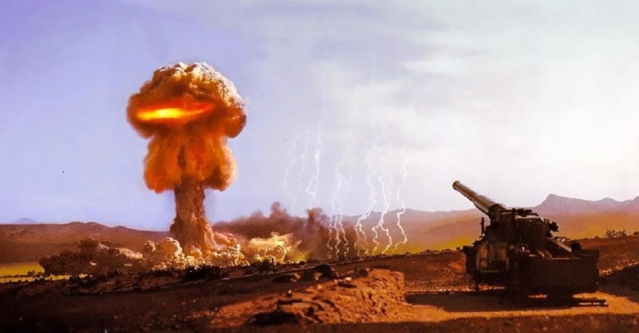
Urgent Ethical Dilemmas: War and Armament
It is assumed that each country has a choice between a high or low level of arms.
Each country’s most-preferred outcome is assumed to be where they choose high arms and their rivals low, gaining a clear military advantage.
Their least-preferred outcome is the reverse. However, the second best outcome for each is where both choose low: if no advantage is gained, it is assumed to be cheaper and more secure to avoid the arms race.
Nuclear weapons are an existential threat to humanity, as are the increasingly intense manifestation of climate change.

Slide 8
Urgent Ethical Dilemmas: Discrimination Based on Gender and Ethnicity
In one study, 1,029 male and female hiring managers were asked to review the resume of a candidate for a hypothetical Regional Sales Manager position and rate his skills. The majority of hiring managers chose the male candidate over a female and male management candidate with identical resumes.
This study is a clear example of why candidates might not want to share gender information, or even their name, trying to avoid unconscious bias and possible discrimination.
An ethical dilemma also arises when a patient refuses care from a doctor because of the doctor's religion, ethnicity, color, or gender.
Although discrimination is attempted to be deterred by laws in various countries, it is anticipated that these incidents will increase due to the current political climate and the increasing diversity of the population.

Slide 9
Most Common Ethical Dilemmas of 21st Century : The Paradox of Technological Progress
The paradox of technological progress (smart phones, etc.) is like a double-edged sword the very innovations that can unlock doors to knowledge and freedom can also lock us into new forms of dependency and even peril.
From a philosophical perspective: Martin Heidegger who posited that technology is not merely about gadgets; it is a mode of comprehending the world that can confine us to only what can be quantified and exploited. Marshall McLuhan: “The medium is the message.”
In addition to carrying information, technology shapes how we converse and reflect.
This paradox suggests that while technology extends our capacities, it may amplify both our finest qualities including inventiveness and sociability and darker ones like greed or isolation.

Slide 10
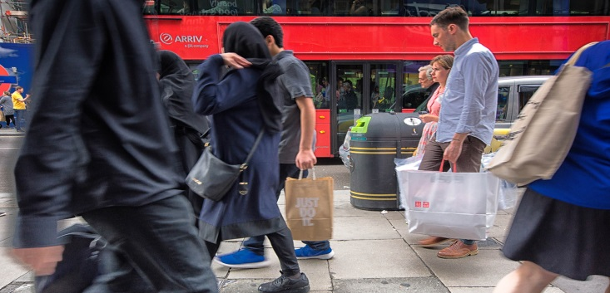
Most Common Ethical Dilemmas of 21st Century : Globalization and Ethical Pluralism
Thanks to globalization, at times, the flavors clash. This is ethical pluralism: how, in our interconnected world, different systems can rub up against one another.
One approach might be, “When in Rome, do as the Romans do.” This is cultural relativism the belief that right and wrong are specific to one’s culture.
But what if something in one culture really offends those from another? Take fur: many people see wearing it as perfectly fine and traditional. Plenty of others think it’s an appalling way to treat animals well.
Then there’s the other side universal moral standards. Think of them as the basic dining etiquette rules that everyone is expected to follow, no matter what’s on their plate. These include human rights that many argue should be respected universally, like freedom from torture.

Slide 11
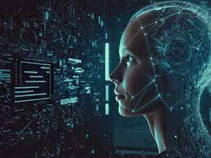
Most Common Ethical Dilemmas of 21st Century : The Morality of Artificial Intelligence and Consciousness
Do these AI systems possess consciousness? If they do, what ethical responsibilities do we have towards them?
It is no longer pure science fiction to imagine machines behaving like they are thinking for themselves, which raises some real questions. If an AI can learn from experience, make choices based on those experiences, and perhaps even suffer for them, shouldn’t we consider it a mind or at least part of one? The responsibility for creating such AIs is enormous.
Philosophers like Immanuel Kant say that with autonomy comes moral agency: the ability to choose right or wrong. But can or should this apply to AI?
This is a philosophical journey that’s only just beginning. We’re entering uncharted territory as we move towards a future where the line between human and machine blurs ever more.

Slide 12
Most Common Ethical Dilemmas of 21st Century : Bioethics and the Redefinition of Life
Bioethics is similar to a referee in a game between biology and ethics. For example, when it comes to genetics and human enhancement, we’re not just talking about picking what color eyes your baby has. It could be possible to edit their genes so they don’t get certain diseases.
But what if, in the future, people start using this technology to make humans stronger or smarter? It would be like playing God.
Genetically modified organisms (GMOs) are another example of how biology gets tricky.
Then, there is the discussion about two of life’s greatest hallmarks: birth and death. We’re using technology to go further with both. We can keep a body alive longer than ever, but when does the quality of life become less important than simply being alive?
It is a philosophical question about the value of life versus living well, which Aristotle called “eudaimonia” or human flourishing. In bioethics, every new development is like opening Pandora’s Box because it brings with it a whole set of moral conundrums: just because we can do something, does that mean we should?

Slide 13
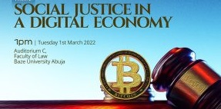
Most Common Ethical Dilemmas of 21st Century : Social Justice and Redistribution in a Digital Economy
In an online marketplace, new companies can become extremely valuable very quickly. But does this mean that profits are made fairly? Some people make huge amounts of money from the Internet, while others don’t make any at all.
This difference has led to much debate about social justice: whether wealth should be shared more fairly in society.
Some people say we should take from the haves online and help the have nots offline just like Robin Hood. They want to make sure everyone has the same chance as each other to succeed.
This is called redistribution. It’s an old idea supported by new theories such as John Rawls’ “veil of ignorance” (not knowing where you would end up in society).
On the other hand, there is an argument in favor of meritocracy the belief that you should get out what you put in, or as applied to the digital world, what you code.

Slide 14
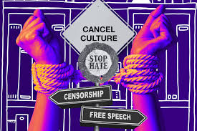
Most Common Ethical Dilemmas of 21st Century : Freedom of Expression in an Era of Cancel Culture
In today’s world, where social media can spread information faster than the speed of sound, we’re still grappling with an ancient question: how do we balance freedom of expression with the potential consequences of what we say?
One way this debate is playing out is through “cancel culture.” It is the idea that there’s now a social equivalent to being shouted down if enough people don’t like what you’re saying.
Thinkers such as John Stuart Mill defended this, seeing immense value perhaps even society-changing truth in allowing every voice (even those others find annoying or worse) to speak freely.
But what if your words are like a match tossed into dry grass, capable of causing real harm? Things get ethically tricky here: how to weigh society’s need for robust discussion against individuals’ rights not to be harmed by lies or abuse.
Karl Popper argued that if a society is too open-minded if it tolerates absolutely everything then its openness will ultimately be destroyed by those who are themselves intolerant.
Freedom of speech isn’t just about having the right to say anything. It’s also about being heard and society collectively deciding what can and can’t be said.

Slide 15
Thank you
for listening.
ETHICAL
DILEMMAS
Res. Asst. Pelin ÖZÇELİK
References:
https://dictionary.apa.org/ethical-dilemma
https://www.thecollector.com
https://dergipark.org.tr/tr/download/article-file/381931
https://www.insanveinsan.org
https://www.britannica.com
https://medium.com

