Slide 1
Chapter Three
Interest Rates and Security Valuation
©McGraw-Hill LLC. All rights reserved. No reproduction or distribution without the prior written consent of McGraw-Hill.

Slide 2
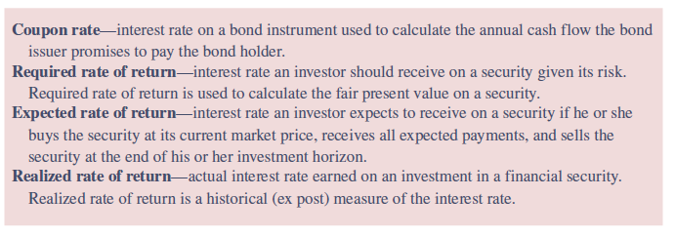
Various Interest Rate Measures
The term interest rates can have many different meanings depending on the time frame used for analysis and the type of security being analyzed

Slide 3
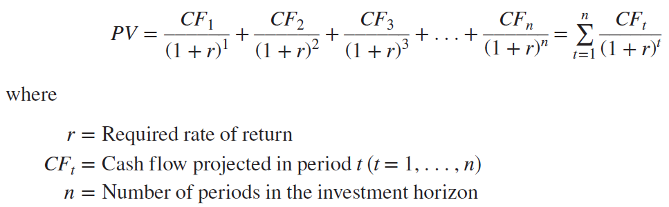
Required Rate of Return
The interest rate used to find the fair present value of a financial security is called the required rate of return (r)
  Function of the various risks associated with a security and is thus the interest rate the investor should receive on the security given its risk (default risk, liquidity risk, etc.)
  Ex ante measure of the interest rate on a security

Slide 4
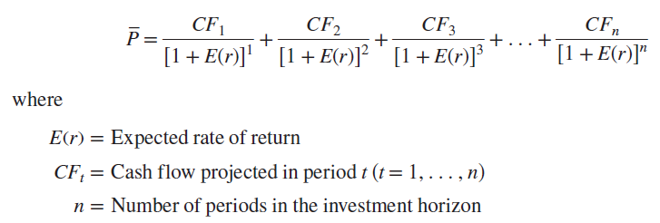

Expected Rate of Return
Expected rate of return, E(r), on a financial security is the interest rate a market participant expects to earn by buying the security at its current market price ($\overline{P}$), receiving all projected cash flow payments (CFs) on the security, and selling the security at the end of the participant’s investment horizon
Notes:
Expected rate of return is also an ex ante measure of the interest rate on a security.

Slide 5
Required versus Expected Rates of Return: The Role of Efficient Markets
The speed with which financial security prices adjust to unexpected news, to maintain equality with the fair present value of the security, is referred to as market efficiency
  If financial markets are efficient, which tends to be the case most of the time, the current market price of a security tends to equal its fair price present value
  When an event occurs that unexpectedly changes interest rates or a characteristic of a financial security, the current market price of a security can temporarily diverge from its fair present value

Slide 6
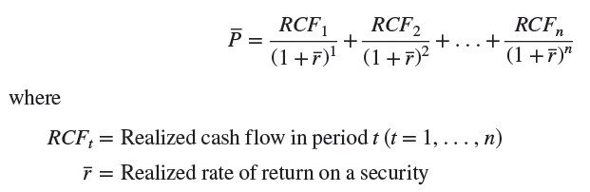
Realized Rate of Return
The realized rate of return, ( r ), on a financial security is the interest rate actually earned on an investment in a financial security
  Ex post measure of the interest rate on the security
  If the realized rate of return ( r ) is greater (less) than the required rate of return (r), the market participant earned more (less) than was needed to be compensated for the ex ante or expected risk of investing in the security

Slide 7
Bond Valuation
Bond valuation employs time value of money concepts
  Fair value of a bond reflects the present value of all cash flows promised or projected to be received on that bond discounted at the required rate of return (r_{b})
  Expected rate of return, E(r_{b}), is the interest rate that equates the current market price of the bond with the present value of all promised cash flows received over the life of the bond
  Realized rate of return (r_{b}) on a bond is the actual return earned on a bond investment that has already taken place
Promised cash flows on bonds come from two sources:
  Interest or coupon payments paid over the life of the bond
  Lump sum payment (face or par value) when a bond matures

Slide 8
Bond Valuation Formula Used to Calculate Fair Present Values
Coupon bonds pay interest based on a stated coupon rate, and the interest (i.e., coupon) payments per year, INT, are generally constant over the life of the bond
Zero-coupon bonds do not pay coupon interest
  In other words, INT = 0
The face or par value of the bond, M, is a lump sum payment received by the bond holder at maturity
  Face value is generally set at $1,000 in the U.S. bond market
  When new bonds are issued, the coupon rate on the new bonds is typically set at the current required rate of return

Slide 9
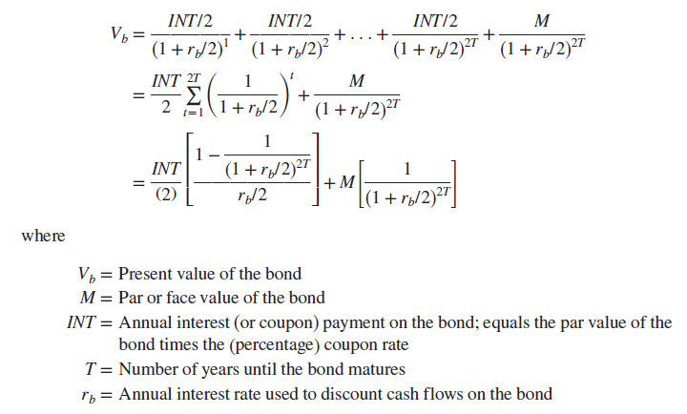
Calculating Present Value of a Bond
Notes:
Here, we are assuming that the bond issuer makes its promised semiannual coupon and principal payments.

Slide 10
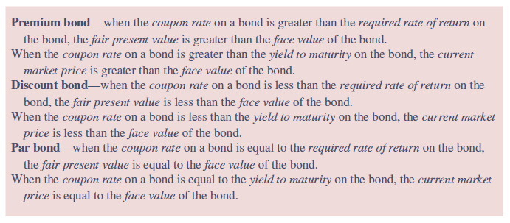
Description of a Premium, Discount, and Par Bond

Slide 11
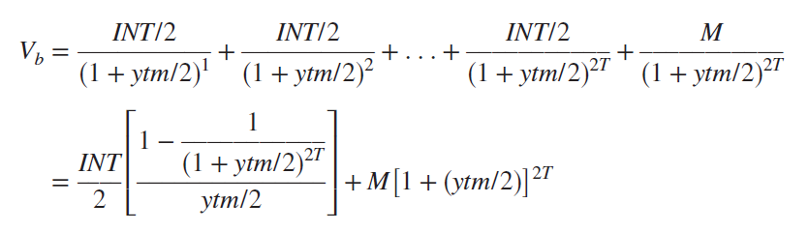
Bond Valuation Formula Used to Calculate Yield to Maturity
The return, or yield, the bond holder will earn on the bond if he or she buys it at its current market price, receives all coupon and principal payments as promised, and holds the bond until maturity is the yield to maturity (ytm)
YTM may be solved for as follows:
Notes:
The yield to maturity calculation implicitly assumes that all coupon payments periodically received by the bond holder can be reinvested at the same rate—that is, reinvested at the calculated yield to maturity.

Slide 12
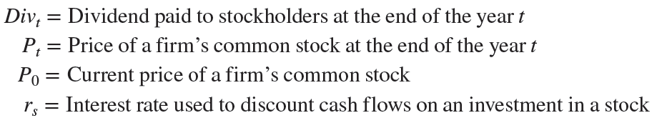
Equity Valuation
©McGraw Hill LLC. All rights reserved. No reproduction or distribution without the prior written consent of McGraw Hill.
Valuation process for an equity instrument (such as preferred or common stock) involves finding the present value of an infinite series of cash flows on the equity discounted at an appropriate interest rate
  Cash flows from holding equity come from dividends paid out by the firm over the life of the stock
These variables are often used in equity valuation:

Slide 13

Equity Valuation (Continued)
Present value methodology applies time value of money to evaluate a stock’s cash flows over its life as follows:
The price of a stock is equal to the present value of its future dividends (Div_{t}), whose values are uncertain
Common assumptions made regarding expected pattern of uncertain flow of dividends over life of the stock
  Zero growth in dividends over (infinite) life of stock
  Constant growth rate in dividends over (infinite) life of stock
  Nonconstant growth in dividends over (infinite) life of stock
©McGraw Hill LLC. All rights reserved. No reproduction or distribution without the prior written consent of McGraw Hill.
Notes:
Because future dividends are uncertain, an infinite number of future dividend values must be estimated, which makes the equation difficult to use for stock valuation and r_{s} calculation in practice.

Slide 14

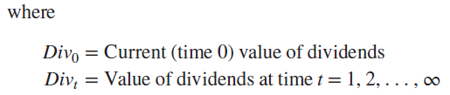

Zero Growth in Dividends
©McGraw Hill LLC. All rights reserved. No reproduction or distribution without the prior written consent of McGraw Hill.
Zero growth in dividends means that dividends are expected to remain at a constant level forever
In generalized form:

Slide 15

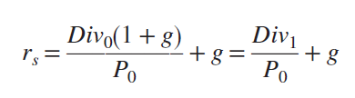
Constant Growth in Dividends
Constant growth in dividends means that dividends on a stock are expected to grow at a constant rate, g, each year into the future
Rate of return on the stock, if it were purchased at a price P₀, may be determined as follows:
©McGraw Hill LLC. All rights reserved. No reproduction or distribution without the prior written consent of McGraw Hill.

Slide 16
Supernormal (or Nonconstant) Growth in Dividends
Firms often experience periods of supernormal or nonconstant dividend growth, after which dividend growth settles at some constant rate
To find the present value of a stock experiencing supernormal or nonconstant dividend growth, a three-step process is used:
  Find the present value of the dividends during the period of supernormal (nonconstant) growth.
  Find the price of the stock at the end of the supernormal (nonconstant) growth period using the constant growth in dividends model. Then, discount this price to a present value.
  Add the two components of the stock price together.
©McGraw Hill LLC. All rights reserved. No reproduction or distribution without the prior written consent of McGraw Hill.

Slide 17
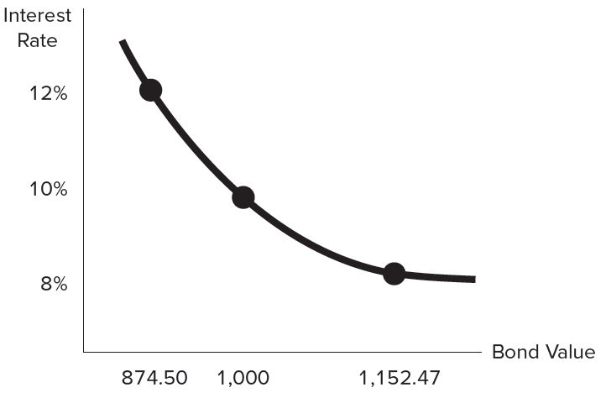
Impact of Interest Rate Changes on Security Values
As interest rates increase, present values of bonds (and bond prices) decrease at a decreasing rate
©McGraw Hill LLC. All rights reserved. No reproduction or distribution without the prior written consent of McGraw Hill.

Slide 18
Impact of Maturity on Security Values
A bond’s price sensitivity is measured by the percentage change in its present value for a given change in interest rates
  The shorter the time remaining to maturity, the closer a bond’s price is to its face value
  The further a bond is from maturity, the more sensitive the price of the bond as interest rates change
  Relationship between bond price sensitivity and maturity is not linear
    As the time remaining to maturity on a bond increases, price sensitivity increases but at a decreasing rate
©McGraw Hill LLC. All rights reserved. No reproduction or distribution without the prior written consent of McGraw Hill.

Slide 19
Impact of Coupon Rates on Security Values
The following relationships hold when evaluating either required rates of return and the resulting fair present value of the bond or expected rates of return and the current market price of the bond
  The higher the bond’s coupon rate, the higher its present value at any given interest rate
  The higher the bond’s coupon rate, the smaller the price changes on the bond for a given change in interest rates
©McGraw Hill LLC. All rights reserved. No reproduction or distribution without the prior written consent of McGraw Hill.

Slide 20
Duration
Duration is the weighted-average time to maturity on an investment using the relative present values of the cash flows as weights
  Produces an accurate measure of the price sensitivity of a bond to interest rate changes for relatively small changes in interest rates
    Less accurate measure of price sensitivity the larger the change in interest rates
  In addition to being a measure of the average life of an asset or liability, duration also has economic meaning as the sensitivity, or elasticity, of that asset or liability’s value to small interest rate changes (either required rate of return or yield to maturity)
©McGraw Hill LLC. All rights reserved. No reproduction or distribution without the prior written consent of McGraw Hill.

Slide 21
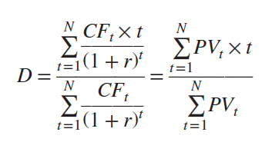
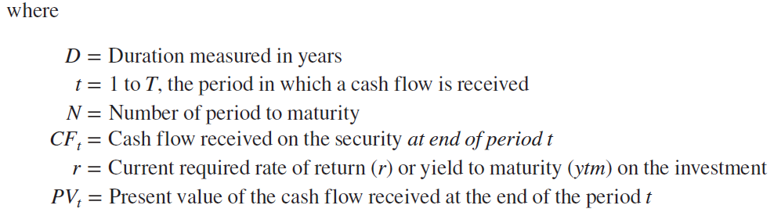
A General Formula for Duration
Duration, for any fixed-income security that pays interest annually, may be calculated using the following formula:
©McGraw Hill LLC. All rights reserved. No reproduction or distribution without the prior written consent of McGraw Hill.

Slide 22
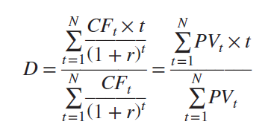

A General Formula for Duration (Continued)
Recall that most bonds pay interest semiannually rather than annually
For bonds that pay interest semiannually, the duration equation becomes:
©McGraw Hill LLC. All rights reserved. No reproduction or distribution without the prior written consent of McGraw Hill.

Slide 23
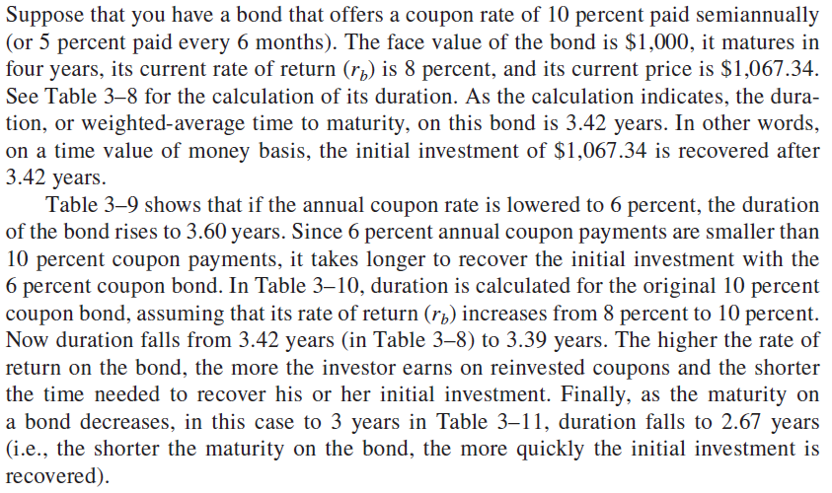
Duration: Example
©McGraw Hill LLC. All rights reserved. No reproduction or distribution without the prior written consent of McGraw Hill.
Notes:
Example 3-13

Slide 24
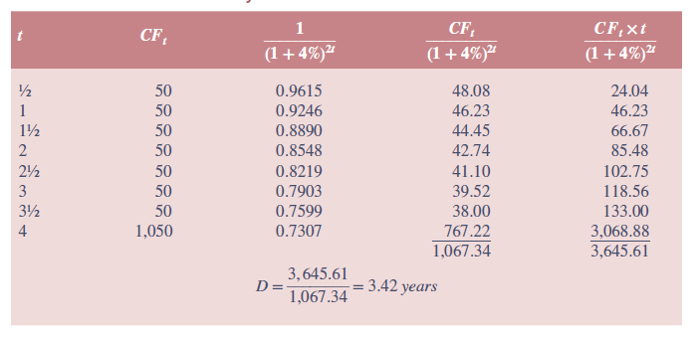
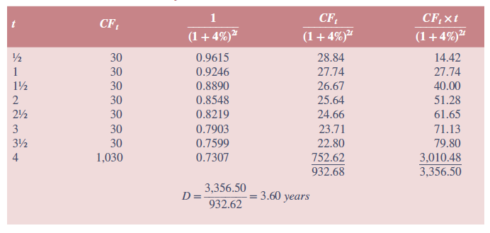
Duration: Example (Continued)
©McGraw Hill LLC. All rights reserved. No reproduction or distribution without the prior written consent of McGraw Hill.
Notes:
Tables 3-8 and 3-9, respectively.

Slide 25
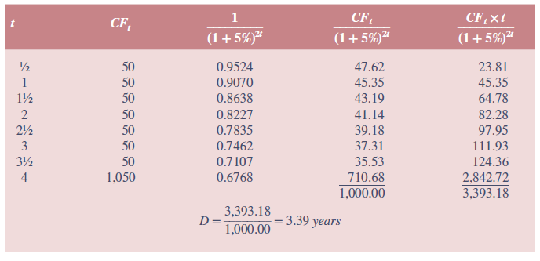
Duration: Example (Concluded)
©McGraw Hill LLC. All rights reserved. No reproduction or distribution without the prior written consent of McGraw Hill.
Notes:
Table 3-10

Slide 26
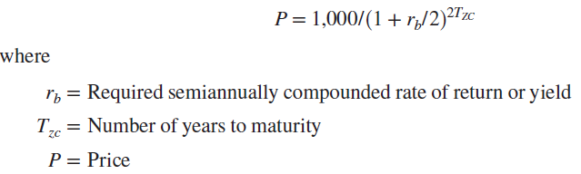
The Duration of a Zero-Coupon Bond
The current price that an investor is willing to pay for a zero-coupon bond, assuming semiannual compounding of interest, is equal to the present value of the single, fixed (face value) payment on the bond that is received on maturity (here, $1,000):
©McGraw Hill LLC. All rights reserved. No reproduction or distribution without the prior written consent of McGraw Hill.

Slide 27
Features of Duration
Duration and coupon interest
  The higher the coupon or promised interest payment on the bond, the shorter its duration
    The larger the coupon or promised interest payment, the more quickly investors receive cash flows on a bond and the higher are the present value weights of those cash flows in the duration calculation
Duration and rate of return
  Duration decreases as the rate of return on the bond increases
Duration and maturity
  Duration increases with maturity, but at a decreasing rate
©McGraw Hill LLC. All rights reserved. No reproduction or distribution without the prior written consent of McGraw Hill.

Slide 28



Economic Meaning of Duration
In addition to being a measure of the average life of a bond, duration is also a direct measure of its price sensitivity to changes in interest rates, or elasticity
For small changes in interest rates, bond prices move in an inversely proportional manner based on the size of D
  Annual compounding of interest:
  Semiannual compounding of interest:
Modified duration (MD):
©McGraw Hill LLC. All rights reserved. No reproduction or distribution without the prior written consent of McGraw Hill.
Notes:
MD is calculated as duration divided by 1 plus the initial interest rate.

Slide 29
Large Interest Rate Changes and Duration
Duration accurately measures the price sensitivity of financial securities only for small changes in interest rates of the order of one or a few basis points
  A basis point is equal to one-hundredth of 1 percent
Duration misestimates the change in the value of a security following a large change (either positive or negative) in interest rates
  As a result of convexity, the capital loss effect of large rate increases tends to be smaller than the capital gain effect of large rate decreases
  Convexity is the degree of curvature of the price-interest rate curve around some interest rate level
©McGraw Hill LLC. All rights reserved. No reproduction or distribution without the prior written consent of McGraw Hill.

Slide 30
Characteristics of Convexity
Convexity is desirable.
  The greater the convexity of a security or portfolio of securities, the more insurance or interest rate protection an investor or FI manager has against rate increases and the greater the potential gains after interest rate falls.
Convexity increases the error in duration as an investment criterion.
  The larger the interest rate changes and the more convex a fixed-income security or portfolio, the greater the error in using just duration (and duration matching) to immunize exposure to interest rate shocks.
All fixed-income securities are convex.
  That is, as interest rates change, bond prices change at a nonconstant rate.
©McGraw Hill LLC. All rights reserved. No reproduction or distribution without the prior written consent of McGraw Hill.

