Slide 1
Chapter 1 Introduction

Slide 2
It is possible to classify financial markets in different ways. One of these classifications is the definition of markets as spot markets and futures markets (or derivative markets) according to the type of transaction.
In spot markets, payment is made upon product delivery. For example, when a share is purchased, the market price is paid and the share is received.

Slide 3
In futures and derivatives markets, payment and delivery are generally made at a later date, subject to certain conditions.
Financial products developed based on spot market products are called derivatives.
The financial products from which derivatives are derived are called underlying assets. The performance of derivatives depends on the value of the underlying assets over the life of the contract.

Slide 4
In these markets, payments are made at a later date and subject to certain conditions, depending on the content of the contracts. In derivative contracts, there is a buyer and a seller, just like in spot market products. Generally, cash payment may not be made during the transaction, but a certain collateral payment may be required depending on the situation.

Slide 5
Derivatives can be traded in two separate types of markets, known as organized markets (exchange traded) and over the counter markets. Organized markets are markets where there are legal regulations and standard derivative products are bought and sold.

Slide 6
Why Are Derivative Markets Necessary?
Derivative markets serve many purposes. First of all, futures transactions allow the dissemination of transparent information in the markets, as uncertainties that may occur in the future are constantly priced.
One of the most important benefits of these products is that a price is determined in advance for future uncertainties in the underlying asset. In this way, these products serve a very important insurance function in terms of managing future risks.

Slide 7
In particular, the fact that they are liquid and can be bought and sold globally highlights the hedging properties of derivative products. Thanks to these products, price risks that may arise from commodities and exchange rates can be insured.

Slide 8
In summary, thanks to derivative markets, information is obtained on how expectations for the future period are priced by market players.
By adding the information on how to price the volatility in the future, derivative markets provide the benefit called "price discovery" in the literature.

Slide 9
Derivatives are also used in speculative investment transactions. For example, an investor who expects the exchange rate to increase or decrease can take a position in derivative products instead of buying or selling foreign currency in the spot market.

Slide 10
Arbitrage and Speculation in Financial Markets
In financial markets, arbitrage is the name given to risk-free buying and selling transactions. For example, if the same share is sold for 95 USD in Istanbul and traded at 100 USD in New York, an arbitrage opportunity may arise.

Slide 11
What is a Derivative?
A derivative is an instrument whose value depends on, or is derived from, the value of another asset.
Examples: futures, forwards,
swaps ,options,
Risk and Valuation

Slide 12
Hedging involves taking on one risk to offset another.
It potentially removes all uncertainty,eliminating the chance of both happy and unhappy surprises.
Some tools are specially designed for hedging.
These are forwards, futures , swaps and options and known as derivative instruments or derivatives.

Slide 13
RISK
What is risk?
Underlying nature of the business (BUSINESS RISK)
Such as: future sales / cost of inputs
Uncertainities
Interest Rates, Stock Prices, Commodity Prices
Exchange Rates.

Slide 14
Why Derivatives Are Important
Derivatives play a key role in transferring risks in the economy
The underlying assets include stocks, currencies, interest rates, commodities, debt instruments, electricity, insurance payouts, the weather, etc
Many financial transactions have embedded derivatives
The real options approach to assessing capital investment decisions has become widely accepted

Slide 15
How Derivatives Are Traded
1.Striking a deal
2.Clear (Specification)
3.Settle (Deliver)
4.Update records of ownership

Slide 16
How Derivatives Are Traded
On exchanges such as the Chicago Board Options Exchange (CBOE)
In the over-the-counter (OTC) market where traders working for banks, fund managers and corporate treasurers contact each other directly.
Banks, other large financial institutions, fund managers, and corporations are the main participants in OTC derivatives markets

Slide 17
The OTC Market Prior to 2008
Largely unregulated
Banks acted as market makers quoting bids and offers
Master agreements usually defined how transactions between two parties would be handled
But some transactions were handled by central counterparties (CCPs). A CCP stands between the two sides to a transaction in the same way that an exchange does
CLEARING HOUSE

Slide 18
Since 2008…
OTC market has become regulated. Objectives:
Reduce systemic risk (see Business
Increase transparency
In the U.S and some other countries, standardized OTC products must be traded on swap execution facilities (SEFs) which are similar to exchanges
CCPs must be used for standardized transactions between dealers in most countries
All trades must be reported to a central registry (ch2. p.32)

Slide 19
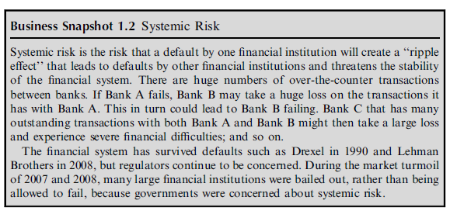

Slide 20
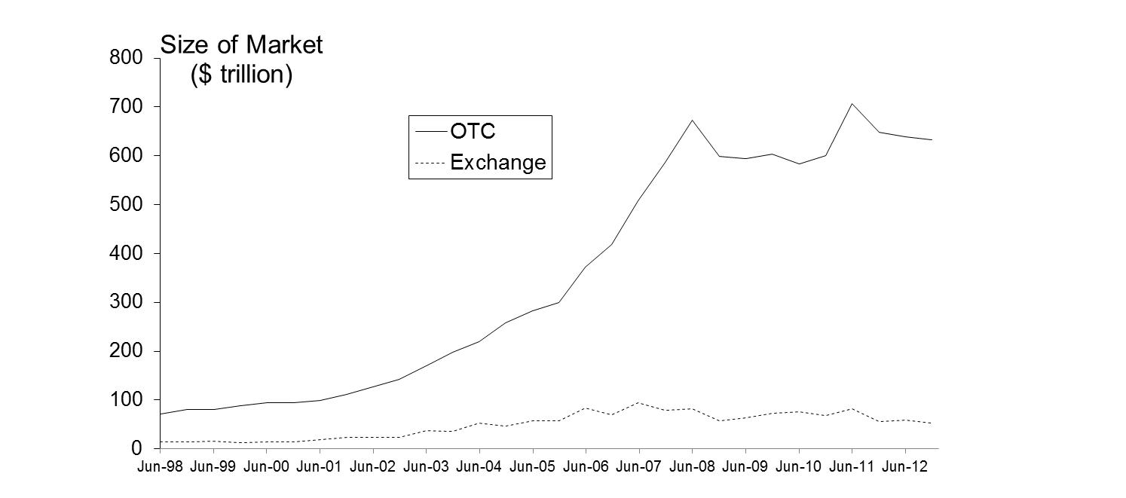
Size of OTC and Exchange-Traded Markets (Figure 1.1, Page 5)
Source: Bank for International Settlements. Chart shows total principal amounts for OTC market and value of underlying assets for exchange market

Slide 21
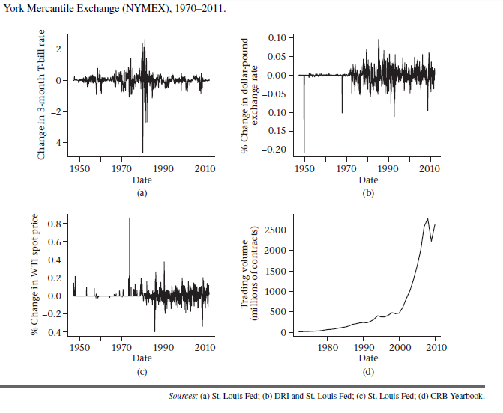

Slide 22
The Lehman Bankruptcy (Business Snapshot 1.1, pg. 4)
Lehman’s filed for bankruptcy on September 15, 2008. This was the biggest bankruptcy in US history
Lehman was an active participant in the OTC derivatives markets and got into financial difficulties because it took high risks and found it was unable to roll over its short term funding.
It had hundreds of thousands of transactions outstanding with about 8,000 counterparties.

Slide 23
How Derivatives are Used
To hedge risks
To speculate (take a view on the future direction of the market)
Reduced transaction cost
To lock in an arbitrage profit
To change the nature of a liability
To change the nature of an investment without incurring the costs of selling one portfolio and buying another
Notes:
4

Slide 24
Foreign Exchange Quotes for GBP, May 26, 2013 (See page 6)
 | Bid | Offer
Spot | 1.5541 | 1.5545
1-month forward | 1.5538 | 1.5543
3-month forward | 1.5533 | 1.5538
6-month forward | 1.5526 | 1.5532

Slide 25
Forward Price
The forward price for a contract is the delivery price that would be applicable to the contract if were negotiated today (i.e., it is the delivery price that would make the contract worth exactly zero)
The forward price may be different for contracts of different maturities (as shown by the table)
Notes:
11

Slide 26
Terminology
The party that has agreed to buy has what is termed a long position
The party that has agreed to sell has what is termed a short position
Notes:
10

Slide 27
Example (page 6)
On May 6, 2013, the treasurer of a corporation enters into a long forward contract to buy £1 million in six months at an exchange rate of 1.5532
This obligates the corporation to pay $1,553,200 for £1 million on November 6, 2013
What are the possible outcomes?

Slide 28
 | Bid | Offer
Spot | 1.5541 | 1.5545
1-month forward | 1.5538 | 1.5543
3-month forward | 1.5533 | 1.5538
6-month forward | 1.5526 | 1.5532
Buy 1 million £ in the rate of 1,5532
Pays: 1.000.000 x 1,5532 = 1.553.200 $
If the rate was 1,60
Pays: 1.000.000 x 1,60 = 1.600.000 $
So gain is 1.600.000 – 1.553.200 = 46.800 $
If the rate was 1,50
Pays: 1.000.000 x 1,50 = 1.500.000 $
So lose is 1.500.000 – 1.553.200 = -53.200$ loss

Slide 29
Profit from a Long Forward Position (K= delivery price=forward price at time contract is entered into)
Profit
46.800
Price of Underlying at Maturity, S_{T}
1,50
1,60
K
=1,5532
-53.200
Notes:
14

Slide 30
Profit from a Short Forward Position (K= delivery price=forward price at time contract is entered into)
Profit
53.200
1,50
Price of Underlying
at Maturity, S_{T}
1,60
K
=1,5532
-46.800
Notes:
15

Slide 31
In general, the payoff from a long position in a forward contract on one unit of an asset is
ST- K
where K is the delivery price and ST is the spot price of the asset at maturity of the contract. This is because the holder of the contract is obligated to buy an asset worth ST for K.
Similarly, the payoff from a short position in a forward contract on one unit of an asset is
K - ST

Slide 32
Futures Contracts (page 8)
Agreement to buy or sell an asset for a certain price at a certain time
Similar to forward contract
Whereas a forward contract is traded OTC, a futures contract is traded on an exchange

Slide 33
Exchanges Trading Futures
CME Group (formed when Chicago Mercantile Exchange and Chicago Board of Trade merged)
NYSE Euronext (being acquired by the InterContinental Exchange)
BM&F (Sao Paulo, Brazil)
TIFFE (Tokyo)
and many more (see list at end of book)

Slide 34
VIOP
https://www.borsaistanbul.com/en/sayfa/3072/futures

Slide 35
1. Gold: An Arbitrage Opportunity?
Suppose that:
The spot price of gold is US$1,400
The 1-year forward price of gold is US$1,500
The 1-year US$ interest rate is 5% per annum
Is there an arbitrage opportunity?
The real forward price= 1.400 x 1,05= 1.470
Buy the spot = 1.400
Borrow = 1.400
Short forward = 1.500
Cost of borrow = 1.470
Profit => 1.500 – 1.470 = 30 $
Notes:
18

Slide 36
2. Gold: Another Arbitrage Opportunity?
Suppose that:
The spot price of gold is US$1,400
The 1-year forward price of gold is US$1,400
The 1-year US$ interest rate is 5% per annum
Is there an arbitrage opportunity?
Real Forward Price = 1.400 x 1,05 = 1.470
Short spot = 1.400
Invest = 1.400
Long forward = 1.400
Invest : 1.400 x 1,05 = 1.470
Profit => 1.470 – 1.400 = 70$
Notes:
19

Slide 37
The Forward Price of Gold (ignores the gold lease rate)
If the spot price of gold is S and the forward price for a contract deliverable in T years is F, then
F = S (1+r )^{T}
where r is the 1-year (domestic currency) risk-free rate of interest.
In our examples, S = 1400, T = 1, and r =0.05 so that
F = 1400(1+0.05) = 1470
Notes:
20

