Slide 1
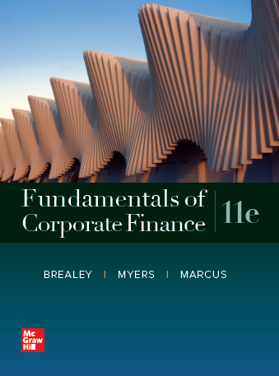
Fundamentals of Corporate Finance, 11th Edition
CHAPTER 5: The Time Value Of Money
© McGraw Hill LLC. All rights reserved. No reproduction or distribution without the prior written consent of McGraw Hill LLC.

Slide 2
Topics Covered
5.1 Future Values and Compound Interest.
5.2 Present Values.
5.3 Multiple Cash Flows.
5.4 Reducing the Chore of the Calculations: Part 1.
5.5 Level Cash Flows: Perpetuities and Annuities.
5.6 Reducing the Chore of the Calculations: Part 2.
5.7 Effective Annual Interest Rates.
5.8 Inflation & The Time Value of Money.

Slide 3
Future Values and Compound Interest 1
Future Value.
  Amount to which an investment will grow after earning interest.
Simple Interest.
  Interest earned only on the original investment.
Compound Interest.
  Interest earned on interest (and the original investment).

Slide 4
Future Values and Compound Interest 2
Example — Simple Interest.
Interest earned at a rate of 6% for five years on a principal balance of $100.
Interest earned per year = 100 × .06 = $6.

Slide 5
Future Values and Compound Interest 3
Example — Simple Interest.
Interest earned at a rate of 6% for five years on a principal balance of $100.
Blank | Today | Blank | Blank | Future Years | Blank | Blank
Blank | 1 | 2 | 3 | 4 | 5 | 6
Interest Earned |  | $6 | 6 | 6 | 6 | 6
Value | $100 | 106 | 112 | 118 | 124 | 130
Value at the end of Year 5 = $130.

Slide 6
Future Values and Compound Interest 4
Example — Compound Interest.
Interest earned at a rate of 6% for five years on the previous year’s balance.
Interest earned per year = prior year balance × .06.

Slide 7
Future Values and Compound Interest 5
Example — Compound Interest.
Interest earned at a rate of 6% for five years on the previous year’s balance.
 | Today |  |  | Future Years
 |  | 1 | 2 | 3 | 4 | 5
Interest Earned |  | $6.00 | 6.36 | 6.74 | 7.15 | 7.57
Value | $100.00 | 106.00 | 112.36 | 119.10 | 126.25 | 133.82
Value at the end of Year 5 = $133.82.

Slide 8
Future Values and Compound Interest 6
Future Value = F V.

Slide 9
Future Values and Compound Interest 7
Example — Future Value.
What is the future value of $100 if interest is compounded annually at a rate of 6% for five years?

Slide 10
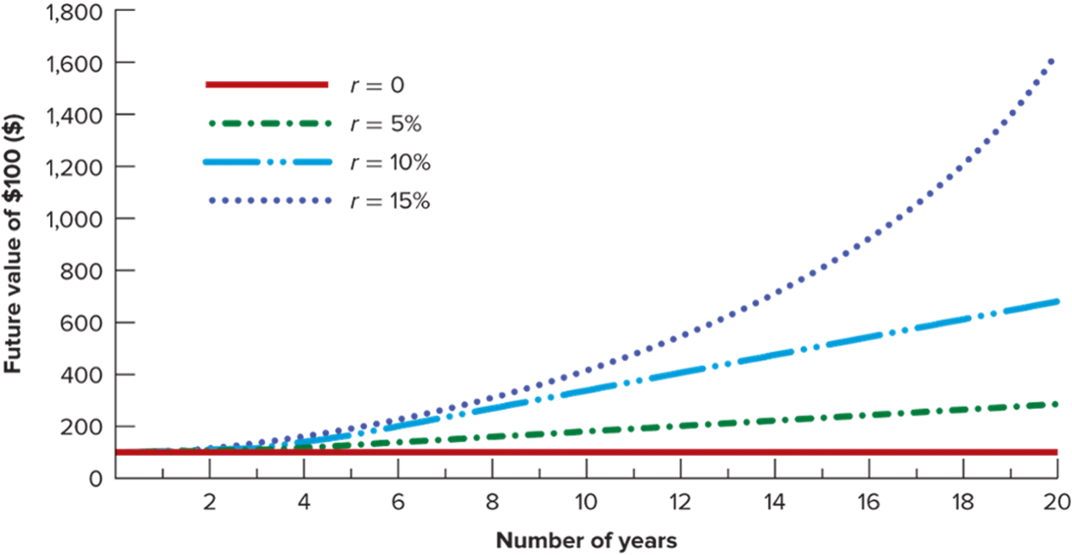
Future Values and Compound Interest 8
Access the text alternative for these images.

Slide 11
Manhattan Island Sale
Peter Minuit bought Manhattan Island for $24 in 16 26. Was this a good deal?
To answer, determine what $24 is worth in the year 2016, compounded at 8%.
Note: The value of Manhattan Island land is well below this figure…

Slide 12
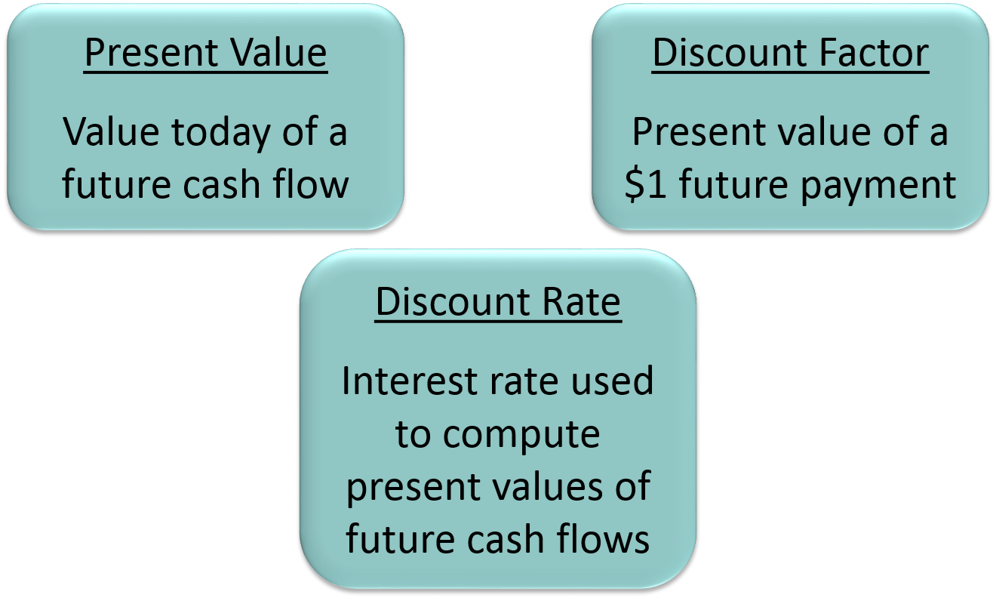
Present Values 1
Access the text alternative for these images.

Slide 13
Present Values 2
Present value = P V.

Slide 14
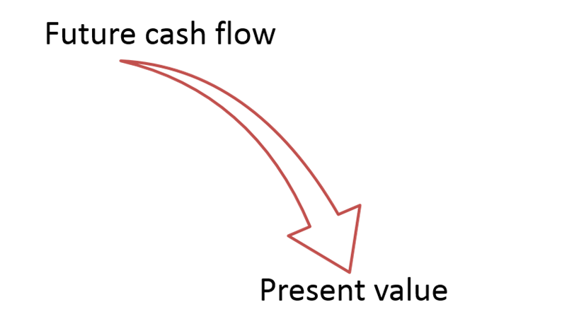
Present Values 3
Discounted Cash Flow (D C F).
  Method of calculating present value by discounting future cash flows.

Slide 15
Present Values 4
Example.
You just bought a new computer for $3,000. The payment terms are 2 years same as cash. If you can earn 8% on your money, how much money should you set aside today to make the payment due in two years?

Slide 16
Present Values 5
Discount Factor = D F = P V of $1.
Discount factors can be used to compute the present value of any cash flow.

Slide 17
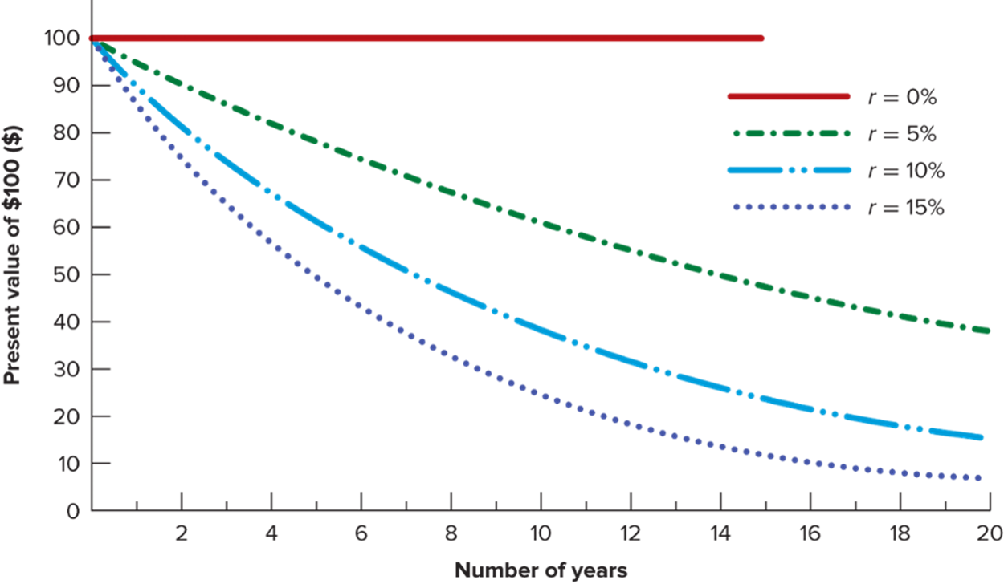
Present Values 6
Access the text alternative for these images.

Slide 18
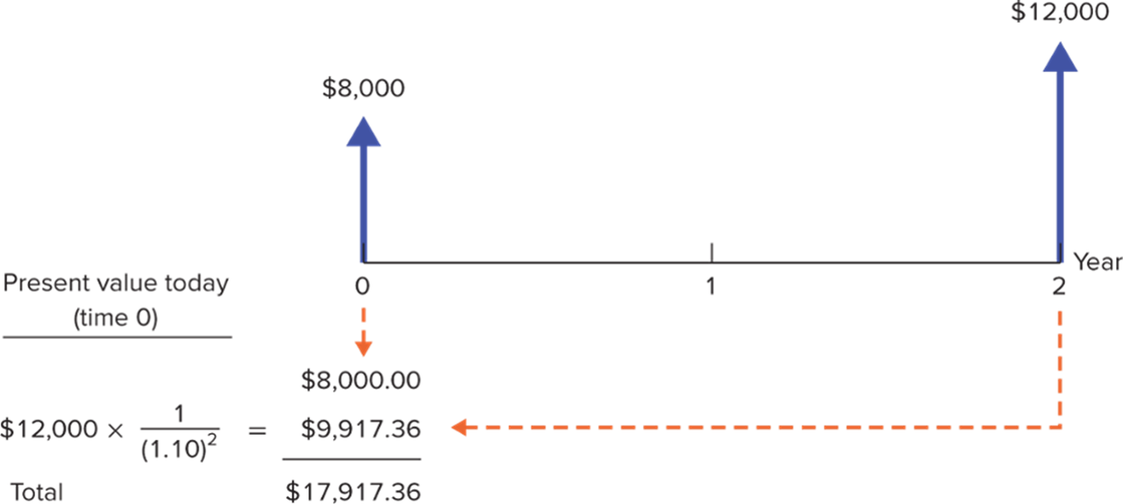
The Statement of Cash Flows
Drawing a timeline helps to calculate the present value of the payments ($8,000 now, $12,000 in two years).
Access the text alternative for these images.

Slide 19
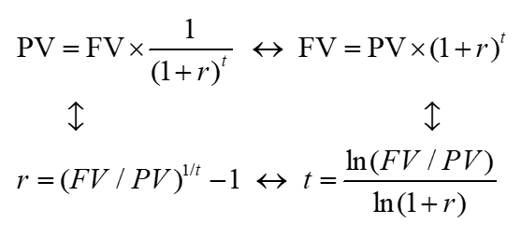
Time Value of Money (Applications) 1
The P V formula has many applications. Given any variables in the equation, you can solve for the remaining variable.
Access the text alternative for these images.

Slide 20
Time Value of Money (Applications) 2
Example.
The U.S. Treasury borrowed money for 10 years, selling each I O U for $777.40. What is the interest rate?

Slide 21
Time Value of Money (Applications) 3
Value of Free Credit.
Implied Interest Rates.
Internal Rate of Return.
Time necessary to accumulate funds.

Slide 22
Future Value of Multiple Cash Flows
Example.
You invest $1,200 in the bank now, and another $1,400 in 1 year. At 8% rate of interest, how much will you be able to spend on a computer in 2 years?
F V₁ = $1,400 × (1.08) = $1,512.00
F V₂ = $1,200 × (1.08 )² = $1,399.68
Total F V = $2,911.68

Slide 23
Present Value of Multiple Cash Flows 1
P Vs can be added together to evaluate multiple cash flows.

Slide 24
Present Value of Multiple Cash Flows 2
Example.
Your auto dealer gives you the choice to pay $15,500 cash now or make three payments: $8,000 immediately and $4,000 at the end of the next two years. If your cost of money is 8%, which do you prefer?

Slide 25
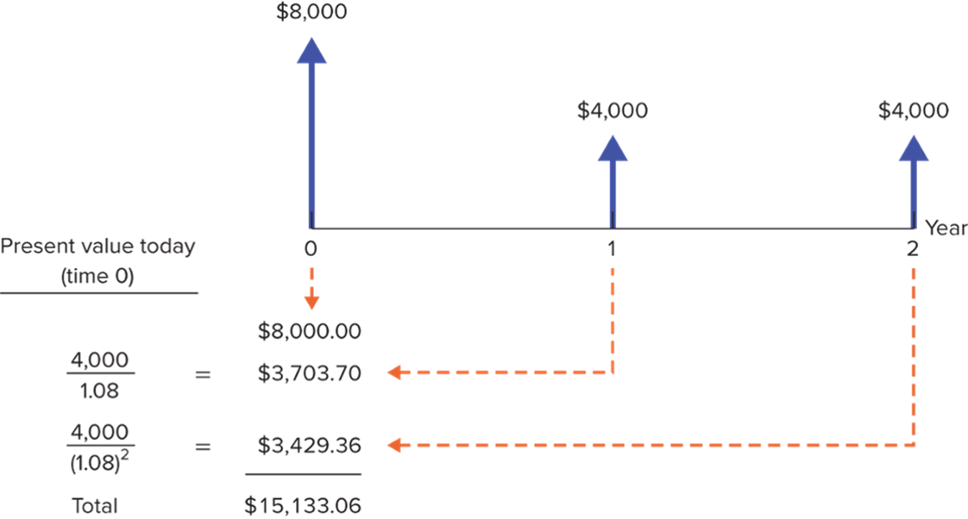
Present Value of Multiple Cash Flows 3
Access the text alternative for these images.

Slide 26
Calculations: Part 1 – Spreadsheets
Example.
Your auto dealer gives you the choice to pay $15,500 cash now or make three payments: $8,000 immediately and $4,000 at the end of the next two years. If your cost of money is 8%, which do you prefer?
Finding the Present Value of Multiple Cash Flows by Using a Spreadsheet
Blank | A | B | C | D
1 | Time until C F | Cash Flow | Present Value | Formula in Column C
2 | 0 | 8000 | $8,000.00 | =P V ($B$6,A2,0,−B2)
3 | 1 | 4000 | $3,703.70 | =P V ($B$6,A3,0, −B3)
4 | 2 | 4000 | $3,429.36 | =P V ($B$6,A4,0, −B4)
5 | SUM: | Blank | $15,133.06 | =SUM(C2:C4)
6 | Discount rate: | .08 | Blank | Blank

Slide 27

Calculations: Part 1 – Financial Calculators 1
n = number of periods.
i = interest rate, expressed as a percentage (not a decimal).
P V = present value.
P M T = amount of any recurring payment.
F V = future value.

Slide 28
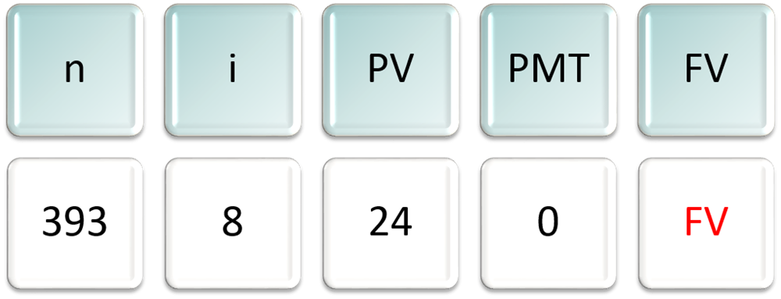
Calculations: Part 1 – Financial Calculators 2
Example.
What is the future value of Peter Minuit’s $24 investment if invested at 8% for 393 years?
Enter each number then push the corresponding financial function key. Compute (C P T) F V and you will get −$327.90 trillion. (Why is there a minus sign?).

Slide 29
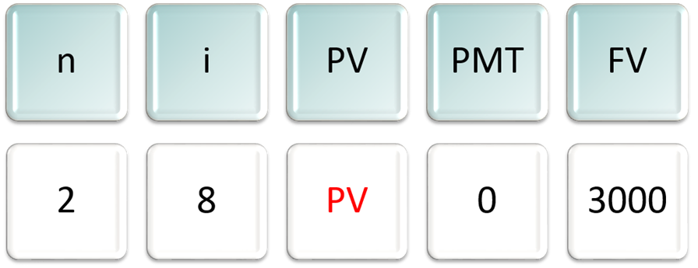
Calculations: Part 1 – Financial Calculators 3
Example.
You just bought a new computer for $3,000. The payment terms are 2 years same as cash. If you can earn 8% on your money, how much money should you set aside today in order to make the payment when due in two years?
Enter known variables and compute (C P T) P V → −$2,572.02.

Slide 30
Perpetuities and Annuities 1
Perpetuity.
  A stream of level cash payments that never ends.
Annuity.
  Level stream of cash flows at regular intervals with a finite maturity.

Slide 31
Perpetuities and Annuities 2
P V of Perpetuity Formula.
C = cash payment.
r = interest rate.

Slide 32
Perpetuities and Annuities 3
Example.
In order to create an endowment, which pays $100,000 per year forever, how much money must be set aside today in the rate of interest is 10%?

Slide 33
Perpetuities and Annuities 4
Example.
If the first perpetuity payment will not be received until three years from today, how much money needs to be set aside today?

Slide 34
Perpetuities and Annuities 5
P V of Annuity Formula.
C = cash payment.
r = interest rate.
t = Number of years cash payment is received.

Slide 35
Perpetuities and Annuities 6
P V of Annuity Factor (P V A F).
  The present value of $1 a year for each of t years.

Slide 36
Perpetuities and Annuities 7
Example.
You are purchasing a car. You are scheduled to make 3 annual installments of $8,000 per year. Given a rate of interest of 10%, what is the price you are paying for the car (that is, what is the P V)?

Slide 37
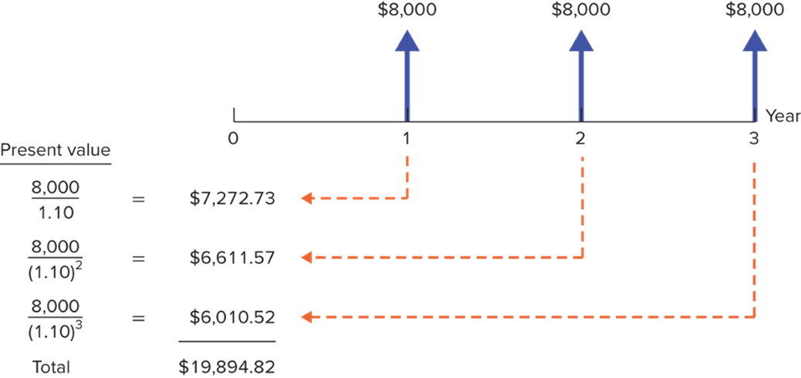
Perpetuities and Annuities 8
Example.
You are purchasing a car. You are scheduled to make 3 annual installments of $8,000 per year. Given a rate of interest of 10%, what is the price you are paying for the car (that is what is the P V)?
Access the text alternative for these images.

Slide 38
Perpetuities and Annuities 9
Applications.
  Value of payments.
  Implied interest rate for an annuity.
  Calculation of periodic payments.
    Mortgage payment.
    Annual income from an investment payout.
    Future Value of annual payments.

Slide 39
Perpetuities and Annuities 10
Example — Future value of annual payments.
You plan to save $3,000 every year for 4 years. Given an 8% rate of interest, what will be the F V of your account?

Slide 40
Perpetuities and Annuities 11
Example.
You are purchasing a home and are scheduled to make 30 annual installments of $10,000 per year. Given an interest rate of 5%, what is the price you are paying for the house (that is, P V)?

Slide 41
Perpetuities and Annuities 12
Example— Future value of annual payments.
You plan to save for 50 years and then retire. Given a 10% rate of interest, if you desire to have $500,000 at retirement, how much must you save each year?

Slide 42
Annuities Due 1
Annuity Due.
  Level stream of cash flows starting immediately.
How does it differ from an ordinary annuity?
P V _{Annuity Due} = P V _{Annuity} × (1 + r).
How does the future value differ from an ordinary annuity?
F V _{Annuity Due} = F V _{Annuity} × (1 + r).

Slide 43
Annuities Due 2
Example.
Suppose you invest $429.59 annually at the beginning of each year at 10% interest. After 50 years, how much would your investment be worth?
F V _{AD} = F V _{Annuity} × (1 + r).

Slide 44
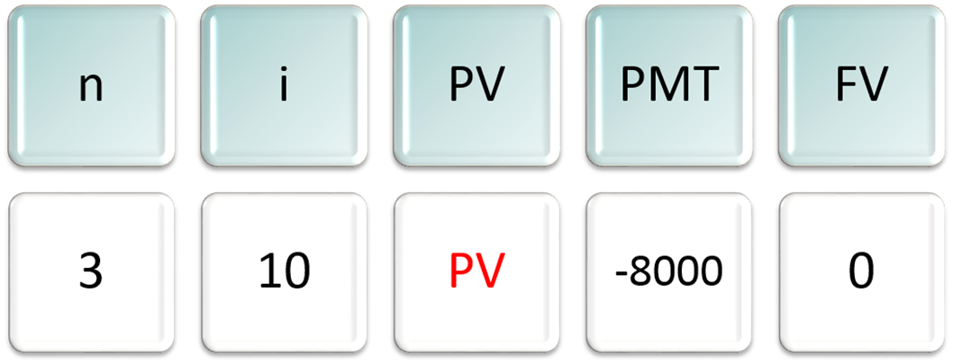
Calculations: Part 2 – Financial Calculators 1
Example.
You are purchasing a car with 3 annual installments of $8,000 per year. At 10% interest, what is the price of the car (that is, P V)?
To get the final answer, compute (C P T) P V and you will get −$19,894.82.

Slide 45
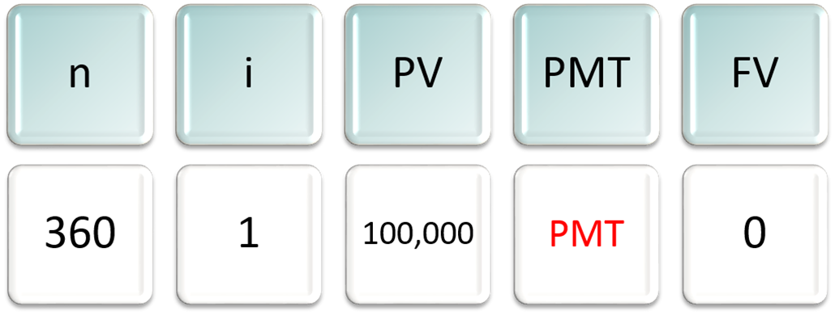
Calculations: Part 2 – Financial Calculators 2
Example.
You are taking out a mortgage for $100,000. You will pay it back over 30 years paying 1% per month. What is your monthly payment?
Compute (C P T) P M T to get −$1,028.61.

Slide 46
Effective Interest Rates 1
Effective Annual Interest Rate.
  Interest rate that is annualized using compound interest.
Annual Percentage Rate.
  Interest rate that is annualized using simple interest.

Slide 47
Effective Interest Rates 2
Annual Percentage Rate (A P R).
Effective Annual Interest Rate (E A R).
Where- M R = monthly interest rate.

Slide 48
Effective Interest Rates 3
Example.
Given a monthly rate of 1%, what is the Effective Annual Rate(E A R)? What is the Annual Percentage Rate (A P R)?

Slide 49
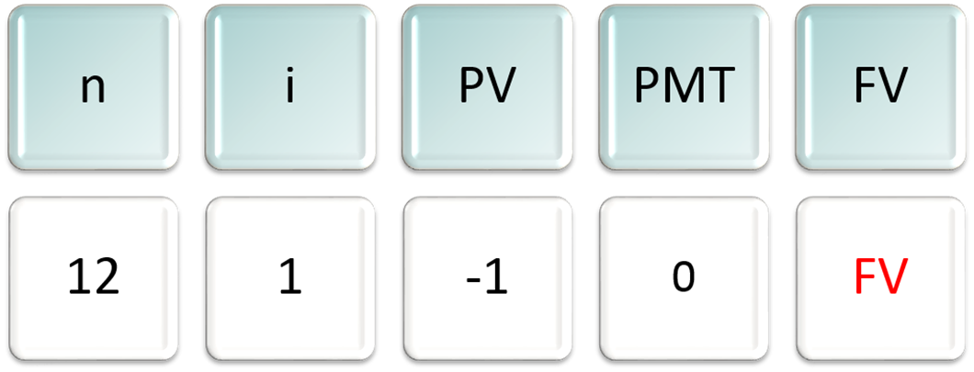
E A R and Financial Calculators
Example.
Given a 12% A P R, what is the Effective Annual Rate, given monthly compounding?
Compute (C P T) F V to get 1.1268 → E A R = .1268, or 12.68%.

Slide 50
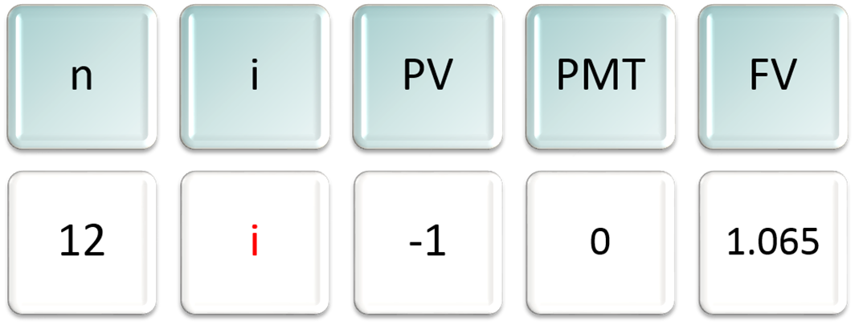
A P R and Financial Calculators
Example.
Given a 6.50 % E A R what is the A P R, given monthly compounding?
Compute (C P T) i to get .5262. Multiply by 12 → A P R = .0631, or 6.31%

Slide 51
Inflation 1
Inflation.
  Rate at which (overall) prices increase.
Nominal Interest Rate.
  Rate at which money invested grows.
Real Interest Rate.
  Rate at which purchasing power grows.

Slide 52
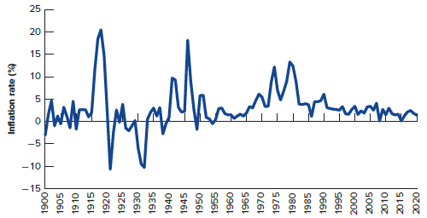
Inflation 2
Annual U.S. Inflation Rates from 1900 – 2015.
Access the text alternative for these images.

Slide 53
Inflation 3
Exact relationship.
Approximation formula.
Real interest rate ≈ nominal interest rate − inflation rate.

Slide 54
Inflation 4
Example.
If the interest rate on one-year government bonds is 6.0% and the inflation rate is 2.0%, what is the real interest rate?
Approximation = .06 − .02 = .04 or 4.0%.

Slide 55
Inflation 5
Remember:
  Current dollar cash flows must be discounted by the nominal interest rate.
  Real cash flows must be discounted by the real interest rate.

Slide 56
End of Main Content
© McGraw Hill LLC. All rights reserved. No reproduction or distribution without the prior written consent of McGraw Hill LLC.
Notes:
End of Chapter 1

Slide 57
Accessibility Content: Text Alternatives for Images

Slide 58
Future Values and Compound Interest 8 – T Text Alternative
Return to parent-slide containing images.
The x-axis is labeled Number of years and spans from 0 to 20 years. The y-axis is labeled Future value of $100 in $ and spans from $0 to $1800 in increments of $200. The 0% interest curve is horizontal at $100. The 5% interest curve begins at the point (0,100) and ends at the approximate point (20,300) and appears linear. The 10% interest curve begins at the point (0,100) and ends at the approximate point (20, 600) and appears linear. The 15% interest curve begins at (0,100) and ends at the approximate point (20, 1800) and appears linear for the first 12 years, then begins to curve upward.
Return to parent-slide containing images.

Slide 59
Present Values 1 – Text Alternative
Return to parent-slide containing images.
Three boxes in a triangle shape contain the following information. The box at the top left reads: Present Value- Value today of a future cash flow. The box at the top right reads: Discount Factor- Present value of a $1 future payment. The box at the bottom reads: Discount rate- Interest rate used to compute present values of future cash flows.
Return to parent-slide containing images.

Slide 60
Present Values 6 – Text Alternative
Return to parent-slide containing images.
A graph that shows the present value of a future cash flow of $100 with interest rates of 0, 5, 10, and 15% over 20 years. The x-axis is labeled Number of years and spans from 0 to 20 years. The y-axis is labeled Present value of $100 in $ and spans from $0 to $100 in increments of $10. The 0% interest curve is horizontal at $100. The 5% interest curve begins at the point (0,100) and ends at the approximate point (20,40) and appears slightly curved concave up. The 10% interest curve begins at the point (0,100) and ends at the approximate point (20, 20) and appears curved concave up. The 15% interest curve begins at (0,100) and ends at the approximate point (20, 10) and appears curved concave up.
Return to parent-slide containing images.

Slide 61
The Statement of Cash Flows – Text Alternative
Return to parent-slide containing images.
The timeline shows Years 0-2 of the time value of money in the automobile transaction described. At year 0 the value is $8,000, the down-payment. Year 1 passes, and at Year 2 the Present Value formula is used to calculate the payoff amount. $12,000 times 1 divided by 1.10 squared equals $9,917.36. This amount, added to the $8,000 down-payment totals $17,917.36.
Return to parent-slide containing images.

Slide 62
Time Value of Money (Applications) 1 – Text Alternative
Return to parent-slide containing images.
PV equals FV times the fraction with numerator 1 and denominator open parenthesis 1 plus r close parenthesis to the t power is identical with FV equals PV times open parenthesis 1 plus r close parenthesis to the t power is identical with t equals the fraction with numerator natural log of FV over PV and denominator natural log of open parenthesis 1 plus r close parenthesis is identical with r equals open parenthesis FV over PV close parenthesis to 1 over t power minus 1 is identical with PV equals FV times the fraction with numerator 1 and denominator open parenthesis 1 plus r close parenthesis to the t power.
Return to parent-slide containing images.

Slide 63
Present Value of Multiple Cash Flows 3 – Text Alternative
Return to parent-slide containing images.
The timeline shows Years 0-2 of the present value of a stream of cash flows. At year 0, the value is $8,000. At year 1, the calculation is $4,000 divided by 1.08 equals $3703.70. At year 2, the calculation is $4,000 divided by 1.08 squared equals $3429.36. To get the present value in year 2, find the sum of years 0 through 2: $8,000.00 plus $3703.70 plus $3429.36 equals $15,133.06.
Return to parent-slide containing images.

Slide 64
Perpetuities and Annuities 8 – Text Alternative
Return to parent-slide containing images.
The timeline shows Years 0-3 of the present value of an annuity. At year 1, the calculation is $8,000 divided by 1.10 equals $7,272.73. At year 2, the calculation is $8,000 divided by 1.10 squared equals $6,611.57. At year 3, the calculation is $8,000 divided by 1.10 cubed equals $6,010.52. The total, shown under year 0 is $19,894.82.
Return to parent-slide containing images.

Slide 65
Inflation 2 – Text Alternative
Return to parent-slide containing images.
On the x-axis is time in years, starting with 1900 and listing every 5th year to 2020. On the y-axis is the inflation rate as a percent, with values from negative 15% to 25% in increments of 5. In 1900, inflation was at about –3% and the rate oscillated from there to about 5% until 1915. At that time, the inflation rate skyrocketed to over 20% by 1918, then dropped sharply to just below –10% around 1920. From then the rate varied between –3% and 5% until about 1929, when it dropped sharply again to –10% by about 1932. The rate again rose and oscillated between –3% and 3% from about 1933 to 1940. Around 1941 it rose sharply to 10%, and by 1945 dropped sharply to about 2%, then spiked again to over 15% a year later, and again dropping back to about –2% around 1949. From then the rate dropped very slightly below 0% around 1954. After then the interest rate stayed positive and fluctuated from just above 0% to about 5% until around 1973, when it spiked again to 10% around 1974. The rate dropped back to 5% around 1976 spiked back to about 10% around 1979. When the inflation rate dropped to just under 5% in the early 1980s, it began the trend where it stayed between about 0% and 3% until 2020.
Return to parent-slide containing images.

