Slide 1
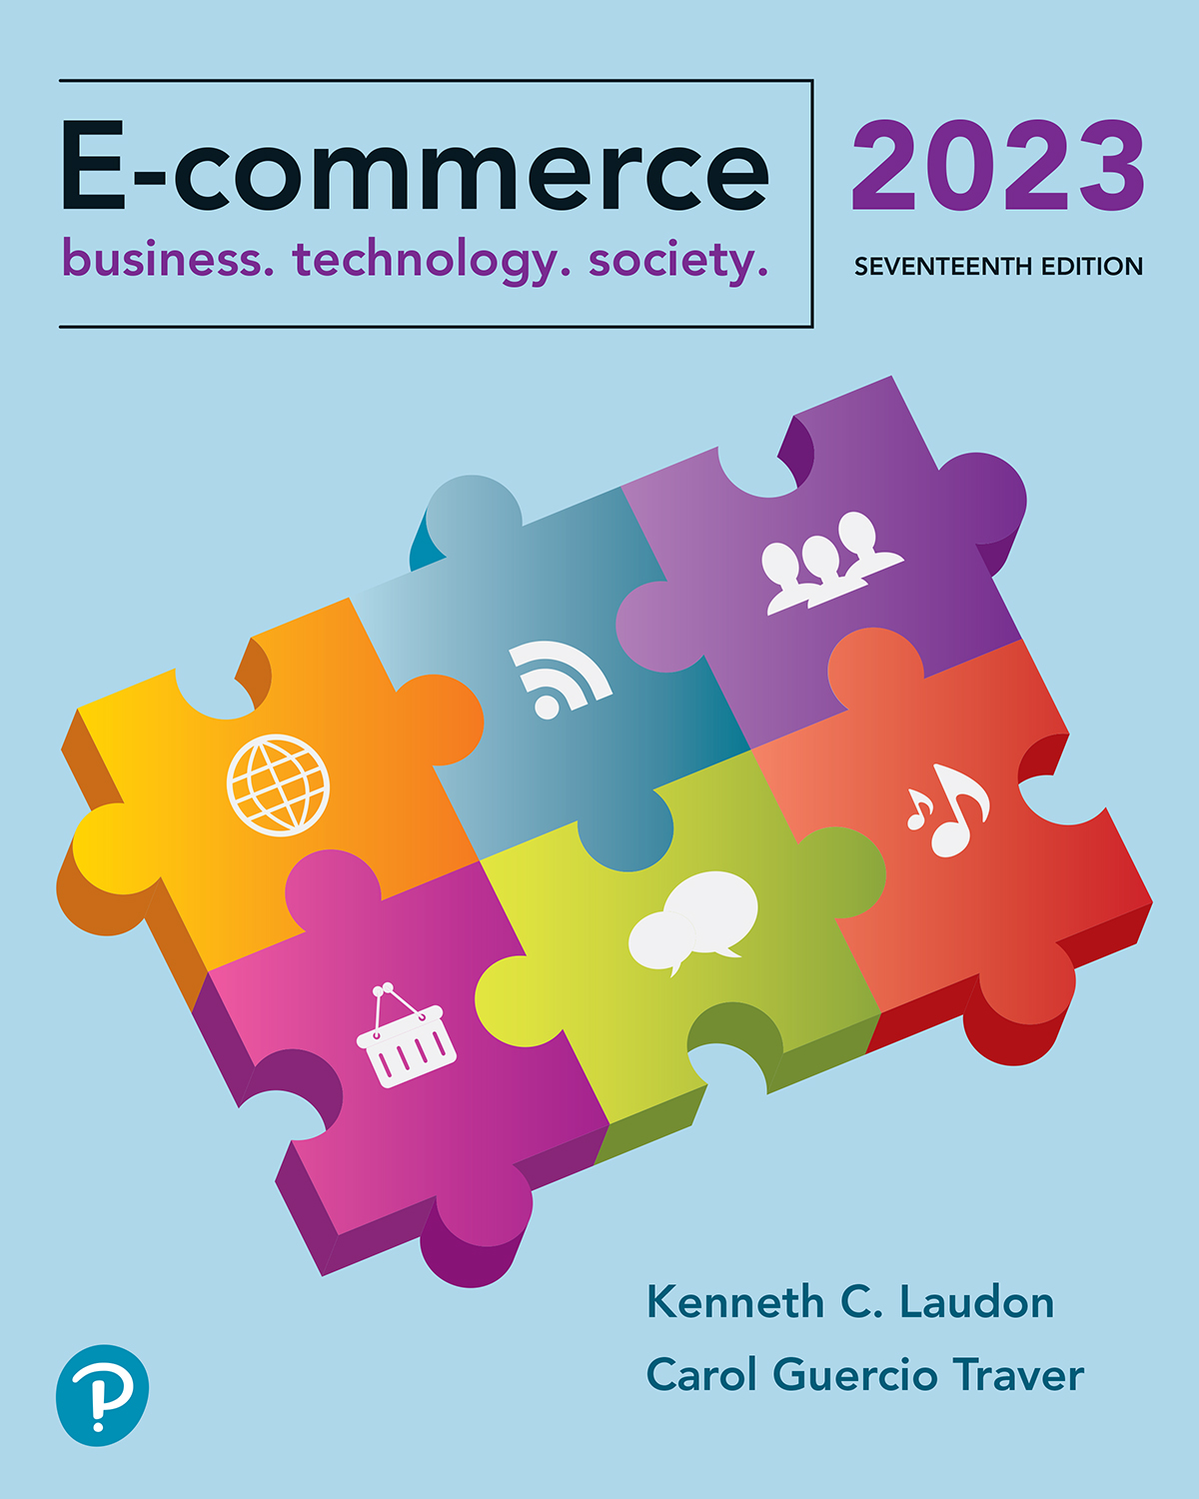
E-commerce 2023: business. technology. society.
Seventeenth Edition
Chapter 5
E-commerce Security and Payment Systems
Copyright © 2024, 2022, 2020 Pearson Education, Inc. All Rights Reserved
Notes:
If this PowerPoint presentation contains mathematical equations, you may need to check that your computer has the following installed:
1) MathType Plugin
2) Math Player (free versions available)
3) NVDA Reader (free versions available)

Slide 2
Learning Objectives
5.1 Understand the scope of e-commerce crime and security problems, the key dimensions of e-commerce security, and the tension between security and other values.
5.2 Identify the key security threats in the e-commerce environment.
5.3 Describe how technology helps secure Internet communications channels and protect networks, servers, and clients.
5.4 Appreciate the importance of policies, procedures, and laws in creating security.
5.5 Identify the major e-commerce payment systems in use today.

Slide 3
SolarWinds: Shining a Light on Software Supply Chain Attacks
Class Discussion
Have you ever heard about software supply chain attacks before reading this case?
What makes software supply chain attacks so menacing?
What techniques do hackers use to carry out software supply chain attacks?
How can organizations protect themselves against software supply chain attacks?

Slide 4
Systems that rely on the Internet are increas-ingly vulnerable to large-scale attacks. Increasingly, these attacks are led by organized gangs of criminals operating globally—an unintended con-sequence of globalization.
Even more worrisome is the growing number of large-scale attacks against critical infrastructure and companies that are funded, organized, and led by various nations. Anticipating and countering these attacks has proved a difficult task for both business and government organizations.
For criminals, the Internet has created entirely new—and lucrative—ways to steal from the more than 4.5 billion Internet users worldwide in 2022. From products and services, to money, and to information, it’s all there for the taking on the Internet.

Slide 5
The issue of cyber crime
Cybercrime is a significant problem for both organizations and consumers. But despite the increasing attention being paid to cybercrime, it is difficult to accurately estimate the actual amount of such crime, in part because many companies are hesitant to report it due to the fear of losing the trust of their customers and because even if the crime is reported, it may be difficult to quantify the actual dollar amount of the loss

Slide 6
Criminals who steal information on the Internet do not always use this information themselves but, instead, derive value by selling the information to others on the so-called underground or shadow economy market, also sometimes referred to as the Dark Web or the Darknet.
Data is currency to cybercriminals and has a “street value” that can be monetized. There are several thousand known underground economy market-places around the world that sell stolen information, as well as malware, such as exploit kits, access to botnets, and more. Prices for various types of stolen data typically vary depending on the quantity being purchased, the supply available, and its “freshness.”
For example, the recent average price for an individual U.S. credit card number with a cardholder name, expiration date, zip code, and CVV (the three-digit number printed on the back of the card) is around $17. Bank account or online account (such as PayPal) login credentials (depending on value and verification) go for around 10% of the account’s balance.

Slide 7
The E-commerce Security Environment
Scope of the problem
Overall size of and losses due to cybercrime unclear
Center for Strategic and International Studies study: Global economic impact of cybercrime and cyberespionage more than $1 trillion; other researchers believe the amount is even higher
IBM Security/Ponemon Institute 2021 Cost of Data Breach Report: total average cost of a data breach(veri ihlali) globally was $4.2 million.
A data breach is any security incident that results in unauthorized access to confidential information.
Underground economy marketplaces sell stolen information, malware (kötü amaçlı yazılım) and more

Slide 8
What Is Good E-commerce Security?
To achieve highest degree of security, use:
New technologies
Organizational policies and procedures: to ensure the technologies are not subverted.
Industry standards and government laws: are required to enforce payment mechanisms, as well as to investigate and prosecute violators of laws
Good e-commerce security requires a set of laws, procedures, policies, and technol-ogies that, to the extent feasible, protect individuals and organizations from unexpected behavior in the e-commerce marketplace.
Other factors
Time value of money
Cost of security versus potential loss
Security often breaks at weakest link

Slide 9
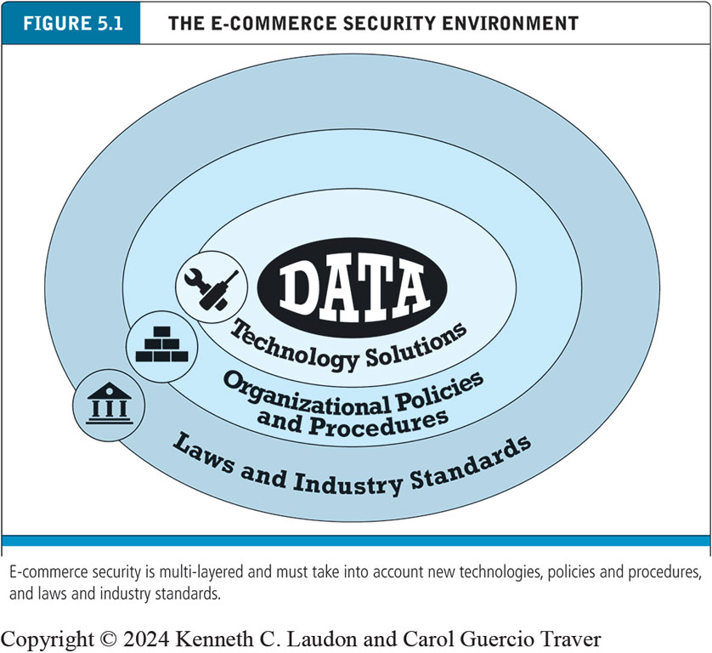
Figure 5.1 The E-commerce Security Environment
Notes:
Figure 5.1, Page 245.
E-commerce security is multi-layered, and must take into account new technology, policies and procedures, and laws and industry standards.
Alt Text:
The illustration consists of four concentric layers. The layers from innermost to outermost are labeled as follows. Data. Technology solutions. Organizational policies and procedures. Laws and industry standards.

Slide 10
Dimensions of E-commerce Security
There are six key dimensions to e-commerce security:.
1. Integrity: refers to the ability to ensure that the information being displayed on a website, or transmitted or received over the Internet, has not been altered in any way by an unauthorized party.
For example, if an unauthorized person intercepts and changes the contents of an online communication, such as by redirecting a bank wire transfer into a different account, the integrity of the message has been compromised because the communication no longer represents what the original sender intended.

Slide 11
Dimensions of E-commerce Security
There are six key dimensions to e-commerce security:.
2. Nonrepudiation(itiraz etmeme): the ability to ensure that e-commerce participants do not deny (i.e., repudiate) their online actions.
For instance, the availability of free e-mail accounts with alias names makes it easy for a person to post comments or send a mes-sage and perhaps later deny doing so. Even when a customer uses a real name and e-mail address, it is easy for that customer to order merchandise online and then later deny doing so.

Slide 12
Dimensions of E-commerce Security
There are six key dimensions to e-commerce security:.
3. Authenticity: refers to the ability to identify the identity of a person or entity with whom you are dealing on the Internet. How does the customer know that the website operator is who it claims to be? How can the merchant be assured that customers really are who they say they are? Someone who claims to be someone he is not is “spoofing” or misrepresenting himself.
4. Confidentiality: refers to the ability to ensure that messages and data are available only to those who are authorized to view them. Confidentiality is sometimes confused with privacy, which refers to the ability to control the use of information a customer provides about himself or herself to an e-commerce merchant.

Slide 13
Dimensions of E-commerce Security
There are six key dimensions to e-commerce security:.
5. privacy :the ability to control the use of information about oneself
6. Availability: the ability to ensure that an e-commerce site or app continues to function as intended

Slide 14
Table 5.3 Customer and Merchant Perspectives on the Different Dimensions of E-commerce Security
Dimension | Customer’s Perspective | Merchant’s Perspective
Integrity | Has information I transmitted or received been altered? | Has data been altered without authorization? Is data being received from customers valid?
Nonrepudiation | Can a party to an action with me later deny taking the action? | Can a customer deny ordering products?
Authenticity | Who am I dealing with? How can I be assured that the person or entity is who they claim to be? | What is the real identity of the customer?
Confidentiality | Can someone other than the intended recipient read my messages? | Are messages or confidential data accessible to anyone other than those authorized to view them?
Privacy | Can I control the use of personal information that I am transmitting to an e-commerce merchant? | What use, if any, can be made of personal data collected as part of an e-commerce transaction? Is the personal information of customers being used in an unauthorized manner?
Availability | Can I access to site or app? | Is the site or app operational?

Slide 15
The Tension Between Security and Other Values
Security is not an unmitigated good.
Tensions between security and ease of use
The more security measures added, the more difficult a site is to use, and the slower it becomes
Too much security can harm profitability; not enough can put a business out of business
Possible solution: aadaptive approach to security
Segment users by risk profile
Adjust security settings to users’ preferences

Slide 16
Security Threats in the E-commerce Environment
Three key points of vulnerability in e-commerce environment
Client
Server
Communications pipeline (Internet communications channels)

Slide 17
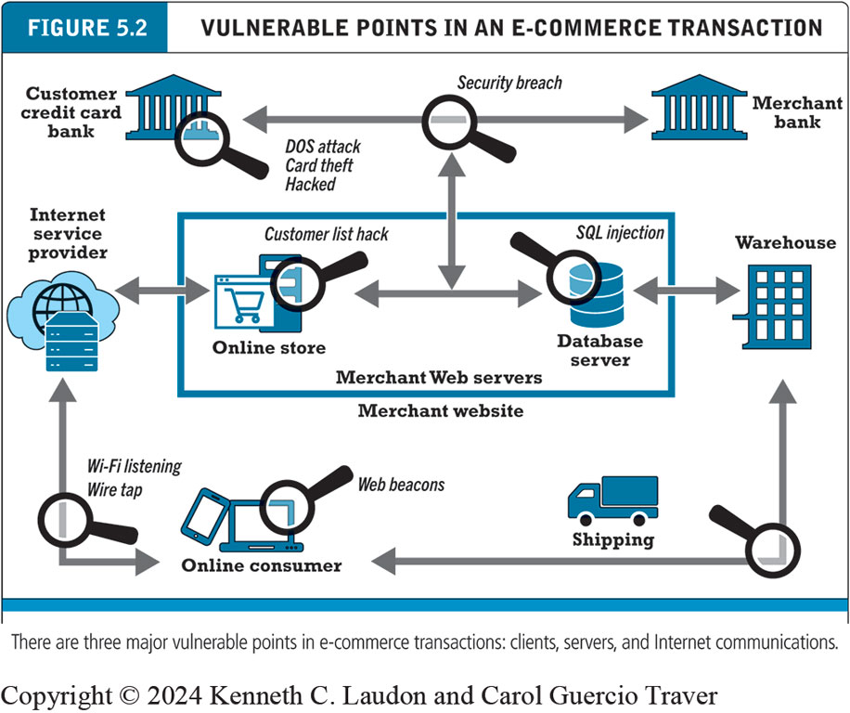
Figure 5.2 Vulnerable Points in an E-commerce Transaction
Notes:
Figure 5.2, Page 248.
There are three major vulnerable points in e-commerce transactions: Internet communications, servers, and clients.
Alt Text
Long description: The online consumer computer is vulnerable to web beacons. The connection between the online consumer and internet service provider is vulnerable to WI FI listening and wire taps. The online store and database servers are part of the merchant website run by merchant web servers. The online store, which is connected on one side to to the internet service provider and on the other side to the database server, is vulnerable to a customer list hack. The database server, which is connected on one side to the online store and on the other side to the warehouse, which is also connected to shipping, is vulnerable to an S Q L injection attack. The customer credit card bank is vulnerable to a D O S attack, card theft, or other hack. The connection between the customer credit card bank and the merchant bank is vulnerable to a security breach that also impacts the online store.

Slide 18
Technology Solutions
Protecting Internet communications
Encryption
Securing channels of communication
T L S, V P N s, Wi-Fi
Protecting networks
Firewalls, proxy servers, I D S, I P S
Protecting servers and clients
Operating system security, anti-virus software

Slide 19
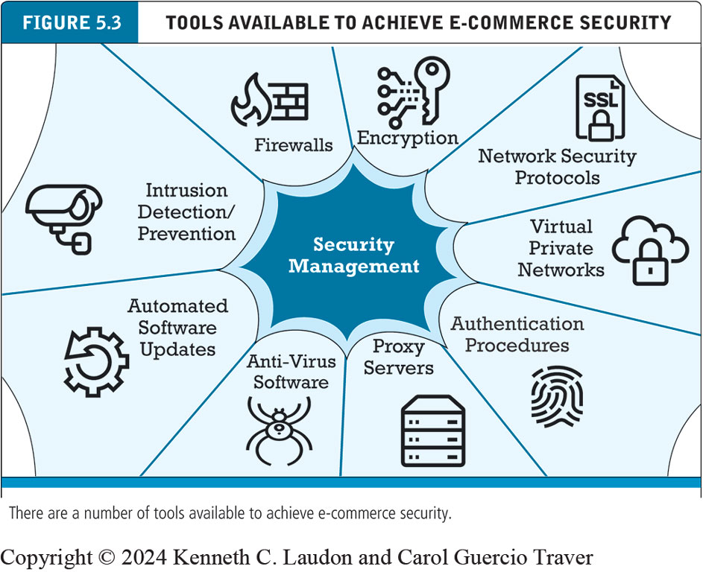
Figure 5.3 Tools Available to Achieve E-commerce Security
Notes:
Figure 5.5, Page 268.
There are a number of tools available to achieve e-commerce security.
Alt Text
Long description: The web-like structure has security management in the middle. Going in a clockwise direction, security management tools are identified as follows: encryption, network security protocols, virtual private networks, authentication procedures, proxy servers, anti virus software, automated software updates, intrusion detection and prevention, and firewalls.

Slide 20
Management Policies, Business Procedures, and Public Laws
Worldwide, in 2022, companies were expected to spend about $300 billion on security hardware, software, services
Managing risk includes:
Technology
Effective management policies
Public laws and active enforcement

Slide 21
A Security Plan: Management Policies
A security plan begins with risk assessment—an assessment of the risks and points of vulnerability. The first step is to inventory the information and knowledge assets of the e-commerce site and company. What information is at risk?
Security policy-Based on your quantified list of risks, you can start to develop a security policy—a set of statements prioritizing the information risks, identifying acceptable risk targets, and identifying the mechanisms for achieving these targets.
Implementation plan: the steps you will take to achieve the
security plan goals.
Security organization
Access controls
Authentication procedures, including biometrics
Authorization policies, authorization management systems
Security audit

Slide 22
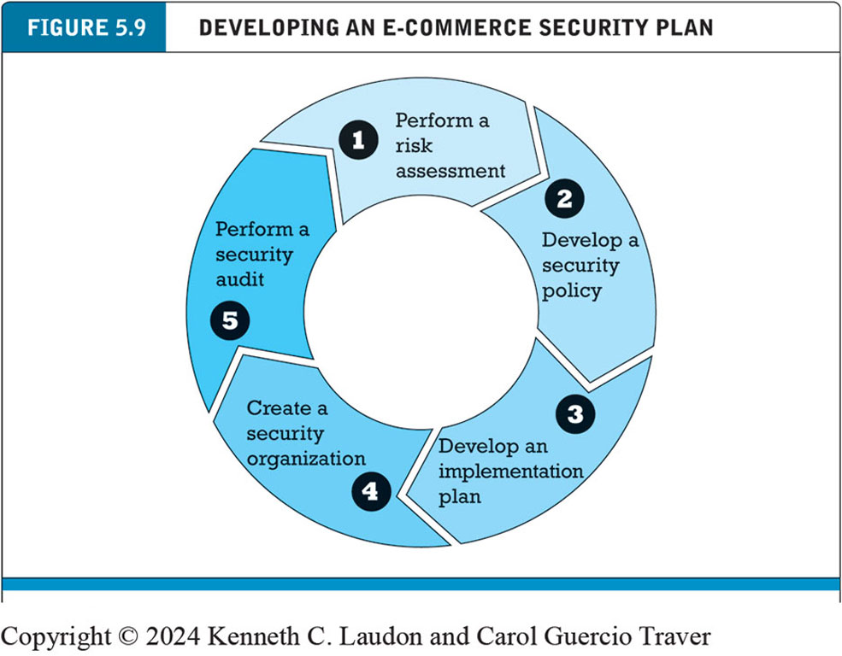
Figure 5.9 Developing an E-commerce Security Plan
Notes:
Figure 5.9, Page 281.
There are five steps involved in building an e-commerce security plan.
Alt Text
Long description: The steps for developing an e commerce security plan are as follows: Step 1, perform a risk assessment. 2, develop a security policy. 3, develop an implementation plan. 4, create a security organization. 5, perform a security audit.

Slide 23
E-commerce Payment Systems
Credit and debit cards primary online payment methods in U.S.
Parties involved: consumers, merchants, clearinghouse, merchant bank, card-issuing bank
Credit card e-commerce enablers
PCI-DSS compliance
Data security standard
Limitations of online credit card payment:
Merchants: security, merchant risk, cost
Consumers: social equity

Slide 24
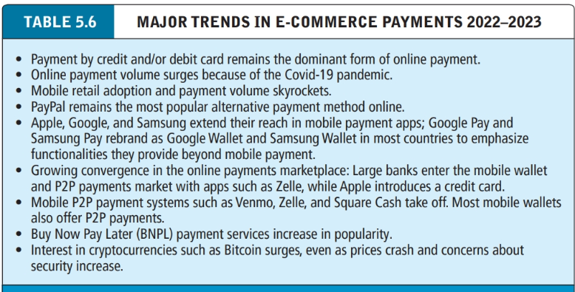

Slide 25
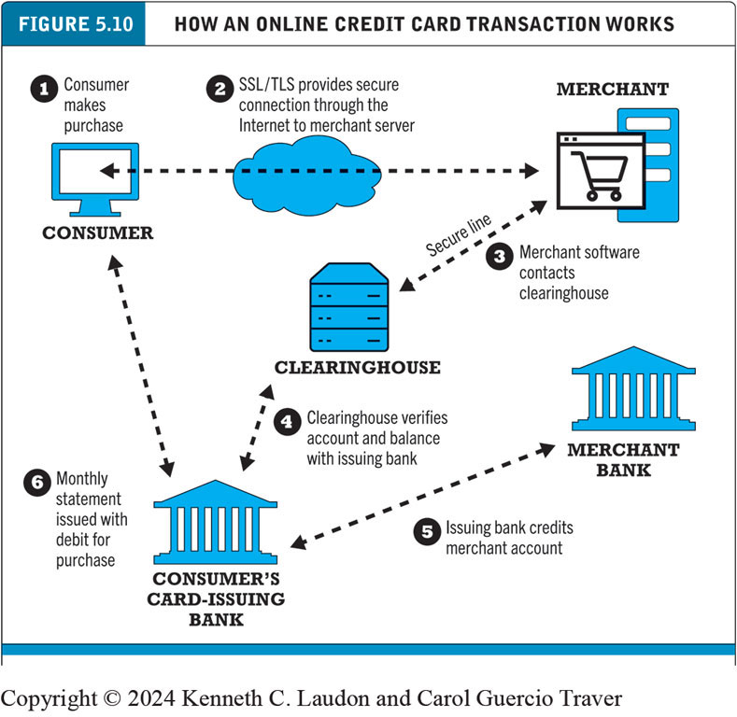
Figure 5.10 How an Online Credit Card Transaction Works
Notes:
Figure 5.10, Page 290.
Alt Text
Long description: The illustration depicts six steps: 1, a consumer makes a purchase. 2, S S L or T L S provides secure connection through the internet to the merchant server. 3, merchant software contacts the clearinghouse over a secure line. 4, the clearinghouse verifies account and balance with issuing bank. 5, the issuing bank credits merchant account. 6, a monthly statement is issued with debit for purchase.

Slide 26
Alternative Online Payment Systems
Online stored value systems:permits consumers to make instant, online payments to merchants and other individuals based on the value stored in an online account. Example: PayPal
Other alternatives
Amazon Pay
Meta Pay
Visa Checkout, Mastercard’s MasterPass
Buy Now Pay Later (BNPL) services
Examples: Klarna, Afterpay

Slide 27
Mobile Payment Systems
Mobile payment systems are one of the fastest-growing types of alternative payments.
Use of mobile phones as payment devices
Established in Europe and Asia
Expanding in United States
Mobile payments involve any type of payment using a mobile device, including bill payment, online purchases, in-store purchases, and P2P payments. Mobile wallets (sometimes also referred to as digital wallets) are smartphone apps that store debit cards, reward coupons, invoices, vouchers, and other means of payment that might be found in a traditional wallet.

Slide 28
Blockchain
Blockchain
Enables organizations to create and verify transactions nearly instantaneously using a distributed P2P database (distributed ledger)
Benefits
Reduces costs of verifying users, validating transactions, and risks of storing and processing transaction information
Transactions cannot be altered retroactively and therefore are more secure
Foundation technology for cryptocurrencies and supply chain management, as well as potential applications in financial services and healthcare industries

Slide 29
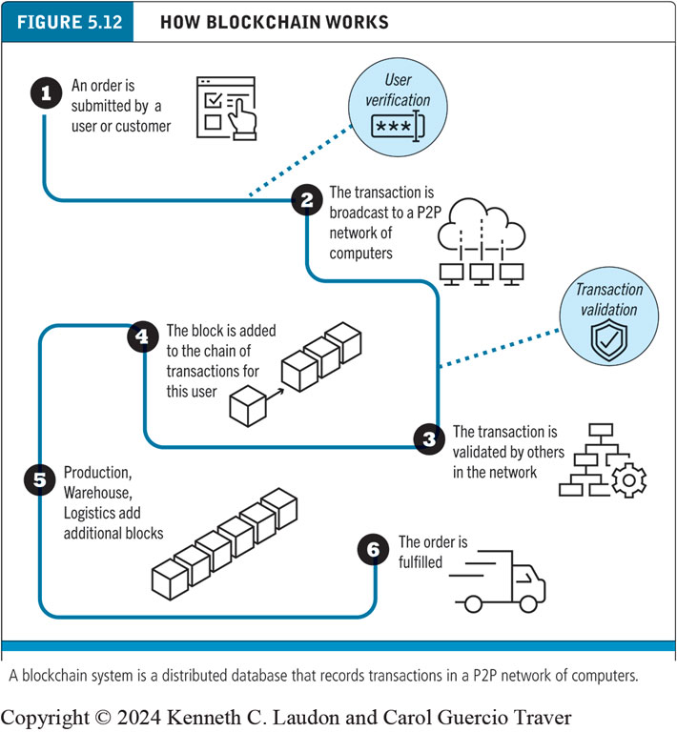
Figure 5.12 How Blockchain Works
Notes:
Figure 5.15, Page 318.
A blockchain system is a distributed database that records transactions in a P2P network of computers.
Alt Text
Long description: The illustration has six steps, as follows. Step 1, an order is submitted by a user or customer. 2, the transaction is broadcast to a P 2 P network of computers. 3, the transaction is validated by others in the network. 4, the block is added to the chain of transactions for this user. 5, production, warehouse, logistics add additional blocks. 6, the order is fulfilled.

Slide 30
Cryptocurrencies
Use blockchain technology and cryptography to create a purely digital medium of exchange
Bitcoin the most prominent example
Value of Bitcoins have widely fluctuated
Major issues with theft and fraud
Some governments have banned Bitcoin, although it is gaining acceptance in the U.S.
Other cryptocurrencies (altcoins) include Ethereum/Ether, Ripple, and Litecoin
Stablecoins are pegged to value of an external asset
Example: Tether

Slide 31
Careers in E-commerce
Position: Cybersecurity Threat Management Team Trainee
Qualification/Skills
Preparing for the Interview
Possible Interview Questions

Slide 32
Copyright
This work is protected by United States copyright laws and is provided solely for the use of instructors in teaching their courses and assessing student learning. Dissemination or sale of any part of this work (including on the World Wide Web) will destroy the integrity of the work and is not permitted. The work and materials from it should never be made available to students except by instructors using the accompanying text in their classes. All recipients of this work are expected to abide by these restrictions and to honor the intended pedagogical purposes and the needs of other instructors who rely on these materials.

