Slide 1
Pricing Concepts

Slide 2
Objectives
Discuss the legal constraints/limits on pricing.
Identify the four major categories of pricing objectives.
Explain price elasticity and its determinants (a thing that controls or influences what happens).
Describe the three practical (technical) problems involved in applying price theory concepts to actual pricing decisions.

Slide 3
Objectives
Explain the two major cost-plus approaches to price setting/fixing.
Discuss the three shortcomings/weaknesses of using breakeven analysis in pricing decisions.
Explain the use of yield/revenue management in pricing decisions.
Identify the five major pricing challenges facing online and international marketers.

Slide 4
Introduction
Price – Exchange/conversion value of a good or service
A higher-than-average price can convey an image of prestige
A lower-than-average price may connote/mean good value

Slide 5
Pricing and the Law
Federal, state, and local laws all influence pricing decisions
Countries impose/put tariffs to protect domestic suppliers

Slide 6
Pricing and the Law
Government regulation/law also imposes costs that affect prices
Some companies use regulatory cost recovery (Regulatory cost recovery charge is a charge associated with payment of government-imposed fees and to recover the costs of compliance with government imposed regulatory requirements -tax) as a source of additional revenue.

Slide 7
Robinson-Patman Act
Federal legislation prohibiting price discrimination (a seller charges customers a different fee for the same product or service) that is not based on a cost differential/difference.
Prohibits selling at an unreasonably low price to eliminate competition
Inspired by price competition triggered/ initiated by the rise of grocery store chains

Slide 8
Robinson-Patman Act
Price discrimination - Some consumers pay more than others for the same product
A defense based on cost differentials works only:
If the price differences do not exceed the cost differences resulting from selling to various classes of buyers e.g. marketing expenditures, overheads.

Slide 9
Unfair-Trade Laws
State laws requiring sellers to maintain minimum prices for comparable merchandise
Intended to protect small specialty stores from loss-leader tactics

Slide 10
Fair-Trade Laws
Statutes enacted/legislated in most states that once permitted manufacturers to stipulate/define a minimum retail price for their product
Assumes a product’s price is part of its image, which the manufacturer owns
These laws became invalid with the passage of the Consumer Goods Pricing Act (1975)

Slide 11
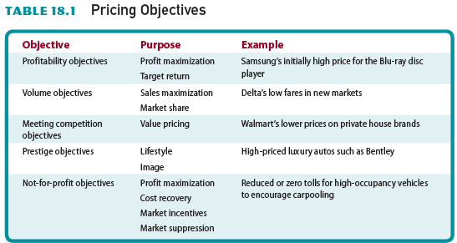
Table 18.1 - Pricing Objectives

Slide 12
Profitability Objectives
Basic formulas for profit and revenue:

Slide 13
Profitability Objectives
Marginal analysis - Method of analyzing the relationship among costs, sales price, and increased sales volume
Profit maximization - Point at which the additional revenue gained/obtained by increasing the price of a product equals the increase in total costs

Slide 14
Profitability Objectives
Target-return objectives - Short-run or long-run pricing objectives of achieving a specified return on either sales or investment i.e. return on investment

Slide 15
Volume Objectives
Belief that increased sales volume is more important in the long run than immediate/ quick profits
Can maximize sales through pricing and nonprice factors such as service and quality
Market-share objective - The goal of controlling a portion/percentage of the market for a firm’s product

Slide 16
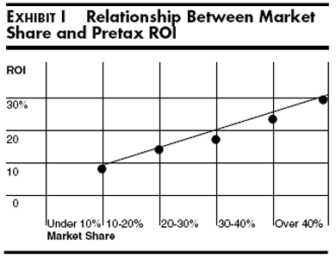
The PIMS Studies
Profit Impact of Market Studies (PIMS) project - Discovered a strong positive relationship/ correlation* between a firm’s market share and product quality and its return on investment. Some market studies reveal an average 32 percent return on investment for firms with market shares above 40 percent (https://hbr.org/1975/01/market-share-a-key-to-profitability, Accessed:
12/26/2020)
*Correlation is a statistical measure that expresses the extent to which two variables are linearly related (meaning they change together at a constant rate). It's a common tool for describing simple relationships without making a statement about cause and effect.

Slide 17
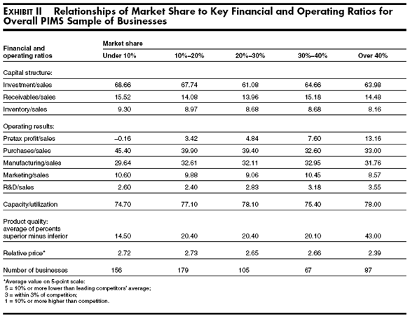

Slide 18
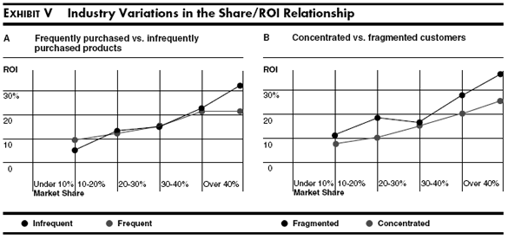

Slide 19
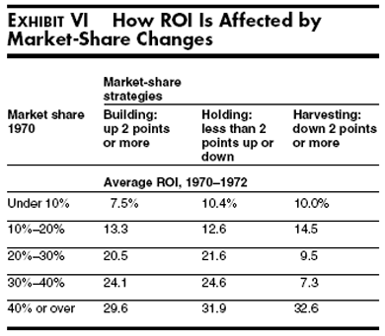

Slide 20
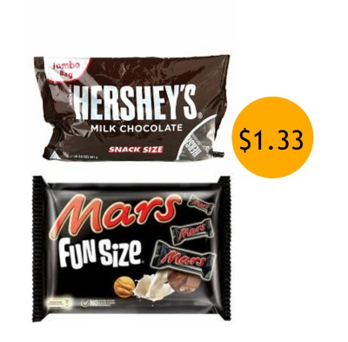
Meeting Competition Objectives
Firms sometimes set prices to match established/ unchanging (successful for a long period of time and widely known) industry price leaders (Sana-Unilever, Selpak-Eczacıbaşı, Mars-Hershey/US)
Shifts marketing mix to focus on nonprice variables.

Slide 21
Value Pricing
Emphasizes benefits derived/obtained from a product in comparison to the price and quality levels of competing offerings
Works best for relatively low-priced goods and services
Challenge is convincing/persuading customers that low-priced brands offer quality comparable to that of a higher-priced product

Slide 22
Prestige Objectives
Develop and maintain an image of quality and exclusiveness that appeals to status-conscious consumers
Example: Tag Heuer watches

Slide 23
Pricing Objectives of Not-for-Profit Organizations
Pricing strategy helps them achieve specific goals
Profit maximization
Cost recovery/just to cover the costs
Market incentives/boost
Market suppression/discouraging potential competitiors to enter the market

Slide 24
Methods for Determining/Setting Prices
Prices are traditionally determined in two basic ways:
Supply and demand
Cost-oriented analyses
Customary prices - Traditional prices that customers expect to pay for certain goods and services (The price is based on the value placed on the product and/or service by the buyer. Historically, customary pricing is used for these –Â–products with a relatively long market history of being sold for a particular amount).

Slide 25
Price Determination in Economic Theory
Demand - The amounts of a firm’s product that consumers will purchase at different prices during a specified time period
Supply - The amounts of a good or service that will be offered for sale at different prices during a specified period
Pure competition - Market structure with so many buyers and sellers that no single participant can significantly influence price

Slide 26
Price Determination in Economic Theory
Monopolistic competition – Diverse/various parties exchange heterogeneous, relatively well-differentiated products, giving marketers some control over prices
Oligopoly - Relatively few sellers; each has large influence on price
Monopoly - Only one seller of a product exists and for which there are no close substitutes/ replacements.

Slide 27
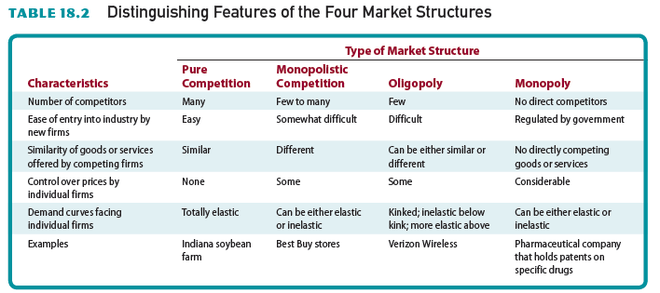
Table 18.2 - Distinguishing Features of the Four Market Structures

Slide 28
Cost and Revenue Curves
A product’s total cost is composed of total variable costs and total fixed costs
Variable costs - Change with the level of production
Raw materials and labor costs
Fixed costs - Remain stable at any production level within a certain range
Lease payments or insurance costs

Slide 29
Cost and Revenue Curves
Average total costs - Costs calculated by dividing the sum of the variable and fixed costs by the number of units produced
Marginal cost - Change in total cost that results from producing an additional unit of output

Slide 30
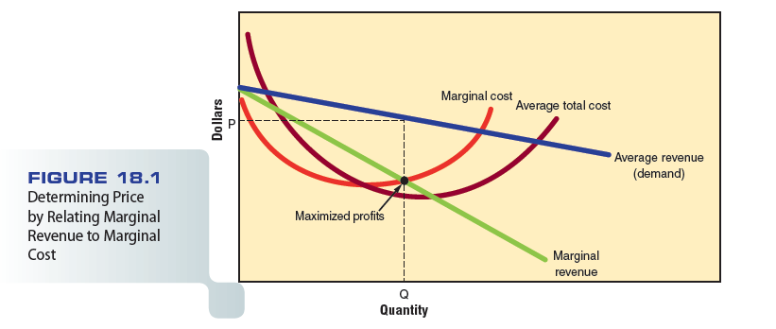
Figure 18.1 - Determining Price by Relating Marginal Revenue to Marginal Cost

Slide 31
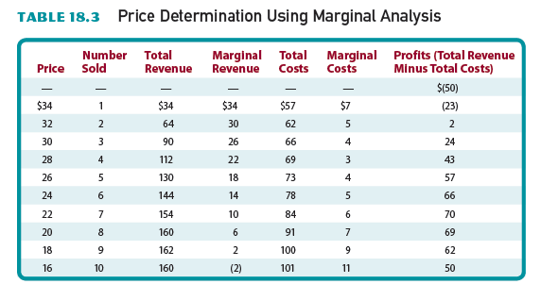
Table 18.3 - Price Determination Using Marginal Analysis

Slide 32
The Concept of Elasticity in Pricing Strategy
Elasticity - Measure of responsiveness/ sensitiveness of purchasers and suppliers to a change in price
Elasticity of demand
Elasticity of supply
Inelastic/inflexible

Slide 33
Determinants of Elasticity
Availability of substitutes or complements
Role as a complement/supplement to another product
Number of business transactions conducted online
Whether product is perceived as a necessity/ requirement or luxury

Slide 34
Determinants of Elasticity
Portion/percentage of a person’s budget spent on an item
Demand shows less elasticity in the short run than in the long run

Slide 35
Elasticity and Revenue
Elasticity has a strong influence/effect on revenue
Price cuts will increase revenues for products with elastic demand
Price increases will increase revenue for products with inelastic demand

Slide 36
Practical Problems of Price Theory
Many firms do not attempt to maximize profits
Demand curves are difficult to estimate

Slide 37
Price Determination in Practice
Cost-plus pricing - Uses a base-cost figure per unit and adds a markup (%) to cover unassigned/unallocated costs and to provide a profit
Allows businesses with low costs to set prices lower than those of competitors’ and still make a profit

Slide 38
Alternative Pricing Procedures
Full-cost pricing
Uses all relevant variable costs in setting a product’s price
Allocates the fixed costs not directly attributed to the production of the priced item
No consideration of competition or demand for the item
Any method for allocating/distributing overhead is arbitrary/discretional and may be unrealistic

Slide 39
Alternative Pricing Procedures
Incremental/gradual-cost pricing - Attempts to use only costs directly attributable/ assignable to a specific output in setting prices

Slide 40
Alternative Pricing Procedures
If firm is contracted for an additional 5,000 units, the lowest possible price would be $9/unit under full-cost pricing
Under incremental-cost pricing, prices above $5/unit are permitted:

Slide 41
Breakeven Analysis
Pricing technique used to determine the number of products that must be sold at a specified price to generate enough revenue to cover total cost

Slide 42
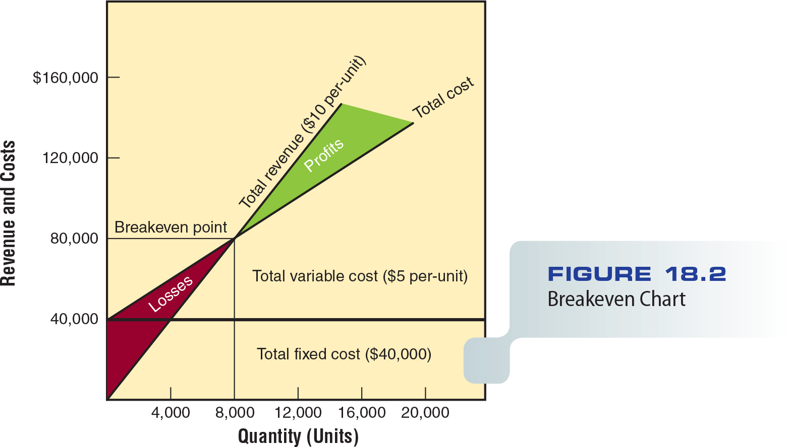
Figure 18.2 - Breakeven Chart

Slide 43
Target Returns
Most managers include a targeted profit in their analyses:

Slide 44
Evaluation of Breakeven Analysis
Easily understood by marketers and nonmarketers
Assumes that costs can be divided into fixed and variable categories
Assumes that per-unit variable costs do not change at different levels of operation
Cost-based model that does not consider demand

Slide 45
The Modified/Improved Breakeven Concept
Modifications that account for demand are necessary for effective pricing
Demand considerations include:
Degree of price elasticity
Consumer price expectations
Existence and size of specific market segments
Buyer perceptions of strengths and weaknesses of substitute products

Slide 46
The Modified Breakeven Concept
Modified breakeven analysis - Pricing technique used to evaluate consumer demand by:
Comparing the number of products that must be sold at a variety of prices to cover total cost with estimates of expected sales at the various prices

Slide 47
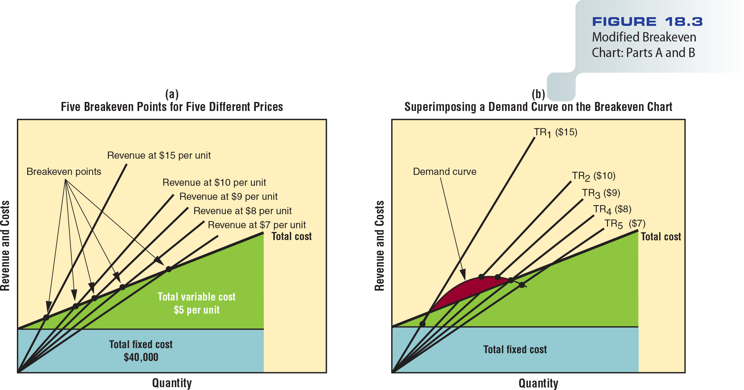
Figure 18.3 - Modified Breakeven Chart: Parts A and B

Slide 48
Table 18.4 - Revenue and Cost Data for Modified Breakeven Analysis

Slide 49
Yield/Return/Revenue/Profit Management
Pricing strategy that allows marketers to vary prices based on such factors as demand, even though the cost of providing those goods or services remains the same

Slide 50
Global Issues in Price Determination
Prices must support the company’s broader/ extensive goals
Domestic pricing strategies:
Profitability
Volume
Meeting competition
Prestige
Price stability/maintaining the current price

Slide 51
Ski Butternut Video
http://www.cengage.com/marketing/book_content/boone_9781133628460/videos/ch18.html

