Slide 1

Translation Technologies in General
Week 2: AET-233 Computer-Aided Translation
Lect. Dr. Fatma TOKÖZ

Slide 2
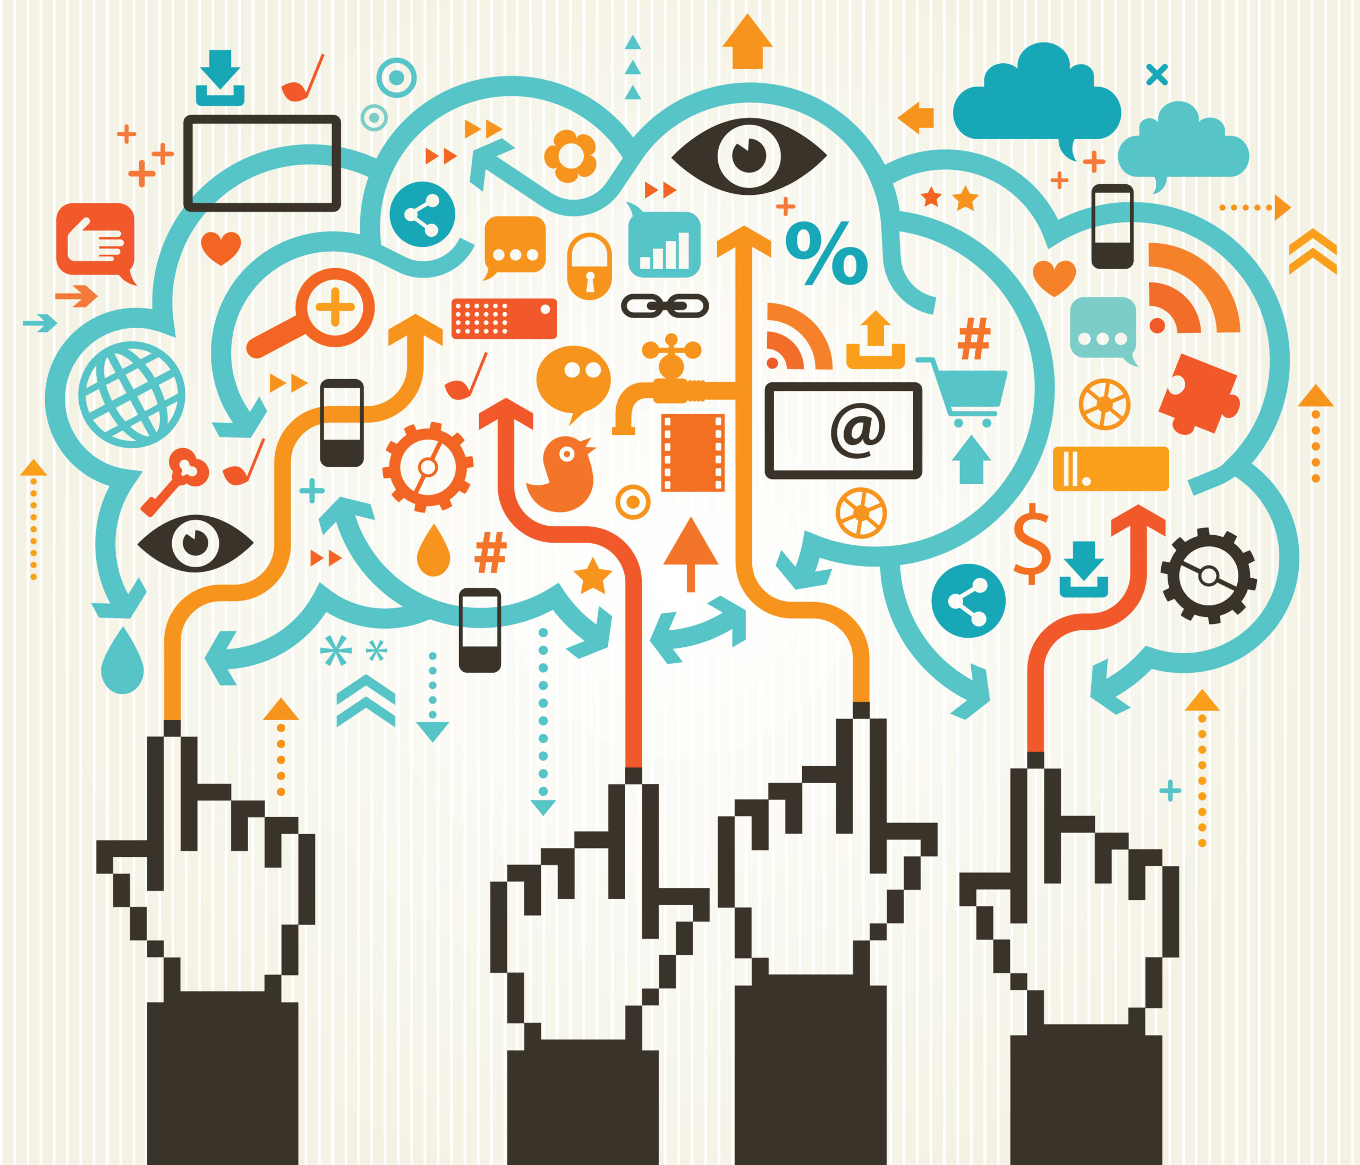
The Evolution of Translation Technology
Translation technology has been around for more than 50 years, but as our world has become increasingly interconnected, it’s only grown more essential.
The advancing technology requires translators to be equipped with more than mere knowledge of languages, cultures and textual competence.
When yesterday is too late, delivering top-quality translations to the client as soon as possible is an absolute must.

Slide 3
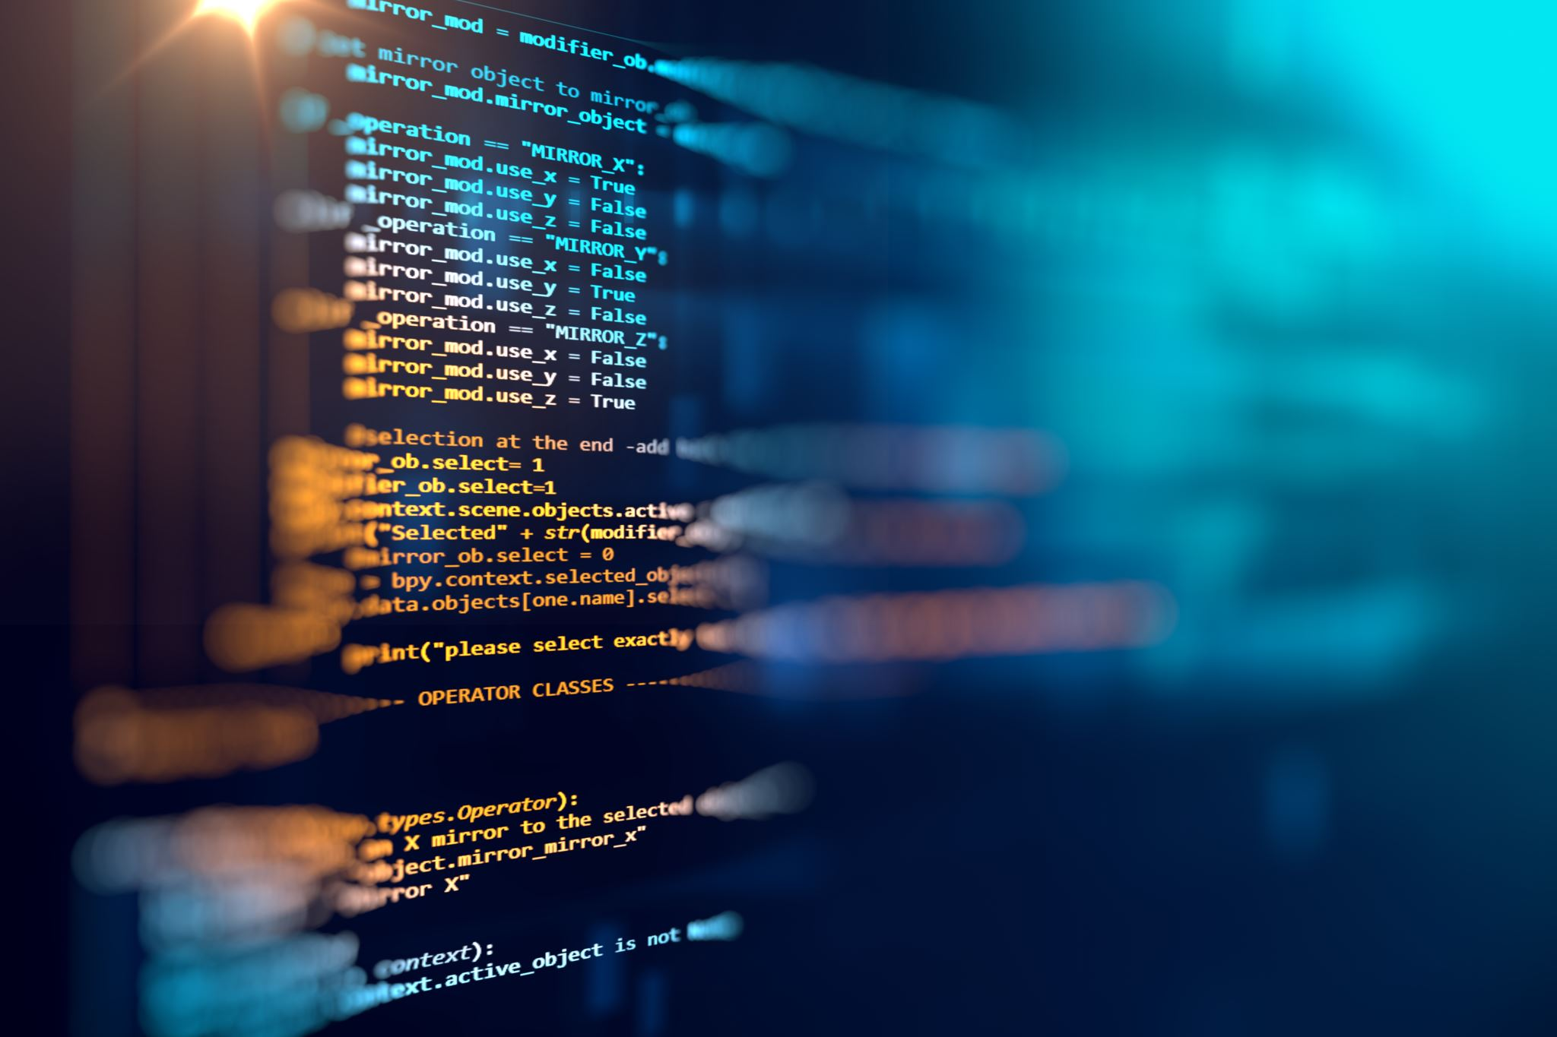
What is translation technology?
Translation technology is the use of software tools that support the process of converting written text from one language to another.
Translation technology tools can increase productivity, accuracy, and overall effectiveness.
The term “translation technology” encompasses everything from translation memories and terminology management tools to machine translation (MT) and virtual interpreting technology.

Slide 4

Before the emergence of translation technology
Translation was done manually, translators consulting paper dictionaries and using their best judgment.
Some proposed problems:
Delayed time
Loss of consistency across content
High costs of inefficient operations
Lower output quality resulting from having to manually check for errors

Slide 5

The emergence of translation technology changed it all…

Slide 6
How does translation technology help?
Ensure quality by checking for spelling and grammar errors
Increase consistency across content by storing previous translations that can be reused or consulted in future projects
Improve operational efficiency by automating translation management tasks
Accelerate time-to-market by enabling the production of more content in less time

Slide 7
The main types of translation technology
Computer-assisted translation (CAT) tools
Machine translation (MT)
Content Management System (CMS)
Translation management systems (TMS)

Slide 8
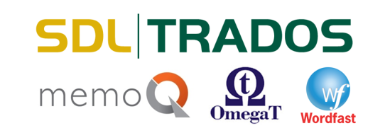
Computer-assisted translation (CAT) tools
CAT tools are software applications created to support translators in their daily work.
They use databases of previous translations (usually from a specific source language and target language) as well as frequency information, segmentation data to aid the translation process.
CAT tool interface usually displays two columns or panels: One shows the source text, and the other displays the target text.
For instance, Memsource, Wordfast, etc.

Slide 9
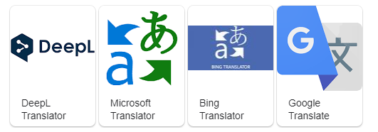
Machine translation (MT)
Machine translation is the process of using artificial intelligence (AI) to automatically translate content from one language (the source) to another (the target) without any human intervention.
Machine translation differs from CAT tools in that it doesn’t rely on human input but produces translations entirely on its own.
Generic MT engines: Google Translate, Microsoft Translator, DeepL

Slide 10
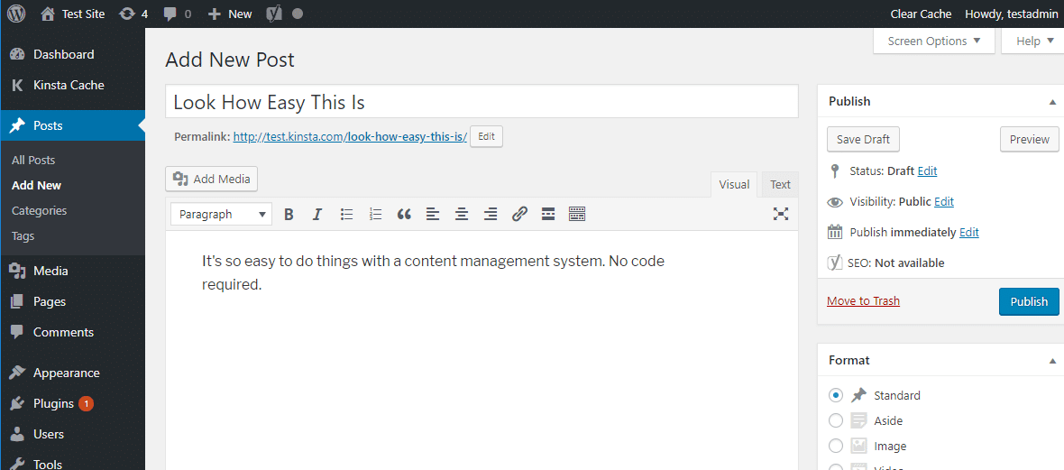
Content Management System (CMS)
CMS is software that helps users create, manage, and modify content on a website without the need for specialized technical knowledge.
In simpler language, a content management system is a tool that helps you build a website without needing to write all the code from scratch.
WordPress is a good example of a content management system.

Slide 11
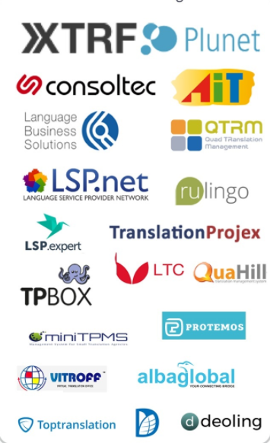
Translation management systems (TMS)
A TMS is a software platform designed for translation project management at scale.
It restructures the translation process from start to finish, creating a workflow from the initial request to project completion, and allowing users to plan, assign, and manage translation projects in an organized manner.
For example, XTFR

Slide 12
The Future of Translation Technology
Translation technology will grow stronger as artificial intelligence (AI) continues to advance.
The future of translation will combine human intelligence and AI-powered machine translation to produce the best results.
It’s not the question of whether or not to use translation technology; the next question is: Which one?

Slide 13


