Slide 1

CAG UNIVERSITY
2018 – 2019 FALL SEMESTER
MAN 429
HEALTH CARE MANAGEMENT

Slide 2
Chapter 2 Leadership
Learning Objectives
Distinguish between leadership and management
Summarize the history of leadership in the US from the 1920s
Compare and contrast leadership styles
Summarize old and new governance trends
Analyze key barriers and challenges to succesful leadership
Provide a rationale for why health care leaders have greater need for ethical behavior

Slide 3
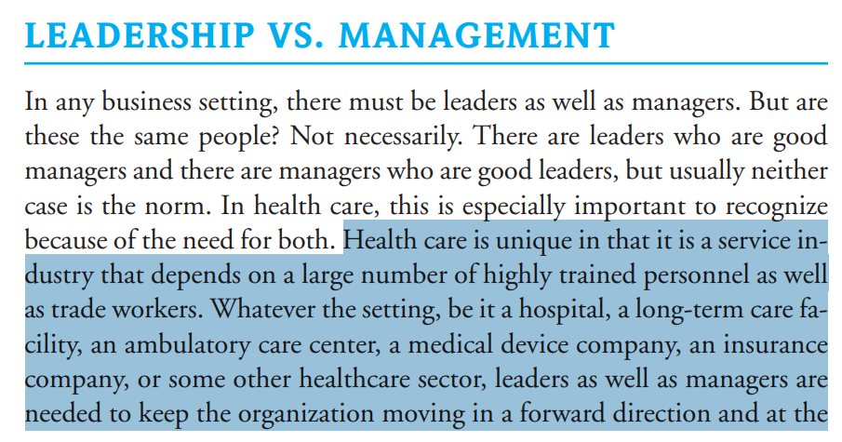

Slide 4
Leaders usually take a focus that is more external, whereas the focus of managers is more internal.
Strategic leader, who defines purpose and vision and aligns people, processes, and values, may be needed.
Network leader, who could connect people across disciplines, organizational departments, and regions, may be essential.
These managers can certainly be leaders in their own areas, but their focus will be more internal within the organization’s operations. They are operational leaders of the organizations.

Slide 5
Leaders need to set a vision or direction for the organization.
They need to be able to motivate their employees, as well as other stakeholders, so the business continues to exist and, hopefully, thrive in periods of change.
Leaders are needed to keep the entity on course and to maneuver around obstacles, like a captain commanding his ship at sea.

Slide 6
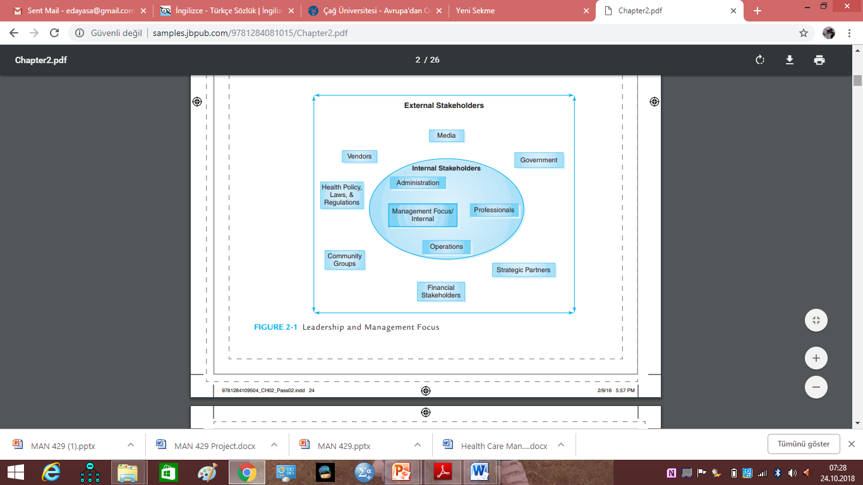

Slide 7
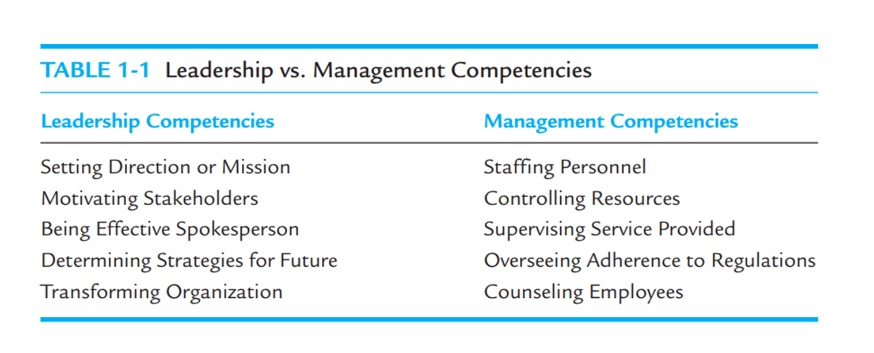

Slide 8
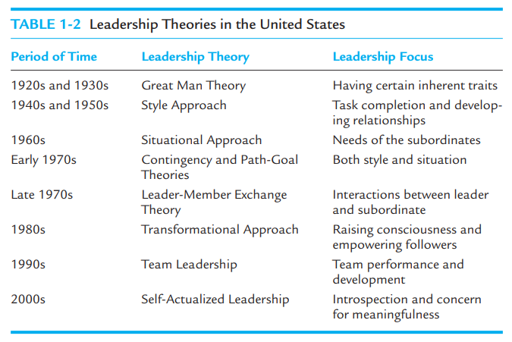

Slide 9
Today’s astute health care leaders recognize the importance of considering the global environment, as health care wrestles with international issues that impacts us locally, such as outsourcing services, medical tourism, and over the-the-border drug purchases, giving rise to the global leader.

Slide 10
Homework
Check the background of Turkish healthcare facilities, up to now.

Slide 11
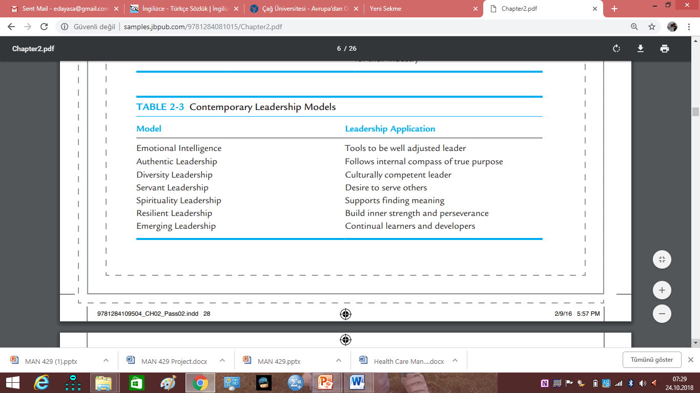

Slide 12
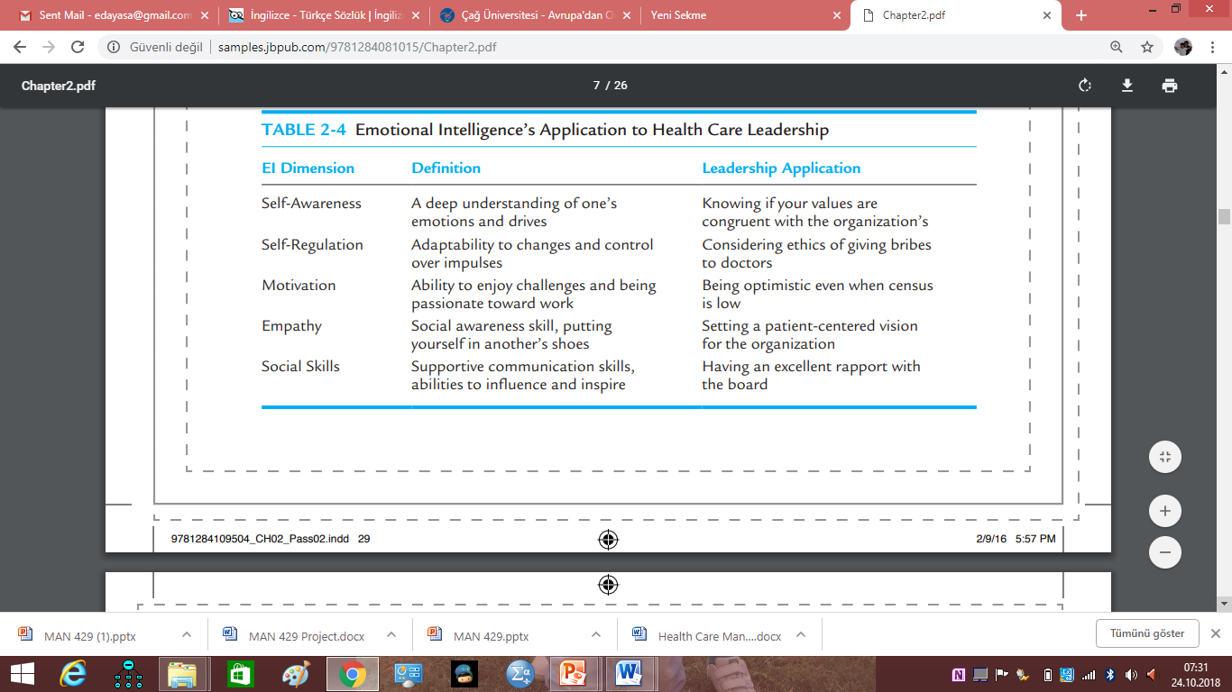

Slide 13
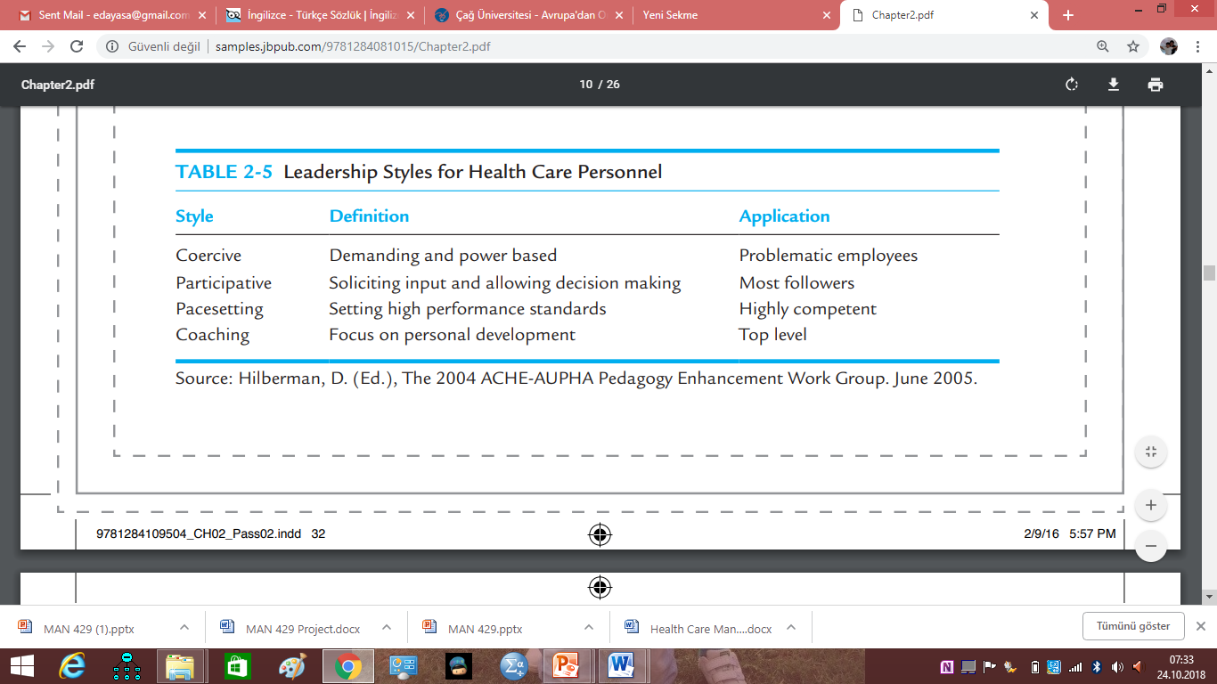

Slide 14
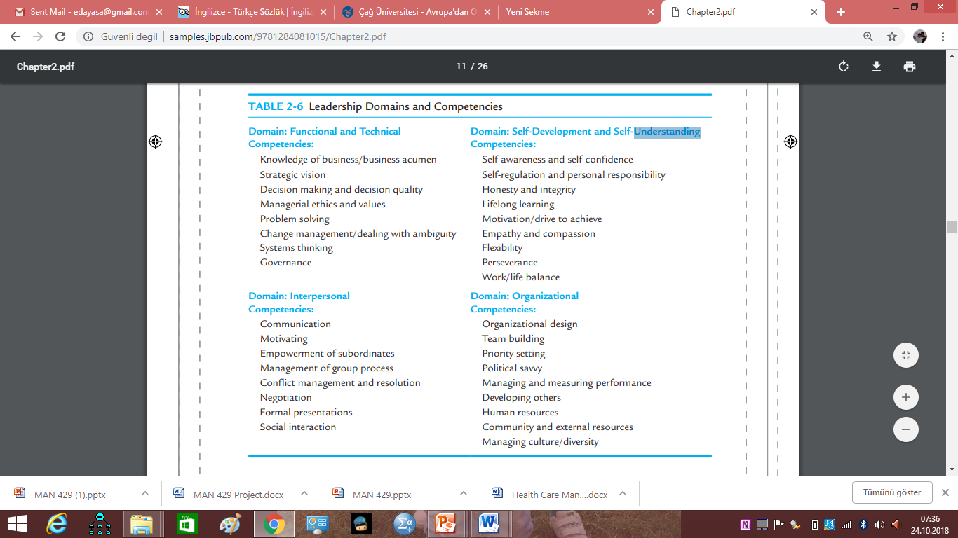

Slide 15
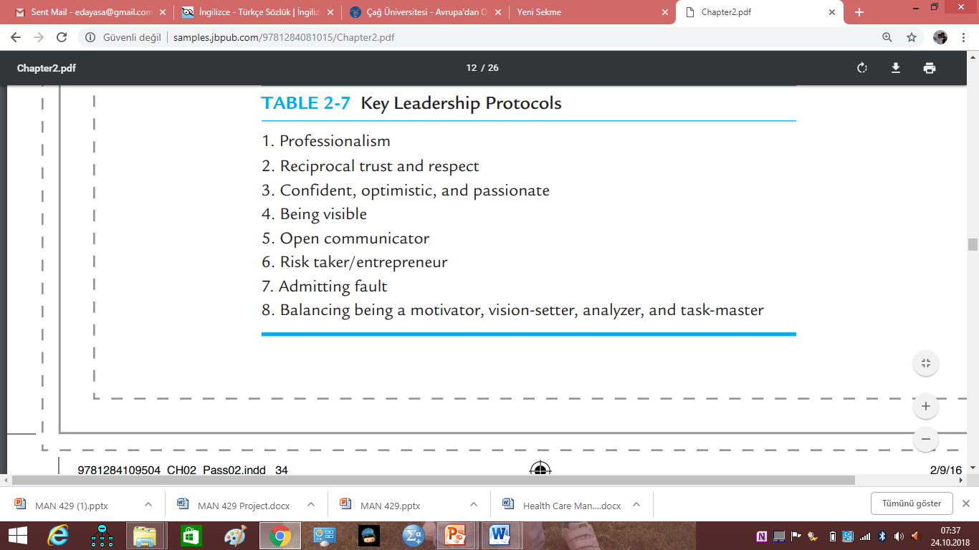

Slide 16
