Slide 1
Chapter Nineteen
Fintech Companies
©McGraw Hill LLC. All rights reserved. No reproduction or distribution without the prior written consent of McGraw Hill.

Slide 2
Introduction
In recent years, the financial sector has seen fast-growing adoption of financial technology, or fintech
  Global venture capital (VC)-backed fintech funding has increased from $21.8 billion (2015) to $139.8 billion (2021) and $75.2 billion (2022)
Banks are also increasing their investments in fintech

Slide 3
Global Fintech Venture Capital Investments
Notes:
According to the 2022 report by CB Insights, global venture capital (VC)–backed fintech funding has increased from $21.8 billion in 2015 to $139.8 billion in 2021 and $75.2 billion in 2022 (Figure 19–1).

Slide 4
Defining Fintech
Financial Stability Board (FSB) defines fintech as, “technology-enabled innovation in financial services that could result in new business models, applications, processes or products with an associated material effect on the provision of financial services”
Term fintech is used to describe firms whose business model focuses on these innovations. Due to this recent wave of innovations, risks of digital disruption stemming from increased competition is rising.

Slide 5
Evolution of Fintech Innovations
1865 – Pantelegraph, an early form of fax machine, was invented
1866 – First trans-Atlantic telegraph cable was laid
1918 – Fedwire was established
1933 – German Reich mail service held trail run of world’s first telex network
1958 – Western Union started to build a telex network in the U.S.
1960 – Quotron Systems introduced the Quotron, the first electronic system to provide stock quotes in real time to stockbrokers and money managers
1966 – Telex network replaced the telegraph as the standard for long-distance instantaneous communication of information
Late 1960s and 1970s saw rapid advances in electronic payment systems
1971 – NASDAQ was established
1980s saw rise of electronic trading, bank mainframe computers, and more sophisticated data and record-keeping systems
In the 1990s, the Internet and e-commerce business models flourished
Early 2000s saw stock market decimalization, algorithmic trading, and HFT
Notes:
Technological innovations have long been essential part of the financial services industry.

Slide 6
Number of Commercial Bank Branches in the U.S.
Notes:
While developments of these technologies became mainstream and widely used by FIs and their customers, the financial services sector was not threatened by these technological innovations. On the contrary, FIs grew.
In looking at the FDIC data, the number of bank branches in the United States grew steadily from approximately 4,200 in 1948 to over 85,000 in 2009. After staying at that level until 2012, the number of bank branches started falling from 2013, the trend that seems to continue today (Figure 19–2).

Slide 7
Supply and Demand Factors that Explain the Evolution of Fintech
Supply factors
  2008 global financial crisis, which left brand image severely shaken and resulted in banks pulling back from some lending activities
  Macroeconomic conditions, particularly the low interest rate environment
    Low interest rate environment put downward pressure on profits and increased the incentives of FIs to cut costs
Demand factors
  Increasing prevalence of mobile technology
    Global smartphone penetration rate reached 68% in 2022
  Demographics
    Millennials became the largest generation in the labor force in 2016, representing 35% of labor force participants in the U.S.
Notes:
We now discuss examples of supply and demand factors provided by economists and analysts at the Board of Governors of the Federal Reserve System, as well as UBS, to explain why fintech is evolving into what it is today.

Slide 8
Changing Relationship between Banks and Fintechs
Fintechs have several advantages relative to banks, including being unburdened by regulators, legacy IT systems, branch networks, not having the need to protect existing businesses, possessing an innovation mindset, agility, and a consumer-centric perspective
While some were initially concerned about the demise of banks, retail banks still hold (and will retain) huge advantage
  Three “big Cs” of customers, compliance, and capital
Most fintech CEOs expect increasing fintech-bank partnership in the future
  Demonstrates that fintechs and banks can have mutually beneficial partnerships in which the fintechs can leverage on the banks’ reputation and the banks can leverage on the fintech companies’ technology infrastructure
Notes:
Compared to fintechs, big banks have tens of millions of trusting customers who interact with them every day. They have decades of compliance experience and experienced legal teams. Finally, banks have a cost of capital close to zero.

Slide 9
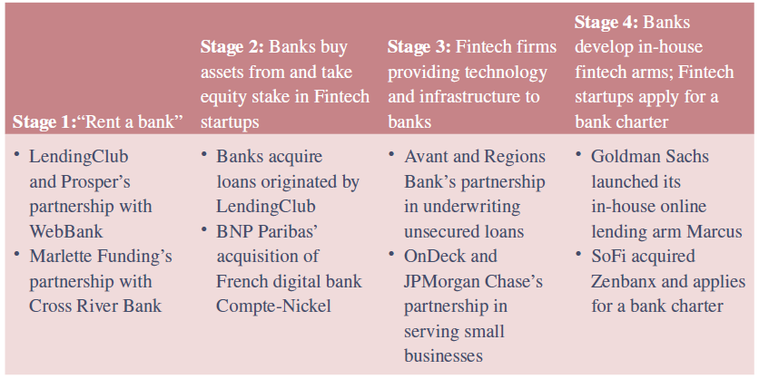
Evolving Relationship between Fintech Startups and Banks
Notes:
A 2017 report by AMTD Asset Management described the evolving relationship between incumbent banks and fintech firms in four stages (Figure 19–4) as most fintech CEOs expect increasing fintech-bank partnership going forward.

Slide 10
Banking-as-a-Service (BaaS)
BaaS is an end-to-end process that allows fintechs and other third parties to connect with banks’ systems directly via application programming interfaces (APIs) so that they can build banking offerings on top of the banks’ infrastructure to reach users outside of the banks’ existing footprint
  Two main monetization strategies for BaaS include charging clients a monthly fee for access to the BaaS platform or charging a la carte for each service used
Open banking is a system that provides a user with a network of FI’s data using APIs. By opening APIs to sharing, third parties have easier access to financial information for existing bank customers, which allows them to build new apps and services
Notes:
While open banking and BaaS are made of the same elements, the main difference between the two centers are how APIs are used. Open banking uses APIs to access financial data, whereas BaaS uses APIs to access banking functionality.

Slide 11
How Big Tech is Transforming Fintech
Technology heavyweights such as Google, Apple, Amazon, and Facebook have invested heavily in fintech —in the form of both internal projects and external partners
  $2.9 billion in 2018, $2.3 billion in 2019, $2.2 billion in 2020, $2.1 billion in 2021, and $1.2 billion in the first nine months of 2022
By combining the digital agility of startups with the customer base and scale of traditional banks, big tech poses a growing risk to the traditional banking model

Slide 12
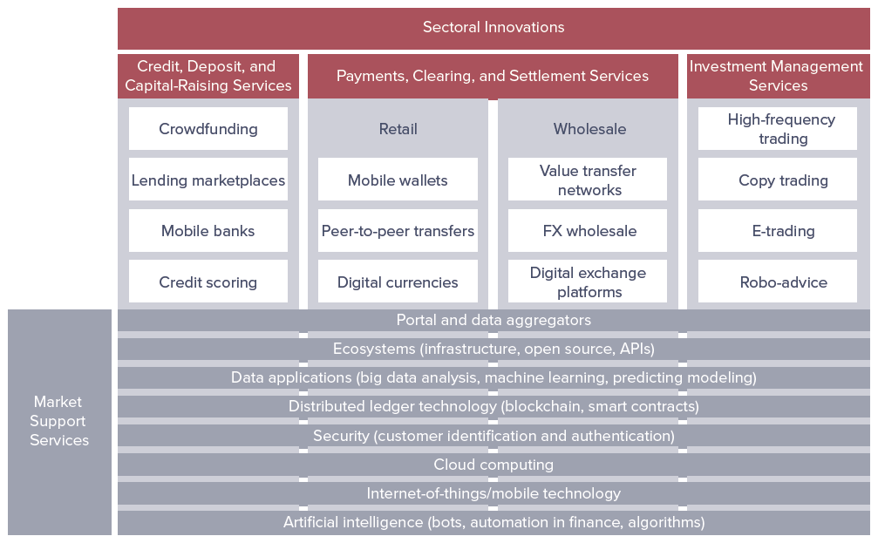
Types of Fintech Innovations
Notes:
The Basel Committee on Banking Supervision (BCBS) categorizes fintech innovations into three product sectors, as well as market support services (Figure 19–5). The three sectors relate directly to core banking services, while the market support services relate to innovations and new technologies that are not specific to the financial sector but also play a significant role in fintech developments.

Slide 13
Recent Developments in Payments, Clearing, and Settlement Services
Mobile Wallets are apps on the mobile service that store payment information from a credit or debit card (e.g., Apply Pay, Samsung Pay, and Google Pay)
Peer-to-Peer (P2P) Payments allow customers to use a bank account or a credit/debt card to pay friends and family from their mobile phones (e.g., PayPal, Venmo, and Square Cash)
Digital Currencies combine new payments system with new currencies that are not issued by a central bank (e.g., Bitcoin (BTC), Litecoin (LTC), Ether (ETH), and XRP (XRP))
  Cryptocurrency is a digital currency in which encryption techniques are used to regulate the generation of units of currency and verify the transfer of funds, operating independently of a central bank
  Central bank digital currencies (CBDCs) offer in digital form the unique advantages of central bank money but would be a liability of the Federal Reserve, not of a commercial bank
Notes:
The payments landscape has been transformed by the application of technology both behind the scenes (clearing and settlement) and at the point of sale (POS).

Slide 14
Recent Developments in Payments, Clearing, and Settlement Services (Continued)
Value Transfer Networks
  Corporate customers’ need for modernization in payments is just as strong, and increasing numbers of fintech providers of all sizes and types are turning their attention to wholesale payments innovation
  E.g., Cambridge Global Payments and Transpay
Business-to-Business (B2B) Payments
  E.g., Acquisition of Fraedom by Visa and partnership between Square and Handshake
Foreign Exchange (FX) Wholesale
  E.g., Qonto partnership with Kantox
  With the development of its Dynamic Hedging platform, FX management fintech Kantox not only enables its B2B clients to eliminate the risk of market volatility, it can also integrate and automate the entire process into its existing operational software

Slide 15
Recent Developments in Payments, Clearing, and Settlement Services (Concluded)
Digital Exchange Platforms
  Crypto exchanges are creating systems to ensure the blockchain ecosystem remains stable by serving as a bridge between the traditional business world and the new digital cryptocurrency world
  “Bridge” requires incorporation of fiat currencies, such as the HKD (Hong Kong Dollar), into these digital exchange platforms
  First thing individuals need to do if they are looking to invest more money in crypto is convert their fiat currency to crypto
    E.g., U.S. investors would deposit U.S. dollars (USD) with an exchange in order to get BTC or ETH.
    Exchanges that accept fiat currencies are called “fiat gateways”
  Top cryptocurrency exchanges for USD deposits include Coinbase, GDAX, Kraken, CEX.io, BitStamp, Gemini, BitFlyer, and PaxFul
Notes:
Cryptocurrency exchanges are exchanges that allow consumers to buy, sell, and trade cryptocurrencies, whether through fiat currency like dollars, euros, or yen, or another cryptocurrency like Bitcoin or Ether.

Slide 16
Recent Developments in Market Support Services
Distributed Ledger Technology
  Distributed ledger technology (DLT) is a digital system for recording the transaction of assets in which the transactions and their details are recorded in multiple places at the same time
    Unlike traditional databases, distributed ledgers have no central data store or administration functionality
    Digital ledger is a database held and updated independently by each participant (or node) in a large network
    Every single participant (or node) on the network processes every transaction, coming to its own conclusions and then voting on those conclusions to make certain the majority agree with the conclusions
    Once there is consensus, the distributed ledger has been updated, and all nodes maintain their own identical copy of the ledger
  Blockchain is a particular type of a DLT, wherein it bundles transactions into blocks that are chained together and then broadcasts them to the nodes in the network

Slide 17
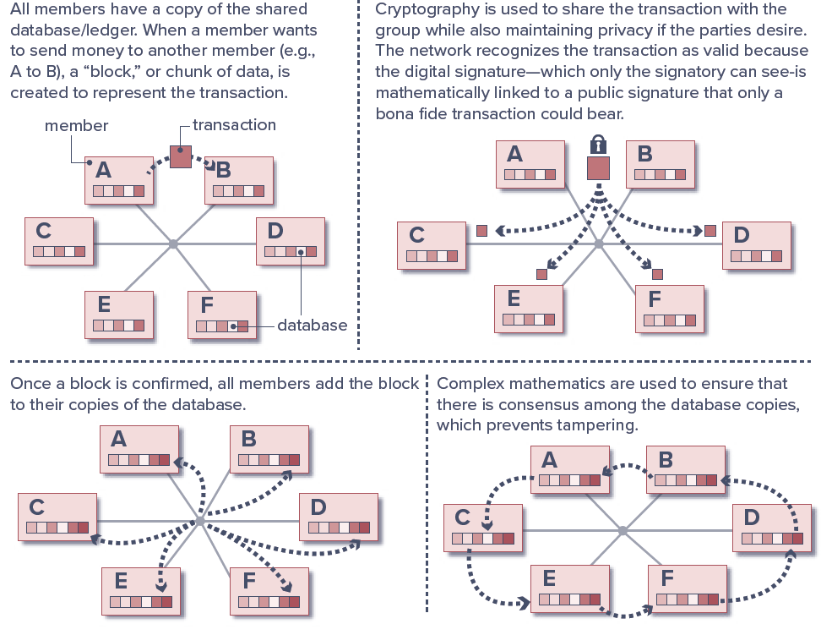
How Blockchain Works
Notes:
Blockchain organizes data into blocks (or batch of transactions) that are chained together in an append-only data structure. New additions to the database are initiated by one of the members (nodes), which creates a new “block” of data, for example, containing several transaction records. This approach can be used to record transactions on any asset which can be represented in a digital form (see Figure 19–7).

Slide 18
Distributed Ledger Technology (DLT)
DLT may radically change how assets are maintained and stored, obligations are discharged, contracts are enforced, and risks are managed
Proponents highlight its ability to transform financial services and markets by:
  Reducing complexity;
  Improving end-to-end processing speed and, thus, availability of assets and funds;
  Decreasing the need for reconciliation across multiple record-keeping infrastructures;
  Increasing transparency and immutability in transaction record keeping;
  Improving network resilience through distributed data management; and
  Reducing operational and financial risks.
DLT may also enhance market transparency if information contained on the ledger is shared broadly with participants, authorities, and others

Slide 19
Distributed Ledger Technology (DLT) (Continued)
Committee on Payments and Market Infrastructures (CPMI) cautions that the use of DLT does not come without risks
  In most cases, risks are the same regardless of whether activities occur on a single central ledger or a synchronized distributed ledger
DLT may pose new or different risks (relative to those presented when using a single central ledger), including:
  Potential uncertainty about operational and security issues arising from the technology;
  Lack of interoperability with existing processes and infrastructures;
  Ambiguity relating to settlement finality;
  Questions regarding the soundness of the legal underpinning for DLT implementations;
  Absence of an effective and robust governance framework; and
  Issues related to data integrity, immutability, and privacy.

Slide 20
Smart Contracts
Smart contracts are applications made possible by blockchains; they are self-executing contracts or applications that run exactly as programmed without any possibility of downtime, censorship, fraud, or third-party interference
  Terms of agreement between buyer and seller are directly written into lines of code
  Trust between the parties is not an issue because the transaction is witnessed and verified by hundreds of people; therefore, there is no need for an intermediary
Ethereum is the biggest, most widely used, and most developed smart contract platform in the world
  Launched in 2014 by Vitalik Buterin

Slide 21
Decentralized Finance (DeFi)
DeFi is an umbrella term encompassing the vision of a financial system that functions without any intermediaries, such as banks, insurance companies, or clearinghouses, and is operated just by the power of smart contracts
  DeFi is a niche market with relatively low volumes—however, these numbers are growing rapidly

Slide 22
Recent Developments in Market Support Services (Continued)
Artificial Intelligence (AI) and Machine Learning
  Artificial intelligence is the application of computational tools to address tasks traditionally requiring human sophistication
  Machine learning is a subcategory of AI, defined as a method of designing a sequence of actions to solve a problem (i.e., algorithms) which optimize automatically through experience and with limited or no human intervention
    Machine learning algorithms are used to identify patterns that are correlated with other events of patterns
Internet-of-Things (IOT) encompasses everything connected to the Internet, but the term is increasingly being used to define objects that “talk” to each other
  Made up of connected devices from simple sensors to smartphones and wearables (e.g., bank apps for Apple Watch and Barclay’s bPay wearable contactless payment solution)

Slide 23
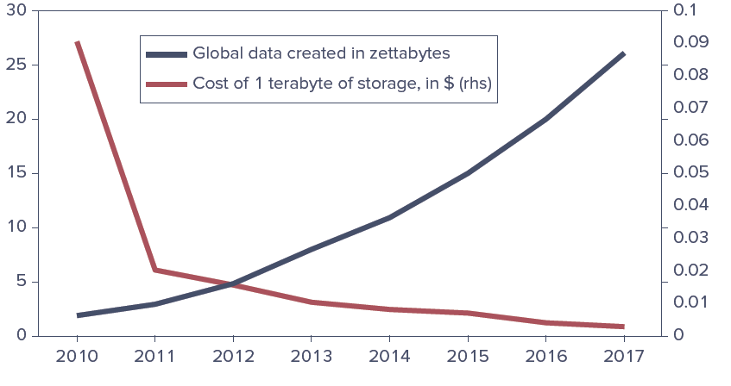
Cost of Storage and Global Data Availability, 2009-2017
Notes:
While AI has existed for many years, recent increases in the availability of data have resulted in a resurgence of interest in potential applications of AI (see Figure 19–9).

Slide 24
Recent Developments in Market Support Services (Concluded)
Credit, Deposit, and Capital-Raising Services
  Fintech innovations include crowdfunding, lending marketplaces, mobile banks, and credit scoring
    Crowdfunding is a way of raising money through the collective effort of family, friends, individual investors, and customers (e.g., KickStarter, CrowdCube, Indiegogo, and GoFundMe)
    Lending marketplaces are part of a nonbank lending industry that makes loans to consumers and small businesses (e.g., LendingClub, OnDeck, Avant, GreenSky, Kabbage, and SoFi)
Investment Management Services
  Fintechs in this space provide solutions for high-frequency trading (HFT), copy trading, e-trading, and robo-advice
    HFT allows trades to be executed in micro-seconds
    Copy trading allows millions of individuals to trade FX on platforms such as Trade360, eToro, OctaTX, and ZuluTrade
    Robo-advice is an online service that provides automated portfolios based on your preferences

Slide 25
Regulatory Approaches to Fintech: Fintech Charters and Other Licenses
Fintech firms currently represent a relatively small portion of the global banking service market, but, regionally, some already provide a considerable part of local banking services
Regulators have lowered barriers in forms of virtual bank licenses, fintech charters and e-money licenses
  Fintech charter is a special-purpose bank charter for nonbank fintech companies to operate in the banking system providing preemption from many state laws
Regulatory sandboxes are frameworks set up by a financial regulator to allow early-stage fintech startups to test their offerings in a controlled environment under the regulator’s supervision
  2015 - UK Financial Conduct Authority (FCA) launched first regulatory sandbox for fintech startups. By 2020, around 50 countries have followed
  March 2018 - Arizona became first U.S. state to launch a fintech sandbox
  In 2021 lawmakers in 11 states and Washington, DC, proposed bills that would create fintech sandboxes

Slide 26
Regulatory Approaches to Fintech: International Regulations
Two significant changes to EU regulations have given the fintech industry a major shot in the arm and strengthened its position as a competitor to traditional banking:
  General Data Protection Regulation (GDPR) is the world’s strongest set of data protection rules, which enhance how people can access information about them and places limits on what organizations can do with personal data
    Adopted by the EU in 2016 and now recognized as law
  Payment Services Directive 2 (PSD2) seeks to make payments more secure in Europe, boost innovation, and help banking services adapt to new technologies
    Passed in 2015 and came into force in 2018
Open Banking phenomenon emerged from PSD2, which forced the EU’s and UK’s biggest banks to release their data in a secure, standardized form so that it can be shared more easily among authorized organizations online
Notes:
Open Banking and PSD2 have catalyzed the development of “fintech utilities”— such as Yapily and Tink—which provide financial APIs to help incumbent banks comply and compete.

