Slide 1
Product and Branding Concepts

Slide 2
Learning Objectives
11.1 Distinguish between goods and services.
11.2 Contrast the three classifications of consumer products in terms of consumer factors and marketing mix factors.
11.3 Identify the six types of business products.
11.4 Summarize the major elements of brand equity.
11.5 Differentiate the methods used to develop and protect brand identity.
11.6 Outline the various types of brand strategies used by marketers.

Slide 3
What are Goods and Services?
11-1

Slide 4
11-1 What are Goods and Services? (1 of 2)
Goods are tangible products that customers can see, hear, smell, taste, and/or touch
Examples: televisions, shovels, cereal
Services are intangible products
Examples: haircuts, car repairs, dental work

Slide 5
11-1 What are Goods and Services? (2 of 2)
Services can be distinguished from goods in several ways.
Services are intangible.
They do not have physical features that buyers can see, hear, smell, taste, or touch prior to purchase.
Services are inseparable from the service providers.
The names of doctors or lawyers are synonymous with the service they provide.
Services are perishable.
Providers cannot maintain inventories of their services.
Companies cannot easily standardize services.
Example: A hair coloring from a salon stylist will be slightly different for each customer.

Slide 6
Exhibit 11.1 The Goods-Services Continuum
This is a tool that marketers use to distinguish services from goods.

Slide 7
Types of Consumer Products
11-2

Slide 8
Exhibit 11.2 Classification of Consumer Products
Not all consumer products can be marketed the same.
A good starting point for a company building a marketing mix is to understand the type of product it is selling.
Consumer products are classified into three groups.

Slide 9
11-2 Types of Consumer Products (1 of 3)
Convenience products are goods and services consumers want to purchase frequently, immediately, and with minimal effort
Because these are generally low-cost items, advertising is the most effective form of promotion.
Examples: bread, toothpaste
Exampla: Convenience services include 24-hour roadside assistance, walk-in nail salons, copy shops, and dry cleaners.
Subdivison of convenience products:
1. Impulse goods and services are products purchased on the spur of the moment
Example: a pack of gum from the checkout line
2. Staples are convenience products that consumers frequently purchase to maintain a ready inventory
Examples: gasoline, shampoo, milk

Slide 10
11-2 Types of Consumer Products (2 of 3)
Shopping products are products that are more expensive than convenience items and ones where the shopper lacks complete information prior to the buying process
Requires more planning: Customer compares competing products’ price, quality, style and color.
The purchaser of a shopping product lacks complete information prior to the buying trip, and gathers information during the buying process.
Examples: cars, furniture, services such as child care and insurance
Although advertising can be used to raise brand awareness, personal selling is often involved during the purchase process of these items.

Slide 11
11-2 Types of Consumer Products (3 of 3)
Specialty products are higher-end products offering unique characteristics that compel buyers to purchase particular brands.
Purchasers of specialty products typically undergo an extensive search for their first purchase of a particular product or brand.
But once loyal to that brand, buyers making future purchases know exactly what they want and they are willing to pay accordingly. These buyers begin shopping with complete information, and they often refuse to accept substitutes.
Examples: Hermès scarves, Tiffany jewelry
Marketers promote these items through:
Personalized service by sales associates
Image advertising

Slide 12
11-2 How the Marketing Mix Applies
Although not all products can be easily classified into one of three categories, this system helps guide marketers in developing a successful marketing strategy.
Buyer behavior differs for the three types of purchases.

Slide 13
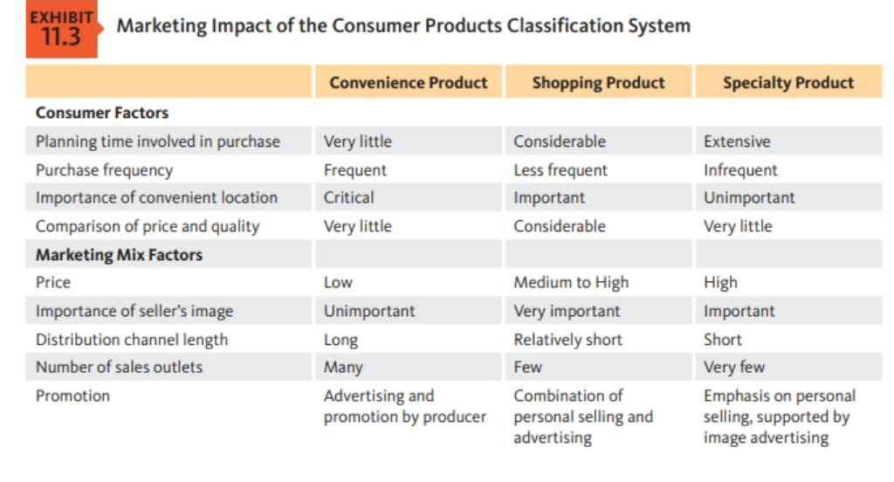

Slide 14
Managing Brands for Competitive Advantage
11-4

Slide 15
11-4 Managing Brands for Competitive Advantage
BRAND
A brand is a name, term, sign, symbol, design, or some combination that identifies the products of one firm while differentiating these products from competitors
Marketers work to create strong identities for their products and to protect them.
Branding is the process of creating that identity.
Branding is the process of creating identity. Satisfied buyers respond to branding by making repeat purchases of the same product because THEY IDENTIFY THE ITEM WITH THE NAME OF ITS PRODUCER.

Slide 16
11-4 Brand Loyalty
**Marketers measure brand loyalty in three stages: brand recognition, brand preference, and brand insistence.
Brand recognition: consumer awareness and identification of a brand
Often a company’s first objective for newly introduced products
Advertising is an effective way to increase consumer awareness of a brand.
Brand preference: buyers rely on previous experiences when choosing it, when buyers choose a product over a competitor based on experience its called brand preference.
Brand insistence: when consumers refuse alternatives and search extensively for the desired product. Few firms achieve this goal. The ultimate stage in brand loyalty. Monopoly position within the minds of its consumers.

Slide 17
11-4 Brand Equity and Personality
Brand equity: the added value the brand gives to a product in the marketplace
Brands with high brand equity often command comparatively large market shares and higher prices.
Brand awareness, customer loyalty, repeat purchases contribute forming brand equity.
According to a brand equity system developed by global ad agency Young & Rubicam, a firm builds brand equity on four dimensions of brand personality:
Differentiation: a brand’s ability to stand apart from competitors
Relevance: the real and perceived pertinence of the brand to a consumer segment
Esteem: a combination of perceived quality and consumer perceptions about a brand
Knowledge: the extent of customer awareness of the brand and understanding of what it stands for

Slide 18
The Product Lifecycle
12-4

Slide 19
12-4 The Product Lifecycle (1 of 5)
Product lifecycle is the progression of a product through four basic stages: introduction, growth, maturity, and decline
Applies to products or product categories within an industry, not to individual brands
No set schedule or time frame for each stage

Slide 20
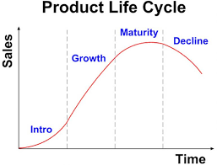
Exhibit 12.4 Stages in the Product Lifecycle

Slide 21
12-4 The Product Lifecycle (2 of 5)
Introductory stage: first stage of the product lifecycle, in which a firm works to stimulate sales of a new product
The public becomes acquainted with the item’s merits and begins to accept it. Sales volume begins to grow, profits don’t immediately follow.
Example: Driverless cars are currently in the introductory stage.
GM, Ford, and BMW have all expressed their intent to put driverless cars on the road within the next decade. Initially, costs will be high and profits minimal. However, these companies hope market growth in the category will eventually produce big profits.1

Slide 22
12-4 The Product Lifecycle (3 of 5)
Growth stage: second stage of the product lifecycle that begins when a firm starts to realize substantial profits from its investment
Sales volume rises rapidly in this stage.
Category becomes attractive and competitors start to enter the marketplace.
Creates new challenges for marketers
Industry profits often peak and begin to decline.
Example: After early years of strong growth and profitability in the cell phone market, competition has turned fierce among Apple, Samsung, and LG Electronics.

Slide 23
12-4 The Product Lifecycle (4 of 5)
Maturity stage: third stage of product lifecycle, in which industry sales reach a plateau
Industry profits continue to decline as competition intensifies.
Many competitors have entered the market, and industry profits continue to decline as competition intensifies.
Example: Digital cameras are in the maturity stage.

Slide 24
12-4 The Product Lifecycle (5 of 5)
Decline stage: final stage of the product lifecycle, in which innovations or shifts in consumer preferences bring about a steady decline in industry sales
Example: Dial telephones → touch-tone phones → portable phones → cell phones
35-mm home movies → videotape → DVD → streaming services

Slide 25
Exhibit 12.5 Marketing Challenges Across the Product Lifecycle
Stage in Product Lifecycle | Key Marketing Challenge | Key Marketing Approach
Introductory | Need to stimulate initial demand | Communicate information to consumers about product features through advertising Induce distribution channel members to carry the product, sometimes through discounting
Growth | Need to encourage trial purchases | Use promotional tools and price discounts to motivate hesitant buyers
Maturity | Need to counter intense competition | Shift focus of promotions to emphasize competitive differences Differentiate product through focus on attributes like quality, reliability, service, redesign Possibly redesign product or offer additional colors, styles, features
Decline | Maximize remaining profits | Prune product lines to streamline production and lower costs Cut back on advertising and other promotional expenses Evaluate product for deletion

Slide 26
What Is a Price?
Price is the amount of money charged for a product or service, or the sum of all the values that customers exchange for the benefits of having or using the product or service.
Price is important for determining a firm’s market share and profitability.
Price is the only element in the marketing mix that produces revenue; all other elements represent costs.
Notes:
Discussion Question
How does a company like Starbucks price their products?
This will lead to a good overview of the chapter as students will most likely focus on customers, costs, and competitors.
Historically, price has been the major factor affecting buyer choice. In recent decades, however, nonprice factors have gained increasing importance. Even so, price remains one of the most important elements that determines a firm’s market share and profitability.
In the narrowest sense, price is the amount of money charged for a product or a service. More broadly, price is the sum of all the values that customers give up to gain the benefits of having or using a product or service.
Price is the only element in the marketing mix that produces revenue; all other elements represent costs.
Price is also one of the most flexible marketing mix elements; prices can be changed quickly. Smart managers treat pricing as a key strategic tool for creating customer value and building customer relationships. Prices have a direct impact on a firm’s bottom line.

Slide 27
Learning Objective 2
Define price, identify the three major pricing strategies, and discuss the importance of understanding customer-value perceptions, company costs, and competitor strategies when setting prices.

Slide 28
Major Pricing Strategies (1 of 17)
Figure 10.1 Major Considerations in Setting Price
Customer perceptions of the product’s value set the ceiling for its price.
Notes:
Figure 10.1 suggests three major pricing strategies: customer value-based pricing, cost-based pricing, and competition-based pricing.
The price the company charges will fall somewhere between one that is too low to produce a profit and one that is too high to produce any demand.
Figure 10.1 summarizes the major considerations in setting price. Customer perceptions of the product’s value set the ceiling for prices. Likewise, product costs set the floor for a product’s price.
In setting its price between these two extremes, the company must consider several external and internal factors, including competitors’ strategies and prices, the overall marketing strategy and mix, and the nature of the market and demand.
Long Description
The three boxes in the figure show the following text:
Product costs
Competition and other external factors: Competitors’ strategies and prices; Marketing strategy, objectives, and mix; Nature of the market and demand.
Consumer perceptions of value
The center box is connected to boxes on either side by double-headed arrows.
A long double-headed arrow at the bottom of the figure is labeled "Price." The left corner of it has a single dollar symbol with the text: "Price floor: No profits below this price" and the right corner of it has two dollar symbols with the text: "Price ceiling: No demand above this price."
If customers perceive that a product’s price is greater than its value, they won’t buy it. If the company prices the product below its costs, profits will suffer. Between the two extremes, the "right" pricing strategy is one that delivers both value to the customer and profits to the company.

Slide 29
Major Pricing Strategies (2 of 17)
Customer Value-Based Pricing
Value-based pricing uses the buyers’ perceptions of value rather than the seller’s cost.
Value-based pricing is customer driven.
Cost-based pricing is product driven.
Price is set to match perceived value.
Notes:
Note to Instructor
Students often confuse value with low price. You might want to bring up a product that some of them will value even at a high price. You can bring up the latest iPhone product or a luxury car. Some students will feel that the price for these products is too high, however, others will see the value these products offer to the consumer.
Customer Value-Based Pricing
In the end, the customer will decide whether a product’s price is right. Pricing decisions, like other marketing mix decisions, must start with customer value. Effective customer-oriented pricing involves understanding how much value consumers place on the benefits they receive from the product and setting a price that captures that value.
Figure 10.2 (shown on the next slide) compares value-based pricing with cost-based pricing. Although costs are an important consideration in setting prices, cost-based pricing is often product driven and sets a price that covers costs plus a target profit. Marketing must then convince buyers that the product’s value at that price justifies its purchase. If the price turns out to be too high, the company must settle for lower markups or lower sales, both resulting in disappointing profits.
In the end, the customer will decide whether a product’s price is right. Pricing decisions, like other marketing mix decisions, must start with customer value. When customers buy a product, they exchange something of value (the price) to get something of value (the benefits of having or using the product). Effective, customer-oriented pricing involves understanding how much value consumers place on the benefits they receive from the product and setting a price that captures that value.

Slide 30
Major Pricing Strategies (3 of 17)
Figure 10.2 Value-Based Pricing versus Cost-Based Pricing
Notes:
Long Description
The flowchart shows the following information:
Cost-based pricing shows the following steps:
Design a good product
Determine product costs
Set price based on cost
Convince buyers of product’s value.
Value-based pricing shows the following steps:
Assess customer needs and value perceptions
Set target price to match customer-perceived value
Determine costs that can be incurred
Design product to deliver desired value at target price.
Costs play an important role in setting prices. But like everything else in marketing, good pricing starts with the customer.

Slide 31
Major Pricing Strategies (4 of 17)
Customer Value-Based Pricing
Good-value pricing is offering just the right combination of quality and good service at a fair price.
In many cases, this has involved introducing less-expensive versions of established brand name products or new lower-price lines.
Notes:
The Great Recession of 2008 to 2009 caused a fundamental and lasting shift in consumer attitudes toward price and quality. In response, many companies have changed their pricing approaches to bring them in line with changing economic conditions and consumer price perceptions.
More and more, marketers have adopted the strategy of good-value pricing—offering the right combination of quality and good service at a fair price. In many cases, this has involved introducing less-expensive versions of established brand name products or new lower-price lines.
In other cases, good-value pricing has involved redesigning existing brands to offer more quality for a given price or the same quality for less. Some companies even succeed by offering less value but at very low prices. For example, the ALDI supermarket chain has established an impressive good-value pricing position by which it gives customers “more ‘mmm’ for the dollar.” ALDI practices everyday low pricing (EDLP).
EDLP involves charging a constant, everyday low price with few or no temporary price discounts. The king of EDLP is Walmart, which practically defined the concept.

Slide 32
Major Pricing Strategies (5 of 17)
Customer Value-Based Pricing
Everyday low pricing (E D L P) involves charging a constant everyday low price with few or no temporary price discounts.
Ex. Walmart
Notes:
Good-value pricing: ALDI keeps costs low so that it can offer customers “impressively high quality at impossibly low prices” every day.

Slide 33
Major Pricing Strategies (6 of 17)
Customer Value-Based Pricing
High-low pricing involves charging higher prices on an everyday basis but running frequent promotions to lower prices temporarily on selected items.
Walmart promises everyday low prices on everything it sells. In contrast, high-low pricing involves charging higher prices on an everyday basis but running frequent promotions to lower prices temporarily on selected items.
Notes:
Department stores such as Sears and Macy’s practice high-low pricing by having frequent sale days, early-bird savings, and bonus earnings for store credit-card holders.

Slide 34
Major Pricing Strategies (7 of 17)
Customer Value-Based Pricing
Value-added pricing attaches value-added features and services to differentiate a company’s offers and thus their higher prices.
Value-based pricing doesn’t mean simply charging what customers want to pay or setting low prices to meet competition. Instead, many companies adopt value-added pricing strategies. Rather than cutting prices to match competitors, they add quality, services, and value-added features to differentiate their offers and thus support their higher prices.
Notes:
Value-based pricing doesn’t mean simply charging what customers want to pay or setting low prices to meet competition. Instead, many companies adopt value-added pricing strategies rather than cut prices to match competitors.
For example, even as frugal consumer spending habits linger, some movie theater chains are adding amenities and charging more rather than cutting services to maintain lower admission prices.

Slide 35
Major Pricing Strategies (8 of 17)
Cost-Based Pricing
Cost-based pricing sets prices based on the costs for producing, distributing, and selling the product plus a fair rate of return for effort and risk.
Some companies, such as Walmart or ALDI, work to become the low-cost producers
in their industries. Companies with lower costs can set lower prices that result in smaller margins but greater sales and profits.
However, other companies—such as Apple, BMW, and Steinway—intentionally pay higher costs so that they can add value and claim higher prices and margins. For example, it costs more to make a “handcrafted” Steinway piano than a Yamaha production model. But the higher costs result in higher quality
Notes:
Whereas customer-value perceptions set the price ceiling, costs set the floor for the price that the company can charge.
Some companies, such as Walmart or Southwest Airlines, work to become the low-cost producers in their industries. Companies with lower costs can set lower prices that result in smaller margins but greater sales and profits. However, other companies—such as Apple, BMW, and Steinway—intentionally pay higher costs so that they can add value and claim higher prices and margins.

Slide 36
Major Pricing Strategies (9 of 17)
Cost-Based Pricing
Fixed costs are the costs that do not vary with production or sales level.
Rent
Heat
Interest
Executive salaries
Notes:
Fixed costs (also known as overhead) are costs that do not vary with production or sales level.

Slide 37
Major Pricing Strategies (10 of 17)
Cost-Based Pricing
Variable costs vary directly with the level of production.
Raw materials
Packaging
Each smartphone or tablet produced by Samsung involves a cost of computer chips, wires, plastic, packaging, and other inputs. Although these costs tend to be the same for each unit produced, they are called variable costs because the total varies with the number of units produced.
Notes:
Variable costs vary directly with the level of production. Each PC produced by HP involves a cost of computer chips, wires, plastic, packaging, and other inputs. Although these costs tend to be the same for each unit produced, they are called variable costs because the total varies directly with the number of units produced.

Slide 38
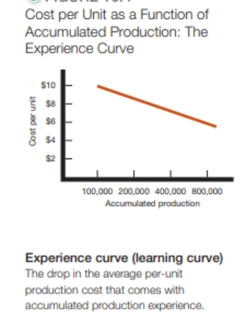
Major Pricing Strategies (11 of 17)
Cost-Based Pricing
Total costs are the sum of the fixed and variable costs for any given level of production.
Management wants to charge a price that will at least cover the total production costs at a given level of production.
Notes:
Management wants to charge a price that will at least cover the total production costs at a given level of production.
The company must watch its costs carefully. If it costs the company more than its competitors to produce and sell a similar product, the company will need to charge a higher price or make less profit, putting it at a competitive disadvantage.

Slide 39
Major Pricing Strategies (14 of 17)
Cost-Based Pricing
Cost-plus pricing adds a standard markup to the cost of the product.
Benefits
Sellers are certain about costs.
Price competition is minimized.
Buyers feel it is fair.
Disadvantages
Ignores demand and competitor prices
Notes:
The simplest pricing method is cost-plus pricing (or markup pricing). Price is calculated by adding a standard markup to the manufacturer’s costs.
To illustrate markup pricing, suppose a manufacturer of toasters has a cost of $16/unit. If the manufacturer wants to earn a 20 percent markup on sales, the price is calculated by the following:
markup price = unit cost/(1 - desired return on sales) =$16/(1 - .2) = $20
The manufacturer would charge dealers $20 per unit and make a profit of $4 per unit. The dealers, in turn, will mark up the toaster. If dealers want to earn 50 percent on the sales price, they will mark up the toaster to $40 ($20 + 50% of $40). This number is equivalent to a markup on cost of 100 percent ($20/$20).
Does using standard markups to set prices make sense? Generally, no. Any pricing method that ignores demand and competitor prices is not likely to lead to the best price. Still, markup pricing remains popular for many reasons.
Sellers are more certain about costs than about demand.
By tying the price to cost, sellers simplify pricing.
There is no need to make frequent adjustments as demand changes.
If the industry uses this method, prices tend to be similar and price competition is minimized.
Many people feel that cost-plus pricing is fairer to both buyers and sellers.
Sellers earn a fair return but do not take advantage of buyers if demand becomes great.

Slide 41
Major Pricing Strategies (15 of 17)
Cost-Based Pricing
Break-even pricing (target return pricing) is setting price to break even on costs or to make a target return.
Figure 10.5 Break-Even Chart for Determining Target Return Price and Break-Even Volume
Notes:
Another cost-oriented pricing approach is break-even pricing (or a variation called target return pricing). The firm tries to determine the price at which it will break even or make the target return it is seeking.
Target return pricing uses the concept of a break-even chart, which shows the total cost and total revenue expected at different sales volume levels.
Long Description
The chart shows "Sales volume in thousands of units" on the x-axis. Its values range from 0 to 50, in increments of 10. The y-axis shows the "Cost in thousands of dollars." Its values range from 0 to 1,200 in increments of 200.
The chart shows three lines - "Total revenue," "Total cost," and "Fixed cost."
The "Fixed cost "line is horizontal and is drawn at y equals 300.
The "Total cost "line starts from 300 on the y-axis and is upward inclined.
The "Total revenue" line starts from (0, 0) and is inclined upward, much steeper than "Total cost" line. A note is tagged to the point of intersection of "Total revenue" and "Total cost." The note reads "At the break-even point, here 30,000 units, total revenue equals total cost."
At a sales volume of 50,000 units, the "Total cost" line shows a cost of $800,000. At the same volume, "Total revenue" is $1,000,000. The gap between the two is labeled "Target return ($200,000)." A note tagged to "Target return" reads "To make a target return of $200,000, the company must sell 50,000 units. But will customers buy that many units at the $20 price? The company should consider different prices and estimate break-even volumes and probable demand at each price. Take a look at Table 10.1."

Slide 42
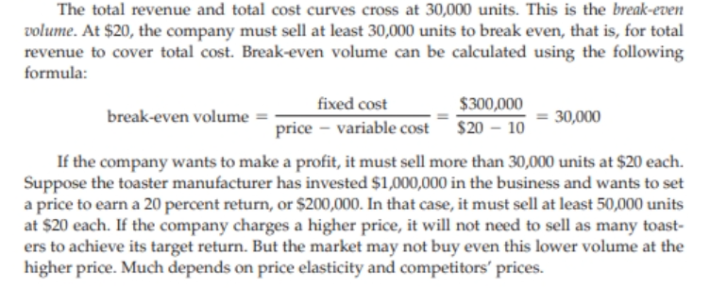

Slide 43
Major Pricing Strategies (16 of 17)
Table 10.1 Break-Even Volume and Profits at Different Prices
Price | Unit Demand Needed to Break Even | Expected Unit Demand at Given Price | Total Revenue (1) × (3) | Total Costs* | Profit (4) - (5)
$14 | 75,000 | 71,000 | $994,000 | $1,010,000 | –$16,000
16 | 50,000 | 67,000 | 1,072,000 | 970,000 | 102,000
18 | 37,500 | 60,000 | 1,080,000 | 900,000 | 180,000
20 | 30,000 | 42,000 | 840,000 | 720,000 | 120,000
22 | 25,000 | 23,000 | 506,000 | 530,000 | –24,000
*Assumes fixed costs of $300,000 and constant unit variable costs of $10.
Notes:
From the toaster example on the previous two slides, the manufacturer should consider different prices and estimate break-even volumes, probable demand, and profits for each. This is done in Table 10.1. The table shows that as price increases, the break-even volume drops (column 2). But as price increases, the demand for toasters also decreases (column 3).
The manufacturer should consider different prices and estimate break-even volumes, probable demand, and profits for each.

Slide 44
Major Pricing Strategies (17 of 17)
Competition-Based Pricing
Competition-based pricing is setting prices based on competitors’ strategies, costs, prices, and market offerings.
Pricing versus competitors: Caterpillar dominates the heavy equipment industry despite charging premium prices. Customers believe that Caterpillar gives them a lot more value for the price over the lifetime of its machines.
Notes:
Pricing versus competitors: Caterpillar dominates the heavy equipment industry despite charging premium prices. Customers believe that Caterpillar gives them a lot more value for the price over the lifetime of its machines.
Competition-based pricing involves setting prices based on competitors’ strategies, costs, prices, and market offerings. Consumers will base their judgments of a product’s value on the prices that competitors charge for similar products.
In assessing competitors’ pricing strategies, the company should ask:
How does the company’s market offering compare with competitors’ offerings in terms of customer value?
How strong are current competitors and what are their current pricing strategies?

