Slide 1
Economics
Chap 3: Market Equilibrium
Dr. Cansu Unver-Erbas
cnsunvr@gmail.com
cansu.u.e@cag.edu.tr

Slide 2
AIM OF THIS LECTURE
In this lecture, we will learn about: MARKET EQUILIBRIUM
In the previous lecture, we have looked at the demand and supply side of the market separately. We now put them together.
Equilibrium refers to a situation in which the price has reached the level where quantity supplied equals quantity demanded.
Following the lecture, you should be able to
explain how a market will converge on the equilibrium price
illustrate changes in equilibrium prices and quantities using a supply
and demand diagram

Slide 3
EXAMPLE OF AN EQUILIBRIUM
The market for ice-cream cones
Demand Schedule
Price of Ice- Market Cream Cone
€ 0.00 19
€ 0.50 16
€ 1.00 13
€ 1.50 10
€ 2.00 7
€ 2.50 4
€ 3.00 1
Supply Schedule
Price of Ice- Market Cream Cone
€ 0.00 0
€ 0.50 0
€ 1.00 2
€ 1.50 4
€ 2.00 7
€ 2.50 9
€ 3.00 11
At €2.00, the quantity demanded is equal to the quantity supplied!

Slide 4

EXAMPLE OF AN EQUILIBRIUM
The market for ice-cream cones
Price of Ice-Cream
Cones
Supply
Equilibrium price
Equilibrium
€ 2.00
Equilibrium quantity
Demand
0 1 2 3 4 5 6 7 8 9 10 11 12 13
Quantity of Ice-Cream Cones
Copyright©2011 South-Western

Slide 5
EQUILIBRIUM
Equilibrium Price
  The price that balances quantity supplied and quantity demanded.
  On a graph, it is the price at which the supply and demand curves
intersect.
Equilibrium Quantity
  The quantity supplied and the quantity demanded at the equilibrium price.
  On a graph it is the quantity at which the supply and demand curves
intersect.

Slide 6
EXCESS SUPPLY AND EXCESS DEMAND
What happens when the market is NOT in equilibrium?
Supply may be higher than demand: excess supply. There is a surplus of the
good on the market.
Supply may be lower than demand: excess demand. There is a shortage of the good on the market.

Slide 7
EXAMPLE OF A MARKET NOT IN EQUILIBRIUM
The market for ice-cream cones
(a) Excess Supply
Price of
Ice-Cream
Cones
Supply
Surplus
€ 2.50
2.00
Demand
0
4
7
10
Quantity of
Quantity demanded
Quantity supplied
Ice-Cream
Cones
Copyright©2011 South-Western

Slide 8
EXAMPLE OF A MARKET NOT IN EQUILIBRIUM
The market for ice-cream cones
(b) Excess Demand
Price of
Ice-Cream
Cones
Supply
€ 2.00
1.50
Shor
tage
Demand
0
4
7
10
Quantity of Ice-Cream
Cones
Quantity supplied
Quantity
demanded
Copyright©2011 South-Western

Slide 9
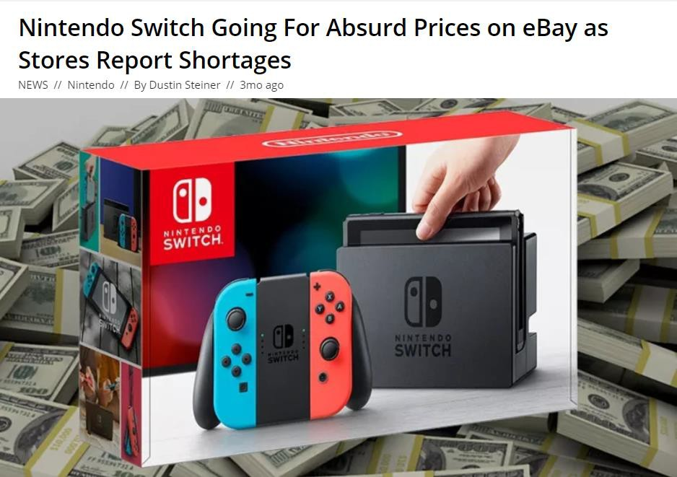
EXAMPLE OF SHORTAGE: DEMAND > SUPPLY

Slide 10







MARKETS NOT IN EQUILIBRIUM
Excess demand: when quantity demanded > quantity supplied Excess supply: when quantity supplied > quantity demanded
excess supply
Supply (S)
Price
_{P}*
The market clears when there is no
excess demand or excess supply
excess
demand
Demand (D)
_{Q}*
Quantity

Slide 11





LAW OF SUPPLY AND DEMAND
When the market is not in equilibrium, it will move towards the equilibrium:
When there is excess supply, sellers are not able to sell all their stocks at current
prices → they will cut prices.
The price will fall until the market reaches equilibrium.
When there is excess demand, consumers are not able to buy all they want at current prices → sellers can raise prices without cutting sales.
The price will rise until the market reaches equilibrium.
Law of supply and demand: The claim that the price of any good adjusts to bring the quantity supplied and the quantity demanded of that good into balance

Slide 12
THE ALGEBRA OF MARKET EQUILIBRIUM
Assume that:
Q_{d}= 32 – 2P
Q_{s}= 20 + 4P
Find the equilibrium price and quantity.

Slide 13
THE ALGEBRA OF MARKET EQUILIBRIUM
Assume that:
Q_{d}= 32 – 2P
Q_{s}= 20 + 4P
Find the equilibrium price and quantity. Q_{d} = Q_{s}

Slide 14
THE ALGEBRA OF MARKET EQUILIBRIUM
Assume that:
Q_{d}= 32 – 2P
Q_{s}= 20 + 4P
Find the equilibrium price and quantity. Q_{d} = Q_{s}
32 – 2P = 20 + 4P
12 = 6P
=> P* = 2
=> Q* = 32 – 2*2 = 28 (or Q* = 20 + 4*2 = 28)

Slide 15
CHANGES IN EQUILIBRIUM
When some event shifts the equilibrium changes.
supply or the demand curve, the market
Three steps are used for analyzing changes in equilibrium:
Decide whether the event shifts the supply or the demand curve (or
perhaps both)
Decide in which direction the curve shifts
Use the supply-and-demand graph to see how the shift changes the equilibrium (i.e., how the equilibrium quantity and price change)

Slide 16
CHANGES IN EQUILIBRIUM
-> How an increase in demand affects the equilibrium? Example 1: equilibrium in ice-cream market and hot weather.
-> How a decrease in supply affects the equilibrium?
Example 2: equilibrium in ice-cream market and increase in price of sugar.

Slide 17
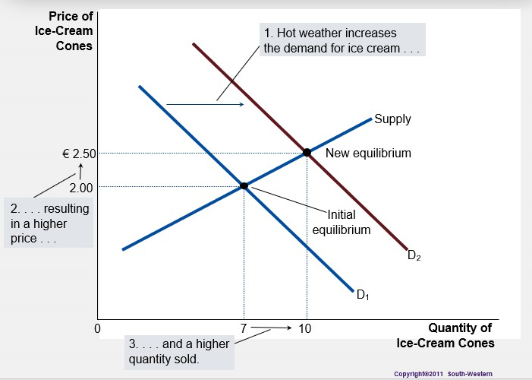
EXAMPLE OF A CHANGE IN EQUILIBRIUM
Equilibrium in ice-cream market and hot weather

Slide 18
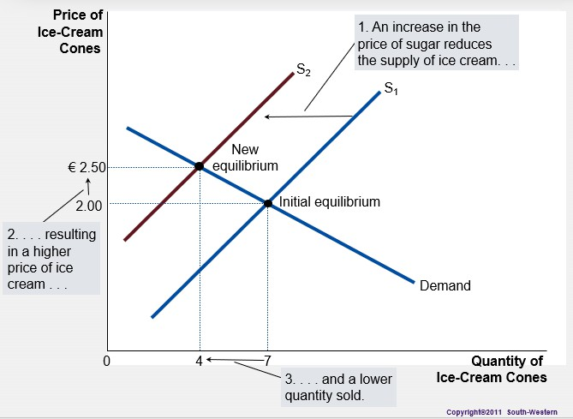
EXAMPLE OF A CHANGE IN EQUILIBRIUM
Equilibrium in ice-cream market and increase in price of sugar

Slide 19




Quick Exercise
Reflect and generate a prediction of how the price of the FitBit and the
quantity sold should change as income increases.
Price
supply (S)
_{P}*
new demand (D)
demand (D)
_{Q}*
Quantity

Slide 20

Quick Exercise
Reflect and generate a prediction of how the price of the FitBit and the
quantity sold should change as income increases.
Price
supply (S)
new P*
_{P}*
new demand (D)
demand (D)
_{Q}*
new Q*
Quantity

Slide 21
SUMMARY OF THE CHANGES
 | Equilibrium price | Equilibrium quantity
Increase in demand | increase | increase
Decrease in demand | decrease | decrease
Increase in supply | decrease | increase
Decrease in supply | increase | decrease

Slide 22
GENERAL SUMMARY
There is excess demand if quantity demanded [ ] than quantity supplied.
If quantity demanded less than quantity supplied, there is excess [ ].
When supply and demand curves intersect, a market is in [ ].
Shifts in demand and supply cause changes in equilibrium price and [ ]. Prices in other markets can cause a market demand and supply curve to [ ].

Slide 23
GENERAL SUMMARY
There is excess demand if quantity demanded is [greater] than quantity supplied.
If quantity demanded less than quantity supplied, there is excess [supply].
When supply and demand curves intersect, a market is in [equilibrium].
Shifts in demand and supply cause changes in equilibrium price and [quantity].
Prices in other markets can cause a market demand and supply curve to [shift].

