Slide 1
Professional English III
Öğretim Görevlisi
Özen TEKİN

Slide 2
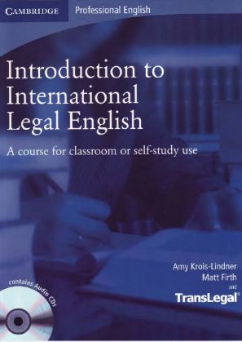
Introduction To International Legal English
https://vk.com/wall257225255_10577

Slide 3
Pacing
16 weeks
5 units
Midterm period: November 11-22, 2024 (40%) (8th week)
January 10,2025 classes are over
Finals: January 13-24, 2025 (60%) (14th week)
16 hours absence
Particpation and coming to the class with materials will be taken into consideration in terms of grading

Slide 4
zoom: 835 985 2787
Pass: 123456
E-mail: ozentekin@cag.edu.tr

Slide 5
UNIT 1: A Career In Law
Which subjects would be part of the core course in every counrty?

Slide 6
Constitutional Law – Principles governing the structure and powers of government.
Contract Law – Laws related to agreements between individuals or entities.
Tort Law – Civil wrongs causing harm or loss, and liability for damages.
Criminal Law – Laws addressing crimes and punishment.
Property Law – Rights and regulations concerning ownership and use of property.
Administrative Law – Governing the actions of administrative agencies.
International Law – Legal principles governing relations between nations.

Slide 7
How might the study of law differ from country to counrty?
- lenght of course
- core and optional subjects covered
- the balance between theory and practice

Slide 8
What Are The Key Differences Between American and British Law Education Systems?

Slide 9
Britain
USA
Undergraduate degree (LLB) for 3 years
Must then complete a postgraduate qualification
Legal Practice Course (LPC) for solicitors; dealing with clients, Bar Vocational Course (BVC) for barristers; representing clients in court
After completion of a bachelor’s degree (in any 4 years subject) further 3 years at law school
State’s Bar Exam (after they can be fully qualified)

Slide 10
In Britain;
Core Subjects
Optional Subjects

Slide 11
Core Subjects
Criminal Law
Tort Law
Equity and Trusts
Optional Subjects
Family Law
Employment Law
Housing Law
Contract Law
Administrative Law
Constitutional Law
Company Law
Commercial Law
Litigation and Arbitration

Slide 12
True & False. If the statement is false, correct it.
A course in family law is usually included among the core subjects at law schools in the UK.
Some law degree programmes offer courses in some of the important skills that lawyers need in order to do their work, such as legal writing or legal English.
Law clinics give law students the opportunity to learn about the legal problems of the medical profession.
Today, commercial law firms expect recruits to be completely fluent in English.

Slide 13
Collocations
A pair or group of words which are commonly used together.
For instance;
- take a photo
- interested in
- fast asleep
Colloactions are also important for understanding, as certain words only make sense in the context of their collocations
E.g. Afford in the collocation Can’t afford
Now find 5 collocations begging with «LAW» and 5 beginning with the word «LEGAL»

Slide 14
LEGAL;
Legal writing, legal research, legal practice, legal assistance, legal community
LAW;
- Law degree programme, law student, law practice, law clinic, law firm

Slide 15
What type of law firm would you like to work in? Why? Advantages and Disadvantages?
I would like to work… / I would prefer to …
Sole practitioner
Law firm

Slide 16
Reading Strategies
Try to understand the new word with the help of surrounding words.
Sentence: «The judge said the defendant was guilty and must pay a fine.»
Context Clue: The phrase "must pay a fine" explains that guilty means the defendant did something wrong and has to face consequences.
In this case, the word guilty is understood from the context, indicating someone has been judged as having broken the law.

Slide 17
Look up every unknown word
Ignore the unknown word and read on Sentence: "The defendant claimed that they did not breach the contract, but the court still ruled against them.«
Even if you don’t understand the word breach, you can continue reading and still understand the overall meaning of the sentence: the defendant said they didn’t do something wrong, but the court didn’t agree.
In this case, you can grasp the main idea without knowing every term.

Slide 18
The first time you read a text, get a general idea, avoid analysing
Some texts demand intensive reading (understanding every word) In this case every unknown word should be checked. E.g: It can be a legal dispute
Extensive reading, large amount of text have to be searched for specific information. E.g: Lawyers analyse huge amounts of company’s paperwork
Not to get bogged down in language analysis when the aim is to get information

Slide 19
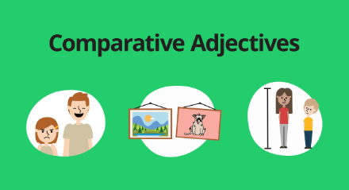
Language Use
Comparatives
Comparative adjectives enable us to express the difference between two people or things. In order to say that someone or something has a superior quality, size, or characteristic.

Slide 20
If an adjective has one syllable, or two syllables with -y as the second syllable, we add -er to create the comparative. For example:
Your house is bigger than mine.
Taking the bus is cheaper than taking the car.
This box is heavier than that one.
As you can see in the first example, if an adjective ends in a vowel and consonant (e.g. big) you need to double the final consonant. For example, bigger, fatter, thinner.

Slide 21
More for long adjectives.
If an adjective has two or more syllables, we add the word ‘more’ in front to create the comparative form. For example:
This hotel is more expensive than the last hotel we stayed at.
Reading is more interesting than watching television.
The sea here is more beautiful than the sea in my country.

Slide 22
As is often the case in English, there are some adjectives that are irregular and don’t follow these rules. Here are the irregular comparatives:
good – better
bad – worse
far – further (U.K. English) farther (US English)
For example,
Your cooking is better than my cooking.
Arriving late is worse than arriving early.
Their house is further from here than our house.

Slide 23
In many countries, the process of going to court is __________ (complex) filing a complaint online.
A judge is __________ (important) a court clerk in a trial.
The law can be __________ (strict) in some states compared to others.
An attorney’s job is __________ (difficult) than a legal assistant’s job.
A contract is __________ (binding) when it is signed by both parties.
Legal documents are __________ (formal) than personal letters.

Slide 24
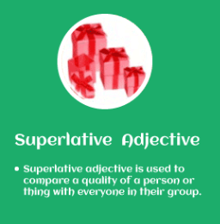
Superlatives
We use superlatives to compare one person or thing to several others. For example,
New York is the busiest city I’ve ever seen.
This means that I’ve seen several cities and I consider New York as the number one in terms of being busy.

Slide 25
If an adjective has one syllable, or two syllables with -y as the second syllable, we add -est to create the superlative. For example:
It’s the shortest route to the stadium.
What’s the longest flight you’ve ever taken?
He’s the nicest guy I’ve met here.
As with comparatives, if an adjective ends in a vowel and consonant (e.g. sad) you need to double the final consonant. For example, saddest, fittest, hottest.

Slide 26
If an adjective has two or more syllables, we add ‘the most’ in front to create the superlative form. For example:
She’s the most determined candidate we’ve seen today.
It’s the most difficult part of my job.
This is the most successful year the company’s ever had.

Slide 27
The same adjectives that are irregular for comparatives are also irregular for the superlative form:
good – best
bad – worst
far – furthest (U.K. English) farthest (US English)
Here are some examples:
Is this the best place to eat in town?
Yesterday’s performance was my worst ever.
Alaska is the furthest state from Florida.

Slide 28
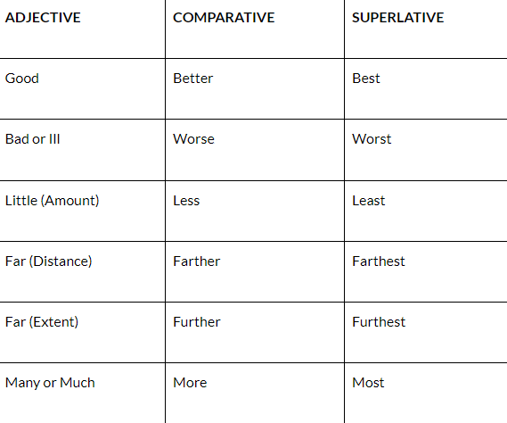
Comparative Adjectives:
I did better than the rest of my class on the final.
She ran farther in this race than she did in the last one.
Superlative Adjectives:
That was the best birthday present ever!
I bought the least expensive souvenir that I could find.

Slide 29
The Supreme Court is the __________ (high) court in the country.
The courtroom is __________ (large) than a lawyer's office.
The chief justice is the __________ (powerful) person in the court system.
An attorney is __________ (experienced) than a junior lawyer.
The court is the __________ (formal) place for legal proceedings.
The lawsuit was __________ (expensive) than expected.
The attorney is __________ (knowledgeable) about the case than the client.

Slide 30
What is the difference between working in a small law firm and a larger one?
Larger firms; tend to specialise in specific areas, dealing with commercial transactions or registering patents
Smaller firms; general legal issues, contacting colleagues for assistance

Slide 31
Subject: Application for Graduate Recruitment Programme
Dear [Recipient's Name],
I am writing to express my interest in the Graduate Recruitment Programme at [Law Firm's Name]. I have recently completed my law degree at [University Name] and have a strong interest in commercial law. During my studies, I took courses in company law, commercial litigation, and finance.
I believe this programme will be a great opportunity for me to develop my skills in a professional and challenging environment. I am particularly interested in working on commercial matters and learning more about how commercial law is applied in real-world cases.
I would be grateful if you could consider my application. Please let me know if you need any further information.
Thank you for your time.
Yours sincerely, [Your Name]

