Slide 1
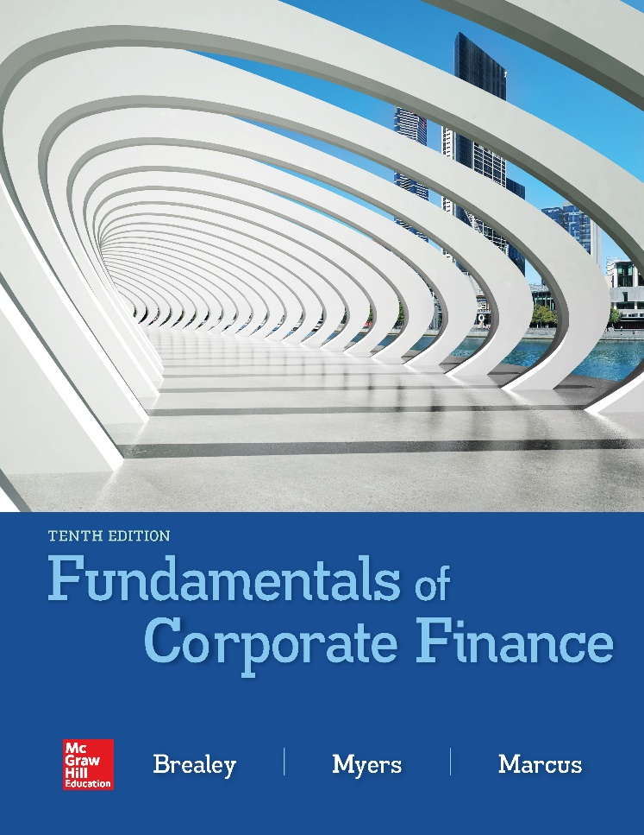

Slide 2
Topics Covered
5.1 Future Values and Compound Interest
5.2 Present Values
5.3 Multiple Cash Flows
5.4 Reducing the Chore of the Calculations: Part 1
5.5 Level Cash Flows: Perpetuities and Annuities
5.6 Reducing the Chore of the Calculations: Part 2
5.7 Effective Annual Interest Rates
5.8 Inflation & The Time Value of Money
Notes:
2

Slide 3
Future Values and Compound Interest (1 of 8)
Future Value
Amount to which an investment will grow after earning interest
Compound Interest
Interest earned on interest
Simple Interest
Interest earned only on the original investment
Notes:
3

Slide 4
Future Values and Compound Interest (2 of 8)
Example — Simple Interest
Interest earned at a rate of 6% for five years on a principal balance of $100
$$\text{Interest} \text{earned} \text{per} \text{year}\text{ = 100 }\text{×}\text{ .06 = \$6}$$
$
$
$
Notes:
5

Slide 5
Future Values and Compound Interest (3 of 8)
Example — Simple Interest
Interest earned at a rate of 6% for five years on a principal balance of $100
Today Future Years
 | 1 | 2 | 3 | 4 | 5 | 6
Interest Earned |  | 6 | 6 | 6 | 6 | 6
Value | 100 | 106 | 112 | 118 | 124 | 130
$$\text{Value} \text{at} \text{the} \text{end} \text{of} \text{Year}\text{ 5 =} \text{\$130}$$
Notes:
12

Slide 6
Future Values and Compound Interest (4 of 8)
Example — Compound Interest
Interest earned at a rate of 6% for five years on the previous year’s balance
$$\text{Interest} \text{earned} \text{per} \text{year}\text{ = }\text{prior} \text{year} \text{balance} \text{×}\text{ .06}$$
Notes:
14

Slide 7
Future Values and Compound Interest (5 of 8)
Example — Compound Interest
Interest earned at a rate of 6% for five years on the previous year’s balance
Today Future Years
 |  | 1 | 2 | 3 | 4 | 5
Interest Earned |  | 6 | 6.36 | 6.74 | 7.15 | 7.57
Value | 100 | 106 | 112.36 | 119.10 | 126.25 | 133.82
$$\text{Value} \text{at} \text{the} \text{end} \text{of} \text{Year}\text{ 5 = \$133.82}$$
Notes:
12

Slide 8
Future Values and Compound Interest (6 of 8)
Future Value = FV
$$\text{FV}\text{ = \$100 }\text{×} \left(\text{1 + }\text{r}\right)\text{t}$$
Notes:
21

Slide 9
Future Values and Compound Interest (7 of 8)
Example — FV
What is the future value of $100 if interest is compounded annually at a rate of 6% for five years?
$$\text{FV}\text{ = \$100 }\text{×} \left(\text{1 + }\text{r}\right)\text{t}$$
$\text{FV}\text{ = \$100 }\text{×} \left(\text{1 + .06}\right)\text{5 }$= $133.82
Notes:
23

Slide 10
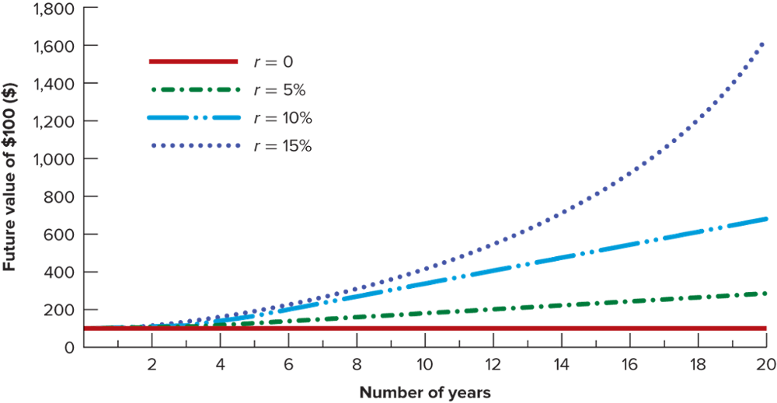
Future Values and Compound Interest (8 of 8)
Notes:
24

Slide 11
Manhattan Island Sale
Peter Minuit bought Manhattan Island for $24 in 1626. Was this a good deal?
To answer, determine what $24 is worth in the year 2016, compounded at 8%
$$\text{FV}\text{ = \$24 }\text{×} \left(\text{1 + .08}\right)\text{393 }\text{=} \text{\$}\text{328} \text{trillion}$$
Note: The value of Manhattan Island land is well below this figure

Slide 12
Present Values (1 of 7)
Present Value
Value today of a future cash flow
Discount Factor
Present value of a $1 future payment
Discount Rate
Interest rate used to compute present values of future cash flows
Notes:
31

Slide 13
Present Values (2 of 7)
$\text{Present} \text{value}\text{ = }\text{PV}$
$$\text{PV}\text{ = }\frac{\text{Future} \text{value} \text{after} \text{t} \text{periods}}{\left(\text{1 + }\text{r}\right)\text{t}}$$
Notes:
32

Slide 14
Present Values (3 of 7)
Discounted Cash Flow (DCF)
Method of calculating present value by discounting future cash flows
Future cash flow
Present value
Notes:
34

Slide 15
Present Values (4 of 7)
Example
You just bought a new computer for $3,000. The payment terms are 2 years same as cash. If you can earn 8% on your money, how much money should you set aside today in order to make the payment when due in two years?
$\text{PV}\text{ = }\frac{\text{3,000}}{\left(\text{1.08}\right)\text{2}} \text{=}$ $2,572
Notes:
34

Slide 16
Present Values (5 of 7)
Discount Factor = DF = PV of $1
$$\text{DF}\text{ = }\frac{\text{1}}{\left(\text{1 + }\text{r}\right)\text{t}}$$
Discount factors can be used to compute the present value of any cash flow
Notes:
36

Slide 17
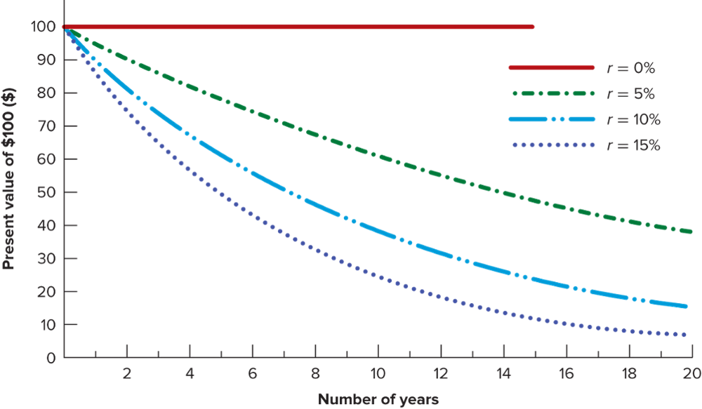
Present Values (6 of 7)
Notes:
24

Slide 18
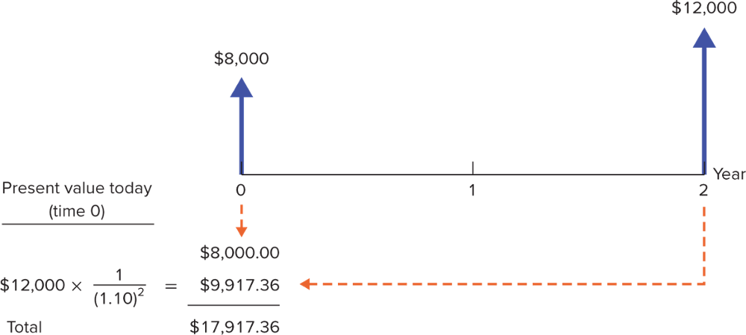
Present Values (7 of 7)
Drawing a time line can help us to calculate the present value of the payments to Kangaroo Autos
Notes:
24

Slide 19
Time Value of Money (Applications) (1 of 3)
The PV formula has many applications. Given any variables in the equation, you can solve for the remaining variable.
$$\text{PV}\text{ = }\text{future} \text{payment}\text{ × }\frac{\text{1}}{\left(\text{1 + }\text{r}\right)\text{t}}$$
Notes:
38

Slide 20
Time Value of Money (Applications) (2 of 3)
Example
The US Govt borrowed money for 10 years, but it did not announce an interest rate. It simply offered to sell each IOU for $777.40. What is the interest rate?
$$\text{777.40 }\text{=}\text{ 1,000 }\text{×} \frac{\text{1}}{\left(\text{1 + }\text{r}\right)\text{10}}$$
$$\text{r} \text{=}\text{ .0255 }\text{or}\text{ 2.55\%}$$
Notes:
38

Slide 21
Time Value of Money (Applications) (3 of 3)
Value of Free Credit
Implied Interest Rates
Internal Rate of Return
Time necessary to accumulate funds
Notes:
39

Slide 22
Future Value of Multiple Cash Flows
Example
You are able to put $1,200 in the bank now, and another $1,400 in 1 year. If you earn an 8% rate of interest, how much will you be able to spend on a computer in 2 years?
$$\text{FV}\text{1 }\text{=}\text{ 1,400 }\text{×} \left(\text{1}\text{.08}\right)\text{ = 1,512.00}$$
$$\text{F}\text{V}\text{2 }\text{=} \text{1,}\text{2}\text{00} \text{×} \left(\text{1.08}\right)\text{2 }\text{=} \text{1,}\text{399}\text{.}\text{68}$$
________________________________________________________________________________
$$\text{Total} \text{FV}\text{ = \$2,911.68}$$
Notes:
42

Slide 23
Present Value of Multiple Cash Flows (1 of 3)
PVs can be added together to evaluate multiple cash flows
$\text{PV}\text{ = }\frac{\text{C}\text{1}}{\left(\text{1 + }\text{r}\right)\text{1}}$ $\text{+ }\frac{\text{C}\text{2}}{\left(\text{1} \text{+} \text{r}\right)\text{2}} \text{+}$…
Notes:
43

Slide 24
Present Value of Multiple Cash Flows (2 of 3)
Example
Your auto dealer gives you the choice to pay $15,500 cash now, or make three payments: $8,000 now and $4,000 at the end of the following two years. If your cost of money is 8%, which do you prefer?
$\text{Immediate}$ payment 8,000.00
$$\text{PV}\text{1 }\text{=} \frac{\text{4,000}}{\left(\text{1} \text{+} \text{.08}\right)\text{1}} \text{= 3,}\text{703}\text{.}\text{70}$$
$$\text{PV}\text{2 }\text{=} \frac{\text{4,000}}{\left(\text{1} \text{+.} \text{08}\right)\text{2}} \text{= 3,}\text{429}\text{.}\text{36}$$
_____________________________________
$$\text{Total} \text{PV}\text{ = \$15,133.06}$$
Notes:
42

Slide 25
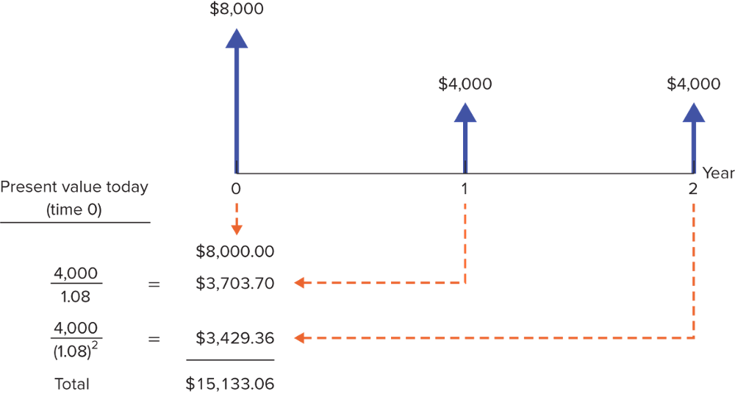
Present Value of Multiple Cash Flows (3 of 3)

Slide 26
Calculations: Part 1 – Spreadsheets
Example
Your auto dealer gives you the choice to pay $15,500 cash now, or make three payments: $8,000 now and $4,000 at the end of the following two years. If your cost of money is 8%, which do you prefer?
Finding the Present Value of Multiple Cash Flows by Using a Spreadsheet
Time until CF | Cash Flow | Present Value | Formula in Column C
0 | 8000 | $8,000 | =PV ($B$11,A4,0,-B4)
1 | 4000 | $3,703.70 | =PV ($B$11,A5,0,-B5)
2 | 4000 | $3,429.36 | =PV ($B$11,A6,0,-B6)
SUM: |  | $15,133.06 | =SUM(C4:C6)
Discount rate: | .08
Notes:
51

Slide 27
Calculations: Part 1 – Financial Calculators (1 of 3)
n
PMT
FV
i
PV
n is the number of periods
i is the interest rate, expressed as a percentage (not a decimal)
PV is the present value
PMT is the amount of any recurring payment
FV is the future value
Notes:
51

Slide 28
Calculations: Part 1 – Financial Calculators (2 of 3)
Example
What is the future value of Peter Minuit’s $24 investment if invested at 8% for 393 years?
n
PMT
FV
i
PV
393
0
FV
8
24
Enter the number listed below the key and then push the financial function key. To get the final answer, then push FV and you will get -$327.90 trillion. Ignore the minus sign and that is the answer.
Notes:
51

Slide 29
Calculations: Part 1 – Financial Calculators (3 of 3)
Example
You just bought a new computer for $3,000. The payment terms are 2 years same as cash. If you can earn 8% on your money, how much money should you set aside today in order to make the payment when due in two years?
n
PMT
FV
i
PV
2
0
3000
8
PV
To get the final answer, then push PV and you will get -$2,572.02. Ignore the minus sign and that is the answer.
Notes:
51

Slide 30
Perpetuities and Annuities (1 of 12)
Perpetuity
A stream of level cash payments that never ends
Annuity
Level stream of cash flows at regular intervals with a finite maturity
Notes:
44

Slide 31
Perpetuities and Annuities (2 of 12)
PV of Perpetuity Formula
$$\text{PV}\text{ =} \frac{\text{C}}{\text{r}}$$
C = cash payment
r = interest rate
Notes:
45

Slide 32
Perpetuities and Annuities (3 of 12)
Example
In order to create an endowment, which pays $100,000 per year forever, how much money must be set aside today in the rate of interest is 10%?
$\text{PV}\text{ = }\frac{\text{100,000}}{\text{.10}}$ $\text{=}\text{ \$1,000,000}$
Notes:
47

Slide 33
Perpetuities and Annuities (4 of 12)
Example (continued)
If the first perpetuity payment will not be received until three years from today, how much money needs to be set aside today?
$\text{PV}\text{ = }\frac{\text{1,000,000}}{\left(\text{1 + .10}\right)\text{3}}$ $\text{=}\text{ \$751,315}$
Notes:
49

Slide 34
Perpetuities and Annuities (5 of 12)
PV of Annuity Formula
$$\text{PV}\text{ = }\text{C}\left[ \frac{\text{1}}{\text{r}}\text{ − }\frac{\text{1}}{\text{r}\left(\text{1 + }\text{r}\right)\text{t}} \right]$$
C = cash payment
r = interest rate
t = Number of years cash payment is received
Notes:
50

Slide 35
Perpetuities and Annuities (6 of 12)
PV Annuity Factor (PVAF)
The present value of $1 a year for each of t years
$$\text{PVAF}\text{ = }\left[ \frac{\text{1}}{\text{r}}\text{ − }\frac{\text{1}}{\text{r}\left(\text{1 +} \text{r}\right)\text{t}} \right]$$
Notes:
51

Slide 36
Perpetuities and Annuities (7 of 12)
Example
You are purchasing a car. You are scheduled to make 3 annual installments of $8,000 per year. Given a rate of interest of 10%, what is the price you are paying for the car (i.e., what is the PV)?
$$\text{PV}\text{ = 8,000 }\text{×} \left[ \frac{\text{1}}{\text{.10}}\text{ − }\frac{\text{1}}{\text{.10}\left(\text{1 + .10}\right)\text{3}} \right]$$
$$\text{PV} \text{=} \text{\$19,894.82}$$
Notes:
53

Slide 37
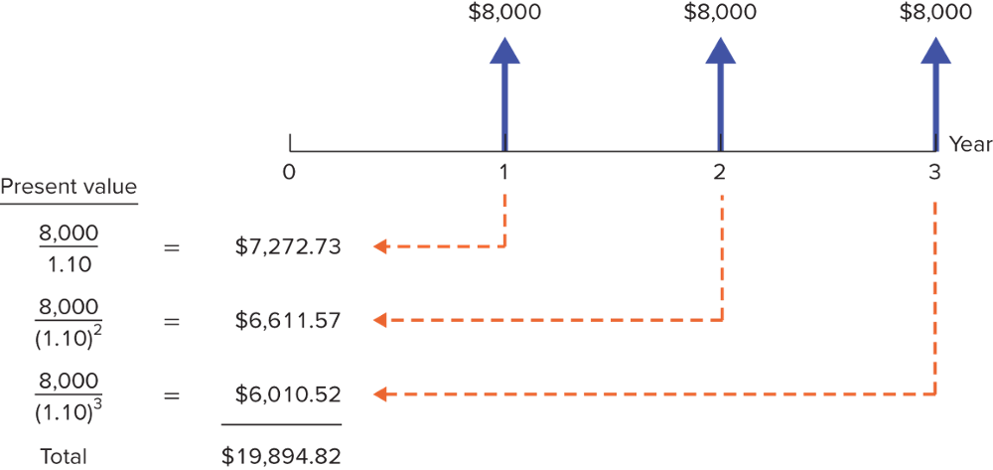
Perpetuities and Annuities (8 of 12)
Example (continued)
You are purchasing a car. You are scheduled to make 3 annual installments of $8,000 per year. Given a rate of interest of 10%, what is the price you are paying for the car (i.e. what is the PV)?
Notes:
53

Slide 38
Perpetuities and Annuities (9 of 12)
Applications
Value of payments
Implied interest rate for an annuity
Calculation of periodic payments
Mortgage payment
Annual income from an investment payout
Future Value of annual payments
$$\text{FV}\text{ = }\left[\text{C} \text{×} \text{PVAF}\right] \text{×} \left(\text{1 + }\text{r}\right)\text{t}$$
Notes:
54

Slide 39
Perpetuities and Annuities (10 of 12)
Example — Future value of annual payments
You plan to save $3,000 every year for 4 years. Given an 8% rate of interest, what will be the FV of your account?
$$\text{PV}\text{ = 3,000 }\text{×} \left[ \frac{\text{1}}{\text{.08}}\text{ − }\frac{\text{1}}{\text{.08}\left(\text{1 + .08}\right)\text{4}} \right]$$
$$\text{P}\text{V} \text{=} \text{\$9,936}$$
$\text{FV}\text{ = \$9,936 }\text{×} \left(\text{1.08}\right)\text{4 }\text{=}$ $13,518
Notes:
56

Slide 40
Perpetuities and Annuities (11 of 12)
Example
You are purchasing a home and are scheduled to make 30 annual installments of $10,000 per year. Given an interest rate of 5%, what is the price you are paying for the house (i.e. what is the present value)?
$$\text{PV}\text{ = \$10,000}\left[ \frac{\text{1}}{\text{.05}}\text{ − }\frac{\text{1}}{\text{.05}\left(\text{1 + .05}\right)\text{30}} \right]$$
$$\text{PV}\text{ = \$153,724.51}$$
Notes:
56

Slide 41
Perpetuities and Annuities (12 of 12)
Example — Future value of annual payments
You plan to save for 50 years and then retire. Given a 10% rate of interest, if you desire to have $500,000 at retirement, how much must you save each year?
500,000$\text{=} \text{Annual} \text{Savings} \text{×}\left[ \frac{\text{1}}{\text{.10}}\text{ − }\frac{\text{1}}{\text{.10}\left(\text{1 + .10}\right)\text{5}\text{0}} \right]$
Annual Savings $\text{=} \text{\$}\text{429.59}$
Notes:
56

Slide 42
Annuities Due (1 of 2)
Annuity Due
Level stream of cash flows starting immediately
How does it differ from an ordinary annuity?
$$\text{PV}\text{Annuity} \text{Due}\text{ = }\text{PVAn}\text{nuity} \text{×} \left(\text{1 + }\text{r}\right)$$
How does the future value differ from an ordinary annuity?
$$\text{FV}\text{Annuity} \text{Due} \text{=} \text{FV}\text{Annuity} \text{×} \left(\text{1} \text{+} \text{r}\right)$$
Notes:
44
Annuity Due: Level stream of cash flows starting immediately.

Slide 43
Annuities Due (2 of 2)
Example
Suppose you invest $429.59 annually at the beginning of each year at 10% interest. After 50 years, how much would your investment be worth?
$$\text{FV}\text{AD}\text{ = }\text{FVAn}\text{nuity} \text{×} \left(\text{1 + }\text{r}\right)$$
$$\text{FV}\text{AD}\text{ = 429.59 }\text{×} \left[\frac{\text{1}}{\text{.10}} \text{− }\frac{\text{1}}{\text{.10}\left(\text{1 + .10}\right)\text{50}}\right] \text{×}\text{ 1.10 }\text{×}\text{ 1.10}$$
$$\text{=}\text{ 550,000}$$
Notes:
54
Annuity Due: Level stream of cash flows starting immediately.

Slide 44
Calculations: Part 2 – Financial Calculators (1 of 2)
Example
You are purchasing a car. You are scheduled to make 3 annual installments of $8,000 per year. Given a rate of interest of 10%, what is the price you are paying for the car (i.e. what is the PV)?
n
PMT
FV
i
PV
3
-8000
0
10
PV
To get the final answer, push PV and you will get -$19,894.82. Ignore the minus sign and that is the answer.
Notes:
51

Slide 45
Calculations: Part 2 – Financial Calculators (2 of 2)
Example
You are taking out a mortgage for $100,000. You will pay it back over 30 years paying 1% per month. What is your monthly payment?
n
PMT
FV
i
PV
360
PMT
0
1
100,000
To get the final answer, push PMT and you will get -$1,028.61.
Notes:
51

Slide 46
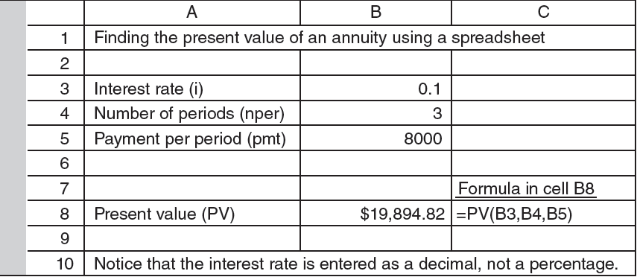
Calculations: Part 2 – Spreadsheets
Notes:
51

Slide 47
Effective Interest Rates (1 of 3)
Effective Annual Interest Rate
Interest rate that is annualized using compound interest
Annual Percentage Rate
Interest rate that is annualized using simple interest
Notes:
26

Slide 48
Effective Interest Rates (2 of 3)
Annual Percentage Rate (APR)
$$\text{APR}\text{ = }\text{MR} \text{×} \text{12}$$
Effective Annual Interest Rate (EAR)
$$\text{EAR}\text{ = }\left(\text{1 + }\text{MR}\right)\text{12 }\text{− 1}$$
*where MR = monthly interest rate
Notes:
26
Effective annual interest rate: Interest rate that is annualized using compound interest.
Annual percentage rate: Interest rate that is annualized using simple interest.

Slide 49
Effective Interest Rates (3 of 3)
Example
Given a monthly rate of 1%, what is the Effective Annual Rate(EAR)? What is the Annual Percentage Rate (APR)?
$$\text{EAR}\text{ = }\left(\text{1 + .01}\right)\text{12 }\text{− 1 = }\text{r}$$
$$\text{EAR}\text{ = }\left(\text{1 + .01}\right)\text{12 }\text{− 1 = .1268 }\text{or}\text{ 12.68\%}$$
$$\text{APR}\text{ = .01 }\text{×}\text{ 12 = .12 }\text{or}\text{ 12.00\%}$$
Notes:
28

Slide 50
EAR and Financial Calculators
Example
Given a 12% APR, what is the Effective Annual Rate, given monthly compounding?
n
PMT
FV
i
PV
12
0
FV
1
-1
To get the final answer, push FV and you will get 1.1268. Subtract 1, and your answer is 12.68%.
Notes:
51

Slide 51
APR and Financial Calculators
Example
Given a 6.50 % EAR what is the APR, given monthly compounding?
n
PMT
FV
i
PV
12
0
1.065
i
-1
To get the final answer, push i and you will get .5262. Multiply by 12, and your answer is 6.314%.
Notes:
51

Slide 52
Inflation (1 of 5)
Inflation
Rate at which prices as a whole are increasing
Nominal Interest Rate
Rate at which money invested grows
Real Interest Rate
Rate at which the purchasing power of an investment increases
Notes:
57

Slide 53
Inflation (2 of 5)
Annual U.S. Inflation Rates from 1900 - 2015

Slide 54
Inflation (3 of 5)
$$\text{1 + }\text{real} \text{interest} \text{rate}\text{ = }\frac{\text{1 + }\text{nominal} \text{interest} \text{rate}}{\text{1 + }\text{inflation} \text{rate}}$$
Approximation formula
$$\text{Real} \text{int}\text{. }\text{rate}\text{ ≈ }\text{nominal} \text{int}\text{. }\text{rate}\text{ − }\text{inflation} \text{rate}$$
Notes:
59

Slide 55
Inflation (4 of 5)
Example
If the interest rate on one year govt. bonds is 6.0% and the inflation rate is 2.0%, what is the real interest rate?
$$\text{1 + }\text{real} \text{interest} \text{rate}\text{ = }\frac{\text{1+.06}}{\text{1+.02}}$$
$$\text{1} \text{+} \text{real} \text{interest} \text{rate} \text{=} \text{1.039}$$
$$\text{1} \text{+} \text{real} \text{interest} \text{rate} \text{=} \text{.039 }\text{or}\text{ 3.9\%}$$
$$\text{Approximation}\text{ = .06 − .02 = .04 }\text{or}\text{ 4.0\%}$$
Notes:
62

Slide 56
Inflation (5 of 5)
Remember:
Current dollar cash flows must be discounted by the nominal interest rate
Real cash flows must be discounted by the real interest rate

