Slide 1


Slide 2
Topics Covered
2.1 The Importance of Financial Markets and Institutions
2.2 The Flow of Savings to Corporations
2.3 Functions of Financial Markets and Intermediaries
2.4 The Crisis of 2007-2009
Notes:
3
2
2
2
2
2

Slide 3
The Importance of Financial Markets (1 of 3)
Businesses have to go to financial markets and institutions for the financing they need to grow
Financing Decision
  Source of Funds (Capital)
  Capital Structure
Notes:
6
5
5
5
5
5

Slide 4
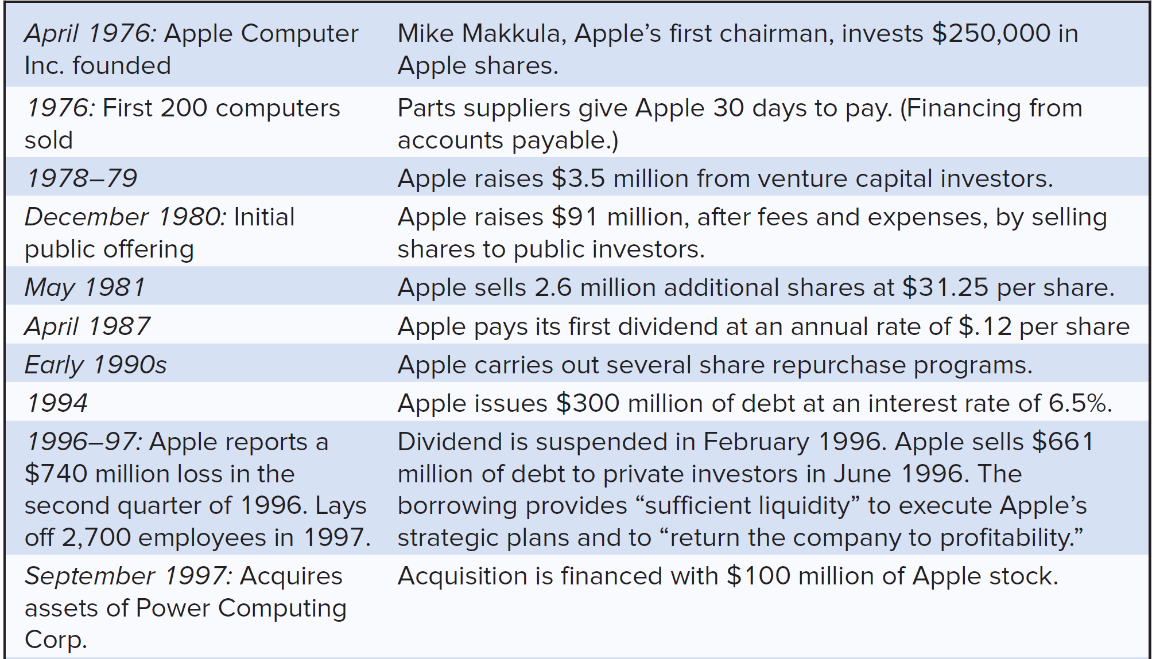
The Importance of Financial Markets (2 of 3)
Examples of financing decisions by Apple Computer
Notes:
6
5
5
5
5
5

Slide 5
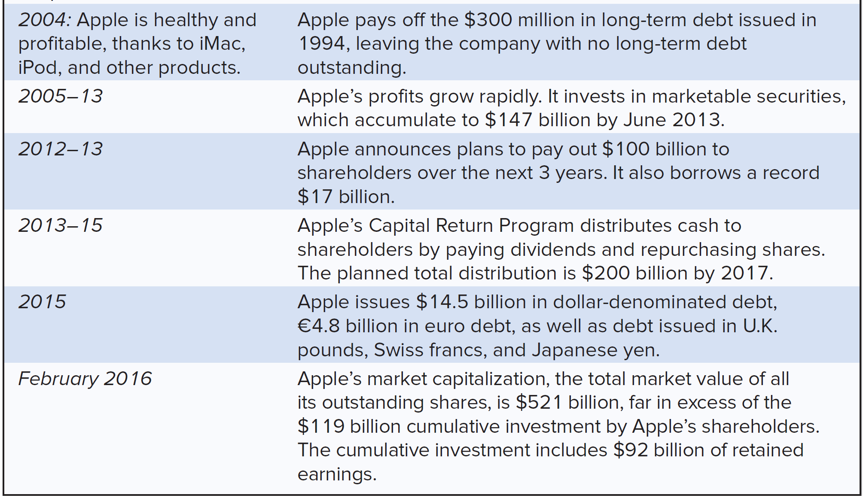
The Importance of Financial Markets (3 of 3)
Examples of financing decisions by Apple Computer (continued)
Notes:
6
5
5
5
5
5

Slide 6
The Flow of Savings to Corporations (1 of 15)
Cash raised from
share issues
Corporation
Investment
in real assets
Investors
Shareholders in closely held corporation
Cash
reinvested
Notes:
12
11
7
7
7
7

Slide 7
The Flow of Savings to Corporations (2 of 15)
Financial Markets
Stock markets
Fixed-income markets
Money markets
Corporation
Investment in real assets
Investors
worldwide
Reinvestment
Financial Institutions
Banks
Insurance Companies
Financial Intermediaries
Mutual Funds
Pension Funds

Slide 8
The Flow of Savings to Corporations (3 of 15)
Money
OTC
Markets
Primary Markets
Secondary Markets

Slide 9
The Flow of Savings to Corporations (4 of 15)
Financial Market
  Market where securities are issued and traded
Primary Market
  Market for the sale of new securities by corporations
Secondary Market
  Market in which previously issued securities are traded among investors
Notes:
12
11
7
7
7
7
Financial Market – Market where securities are issued and traded.
Primary Market – Market for the sale of new securities by corporations.
Secondary Market – Markets in which previously issued securities are traded among investors.

Slide 10
The Flow of Savings to Corporations (5 of 15)
Fixed-income market
Market for debt securities
Capital market
Market for long-term financing
Money market
Market for short-term financing (less than 1 year)

Slide 11
The Flow of Savings to Corporations (6 of 15)
Foreign exchange markets
Chapter 22
Commodities markets
Chapter 24
Markets for options and other derivatives
Chapters 23 and 24

Slide 12
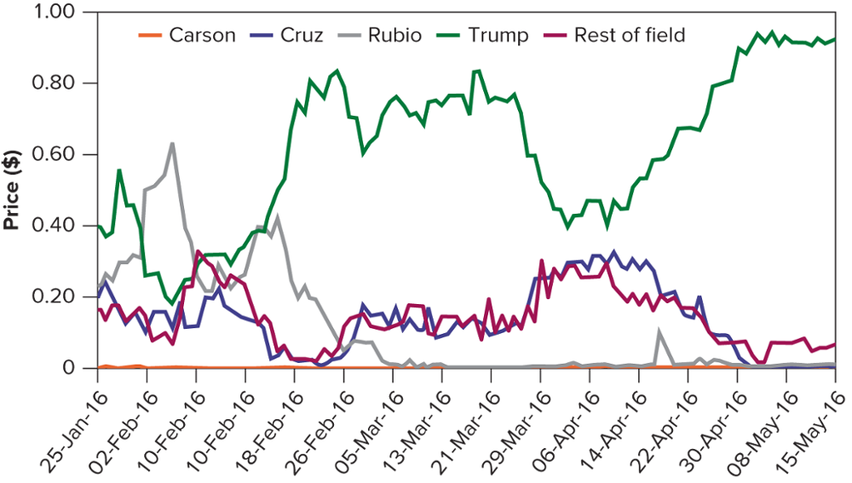
The Flow of Savings to Corporations (7 of 15)
2016 U.S. Republican Convention Nomination Market
Source: Iowa Electronic Markets: Iowa Electronic Markets

Slide 13
The Flow of Savings to Corporations (8 of 15)
Financial Intermediary
  An organization that raises money from investors and provides financing for individuals, companies, and other organizations
Financial Institution
  A bank, insurance company, or similar financial intermediary
Notes:
12
11
7
7
7
7
Financial Intermediary – An organization that raises money from investors and provides financing for individuals, corporations, or other organizations
Mutual Fund – An investment company that pools the savings of many investors and invests in a portfolio of securities
Hedge Fund – A private investment pool, open to wealthy or institutional investors, that is only lightly regulated and therefore can pursue more speculative policies than mutual funds
Pension Fund – Fund set up by an employer to provide for employees’ retirement

Slide 14
The Flow of Savings to Corporations (9 of 15)
Mutual Fund
  An investment company that pools the savings of many investors and invests in a portfolio of securities
Hedge Fund
  A private investment pool, open to wealthy or institutional investors, that is only lightly regulated and therefore can pursue more speculative policies than mutual funds
Pension Fund
  Fund set up by an employer to provide for employees’ retirement
Notes:
12
11
7
7
7
7
Financial Intermediary – An organization that raises money from investors and provides financing for individuals, corporations, or other organizations
Mutual Fund – An investment company that pools the savings of many investors and invests in a portfolio of securities
Hedge Fund – A private investment pool, open to wealthy or institutional investors, that is only lightly regulated and therefore can pursue more speculative policies than mutual funds
Pension Fund – Fund set up by an employer to provide for employees’ retirement

Slide 15
The Flow of Savings to Corporations (10 of 15)
$
$
Bank of America
Explorer Fund
Investors
Sells shares
Issues shares
Notes:
12
11
7
7
7
7

Slide 16
The Flow of Savings to Corporations (11 of 15)
Company
Funds
Obligations
Intermediaries
Banks
Insurance Cos.
Brokerage Firms

Slide 17
The Flow of Savings to Corporations (12 of 15)
Intermediaries
Funds
Obligations
Investors
Depositors
Policy Holders
Investors

Slide 18
The Flow of Savings to Corporations (13 of 15)
Company
Obligations
Funds
Banks
Insurance Cos.
Brokerage Firms
Intermediary/
Institutions
Obligations
Funds
Depositors
Policyholders
Investors
Investor
Notes:
16
15
8
8
8
8

Slide 19
The Flow of Savings to Corporations (14 of 15)
Company
Loan
$2.5 mil
Bank
Institution
Deposits
$2.5 mil
Depositors
Investor
Notes:
16
15
8
8
8
8

Slide 20
The Flow of Savings to Corporations (15 of 15)
Company
Issue Debt
$2.5 mil
Insurance Company
Institution
Sell Policies
$2.5 mil
Policyholders
Investor
Notes:
16
15
8
8
8
8

Slide 21
Total U.S. Financing (1 of 2)
Holdings of Corporate and Foreign Bonds (Qtr. 3, 2015)

Slide 22
Total U.S. Financing (2 of 2)
Holdings of Corporate Equities (Qtr. 3, 2015)

Slide 23
Function of Financial Markets (1 of 3)
Transporting cash across time
Risk transfer and diversification
Liquidity
Payment mechanism
Provide information
Notes:
18

Slide 24
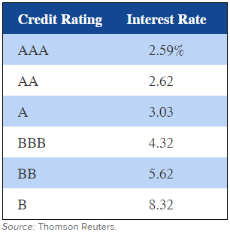
Function of Financial Markets (2 of 3)
Information Provided by Financial Markets
Commodity prices
Interest rates
Company values
Interest rates on long-term corporate bonds, March 2016
Notes:
18

Slide 25
Function of Financial Markets (3 of 3)
Market Capitalization ($ millions)
 | Number of Shares | x | Stock Price | = | Market Capitalization
Callaway Golf (ELY) | 93.8 | x | $8.76 | = | $821.69
Alaska Air Group (ALK) | 124.7 | x | $80.77 | = | $10,072.02
Entergy (ETR) | 178.5 | x | $75.92 | = | $13,551.72
Yum! Brands (YUM) | 408.7 | x | $77.77 | = | $31,784.60
General Electric (GE) | 9,331.0 | x | $30.34 | = | $283,102.54
Notes:
18

Slide 26
The Crisis of 2007-2009
Easy money
Subprime mortgages
Mortgage backed securities
Bear Sterns
AIG
IMF
Greece
Notes:
18

