Slide 1
Irresolvable Conflicts: Israeli Palestinian Impasse
Assist. Prof. Saffet Akkaya
Find course material at my page on IIBF https://www.cag.edu.tr/tr/akademik-kadro/429/hakkinda
E-mail: saffetakkaya@cag.edu.tr

Slide 2
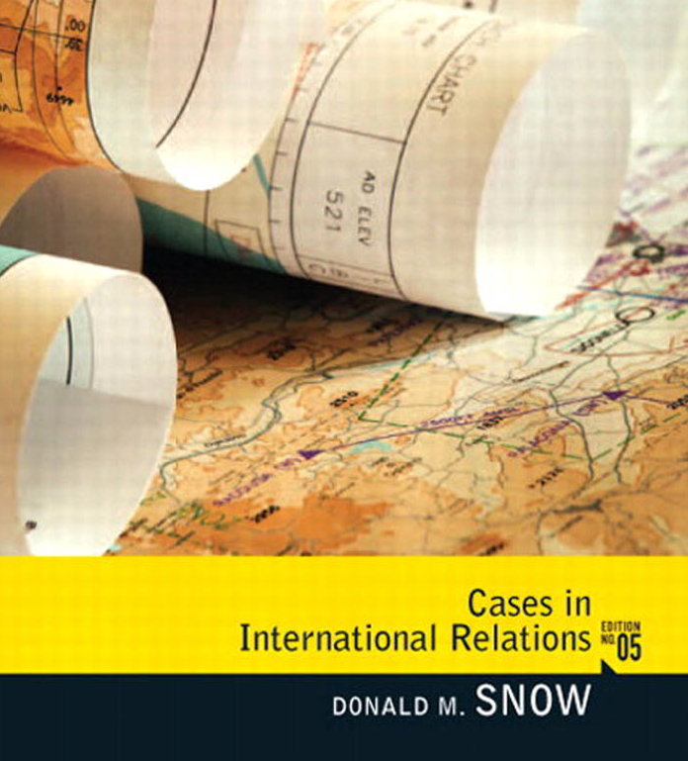

Main Source for the Course
Pages: 62-84

Slide 3
Current Issues in World Politics
Syllabus weeks
1st : Sovereignty: The Violation and Restoration of Iraqi Authority
2nd: Resource Scarcity: The Changing Dynamics and Implications of Global Energy
3rd: War Crimes and International Criminal Court and Syria
4th: Irresolvable Conflicts: Arab Israeli conflict
5th: Irresolvable Conflicts: Israeli Palestinian Impasse
6th: Asymmetrical Warfare: New/Old Wars in the world
Midterm Exam
7th: The Proliferation Problem Applied: The Case of North Korea
8th: Pivotal States: Confronting and Accommodating Iran
9th: The Phenomenon of Fundamental Political Change: The Arab Spring
10th: Global Warming :Facing the Problem After Copenhagen
11th: International Immigration, Refugees & Syrian Refugees
12th: Failed and Failing States: Pakistan case
Final Exam

Slide 4
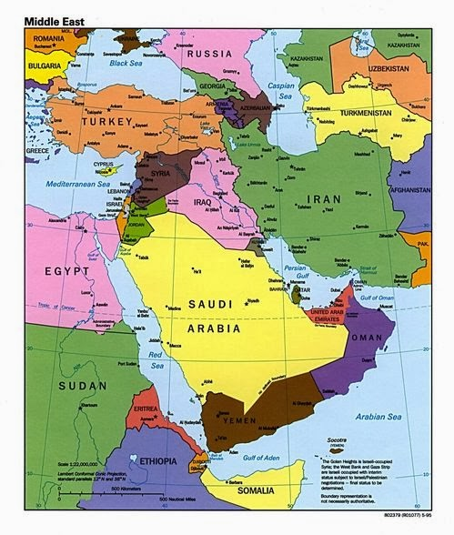
Crossroad between three continents
Center of three big religions (Jewish, Christian, Muslim)
Center of energy resources (oil-natural gas)

Slide 5
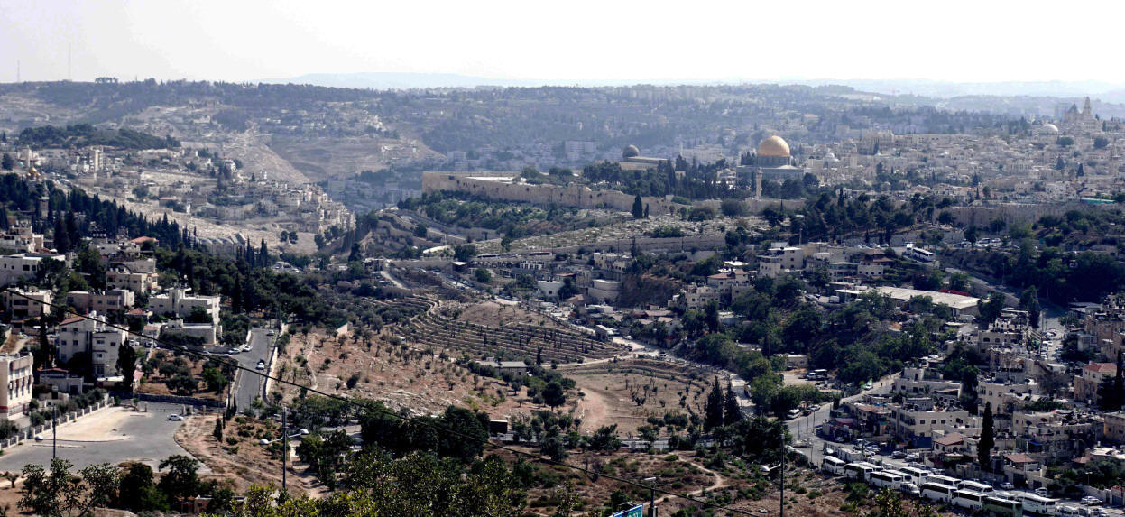
Sion Mountain in Jerusalem

Slide 6
Jewish Immigration to Palestine
Until 1917 World Zionist Organization/WZO has supported small scale immigrations into Palestine.
For this aim the WTO has established two funds;
Jewish National Fund (1901 – Purchase of Land for Jewish Settlements in Palestine)
British-Palestine Bank (1903 – Maintain credit to Jewish Agriculture Companies and Farmers in Palestine
Until 1942 “Israel State Formation” has not been put into Words.

Slide 7
Jewish Immigration to Palestine
Year | Muslims | Jews | Christians | Others
1922 | 486.177 | 83.790 | 71.464 | 7.617
1931 | 493.147 | 174.606 | 88.907 | 10.101
1941 | 906.551 | 474.102 | 125.413 | 12.881
1946 | 1.076.783 | 608.225 | 145.063 | 15.488

Slide 8
End of British Rule in Palestine
After World War II (1939-1945), the British soon realized that mandate in Palestine was not workable.
In February 1947, Britain asked the fledgling United Nations to address the question of Palestine.
United Nations Special Committee on Palestine (UNSCOP) favored a partition of Palestine into two states, a Jewish one and an Arab one.

Slide 9
UN Partition Plan
According to UNSCOP, the Arab state would be about 42% of Palestine and the Jewish one about 55%.
The remaining territory, including Jerusalem, would be an international zone.
The Jewish state would have about 500,000 Jews and 400,000 Arabs.
On November 29, 1947, UNSCOP’s majority report was approved by the United Nations General Assembly as resolution 181.
The Jews accepted partition, and the Arabs rejected it.

Slide 10
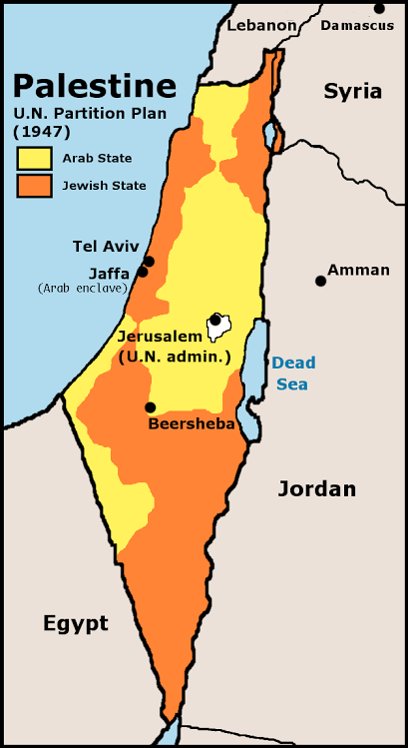
UN Partition Plan
Palestine and Israel States
Jerusalem Common Capital City

Slide 11
Irresolvable Conflicts
Irresolvable conflicts, mainly originate from sovereignty disputes.
The most extreme example of such conflicts in the contemporary international system is the conflict between the Israelis and the Palestinians.
In following slides, we begin with a description of irresolvable conflicts, their common characteristics and the basic methods that are available to try to resolve them.
With that framework established, the dynamics of irresolvable conflicts will be applied to the conflict between Israelis and the Palestinians.
Following a brief description of the issues involved, the discussion looks at the American-brokered peace process that has been ongoing for over a quarter century.

Slide 12
Irresolvable Conflicts
In these kinds of conflicts, the issues that divide the two (or more) sides are so deep and fundamental that they cannot be resolved peaceably through diplomatic methods.
Moreover, in these situations a military resolution wherein one side imposes its will on the other is either impossible or unacceptable to the international community as a whole.
Within the contemporary international system, the ongoing differences between;
  Taiwan and mainland China about the status of the island,
  Indo-Pakistani conflict over Kashmir,
But the most difficult example is the division between Israel and the Palestinian people .

Slide 13
Irresolvable Conflicts
Irresolvable conflicts share at least seven common characteristics.
The first is that the scarce resource normally involved is territory.
The scarceness arises from the fact that there are multiples claimants to sovereign control over a piece of territory over which only one side can exercise sovereignty.

Slide 14
Irresolvable Conflicts
The second characteristic is that these territorial conflicts tend to be extremely emotional, deep, and fundamental.
The emotion and depth arises from the fact that the territory is generally viewed as the rightful homeland of one or both sides, or the claims are rooted in some deep and fundamental division such as religion or ethnicity.
This emotional element can be politically manipulated by those either seeking to avoid resolution of the conflict or wanting to subvert outcomes that do not work to their advantage.

Slide 15
Irresolvable Conflicts
Third, irresolvable conflicts tend to be viewed by both parties as strictly zero-sum exercises, in which one side’s success is the other side’s loss.
There is little effort made or point in trying to find an accommodation in which both sides can benefit (a positive-sum exercise) or in which losses are equitably and acceptably apportioned (negative-sum games).
In irresolvable conflicts, both sides will only accept outcomes in which they succeed and the other side does not.

Slide 16
Irresolvable Conflicts
Fourth, the populations are affected in such a way as if the unwillingness and unacceptability are inevitable.
The position of each side often becomes viewed as “righteous” by the antagonists to the point that the idea of compromise becomes a sacrilege to dawa/cause.
Such depth of emotion may be limited to the extremists on both sides of the conflict, but their influence may be disproportionate to their numbers.

Slide 17
Irresolvable Conflicts
A fifth shared characteristic is often the failure of outside mediation to move the dispute toward resolution.
The outsiders pay attention in case of thir national intrests or ideologies matter, or the conflict is too dangerous to the global peace.
Conflicts between the government of Indonesia and East Timorese seeking independence did not attract much notice until reports of large-scale killings focused attention on the island of Timor.

Slide 18
Irresolvable Conflicts
The sixth characteristic is the inability of the parties to find acceptable outcomes to the conflict, thereby guaranteeing its continuation.
Conflicts over exclusive possession of scarce territorial resources are, of course, inherently difficult to resolve in normal methods.
In this case, the only way to reach a conclusion may be through the imposition of a settlement favoring one side at the expense of the other, which may be impossible for one of two reasons.

Slide 19
Irresolvable Conflicts
A seventh characteristic is that the longer an irresolvable conflict remains unresolved, the more the status quo may harden into a de facto solution.
The situations in Kashmir and Palestine (especially the West Bank) are exemplary.
Both conflicts have their roots in 1948 (the partition of the Indian subcontinent and the independence of Israel), and neither has moved toward resolution in the sixty-plus years.
The issues—Muslim claims on Kashmir and Palestine—remain unresolved, and an unhappy de facto status quo (division of Kashmir along the “Line of Control” and Israeli occupation of the West Bank) has evolved an uneasy permanence.

Slide 20
THE ISRAELI–PALESTINIAN CONFLICT
In order to understand this conflict as irresolvable, it is necessary to examine it.
This examination begins by looking at the structure of the problem, how it has evolved, and what the basic unresolved obstacles to resolution are. (last week we did)
One factor that distinguishes this conflict from other irresolvable conflicts is the extraordinary efforts The United States has invested in trying to overcome the conflict.
The attemps beginning with the efforts of Jimmy Carter at Camp David in 1978 and going forward through Bill clinton, and George W. Bush’s “road map” for peace.
Obama and Trump terms are not that much occupied by this conflict.

Slide 21
THE ISRAELI–PALESTINIAN CONFLICT
The 1948 war established the basic conditions that exist today, although the details have changed over time.
There were two major effects. The first, most profound and most relevant, was the effect on the Palestinian Muslims. Most of the Palestinian population fled their homes in Israel and became refugees, and the Palestinians constituted a stateless nation.
Such statelessness had been part of the burden of the Jewish population for nearly a millennium; the status was now transferred to the Palestinians.
Because the surrounding territories into which the Palestinians fled were generally poor and incapable of absorbing the new residents, the status of most refugees was wretched, powerless, and, as time went by, increasingly hopeless.

Slide 22
THE ISRAELI–PALESTINIAN CONFLICT
Second, these circumstances forms the basic rationale for the creation of an independent Palestinian state.
Such a state could be of two natures;
  One possibility is that the Palestinian state could be carved out of part of the original Palestine.
  The other possibility is to return Palestinian domain over the entirety of the area, by eliminating Israel State.

Slide 23
6 Days War
After the Suez war of 1956, war broke out again between Israel and its neighbors.
The start of the fighting was the removal of a UN force (the United Nations Emergency Force, or UNEF) from the Egyptian-Israeli border, where it had acted as a peacekeeping fence to prevent either country from attacking the other.
When it left, Egypt launched an attack on Israel and was joined by the armies of Jordan and Syria. The result was an utter disaster for the Muslim states.
The Israelis won the war in six days, changing fundamentally the power balance in the region and setting the groundwork for the current conflict.
When the dust had settled at the end of the war, Israel defeated the armed forces of each of its opponents and also occupied significant territories belonging to each.
From Egypt, the Israelis gained the Sinai Peninsula and the Gaza Strip.

Slide 24
6 Days War
These outcomes both altered the geopolitical balance in the region and created the physical basis for the peace process that would follow.
Egyptian loss of Sinai and Gaza and the consequent desire to regain those lost territories helped to form the basis for negotiations with Israel a decade later that would begin the peace process at Camp David.
Also, Jordan’s loss of the West Bank changed greatly the Palestinian situation. Many Palestinian refugees had settled on the West Bank after 1948, and they were again displaced by the events of 1967, as more fled into Jordan and also Lebanon.
Many Palestinians, however, remained in the occupied West Bank, where they were subjected to Israeli rule.
The occupation of the West Bank and Gaza created the precondition for Israeli settlements in both areas which undermined the peace process in recent years..

Slide 25
Yom Kippur War
The Six Days War created the conditions with which the peace process would have to deal, and the Yom Kippur War created the necessity to begin that process.
Two things stand out about the 1973 war. The first is that it was the first time the Israelis suffered significant military defeats against their Muslim rivals. As a result, the Israelis reportedly authorized nuclear arsenal for possible use against neighboring capitals.
This behaviour of Israel might escalate into a superpower nuclear confrontation, as the United States backed Israel and the Soviet Union backed the Islamic states.
Second, after the Israelis reversed the tide of military events the Soviets threatened to airlift troops to save an Egyptian army, thereby increasing the possibility of a superpower showdown.

Slide 26
Yom Kippur War
The outcome of the war changed the calculation of Middle East conflict in two ways.
First, the war could somehow draw the United States into a confrontation that could have led to World War III. The United States realized that such a possibility could destroy the United States.
Second, the Soviets did not resupply their allies in the war—notably the Egyptians—as they would have liked, and Egypt broke its ties with the Soviet Union.
The United States leaped into the power vacuum created by the Soviet departure and quickly established leverage with the Egyptians.
The possibility of a peace process was thus added to its perceived necessity.

Slide 27
The Peace Process
The process began with the convening of Egypt and Israel for peace negotiations in the United States by U.S. President Jimmy Carter in 1978 at Camp David. Bill Clinton resumed talks in 2000.
Between those events, Israel and Jordan independently negotiated an agreement, leaving only Syria and the Palestinians with unsettled differences with Israel.
George W. Bush reactivated outside assistance in the process in 2003 when he presented his “road map” for solving the differences.
That initiative did not bear fruit, nor have attempts by the Obama administration broken the impasse.

Slide 28
Camp David I
That there even was a first meeting at Camp David is one of the miracles of twentieth-century diplomacy.
Prior to the events that led to the meeting;
  Israel had never held official meetings of any kind with its neighbors (or the Palestinians),
  all the Muslim states in the region were denying the legitimate existence of Israel
  and also aim to destroy the Israeli state and hence to restore Palestine.
When Jimmy Carter came to White House in 1977, a peace in the region was at the top of his list of foreign policy, and his first act was to issue his plan for peace.
The governments on both sides rejected the plan Carter proposed, but it became at least a beginning point for future discussions.

Slide 29
Sadat-Begin Meeting-1977
Egyptian president Anwar Sadat jump-started the process.
In 1977, Sadat flew to Jerusalem, where he pointedly visited the Dome of the Rock and Al Aqsa mosque, and met with Israeli Prime Minister Menachem Begin.
The move was extremely bold because going to Jerusalem implicitly recognized the existence of Israel and thus broke ranks with his Islamic brethren in the region.
Egypt and Sadat were roundly condemned in the region because of this contact, and, after the Camp David accords, were diplomatically and economically isolated.
Begin took a chance because there was considerable Israeli opposition to the potential return of Sinai and Gaza to the Egyptians.

Slide 30
Camp David I
Sadat’s visit to Jerusalem proved the stepping-stone for the meeting at Camp David in 1978.
The meetings succeeded partly because Begin and Sadat showed extraordinary leadership in the face of tremendous opposition.
There were three basic issues between the two negotiators.;
  The first was Israel’s desire to be recognized by its neighbors.
  Egypt represented the second and third interests. Egypt had been enormously humiliated by the forced cessation of Sinai and Gaza and badly wanted both back as a matter of national prestige and pride.
  At the same time, Egypt hoped that opposition to its discussions with the hated Israelis would be moderated in the Muslim world if it also managed to get the Israelis to move toward a Palestinian state.

Slide 31
Camp David I
As a result, the Camp David Accord consisted of three agreements:
  The withdrawal of Israel from the Sinai Peninsula;
  2. A peace treaty between Israel and Egypt that included recognition of Israel;
  3. A promise to resolve the Palestinian question in the form of autonomy for the West Bank and Gaza Strip, a basis for a Palestinian state.
The first two provisions were implemented routinely. The Israelis withdrew from Sinai in two steps in 1979 and 1982.
The peace treaty between the two countries was signed in 1979, beginning the process leading to normal relations between them.
Egypt got back the territory it wanted, and Israel got the recognition it desired.

Slide 32
Camp David I
The fate of the Palestinian state was much more complex than the other two issues. The disposition of Jerusalem symbolizes this dispute.
The problem is that both sides claimed (and continue to claim) the Old City (East) Jerusalem as their capitals, and there are numerous religious shrines that neither religious group is willing to entrust control over to the other side.
The issue was thus intractable and effectively too difficult to resolve, so it was left unresolved for future negotiators.
The fate of Jerusalem has remained a major sticking point in the process. At Camp David I, it was left to the future.

Slide 33
Camp David II
Between 1978 and the second Camp David summit in 2000 the peace process evolved. (22 years !!)
The most prominent example was the peace accord between Israel and Jordan signed in 1994.
There was progress on some aspects of the relationship between Israel and its neighbors, but reaching a mutually satisfactory progress on the question of the Palestinians remained elusive.

Slide 34
Camp David II
The first Camp David Accord had promised a movement toward Palestinian “autonomy,” but there was disagreement about exactly what autonomy implied.
In the eyes of most of the Muslim world and among Palestinians themselves, autonomy over specific parts of the occupied territory was part of a process leading to full Palestinian control and sovereignty over the West Bank and Gaza and, eventually, to the establishment of a Palestinian state.
To many in Israel, autonomy certainly meant turning over various local governmental functions to the Palestinian Authority (PA), but not necessarily total authority and a sovereign Palestinian state.

Slide 35
Camp David II
A major breakthrough appeared to occur in 1993, when representatives of Palestine and Israel met secretly in Oslo, Norway, at the invitation of the Norwegian government.
At those meetings, the parties agreed to what became known as the Oslo framework as a way to move talks forward.
The Palestinian Liberation Organization (PLO) represented the Palestinians and agreed to end its call for the destruction of Israel and to renounce terrorism.
In return, the Israelis agreed to withdraw their authority from Gaza and the West Bank city of Jericho and turn that authority over to the Palestinians.
A deadline was also set for a final agreement to all issues by September 12, 2000.

Slide 36
Camp David II
Like Camp David I, progress toward fulfilling the promises of the Oslo accord lagged behind expectations.
Violence continued on both sides, the first intifada by Palestinians and acts such as the assassination of Israeli Prime Minister Yitzhak Rabin by an Israeli extremist in 1995 and an attack against a Jerusalem mosque that left over 25 dead.
At the same time, both sides accused the other of not living up to its side of the Oslo accords. The Israelis accused the PLO of failing to renounce terrorism.
The Palestinians countered that the Israelis were not living up the agreements they had made for turning over jurisdiction to the PA.
American president William J. Clinton sought to revive the peace process in July 2000 by inviting Yasser Arafat, head of the PA, and Israeli prime minister Ehud Barak for a reprise of the 1978 meeting at Camp David.

Slide 37
Camp David II
By the time Clinton convened the parties at Camp David II, there were four major outstanding issues facing the conferees. They are presented from easiest to most difficult to resolve.
  First question was Israeli settlements in both Gaza and the West Bank exacerbated and continue to exacerbate the problem.
  The second question was the physical extent of the Palestinian state that would be created.
  The third was the question of East Jerusalem.
  The fourth and most irresolvable issue, repatriation.
In the end, the impasse could not be overcome.

Slide 38
CONCLUSION
The Israeli–Palestinian dispute has remained irresolvable despite nearly 30 years of negotiations in which the United States has taken an active lead.
Future possibilities;
  The first possibility outcome is a continuation of the status quo of Israeli occupation of the West Bank. Many Israelis, and especially Netanyahu and his supporters, endorse this outcome, at least implicitly.
  The second possibility is the two-state settlement, an independent state of Palestine is established on the current occupied land on the West Bank and in Gaza. This solution is the preference of outside world, was favored by the Obama administration, and the Israeli left.
  The third possibility is a single Israeli/Palestinian state encompassing both pre-1967 Israel and the West Bank and Gaza, which might fulfill the Palestinian dream.

Slide 39
CONCLUSION
Demographically, such a state would have a majority of
Palestinian Muslims, meaning it could remain a Jewish state (or Jewishdominated
state) only by becoming what former U.S. President Jimmy Carter
referred to as an “apartheid” state wherein the Israeli minority had full
political rights that would be denied to the Palestinian majority. A democratic
(one-man one-vote) state would be dominated by the Palestinians, which is the
ultimate Israeli nightmare.

Slide 40
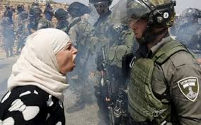
Questions?

