Slide 1
Chapter Twenty-Five
Managing Risk off the Balance Sheet with Loan Sales and Securitization
©McGraw Hill LLC. All rights reserved. No reproduction or distribution without the prior written consent of McGraw Hill.

Slide 2
Loan Sales and Securitization
Loan sales and securitization, the packing and selling of loans and other assets backed by loans issued by the FI, are mechanisms that FIs have used to hedge their credit risk, interest rate risk, and liquidity risk exposures
  Allowed FI asset portfolios to become more liquid
  Provided an important source of fee income
  Helped reduce the effects of regulatory “taxes” (e.g., capital requirements, reserve requirements, and deposit insurance premiums) on FI profitability
Loan sales involve splitting up larger loans and loan portfolios, whereas loan securitization involved the grouping of smaller loans into larger pools

Slide 3
Loan Sales
Loan sale occurs when an FI originates a loan and sells it with or without recourse to an outside buyer
  Recourse is the ability of a loan buyer to sell the loan back to the originator should it go bad
Large part of correspondent banking involves small FIs making large loans and selling (or syndicating) parts of the loans to large FIs, who in turn often sell parts of their loans (called participations) to smaller FIs
  Correspondent banking is a relationship between a small bank and a large bank in which the large bank provides a number of deposit, lending, and other services
Syndicated loan market is the market for buying and selling loans once they have been originated
Notes:
3

Slide 4
Loan Sales (Continued)
Syndicated loan market can be segmented into three categories:
  Market makers are generally the large commercial banks that commit capital to create liquidity and take outright positions in the markets
  Active traders are mainly investment banks, commercial banks, and culture funds
  Occasional participants may be either sellers or buyers of loans
Syndicated loan market grew rapidly in the early 1980s due to the expansion in highly leveraged transaction (HLT) loans to finance leveraged buyouts (LBOs) and mergers and acquisitions (M&As)
  HLT loans finance a merger and acquisition; a leveraged buyout results in a high leverage ratio for the borrower
Notes:
4
The volume of loans sold by U.S. banks increased from less than $20 billion in 1980 to $285 billion in 1989.

Slide 5
Recent Trends in the Loan Sales Market
Notes:
5
Figure 25–1 shows the growth in loan sales over the period 1991–2022.

Slide 6
Types of Loan Sales Contracts
Participation in a loan is the act of buying a share in a loan syndication with limited contractual control and rights over borrower
  Holder (buyer) is not a party to the underlying (primary) credit agreement, so the initial contract between the loan seller and the borrower remains in place after the sale
  Loan buyer can exercise only partial control over changes in the loan contract’s terms
    Holder can vote on only material changes to loan contract
An assignment is the purchase of a share in a loan syndication with some contractual control and rights over the borrower
  All ownership rights are transferred on sale, meaning the loan buyer holds a direct claim on the borrower
  U.S. domestic loans are normally transferred with a UCC filing, meaning there is documentation of a change in ownership in which the buyer has first claim on the borrower’s assets in the event of bankruptcy
Notes:
6
Currently, assignments represent the bulk of loan sales.

Slide 7
The Loan Sales Market
U.S. loan sales market has three segments:
  Traditional short-term loans
    Secured by assets of the borrowing firm or other external guarantors
    Made to investment-grade borrowers or better
    Issued for a short term (90 days or less)
    Sold in units of $1 million and up
    Rates are closely tied to commercial paper rate
  Highly leveraged transactions (HLTs) loans
    Secured by assets of the borrowing firm
    Have long maturity (often three- to six- year maturities)
    Have floating rates tied to the LIBOR, the prime rate, or a CD rate
    Have strong covenant protection
    May be either distressed or nondistressed
  Less developed country (LDC) loans are made to a less developed country (LDC)
Notes:
7
The U.S. loan sales market has three segments: two involve sales and trading of domestic loans and the third involves sales of LDC loans (less developed country loans that have been made to certain Asian, African, and Latin American countries).

Slide 8
The Buyers
For the nondistressed market and the traditional U.S. domestic loan sales market, there are seven major buyers:
  Investment banks are the predominant buyers of loans because:
  Vulture funds are specialized investment funds established to invest in distressed loans, often with an agenda that does not include helping the distressed firm survive
  Other domestic banks, especially small banks, may find the sales market useful as a way to regionally diversify their loan portfolios
  Foreign banks remain the dominant buyer of domestic U.S. loans
  Insurance companies and pension funds are important buyers of long-term loans
  Closed-end bank loan mutual funds are leveraged mutual funds that invest in domestic U.S. bank loans
  Nonfinancial corporations, primarily the financial services arms of the very largest U.S. and European companies, buy loans
Notes:
8
An increasingly specialized group of buyers of distressed loans includes investment banks and vulture funds.

Slide 9
The Sellers
Sellers of domestic loans and HLT loans include the following:
  Major money center banks have dominated loan selling
  Small regional or community banks sell loans to diversify credit risk, though they are not a major player in the loan sales market
  Foreign banks sell loans from branch networks (e.g., the Japanese-owned banks in California) or loans originated in their home country in U.S. loan sales markets
  Investment banks act as loan sellers either as part of their loan origination activities or as active traders in the market
  U.S. government and its agencies have shown an increased willingness to engage in loan sales in recent years
    Aided by passage of Debt Collection Improvement Act of 1996, which authorizes federal agencies to sell delinquent/defaulted loans
Notes:
9

Slide 10
Secondary Market for Less Developed Country (LDC) Debt
Since the mid-1980s, a secondary market for trading LDC debt has developed among large commercial and investment banks in New York and London
  Volume of trading has grown dramatically, from around $2 billion per year in 1984 to over $6 billion today
Three market segments include the following:
  Sovereign bonds (i.e., government-issued debt)
  Performing loans are original or restructured outstanding sovereign loans on which the sovereign country is currently maintaining promised payments to lenders or debt holders
  Nonperforming loans reflect the secondary market prices for the sovereign loans of countries where there are no interest or principal payments currently being made
Notes:
10

Slide 11
Future Loan Sales Growth
Factors encouraging future loan sales growth:
  Fee income – Originating and quickly selling loans can boost an FI’s reported income
  Liquidity risk – FI can mitigate a liquidity problem by selling some of its loans to outside investors
  Capital costs – FIs can boost capital-to-assets ratio by reducing assets (via loan sales) rather than boosting capital
  Reserve requirement – Represents a form of tax that adds to the cost of funding the loan portfolio
Factors deterring future loan sales growth:
  Access to the commercial paper (CP) market – Firms have less need to rely on bank loans to finance short-term expenditures, with fewer loan originations generally resulting in fewer loans being sold
  Customer relationship effects – Loan sales can harm revenues generated by the FI as current and potential future customers take their business elsewhere
  Legal concerns – Fraudulent conveyance is one example of a legal concern hampering growth
Notes:
11
Fraudulent conveyance is any transfer of assets (such as a loan sale) at less than fair value made by a firm while it is insolvent. Fraudulent conveyance prevents an insolvent firm from giving away its assets or selling them at unreasonably low prices and thereby depriving its remaining creditors of fair treatment on liquidation or bankruptcy.

Slide 12
Loan Securitization:
Pass-Through Security
Pass-through securities offer investors an interest in a pool, created by FIs pooling mortgages and other loans they originate
  Though many different types of loans (and other assets) on FI’s balance sheets are currently being securitized as pass-throughs, the original use of this type of securitization is a result of government-sponsored programs to enhance the liquidity of the residential mortgage market
    Pass-through mortgage securities “pass through” promised payments by households of principal and interest on pools of mortgages created by FIs to secondary market investors holding an interest in these pools
  Three government agencies or government-sponsored enterprises are directly involved in the creation of mortgage-backed pass-through securities:
    Ginnie Mae (GNMA), Fannie Mae (FNMA), and Freddie Mac (FHLMC)
Notes:
12
Loan securitization consists of packaging loans or other assets into newly created securities and selling these asset-backed securities (ABS) to investors. By packaging and selling loans to outside parties, the FI removes considerable liquidity, interest rate, and credit risk from its asset portfolio.

Slide 13
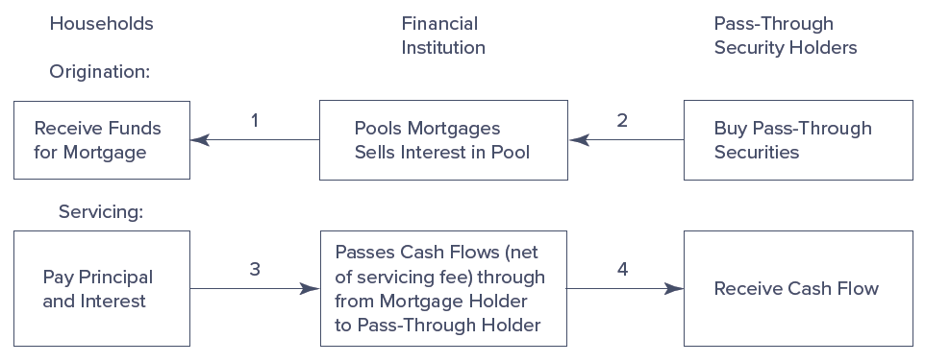
Pass-Through Mortgage Security
Notes:
13
After a financial institution accepts mortgages (step 1 in Figure 25–2), it pools them and sells interests in these pools to pass-through security holders (step 2 in Figure 25–2). Each pass-through mortgage security represents a fractional ownership share in a mortgage pool. Thus, a 1 percent owner of a pass-through mortgage security issue is entitled to a 1 percent share of the principal and interest payments made over the life of the mortgages underlying the pool of securities. The originating financial institutions (e.g., bank or mortgage company) or a third-party servicer receives principal and interest payments from the mortgage holder (step 3 in Figure 25–2) and passes these payments (minus a servicing fee) through to the pass-through security holders (step 4).

Slide 14
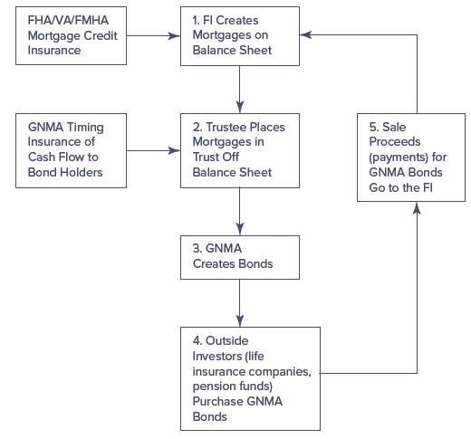
Summary of a GNMA Pass-Through
Notes:
14
The FI begins the securitization process by packaging the $100 million in mortgage loans. The packaged mortgage loans are removed from the balance sheet by placing them with a third-party trustee off the balance sheet. This third-party trustee may be another FI of high creditworthiness or a legal trustee. Next, the FI determines that (1) GNMA will guarantee, for a fee, the timing of interest and principal payments on the bonds issued to back the mortgage pool and (2) the FI itself will continue to service the pool of mortgages for a fee, even after they are placed in trust. Then, GNMA issues pass-through securities backed by the underlying $100 million pool of mortgages. These GNMA securities or pass-through bonds are sold to outside investors in the capital market, and the proceeds (net of any underwriting fees) go to the originating FI.

Slide 15
Prepayment Risk on GNMA Pass-Throughs
Mortgage loan securitization
  Reduces (or removes) the regulatory tax burden, interest rate risk exposure, and liquidity risk exposure that FIs face when they issue mortgages
  Introduces a new risk – prepayment risk – to the pass-through security holder
    Prepay means to pay back a loan before its maturity to the FI that originated the loan
Most fixed-rate mortgages are fully amortized
  Full amortization is the equal, periodic repayment on a loan that reflects part interest and part principal over life of the loan
Propensity to prepay means realized coupons/cash flows on pass-through securities can often deviate substantially from state or expected coupon flows in a no-prepayment world
Notes:
15

Slide 16
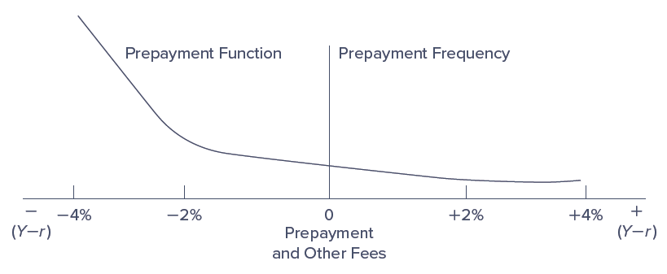
Prepayment Risk on Pass-Through Securities
Notes:
16
The pass-through security places on the investor in the mortgage pool a prepayment risk that reflects the uncertainty, in terms of timing, of the cash flows received from his or her investments in the bonds backed by the mortgage pool.

Slide 17
Collateralized Mortgage Obligations (CMOs)
Collateralized mortgage obligation (CMO) is a mortgage-backed bond issued in multiple classes, or tranches
  Innovated in 1983 by FHLMC and Credit Suisse First Boston
  Makes mortgage-backed securities more attractive to investors by repackaging cash flows from mortgages and pass-through securities in a different fashion to attract different types of investors with different degrees of aversion to prepayment risk
  Pass-through security gives each investor a pro rata share of any promised and prepaid cash flows on a mortgage pool, whereas CMO is a multiclass pass-through with several different bond holder classes (i.e., tranches) differentiated by the order in which each class is paid off
  Type of derivative security with mortgages as the primary asset
  Serves to distribute or reduce prepayment risk
Notes:
17

Slide 18
Creation of CMOs
CMOs are usually created by placing existing pass-throughs in a trust off-the-balance-sheet
  May also be created by packaging and securitizing whole mortgage loans
Trust issues CMOs in three or more different classes, each with a different level of prepayment risk
  Class A CMO holders have the least prepayment protection, and are of great interest to investors seeking short-duration mortgage-backed assets to reduce the duration of their mortgage-related asset portfolios
  After all Class A CMOs have been retired, remaining cash flows (after coupon payments) are used to retire Class B bonds
    Class B holders have higher prepayment protection than Class A
  Class C holders have the most prepayment protection, and are attractive to insurance companies and pension funds
Notes:
18

Slide 19
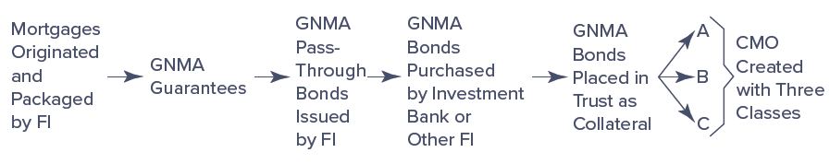
The Creation of a CMO
Notes:
19
We show a three-class or tranche CMO in Figure 25–6.

Slide 20
Creation of CMOs (Continued)
Issuing CMOs is often equivalent to engaging in double securitization
Sum of the prices at which CMO classes can be sold normally exceeds that of the original pass-through
  Gains from repackaging come from the way CMOs restructure prepayment risk to make it more attractive to different classes of investors (i.e., each class has a guaranteed or fixed coupon)
CMOs can have more than the three classes discussed earlier
  Issues of up to 17 different classes have been made
  CMO issues often contain a Z class (standing for “zero”) as the last regular class; Z class has characteristics of both a zero-coupon bond (no coupon payments for a long period) and a regular bond
  Another special CMO class is a planned amortization class (PAC), designed to produce constant cash flows within a range (or band) of prepayment rates
Notes:
20

Slide 21
Mortgage-Backed Bonds
Mortgage- (asset-) backed bonds (MBBs) are bonds collateralized by a pool of assets
MBBs differ from pass-throughs and CMOs in two key areas:
  Mortgage backing MBBs normally remain on the balance sheet
  Cash flows on mortgages backing the bond are not necessarily directly connected to interest and principal payment on the MBB
FI issues an MBB to reduce risk to the MBB holders, who have a firm claim to a segment of the FI’s mortgage assets
Costs of MBB issuance:
  MBBs tie up mortgages on the balance sheet for long periods, thus decreasing the asset portfolio’s liquidity
  FI is subject to any prepayment risk on the underlying mortgages
  FI continues to be liable for capital adequacy and reserve requirement taxes by keeping mortgages on the balance sheet
Notes:
21
A MBB is also a type of derivative with mortgages as the primary security.
Because of the costs associated with issuance, MBBs are the least used of the three basic vehicles of securitization.

Slide 22
Securitization of Other Assets
Major use of securitization vehicles has been to package fixed-rate residential mortgage assets, but these techniques can and have been used for other assets, including the following:
  Automobile loans
  Credit card receivables
  Small-business loans guaranteed by the Small Business Administration
  Commercial and industrial loans
  Student loans
  CDOs/CLOs
  Equipment loans
  Junk bonds
  Adjustable-rate mortgages
Notes:
22

Slide 23
U.S. Asset-Backed Securities Outstanding, 1985-2021
Notes:
23
At the end of 2021, securitized automobile loans totaled $220.6 billion, credit card receivables totaled $53.9 billion, student loans totaled $146.0 billion, equipment loans totaled $80.2 billion, and CDOs/CLOs totaled $819.1 billion (Figure 25–9).

Slide 24
Can All Assets be Securitized?
Can all assets and loans eventually be securitized?
  Conceptually, yes, so long as doing so is profitable or the benefits to the FI from securitization outweigh its costs
With heterogeneous loans, it is important to standardize the salient features of loans
  Default risks, if significant, must be reduced by diversification
  Expected maturities must be reasonably similar
FIs have been able to issue the following securitization packages:
  CLOs are collateralized loan obligations containing high-quality, low-default risk loans
  CDOs are collateralized debt obligations containing a diversified collection of junk bonds or risky bank loans
Notes:
24

Slide 25
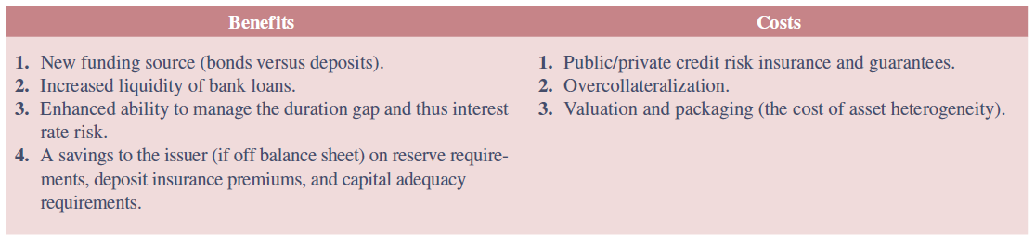
Benefits versus Costs of Securitization
Notes:
25
Table 25–6 summarizes the overall benefits versus the costs of securitization.
From Table 25–6, given any set of benefits, the more costly and difficult it is to find asset packages of sufficient size and homogeneity, the more difficult and expensive it is to securitize.

