Slide 1
Chapter Eight
Stock Markets
©McGraw Hill LLC. All rights reserved. No reproduction or distribution without the prior written consent of McGraw Hill.

Slide 2
The Stock Markets: Chapter Overview
Corporate stock serves as a source of financing for firms, in addition to debt financing or retained earnings financing
Secondary stock markets are the most closely watched and reported of all financial security markets
Stockholders are the legal owners of a corporation
  Have a right to share in the firm’s profits (through dividends) after the payment of interest to bond holders and taxes
  Have a residual claim on the firm’s assets
  Have limited liability
  Have voting rights (e.g., to elect board of directors)

Slide 3
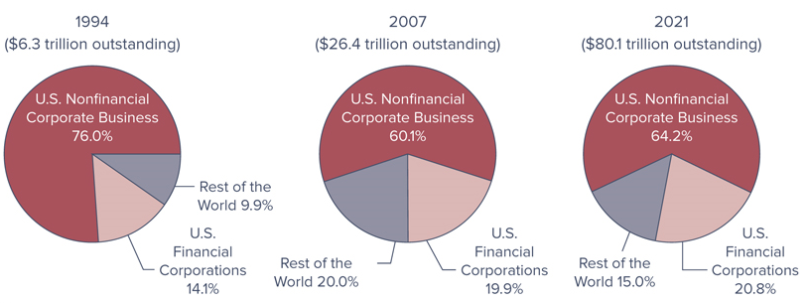
Market Value of Common Stock Outstanding, by Type of Issuer
Notes:
Figure 8–1 shows the market value of corporate stock outstanding in the United States in 1994, 2007, and 2021 by type of issuer.

Slide 4
Stock Market Securities:
Common Stock
Two types of corporate stock exist:
  Common stock
  Preferred stock
All public corporations issue common stock, but few issue preferred stock
Common stock is the fundamental ownership claim in a public or private corporation, and many characteristics differentiate it from other types of securities:
  Discretionary dividend payments
  Residual claim status
  Limited liability
  Voting rights

Slide 5
Common Stock: Dividends
Dividends are discretionary, and are thus not guaranteed
  Payment and size of dividends are determined by the board of directors of the issuing firm
Dividends are taxed twice – once at the firm level and once at the personal level
  May partially avoid this double taxation effect by holding stocks in growth firms that reinvest most of their earnings to finance growth rather than paying larger dividends

Slide 6

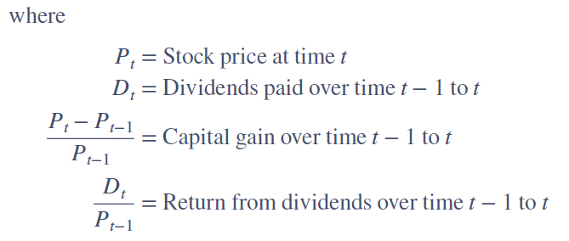
Common Stock: Dividends (Continued)
The return to a stockholder over a period t-1:

Slide 7
Common Stock: Residual Claim
Common stockholders have the lowest priority claim in the event of bankruptcy (i.e., they have a residual claim)
Only after all senior claims are paid are common stockholders entitled to what assets of the firm are left
  Senior claims may be payments owed to creditors such as the firm’s employees, bond holders, the government (taxes), and preferred stockholders
Residual claim feature associated with common stock makes it riskier than bonds as an investible asset

Slide 8
Common Stock: Limited Liability
Limited liability implies that common stockholder losses are limited to the amount of their original investment in the firm if the company’s asset value falls to less than the value of the debt it owes
  In contrast, sole proprietorship or partnership stock interests mean the stockholders may be liable for the firm’s debts out of their total private wealth holdings if the company experiences financial difficulties

Slide 9
Common Stock: Voting Rights
Common stockholders control the firm’s activities indirectly by exercising their voting rights in the election of the board of directors
Typical voting rights arrangement is to assign one vote per share of common stock
Some firms are organized as dual-class firms, where two classes of common stock are outstanding, with different voting and/or dividend rights for each class
Two methods of electing a board are generally used:
  Cumulative voting
  Straight voting
Notes:
With cumulative voting, all directors up for election, as nominated by the shareholders and selected by a committee of the board, are voted on at the same time. The number of votes assigned to each stockholder equals the number of shares held multiplied by the number of directors to be elected.
With straight voting, the vote on the board of directors occurs one director at a time. Thus, the number of votes eligible for each director is the number of shares outstanding.

Slide 10
Common Stock: Proxy Votes
Most shareholders do not attend annual meetings
A proxy is a voting ballot sent by a corporation to its stockholders
  When returned to the issuing firm, a proxy allows stockholders to vote by absentee ballot or authorizes representatives of the stockholders to vote on their behalf
By the 2010s, virtually all U.S. firms were putting proxy statements online and allowing votes to be cast via the Internet

Slide 11
Preferred Stock
Preferred stock is a hybrid security that has characteristics of both bonds and common stock
  Similar to common stock in that it represents an ownership interest in the issuing firm, but like a bond it pays a fixed periodic (dividend) payment
Dividends are generally fixed (paid quarterly)
Preferred stockholders generally do not have voting rights in the firm, but most stock may be converted to common stock at any time the investor chooses

Slide 12
Preferred Stock (Continued)
Typically, preferred stock is nonparticipating and cumulative
  Nonparticipating preferred stock means the dividend is fixed regardless of any increase of decrease in the issuing firm’s profits, while participating preferred stock means actual dividends paid in any year may be greater than promised dividends
  Cumulative preferred stock means that any missed dividend payments go into arrears and must be made up before any common stock dividends can be paid, while dividends of noncumulative preferred stocks do not go into arrears and are never paid

Slide 13
Primary Stock Markets
Primary stock markets are markets in which corporations raise funds through new issues of stocks
  Most primary market transactions go through investment banks
Investment bank can conduct a primary sale using either a firm commitment or best efforts underwriting basis
  In firm commitment underwriting, the investment bank guarantees the corporation a price for the newly issued securities
  Best efforts underwriting occurs when the underwriter does not guarantee a price to the issuer
A syndicate is a group of investment banks working in concert to sell and distribute a new issue; the lead banks in the syndicate is the originating house

Slide 14
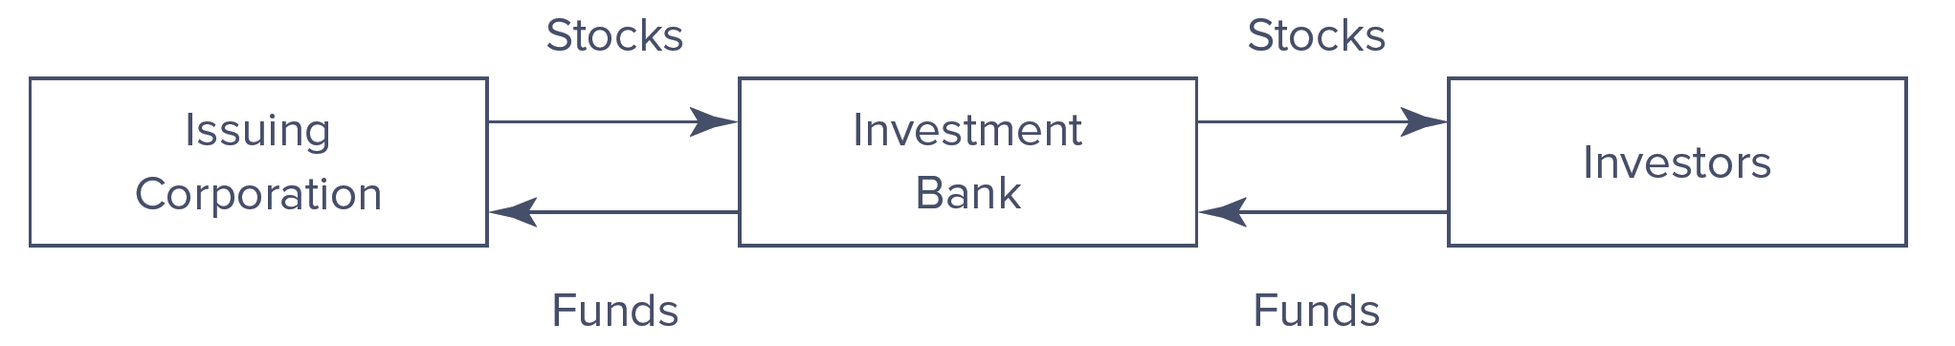
Primary Market Stock Transaction
Notes:
As illustrated in Figure 8–2, most primary market transactions go through investment banks (e.g., Morgan Stanley or Bank of America Merrill Lynch—see Chapter 16), which serve as the intermediary between the issuing corporations (fund users) and ultimate investors (fund suppliers) in securities.

Slide 15
Primary Stock Markets (Continued)
An initial public offering (IPO) is the first public issue of a financial instrument by a firm
A seasoned offering is the sale of additional securities by a firm whose securities are currently publicly traded
  Preemptive rights give existing stockholders the ability to maintain their proportional ownership
Registration of a stock can be a lengthy process
  A red herring prospectus is a preliminary version of the prospectus that describes a new security issue
  Shelf registration allows firms that plan to offer multiple issues of stock over a two-year period to submit one registration statement (i.e., master registration statement)
Notes:
It is important to emphasize that primary market sales include both IPOs and seasoned offerings. In both cases, the issuer receives the proceeds of the sale and the primary market investors receive the securities.

Slide 16
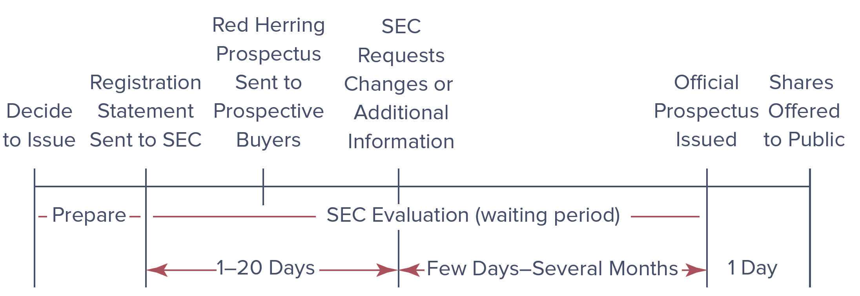
Getting Shares of Stock to the Investing Public
Notes:
The process of registering a stock is illustrated in Figure 8–4.

Slide 17
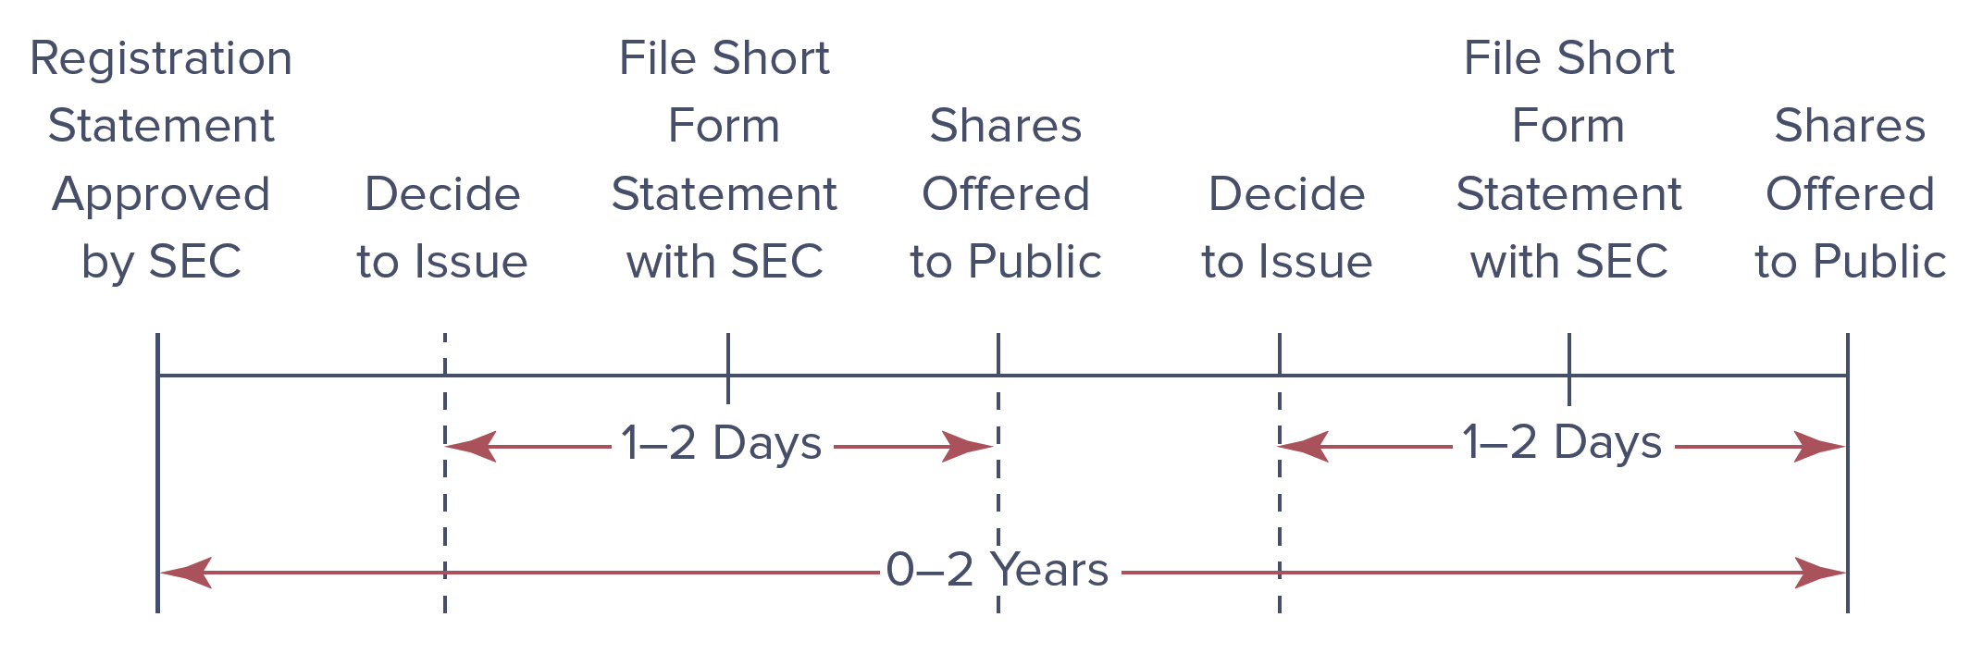
Getting Shelf Registrations to the Investing Public
Notes:
The process of shelf registrations is illustrated in Figure 8-5.

Slide 18
Secondary Stock Markets:
Stock Exchanges
Secondary stock markets are the markets in which stocks, once issued, are traded by investors
  In secondary market transactions, funds are exchanged, usually with the help of a securities broker or firm acting as an intermediary between the buyer and seller of the stock
  Original issuer of the stock is not involved in this transfer of stocks or funds
Two major U.S. stock markets are the following:
  New York Stock Exchange Euronext (NYSE Euronext)
  National Association of Securities Dealers Automated Quotation (NASDAQ) system
Notes:
While historically the NYSE was the premier stock market, the NASDAQ has become a strong second market.

Slide 19
Secondary Stock Markets:
The New York Stock Exchange
Worldwide, the NYSE Euronext is the most well known of all the organized exchanges
  Exchange was created by the merger of the NYSE Group, Inc. and Euronext N.V. on April 4, 2007
  World leader for listings, trading in cash equities, equity and interest rate derivatives, bonds, and the distribution of market data
  First to create a truly global stock market

Slide 20
Trading Process
All transactions occurring on the NYSE occur at a specific place on the floor of the exchange (trading post), and each stock is assigned a special market maker (a specialist)
  Specialists often organize themselves as firms due to large amount of capital needed to serve the market-making function
Three types of transactions can occur at a given post:
  Brokers trade on behalf of customers at the “market” price (market order)
  Limit orders are left with a specialist to be executed
  Specialists transaction for their own account
Notes:
As of December 2005, trading licenses are needed to make trades on the floor of the New York Stock Exchange. These trading licenses are made available by means of a Dutch auction through a process called the Stock Exchange Auction Trading System (SEATS). Only a member organization of NYSE is eligible to bid for one of the 1,400 available trading licenses.

Slide 21
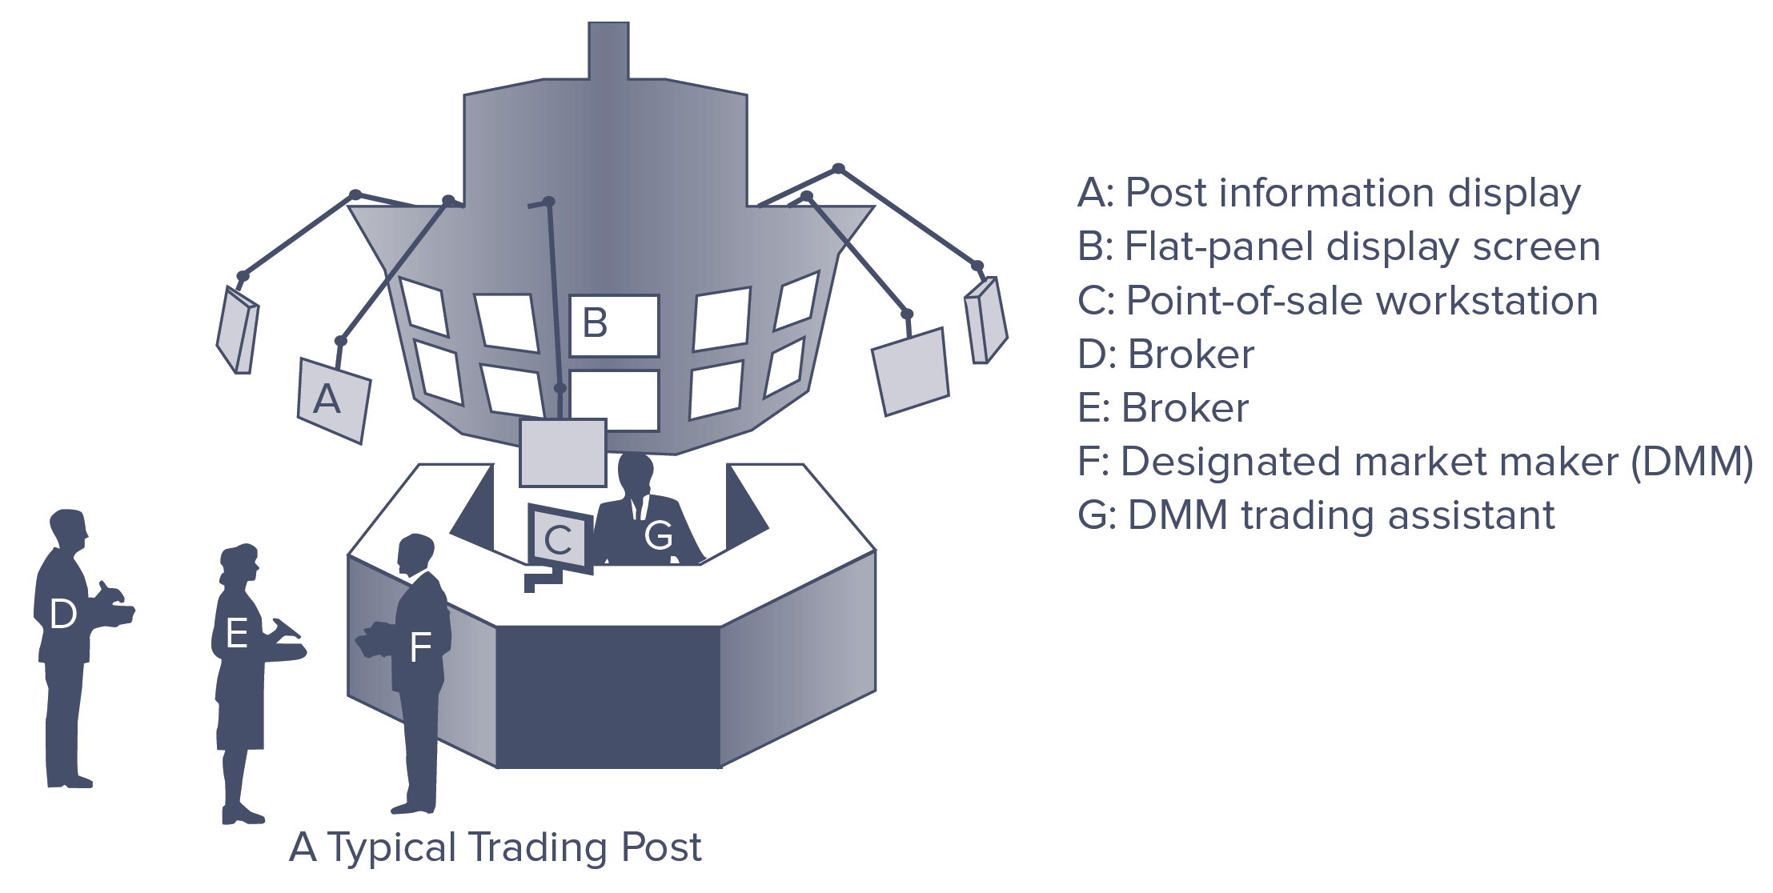
Trading Process (Continued)
Majority of orders sent to brokers are of two types:
  A market order is an order to transact at the best price available when the order reaches the post
  A limit order is an order to transact at a specified price

Slide 22
Program Trading
Program trading is the simultaneous buying and selling of a portfolio of at least 15 different stocks valued at more than $1m, using computer programs to initiate the trades
  Criticized for impact on stock market prices and increased volatility
NYSE introduced circuit breakers, which served as trading curbs, to account for increased volatility
  Circuit breakers are an imposed halt in trading that gives buyers and sellers time to assimilate incoming information
  Limit up-limit down (LULD) rules halts trading on individual stocks if the stock price moves outside the following price band:

Slide 23
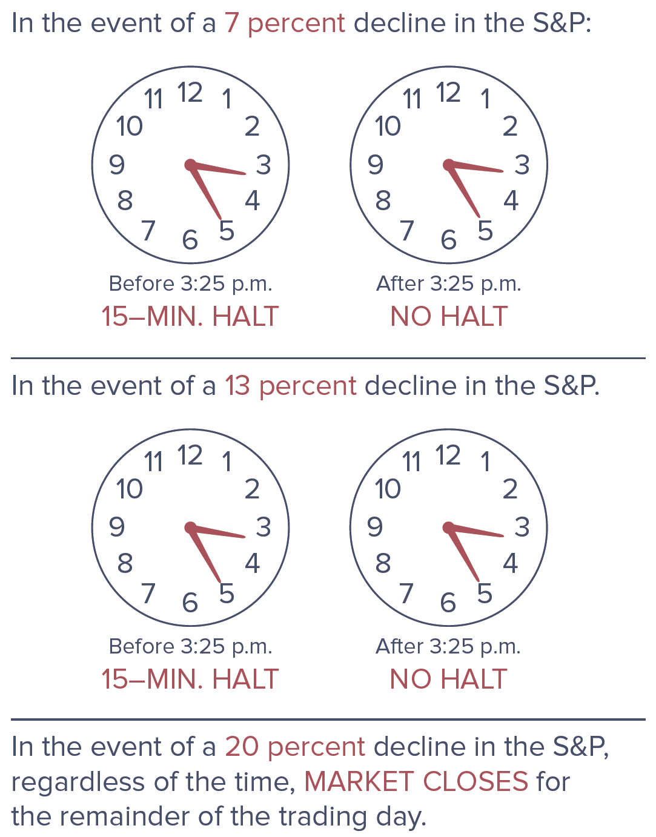
Circuit-Breaker Levels

Slide 24
Controversial Trading Practices
Flash trading is a practice in which, for a fee, traders are allowed to see incoming buy or sell orders milliseconds earlier than general market traders
Naked access allows some traders to rapidly buy and sell stocks directly on exchanges using a broker’s computer code without exchanges or regulators always knowing who is making the trades
  SEC banned naked access trading in late 2010
Dark pools of liquidity are trading networks that provide liquidity but that do not display trades on order books
  In 2013, the SEC approved a plan for new rules requiring dark pools to disclose and detail trading activity on their platforms

Slide 25
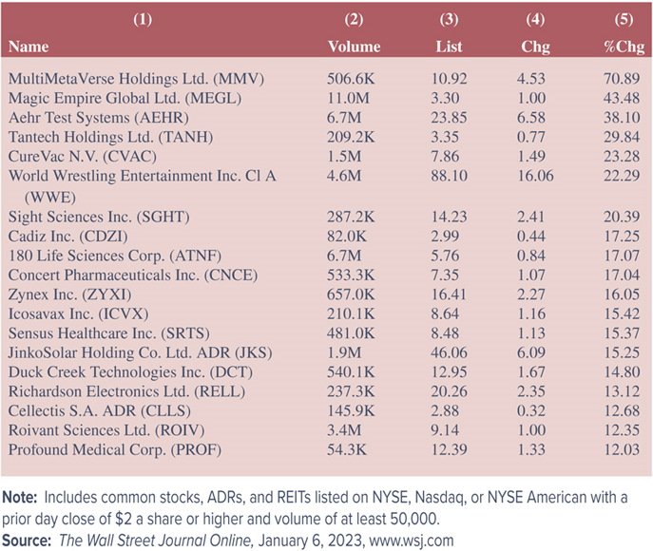
U.S. Stock Gainers,
January 6, 2023
Notes:
Table 8–1 presents a small part of a NYSE stock quote list from The Wall Street Journal Online summarizing stock gainers on January 6, 2023.
Column 1 lists the name of the corporation.
Columns 2 and 3 of the stock table list the volume and the closing price, respectively, of the stocks that gained on January 6, 2023.
Chg (column 4), is the dollar change in the closing price from the previous day's closing price [e.g., Concert Pharmaceuticals Inc. closed at $6.28 ($7.35 − $1.07) on January 5, 2023].
Column 5 lists the change from the previous day's close in percentage terms (e.g., $1.07/$6.28 = 17.04 percent).

Slide 26
The NASDAQ and OTC Market
Securities not sold on one of the organized exchanges are traded over the counter (OTC)
  OTC markets do not have a physical trading floor; rather, transactions are completed via an electronic market
NASDAQ was the world’s first electronic stock market
  Primarily a dealer market, where dealers are the market makers who stand ready to buy or sell particular securities
  In contrast to the NYSE, NASDAQ is a negotiated market (e.g., quotes from several dealers are usually obtained before a transaction is made)
  Small Order Execution System (SOES) provides automatic order execution for individual traders with orders of less than or equal to 1,000 shares

Slide 27
Choice of Market Listing
Firms listed with the NYSE Euronext must meet the listing requirements of the exchange
  Requirements are extensive
Reasons a NYSE listing is attractive to a firm:
  Improved marketability of the firm’s stock
  Publicity for the firm
  Improved access to the financial markets
Firms that do not meet the requirements of the NYSE Euronext exchange listings trade on the NASDAQ
  Most NASDAQ firms are smaller, of regional interest, or unable to meet the listing requirements of the organized exchanges
  Over time, many NASDAQ firms apply for NYSE listing

Slide 28
Electronic Communications Networks and Online Trading
Major stock markets currently open at 9:30 am eastern time and close at 4:00 pm eastern time
  Extended-hours trading involves any securities transaction that occurs outside these regular trading hours
  Most extended-hours trading is processed through computerized alternative trading systems (ATSs), also known as electronic communication networks (ECNs) such as NYSE Arca or Instinet
ECNs are computerized systems that automatically match orders between buyers and sellers and serve as an alternative to traditional market making and floor trading

Slide 29
Stock Market Indexes
A stock market index is the composite value of a group of secondary market-traded stocks
  Dow Jones Industrial Average (DJIA) is the most widely reported stock market index and includes the values of 30 large corporations selected by the editors of The Wall Street Journal
    Dow indexes are price-weighted averages
  NYSE Composite Index includes all NYSE-listed common stocks
    NYSE is a value-weighted index
  S&P 500 Index consists of the stocks of the top 500 of the largest U.S. corporations listed on the NYSE and the NASDAQ
  NASDAQ Composite Index consist of stocks traded through NASDAQ that are industrials, banks, and insurance companies
Notes:
Movements in a stock market index provide investors with information on movements of a broader range of secondary market securities.
The S&P 500, as well as the NASDAQ Composite Index, are value-weighted indexes.

Slide 30
Stock Market Indexes (Continued)
Wilshire 5000 Index is the broadest stock market index and possibly the most accurate reflection of the overall stock markets
  Contains virtually every stock that meets three criteria:
    Firm is headquartered in the U.S.
    Stock is actively traded in a U.S.-based stock market
    Stock has widely available price information (which rules out the smaller OTC stocks from inclusion)
  Though the index started with 5,000 firms, because of firm delistings, privatizations, and acquisitions it currently includes just 3,618 stocks
  Value-weighted index

Slide 31
Market Participants
Holders of corporate stock from 1994 through 2021:
  Households are the single largest holders (41.5% in 2021)
  Mutual funds and foreign investors are also prominent holders (20.2% and 17.5%, respectively)
  Households indirectly invest in corporate stock through investments in mutual funds and pension funds
    Together, these holdings totaled approximately 79% in 2021
  As unemployment rate decreased from 2016 through 2022, except for a sharp uptick during the Covid-19 crisis, stock ownership is starting to pick up slightly

Slide 32
Other Issues Pertaining to Stock Markets: Economic Indicators
Stock market indexes might be used to forecast future economic activity
  An increase (decrease) in stock market indexes today potentially signals the market’s expectation of higher (lower) corporate dividends and profits and, in turn, higher (lower) economic growth
Stock prices are one of the 10 variables included in the index of leading economic indicators used by the Federal Reserve as it formulates economic policy

Slide 33
Other Issues Pertaining to Stock Markets: Market Efficiency
Market efficiency refers to the speed with which financial security prices reflect unexpected news
  Weak form market efficiency concludes that investors cannot make more than the fair (required) return using information based on historic price movements
    Empirical research suggests markets are weak form efficient
  According to semistrong form market efficiency, investors cannot make more than the fair (required) return by trading on public news releases
    Financial markets have generally been found to immediately reflect information from news announcements
  Strong form market efficiency states that stock prices fully reflect all information about the firm, both public and private
    Implies that there is no set of information that allows investors to make more than the fair (required) rate of return on a stock

Slide 34
Other Issues Pertaining to Stock Markets: Stock Market Regulations
Main emphasis of SEC regulation is on full and fair disclosure of information on securities issues
Securities Act of 1933 required listed companies to file a registration statement and to issue a prospectus
Securities Exchange Act of 1934 established the SEC as the main administrative agency responsible for the oversight of secondary stock markets
Sarbanes-Oxley Act, passed in July 2002, created an independent auditing oversight board under the SEC, increased penalties for corporate wrongdoers, forced faster and more extensive financial disclosure, and created avenues of recourse for aggrieved shareholders
Notes:
Stock markets and stock market participants are subject to regulations imposed by the SEC as well as the exchanges on which stocks are traded.

Slide 35
Other Issues Pertaining to Stock Markets: Stock Market Regulations (Continued)
SEC has delegated certain regulatory responsibilities to the markets (e.g., NYSE or NASDAQ)
  In these matters, the NYSE and NASDAQ are self-regulatory organizations
Financial Industry Regulatory Authority (FINRA) is the largest independent regulatory for all securities firms doing business in the U.S.
  Formed in July 2007
  Oversees all aspects of the securities business
Wall Street Reform and Consumer Protection Act of 2010 gave the SEC and other regulators new powers to oversee the operations of stock markets

Slide 36
International Aspects of Stock Markets
U.S. stock markets are the world’s largest
  European markets grew in importance during the 2000s, as a result of implementing the euro, a common currency, in 2002
International stock markets are attractive to investors because some risk can be eliminated by holding stocks issued by corporations in foreign countries
International diversification can also introduce risk in the following manners:
  Information about foreign stocks is less complete and timely than that for U.S. stocks
  Foreign exchange risk
  Political (sovereign risk)

Slide 37
Sustainable Investing
Investment approach that considers environmental, social and governance (ESG) factors in portfolio selection and management
  Community investment segment finances projects or institutions that serve poor and underserved communities
Sustainable investing spans a wide range of products and asset classes
Sustainable investors comprised of individuals, and institutions, such as universities, foundations, pension funds, nonprofits, and religious institutions
Notes:
Money managers incorporate ESG factors fairly evenly across environmental, social and governance categories (approximately $16 trillion each).
in asset-weighted terms, climate change/carbon remains the most important specific environmental ESG issue, conflict risk was the largest social criterion, and anti-corruption was the largest governance criterion.

Slide 38
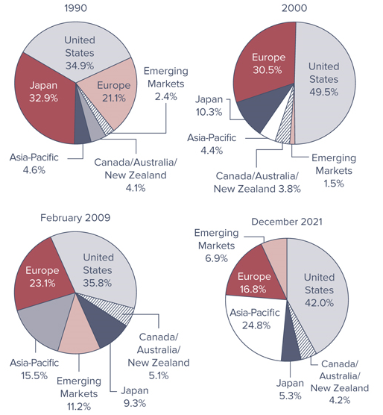
Worldwide Stock Market Capitalization

Slide 39
American Depository Receipts (ADRs)
An ADR is a certificate that represents ownership of a foreign stock
  Typically created by a U.S. bank, which buys stock in foreign corporations in their domestic currencies and places them with a custodian. The bank then issues dollar ADRs backed by the shares of the foreign stock
Three main types of ADR issuances
  Level 1 ADRs are the most common and most basic of the ADRs
    Have the least amount of regulatory requirements
  Level 2 ADRs can be listed on the major stock exchanges, but they have more regulatory requirements than Level 1 ADRs
  Level 3 ADRs represent the most respected ADR level a foreign company can achieve in the U.S. markets

Slide 40
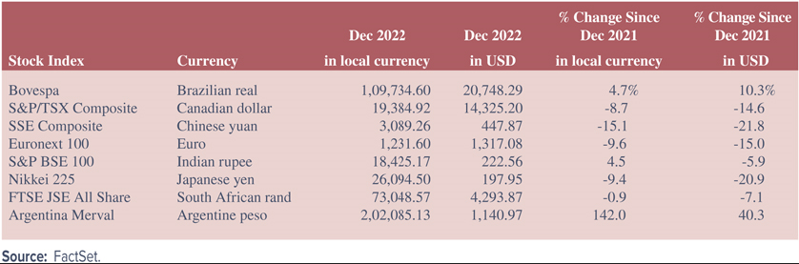
Impact of Change in Foreign Currency Exchange Rates on Index Returns

