Slide 1
Chapter One
Introduction
Notes:
6th Edition

Slide 2
Why Study Financial Markets and Institutions?
Markets and institutions are primary channels to allocate capital in our society
  Proper capital allocation leads to growth in:
    Societal wealth
    Income
    Economic opportunity

Slide 3
Why Study Financial Markets and Institutions Continued…?
In this text we will examine:
  the structure of domestic and international markets
  the flow of funds through domestic and international markets
  an overview of the strategies used to manage risks faced by investors and savers

Slide 4
Financial Markets
Financial markets are one type of structure through which funds flow
Financial markets can be distinguished along two dimensions:
  primary versus secondary markets
  money versus capital markets

Slide 5
Primary versus Secondary Markets
Primary markets
  Markets in which users of funds (e.g., corporations) raise funds by issuing new financial instruments (e.g., stocks and bonds)
Secondary markets
  Markets where existing financial instruments are traded among investors (e.g., exchange traded: NYSE and over-the-counter: NASDAQ)
Notes:
You might also wish to mention electronic communication networks or ECNs. ECNs allow direct electronic trading among buyers and sellers without a third party. Two former ECNs, BATS (formed in 2005) and DirectEdge (formed in 1998), merged in fall 2013, and applied to become an exchange. The combined entity makes them the number two stock market ahead of NASDAQ and behind NYSE. Together the two have about 270 employees. The NYSE and NASDAQ have far more! Sign of the times.
BATS Global Markets is a stock exchange based in Lenexa, Kansas, a suburb of Kansas City. BATS was founded in June 2005 as an Electronic Communication Network (ECN) and its name stands for Better Alternative Trading System.[2] (Trades stocks on BZX and options on BYX exchange.) (source BATS website)

Slide 6
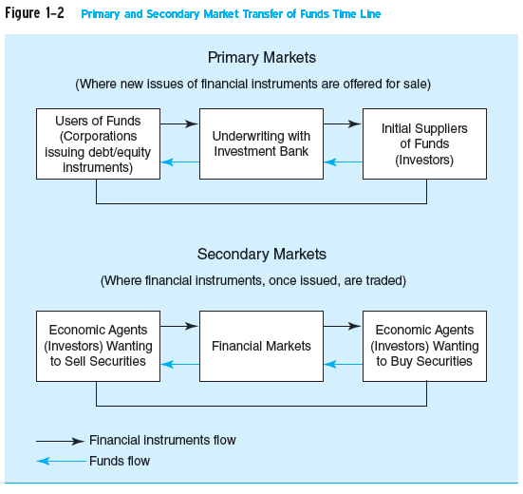
Primary versus Secondary Markets Continued

Slide 7
Primary versus Secondary Markets Concluded
How were primary markets affected by the financial crisis?
Do secondary markets add value to society or are they simply a legalized form of gambling?
  How does the existence of secondary markets affect primary markets?
Notes:
Primary market issuance declined sharply during the crisis, although with low interest rates bond issuance boomed after market uncertainty declined in 2010. Stock issuance remained weaker longer, recovering in 2012.
Secondary markets add liquidity for risky investments and encourage investment in primary markets. Secondary markets also aid in price discovery, providing up to date signals of the ongoing value of firms. These signals also provide benchmarks for corporate performance. It is not true that secondary markets are simply a legalized form of gambling.

Slide 8
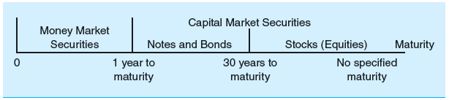
Money versus Capital Markets
Money markets
  Markets that trade debt securities with maturities of one year or less (e.g., CDs and U.S. Treasury bills)
    little or no risk of capital loss, but low return
Capital markets
  Markets that trade debt (bonds) and equity (stock) instruments with maturities of more than one year
    substantial risk of capital loss, but higher promised return
Figure 1.3

Slide 9
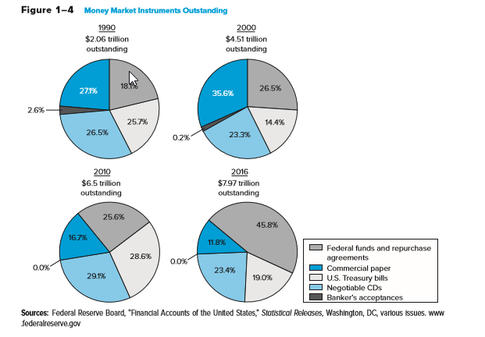
Money Market Instruments Outstanding, ($Tn)
Notes:
Notice with the 2016 data that T-bills are now about 1/5 of total money market instruments. Banker’s Acceptances continue to be used less due to their cost and the growth of other trading arrangements. The commercial paper (cp) market collapsed during the financial crisis and has grown more slowly since. Stress that cp is an alternative to a bank loan and may provide a cheaper source of financing for large well known companies.
Many students will not be familiar with commercial paper, repurchase agreements (repos or RPs) and banker’s acceptances so it is worthwhile to discuss these briefly. In a repo one sells a security and agrees to repurchase it at maturity at a higher price that is set in the contract. A repo is best thought of as a short term collateralized loan as compared to a fed funds loan which is uncollateralized.
Banker’s Acceptances have traditionally been used to finance international trade where a bank is asked to guarantee payment on a commercial contract in case the buyer of the goods does not or cannot pay.

Slide 10
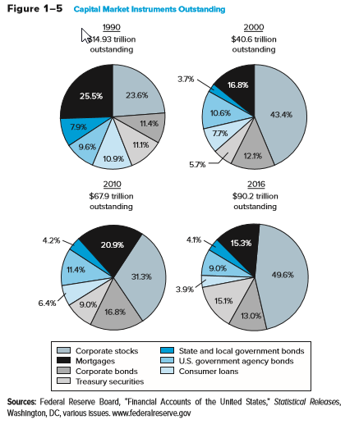
Capital Market Instruments Outstanding, ($Tn)
Notes:
Text: As of mid-March 2009, the Dow Jones Industrial Average (DJIA) had fallen 53.8 percent in value in less than 1 ½ years, larger than the decline during the market crash of 1929 when it fell 49 percent. However, stock prices recovered, along with the economy, in the last half of 2009, rising 71.1 percent between March 2009 and April 2010.

Slide 11
Foreign Exchange (FX) Markets
FX markets
  trading one currency for another (e.g., dollar for yen)
Spot FX
  the immediate exchange of currencies at current exchange rates
Forward FX
  the exchange of currencies in the future on a specific date and at a pre-specified exchange rate
Notes:
Spot FX: Note that ‘immediate’ usually means delivery within one or two business days.

Slide 12
Derivative Security Markets
Derivative security
  A financial security whose payoff is linked to (i.e., “derived” from) another, previously issued security such as a security traded in capital or foreign exchange markets
    Generally an agreement to exchange a standard quantity of assets at a set price on a specific date in the future
  The main purpose of the derivatives markets is to transfer risk between market participants

Slide 13
Derivative Security Markets Continued
Selected examples of derivative securities
  Exchange listed derivatives
    Many options, futures contracts
  Over the counter derivatives
    Forward contracts
    Forward rate agreements
    Swaps
    Securitized loans
Notes:
Exchange listed are more regulated, more transparent, and generally involve no default risk for the counterparty.
OTC derivatives are nonstandard, largely unregulated and may involve substantial counterparty credit risk.
Forward rate agreements are prearranged loan contracts with the loan terms set now, drawdowns in the future.

Slide 14
Derivatives and the Crisis
Mortgage derivatives allowed a larger amount of mortgage credit to be created in the mid-2000s.
  Growing importance of ‘shadow banking system’
Mortgage derivatives spread the risk of mortgages to a broader base of investors.
Change in banking from ‘originate and hold’ loans to ‘originate and sell’ loans.
  Decline in underwriting standards on loans
Notes:
(Optional slide: Hide if you do not wish to cover this topic)
This helped fuel a ‘credit boom’ that led to unsustainable increases in home prices. The shadow banking system refers to non-bank FIs who indirectly provide financing for loans buy originating loans or more likely by purchasing securities backed by loans. Shadow banking allows more rapid growth in credit by increasing the supply of funds available.
When home prices began falling in late 2006, more institutions were affected.
Resulted in a change in culture at some banks as well from a lending culture to a trading culture that was less risk averse.
The instructor may wish to ask students whether it makes sense to blame the instrument or the users. Warren Buffett has called derivatives, ‘weapons of mass destruction.’ However, used properly they allow market participants to transfer risk to other parties that they themselves do not wish to bear, and allow others lower cost methods to gain exposure to markets. It does seem reasonable to require greater transparency in OTC derivatives to ensure that players can cover the promises they make. Derivatives that involve payments of principal, such as credit default swaps, should be required to be traded on an exchange so that there are guarantees of performance and reasonable limits to speculation.

Slide 15
Derivatives and the Crisis Continued
  Subprime mortgage losses were large, reaching over $700 billion.
  The “Great Recession” was the worst since the “Great Depression” of the 1930s.
    Trillions $ global wealth lost, peak to trough stock prices fell over 50% in the U.S.
    Lingering high unemployment and below trend growth in the U.S.
    Sovereign debt levels in developed economies reached post-war all-time highs
Notes:
(Optional slide: Hide if you do not wish to cover this topic)
Led to overall large declines in home prices nationwide. Houses are illiquid assets and falling home values are a drag on economic growth. Millions of homeowners are ‘underwater,’ owing more on their homes than their current market value.
Much of the wealth loss may be temporary over the long term, but growth declined at a rapid rate during the crisis. As of 2014 only now beginnin to see a return to more normal growth rates of the U.S. economy.
The instructor may wish to ask students whether it makes sense to blame the instrument or the users. Warren Buffett has called derivatives, ‘weapons of mass destruction.’ However, used properly they allow market participants to transfer risk to other parties that they themselves do not wish to bear, and allow others lower cost methods to gain exposure to markets. It does seem reasonable to require greater transparency in OTC derivatives to ensure that players can cover the promises they make. Derivatives that involve payments of principal, such as credit default swaps, should be required to be traded on an exchange so that there are guarantees of performance and reasonable limits to speculation.

Slide 16
Financial Market Regulation
The Securities Act of 1933
  Full and fair disclosure and securities registration
The Securities Exchange Act of 1934
  Securities and Exchange Commission (SEC) is the main regulator of securities markets

Slide 17
Financial Institutions (FIs)
Financial Institutions
  Institutions through which suppliers channel money to users of funds
Financial Institutions are distinguished by:
  Whether they accept insured deposits
    Depository versus non-depository financial institutions
  Whether they receive contractual payments from customers
Notes:
Institutions that accept insured deposits must be regulated by the government to offset the government’s liability. Insured deposits are a low cost source of financing, but the regulatory burden increases these institution’s costs significantly.
FIs that receive contractual payments, such as life insurers, pension funds and property and casualty insurers have steady premium income to invest. This allows them to take on more risk in their investment portfolio.

Slide 18
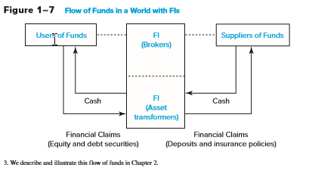
Percentage Shares of Assets of Financial Institutions in the United States, 1948–2016
Notes:
Point out the large decline in the share of commercial banks from 2010 (32.8%) to 2016 (26.1%).

Slide 19
Non-Intermediated (Direct)
Flows of Funds
Flow of Funds in a World without FIs
Direct Financing
Financial Claims
(equity and debt instruments)
Users of Funds
Suppliers of Funds
Cash

Slide 20
Intermediated Flows of Funds
Flow of Funds in a World with FIs
Intermediated Financing
FIs
(brokers)
FIs
(asset
transformers)
Users of Funds
Suppliers of Funds
Cash
Cash
Financial Claims
(equity and debt securities)
Financial Claims
(deposits and insurance policies)

Slide 21
Depository versus Non-Depository FIs
Depository institutions:
  commercial banks, savings associations, savings banks, credit unions
Non-depository institutions
  Contractual:
    insurance companies, pension funds,
  Non-contractual:
    securities firms and investment banks, mutual funds.
Notes:
Note: savings associations, savings banks and credit unions are often called ‘thrifts.’

Slide 22
FIs Benefit Suppliers of Funds
Reduce monitoring costs
Increase liquidity and lower price risk
Reduce transaction costs
Provide maturity intermediation
Provide denomination intermediation

Slide 23
FIs Benefit the Overall Economy
Conduit through which Federal Reserve conducts monetary policy
Provides efficient credit allocation
Provide for intergenerational wealth transfers
Provide payment services

Slide 24
Risks Faced by Financial Institutions
Credit
Foreign exchange
Country or sovereign
Interest rate
Market
Off-balance-sheet
Liquidity
Technology
Operational
Insolvency
Volcker Rule: Insured institutions may not engage in proprietary trading

Slide 25
Regulation of Financial Institutions
FIs are heavily regulated to protect society at large from market failures
Regulations impose a burden on FIs; before the financial crisis, U.S. regulatory changes were deregulatory in nature
Regulators attempt to maximize social welfare while minimizing the burden imposed by regulation

Slide 26
Enterprise Risk Management
Enterprise risk management
  Recognizes the importance of managing the combined impact of the full spectrum of risks as an interrelated risk portfolio
Popularity rose as a result of the failure of advanced risk measurement and management systems to detect exposures that led to the financial crisis
Stresses importance of building a strong risk culture

Slide 27
Globalization of Financial Markets and Institutions
The pool of savings from foreign investors is increasing and investors look to diversify globally now more than ever before
Information on foreign markets and investments is becoming readily accessible and deregulation across the globe is allowing even greater access to foreign markets
International mutual funds allow diversified foreign investment with low transactions costs
Global capital flows are larger than ever

Slide 28
Appendix: FIs and the Crisis
Timeline of events
Home prices decline in late 2006 and early 2007
  Delinquencies on subprime mortgages increase
  Huge losses on mortgage-backed securities (MBS) announced by institutions
Bear Stearns fails and is bought by J.P. Morgan Chase for $2 a share (deal had government backing)
Notes:
In 2007 Citigroup, Merrill Lynch and Morgan Stanley wrote off $40 billion in bad mortgages.
The MBS insurer, MBIA, reported a $2.3 billion loss in the fourth quarter of 2007, Countrywide had to draw down its entire $11.5 billion credit line, leading to a buyout by Bank of America.
Indy Mac Bank, the largest mortgage lender in the U.S. at the time tried to find additional capital throughout 2007, but could not, and was seized by the FDIC in July 2008 after facing deposit withdrawals of $1.3 billion. The cost to the FDIC was betweent $8.5 and $9.4 billion.

Slide 29
Appendix: FIs and the Crisis Continued
Timeline of events
September 2008, the government seizes government-sponsored mortgage agencies Fannie Mae and Freddie Mac
  The two had $9 billion in losses in the second half 2007
  Now run by Federal Housing Finance Agency (FHFA)
September 2008, Lehman Brothers files for bankruptcy; Dow drops 500 points
Notes:
Lehman had been around for over 150 years, Barclays eventually acquires many of Lehman’s assets.

Slide 30
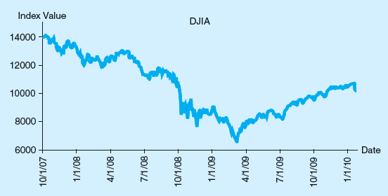
Appendix: FIs and the Crisis Concluded
  Figure 1-9 The Dow Jones Industrial Average, October 2007–January 2010
Notes:
Dow drops during the crisis.

Slide 31
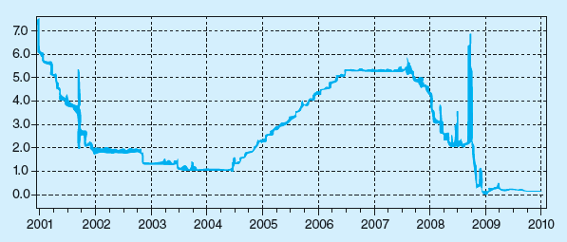
Overnight LIBOR, 2001 - 2010
  Figure 1-10 Overnight London Interbank Offered Rate (LIBOR), 2001–2010
Notes:
International lending market seizes up. LIBOR (London Interbank Offer Rate) climbs rapidly.
(Institutions intentionally misreport LIBOR to hide default risk from the markets.)

Slide 32
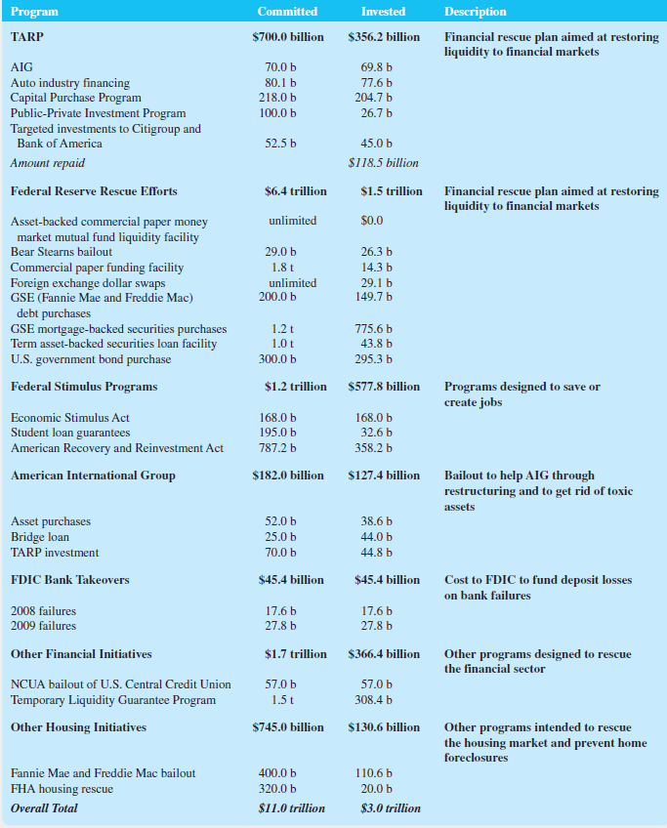
Appendix: Government Rescue Plan
  Table 1-12 Federal Government Rescue Efforts through December 2009

Slide 33
Appendix: Government Rescue Plan Continued
  Table 1-12 Federal Government Rescue Efforts through December 2009

Slide 34
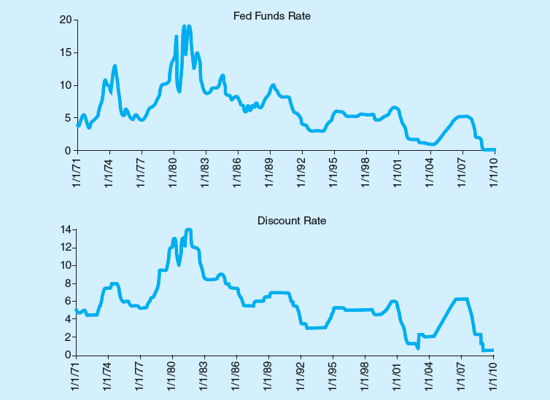
Federal Funds Rate and Discount Window Rate
  Figure 1-11 Federal Funds Rate and Discount Window Rate—January 1971 through January 2010

Slide 35
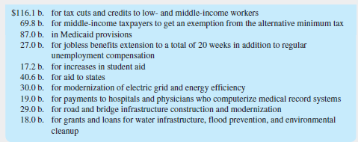
Major Items in the Stimulus Program
  Table 1-13 Major Items in the $787 Billion Stimulus Program as Passed by the U.S. Congress, February 13, 2009

