Slide 1
Economics
Chap 5: Background to Supply (Part 1)
Dr. Cansu Unver-Erbas

Slide 2
AIM OF CHAPTER 5
In Chapter 5, we will learn about: how firms make their decisions (supply side)
In previous lectures, we learned the basics of how markets work.
Following Chap 5, you should be able to determine:
How much output should a firm produce?
How much profit does a firm make?
When is it better for a firm to shut down?
To answer these questions, we need to be able to calculate firms’ costs and
revenues.

Slide 3
AIM OF THIS LECTURE
In this lecture (Part 1), we will learn about: production and costs.
Following the lecture, you should be able to:
Understand the production process;
Understand a firm’s costs;
Describe the relationship between production and costs.

Slide 4
READING MATERIAL
Mankiw, G. and Taylor, M. (2017). Microeconomics. Cengage Learning.
Chapter 6: Background to supply: firms in competitive markets part 1: 112-126 (2017)

Slide 5

FIRM’S OBJECTIVE
The goal of the firm is to maximize profits.
What is a firm’s profit?
Profit = Total revenue – Total cost
Total revenue (TR): The amount a firm receives for the sale of its output (P*Q).
Total cost (TC): The market value of the inputs used for producing the output.

Slide 6
FIRM’S OBJECTIVE
Total revenue is easy to determine.
Total revenue = price x quantity
If a firm produces 100 units of output and sells it at £5 Total revenue = £5 x 100 = £500
When we think about a firm’s cost we must remember one of the ten principles of economics (Chapter 1):
The cost of something is what you give up to receive it.
The opportunity cost of an item refers to all things that must be forgone to acquire that item. Opportunity cost includes both explicit costs and implicit costs.

Slide 7
FIRM’S COSTS
A firm’s cost of production includes both explicit costs and implicit costs.
Explicit costs are input costs that require a payment of money by the firm;
e.g., wage of an employee.
Implicit costs are input costs that do not require a payment of money by the firm; e.g., income that the firm owner could have earned by doing something else.

Slide 8
ECONOMIC PROFIT VERSUS ACCOUNTING PROFIT
The distinction between explicit and implicit costs highlights an important difference between how economists and accountants analyse a business.
Economists are interested in how firms make production and pricing decisions. These decisions are based on both explicit and implicit costs.
→ Economists include both explicit and implicit costs when measuring
a firm’s costs.
Accountants have to keep track of the money that flows into and out of firms.
→ Accountants only measure explicit costs and ignore implicit costs.

Slide 9
ECONOMIC PROFIT VERSUS ACCOUNTING PROFIT
Economists measure a firm’s economic profit as total revenue minus total cost, including both explicit and implicit costs. Economists take into account the opportunity costs.
Economic profit = total revenue – explicit costs – implicit costs
Accountants measure the accounting profit as the firm’s total revenue minus the firm’s explicit costs.
Accounting profit = total revenue – explicit costs
Economic profit < Accounting profit.

Slide 10
PRODUCTION AND COSTS
Firms incur costs when they buy inputs to produce the goods and services they plan to sell.
Important simplifying assumption: in the short run some factors of production cannot be changed; e.g., building a new factory is not possible in the short-run.
The short run: the period of time in which some factors of production cannot
be changed.
The long run: the period of time in which all factors of production can be
altered.

Slide 11
THE PRODUCTION FUNCTION
The production function shows the relationship between the quantity of inputs used to produce a good and the quantity of output of that good.
Q = f(K,L) where Q=output, K=capital, L=labour
This is a simplified production function, in reality more production factors are used: e.g., natural resources like water, industrial enterprise (= initiatives taken by the entrepreneurs, …).
In the short run, labour is variable and capital fixed. A short-term production function states how total output changes with labour (L) for a given level of capital (K).
Total physical product of labour (𝑻𝑷𝑷_{𝑳}) : this is total output that is produced by
the units of labour, for a given capital.

Slide 12
THE PRODUCTION FUNCTION
Paolo’s Pizza Factory
Number of workers | Output (qty of pizzas produced per hour) or 𝑻𝑷𝑷_{𝑳} | Marginal product of labour | Cost of factory (£) | Cost of workers (£) | Total cost of inputs (cost of factory + cost of workers) (£)
0 | 0 | 0 | 30 | 0 | 30
1 | 50 | 50 | 30 | 10 | 40
2 | 90 | 40 | 30 | 20 | 50
3 | 120 | 30 | 30 | 30 | 60
4 | 140 | 20 | 30 | 40 | 70
5 | 150 | 10 | 30 | 50 | 80

Slide 13
Paolo’s Production Function
Quantity of
Output (pizzas per hour)
150
140
130
120
110
100
90
80
70
60
50
40
30
20
10
Production function
0
1
2
3
4
5
Number of Workers Hired
Copyright©2011 South-Western

Slide 14
THE PRODUCTION FUNCTION
The average product of an input in the production process is the units of output produced per unit of input (while keeping other inputs constant).
Average product is a global concept (total output is divided by total input).
The higher the average product, the more productive an input is and vice
versa.
Average product of labour:
AP_{L} = 𝑄/𝐿
Average product of capital:
AP_{K} = 𝑄/𝐾
Example: if 120 pizzas are produced in Paolo’s pizza factory by employing 3 workers, AP_{L} = 120/3 = 40.

Slide 15
THE PRODUCTION FUNCTION
The marginal product of an input in the production process is the increase in output that arises from an additional unit of that input.
change in total product
MP =
F
change in quantity of the factor
Local concept as the additional amount of output is divided by the additional amount of input invested.
Marginal product of labour: MP_{L} = ∆ 𝑄/ ∆ 𝐿
Average product of capital: MP_{K} = ∆ 𝑄/ ∆ 𝐾

Slide 16
PRODUCTION FUNCTION
Paolo’s Pizza Factory
Number of workers | Output (qty of pizzas produced per hour) or 𝑻𝑷𝑷_{𝑳} | Marginal product of labour (MP_{L}) | Cost of factory (£) | Cost of workers (£) | Total cost of inputs (cost of factory + cost of workers) (£)
0 | 0 | 0 | 30 | 0 | 30
1 | 50 | 50 | 30 | 10 | 40
2 | 90 | 40 | 30 | 20 | 50
3 | 120 | 30 | 30 | 30 | 60
4 | 140 | 20 | 30 | 40 | 70
5 | 150 | 10 | 30 | 50 | 80

Slide 17

THE PRODUCTION FUNCTION
Notice: as the number of workers increases, the MP declines. Why?
Diminishing marginal product is the property whereby the marginal product
of an input declines as the quantity of the input increases.
Example: As more and more workers are hired at a firm, each additional worker contributes less and less to production, because equipment is limited.
…hence, in this example: as more and more workers are hired, each
additional worker contributes less to the production of pizzas.

Slide 18




Quick exercise: input focus
Consider a small firm that produces wheat (measured in tonnes). To produce wheat it requires just two factors of production: workers (L) and tractors (K).
Number of workers (L) | Output or 𝑻𝑷𝑷_{𝑳}
0 | 0
1 | 3
2 | 10
3 | 24 | 3 to 4 workers
4 | 36
5 | 40
6 | … |  | 40 units by 5 w
7 | 42 |  | APP = 40/5
₈ Avera | ge work₄e₀r makes | 7 units
APP
= TPP/L
- 3
5
8
9
…
7
6
5
MPP
= ∆TPP/∆L
- 3
7
14
…
4
2
0
-2
MPP = 36 – 24 = 12
orkers
= 8
TPP = APP x L = 7 x 6 = 42
19

Slide 19
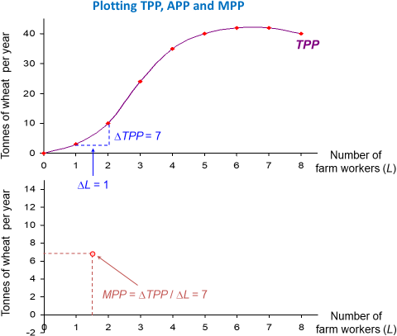

Slide 20
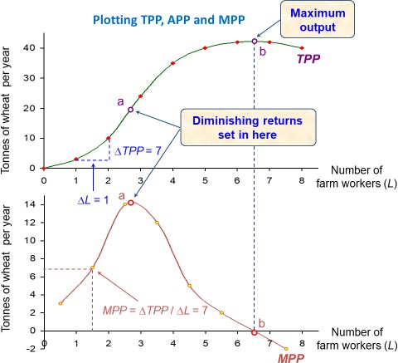

Slide 21
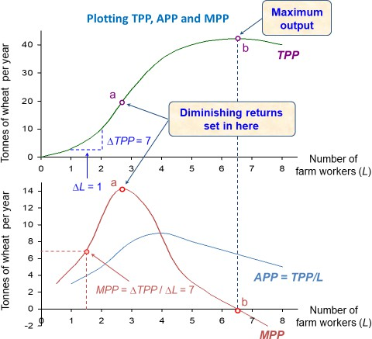

Slide 22
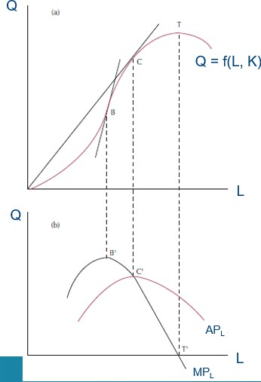

Link between production function, MP and AP
The slope of the production function measures the marginal product of an input, such as a worker.
When the marginal product declines, the slope decreases and the production function becomes flatter.

Slide 23
FROM THE PRODUCTION FUNCTION TO THE TOTAL COST CURVE
The relationship between the quantity a firm produces and the cost of producing that quantity is important, as it determines the firm’s production and pricing decisions.
This relationship can be represented by a table, a function or a graph.
The total cost curve shows this relationship graphically.

Slide 24
PRODUCTION FUNCTION AND TOTAL COST
Paolo’s Pizza Factory
Number of worker | Output (qty of pizzas produced per hour) or 𝑻𝑷𝑷_{𝑳} | Marginal product of labour (MP_{L}) | Cost of factory (£) | Cost of workers (£) | Total cost of inputs (cost of factory + cost of workers) (£)
0 | 0 | 0 | 30 | 0 | 30
1 | 50 | 50 | 30 | 10 | 40
2 | 90 | 40 | 30 | 20 | 50
3 | 120 | 30 | 30 | 30 | 60
4 | 140 | 20 | 30 | 40 | 70
5 | 150 | 10 | 30 | 50 | 80

Slide 25
Paolo’s Cost Function
Total Cost
€ 80
Total-cost curve
70
60
50
40
30
20
10
0 10 20 30 40 50 60 70 80 90 100 110 120 130 140 150 Quantity
of Output
(pizzas per hour)
Copyright©2011 South-Western

Slide 26
THE VARIOUS MEASURES OF COST
Costs of production may be divided into fixed costs and variable costs.
Fixed costs are those costs that do not vary with the quantity of output
produced (e.g., cost for tractors).
Variable costs are those costs that do vary with the quantity of output
produced (e.g., costs of workers).
Total Costs = Total Fixed Costs + Total Variable Costs
i.e., TC(Q) = FC + VC(Q)
Note: FC is not a function of Q (fixed cost), VC is a function of Q (variable cost) and TC is a function of Q.

Slide 27
PRODUCTION FUNCTION AND TOTAL COST
Paolo’s Pizza Factory
Number of worker | Output (qty of pizzas produced per hour) or 𝑻𝑷𝑷_{𝑳} | Marginal product of labour (MP_{L}) | Cost of factory (£) | Cost of workers (£) | Total cost of inputs (cost of factory + cost of workers) (£)
0 | 0 | 0 | 30 | 0 | 30
1 | 50 | 50 | 30 | 10 | 40
2 | 90 | 40 | 30 | 20 | 50
3 | 120 | 30 | 30 | 30 | 60
4 | 140 | 20 | 30 | 40 | 70
5 | 150 | 10 | 30 | 50 | 80

Slide 28
THE VARIOUS MEASURES OF COST
The owner of a business will be interested in answering two questions:
How much does it cost to make a unit of output on average?
  The average cost is the cost of a typical unit of output, i.e., average cost per unit of output.
  Global concept
  It is calculated by dividing the firm’s total costs by the quantity of output
produced.
Average total costs (ATC) = average variable cost (AVC) + average fixed cost (AFC) ATC = TC/Q
= (TVC + TFC)/Q
= TVC/Q + TFC/Q
= AVC + AFC

Slide 29
THE VARIOUS MEASURES OF COST
The owner of a business will be interested in answering two questions:
How much does it cost to produce an extra unit of output?
  Marginal cost (MC) measures the increase in total cost that arises from an extra unit of production, i.e., the extra cost of producing one more unit of output.
  Local concept as it is the ratio of the change in total production cost and the change in the total output
MC = change in total cost / change in quantity
=∆TC/∆Q
(= TC(Q+1) –TC(Q))

Slide 30
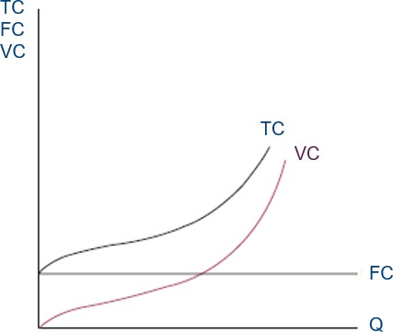
THE VARIOUS MEASURES OF COST

Slide 31



EXAMPLE: output focus
Output per day | Total variable cost (£) | Total cost (£)
0 | 0 | 12
1 | 10 | 22 |  | 1 to 2 units
2 | 16 | 28
3 | 21 | 3 unit 33 | s at TVC of 21
4 | 28 | 40
5 | 40 | 52 |  | 4 units at TC of 40
6 | 60 | 72 |  | ATC = 40/4 = 10
7 | 91 | 103
Average
total cost (£)
-
22.0
14.0
11.0
…
10.4
12.0
14.7
Average variable
cost (£)
-
10
8
…
7
8
10
13
Marginal
cost (£)
-
10
…
5
7
12
20
31
MC = 28 – 22 = 6
AVC = 21/3 = 7

Slide 32
COST CURVES AND THEIR SHAPES
MC
ATC = TC/Q
AVC = TVC/Q
Costs (£)
z
y
x
Output (Q)

Slide 33
COST CURVES AND THEIR SHAPES
Important Properties of Cost Curves
Marginal cost eventually rises with the quantity of output (it can decline with
output in the beginning).
Costs
ATC
The average total cost curve is U-shaped.
The bottom of the U-shaped ATC curve
occurs at the quantity that minimizes average total cost.
This quantity is called the efficient scale of the firm (at this point producing a typical unit is cheapest).
MC
AVC
The marginal cost curve crosses the average total cost curve and the average variable cost curve at their lowest point.
Q
3240

Slide 34


COST CURVES AND THEIR SHAPES
Relationship between Marginal Cost and Average Total Cost
Whenever marginal cost is lower than average total cost (MC < ATC), average total cost is falling.
ATC
Costs
MC
AVC
Whenever marginal cost is higher than average total cost (MC > ATC), average total cost is rising.
The marginal cost curve crosses the average total cost curve (MC = ATC) at the efficient scale (minimum of ATC).

Slide 35
COST CURVES AND THEIR SHAPES
Relationship between Marginal Cost and Average Variable Cost
Whenever marginal cost is lower than average variable cost (MC < AVC), average variable cost is falling.
ATC
Costs
MC
AVC
Whenever marginal cost is higher than average variable cost (MC > AVC), average variable cost is rising.
The marginal cost curve crosses the average variable cost curve (MC = AVC) in the minimum of AVC.

Slide 36
TYPICAL COST CURVES
What do cost curves (total, average, marginal) of typical firms look like in reality?
It depends on the industry and other factors, but for many firms, they look similar to Leila’s costs curves (see next slides).

Slide 37
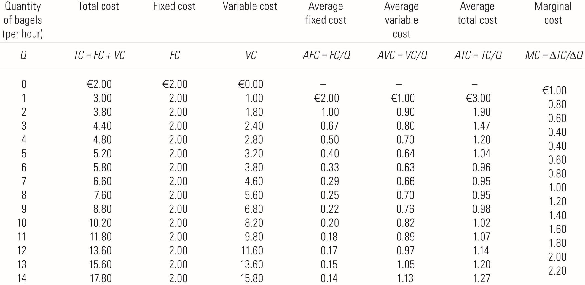
Leila’s cost curves

Slide 38
Leila’s cost curves
(a) Total Cost Curve
Total Cost
€18.00 16.00
14.00
12.00
10.00
8.00
6.00
4.00
2.00
TC
0
2
4
6
8
10
12
14
Quantity of Output (bagels per hour)
Copyright©2011 South-Western

Slide 39
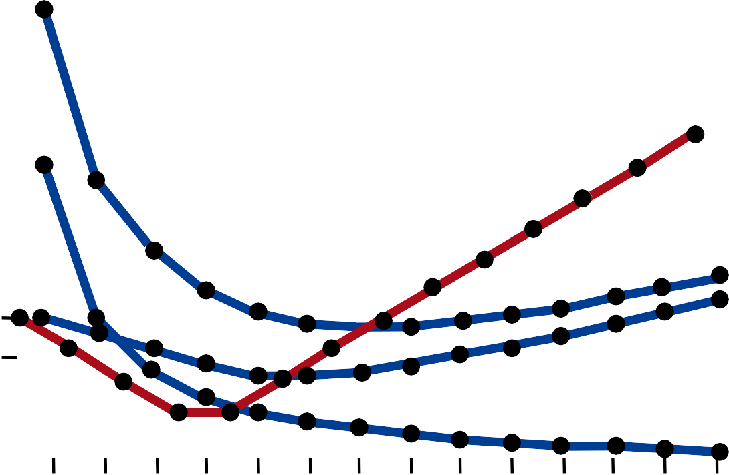
Leila’s cost curves
(b) Marginal and Average Cost Curves
MC ATC AVC
AFC € 3.00
2.50
MC
2.00
1.50
ATC AVC
1.00
0.50
AFC
0
2
4
6
8
10
12
14
Quantity of Output (bagels per hour)
Copyright©2011 South-Western

Slide 40
COSTS IN THE SHORT RUN AND IN THE LONG RUN
For many firms, the division of total costs between fixed and variable costs depends on the time horizon being considered.
The short run: the period of time in which some factors of production cannot be changed
The long run: the period of time in which all factors of production can be
altered
Ex: Rent is fixed cost in short run – have to pay regardless of how much produced. In long-run, you still have to pay rent but it is variable.
Because many costs are fixed in the short run but variable in the long run, a
firm’s long-run cost curve differs from its short-run cost curves.

Slide 41
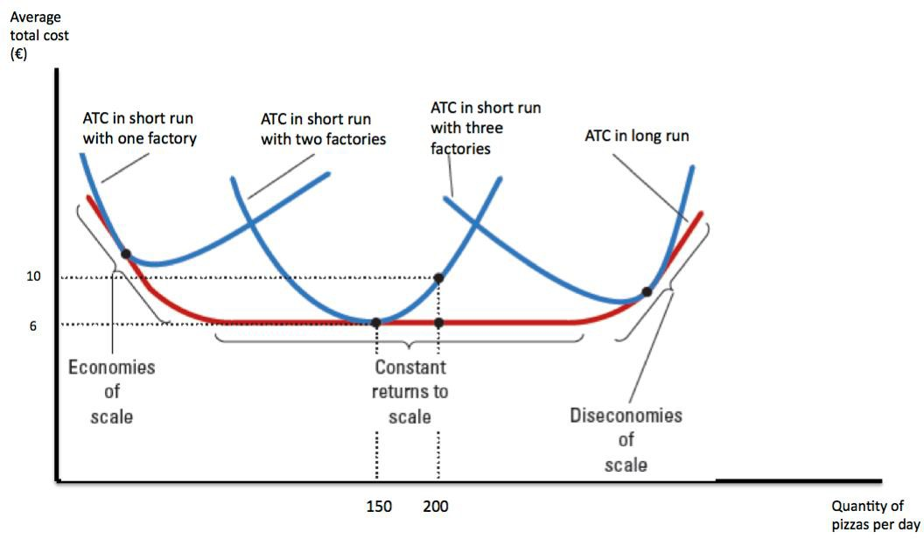
AVERAGE TOTAL COST IN THE SHORT AND LONG RUN

Slide 42






Relationship between short and long-run average costs
Costs
SRAC_{1 SRAC2}
1 factory
2 factories
If a firm had 1 factory in the short run its short run average cost curve is SRAC₁
Building a second factory in the long-run changes the short-run average cost curve from SRAC₁ to SRAC₂
It is cheaper to produce less than q₁ in 1 factory than in 2, but if more than q₁ is produced it is cheaper to produce it in 2
O
q₁
Output

Slide 43
Relationship between short and long-run average costs
Costs
SRAC_{1 SRAC}
SRAC₅
2
SRAC
SRAC
3
4
LRAC
The long run average cost curve traces out the lowest average cost for each level of output
O
q₁
q₂
q₃
q₄
Output

Slide 44





Relationship between short and long-run average costs
Costs
When firms can also vary the size of the factories, the LRAC is smooth
SRAC₅
SRAC₁
_{SRAC3} SRAC₄
SRAC
2
LRAC
LRAC curve at a point of tangency with a SRAC curve for each level of output
Cheaper to build 2 and
a half factories for q₂
O
q₂
Output

Slide 45
Attainable levels of cost
A typical long-run average cost curve
Costs
Economies of scale
Constant costs
Diseconomies of scale
LRAC
Due to increasing
returns to scale
constant returns
Due to decreasing
returns to scale
Unattainable levels of cost
O
Output

Slide 46
RETURNS TO SCALE
Economies of scale = increasing returns to scale: long-run average total cost falls as the quantity of output increases (cost of typical unit decreases as you produce more)
Diseconomies of scale = decreasing returns to scale: long-run average total cost rises as the quantity of output increases (cost of typical unit increases as you produce more)
Constant returns to scale: long-run average total cost stays the same as the quantity of output increases.

Slide 47
RETURNS TO SCALE
Why economies of scale?
  Higher production levels allow specialization and increase the possibility that technology can be used. This permits workers to become better at their tasks.
  Firms operating at larger scale can gain advantages by being in a position to negotiate more favourable borrowing rates or lower supply costs (buying in larger quantities: discounts)
Why diseconomies of scale?
Because of coordination and communication problems that are inherent to any large organization.

Slide 48
GENERAL SUMMARY
The goal of firms is to maximize profit, which equals total revenue minus total cost.
Some costs are explicit while others are implicit.
When analyzing a firm’s behavior, it is important opportunity costs of production.
to include all the
A firm’s costs reflect its production process.
A typical firm’s production function gets flatter as the quantity of input
increases, displaying the property of diminishing marginal product.
A firm’s total costs are divided between fixed and variable costs. Fixed costs do not change when the firm alters the quantity of output produced; variable costs do change as the firm alters quantity of output produced.

Slide 49
GENERAL SUMMARY
Average total cost is total cost divided by the quantity of output.
Marginal cost is the amount by which total cost would rise if output were
increased by one unit.
The marginal cost eventually rises with the quantity of output.
Average cost first falls as output increases and then rises.
The average total cost curve is U-shaped.
A firm’s costs often depend on the time horizon being considered.
In particular, many costs are fixed in the short run but variable in the long run.

Slide 50
GENERAL SUMMARY
Constant returns to scale: when long run ATC stays the same as the quantity of output changes
Economies of scale: when long run ATC falls as the quantity of output increases
Diseconomies of scale: when long run ATC rises as the quantity of output increases

